Slide 1
HealthDL:Deep Learning for Wellbeing Applications
Leveraging Mobile Devices and Edge Computing

Slide 2
HealthDL
2nd International Workshop on Deep Learning for Wellbeing Applications Leveraging Mobile Devices and Edge Computing
Workshop co-located with ACM MobiSys 2021

Slide 3
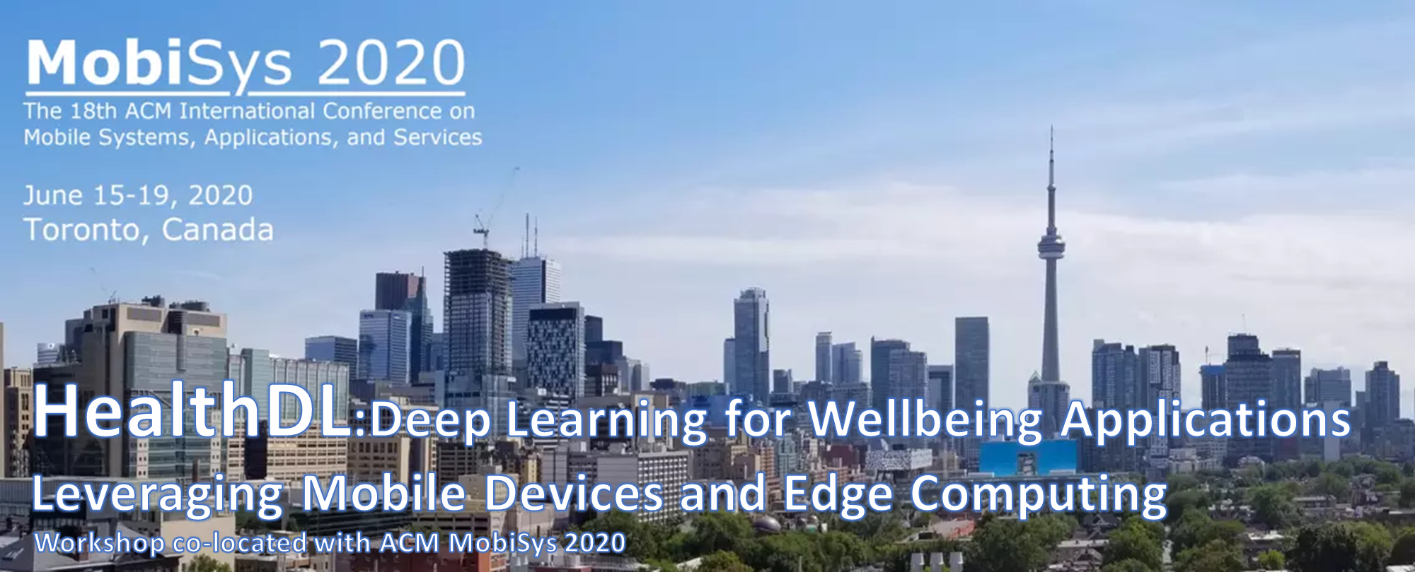

Slide 4
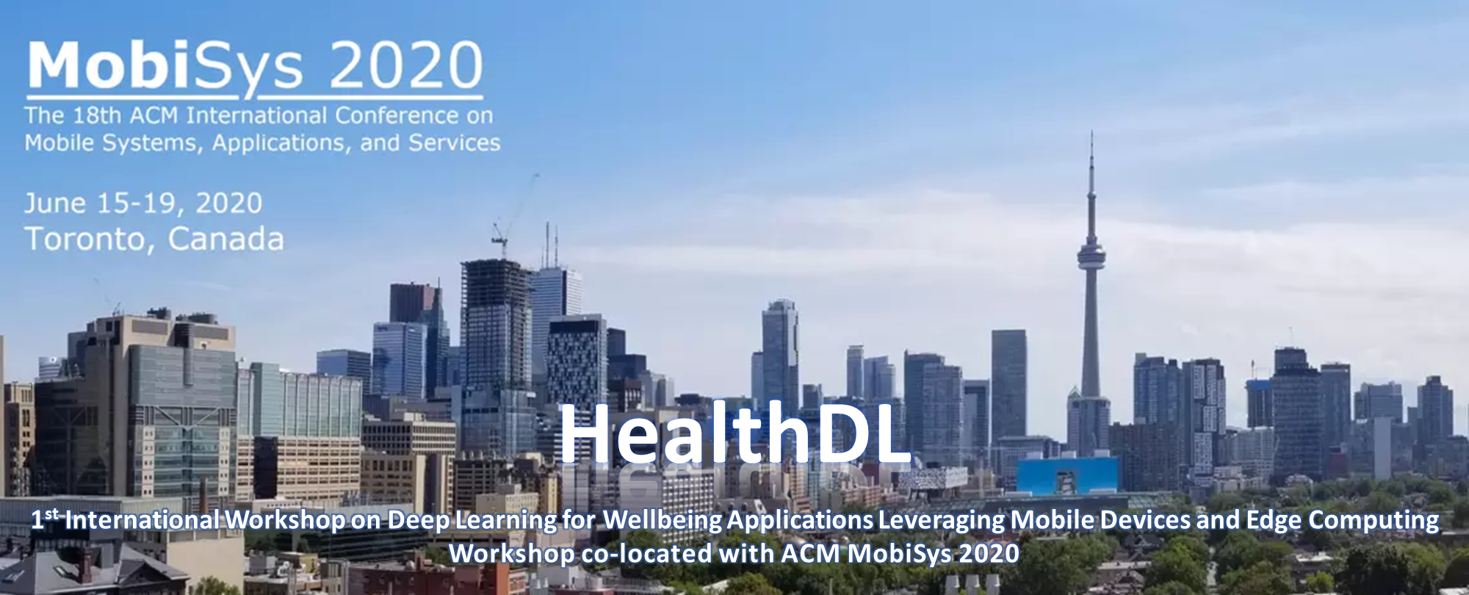

Slide 5
HealthDL
2nd International Workshop on Deep Learning for Wellbeing Applications Leveraging Mobile Devices and Edge Computing
Workshop co-located with ACM MobiSys 2021

