Slide 1

LEVELLER: Fair Communication Scheduling via
Progress-Rate Awareness in Multi-Tenant Training Clusters
Geng Li, Yang Li, Mingyuan Zang, Jie Wu
China Telecom
Cloud Computing Research Institute
Notes:
Good morning, everyone. My name is Geng Li from China Telecom. Today, I’ll present LEVELLER, a simple, scalable, and theoretically grounded system that achieves job-level communication fairness in multi-tenant clusters. This is a joint work with Yang Li, Mingyuan Zang, and Jie Wu.

Slide 2
Deep Learning Training (DLT)
AI explosion
DLT is dominant in infrastructure complexity / capability frontier
LLM
4B
8B
Preprocessing
70B
Post-training
Deployment
Pre-training
Notes:
In recent years, large models and generative AI have experienced explosive growth. Although inference represents a high volume of requests today, Deep Learning Training—including both pre-training and post-training—remains the fundamental bottleneck defining infrastructure scale and complexity.

Slide 3
DLT Job
Distributed across accelerators (data, pipeline, tensor parallelism)
Iterations of computation and communication phases
  Repeat periodically (excluding MoE)
Iteration
Computation
Communication
Time
Notes:
A DLT job is distributed across multiple accelerators using hybrid parallelism. Within each iteration, inter-GPU communication is performed using collective primitives, where some can be overlapped with computation and some cannot. Focusing on dense model rather than MoE, a DLT job is composed of multiple computation and communication phases that repeat periodically throughout the training process.

Slide 4
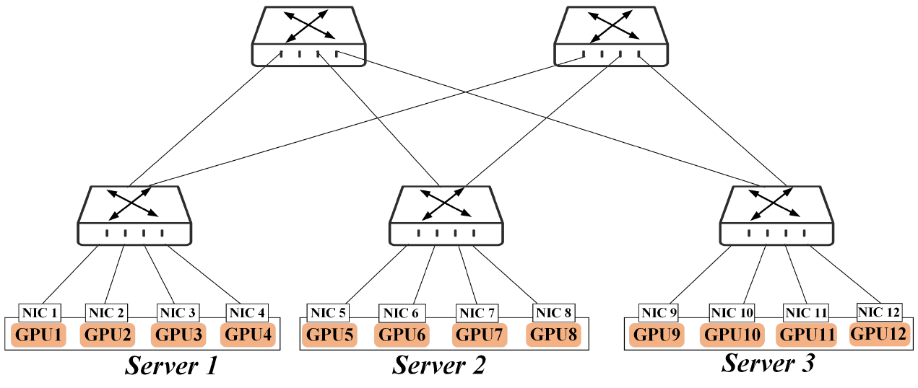
Multi-Tenant Training Cluster
Training multiple jobs concurrently
  30+ jobs in a 2,000-GPU cluster [1]
Job 1
Job 2
Job 3
GPU7
GPU8
GPU9
GPU10
GPU11
GPU12
[1] http://github.com/alibaba/alibaba-lingjun-dataset-2023
Notes:
In production cloud computing environment, to achieve better resource utilization, GPU clusters are often shared among multiple tenants, running multiple jobs concurrently, with over 30 concurrent jobs in peak hours.

Slide 5
Multi-Tenant Training Cluster
Network shared among jobs
  Inter-job network contention, e.g., BW oversubscription, imperfect LB
  36% of DLT jobs suffer from inter-job contention [1]
Job 1
Job 2
Job 3
Contention
GPU7
GPU8
GPU9
GPU10
GPU11
GPU12
[1] Crux: GPU-efficient communication scheduling for deep learning training, SIGCOMM 24
Notes:
In multi-tenant clusters, GPUs are typically dedicated to different jobs, but the network is shared among them. For example, Job 1 uses the orange paths, Job 2 uses the green path, and Job 3 uses the blue path, resulting in inter-job network contention on shared links. Due to resource fragmentation, bandwidth oversubscription, and imperfect load balancing, inter-job network contention is unavoidable—even with packet spraying, which we discuss in detail in the paper. Traces show that one third of DLT jobs suffer from inter-job contention, leading to training slowdown and reduced GPU utilization.

Slide 6
Trade-off: Efficiency vs. Fairness
Efficiency
Fairness
Notes:
Before tackling the problem, let's examine the classic trade-off between efficiency and fairness—a core principle across computer science and economics.

Slide 7





State of the Art
Maximize Utilization
Cloud
Integrity
Efficiency
e.g., measured by the average performance
Fairness
e.g., assessed by the minimum of all
HiveD [OSDI 20],
Lucid [SIGCOMM 23]
THEMIS [NSDI 20], Shockwave [NSDI 23]
Only computational fairness
GPU0
GPU2
Job placement & scheduling
GPU1
GPU3
Intra-job comm scheduling
TACCL [NSDI 23],
TECCL [SIGCOMM 24], SyCCL [SIGCOMM 25]
AllGather
NA
Single job
Inter-job comm scheduling
CASSINI [NSDI 24], CRUX [SIGCOMM 24], MCCS [SIGCOMM 24], Symphony [ICNP 25]
Underexplored!
→
Ours: LEVELLER
Job1
Job2
$$f_{1}$$
Flow/coflow scheduling
pFabric [SIGCOMM 13], PDQ [SIGCOMM 12], Sincronia [SIGCOMM 18]
DCQCN [SIGCOMM 15], Swift [SIGCOMM 20], Coflex [INFOCOM 17]
$$f_{2}$$
Fundamentally different!
$$f_{3}$$
Notes:
Along these two axes. Efficiency is typically measured by average performance to maximize utilization, whereas Fairness is evaluated by the worst-case job performance, which is crucial in multi-tenant clusters to maintain cloud integrity. Prior work extensively explores GPU allocation or placement for efficiency and fairness. However, computational fairness does not translate to execution fairness because a job consists of both computation and communication. On the network side, intra-job schedulers like TACCL optimize single-job collectives but remain agnostic to inter-job contention. Inter-job network schedulers such as CASSINI and CRUX focus primarily on efficiency-oriented metrics — for example minimizing average completion time, or maximizing GPU utilization. Therefore, communication fairness for DLT jobs remains largely underexplored, which motivates our system. One may argue that the efficiency or fairness of communication scheduling has been extensively studied in the context of flows or coflows. For example, pFabric and Sincronia minimize completion time, and many congestion control like DCQCN target flow-level fairness. However, in this paper, we identify a key observation that fairness for DLT jobs is fundamentally different from flow or coflow fairness.

Slide 8

Gap: Flow-level Fairness v.s. DLT Job-level Fairness
$1$ Iter.=3
Comp.
Comm.
Job 1
Job 2
Job 3
0 2 4 6 8 10 12 14 16 18
Time t
Notes:
To illustrate this gap, consider three jobs contending for a link. Jobs 1 and 2 are communication-heavy, while Job 3 is compute-heavy. All three jobs have an identical iteration time of 3 units.

Slide 9
Gap: Flow-level Fairness v.s. DLT Job-level Fairness
$1$ Iter.=3
Comp.
Comm.
3 Iter.
Job 1
…
3 Iter.
Unfair!
Job 2
…
Job 3
4 Iter.
…
0 2 4 6 8 10 12 14 16 18
Time t
Flow-level fair schedule
Converge
Repeating Cycle
Job 1
1 Iter.
…
Job 2
1 Iter.
Fair!
…
Job 3
1 Iter.
…
0 1 2 3 4 5
Time t
(b) Job-level fair schedule
Notes:
Standard flow-level fair sharing equally divides bandwidth, but results in unfair job-level outcomes. By time $t=18$, Jobs 1 and 2 have completed 3 iterations, whereas Job 3 has completed 4. This creates job-level unfairness over time. In contrast, under job-level fair scheduling, all three jobs complete the same number of iterations in the same amount of time.

Slide 10

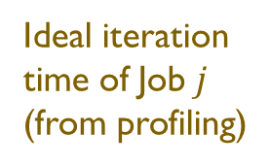



Normalized Progress Rate as Fairness Metric
Normalized Progress Rate
Job$j$’s Progress at time $t$
Ideal iteration time of Job$j$ (from profiling)
$$R_{j}\left(t\right)=\frac{ ActualProgress \left(t\right)}{ IdealProgress \left(t\right)}=\frac{N_{j}\left(t\right)}{\left(t−t_{j}^{0}\right)/T_{j}^{ideal }}$$
Job$j$ starts at time $t^{0}$
How closely a job approaches its maximum potential rate
  Range [0, 1]
  Approximately 1/iteration-time-slowdown
A unified, job agnostic metric reflecting training experience, e.g., 2s delay
  1s-iteration job (rate=1/3)
  100s-iteration job (rate=100/102)
Notes:
To provide a unified measure of how communication scheduling impacts different DLT jobs, we introduce a novel online fairness metric: Normalized Progress Rate, the ratio of a job’s actual progress to its ideal progress when using dedicated network resources. Here, actual progress is represented by the iteration count N(t), and ideal progress is calculated as the elapsed time (t-t_0 ) divided by the ideal iteration time. This metric captures how closely a job approaches its maximum potential rate on a unified range of [0,1], and is inversely proportional to iteration time slowdown. It provides a job-agnostic measure to reflect training experience—for example, a 2-second per-iteration delay is severe for a 1-second iteration job (R_j^t=1/3), but negligible for a 100-second iteration job (R_j^t=100/102).

Slide 11

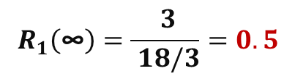

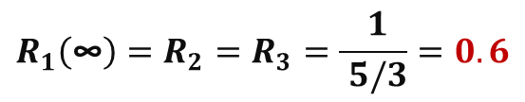
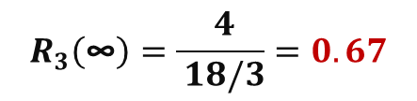
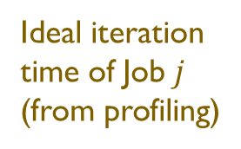
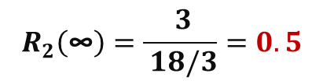

Gap: Flow-level Fairness v.s. DLT Job-level Fairness
$1$ Iter.=3
Comp.
Comm.
$$R_{1}\left(\text{∞}\right)=\frac{ 3}{ 18/3}=0.5$$
3 Iter.
Job 1
…
Job 2
3 Iter.
$$R_{2}\left(\text{∞}\right)=\frac{ 3}{ 18/3}=0.5$$
…
Job 3
4 Iter.
$$R_{3}\left(\text{∞}\right)=\frac{ 4}{ 18/3}=0.67$$
…
0 2 4 6 8 10 12 14 16 18
Time t
Flow-level fair schedule
Converge
Repeating Cycle
$$R_{1}\left(\text{∞}\right)=R_{2}=R_{3}=\frac{ 1}{ 5/3}=0.6$$
Job 1
1 Iter.
…
Job 2
1 Iter.
…
Job 3
1 Iter.
Job$j$’s Progress at time $t$
…
Ideal iteration time of Job$j$ (from profiling)
0 1 2 3 4 5
Time t
$$R_{j}\left(t\right)=\frac{ ActualProgress \left(t\right)}{ IdealProgress \left(t\right)}=\frac{N_{j}\left(t\right)}{\left(t−t_{j}^{0}\right)/T_{j}^{ideal }}$$
(b) Job-level fair schedule
Job$j$ starts at time $t^{0}$
Notes:
Revisiting our example through this metric: under flow-level fair scheduling, $r_{1}$ and $r_{2}$ approximate 0.5 while $r_{3}$ is 0.67. In contrast, a job-level fair schedule enables all three jobs to achieve rates of 0.6, which improves the minimum fairness and even the overall average.

Slide 12
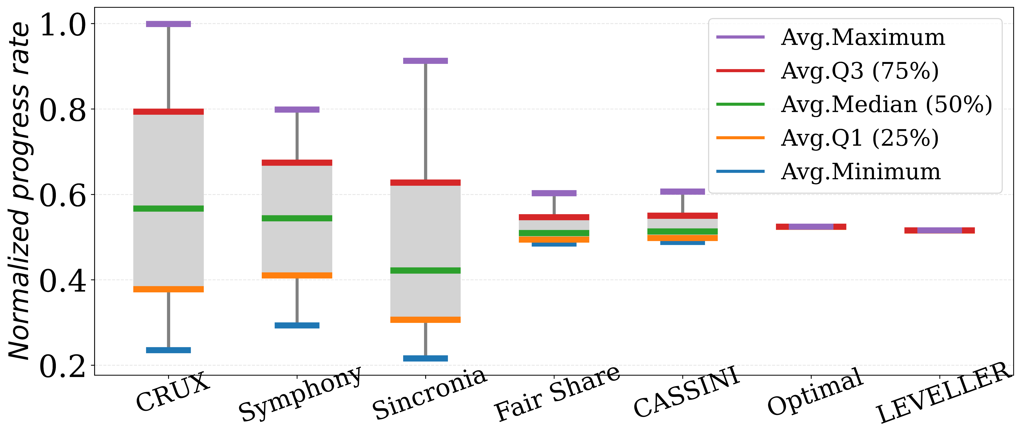
Unfairness in Existing Schedulers
Near starvation
Notes:
Applying this progress rate metric to real production workloads, we observe significant inter-job unfairness in existing communication schedulers. Notably, some jobs reach near-starvation levels with a minimum rate of 0.2.

Slide 13

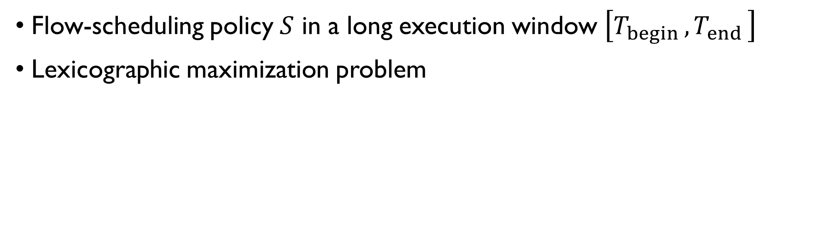

Our Goal: Max-Min Fairness
Flow-scheduling policy $S$ in a long execution window $\left[T_{begin },T_{end }\right]$
Lexicographic maximization problem
Non-decreasing order
$$\max_{S} { sort}_{↑}\left\{R_{j}\left(T_{end }\right)\right\}∣j∈J$$
$$S=\left\{s\left(t\right)∣t∈\left[T_{begin },T_{end }\right]\right\}$$
Intuition: universally share the slowdown
Capture both efficiency and fairness
Notes:
The goal of this paper is to design a flow-scheduling policy $S$ that achieves max-min fairness in a sufficiently long execution window. We formulate this as a lexicographic maximization problem, which optimizes the minimum rate, then the second minimum, and so on. The intuition is to universally share the slowdown among all DLT jobs. Crucially, this max-min formulation captures both efficiency and fairness simultaneously.

Slide 14










Example
$T_{1}^{ideal}$=2
$T_{2}^{ideal}$=3
Job 1
Job 2
Comp.
Comm.
Converge
Repeating Cycle
Converge
Repeating Cycle
R→ $\frac{4⨯T_{1}^{ideal}}{8}=$1
R→ $\frac{3⨯T_{1}^{ideal}}{9}=$0.67
Job 1
1
2
3
4
…
2
3
Job 1
1
1
1
1
…
0 2 4 6 8
0 2 4 6 8 9
R→ $\frac{2⨯T_{2}^{ideal}}{8}=$0.75
R→ $\frac{3⨯T_{2}^{ideal}}{9}=$1
Job 2
1
1
2
2
Job 2
1
1
2
2
3
3
…
…
0 2 4 6 8
0 2 4 6 8 9
Unfair!
Unfair!
(a) Sincronia (SRPT-first) & CRUX
(b) Symphony (FCFS)
Converge
Repeating Cycle
R→$\frac{3⨯T_{1}^{ideal}}{8}=$0.75
Converge
Repeating Cycle
Job 1
1
1
2
3
3
…
R→ $\frac{3⨯T_{1}^{ideal}}{7}=$0.86
Job 1
1
2
3
…
0 2 4 6 8
0 2 4 6 7
R→$\frac{2⨯T_{2}^{ideal}}{8}=$0.75
R→ $\frac{2⨯T_{2}^{ideal}}{7}=$0.86
Job 2
1
2
…
Job 2
1
1
2
2
…
1
1
2
2
0 2 4 6 8
Fair, but not max-min fair!
0 2 4 6 7
Insight: preemptive, dynamic priority scheduling
(c) Fair Share & CASSINI
(d) Optimal
Notes:
Let’s take an example with two jobs. Job 1 requires 1 for both computation and communication, and Job 2 requires 1 for computation and 2 for communication. Sincronia or CRUX favor the compute-intensive Job 1, giving it a rate of 1 but Job 2 at 0.75, which is unfair. Symphony, as a first-come first-served scheduler, benefits Job 2 (rate 1.0) but degrading Job 1 (rate 0.67), also unfair. Standard Fair Share and CASSINI yield rates of 0.75 for both jobs, which is fair, but not max-min fair, where the optimal schedule can increases the rates of both jobs to 0.86. Let's take a closer look at the last figure, the optimal scheduler prioritizes Job 1 at $t=1$ to preempt Job 2, and later prioritizes Job 2 at $t=5$. A key insight from this example is that fine-grained, per-flow bandwidth allocation might be unnecessary; and max-min fairness can be effectively realized by a preemptive, dynamic-priority-based flow scheduler.

Slide 15
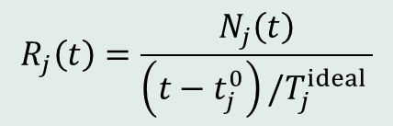


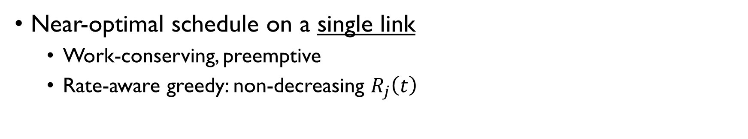
Theoretic Framework (1) of LEVELLER
High Priority
Priority Update
Near-optimal schedule on a single link
  Work-conserving, preemptive
  Rate-aware greedy: non-decreasing $R_{j}\left(t\right)$
$$R_{j}\left(t\right)=\frac{N_{j}\left(t\right)}{\left(t−t_{j}^{0}\right)/T_{j}^{ideal }}$$
Repeating Cycle
R₁*→ $\frac{3⨯T_{1}^{ideal}}{7}=$ 0.86
Job 1
1
2
3
4
5
6
7
8
9
10
11
12
7
…
0 2 4 6 8 10 12 14 16 18 20 22 24 26 28 30 32 34 36 …
Time t
R₂*→ $\frac{2⨯T_{2}^{ideal}}{7}=$ 0.86
Job 2
1
1
2
2
3
3
4
4
5
5
6
6
7
7
8
8
7
…
0 2 4 6 8 10 12 14 16 18 20 22 24 26 28 30 32 34 36 …
Time t
  Theorem 1: The simple greedy scheduling achieves a 1/2-approximation of the max-min fairness.
Notes:
Based on this insight, we develop a theoretical framework. We start with a single link scenario and propose a simple, but near-optimal scheduling algorithm that dynamically assigns communication priorities in non-decreasing order of the normalized progress rates. This figure shows the timeline of the schedule: from time 8, the communication schedule evolves into a repeating cycle of 7, and both jobs converge to the optimal rate of 0.86. We formally prove that this simple greedy scheduling achieves a 1/2-approximation of optimal max-min fairness on a single link.

Slide 16
Theoretic Framework (1) of LEVELLER
High Priority
Priority Update
Repeating Cycle
R₁*→ $\frac{3⨯T_{1}^{ideal}}{7}=$ 0.86
Job 1
1
2
3
4
5
6
7
8
9
10
11
12
7
…
0 2 4 6 8 10 12 14 16 18 20 22 24 26 28 30 32 34 36 …
Time t
R₂*→ $\frac{2⨯T_{2}^{ideal}}{7}=$ 0.86
Job 2
1
1
2
2
3
3
4
4
5
5
6
6
7
7
8
8
7
…
0 2 4 6 8 10 12 14 16 18 20 22 24 26 28 30 32 34 36 …
Time t
Problem: frequent, real-time priority update, substantial overhead!
Notes:
The greedy algorithm is conceptually simple, but its practical implementation can be challenging due to frequent, real-time priority updates.

Slide 17

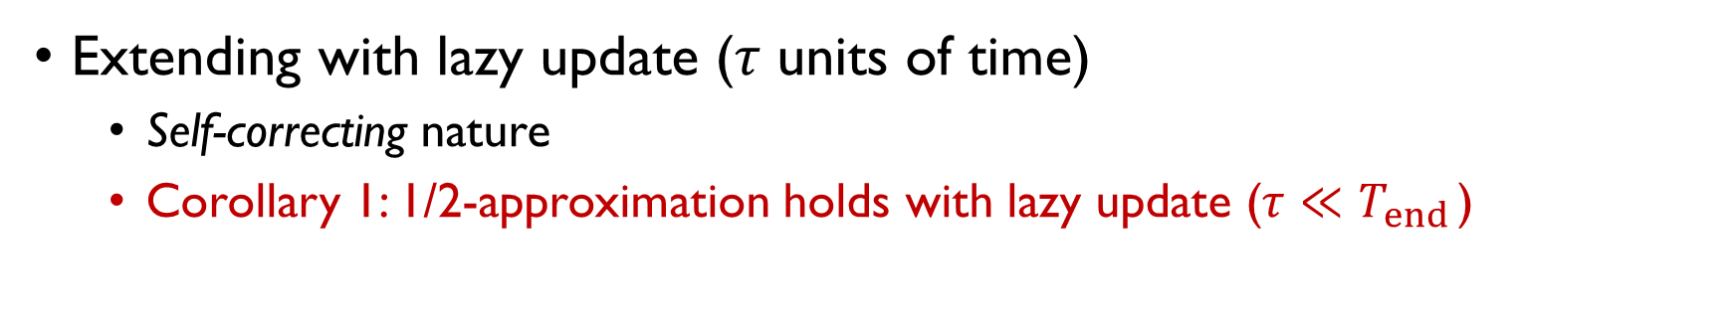


Theoretic Framework (2) of LEVELLER
High Priority
Priority Update
Extending with lazy update (𝜏 units of time)
  Self-correcting nature
  Corollary 1: 1/2-approximation holds with lazy update (𝜏 ${≪T}_{end }$)
Repeating Cycle
Scheduling Slot$τ$
R₁*→ $\frac{3⨯T_{1}^{ideal}}{7}=$ 0.86
Job 1
1
2
3
4
5
6
7
8
9
10
11
12
7
…
0 2 4 6 8 10 12 14 16 18 20 22 24 26 28 30 32 34 36 …
Time t
R₂*→ $\frac{2⨯T_{2}^{ideal}}{7}=$ 0.86
Job 2
1
1
2
2
3
3
4
4
5
5
6
6
7
7
8
8
7
…
0 2 4 6 8 10 12 14 16 18 20 22 24 26 28 30 32 34 36 …
Time t
Basic greedy scheduling
R₁*→ $\frac{12⨯T_{1}^{ideal}}{28}=$ 0.86
Job 1
1
2
3
4
1
5
6
7
8
9
10
11
12
28
…
0 2 4 6 8 10 12 14 16 18 20 22 24 26 28 30 32 34 36 …
Time t
R₂*→ $\frac{8⨯T_{2}^{ideal}}{28}=$ 0.86
Job 2
1
1
2
2
3
3
4
4
5
5
6
6
7
7
8
8
28
…
0 2 4 6 8 10 12 14 16 18 20 22 24 26 28 30 32 34 36 …
Time t
(b) Lazy greedy scheduling with $τ=4$
Notes:
To cope with that, we extend the greedy scheduling with a lazy update mechanism, where priorities are updated only every $τ$ units of time. The bottom figure shows the timeline of lazy updates, where the schedule converges into a repeating cycle of 28 units instead of 7 as in basic greedy. Surprisingly, although it generates a different execution pattern compared to basic greedy, it also converges to the optimal rate. This is thanks to the self-correcting nature of our scheduler: any scheduling inaccuracies in the current slot can be fixed in later slots. We also prove the one half bound holds under the lazy update.

Slide 18
Theoretic Framework (3) of LEVELLER
Extending to general networks and collectives (coflow with dependencies)
  Corollary 2: 1/2-approximation holds in general networks
  Global priority assignment based jobs’ normalized progress rates
A loose bound, but guarantees
No Starvation!
Notes:
Moving beyond a single link, we extend our results to general network topologies and collective communication, where the approximation bound still holds. This enables a simple global priority design to offload flow scheduling complexity to existing priority-enabled transport without hardware or protocol modifications. Note that the 1/2-approximation bound is loose in theory, but it ensures no job is starved by another. In practice, the algorithm achieves near-optimal performance.

Slide 19
LEVELLER System
Priority compression over limited priority levels to minimize fairness loss
Scheduling optimization by leveraging communication-computation overlap
Dynamic RDMA priority (Traffic Class) adjustment via QP Resurrection
LEVELLER Controller
Tenant 1
Tenant 2
DLT Framework
DLT Framework
CCL
CCL
LEVELLER Agent
LEVELLER Agent
…
Transport
Transport
GPU
NIC
GPU
NIC
Network
Notes:
Using these theoretical results, we build LEVELLER, a preemptive, dynamic-priority flow scheduling system for max-min fairness. As shown on the left, LEVELLER uses a centralized controller for periodic global priority assignment and the host agent as a shim layer between the CCL and transport to enforce the priorities. LEVELLER features several practical designs, including: Priority Compression onto limited hardware Traffic Classes, computation-communication Overlap-Aware optimization, and some engineering efforts —such as dynamic RDMA priority adjustment via QP resurrection. Please refer to our paper for more details.

Slide 20
Evaluation Setup
Testbed
  3 hosts, each with 4 NVIDIA A100 GPUs and 4 CX-6 NICs.
  3 leafs and 2 spines
Llama-3.1, ChatGLM-3, Gemma, and DeepSeek-Coder
ECMP and DCQCN by default
CASSINI and CRUX (w/o routing)
Trace-based simulation
  1,024 GPUs across 128 racks
  (1) Oversubscribed (8:1): 3-tier Clos with 128 ToR, 16 leafs, and 8 spines
  (2) Non-blocking (1:1): 2-tier multi-rail, 2 planes with 16 leafs
Trace:
  Empirical workloads [1]
  10 LLMs using STG Chakra and ASTRA-sim
CASSINI, CRUX, Symphony, Sincronia, and Fair Share (DCQCN)
[1] http://github.com/alibaba/alibaba-lingjun-dataset-2023
Notes:
We prototype LEVELLER across RDMA and TCP and evaluate it on both a physical GPU testbed and trace-driven simulations.

Slide 21
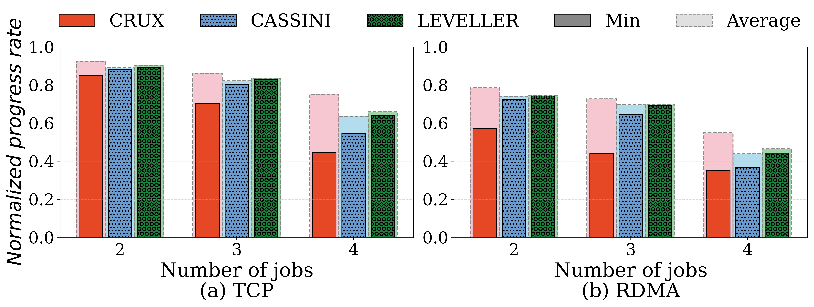
Testbed Results
44%
57%
17%
21%
Improve the minimum progress rate by up to 57%
Notes:
Testbed experiments show that LEVELLER improves the minimum normalized progress rate by up to 57% compared to CRUX and CASSINI.

Slide 22
Testbed Results
-12%
4%
-15%
6%
Efficiency vs. Fairness Trade-off: minimal efficiency loss, or even improve both
Notes:
A common concern with fairness is the potential penalty on efficiency. Our experiments confirm this trade-off while demonstrating that max-min fairness does not require a significant 'tax' on cluster efficiency. And Compared to CASSINI, LEVELLER even improves both fairness and efficiency.

Slide 23
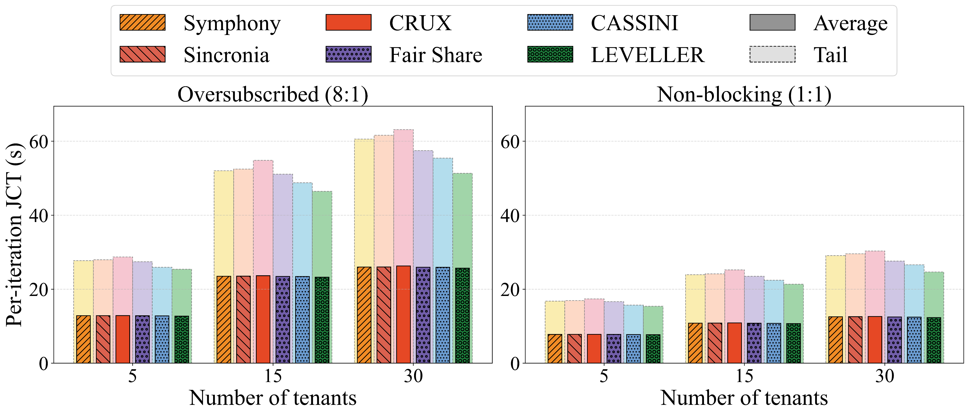
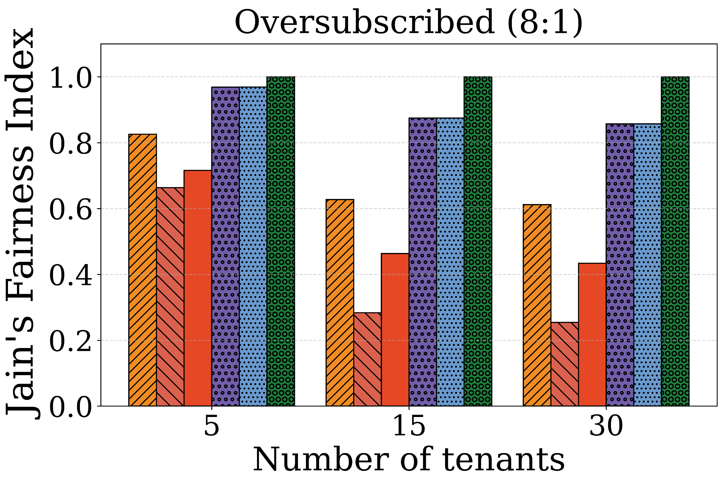
Simulation Results: JCT and Jain Index
18%
9%
2.7×
17%
Reduce tail JCT by 9% to 18% and improve fairness by 17% to 2.7×
Notes:
We conducted extensive simulations, and here we only show the results that LEVELLER reduces tail JCT by up to 18% and improves fairness by up to 2.7×.

Slide 24
Conclusion
Communication scheduling fairness in multi-tenant DLT clusters
  Gap between flow-level fairness and job-level fairness
Normalized progress rate
  Ratio of a job’s actual progress to its contention-free ideal
  A unified, job agnostic metric reflecting training experience
  Metric for future research (e.g., CC and TE) and potential standard for training service
LEVELLER, a practical system for max-min fairness
  Preemptive, dynamic-priority flow scheduling
  1/2-approximated theoretical guarantee
  Improves the minimum progress rate by 57% and fairness by 17%, minimal efficiency loss
Notes:
To conclude, this paper highlights a fundamental gap between flow-level and job-level fairness for communication scheduling in multi-tenant clusters. We introduce Normalized Progress Rate as a unified metric to evaluate network impact on DLT jobs. We hope this metric can be adopted by the networking community for future research and potential standards for training services. We propose LEVELLER, a practical system for max-min fairness using preemptive, dynamic-priority flow scheduling. The system offers theoretical guarantees and is demonstrated to improve fairness with minimal efficiency loss.

Slide 25
Thank you!
Geng Li
  ligeng66@aliyun.com
Notes:
Thank you for listening! I am now happy to take any questions.

