Slide 1
Convergence Analysis of Decentralized Hessian-/Jacobian-Free Algorithm for Nonconvex Stochastic Bi-Level Optimization
Yihan Zhang¹, Xinwen Zhang¹, My T. Thai², Jie Wu¹, Hongchang Gao¹
Temple University
University of Florida

Slide 2
Outline
Problem Definition
Algorithm Design
Convergence Rate
Experiments

Slide 3
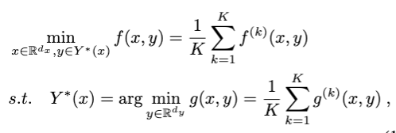
Problem Definition
Decentralized stochastic bilevel optimization
  The lower-level loss function is nonconvex in y but satisfies the PL condition

Slide 4

Problem Definition
Limitations of existing methods
  All decentralized bilevel optimization methods require that the lower-level loss function is strongly-convex in y.
  Existing methods in the single-machine setting requires a regularization term to make the lower-level loss function become strongly convex
regularization

Slide 5
Outline
Problem Definition
Algorithm Design
Convergence Rate
Experiments

Slide 6
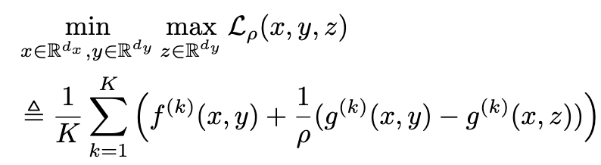
Algorithm Design
Minimax Reformulation
  No need to compute second-order Hessian or Jacobian matrices
  Approximate the original bilevel optimization well given appropriate $\rho$

Slide 7
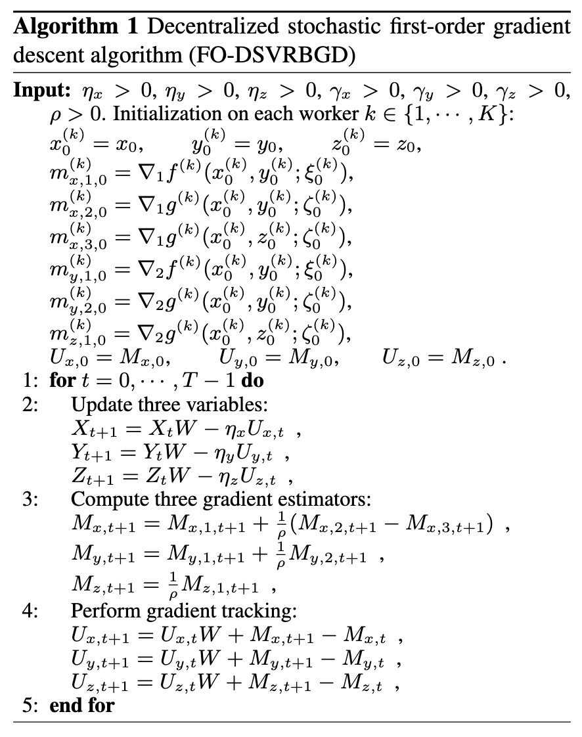
Algorithm Design
Update three variables
Only first-order gradients
Gradient tracking step

Slide 8
Outline
Problem Definition
Algorithm Design
Convergence Rate
Experiments

Slide 9
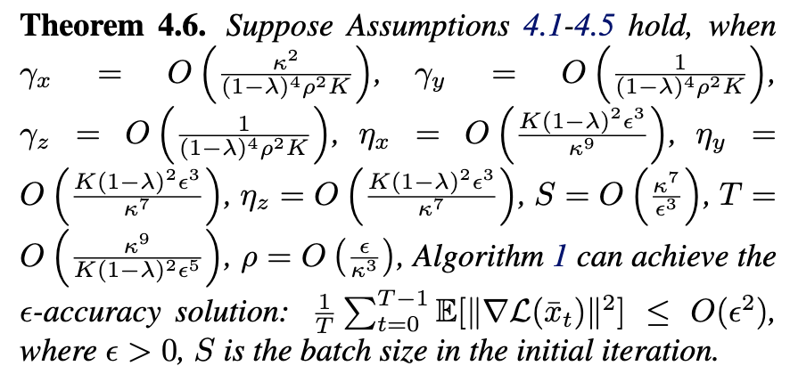
Convergence Rate
Convergence rate
  Linear speedup
  Better dependence on the condition number

Slide 10
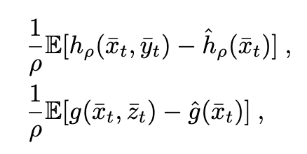


Convergence Analysis
Novelties when measuring the optimality of y and z
  Our method use
  Existing methods in the single-machine setting use

Slide 11
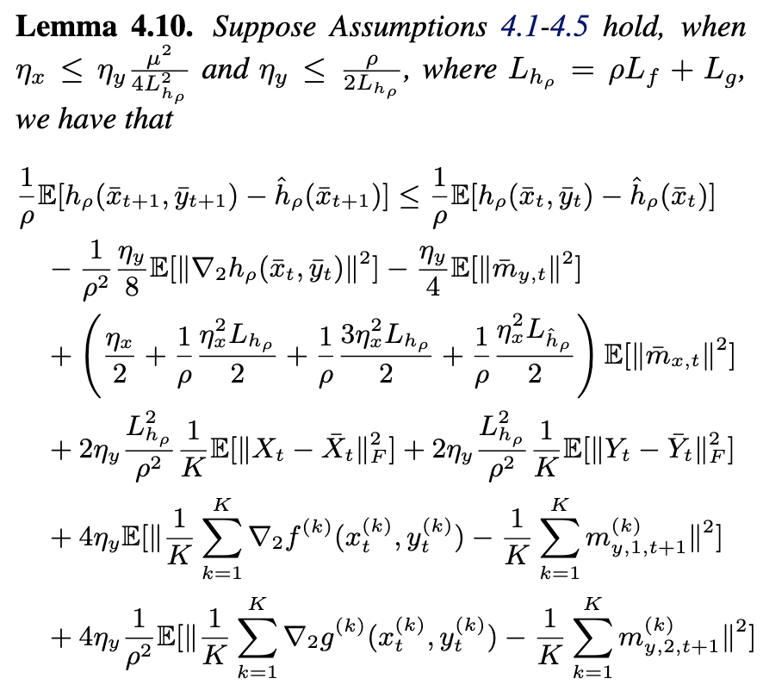
Convergence Analysis
Key Lemmas
Function value

Slide 12
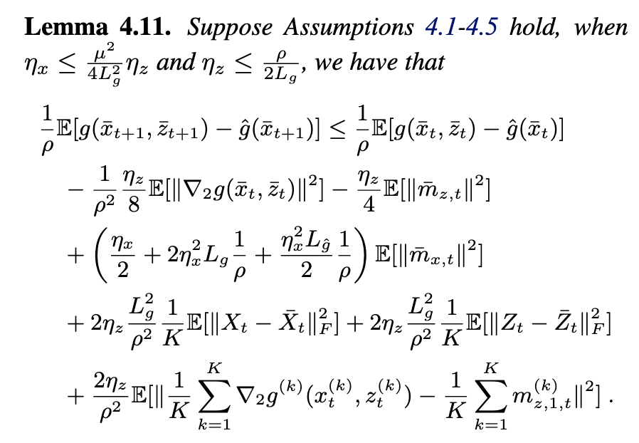
Convergence Analysis
Key Lemmas
Function value

Slide 13
Outline
Problem Definition
Algorithm Design
Convergence Rate
Experiments

Slide 14
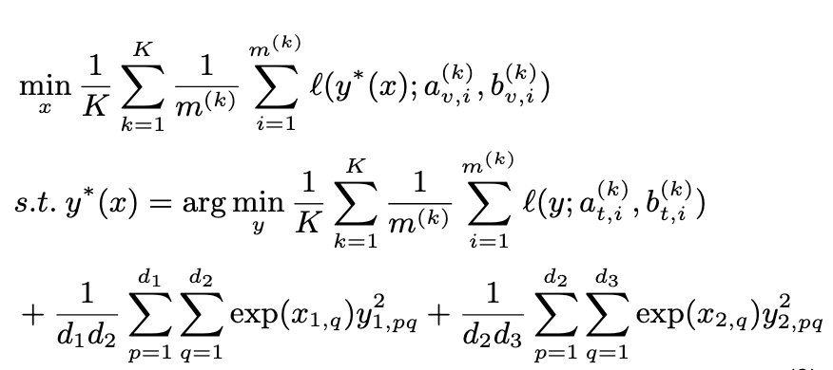
Experiments
Hyperparameter Optimization
  Lower-level learns model parameters
  Upper-level learns hyperparameters

Slide 15
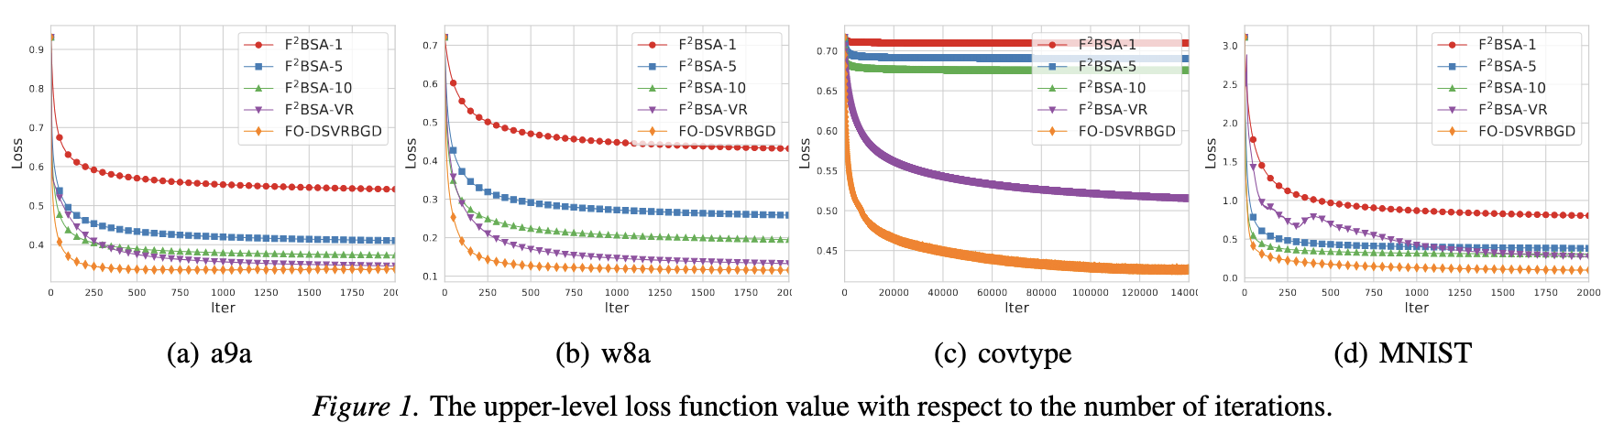
Experiments
Loss function value versus iterations

Slide 16
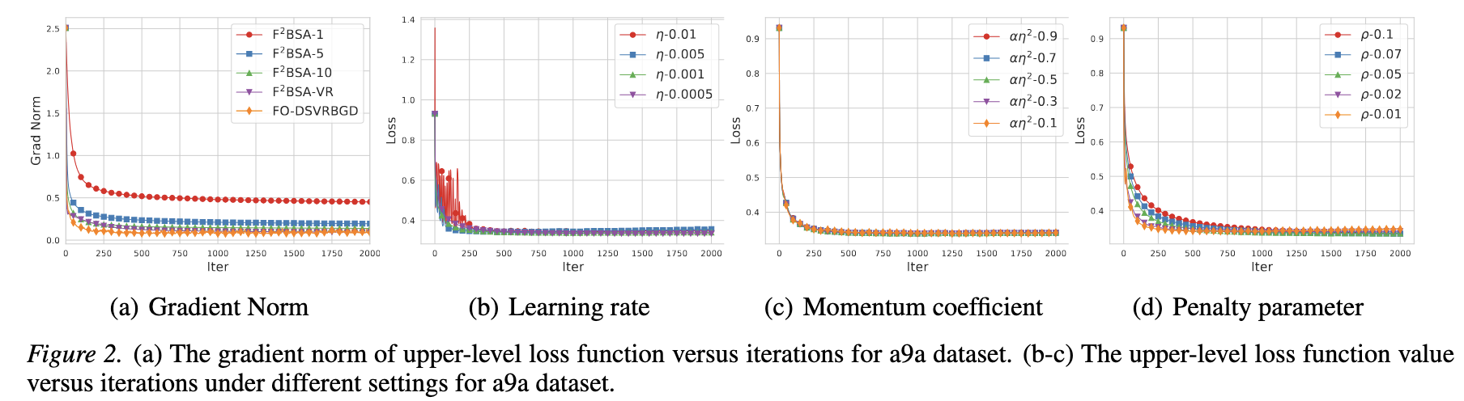
Experiments
Ablation Studies

Slide 17
Conclusions
Algorithm Design
  Fully first-order gradient
  No need to compute second-order Hessian or Jacobian matrices
Convergence Analysis
  Measure lower-level optimality based on function values
  Only require the pure PL condition
  No need to use the regularization term to introduce strong convexity

