Slide 1

On Balancing Middlebox Set-up Cost and Bandwidth Consumption in NFV
Jie Wu
Center for Networked Computing
Temple University, USA

Slide 2
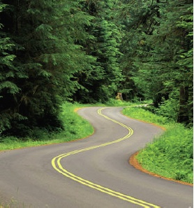
Roadmap
Introduction of Middlebox
Middlebox Placement Problems
Traffic Changing Effects
Our Model and Solutions
Simulation
Conclusion and Future Work

Slide 3



1. Introduction of Middlebox
Network Function Virtualization (NFV)
Technology of virtualizing network functions into software
building blocks
Middlebox: software implementation of network services
Improve the network performance:
Web proxy and video transcoder, load balancer, …
Enhance the security:
Firewall, IDS/IPS, passive network monitor, …
Examples
Web Proxy
Firewall
NAT
Notes:
NFV: a network architecture concept that uses the technologies of IT virtualization to virtualize entire classes of network node functions into building blocks that may connect, or chain together, to create communication services.
a proxy :Intercepts HTTP connections and caches frequently accessed content, may also blacklist certain content.
Network Address Translator (NAT) : remapping one IP address space into another by modifying network address information in the IP header

Slide 4
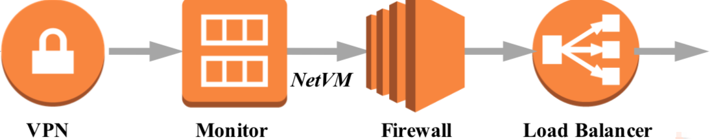
Middlebox Dependency Relations ^{[1]}
Multiple middleboxes may/may not have a serving order
Examples
Firewall usually before Proxy
Virus scanner either before or after NAT gateway
Categories
Non-ordered middlebox set
Totally-ordered middlebox set (service chain)
Partially-ordered middlebox set
[1] Dynamic Service Function Chaining in SDN-Enabled Networks with
Middleboxes (ICNP ’16)
Notes:
Virus scanner: inspector of harmful packets
VPN (virtual private network) (traffic changing effect not known)
Monitor: check traffic
Load Balancer: redistribute traffic

Slide 5
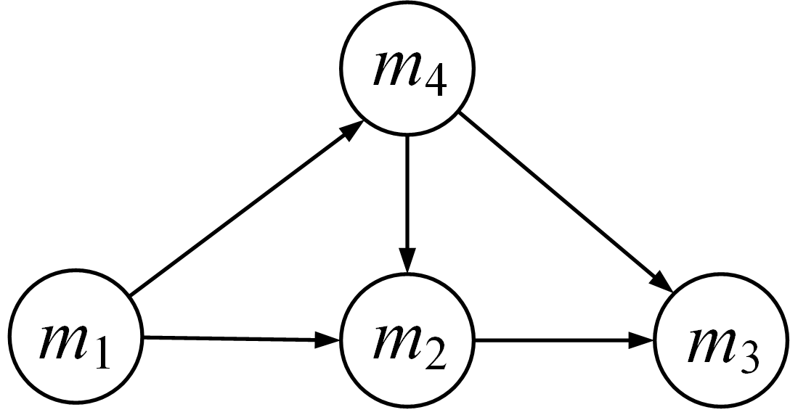
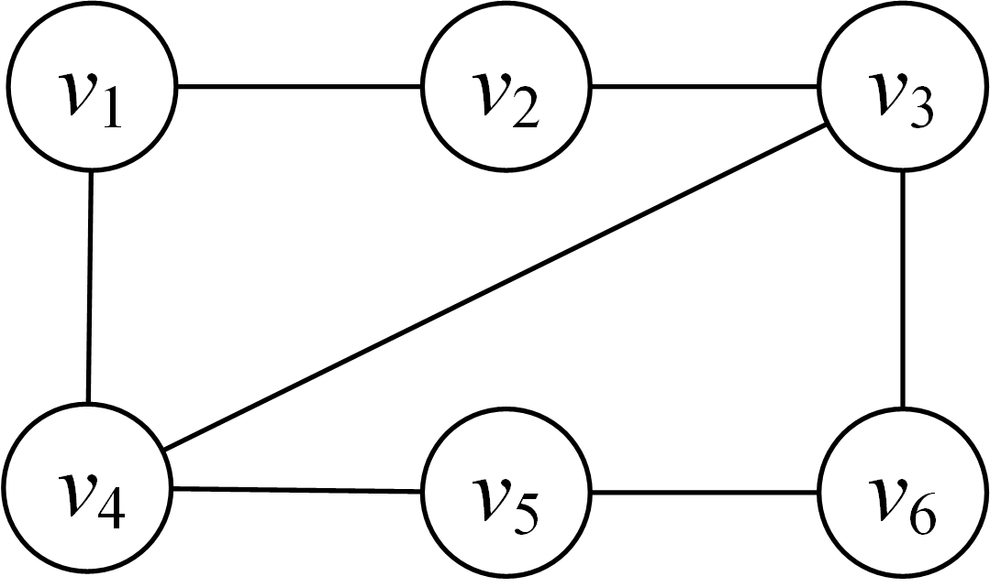
2. Middlebox Placement Problems
Graph embedding ^{[2]}
Middlebox graph, G_{m}, of multiple service chains that needs to be embedded in a give network graph, G_{n.}
Virtual network Physical network
Virtual network
Embedding
[2] Charting the Complexity Landscape of Virtual Network Embedding (IFIP ’18)

Slide 6
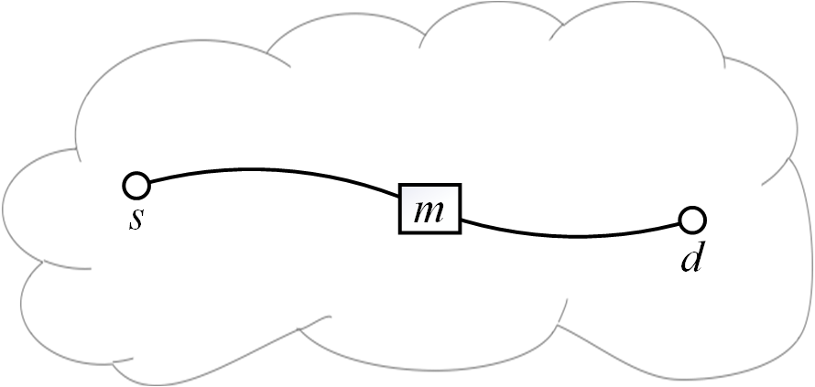
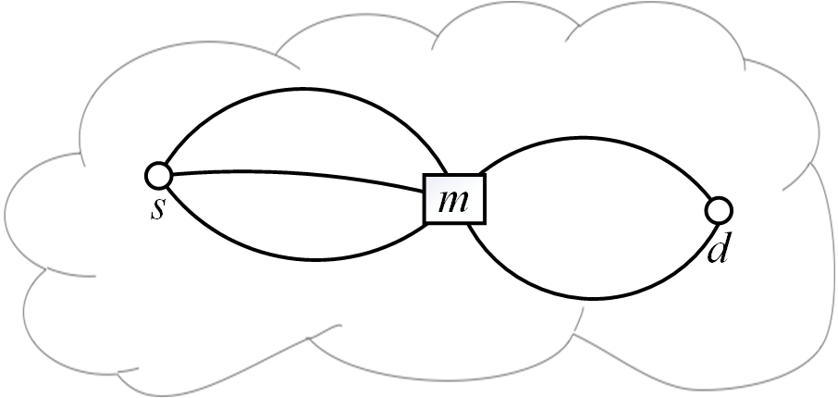
Middlebox Placement Problems (cont’d)
Graph flow routing ^{[3]}
Shortest path or maximum flow between a given source and destination that have to go through a given middlebox in G_{n}.
[3] Provably Efficient Algorithms for Joint Placement and Allocation of Virtual Network Functions (INFOCOM ’17)

Slide 7
Middlebox Placement Problem (cont’d)
Facility allocation ^{[4]}
Optimal placement of facilities (i.e., middlebox) to minimize transportation costs (i.e., traffic, including detour traffic from flows to middleboxes).
Cost
Objective
Minimizing sum of middlebox setup cost and communication cost
m
Setup cost
Communication cost
f₂
f₁
[4] Near Optimal Placement of Virtual Network Functions (INFOCOM ’15)
Notes:
Facility location problem: pick a subset F of facilities to open, to minimize the sum of distances (communication cost) from each demand point to its nearest facility, plus the sum of opening costs of the facilities
Generalized assignment problem: agents to do tasks. Doing each task can earn benefit and incur some cost. Each agent has a cost budget. Maximize the total benefit when the total cost is limited to a specific value.

Slide 8
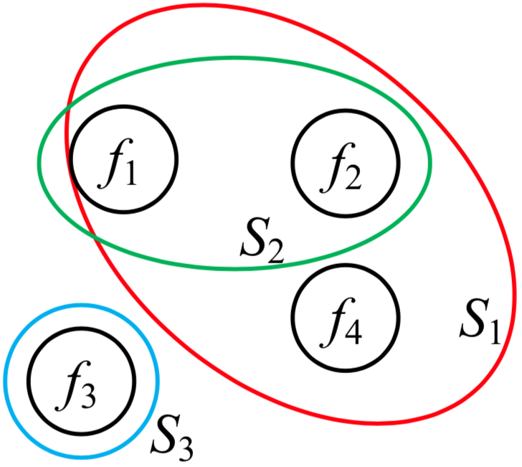
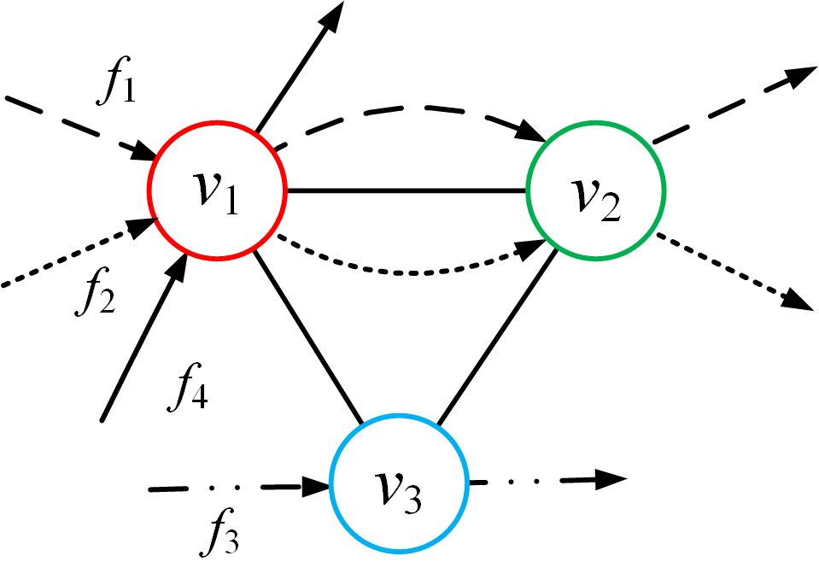
Middlebox Placement Problems (cont’d)
Set covering
Minimize the number of middleboxes used to cover all flows.
NP-hard

Slide 9
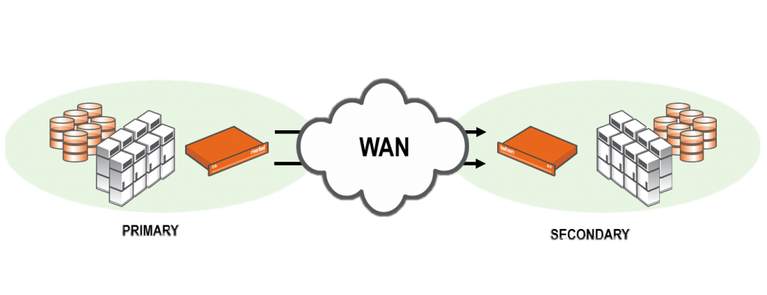
3. Traffic Changing Effects ^{[5]}
Middleboxes may change flow rates in different ways
Citrix CloudBridge WAN accelerator: 20% (diminishing)
BCH(63,48) encoder: 130% (expanding)
Objetive: minimizing total traffic
Data
Checksum
1 | 0 | 1 | 1 | 1 | 0 | 1 | 0
[5] Traffic Aware Placement of Interdependent NFV Middleboxes (INFOCOM ’17)
Notes:
CloudBridge: reduce redundant content (diminishing)
BCH(63, 48): Bose, Chaudhuri, and Hocquenghem (BCH) codes form a large class of powerful random error-correcting cyclic codes.

Slide 10
Service Chain Models
Objective
Minimizing the total bandwidth consumption
Solutions
Consider traffic-changing effects
Place middleboxes for a single flow
m₁
m₂
m₃
m₁
m₂
m₃
m₁
m₂
m₃
Non-ordered
(Optimal greedy: sort
traffic-changing ratios
in increasing order)
Totally-ordered
(Optimal DP: latter
middleboxes must be
after front ones)
Partially-ordered
(NP-hard: reduced
from the Clique Problem)

Slide 11
4. Our Model and Solutions
Problem
Placing middleboxes to satisfy all flows’ network service requests
Network service requests
Multiple middleboxes
Middlebox set with or without dependency relations
Cost
Middlebox setup
Sum of middlebox setup cost (amortized over a period of time)
Bandwidth consumption
Sum of each flow’s bandwidth consumption cost on each link
Objective
Minimizing total cost of middlebox setup and bandwidth consumption

Slide 12

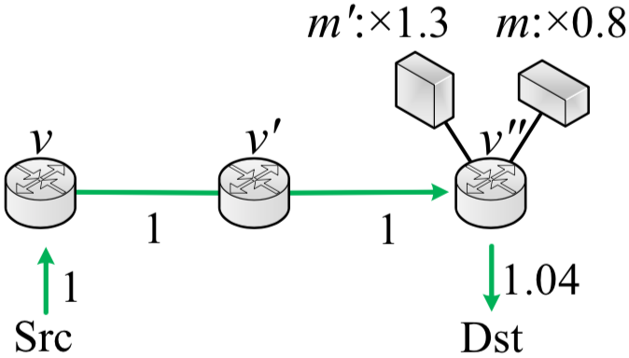
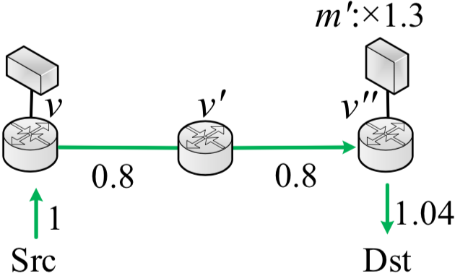
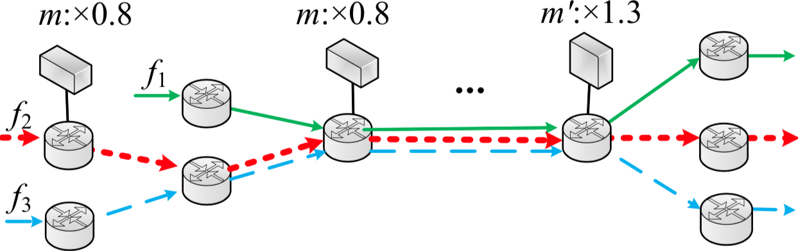
A Motivating Example
m: 0.8 (diminishing)
m’: 1.3 (expanding)
Independent middleboxes
Dependent middleboxes: m’ before m
Red flow with high rate
A flow covered by multiple middleboxes
(When additional setup cost is less than the reduced bandwidth consumption)

Slide 13




Problem Formulation
Middlebox setup cost
c_{m}: unit setup cost of middlebox m
Bandwidth consumption cost
w(b_{f}^{e}): bandwidth cost function of flow f on link e
r_{f}: initial traffic rate of flow f
: traffic-changing ratio of middlebox m
Objective
Minimizing c₁+c₂

Slide 14
Problem Formulation (cont’d)
Translog bandwidth cost function on each link^{[6]}
Reasons
Widely used in Cisco EIGRP and OSPF protocols
Log-linear for easy calculation
The weight of setup cost and bandwidth consumption
Adjusting the traffic-changing ratios and unit setup costs of middleboxes
[6] Computer Networking: A Top-Down Approach (Book)
Notes:
Add reference

Slide 15
Overview
Optimal solutions for homogeneous flows
Single middlebox
Greedy
Non-ordered middlebox set
Greedy
Totally-ordered middlebox set
Dynamic Programming
Performance-guaranteed solution for heterogeneous flows
Notes:
Add reference

Slide 16
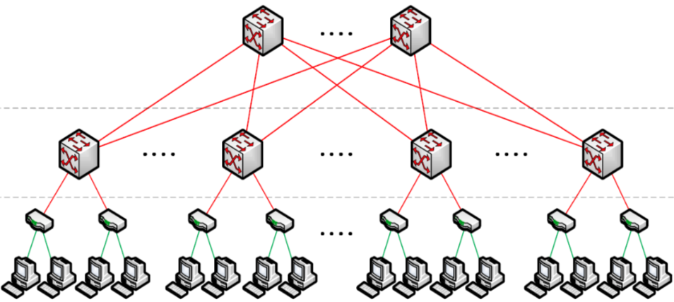
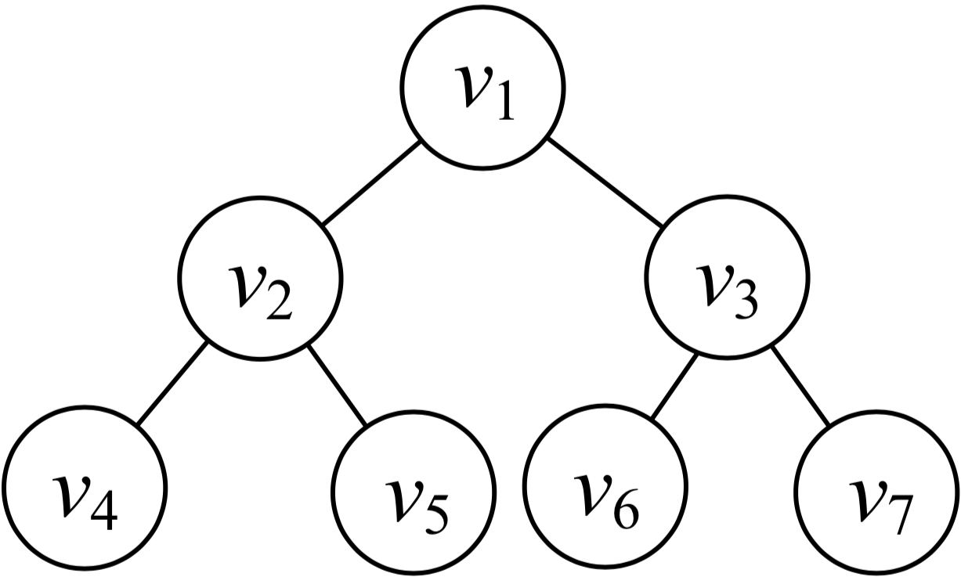
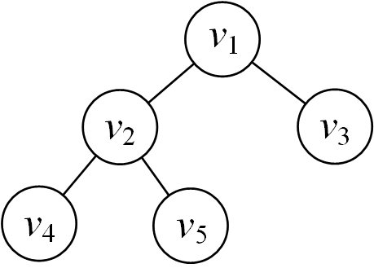
Topology Structure
We focus on tree-structured topologies
Left
Triangle
Right
Triangle
Tree-based data centers
Double-tree structure
Each triangle is mostly a perfect
or complete tree
Perfect tree
Complete tree
Notes:
Trade-off between set up and flow: two extremes

Slide 17
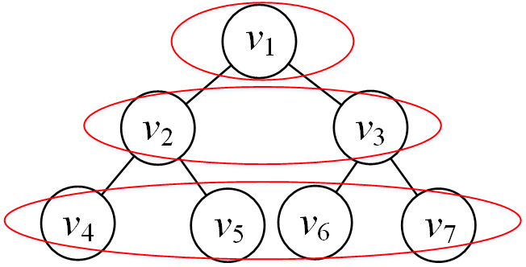
Placing a Single Middlebox
Solution
Local Greedy Algorithm (LGA)
Steps
Calculate the total cost of placing middleboxes in a level
Select the level with the minimum total cost
Convex function: sufficient to select the local minimum
Total cost
Optimal
Level

Slide 18
Placing a Single Middlebox (cont’d)
Time complexity (|V|: #node)
O(|V|) (O(log|V| for perfect tree)
Optimal for perfect tree topologies
Symmetry of placement
No multiple “coverage” situation
Also optimal for complete tree topologies
Also no multiple “coverage” situation

Slide 19
Placing Multiple Middleboxes
Non-ordered middlebox set placement
Solution
Combined Local Greedy Algorithm (CLGA)
Insight
Place each middlebox independently by applying LGA
Time complexity (|V|: #node, |M|: #middlebox)
O(|M| |V|) or O(|M|log|V|)
Optimal for perfect and complete trees
Notes:
No vertex capacity (infinite server capacity)

Slide 20

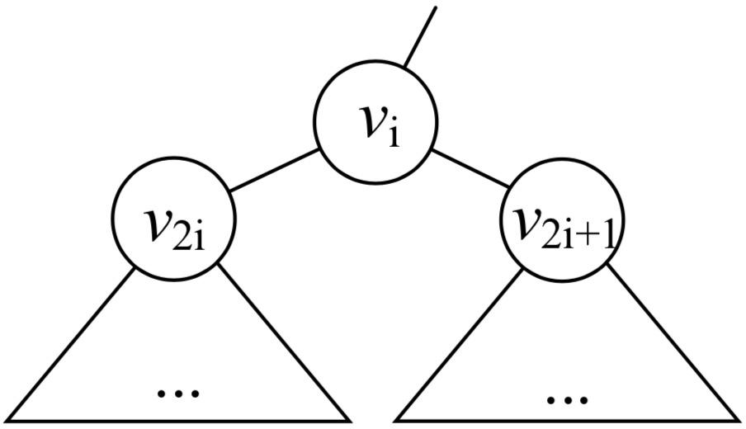
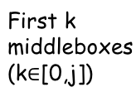
Totally-ordered Middlebox Set Placement
Solution: Dynamic Programming (DP)
Works for infinite and finite vertex capacity
OPT(i, j)
Minimum cost of subtree with root v_{i} when placing first j middleboxes in the set
if capacity is not enough
(k+1)_{th} to j_{th} middleboxes
First j middleboxes

Slide 21
Dynamic Programming Formulation
Left triangle
Right triangle
Similar to the left triangle’s formulation
Left subtree
Right subtree
Changing rate consumption
Base bandwidth consumption
Newly placed middleboxes
Notes:
j-k are placed at the current level
Left triangle and right triangle are two stages

Slide 22
Totally-ordered Middlebox Set Placement (cont’d)
Insights
The optimal placement with root v_{i} by placing first j and its two subtrees by placing no more than j middleboxes
Perfect tree
Transformed to a line
Similar to a single flow placement
Complete tree
No multiple “coverage” situation
Time complexity (|V|: #node, |M|:#middlebox)
O(|M|³ |V|) or O(|M|³ log|V|)

Slide 23
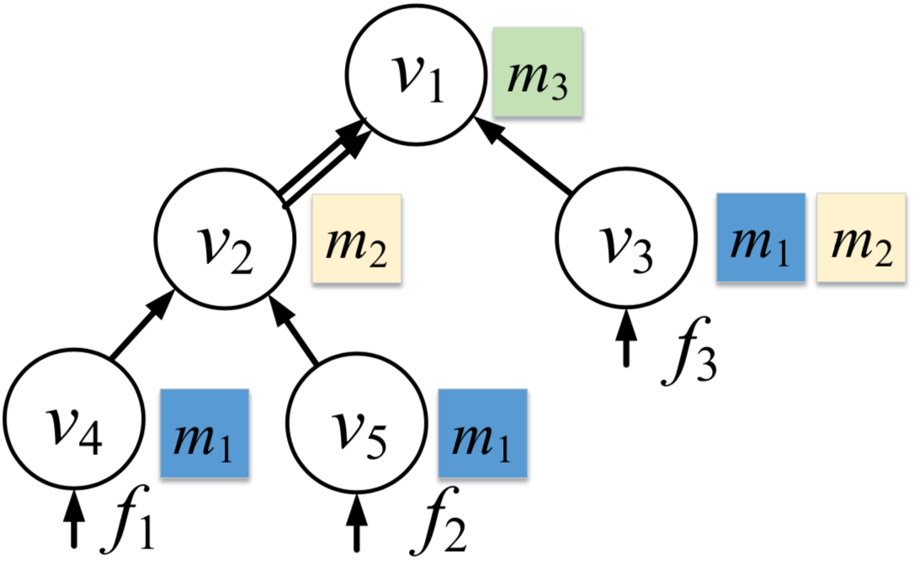
An Example
 | m₁ | m₂ | m₃
Traffic-changing ratio | 0.5 | 0.8 | 1.1
Setup cost | 0.2 | 0.4 | 0.3
Dependency relations
m₁->m₂->m₃
Initial traffic rate
r₁=r₂=r₃=1

Slide 24

Partially-ordered Middlebox Set Placement
NP-hard even for a single flow ^{[2]}
One heuristic solution
Insight
Transform into a totally-ordered middlebox set
Steps ( : traffic-changing ratio)
Treat middleboxes with dependencies as a single middlebox
Sort middleboxes in increasing order of
Example
Middlebox set
Dependency relationship：m₂ -> m_{3,} m₄ -> m₅-> m₆
 | m₁ | m₂ | m₃ | m₄ | m₅ | m₆
 | 0.7 | 1.1 | 0.8 | 1.1 | 0.5 | 1.4
m₁
m₄
m₅
m₆
m₂
m₃
0.7
1.1*0.5*1.4=0.77
1.1*0.8=0.88
[2] Traffic aware placement of interdependent NFV middleboxes (INFOCOM ’17)

Slide 25
Partially-ordered Middlebox Set Placement (cont’d)
Another heuristic solution
Insight
Transform into a non-ordered middlebox set
Steps
Treat middleboxes with dependencies as a single middlebox by a topological order
No dependency relations among new middleboxes
Example
Middlebox set
Dependency relationship：m₂ -> m_{3,} m₄ -> m₅-> m₆
 | m₁ | m₂ | m₃ | m₄ | m₅ | m₆
 | 0.7 | 1.1 | 0.8 | 1.1 | 0.5 | 1.4
m₁
m₂
m₃
m₄
m₅
m₆
0.7
1.1*0.8=0.88
1.1*0.5*1.4=0.77

Slide 26


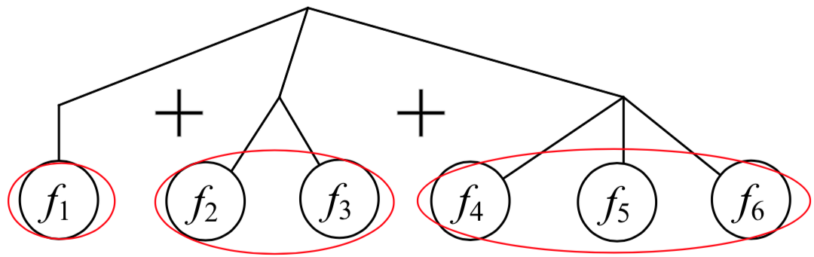
Handling Heterogeneous flows for Non-ordered Middlebox Set
Group Flows by Initial Bandwidths (GFIB)
Group flows by initial traffic rates (r_{f}: f’s traffic rate)
#group:
The traffic rate range of the i^{th} group:
Treat flows in each group as homogeneous
Apply CLGA for each group
An example
Combine
max r_{f}= 7
min r_{f}= 1
Group 1: [1,2)
Group 2: [2,4)
Group 3: [4,8)
CLGA
CLGA
CLGA
r₁=1 r₂=2 r₃=3 r₄=4 r₅=6 r₆=7
Notes:
Upper or lower bound?
Flow and middle box are all counted for empty flow? Multiple boxes at the same node?

Slide 27


Handling Heterogeneous Flows for Non-ordered Middlebox Set (cont’d)
Time complexity
Performance-guaranteed algorithm
Approximation ratio ^{[6]}:
[6] On Optimal Scheduling of Multiple Mobile Chargers in Wireless Sensor Networks (MSCC ’14)

Slide 28
4. Simulation
Our algorithms
LGA
Single middlebox
Select the level with the minimum cost
CLGA
Non-ordered middlebox set
Apply LGA independently
DP
Totally-ordered middlebox set
Dynamic programming
GFIB
Heterogeneous flows
Group flows by initial traffic rates
Combine placement by applying CLGA for each group

Slide 29
5. Simulation
Comparison algorithms
Random-fit
Randomly place middleboxes until all flows are satisfied
NOSP ^{[2]}
For single middlebox or non-ordered middlebox set
Place middleboxes for each flow independently
TOSP ^{[2]}
For totally-ordered middlebox set with or without vertex capacity
Dynamic programming based algorithm for each flow independently
[2] Traffic aware placement of interdependent NFV middleboxes (INFOCOM ’17)

Slide 30
Settings
Topology
Perfect 5-layer binary tree for each triangle
Facebook data center traffic trace
Single-flow initial traffic rate: 1~6 Mb
Middlebox set
Dependency relationship
m₂ -> m₃ -> m₁ -> m₄
 | m₁ | m₂ | m₃ | m₄
Traffic-changing ratio | 0.7 | 0.8 | 1.1 | 1.2
Set-up cost | 0.4 | 0.6 | 0.2 | 0.8

Slide 31
Simulation Results
Single middlebox
Non-ordered middlebox set
Bandwidth heterogeneity
(LGA)
(CLGA)
(GFIB)
LGA costs 20.3% less than NOSP and 35.1% less than Random-fit.
CLGA performs the best even with heavy traffic.
For heterogeneous flows, GFIB saves about 36.9% and 34.0% compared to NOSP and Random-fit.

Slide 32
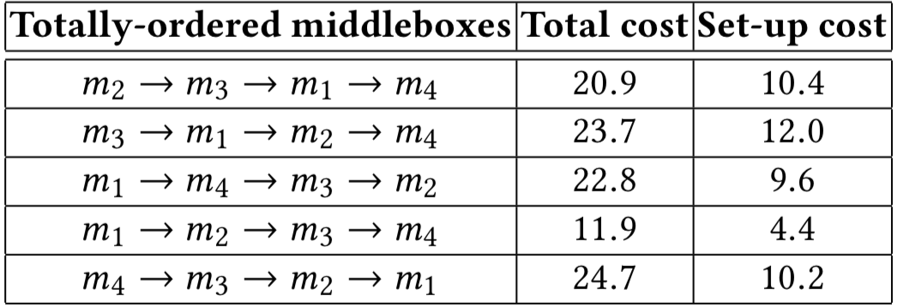
Simulation Results (cont’d)
Totally-ordered middlebox set with (2) and without vertex capacity
Without vertex capacity
With vertex capacity
Middlebox order effect at 3 Mbps (DP)
The total cost is larger than the non-ordered middlebox set.
Limited vertex capacity increases the minimum cost.

Slide 33
5. Conclusion and Future Work
Middlebox constraints
Traffic-changing effects, dependency relations, and flow sharing
Middlebox placement
Balancing middlebox set-up cost and bandwidth consumption
Tree-structured topologies
Optimal algorithms for homogeneous flows
Performance-guaranteed algorithm for heterogeneous flows
Future work
General tree-structure and other topologies

Slide 34
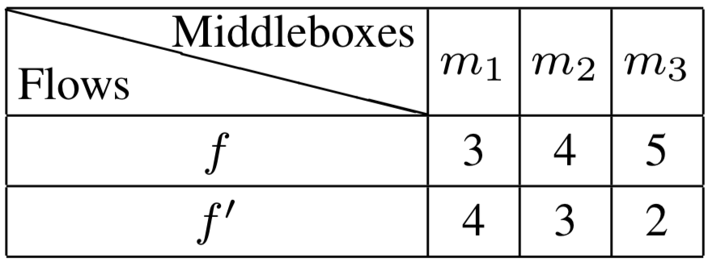
Future Work: Other Chain Models
d₁ = 1 d₂ = 2
Processing time
prolong
f before f’
t = 10
f‘ before f
t’ = 12
Minimizing the makespan (similar to flow shop)
Minimizing the average completion time
Notes:
The completion time of a flow in the current middlebox can not be more than the completion time in the last middlebox plus the transmission delay between these two middleboxes

Slide 35
Q & A
Y. Chen and J. Wu, " NFV Middlebox Placement with Balanced Set-up Cost and Bandwidth Consumption," Proc of ICPP, August 13-16, 2018.
Y. Chen, J. Wu, and B. Ji, " Virtual Network Function Deployment in Tree-structured Networks," Proc. of ICNP, September 24-27, 2018.

Slide 36
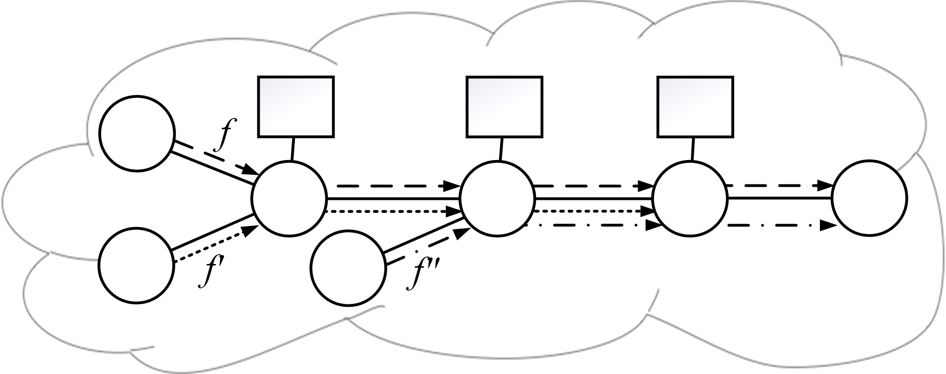
Other Service Chain Models
One box with different volumes/costs
Solutions
Heterogeneous (NP-hard)
V: set of vertices M: set of box types (<10)
c_{max}: Max box number per vertex (<30) w_{max}: Max box cost scale (tunable)

