Slide 1

Protecting Real-time Video Chat against Fake Facial Videos Generated by Face Reenactment
Jiacheng Shang
Dept. of Computer Science, Montclair State University
Jie Wu
Dept. of Computer and Information Science, Temple University

Slide 2
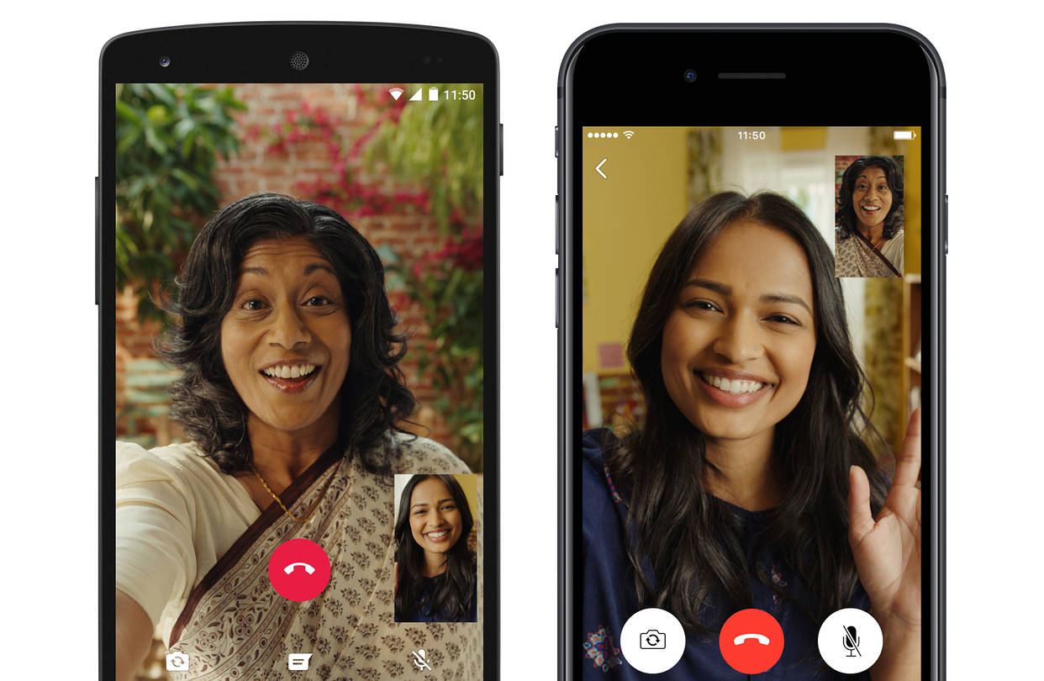

Power of Video
Deliver much more information
Various applications
  E.g. Video calling and video conference

Slide 3
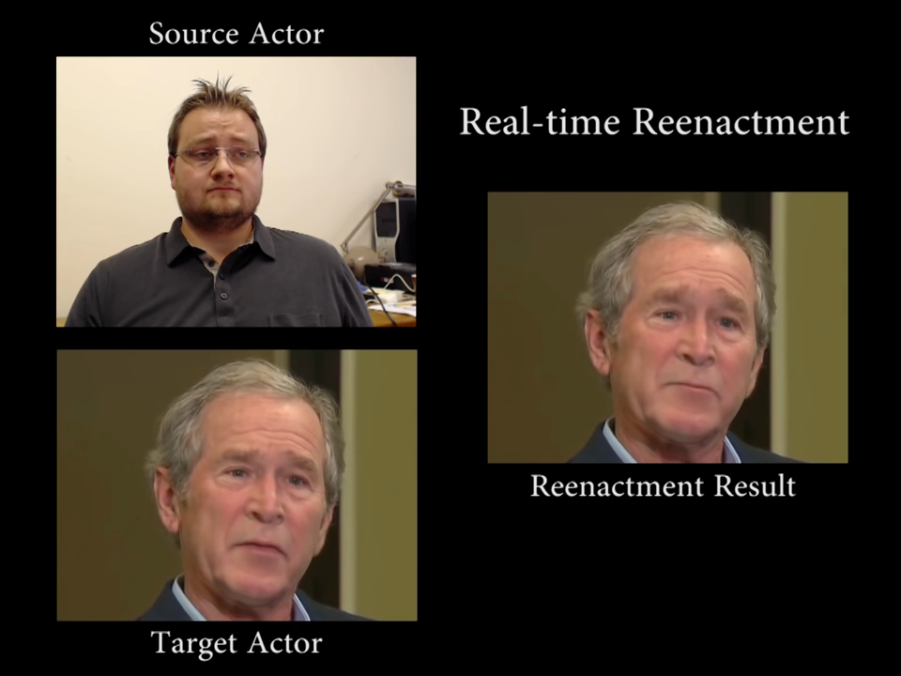
Threats of DeepFakes
Videos are usually assumed to be true
High-quality fake facial videos using deep learning (even in real time)
Face2Face: Real-time Face Capture and Reenactment of RGB Videos (CVPR 2016 Oral)

Slide 4
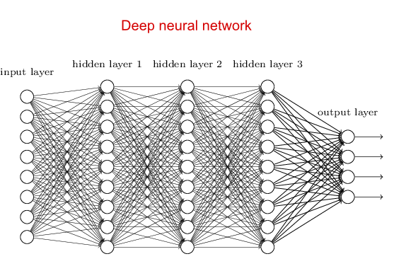

Fake Facial Video Detection
Many fake facial video detection systems have been proposed based on deep learning
Real or Fake

Slide 5
Fake Facial Video Detection
However, they fail to answer two questions
  Generality: Can their detection systems be generally used to detect all types of fake facial videos?
  Cost: Is there any low-cost detection scheme?
Real or Fake

Slide 6
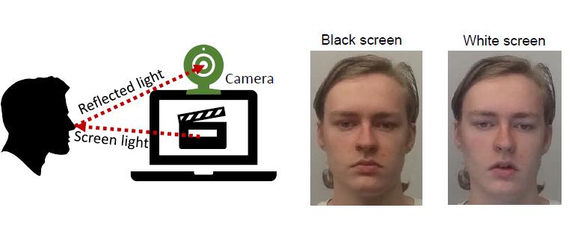
System Overview
Utilizing the face reflected light
  The screen light can be reflected by the face
  The reflected light can be captured by the webcam
  The normal user can change the luminance of the screen light by changing the area of light metering

Slide 7
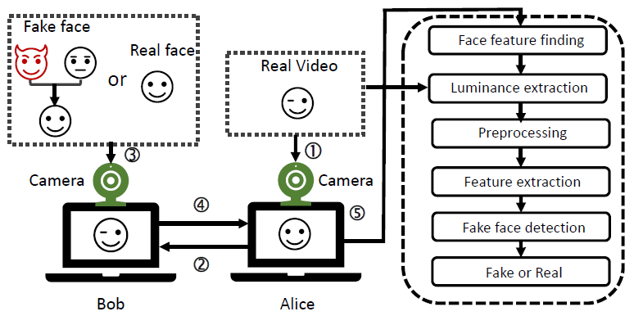
System Overview
Goal: detect the liveness of the face in the video by measuring the correlation between luminance signals of the screen light and face-reflected light

Slide 8

Luminance Extraction
Extract relative luminance information of the screen light
  Compress each frame of the screen into a single pixel
  Use the luminance value of the compressed pixel to represent the overall luminance of the transmitted video
  The luminance of a pixel is defined as

Slide 9
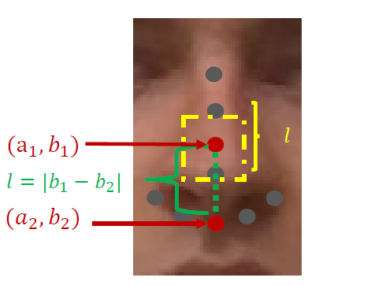
Luminance Extraction
Not all facial parts can be used to measure luminance changes.
We find that the lower part of the nasal bridge has the most stable images and hard to be occluded in most cases

Slide 10
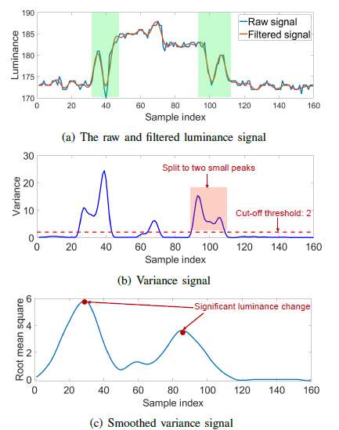
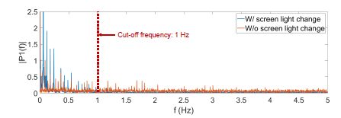
Preprocessing
Raw luminance signal contains noise
  Object movement in the scene
  Inaccurate face localization can lead to jittering in the interested area,

Slide 11
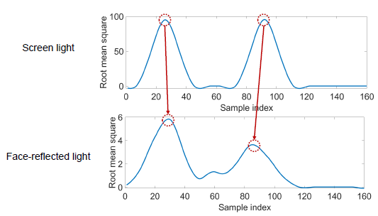
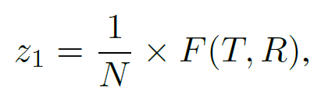

Feature extraction
Luminance change behavior
  For any significant luminance change in one signal, we can always find a matched luminance change in another one.
  We define two behavior similarity metrics $z_{1}$ and $z_{2}$
Num. of luminance changes in the screen light
Num. of matched luminance changes

Slide 12
Feature extraction
Luminance change trend
  Evaluate the correlation of their trends
  Reduce the impact of network delay
    Average time difference between each pair of matched luminance change
  Each signal is cut into two segments with equal length
  Measure correlation using Pearson correlation coefficient for each pair of segments
    Use the smaller one of them as the third feature
  Use the maximum dynamic time warping (DTW) distance (expressed with z4) between each pair of segments as the fourth feature

Slide 13
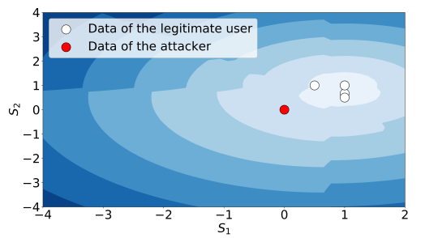
Fake Facial Video Detection
Detection for a single video clip
  Build with good classification performance using only the data of a limited number of legitimate users.
  Local outlier factor (LOF) model

Slide 14
Evaluation
Testbed
  Screen: Dell 27-inch LED monitor with 85% brightness
  Webcam: The front camera of Google Nexus 6 smartphone
  Fake facial video: ICface
    Generating the most visually convincing results of any open-source methods
  10 volunteers (four females and six males)
  Each facial video is 15 seconds in length
  Data processing: desktop computer with Intel(R) i7-8700 @ 3.2 GHz CPU and 32 GB of RAM

Slide 15
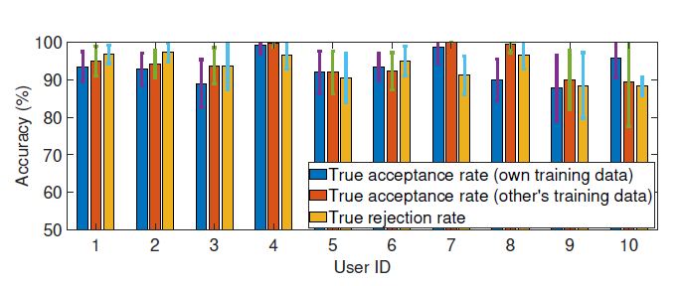
Overall Performance
An average true acceptance rate of 92.5% when the classifier is trained using own data.
Achieve an average true acceptance rate of 92.8% with other’s training data
Reject attackers with average accuracy of 94.4%.

Slide 16
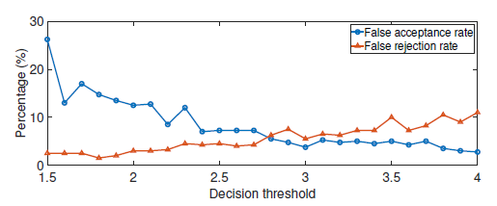
Impact of Decision Threshold
When the decision threshold is between 2.8 and 3, our system can provide an equal error rate of about 5.5%.

Slide 17
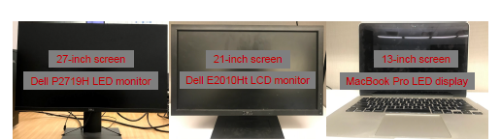
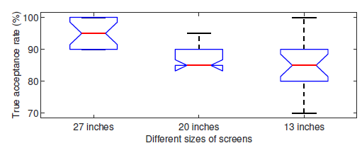
Impact of Screen Size
Screen size has a significant impact on the performance

Slide 18
Conclusion
We show that the face reflected light can be leveraged to detect fake facial video with low cost and high generality.
Our system only requires a limited number of training instances from the legitimate user and does not need to collect data from attackers.
We develop a prototype and conduct comprehensive evaluations. Experimental results show that our system can provide an average true acceptance rate of at least 92.5% for legitimate users and reject face reenactment attackers with mean accuracy of at least 94.4% for each detection

Slide 19
Thank you

