Slide 1

Defending Against Voice Spoofing: A Robust Software-based Liveness Detection System
Jiacheng Shang, Si Chen, and Jie Wu
Center for Networked Computing
Dept. of Computer and Info. Sciences
Temple University

Slide 2


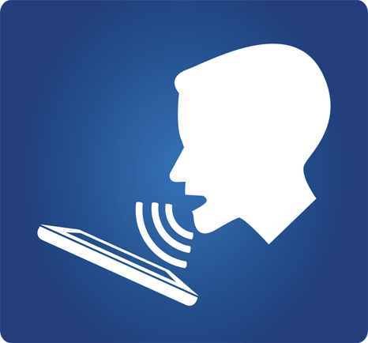

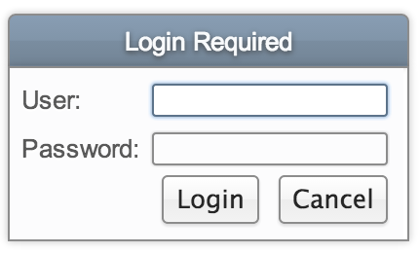



Biometrics: Voiceprint
Voiceprint
  Promising alternative to password
  Primary way of communication
  Better user experience
  Integration with existing techniques for
  multi-factor authentication
Applications

Slide 3
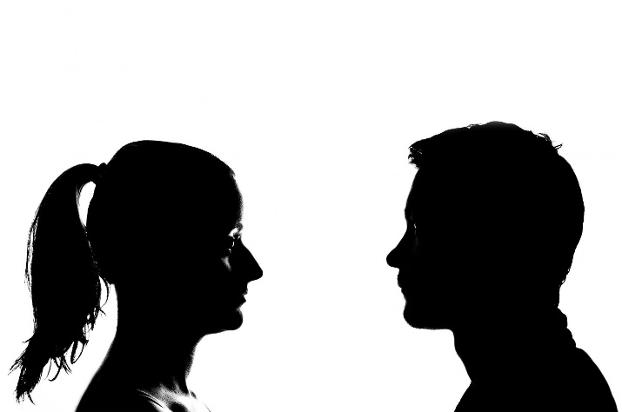

Biometrics: Voiceprint
Voiceprint example
passphrase
Hold button and read digits
“796432”
796432
Accept/Reject
Hold to talk
Voiceprint-based authentication

Slide 4
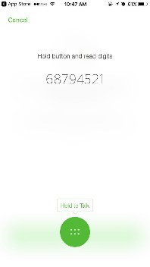












Threats
Human voice is often exposed to the public
Attackers can “steal” victim’s voice with recorders
Security issues
  E.g. Adversary could impersonate the victim to spoof the voice-based authentication system
Passphrase
replay
Victims
Attacker
Steal voice
Replay to voice-based authentication systems

Slide 5
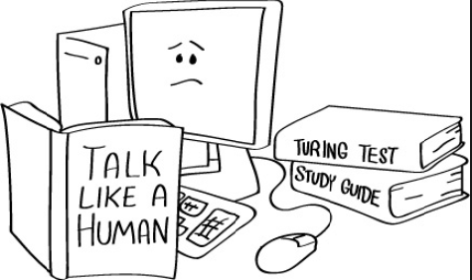

Reverse Turing Test
CAPTCHA
Completely Automated Public Turing test to tell Computers and Humans Apart
or
voice
Voiceprint-based authentication

Slide 6

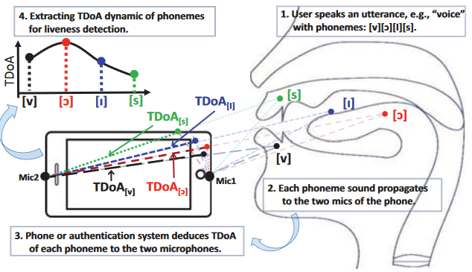
Previous work
Systems | Limitations
Automatic speaker verification | Verifying the speaker’s identity (Bob or Alice) Cannot defend against replay attack
Phoneme localization-based liveness detection (distance) | Low true acceptance rate (TAR): the smartphone needs to be static relative to the mouth VoiceLive: A Phoneme Localization based Liveness Detection for Voice Authentication on Smartphones (L. Zhang et al. CCS 2016)

Slide 7
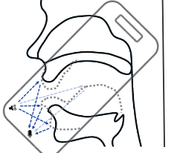
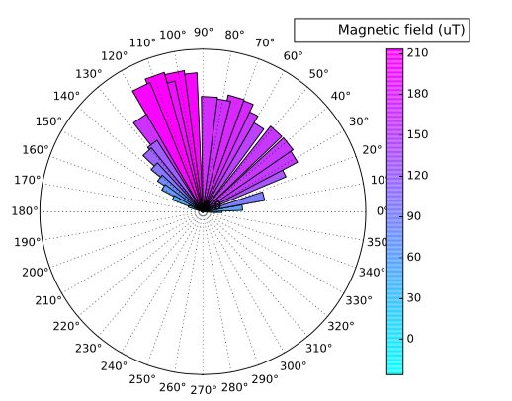
Previous work
Systems | Limitations
Articulatory gesture-based liveness detection (e.g. lip motion) | Low true acceptance rate (TAR): the smartphone needs to be static relative to the mouth Hearing Your Voice Is Not Enough: An Articulatory Gesture Based Mobile Voice Authentication (L. Zhang et al. CCS 2017)
Leveraging the magnetic fields of loudspeakers | Low TAR: cannot work if magnetic noise exists Low true rejection rate (TRR): cannot work if the attacker uses non-conventional loudspeaker You Can Hear But You Cannot Steal: Defending against Voice Impersonation Attacks on Smartphones (S. Chen et al. ICDCS 2017)
(Doppler effect)

Slide 8



Basic idea
  Leveraging the structural differences between the vocal systems of human and loudspeakers
  The voices at the mouth and the throat are different
  (spectrum-based approach)
  Up and down motions exist during speaking
  (motion-based approach)
Voice
Voice
Throat motion

Slide 9


Attack model
  Attack model:
  A simple replay attack: only stealing victim’s voice at the mouth and replaying it
  A strong replay attack: stealing victim’s throat motions and voices at both mouth and throat from the database and replaying it
Passphrase
database
Victim
Attacker
replay
replay

Slide 10

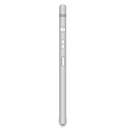

System Architecture
Motion-based solution
Support vector machine-based classifier
Liveness of the speaker
Feature extraction
Acceleration at the throat
Voice-based solution
Voice at the mouth
Compute spectra difference between two voices
Voice at the throat
Random vibration injection
Support vector machine-based classifier
Compute the spectrum of the voice
Noise-based
solution
Energy-based vibration detection

Slide 11

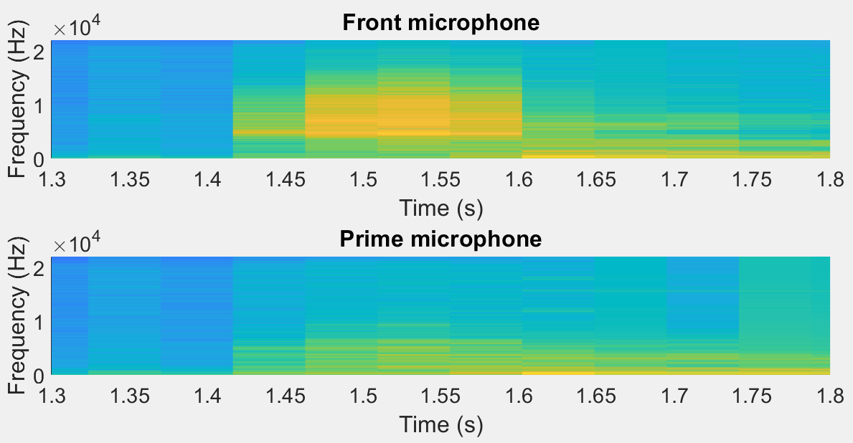
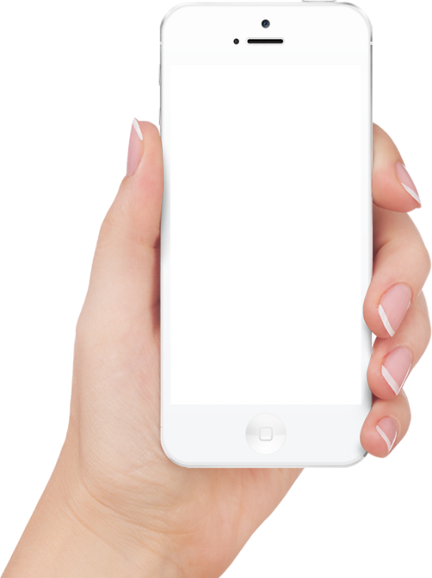
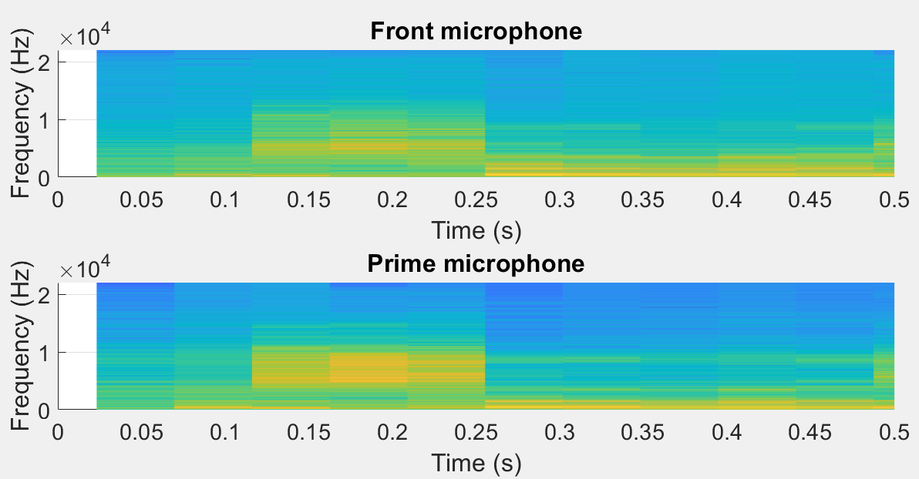


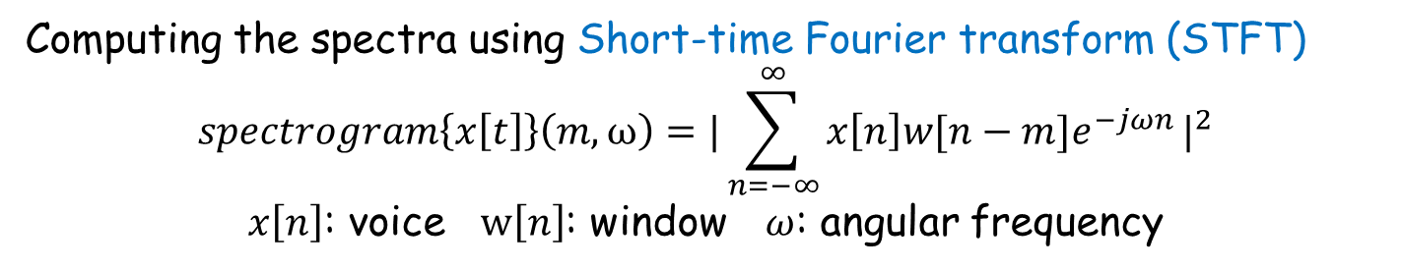
Proposed solutions
  \
Voice-based solution (Simple attack model)
Front microphone
Hold button and read digits
Voice
796432
$$A=πr^{2}$$
Hold to talk
$$A=πr^{2}$$
Voice
Prime microphone
Computing the spectra using Short-time Fourier transform (STFT)
$$spectrogram\left\{x\left[t\right]\right\}\left(m,ω\right)={|\sum_{n=−∞}^{∞}{x\left[n\right]w[n−m]e^{−jωn}}|}^{2}$$
$x\left[n\right]$: voice $w\left[n\right]$: window $ω$: angular frequency
Convolution
Time domain to frequency domain

Slide 12
Proposed solutions
Voice-based solution for simple attack
Spectra
  Normal user: two voices are different
    The voice (prime microphone) does not contain information of the unvoiced part.
    The voice (prime microphone) contains low-frequency information of the voiced part.
  Attacker: two voices are similar
    The voice (prime microphone) contains information of the unvoiced part.
    The voice (prime microphone) contains most information of the voiced part.
$$A=πr^{2}$$
$$A=πr^{2}$$

Slide 13
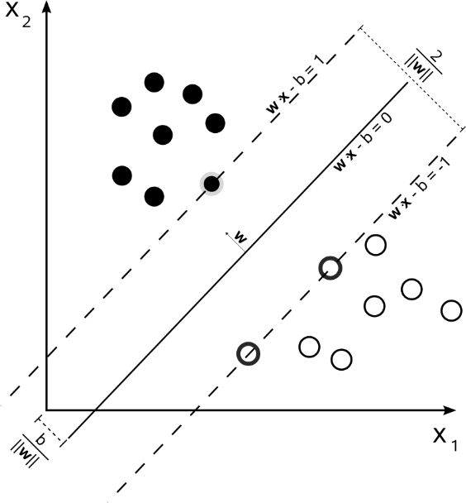

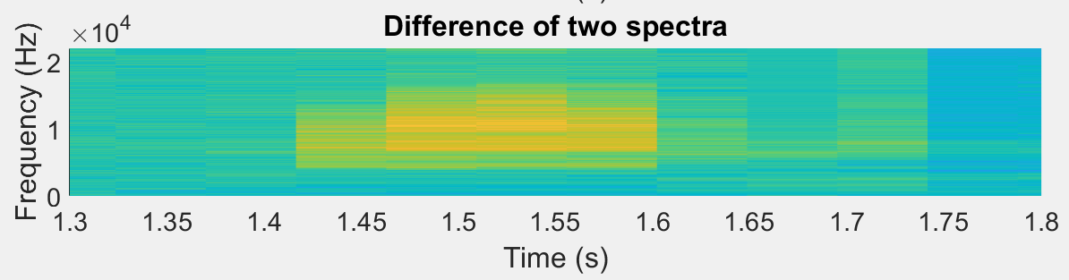


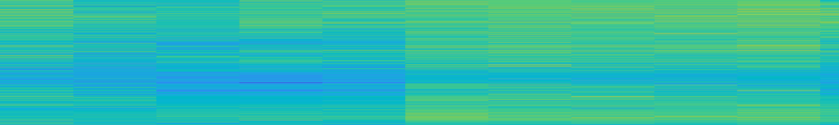
Proposed solutions
Supporting vectors
Voice-based solution for simple attack
  For normal users
pattern
Spectra difference
$$A=πr^{2}$$
$$A=πr^{2}$$
Converting to vector
Support vector machine (SVM)-based classifier
Input
Accept
[32,54,3,…..,34,76]
User:
Vector
Attacker:

Slide 14
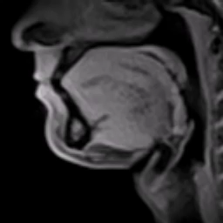
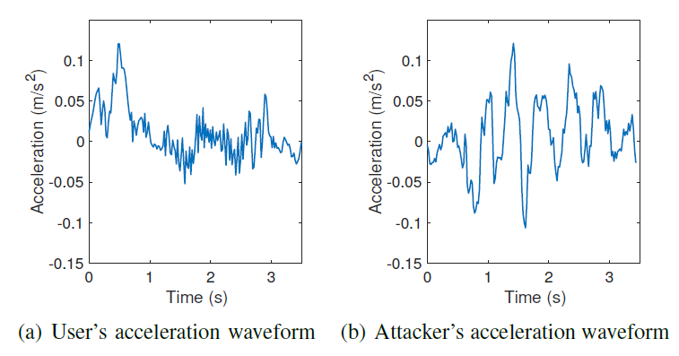

Proposed solutions
Motion-based solution for simple attack
  Using accelerator to capture throat motions
  7 features: Variance, minimum, maximum, mean, skewness, kurtosis, standard deviation
  SVM-based classification model for decision
Normal users
Attacker
Notes:
When a user speaks a passphrase to the smartphone in our system, there are two kinds of movements involved.
The throat will move up and down in a low frequency.
the vocal cords will vibrate in high frequency for voiced phonemes.
7 features: Variance, minimum, maximum, mean, skewness, kurtosis, standard deviation.
SVM-based classification model for decision

Slide 15




Proposed solutions
Random noise-based solution for strong attack
  Attackers who can steal victim’s voices and throat motions from the database and use multiple loudspeakers to imitate the victim
Injecting random noise (vibration motor)
Raw voices
Num. of vibration: 1
Injecting random noise (vibration motor)
Num. of vibration: 2
  Our solution:
  Injecting a random vibration while the user is speaking
  Checking the number of vibration in the voices
Notes:
While the user is speaking, we randomly enable the vibration motor for a short time. For every authentication attempt, we check the number of random vibration. If the number is larger than 1, the voice is stolen from the victim.

Slide 16
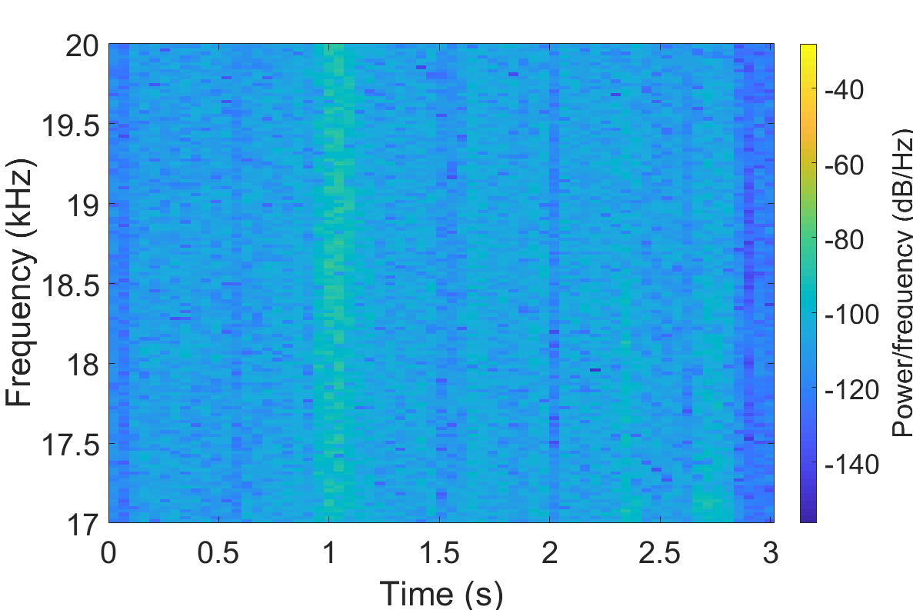
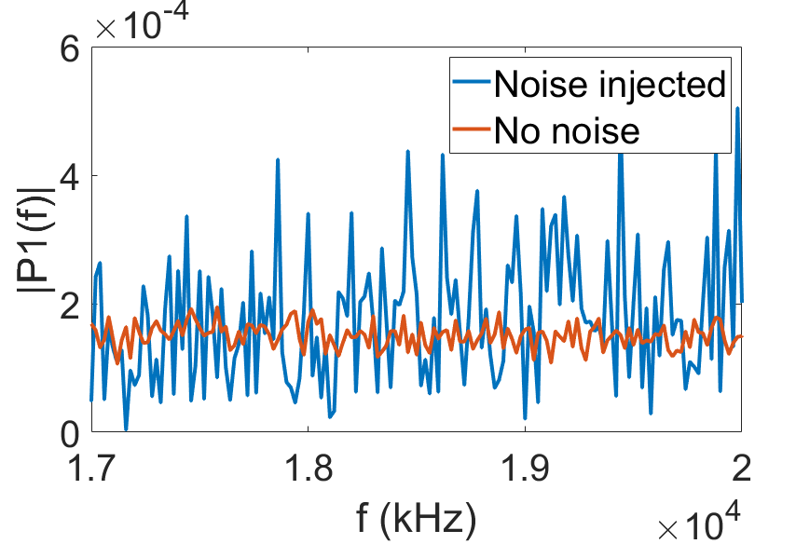
Proposed solutions
Computed by STFT
Random noise-based solution
  For normal users For the attacker
  The vibration introduces high energy to the high-frequency band.
  A vibration is detected if the energy of a moving window exceeds a threshold.

Slide 17
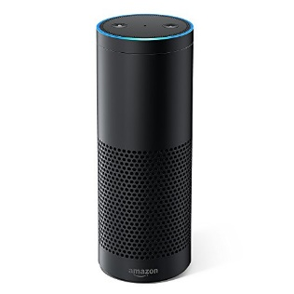
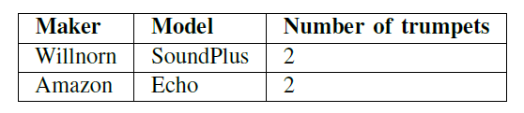
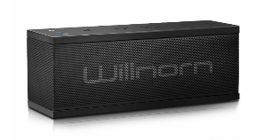
Evaluation
Methodology
  Implementing our system on real smartphones
  Using two loudspeakers to perform replay attack
  Performance metrics
  The standard automatic speaker verification metrics
  True Acceptance Rate (TAR)
  True Rejection Rate (TRR)

Slide 18
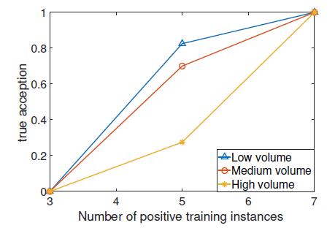
Evaluation
Influence of locations on random noise-based approach
Locations | TAR | TRR
1 | 100% | 100%
2 | 100% | 100%
3 | 100% | 100%
4 | 97.5% | 100%
Influence of acoustic noise on spectrum-based approach
7 training instances from the user are sufficient
TAR
# of training instances of the user

Slide 19
Evaluation
Overall performance
  Simple replay attack
  Strong replay attack
Solutions | TAR | TRR | Computation cost
Voice-based | 100% | 100% | Medium (SVM+STFT)
Motion-based | 93.3% | 88.93% | Low (SVM)
Solutions | TAR | TRR | Computation cost
Voice-based & random noise | 97.5% | 100% | High (SVM+2*STFT)
Motion-based & random noise | 91.0% | 100% | Medium (SVM+STFT)
Notes:
Correct but mis-diagnosed: 97.5% (for random noise)
Attacker catch rate: 100% (for random noise)
91 = 97.5 * 93.3

Slide 20
Conclusion
Smartphone-based liveness detection system
  Leveraging microphones and motion sensors in smartphone – without additional hardware
  Easy to integrate with off-the-shelf mobile phones - software-based approach
Good performance against strong attackers

Slide 21
Q&A

