Slide 1
Optimizing Multi-copy Two-hop Routing in Mobile Social Networks
Huanyang Zheng*, Yunsheng Wang†, and Jie Wu*
* Department of CIS, Temple University, USA
†Department of Computer Science, Kettering University, USA
Presenter: Cong Liu

Slide 2
Introduction
Mobile social networks:
Opportunistic contacts.
Intermittent connectivity.
Two-hop routing:
Uses local network information.
Achieves a high delivery ratio through mobility.
Each message copy will be forwarded at most twice, resulting in the advantage of the bounded resource (e.g., energy and buffer) consumption.

Slide 3
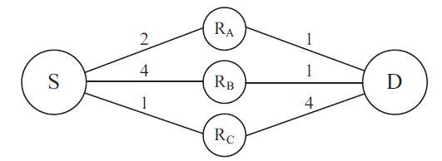
Introduction
Opportunistic two-hop routing (single-copy case)
Link weights indicate average delay.
Forward the message to the first encountered node?
Most likely is R_{C.}
Bad decision, since the delay of R_{C}-D is large.
Wait for S-R_{A}-D is better (2+1<4)

Slide 4
Introduction
Opportunistic two-hop routing (single-copy case)
Link weights indicate average delay.
Always shortest path routing (S-R_{A}-D) ?
Also bad, when opportunistically meeting R_{B.}
The delay of R_{B}-D is smaller than S-R_{A}-D.

Slide 5
Introduction
Opportunistic two-hop routing (single-copy case)
Link weights indicate average delay.
Forwarding set:
The source only forwards its copy to encountered relays in its forwarding set {R_{A},R_{B}}, ignoring R_{C} even if it is the next encounter.

Slide 6
Introduction
Opportunistic two-hop routing (multi-copy case)
Assume the source has 3 copies.
The forwarding set of the 1st sent copy:
Should be{R_{A},R_{B},R_{C}}.
Enough copies are reserved.
Different from the single-copy case.

Slide 7
Introduction
Opportunistic two-hop routing (multi-copy case)
Assume the source has 2 copies (a complex case).
The forwarding set of the 1st sent copy:
Should be{R_{A},R_{B},R_{C}} or {R_{A},R_{B}}?
Not trivial.
The forwarding set of the 2nd sent copy?

Slide 8
Introduction
Opportunistic two-hop routing (multi-copy case)
Assume the source has 2 copies (a complex case).
Suppose the 1st sent copy uses {R_{A},R_{B},R_{C}}:
R_{A} takes the 1st copy.
R_{B} takes the 1st copy.
R_{C} takes the 1st copy.

Slide 9
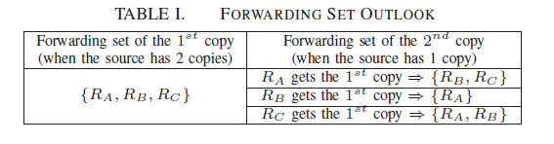
Introduction
Opportunistic two-hop routing (multi-copy case)
Assume the source has 2 copies, very complex.

Slide 10
Introduction
Very challenging problem:
To calculate the forwarding set of the current copy, we need to know the delay reduction brought by the remaining copies.
To calculate the delay reduction brought by the remaining copies, we need to know the actual relay of the current copy, which is opportunistic.

Slide 11
Introduction
Tradeoff:
If the forwarding set we selected for the current copy is too small, the subsequent copies will be blocked, losing the advantage of multiple copies.
On the other hand, if the forwarding set we selected for the current copy is too large, this copy may end up choosing unqualified relays, i.e., this copy is useless.

Slide 12
Outline
Model
Insights and Solutions
Extension
Evaluation

Slide 13
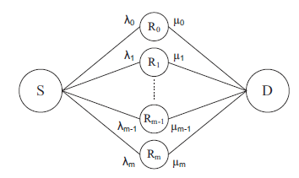
Model
Exponential distributed link delay.
The parameters
for the first and
second hops are
denoted by λ and
μ, respectively.
Direct one-hop routing of S-D?
Equivalent to S-R₀-D, where R₀ and D has zero delay (meet infinite-frequently)

Slide 14

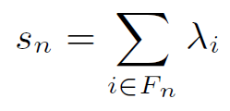
Model
Let F_{n} denote the current forwarding set, then the expected delay with n copies is
The former part is the expected delay of the first sent message copy (including the first hop delay and the second hop delay).
The latter part is the decreased expected delay brought by the remaining n−1 copies.

Slide 15

Insights and Solutions
For a relay node R_{k}, we can decide whether R_{k} is in the forwarding set or not, by comparing
The delivery delay of passing a copy to R_{k} -D path.
The delivery delay of not passing a copy (waiting for the other relays).
This insight means a greedy optimal selection:

Slide 16
Insights and Solutions
How to deal with the decreased expected delay brought by the remaining copies?
Key insights:
The second hop delay of the currently sent copy should have the same order of magnitude with the delay reduction brought by the remaining copies.

Slide 17
Insights and Solutions
The second hop delay of the currently sent copy should have the same order of magnitude with the delay reduction brought by the remaining copies.
If the former one is the major delay, then we should select more qualified relays into the forwarding set of the current copy, i.e., remove unqualified relays.
On the other hand, if the latter one is the major issue, then we should sent out the first copy as soon as possible to take full advantage of subsequent copies.

Slide 18

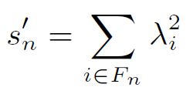
Insights and Solutions
Bounded solution:
Greedily add the relay that has the smallest relay-destination delay into the forwarding set, until the above upper bound increases.

Slide 19
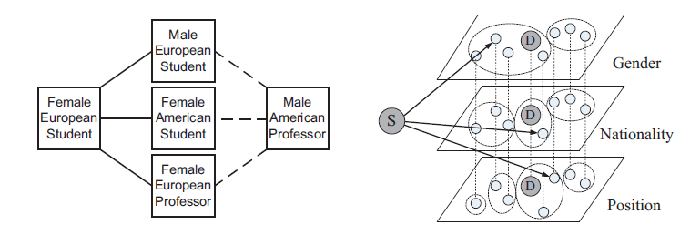
Extension
Feature space routing:
Use the feature differences of two nodes to estimate their contact frequency.
Then iteratively apply the two-hop routing.

Slide 20
Evaluation
Synthetic trace
30 relays between the source and the destination.
Uniform distributed contact frequency.
Intel trace
2-hop connected.
MIT trace.
Infocom06 trace.

Slide 21
Evaluation
Two-hop routing algorithms for comparison:
Infinite Copies, where the source has infinite copies for two-hop routing. Infinite Copies shows the minimum data delivery delay of two-hop routing algorithms.
All New Paths, where the source always forwards one message copy to any inter-meeting relay nodes (if the source has remaining copies).
Repeated STRA, the source routes the n copies using single-copy two-hop routing algorithm recursively (the functionality of remaining copies is ignored).

Slide 22
Evaluation
Other algorithms for comparison:
Epidemic, where the nodes continuously replicate and transmit messages to newly discovered contacts that do not already possess a copy. Epidemic represents the minimum data delivery delay of all routing algorithms.
(Binary) Spray and Wait, where is composed of a spray phase and wait phase.
SimBet where the relays are selected according to similarity and betweenness. Each message holder will give a copy to a inter-meeting relay if this relay does not hold a copy and has shorter feature distance with the destination. Only source holds multiple copies.
The feature space routing that is based on Repeated STRA (FSR-RSTRA for short).

Slide 23
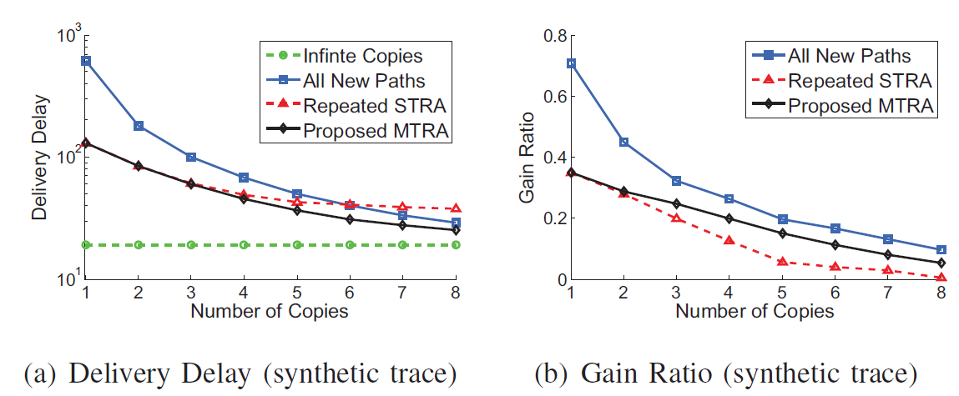
Evaluation
2-hop routing algorithm in the synthetic trace.
Gain ratio is the delay reduction brought by using one more copy.

Slide 24
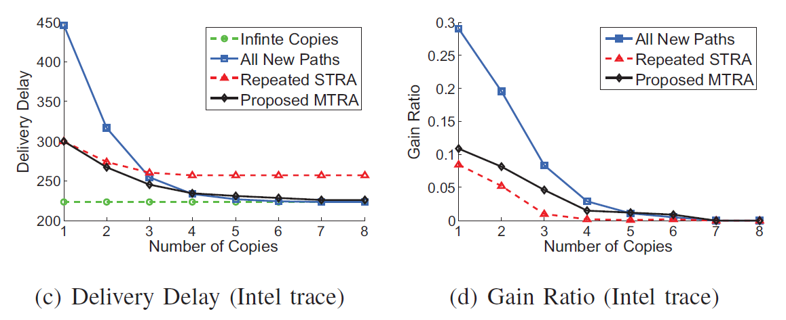
Evaluation
2-hop routing algorithm in the Intel trace.
Gain ratio is the delay reduction brought by using one more copy.

Slide 25
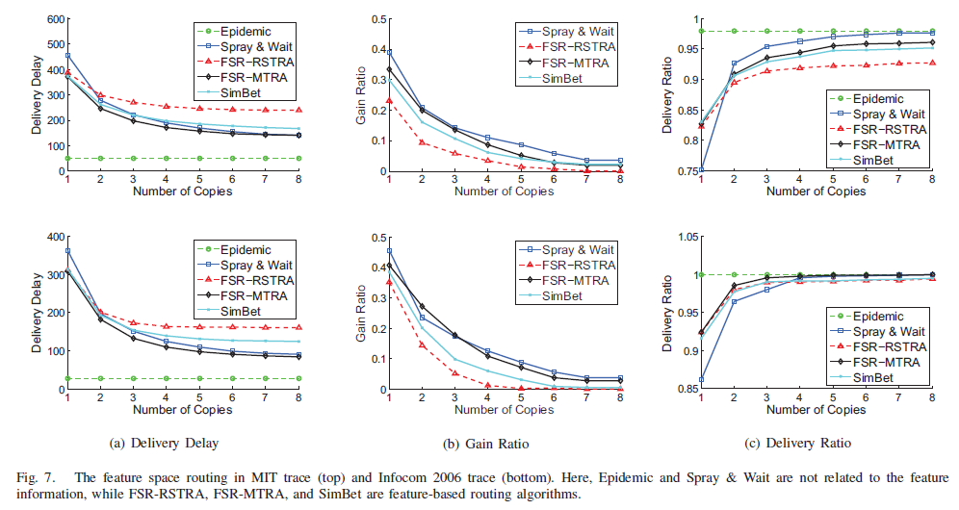
Evaluation
Feature space routing

Slide 26
Conclusion
A multi-copy two-hop routing algorithm (MTRA) is proposed with a performance bound.
All the forwarding sets for the n copies can be efficiently determined with a time complexity of O(mlogm+nm), where m is the number of available relays.
MTRA can be further applied to a feature space routing scheme, where the contact frequencies are estimated by feature distances.
Simulation results show competitive performances of the proposed algorithms, which fully utilize the opportunistic nature of MSNs.

Slide 27
The End
Questions & Answer

