Slide 1

Stable Matching Beyond Bipartite Graphs
Jie Wu
Dept. of Computer and Info. Sciences
Temple University
Notes:
1

Slide 2

Road Map
Introduction
Stable Marriage Problem (SMP)
Gale-Shapley (GS) algorithm
Stable binary matching with multiple genders
Stable K-ary matching with multiple genders
Extensions
Conclusion

Slide 3
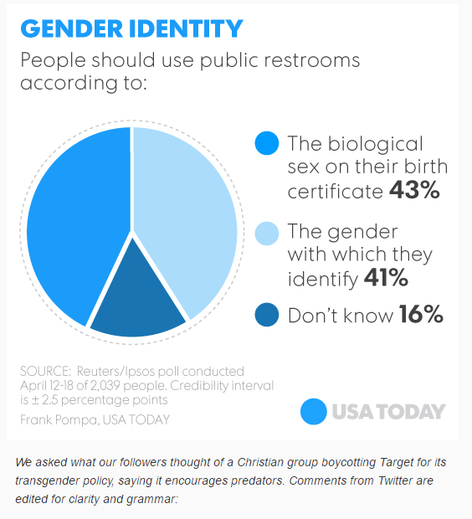
Introduction
Restroom Rules
North Carolina
Donald Trump
Target’s policy
Sex vs. gender
Stable matching with
multiple genders
Binary matching
K-ary matching

Slide 4
Stable Marriage Problem (SMP)
Perfect matching
Stable matching: does not exist
m of the first pair prefers w’ over w, and
w’ of the second pair prefers m over m’
m
w
men
women
m’
w’

Slide 5
Gale-Shapley (GS) Algorithm
Each person has his/her preference list.
GS algorithm
Each unengaged man proposes to the woman he prefers most.
Each woman replies “maybe” to her suiter she most prefers, and replies “no” to all others. (She is then provisionally “engaged”.)
If all men are engaged, stop; otherwise, each unengaged man proposes to the most-preferred woman he has not yet proposed.
Go to step 2.
Complexity: n² (n: number of elements in a gender)

Slide 6
Some Well-known Extensions
Stable roommate problem
Single gender
College admission problem
Multiple matchings
Hospital/residents problem
With couples

Slide 7
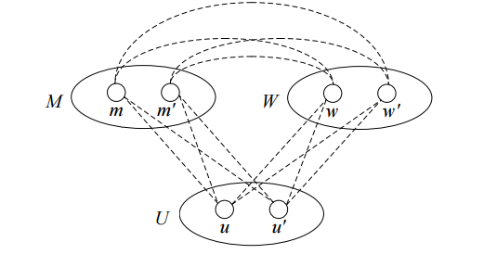
Multiple Genders: k-nary matching
M: men
W: women
U: undecided
Blocking family: if each member prefers each member of that family to its current family
Example 1: current matching is {(m, w, u), (m’, w’, u’)}
(m’, w, u) is a blocking family if m’ prefers w and u and both w and u prefers m’

Slide 8
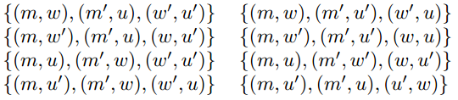
Stable Binary Matching with Multi-Genders
Theorem 1: There exists preference lists under which there exists no stable binary matching with
k (≠2) genders.
Note
Result holds even if self-matching is allowed, as in U.
Stable roommate solution can be used to find one if it exists.

Slide 9
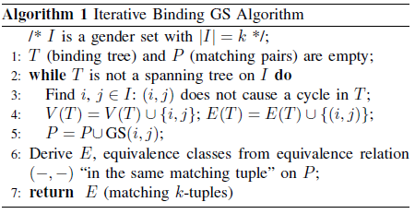
Stable k-ary Matching with Multi-Genders
K-ary matching: (u₁, u₂, …, u_{k}) (k: the number of genders)
Iterative Binding: Iteratively apply GS to pair wisely and bind all disjoint sets through a spanning tree.

Slide 10
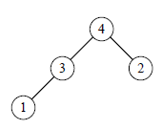
Stable k-ary Matching
Theorem 2: The iterative GS constructs a stable k-ary matching.
Theorem 3: The k-1 rounds of the binding process is tight.
Note
k^{k-1} binding trees
(k-1)n² iterations of pairwise matching

Slide 11
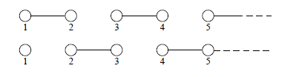
Extension: Parallel Implementation
Theorem 4: Using EREW PRAM, the iterative GS takes at most ∆n² iteration, where ∆ is the maximum node degree.
Note
When ∆=2, two rounds are needed (even-odd matching)
Under CREW PRAM, binding can be done simultaneously.
(CREW PRAM can be emulated under EREW PRAM through log ∆ rounds of data replication.)

Slide 12
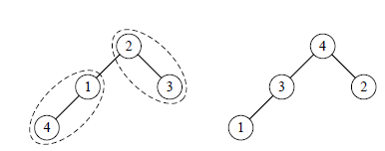
Extension of Unstable Condition
In a blocking family, the lead member of components from the same family decides the subgroup preference.
(In Example 1, w and u form a subgroup. If W has a higher priority than U, w decides for u.)
Bitonic sequence: it monotonically increases and then monotonically decreases, e.g., (1, 3, 4, 2) and (4, 3, 2, 1).
Bitonic tree: if any two nodes in the tree is connected through a path that is a bionic sequence.

Slide 13
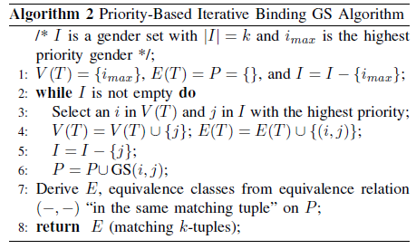
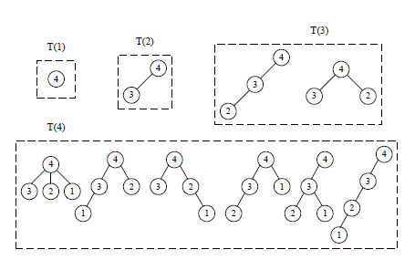
Priority-Based Iterative GS
Number of priority tree: (k-1)!

Slide 14
Conclusions
Stable matching with k genders
binary matching (negative result)
k-ary matching (positive result): iterative GS
Two extensions
Parallel implementation of iterative GS
Extension of unstable condition
Future work
Other possible weakened blocking family

Slide 15

Special Thanks
The WeChat group of the classmates from Shanghai Guling No. 1 Elementary School
Inspired by the discussion on matching making in the group discussion

