Slide 1
Integration of Spectrum Database and Sensing Results for Hybrid Spectrum Access Systems
Ying Dai and Jie Wu
Department of Computer and Information Sciences, Temple University
Notes:
Hello everyone, I am here to present our paper: “Integration of Spectrum Database and Sensing Results for Hybrid Spectrum Access Systems“.

Slide 2
Outline
Motivation
Overview
Integration framework
Depict spectrum map
Integration process
Performance evaluation
Conclusion
Notes:
Here is the outline of today’s presentation. First is the motivation and background knowledge of our work. Second is the overview. Then, the integration framework will be introduced from two parts: depict spectrum map and integration process. Next, the performance evaluation will be presented. And finally, the conclusion.
First, I will talk about the motivation behind our work.

Slide 3
Motivation
Cognitive radio networks
Spectrum sharing between primary user and Secondary user
Spectrum sensing Vs Spectrum database
Aggressive Vs Conservative
What about a combination…
Notes:
Some background about our motivation. Our work is in cognitive radio networks, where spectrum is shared by primary users and secondary users. This is a very promising solution for the spectrum congestion problem nowadays. In order to implement the spectrum sharing, the key issue lies in the protection of primary users, which requires each secondary user to make sure that no active primary user exists when accessing the spectrum. Therefore, we need an effective and also precise scheme to detect the presence of primary users.
Many traditional work relies on spectrum sensing to detect primary users. Secondary users need to sense the spectrum and only access it when PUs are inactive. However, it has very high requirements on the sensing accuracy. Also, it is time- consuming and degrades the network performances for second users. Moreover, the sensing results tend to be more aggressive, since it predicts the spectrum opportunities only based on a certain time period. Once the PUs become active, the corresponding SUs need to quit from the spectrum in order to protect PUs.
There is another scheme which has draw lots of attention. It aims to identify the presence of primary users based on a spectrum database. The spectrum database usually contains static data, e.g., regulatory rules. Given the secondary users’ location and time information, the database is able to calculate the access rules. However, the existing methods for calculating the spectrum access rules are overly conservative, which reduces the spectrum opportunities for secondary users.
So our motivation is to fill out the user cases in between: a combination of these two schemes, which is able to achieve an acceptable performance while requiring limited amount of overhead.

Slide 4
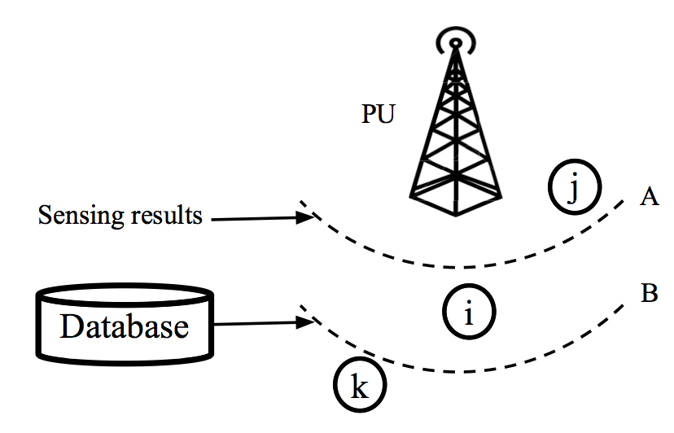
Motivation
Integration is not that easy:
Coverage issue
Weighted spectrum information
Notes:
However, the integration is not that easy. There are couple of issues need to be resolved. First, it is the coverage issue of sensing results. Since the sensing results are provided by secondary users, not every location has the reported sensing results. We need to make use of some statistical methods to predict the sensing results at some locations. The second question is the weighted integration of database information and sensing results. We know that, in general, the database information is conservative and the sensing results are aggressive. But how to quantify the conservative or aggressive levels is a problem.
For example, suppose there is a primary user and several secondary users, {i, j, k}. When the primary user is active, the information given by the database will claim that nodes within boundary B cannot transmit data. However, it is possible that the sensing results of node i and/or other nodes claim that the boundary of the primary area is A. Therefore, for node i, it cannot access the spectrum based on database information while it can see the spectrum opportunity under the sensing results. Therefore, an appropriate integration scheme is necessary. Also, as discussed above, the sensing results cannot cover every location. In this example, we can make use of the sensing results from {i, j, k} to make predictions for their nearby locations.

Slide 5
Outline
Motivation
Overview
Integration framework
Depict spectrum map
Integration process
Performance evaluation
Conclusion
Notes:
Next is the overview of our work.

Slide 6
Overview
We propose our integration framework, for the hybrid spectrum access systems of the database-driven and sensing-based models.
We make use of the spacial-based statistical methods to predict the sensing information for locations that have no sensing results reported.
We propose a scheme to find a balanced combination of the database information and sensing results, which evaluate the current weight assignments and make iterative adjustments.
Notes:
Here is the overview of our work. We consider the integration problem under the hybrid spectrum access systems of the database-driven and sensing-based models. We assume the existence of the database engine, which takes inputs from database and sensing results, and implements the integration phases. We propose our integration framework, which solves the problem from two components. The first component is to construct the sensing information for locations that have no sensing results reported. The second component is to find a balanced combination of the database information and the sensing results.
For the first component of our framework, we can make use of the spacial-based statistical methods to predict the sensing information for locations that have no sensing results reported. The database engine first collects the sensing results from SUs. It decides the optimal sample size for the fusion of sensing results. Then, it depicts the spectrum map purely based on the collected and predicted sensing information.
For the second component of our framework, we need to find a balanced combination of the database information and sensing results. Obviously, this is not a one-step work. Instead, we need to evaluate the current weight assignments and make iterative adjustments.

Slide 7
Outline
Motivation
Overview
Integration framework
Depict spectrum map
Integration process
Performance evaluation
Conclusion
Notes:
The next part is the brief introduction of our integration framework.

Slide 8
Integration Framework
Ensure coverage
Depict spectrum map from sensing results
Combine sensing results with database information
Formulate as partially observable Markov decision process
Notes:
Here is how our integration framework works.
For a certain location, if there are sensing results reported by secondary users, then nothing needs to be done. Otherwise, the database engine needs to apply spatial statistics- based methods, as to generate the corresponding sensing information. Then, the database engine purely uses the sensing information to depict the spectrum map;
After the spectrum availabilities are generated by sensing results, the database engine combines the results with the corresponding availability information existing in the database. This integration process is formulated as a partially observable Markov decision process. The weights of both resources are adjusted dynamically.
Next, each step will be introduced in detail.

Slide 9
Outline
Motivation
Overview
Integration framework
Depict spectrum map
Integration process
Performance evaluation
Conclusion
Notes:
I will talk about the depict of the spectrum map in the following.

Slide 10
Depict Spectrum Map
Collect spectrum sensing results
Make estimation for unknown area
Process collected and estimated results
Notes:
The depiction of the collected sensing results is performed by the database engine.
It contains the process of retrieving information from the collected sensing results, which can be further divided into two phases: 1) estimate the sensing information for locations without sensing results reported; 2) process the collected and estimated sensing results to compute the spectrum availability for each location.
For the estimation, we apply the inter- and extra-polation. This is because, in our model, the local spatial correlation regarding the spectrum sensing results can be found easily.
For the fusion of the collected and estimated results, traditional AND/OR rules are simple and easy to compute. However, since the database engine can have very powerful calculation ability, we can adopt the optimal voting rule for the fusion of our framework, which is represented as K_opt out of K voting rule.

Slide 11
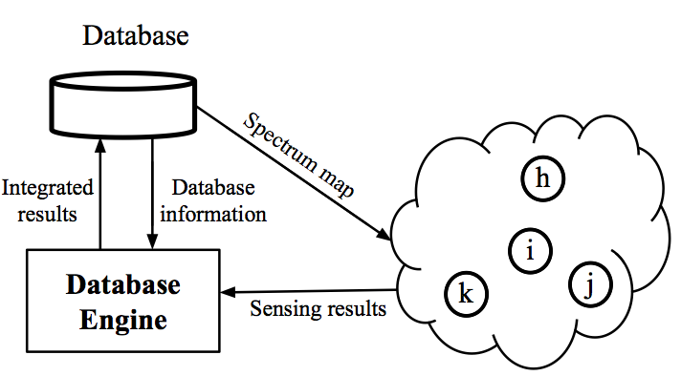
Depict Spectrum Map
The key point is: sensing results are not directly used for spectrum access, but for depicting spectrum map.
Notes:
Having both the measurement-based estimation method and the fusion rule ready, the spectrum availability can be generated for each location, and the spectrum map can be obtained. One thing to notice is that the information contained in the spectrum map is multi-dimensional, which could contain the location, available time duration, and spectrum frequencies. The information of spectrum map can be altered based on different user queries.
The key point is that the sensing results are used for integration, rather than the spectrum access at each node.
Suppose there are four locations of nodes {h,i,j,k}. The sensing results are collected by the database engine at each location, and there are no sensing results at location i reported. The database will first estimate the spectrum sensing results at location i, and calculate the spectrum map. However, the four nodes do not use the sensing results for spectrum access, but use the spectrum map returned by the database. The sensing results are integrated with the database information, and are written to the database by the database engine in this example. Later, if node i sends queries for spectrum access, the spectrum map returned by the database will include the updated results.

Slide 12
Outline
Motivation
Overview
Integration framework
Depict spectrum map
Integration process
Performance evaluation
Conclusion
Notes:
The integration process will be discussed next.

Slide 13
Integration Process
How to integrate: Iterative way.
Given the information from two resources, adjust the weights for each part..
Observe Adjust Observe …
Notes:
Given the information from two resources, we need to adjust the weights for the values, e.g., availability, signal strength, transmission parameters, and so on, of both resources.
For the database engine, given the current settings of weight distribution, it needs to first decide whether its current combination is balanced, or too conservative or aggressive. However, it cannot directly identify the situation without any measurements or observations. Also, after each measurement, e.g., the feedbacks collected from secondary users, the database engine needs to decide whether to continue waiting for more measurements, or to conclude its current state. If it concludes its current state from balanced, then no adjustments on the weights are necessary. Otherwise, an adjustment on the weights is needed, based on whether the current weight settings are conservative or aggressive.

Slide 14
Integration Process
Formed as partially observable Markov decision process
State: balanced, conservative, aggressive
Action: produce state conclusion, plus taking measurement without state change
State transition probability: State evolvement
Reward: correct/incorrect state, measurement cost.
Observation: feedback from secondary users
Belief: Based on current observation and last action.
Notes:
We formed the integration process as partially observable Markov decision process.
The state is the conservative state, the aggressive, or the balanced state that the database engine is in.
The action contains taking a measurement, or take conclusions and produce the result in one of three states.
State-transition probabilities describe how the state evolves at each step, after taking one action.
The reward function is defined based on whether the database identifies its current state correctly. Also, as pointed out before, each measurement takes the time cost of the database engine and the secondary users.
The observations are the measurements based on the feedbacks from secondary users.
The database engine keeps its belief state b to contain its past information. Given the previous belief state, the updating of the belief state is based on the last action and the current observation.

Slide 15
Integration Process
Dynamic integration policy
Stepwise
Case study: Maximum allowed interference
Acceptable range
Triggered when balanced status is broken
Notes:
After the database engine decides whether its current weight distributions are balanced, or too conservative or aggressive, it can dynamically adjust the weight distributions. Here, we apply the stepwise of weight adaptations, which is combined with the POMDP to dynamically integrate the database information and sensing results.
We study the threshold of maximum allowed interference at a given location. The other information stored in the database can be integrated with the sensing results in the similar way.
To be more practical, we can set an acceptable range to determine if the status is balanced, instead of a specific value.
Moreover, since the sensing results are dynamic, the database engine needs to trigger the integration process if the current balanced status is broken.

Slide 16
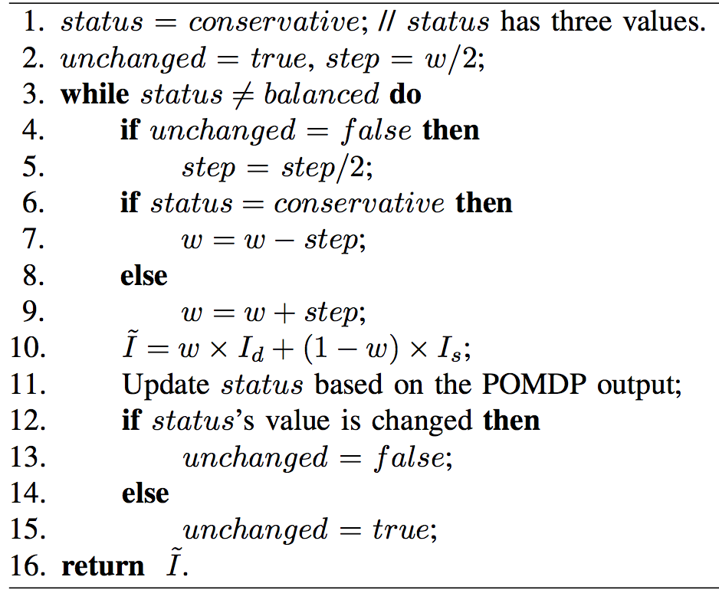
Integration Process
Notes:
The main idea of this dynamic integration process is very straightforward. We set the weight of the database information as w, with the initial value 1. Then, the weight of the sensing results is 1 − w. For a given location, we use “Id” to denote the maximum allowed interference in the database, and “Is” to denote the value in the sensing results.
Then, the integration function of the maximum allowed interference at a given location is: (Read line 10 in above picture)
By setting the initial value of w as 1, it makes sure that PUs are not initially interfered with.
The three values of status denote if the current weight settings are balanced, conservative, or aggressive. The process is to dynamically adjust the value of w until the status is balanced. The stepwise is initially large, and would be reduced to reach the balanced status. There are oscillations of the status values. Increasing or decreasing the value of w depends on the current value of status.
Note that the process here ends only when the status is balanced. However, to be more practical, we can set an acceptable range to determine if the status is balanced, instead of a specific value. Another consideration is every time we divide the step by 2 to converge to the final value. Other similar methods can be applied to update the value of step, as long as the balanced status is achievable. The algorithm is run by the database engine after the POMDP is finished.

Slide 17
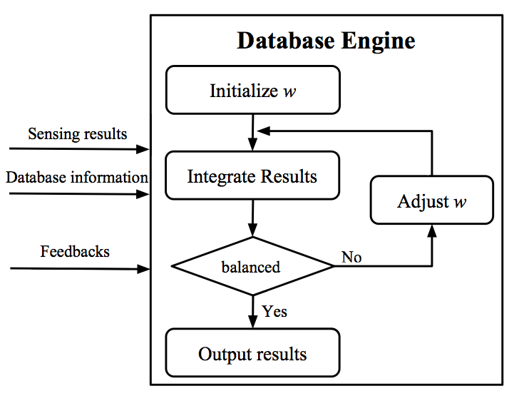
Integration Process
Main flow graph:
Notes:
Here is the flow process in the database engine. It takes the initial value of w. The inputs are the sensing results and database information. After using the feedbacks, the database engine concludes the status through POMDP. It outputs the results under the current value of w, if the status is balanced. Otherwise, the database engine adjusts w using the previous process until the balanced status is arrived. The output results would be used as the spectrum map for nodes to access the spectrum.

Slide 18
Outline
Motivation
Overview
Integration framework
Depict spectrum map
Integration process
Performance evaluation
Conclusion
Notes:
I will present the performance evaluation next.

Slide 19
Performance Evaluation
Primary users:
Randomly distributed
Different transmission range and channel
Secondary users:
Randomly distributed
Simulated accurate sensing results
Database engine:
Primary users’ transmission range
Maximum allowable interference
Notes:
Here is the settings of our performance evaluation.
We randomly distribute a set of PUs in the area. Each PU has its own transmission power and is randomly assigned a channel. We apply the SINR threshold for PUs to calculate their maximal allowable interference at a certain location. Also, each PU is configured with an active pattern, and is periodically turned active for the active duration
A number of SU nodes are randomly distributed in the area. Each SU performs spectrum sensing, and collects the sensed PU signal strength at all channels. We omit the sensing technique here by simply using the setting information to provide expected sensing results.
the spectrum information stored in the database conservatively protects the primary users. The database marks the transmission range of each primary, whether it is active or not. The maximal allowable interference stored in the database ensures that the signals from secondary users at any location cannot cause the interference within the primary user’s transmission range.

Slide 20
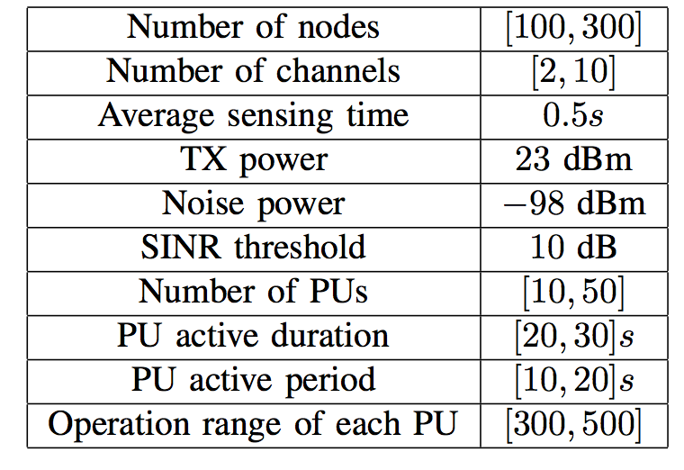
Performance Evaluation
Settings:
Notes:
A more detailed setting values are shown in this table.

Slide 21
Performance Evaluation
Performance metrics
Available time percentage
The percentage of the available time durations over the total time.
Ratio of transmission time over sensing time
A larger value of the ratio indicates that the transmission is less frequently interrupted by primary users
Notes:
We compare two performance metrics.
The first one is Average available time percentage: we iteratively calculate the percentage of the available time durations over the total time. We calculate the average value of all nodes with transmission tasks in the network for 5 mins. In our model, the percentage is indicated by the integrated spectrum map. We also show the original database spectrum map, which is not combined with the sensing results, for comparison.
The second one is Ratio of transmission time over sensing time:
we iteratively calculate the ratio of the transmission time over the sensing time. A larger value of the ratio indicates that the transmission is less frequently interrupted by primary users.

Slide 22
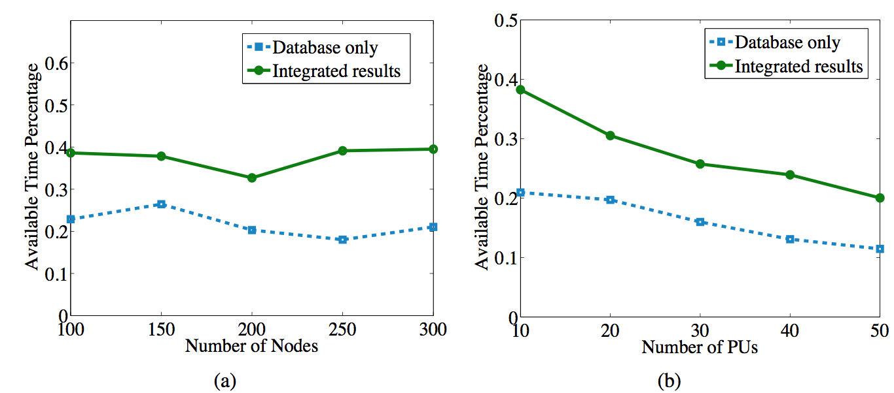
Performance Evaluation
Available time percentage:
Notes:
For Available time percentage:
When the number of nodes increases, the average available time percentage of the database-only scheme does not change notably. The value of our integrated results increases slightly. Therefore, the total number of nodes in the network does not have an obvious influence on the average available time percentage. In addition, the integrated spectrum map indicates more available spectrum opportunities than the database-only scheme.
When the number of PUs increases, the values of both schemes decrease. The integrated results outperform the database-only scheme by 30% on the average available time percentage. The gap between the two lines decreases. This is because when the number of PUs increases, there are fewer spectrum opportunities.

Slide 23
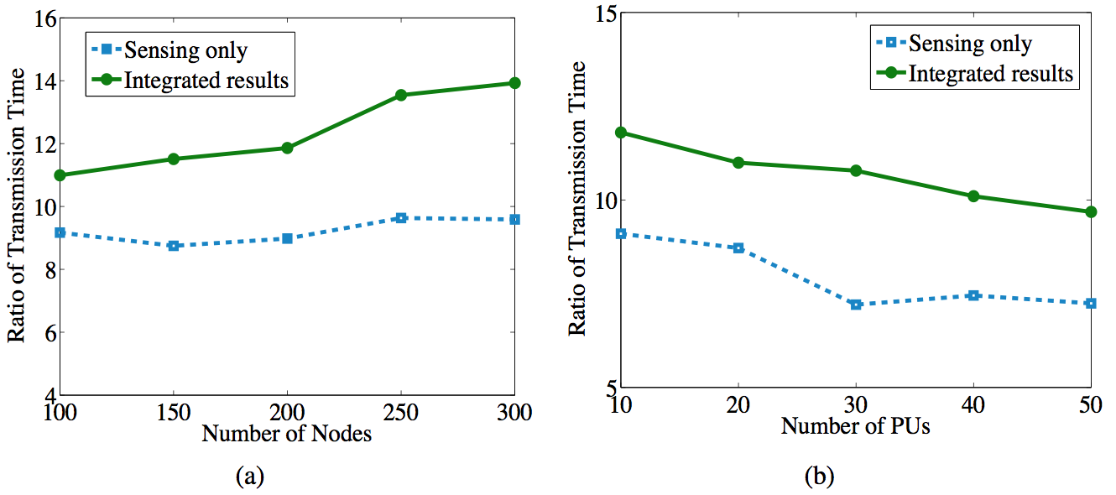
Performance Evaluation
Ratio of transmission time over sensing time
Notes:
In Fig. a, the number of nodes is varied from 100 to 300. The number of PUs is set as 10 and the number of total channels is also 10. The ratio of the transmission time increases for both schemes. Nodes access the spectrum based on the integrated results, and receive a larger ratio of transmission time over sensing time compared to the ones only based on spectrum sensing.
in Fig. b. The ratio of the transmission time decreases for both schemes. Nodes using the integrated results have a larger ratio of the transmission time over the sensing time.

Slide 24
Outline
Motivation
Overview
Integration framework
Depict spectrum map
Integration process
Performance evaluation
Conclusion
Notes:
Here comes the conclusion of our work.

Slide 25
Conclusion
Integration framework
Coverage issue
Dynamic integration policy
Notes:
To conclude, we propose an integration framework for the hybrid spectrum access systems, which solves the problem of how to combine the static database information and dynamic sensing result.
We solve the coverage issue of the sensing results by applying spatial statistics-based methods, and make the database engine aware of the optimal sampling sizes for the fusion of sensing results.
We formulate the evaluation of integration policy as a POMDP, which enables the database engine to become aware of the current status. A stepwise-based algorithm is proposed for the database engine to dynamically adjust the weights for integration.

Slide 26
Thank you!
Notes:
Thank you. Please contact the authors if you have any question.

