Slide 1


On Maximum Elastic Scheduling of Virtual
Machines for Cloud-based Data Center Networks
Jie Wu^{b}, Shuaibing Lu^{a,b}, and Huangyang Zhengª
ªCollege of Computer Science and Tech., Jilin University
^{b}Dept. of Computer and Info. Sciences, Temple University
Notes:
1

Slide 2
Outline
  Background
  Model and Formulation
  Simple and Optimal Solutions
  Properties
  Simulation Comparisons
  Conclusions

Slide 3
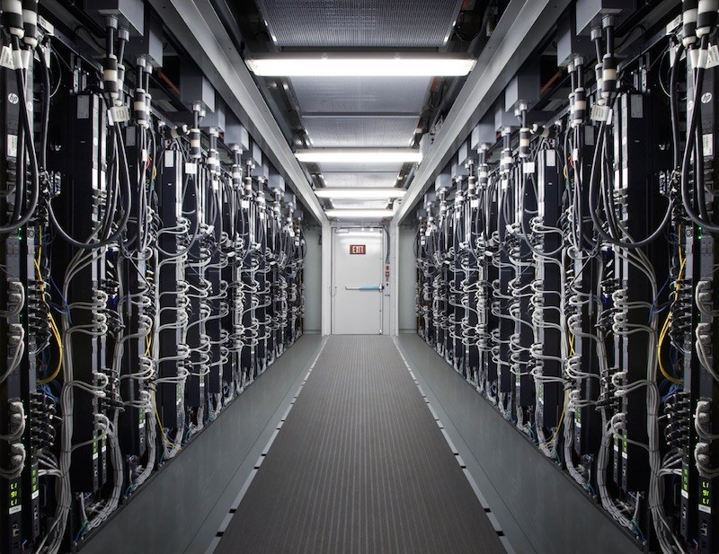
1. Background
  Cloud Data Center Networks (DCNs)
    Supporting cloud-based applications for large enterprises
  Virtual Machine Placement
    Solving the resource utilization problem in a cloud DCN
  Motivation
    Allocating physical machines (PMs) to virtual machines (VMs)
    Meeting computation and communication demands
    Avoiding load redistribution during a run time

Slide 4
Hose Model
Each hose has aggregated performance guarantees instead of pairwise performance guarantees^{[1]}.
A
A
C
C
B
B
pairwise
hose
[1]. Duffield, Nick G., et al. "A flexible model for resource management in virtual private networks." ACM SIGCOMM Computer Communication Review. Vol. 29. No. 4. ACM, 1999.

Slide 5
2. Model and Formulation
  Problem
    Provisioning the maximum admissible load (MAL) of VMs in PMs with tree-structured DCNs using the hose model.
  Maximum Elastic Scheduling
    A task assignment scheme that supports maximum uniform growth in both computation and communication without resorting to task reassignment.

Slide 6
Hose-based Elastic Scheduling
Schedule 6 VMs
u(4)
4
u(4)
4
100%
link
100%
link
w(4)
w(4)
3
3
v(6)
50%
v(6)
200%
7
7
200%
100%
overall: 50% < overall: 100%

Slide 7



3. A Simple Up-Down Solution
Up: 3-node block as a unit
v₁
14
8
6
MAL
$$min\left\{N_{l},L_{l}\right\}$$
v₂
v₃
4
7
2
5
5
6
6
4
8
6
v₄
v₅
v₆
v₇
10
6
Down: Given a load < MAL at root
v₁
Left
$$min\left\{N_{l},L_{l}\right\}/N$$
8
8
6
v₂
v₃
Right
$$min\left\{N_{r},L_{r}\right\}/N$$
4
7
2
5
The simple solution uses n steps, where n is the number of leaf nodes.
5
6
6
4
8
6
5
3
v₄
v₅
v₆
v₇

Slide 8
Why Simple Solution may Fail?
v₁
14
A Simple Solution
8
6
MAL
v₂
v₃
4
7
2
5
5
6
6
4
8
6
v₄
v₅
v₆
v₇
10
6
However
How to find the OPT Solution?
v₁
8
6
v₂
v₃
4
7
2
5
8
6
16
>
14
5
6
6
4
10
6
10+6
v₄
v₅
v₆
v₇

Slide 9
How to Calculate?
  Hose-model-based orientation
    Link orientation is important
    min{L,R} where L + R is a constant
50%
50%

Slide 10
An Optimal Distributed Solution
Insights
    Apply the simple solution to different orientations
    Select the best orientation
  MAL at the left leaf node
  MAL at the right leaf node
MAL at the center node

Slide 11
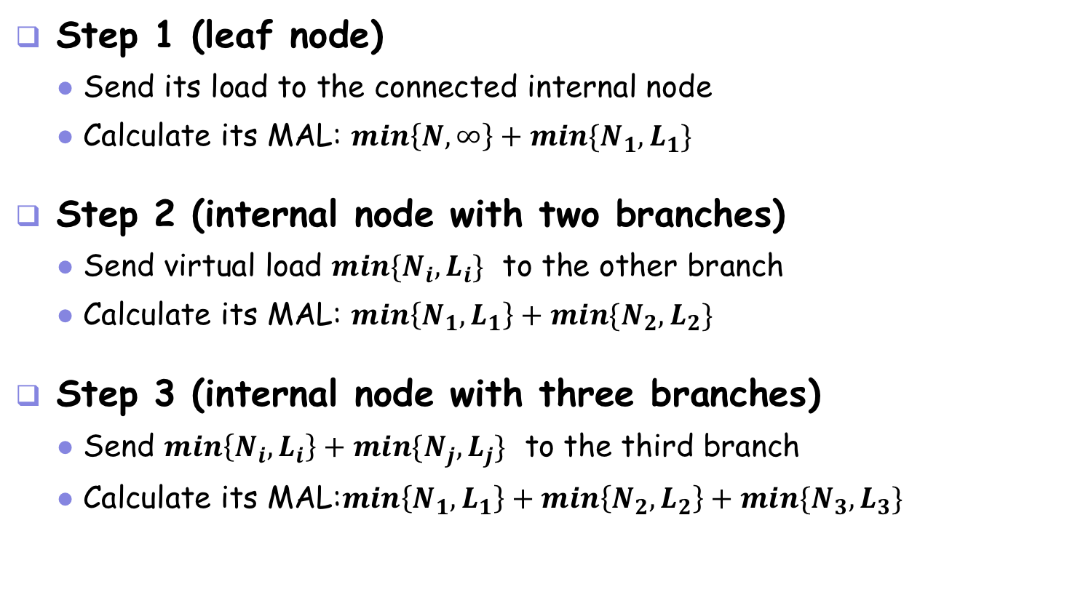
Optimal Solution: Details
Step 1 (leaf node)
Send its load to the connected internal node
Calculate its MAL: $\min\left\{N,∞\right\}+min\{N_{1},L_{1}\}$
Step 2 (internal node with two branches)
Send virtual load $min⁡\{N_{i},L_{i}\}$ to the other branch
Calculate its MAL: $\min\left\{N_{1},L_{1}\right\}+min⁡\{N_{2},L_{2}\}$
Step 3 (internal node with three branches)
Send $\min\left\{N_{i},L_{i}\right\}+min⁡\{N_{j},L_{j}\}$ to the third branch
Calculate its MAL:$\min\left\{N_{1},L_{1}\right\}+\min\left\{N_{2},L_{2}\right\}+min⁡\{N_{3},L_{3}\}$
leaf node
tree root
internal node

Slide 12
Optimal Solution: Example
An example
v₁
4+6+6
8
6
16
v₂
v₃
4
7
2
5
5
6
6
4
4
7
min{8,6}
v₄
v₅
v₆
v₇
5
6
6

Slide 13
4. Properties
Theorem 1: The optimal solution determines the MAL.
Theorem 2: Hierarchical load distribution generates a schedule with maximum elasticity.
Theorem 3: The optimal solution uses 2logn+1 steps. The computation complexity is 5(n−1), and the communication complexity is 4(n − 1) .
Theorem 4: Simple solution is optimal for a fat-tree.

Slide 14
5. Simulation Comparisons
  Basic Setting
    A strict binary tree with levels k = 4 , 5 , and 6
    Heterogeneous node space from 0 to 100 units
    Bandwidth demand per-pair of VMs is 1 Gbps
  Three Comparison algorithms
    Equally Distributed Placement (EDP)
    Proportion with PM Capacities (PPMC)
    Proportion with Physical Link (PL) Capacities (PPLC)
    Proportion with Physical Combinational Capacities (PPCC)

Slide 15
Experiments
Comparison of the elasticities
simple and optimal solutions
  (a) k = 4
  (b) k = 5
  (c) k = 6

Slide 16
Experiments (cont’d)
Comparison of the elasticities
Three comparison algorithms and PPCC
  (a) k = 4
  (b) k = 5
  (c) k = 6

Slide 17
6. Conclusions
Objective of maximum communication elasticity
  Hose model
Maximum elastic scheduling (distributed, optimal solution)
  Maximum admissible load (MAL)
  Maximum elastic scheduling of admissible load
Experiments
  Efficiency and effectiveness

Slide 18


Q&A
Journal’s Aims and Scope:
System architecture, operating systems and network hardware for sensor and actuator networks
Communication and network protocols
Data processing, data storage and data management within sensor and actuator networks
Programming models and middleware for sensor/actuator networks
Embedded systems
Security and privacy
Publication: 143
Page view:
2015 (43,034)
2016 (62,526)
2017 (160,876)
2018 (77,310)
Editor-in-Chief
Prof. Dr. Dharma P. Agrawal
University of Cincinnati, Cincinnati, OH 45221-0030, USA
Founding Editor-in-Chief
Prof. Dr. Stefan Fischer
Director of Institute of Telematics, University of Luebeck, Lübeck 23562, Germany

