Slide 1
Up-and-Down Routing in Mobile
Opportunistic Social Networks with
Bloom-Filter-Based Hints
Huanyang Zheng and Jie Wu
Dept. of Computer and Info. Sciences
Temple University, USA

Slide 2
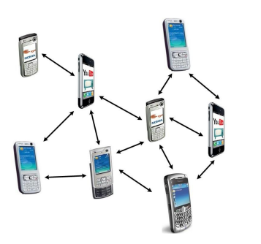
Introduction
Mobile opportunistic social networks (MOSN)
Opportunistic contacts
Intermittent connectivity
Instantaneous end-to-end paths may not exist
A scenario
People walk around with phones
that communicate with each other
via Bluetooth or WiFi

Slide 3
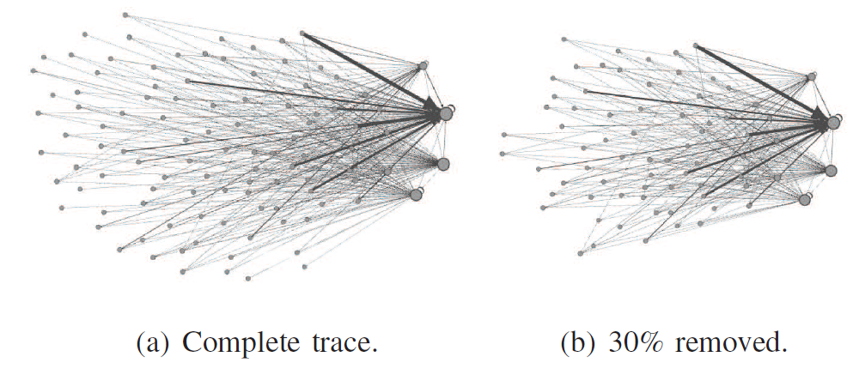
Introduction
Contact and state information
Contact information
  local, but large volume (per node vs. per destination)
State information
  costly due to the iterative process
Network structure information of MOSNs
Nested core-periphery structures (nested hierarchy)
MIT trace

Slide 4
Introduction
Up-and-down routing based on nested hierarchy: per node contact with limited state information
Up phase
  Single-copy routing from source to network core
  Nested hierarchy
Down phase
  Multi-copy routing from network core to destination
    Bloom filter as the routing hint

Slide 5
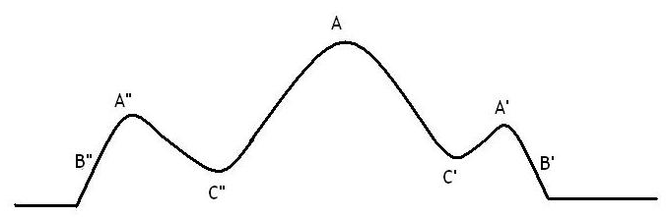
Introduction
Challenges for traditional hierarchical routings
Trap in local maximums when moving up
Cannot find the down path efficiently
  High storage space for descendants: each node tracks its child nodes and their child nodes.

Slide 6
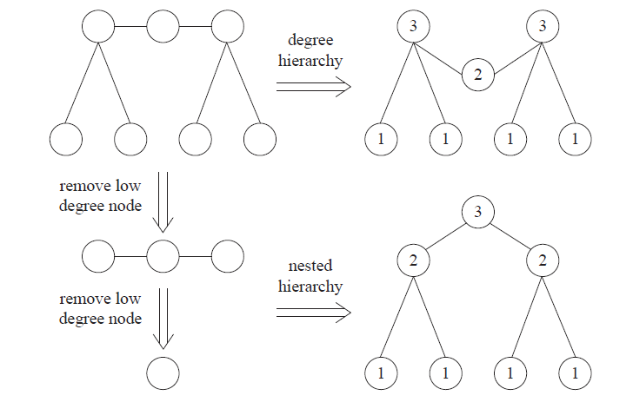
Up Phase
Degree hierarchy vs. nested hierarchy

Slide 7
Local Maximum
Local maximums in real dataset
(Stanford Large Network Dataset Collection)
AS-733 (autonomous system dataset)
6,747 nodes
1 local maximum in nested hierarchy (17 levels)
8 local maximums in degree hierarchy
p2p-Gnutella08 (Gnutella peer-to-peer network)
20,777 nodes
3 local maximums in nested hierarchy (20 levels)
76 local maximums in degree hierarchy
Nested hierarchy has fewer local maximums!

Slide 8
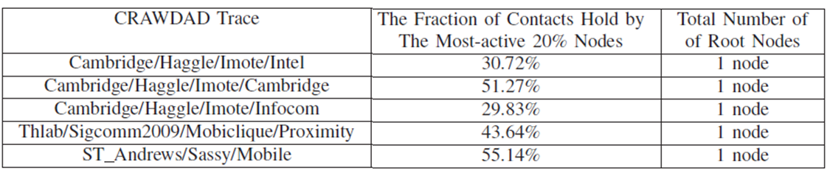
Local Maximum

Slide 9
Up Phase
Weighted degree of a node: sum of weights of adjacent links (total contact frequency)
Effective weighted degree of a node: weighted degree to unlabeled neighbors
Labeling scheme for nested hierarchy
  A node labels itself when it has the lowest effective weighted degree among unlabeled neighbors
  The label is set to be the largest label among its labeled neighbors plus one

Slide 10
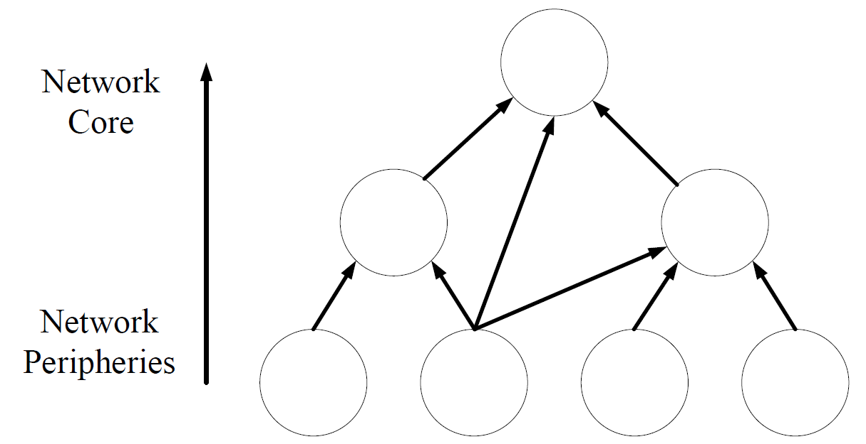
Up Phase
The message is routed towards the root along a DAG
Single-copy routing to save the forwarding cost
Switch to the down phase, when first reaching a node that matches (in Bloom filter)

Slide 11
Down Phase
Each node uses the Bloom-filter-based routing hint to record its descendants
Existence of false positive (i.e., a false match)
The size of Bloom-filter-based routing hint being bounded based on a given false positive rate

Slide 12

Bloom Filters
Used to test whether an element is a member of a set or not
A Bloom filter is a bit array of m bits
k hash functions are used to map an element
An example (m=5, k=2) of mapping element e₁

Slide 13
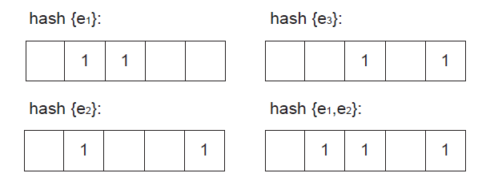
Bloom Filters
Space-efficient at the cost of false positives
An example of false positive for e₃ in {e₁, e₂}

Slide 14
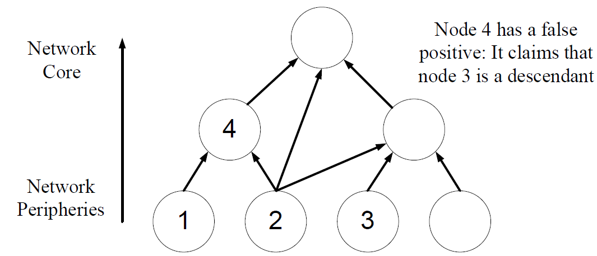
False Positive
False positive rate reduces as the level goes up: all child nodes have false positives

Slide 15
Multi-Copy
Multi-copy routing serving two objectives
  Improving delivery ratio by mitigating false positive
  Reducing down phase delay
Distributing multiple copies
  Binary split of copies whenever there is a match
Bloom filter robustness ratio
  Ratio of Bloom filter size to number of descendants d(ɑ-1)^{d-2} (ɑ: network parameter, d: node degree)
  Keeping robustness level constant at each level

Slide 16
Evaluation Setting
Traces
Sigcomm trace (76 nodes with ɑ=2.5)
Synthetic trace (100 nodes with average d=10, by Barabasi-Albert’s preferential attachment with ɑ=2.1, edge weights: 0-0.1)
Algorithms in comparison
Epidemic (no contact info. with unlimited copies)
(Binary) Spray and Wait (contact info. per dest.)
(Binary) Spray and Focus (contact info. per dest.)
(Modified) Delegation Forwarding (info. per dest. with bounded copies)

Slide 17
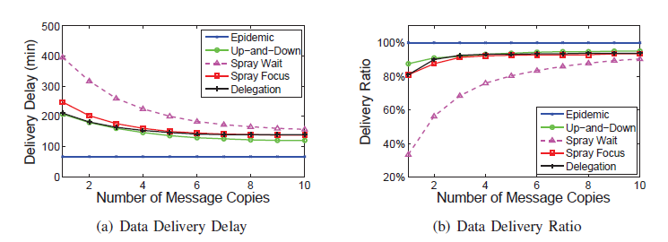
Sigcomm Trace
Data delivery delay and ratio
  deadline: 500 mins
  no delivery: deadline as delay

Slide 18
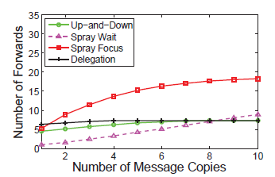
Sigcomm Trace
Number of forwards

Slide 19
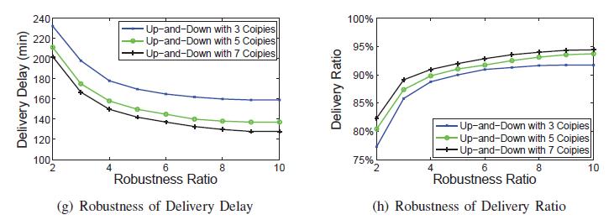
Sigcomm Trace
Robustness ratio
Overall false positive rate: 38%, 28%, 17%, 10%, 06%, 03%, 02%, 01%, 0.7%
Storage saving percentage: 81%, 72%, 62%, 53%, 44%, 31%, 21%, 10%, 0%

Slide 20
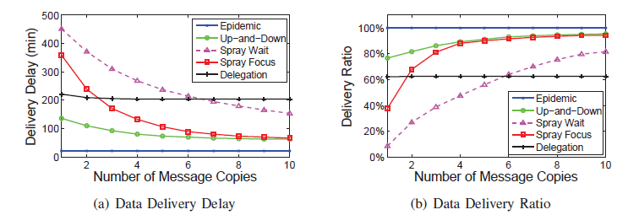
Synthetic Trace
Data delivery delay and ratio

Slide 21
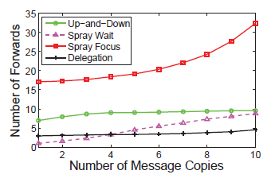
Synthetic Trace
Number of forwards

Slide 22
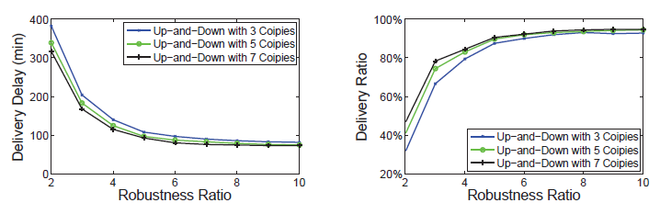
Synthetic Trace
Robustness ratio
Overall false positive rate: 39%, 24%, 15%, 09%, 06%, 04%, 02%, 01%, 0.8%
Storage saving percentage: 83%, 74%, 65%, 57%, 48%, 39%, 30%, 22%, 13%

Slide 23
Evaluation Summary
A competitive performance on the data delivery delay and ratio
Real vs. synthetic traces
  Real: clustering with more parallel paths
  Synthetic: multi-hop with fewer parallel paths
A small diameter does not guarantee a short delay!

Slide 24
Conclusions
Up-and-down routing
Single-copy up phase and multi-copy down phase
Nested core-periphery property (nested hierarchy)
Future work
Bound the number of copies in the down phase
Coarse grain level
Deal with multiple local maximums

