Slide 1
Efficient Switch Migration for Controller Load Balancing in Software Defined Networking
Rajorshi Biswas and Jie Wu
Dept. of Computer and Info. Sciences
Temple University

Slide 2

Outline
Switch migration and System Model
Some existing works
Problem Definition: Minimizing Cost
Different solutions
Simulation and Experimental results
Q&A
Notes:
This is the outline of my talk

Slide 3
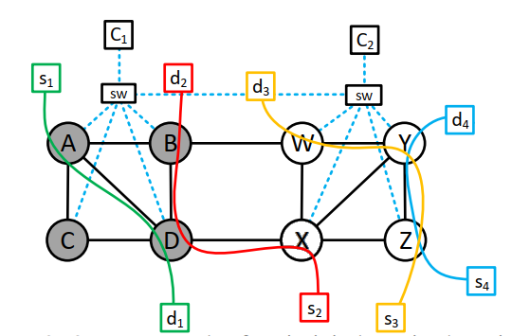
System Model
Switch Migration
  Changing the controller of an SDN switch
Controller Load
  Path finding requests
  Intermediate node query requests
Response Delay:
  # of hops to controller
  Controller load
Green Flow
  path construction (A) + intermediate query (D)
Red Flow
  path construction (X) + path construction (D) + intermediate query (B)

Slide 4
Switch Migration is Challenging
Challenges
  Sporadic assignment leads to higher number of path construction.
  Flows change frequently.
  Live migration is not possible.

Slide 5
Previous Works
Systems | Limitations
ILP based Systems: X. Zhang, L. Li and C. -b. Yan, "Robust Controller Placement Based on Load Balancing in Software Defined Networks," ICNSC, 2020 L. Li, N. Du, H. Liu, R. Zhang and C. Yan, "Towards robust controller placement in software-defined networks against links failure," 2019 IFIP/IEEE Symposium on Integrated Network and Service Management. | ILP based solutions takes long time in large topologies. Does not consider dynamic/incremental adjustment.
Heuristic/Greedy F. He and E. Oki, "Load Balancing Model against Multiple Controller Failures in Software Defined Networks," ICC 2020. | Does not consider the control network delay. Dynamic/incremental adjustments is not considered.

Slide 6
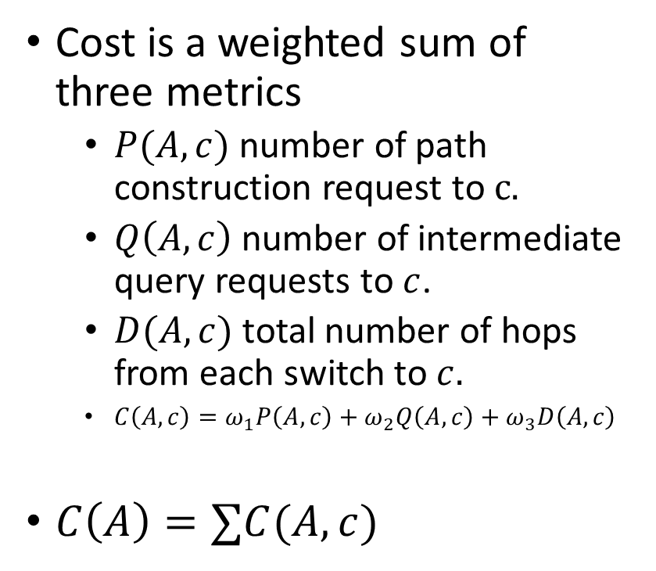
Problem: Minimize Cost of Assignment
Cost is a weighted sum of three metrics
  $P(A, c)$ number of path construction request to $c.$
  $Q\left(A,c\right)$ number of intermediate query requests to $c$.
  $D(A, c)$ total number of hops from each switch to $c.$
  $C\left(A,c\right)=ω_{1}P\left(A, c\right)+ω_{2}Q\left(A, c\right)+ω_{3}D\left(A, c\right)$
$C\left(A\right)=∑C(A,c)$
Problem:
  Find a Switch-Controller Assignment that minimizes cost.
Constraints:
  Controller capacity constraints
  Switch migration can be only to neighbors
Two Scenarios:
  Initial deployment
    Greedy
    Clustering
  Incremental deployment
    Greedy
NP-Hard, Graph Partitioning Problem

Slide 7
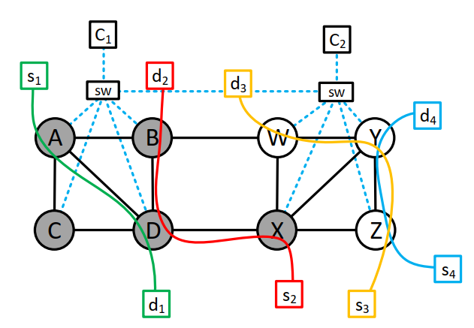
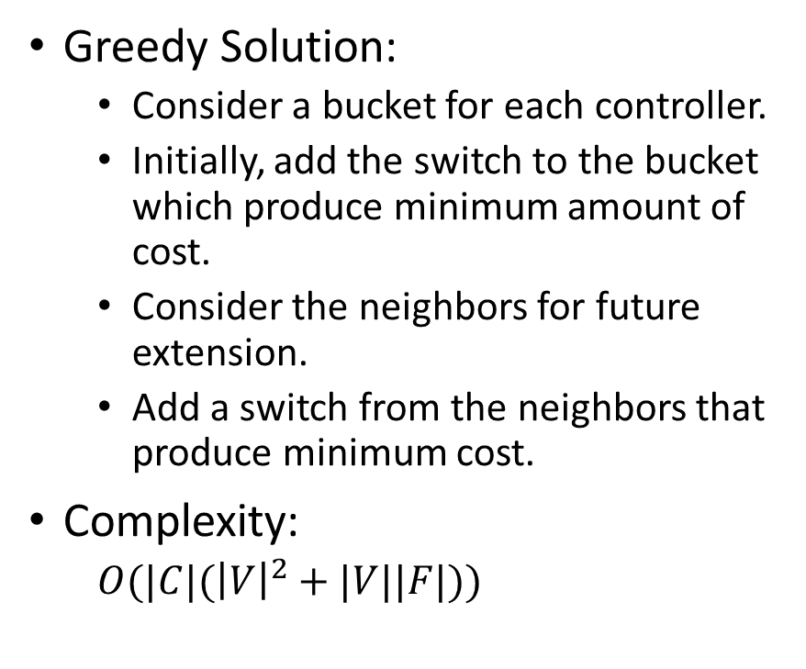
Initial deployment: Minimize Cost
Greedy Solution:
  Consider a bucket for each controller.
  Initially, add the switch to the bucket which produce minimum amount of cost.
  Consider the neighbors for future extension.
  Add a switch from the neighbors that produce minimum cost.
Complexity:
  $O(|C|({\left|V\right|}^{2}+|V||F|))$
Notes:
Usually, W1 is 10 times of W2

Slide 8
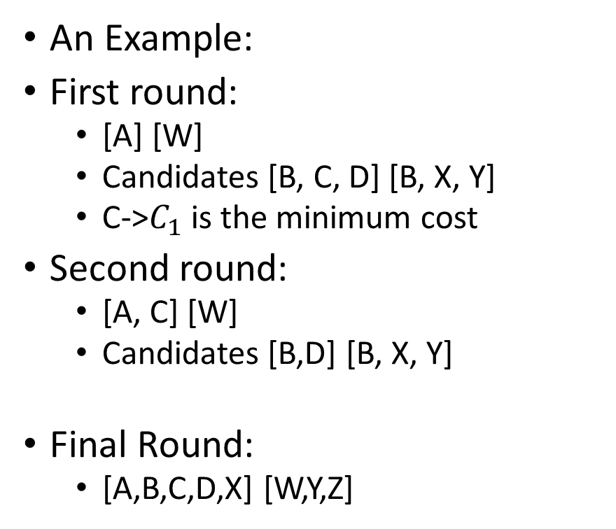
Initial deployment: Minimize Cost
An Example:
First round:
  [A] [W]
  Candidates [B, C, D] [B, X, Y]
  C->$C_{1}$ is the minimum cost
Second round:
  [A, C] [W]
  Candidates [B,D] [B, X, Y]
Final Round:
  [A,B,C,D,X] [W,Y,Z]
Notes:
Usually, W1 is 10 times of W2

Slide 9
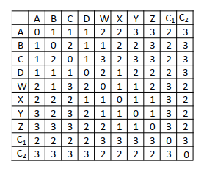
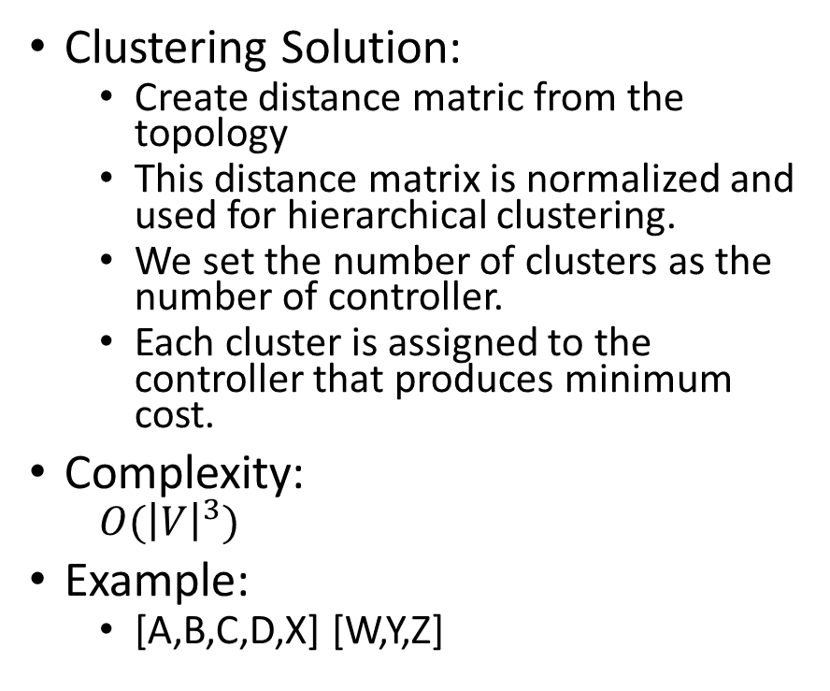
Initial deployment: Minimize Cost
Clustering Solution:
  Create distance matric from the topology
  This distance matrix is normalized and used for hierarchical clustering.
  We set the number of clusters as the number of controller.
  Each cluster is assigned to the controller that produces minimum cost.
Complexity:
  $O({\left|V\right|}^{3})$
Example:
  [A,B,C,D,X] [W,Y,Z]
Notes:
Usually, W1 is 10 times of W2

Slide 10
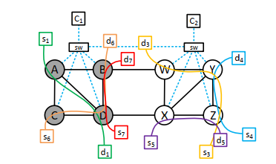
Incremental Deployment
Problem:
  Find a Switch-Controller Assignment that minimizes cost.
Constraints
  Controller capacity constraints
  Old switch assignment-new switch assignment < K
  Switch migration can be only to neighbors

Slide 11
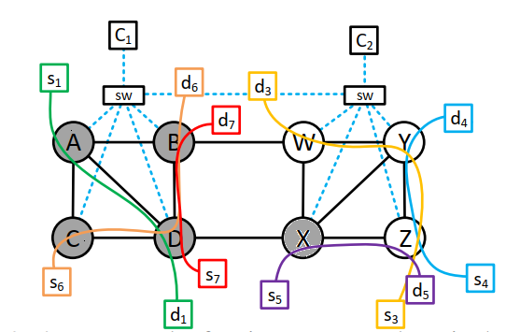

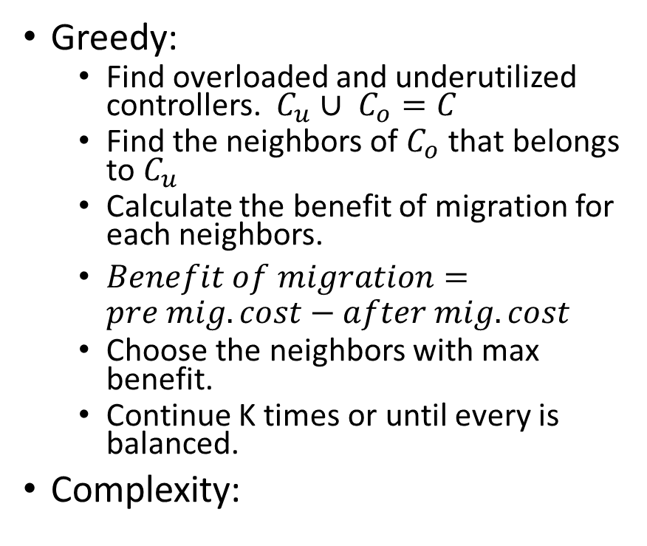
Incremental Deployment Solution
Greedy:
  Find overloaded and underutilized controllers. $C_{u}∪ C_{o}=C$
  Find the neighbors of $C_{o}$ that belongs to $C_{u}$
  Calculate the benefit of migration for each neighbors.
  $Benefit of migration=pre mig. cost−after mig. cost$
  Choose the neighbors with max benefit.
  Continue K times or until every is balanced.
Complexity:
overloaded
underutilized
Migration of X is more beneficiary than migration of B

Slide 12
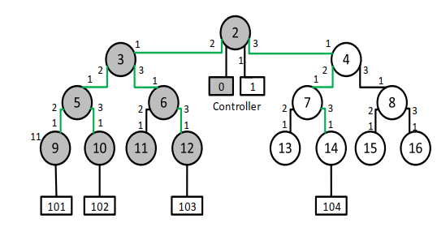
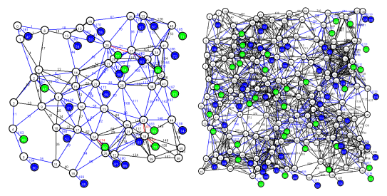
Experiments and Simulations
Migration delay: 5.2s
Sparse T1
Dense T2

Slide 13
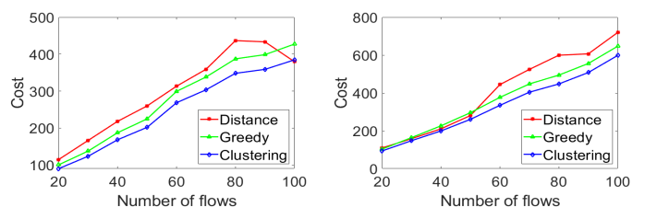
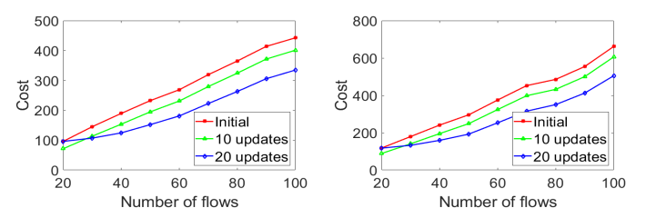
Simulation Results
Initial Deployment:
Distance based has the highest cost
Greedy is 10% lower and
Clustering is 20% lower than distance based
Incremental Deployment:
Distance based has the highest cost
10 updates is 11% lower and
20 updates is 24% lower than distance based
Sparse T1
Dense T2

Slide 14
Thank You
Q&A

