Slide 1



Towards a Unified Few-Shot Learning Evaluation Framework for RF Fingerprinting
†Sai Shi, †Vahid Mahzoon, ‡Xuyu Wang, §Shiwen Mao, †Jie Wu, and †Slobodan Vucetic
†Computer and Information Science Department, Temple University, Philadelphia, PA
‡Knight Foundation School of Computing and Information Sciences, Florida International University, Miami, FL
§Department of Electrical and Computer Engineering, Auburn University, Auburn, AL

Slide 2
Outline
Introduction
Related Work
Approaches and Experimental Design
Results
Conclusions

Slide 3
Introduction
RF device fingerprints: Variations in transmitted signals due to hardware imperfections, creating unique characteristics in the physical layer, which can be used as device fingerprints
  Hard to disguise
  Robust to software modification
RF fingerprinting (RFFI): Identify wireless devices based on the emitted signal captured by a receiver
Applications of RFFI
  Intrusion Detection: Detect unauthorized devices by recognizing unfamiliar RF signal patterns
  Device Authentication: Verify device identity using RF fingerprints
  User Tracking: Monitor user movement via consistent RF fingerprints across locations
Notes:
Wireless communication transmits information from a transmitter to a receiver without using any physical connections, such as wires or cables. Each wireless device introduces variations in transmitted signals due to hardware imperfections, creating unique characteristics in the physical layer. These can be used as fingerprints or signatures for the device. RF fingerprinting is the identification of individual wireless devices based on these characteristics of the physical layer without relying on standard identifiers such as MAC or IP addresses.
RF fingerprinting improves security, identification, and monitoring in wireless communication systems because hardware-based fingerprints are difficult to disguise and robust against software modifications. RF fingerprinting is actively investigated for its potential in applications such as intrusion detection, device authentication, and user tracking.

Slide 4
Introduction
Traditional RFFI methods rely on hand-crafted physical layer features, such as transient phase, modulation, or spectral analysis
  Only work well with good features
  May not capture all the complexities of real-world RF signals
Deep learning methods can automatically capture complex feature representations from raw signals, and have been used in RF fingerprinting
  Requirements for deep learning models to work well:
    Large amounts of labeled data are available for model training
    The environmental conditions are stable
Notes:
Hand-crafted physical layer features are manually selected based on domain expertise: very feature dependent.
Deep learning has achieved success in solving many big-data problems because ….
The environmental conditions are stable, where a pretrained deep learning model can be reused without losing significant performance.

Slide 5
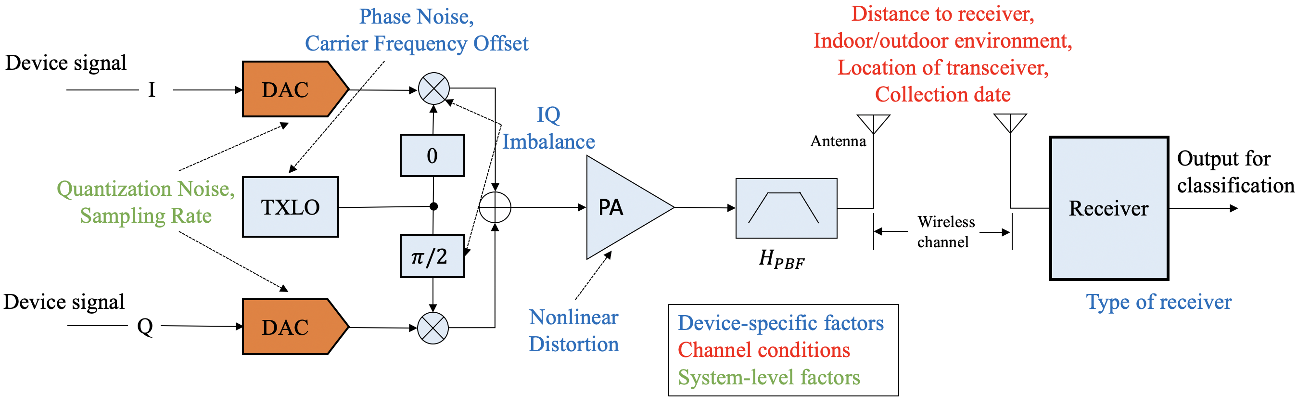
Introduction
Challenge: Distributional/domain shift − a change in the statistical properties of the data distributions between different environments
RFFI is very sensitive to environmental conditions, which causes a model trained in one setting to perform poorly in a another
Figure - Potential domain shift in a wireless communication system (Our work focus on channel conditions - changes in the operating environment that affect signal propagation)
Notes:
One major challenge of the applicability of deep learning in RF fingerprinting is domain shift.
There are different types of domain shift causes, such as ….. In this work, we focus on channel conditions, because the wireless channel conditions are often dynamic, complicated, and not trackable. They often cause severe domain shift.

Slide 6
Related Work
Few-shot learning (FSL): Enable models to generalize to new tasks or classes using only a few labeled examples per class
  Metric-based methods: prototypical network, matching network, etc.
  Meta-learning methods: MAML, Reptile, Meta-SGD
  Generation-based methods: data augmentation
Domain adaptation (DA): adapt a model trained on one data distribution (source domain) to perform well on a different but related distribution (target domain)
  Divergence-based methods: Maximum Mean Discrepancy (MMD), KL-divergence
  Adversarial-based methods: Adversarial Discriminative Domain Adaptation
  Reconstruction-based methods: Deep Reconstruction-Classification Network
Few-shot Domain Adaptation: generalize a model trained on a source domain to a target domain with limited labeled data (typically a few examples per class) in the presence of domain shift
Notes:
There are existing work to mitigate the data scarcity and domain shift problem in deep learning.
Few-shot Domain Adaptation is a combination of the two. It is useful in RF fingerprinting because such tasks often face large domain shifts and limited supervision in real-world deployments.

Slide 7
Related Work: RF Fingerprinting
Model fine-tuning [1-2]
  Freeze parameters of a pre-trained neural network and fine-tune parameters in the last few layers on target data
  Limited performance and only compare with zero-shot baseline
Domain adaptation
  Adversarial-based domain adaptation [3]: Focus on a single environmental change
  KL-based alignment [4]: Does not compare with other domain adaptation baselines
Few-shot learning
  Prototypical network with data augmentation [5]: Only compare with zero-shot baseline
  Siamese network [6]: Focus on a single environmental change, does not compare with other meta-learning baselines
Notes:
A typical baseline method is model fine-tuning: utilize a pre-trained model, which works well in the source domain. Then …

Slide 8
Related Work: Research Gaps
Limitations in literature:
  Evaluate on limited datasets or scenarios and often compare with weak or inconsistent baselines
  Lack of analysis on the broader impacts of diverse environmental factors
  Lack of deeper analysis on how their methods mitigate domain shift
Motivated by these research gaps, we aim to establish a standardized and reproducible FSL evaluation framework for RF fingerprinting
Research Questions:
  RQ1: How can RF fingerprinting models be adapted to new domains with minimal performance degradation with the help of FSL?
  RQ2: How to fairly compare different FSL methods in RF fingerprinting and how exactly each method mitigates the domain shift problem?
Notes:
While prior studies demonstrate the potential of the above methods to mitigate domain shifts in RF fingerprinting, they have several limitations. They tend to evaluate on limited datasets or scenarios and often compare with weak or inconsistent baselines. Some studies focus on specific factors, such as data collection time or receiver impact, without analyzing a broader impact of diverse environmental factors. Others propose methods like data augmentation or domain alignment but lack deeper analysis into how these methods mitigate domain shift. No prior work provides a fair comparison of different baselines and advanced methods within a unified few-shot evaluation framework.

Slide 9


Problem Statement
Goal: to identify the transmitter of a received signal based on transmitter-specific characteristics
Received signal: X, transmitter identity: Y, and the environment condition at the transmission time: Z
  Received signal:
Objective: Find the inverse mapping without explicit access to Z:
Challenge: Z is dynamic ➔ distribution shift between the training and testing environment ➔ domain shift
Notes:
We utilized three publicly available datasets for our study, covering multiple scenarios with different device types and testbed.

Slide 10





Transfer Learning
Source domain: Input space and the joint probability distribution over inputs and labels
Target domain: A different environment with a shifted signal distribution which has limited labeled data
Goal: Given a large dataset from the source domain and a small dataset from the target domain, to learn a predictor that maximizes the accuracy over the target domain, while maintaining high accuracy over the source domain
Notes:
We utilized three publicly available datasets for our study, covering multiple scenarios with different device types and testbed.

Slide 11
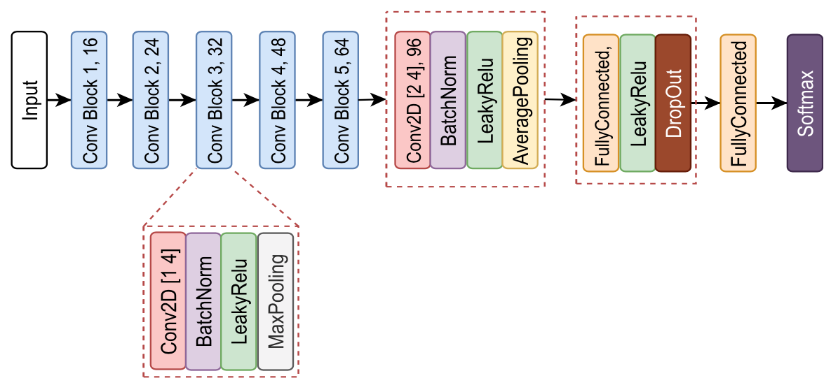
Approaches
CNN architecture for feature extraction
Total parameters: 76,731
Batch size: 16
MaxPooling Layers: kernel size (1, 2) with stride (1, 2)
AveragePooling Layer: kernel size (1, 250)

Slide 12
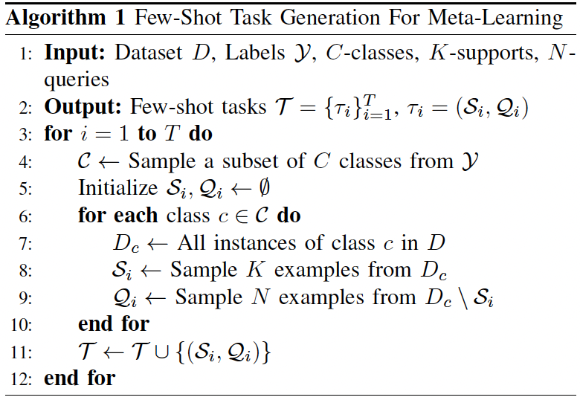
Approaches: Few-shot Learning
Metric-based FSL: Learn an embedding space and classify examples based on distance, two types of such methods are Prototypical Network (PTN) and Matching Network (MN)
Strength
  Achieve strong performance in FSL without requiring complex training procedures
  Their distance‑based classification mechanism is particularly suitable for RF fingerprinting, where signal similarity in the feature space often correlates with device identity
Model is trained on a series of small classification tasks, each constructed from a subset of training data
  Each task consists of a support set and a query set, each containing a few labeled examples for a subset of classes
Notes:
MN uses attention mechanism to compare query examples with support examples

Slide 13
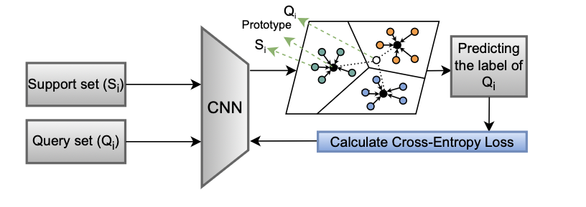
Approaches: Few-shot Learning
Prototypical Network (PTN): (i) First computing a prototype for each class, by averaging the embeddings of its support examples; (ii) Classification is then based on the closest prototype
Matching Network (MN)
  Compare each query example directly with every support example by computing pairwise similarity scores based on distance between their embeddings
  Prediction is derived by computing a weighted sum of the support labels, where the weights correspond to the calculated similarity scores
Notes:
MN uses attention mechanism to compare query examples with support examples

Slide 14
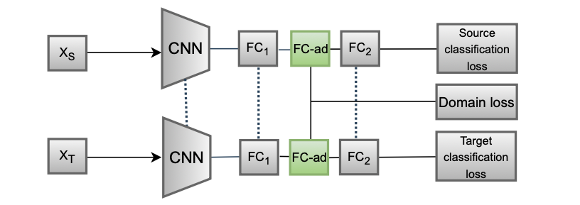
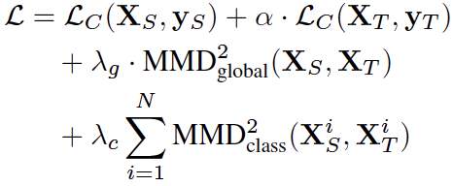
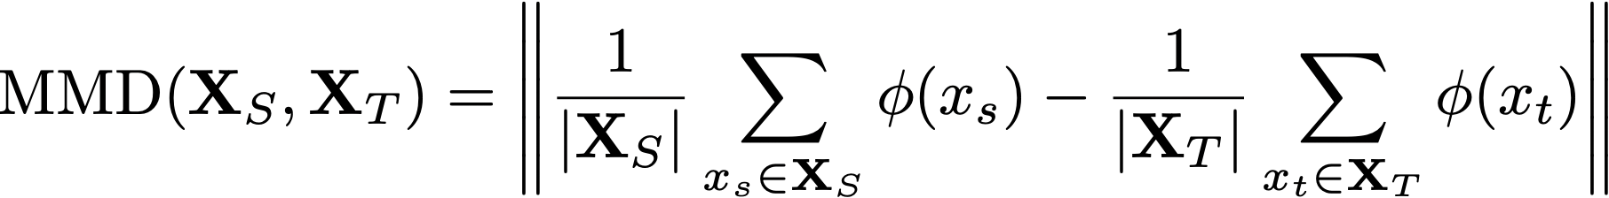
Approaches: Domain Adaptation
Divergence-based DA: Learn domain-invariant feature representations by explicitly minimizing some distance metrics between source and target distributions
  e.g., Maximum Mean Discrepancy (MMD) focuses on distance between mean embeddings of features
Strength
  Strong theoretical foundation on transferability across domains
  Achieve competitive performance with lower computations compared to adversarial-based DA
Adaptation layer
Notes:
An adaptation layer is added between the first and second FC layer, which uses ReLU activation function, a batch normalization layer, and a dropout layer with p = 0.5.
The MMD loss is computed using the feature representations produced by this adaptation layer.

Slide 15
Experimental Setup: Datasets
LoRa RF dataset: time-domain IQ samples from 25 PyCom IoT devices
  Scenario I: Different days
  Scenario II: Different locations
  Scenario III: Different configurations
  Scenario IV: Different distances
WiSig dataset: time-domain IQ samples collected over four days on 130 devices at the Orbit Testbed
CORES dataset: signals collected over four days on 58 devices at the Orbit Testbed
Notes:
We utilized three publicly available datasets for our study, covering multiple scenarios with different device types and testbed.
3 different locations/environments: room, outdoor, and office.

Slide 16
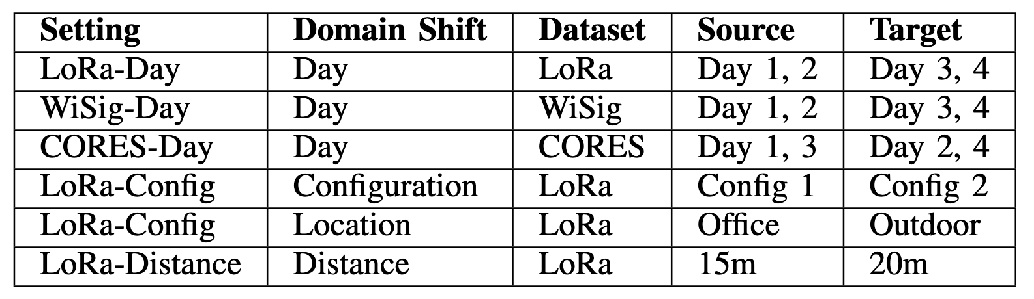
Experimental Setup: Scenarios
Table - Six domain-shift scenarios with diverse environmental changes
Both source and target are split into 80% train set, 10% validation set, and 10% test set
Model is trained using training samples from source and target, then evaluate on test samples from source and target
Each experiment is repeated 100 times with different random seeds
Evaluate on two baselines (weak and strong), two meta-learning and one domain adaptation methods
Notes:
We design the FSL experiments in a specific way to make sure it is a fair comparison between different methods, and we compare with two baselines: a weak baseline and a strong baseline.

Slide 17
Results: Zero-shot Baselines
Four configurations: spreading factor (7, 8, 11, 12) and bit rate (5470, 3125, 537, 293 bps)
Leave-one-out uses all source tasks as train set excluding the target task, while all-included uses all source tasks as train set, including the target task
Accuracy under the scenario of different configurations on LoRa dataset
Accuracy |  | Target Domain
 |  | Config 1 | Config 2 | Config 3 | Config 4
Source Domain | Config 1 | 65.25% | 3.93% | 4.13% | 3.28%
 | Config 2 | 2.52% | 69.41% | 3.97% | 4.26%
 | Config 3 | 3.25% | 5.97% | 58.69% | 8.46%
 | Config 4 | 2.10% | 0.82% | 4.26% | 39.67%
Leave-One-Out |  | 1.90% | 3.44% | 3.51% | 7.15%
All-included |  | 80.52% | 73.61% | 58.36% | 38.56%

Slide 18
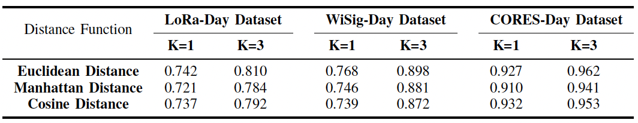
Results: Different PTN’s Hyperparameters
Comparison of PTN performance across different distance functions and k-shot values for three datasets
PTN’s performance on target task for three different distance functions (Manhattan, Euclidean, and Cosine) and two different K-shot values in day-based settings across three datasets
Euclidean distance outperforms both Manhattan and Cosine distances
The 3-shot setting is superior to the 1-shot setting across all distance metrics and settings

Slide 19
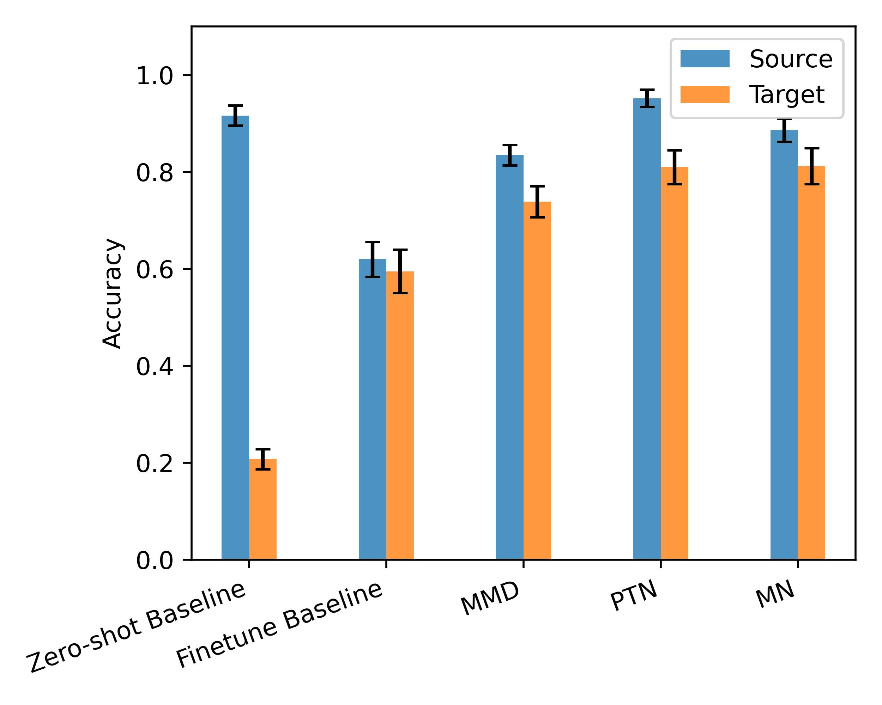
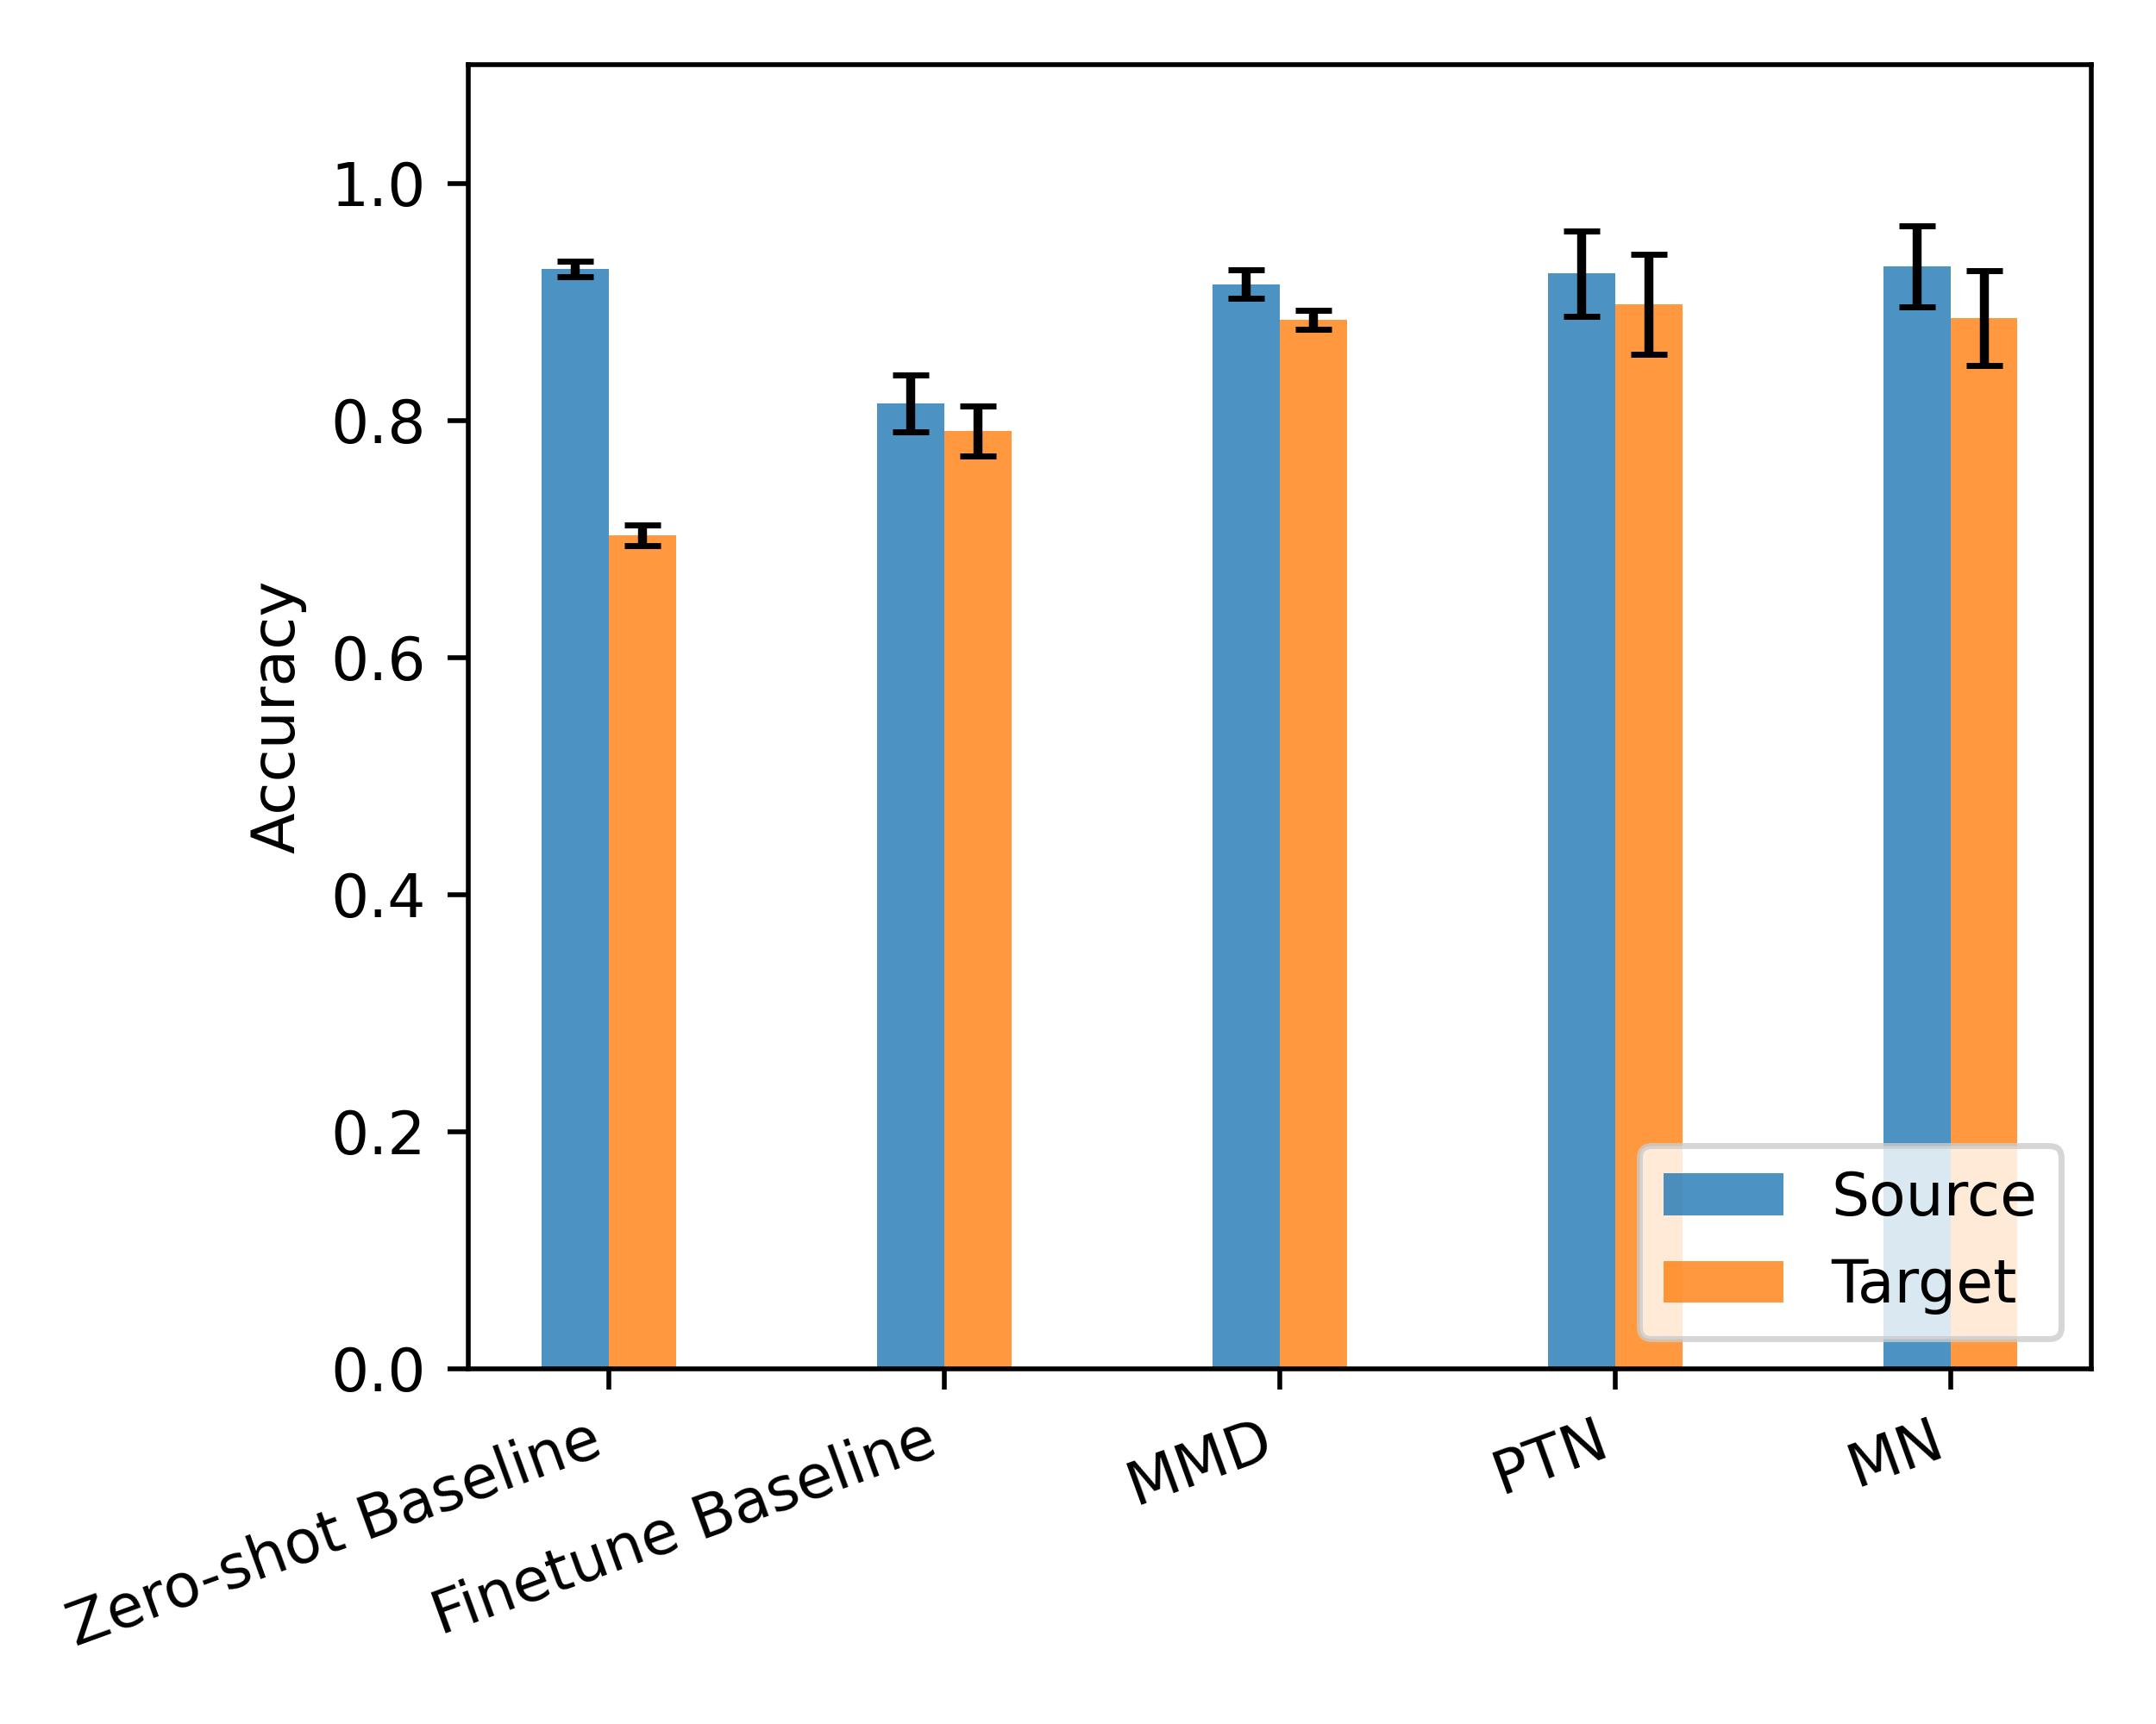
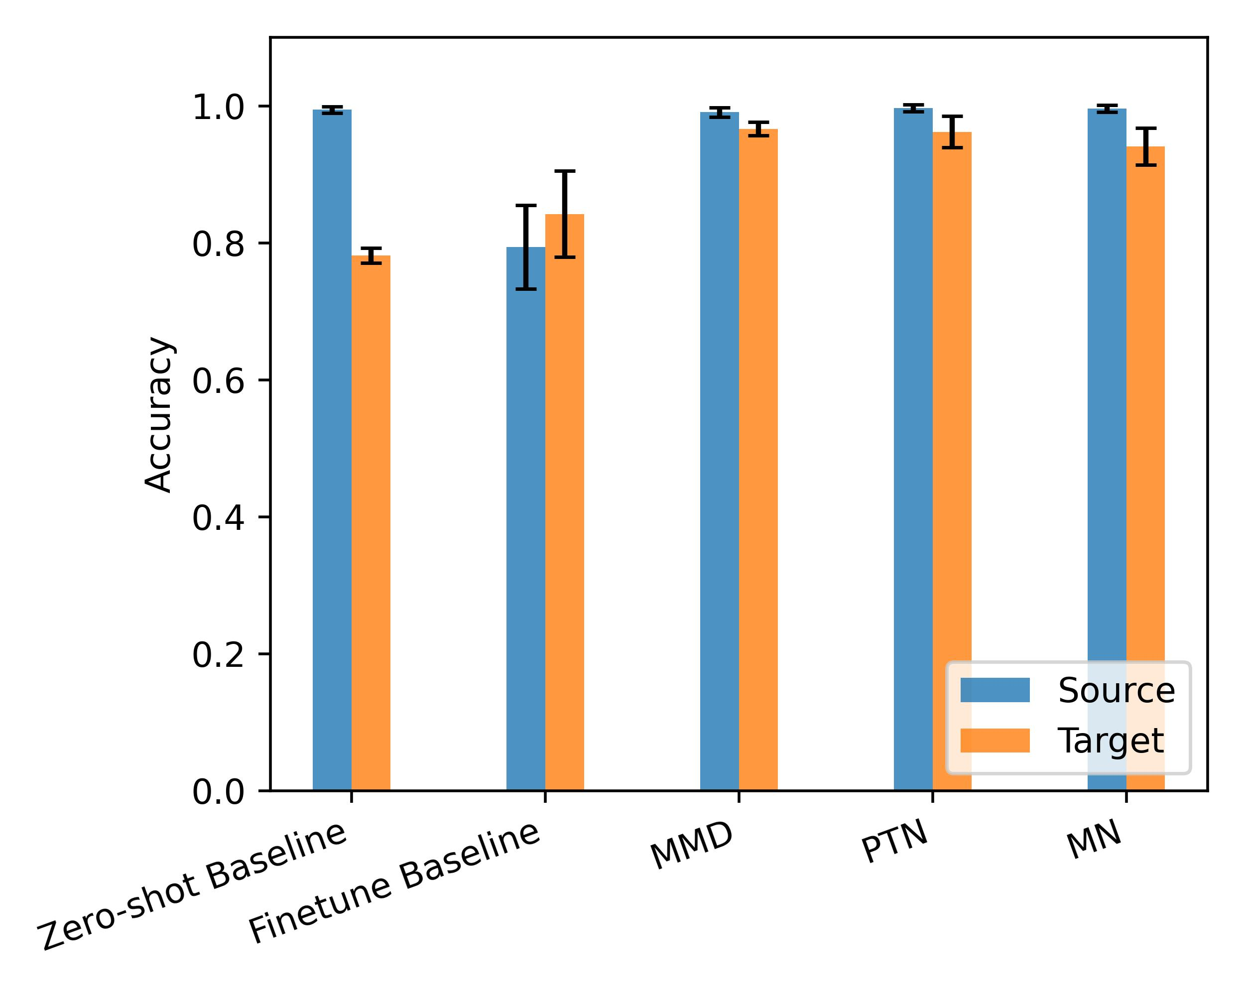
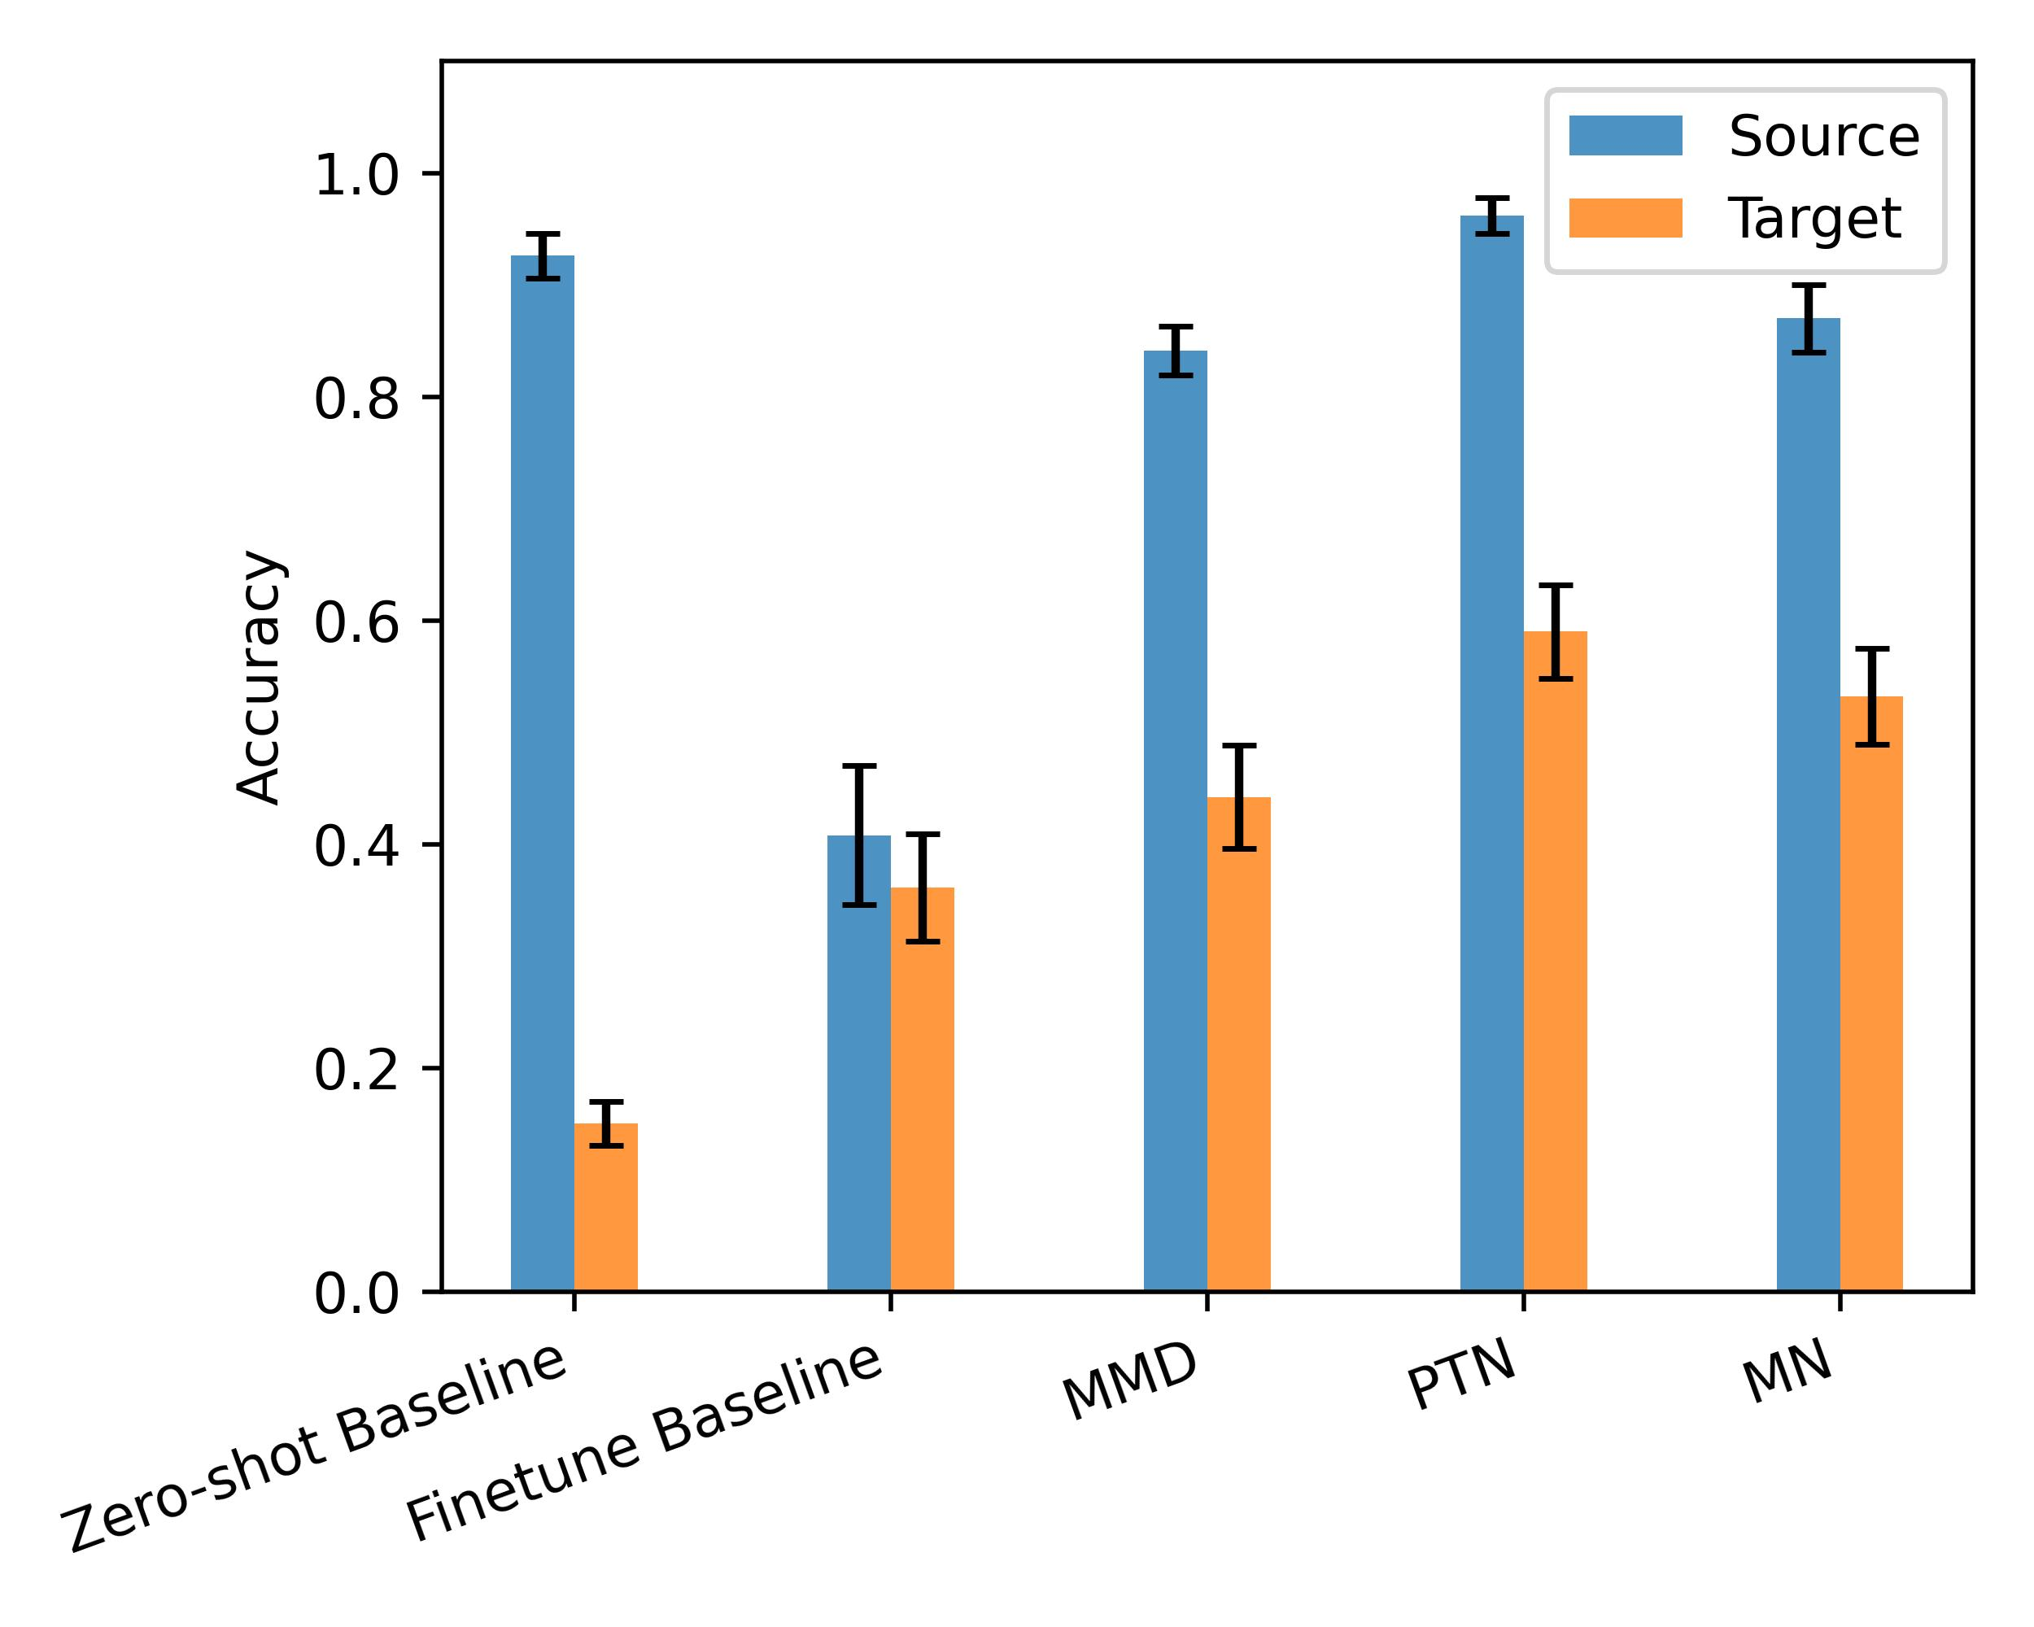
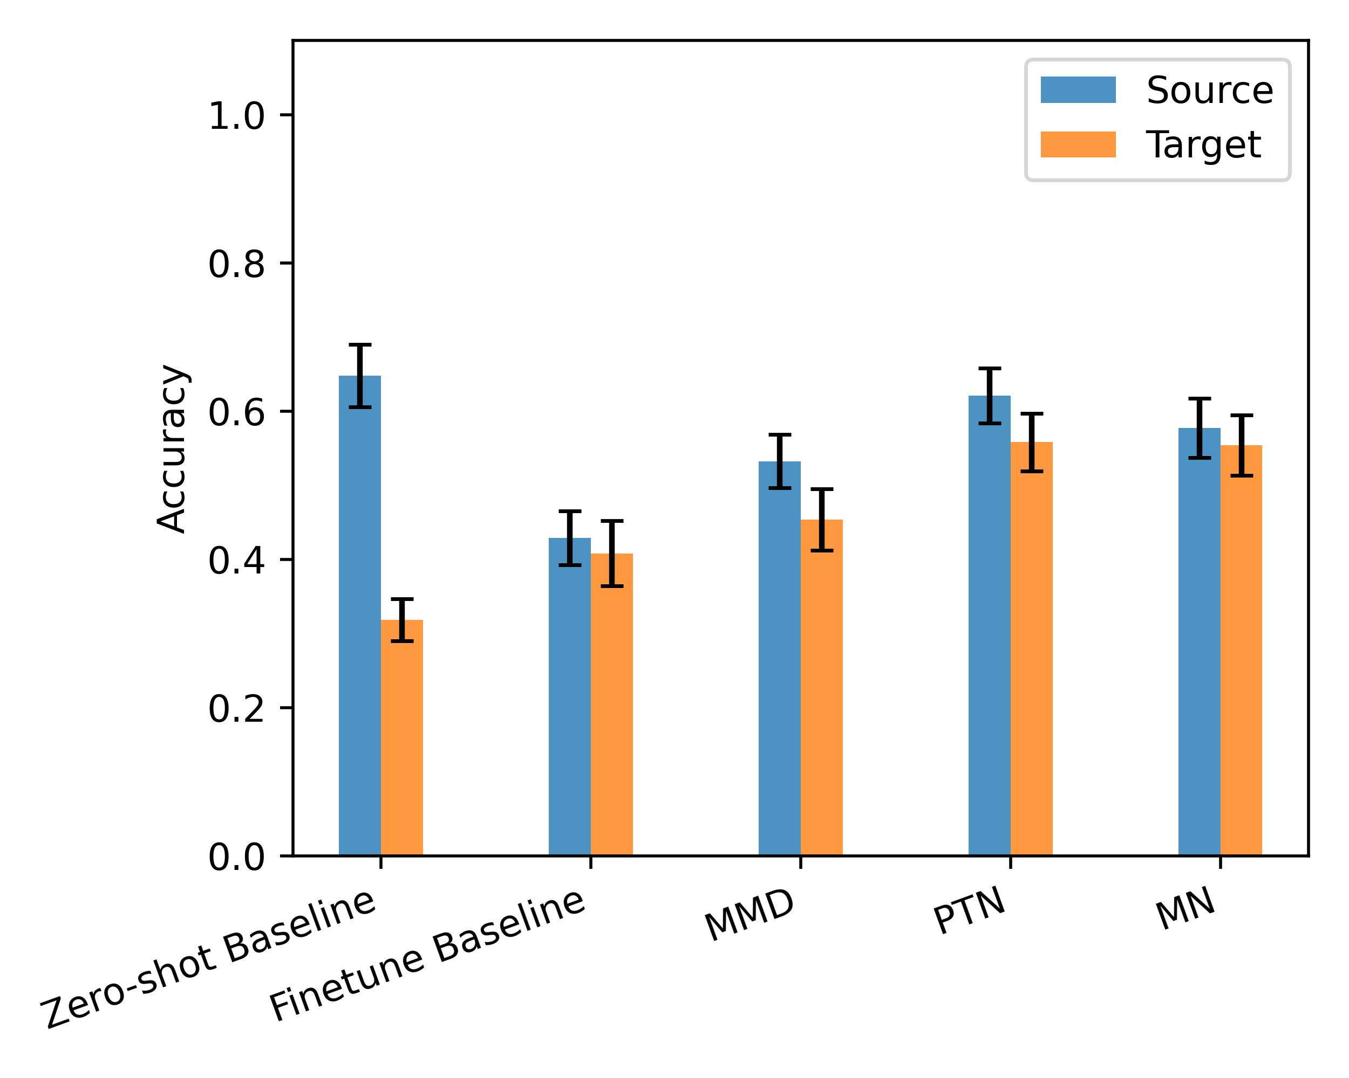
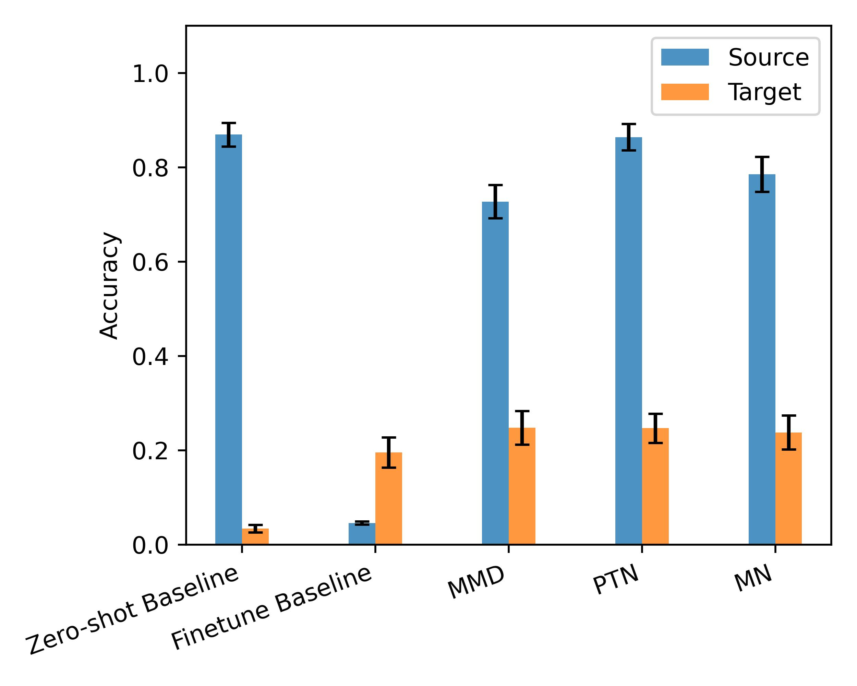
Results: FSL and DA Performance
Scenario: Lora-Day
Scenario: WiSig-Day
Scenario: Cores-Day
Scenario: Lora-Location
Scenario: Lora-Distance
Scenario: Lora-Config
Notes:
PTN and MN are the best, the second best is MMD; all three methods significantly improve the accuracy in target domain compared to two baselines.
Especially for the most challenging scenario - Lora-Config, where domain shift is very large due to different configurations in the RF system.

Slide 20

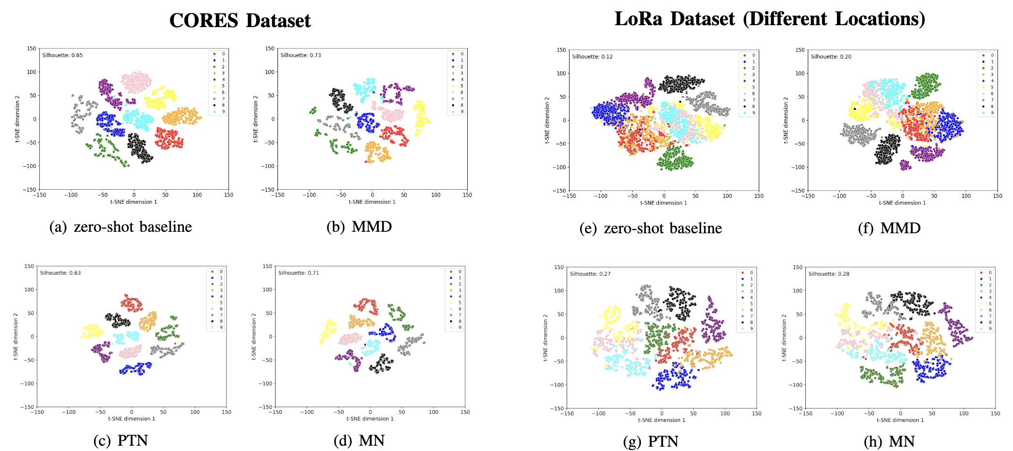
Results: t-SNE Plot
Silhouette score is a scale-invariant measurement on how similar a data point is to its own cluster compared to other clusters
t-SNE (t-distributed stochastic neighbor embedding) plots comparing predictions from different methodologies across 10 classes on two datasets
Notes:
Additionally, we visualize the learned embeddings (before the last softmax layer) using t-SNE plots and compare them in different methods. We evaluate the visualizations based on two factors: the intra-class compactness, which represents how tightly samples from the same class cluster together, and inter-class separation, which represents how distinctly clusters of different classes are separated in space. To better interpret the t-SNE visualizations, we quantize the cluster compactness and separation of all methods by computing the silhouette score using feature embeddings before t-SNE dimensionality reduction. Silhouette score is scale-invariant measurement on how similar a data point is to its own cluster compared to other clusters.
From the two scenarios plots, certain classes (e.g., 0, 3, and 5) exhibit higher intra-class compactness, and others (e.g., 5 vs. 6 vs. 9, and 0 vs. 3) demonstrate better inter-class separation. These improvements suggest that FSL methods enhance the model’s ability to generalize to the target domain. Additionally, from the results of PTN and MN, it can be seen that these two methods yield less compact clusters but slightly better separation between clusters compared to MMD. These plots and metric provides us a deeper representation analysis visually, to reveal how each method mitigates domain discrepancy.
t-distributed Stochastic Neighbor Embedding (t-SNE) is a machine learning algorithm used for visualizing high-dimensional data in a lower-dimensional space (usually 2D or 3D) while preserving the structure of the data as much as possible.
a(i) represents the mean distance between i and all other points in the same cluster; b(i) represents the mean distance between i and all points in the nearest neighboring cluster.
A higher silhouette score indicates a better group clustering performance.

Slide 21
Conclusions
Unified evaluation framework: Fixes datasets, data splits, and baselines (zero‑shot and fine‑tune), enabling apples‑to‑apples comparisons across methods
Empirical benchmarking: implement and compare three advanced methods with fine‑tuning on three public RF datasets under six realistic domain shifts
Representation analysis: visualize learned embeddings and quantify clustering quality using silhouette scores to reveal how each method mitigates domain discrepancy
Practical guidelines: distill recommendations on method choice, shot‑count, and evaluation design to help future RF fingerprinting FSL studies achieve fair and reproducible results

Slide 22
References
T. Tian et al., "Transfer Learning-Based Radio Frequency Fingerprint Identification Using ConvMixer Network," in Proc. IEEE GLOBECOM 2022, Rio de Janeiro, Brazil, Dec. 2022, pp. 4722-4727.
S. Kuzdeba, J. Robinson, and J. Carmack, "Transfer Learning with Radio Frequency Signals," in Proc. IEEE CCNC 2021, Las Vegas, NV, Jan. 2021, pp. 1-9.
A. Elmaghbub, B. Hamdaoui, and W. -K. Wong, "ADL-ID: Adversarial Disentanglement Learning for Wireless Device Fingerprinting Temporal Domain Adaptation," in Proc. IEEE ICC 2023, Rome, Italy, June 2023, pp. 6199-6204.
L. Yang, Q. Li, X. Ren, Y. Fang, and S. Wang, "Mitigating Receiver Impact on Radio Frequency Fingerprint Identification via Domain Adaptation," IEEE Internet of Things Journal, vol. 11, no. 13, pp. 24024-24034, July 2024.
T. Zhao, X. Wang, and S. Mao, "Cross-domain, Scalable, and Interpretable RF Device Fingerprinting,” in Proc. IEEE INFOCOM 2024, Vancouver, BC, Canada, May 2024, pp. 2099-2108.
Z. Zhang, G. Li, J. Shi, H. Li, and A. Hu, "Real-World Aircraft Recognition Based on RF Fingerprinting With Few Labeled ADS-B Signals," IEEE Transactions on Vehicular Technology, vol. 73, no. 2, pp. 2866-2871, Feb. 2024.

Slide 23

This work was supported in part by the US National Science Foundation under Grants CNS-2317190, CNS-2107190, and CNS-2107164.
http://www.eng.auburn.edu/~szm0001/

