Slide 1
Effective Social Network Quarantine with Minimal Isolation Costs
Huanyang Zheng and Jie Wu
Presenter: Dongyang Zhan
Dept. of Computer and Info. Sciences
Temple University, USA
Notes:
Good afternoon, ladies and gentlemen. I’m going to present the paper “Effective Social Network Quarantine with Minimal Isolation Costs”. The authors, Huanyang Zheng and Jie Wu, are absent due to some private reasons. This is Dongyang Zhan, and I will be the presenter.

Slide 2
Introduction
Notion of diseases
Human communities (e.g., Ebola)
Online social networks (e.g., rumours)
Distributed systems (e.g., computer virus)
Susceptible-Infected-Susceptible
Two states: susceptible and infected
Susceptible people can be infected
Infected people return to susceptible by recovery
Notes:
Nowadays, the notion of diseases has been extended from real human diseases to general epidemic information propagations, such as the rumors in distributed systems. Controlling the spread of a disease in a population is usually done through quarantine where people that have, or are suspected to have, a disease are restricted from having interactions with others. However, the human interactions are inevitably degraded by the quarantine. This motivates us to explore an effective quarantine strategy that can maximally preserve the human interactions.
We use the classic Susceptible-Infected-Susceptible (SIS) model to simulate the epidemic spreading, where each person has a state of being either susceptible or infected. People transfer their states through a cycle in which their susceptibility (S) causes them to become infected (I), and they return to being susceptible (S) by recovery. Clearly, the epidemic breaks out when the average infection rate becomes larger than the average recovery rate.

Slide 3
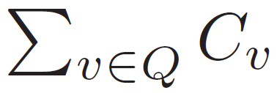
Problem Formulation
Social Network G = (V, E)
V is a set of nodes (people)
E is a set of directed edges
C_{v} is the isolation cost of the node v
Q is the set of isolated nodes (people)
Objective and Constraint
Minimize the total isolation cost of
Epidemic outbreaks are eliminated
Notes:
Our social network model is based on a directed graph G = (V, E), where V is a set of nodes, and E is a set of directed edges (social relationships)., respeLet To control epidemic outbreaks, some nodes are isolated by the quarantine strategy. A node v is isolated, if all the incoming and outgoing edges of v are removed. An isolated node can no longer interact with its neighbors, but it remains in the network. The isolation cost of v is C_v. The set of nodes isolated by the quarantine strategy is denoted by Q. The objective is to explore a quarantine strategy that eliminates epidemic outbreaks with minimal isolation cost.

Slide 4






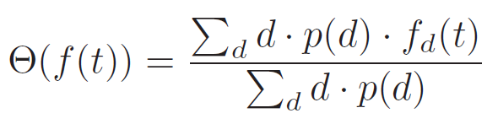
Epidemic Model
Parameters
is a constant infection rate
is a constant recover rate
is the fraction of nodes with in-degree d
is the fraction of infected nodes with in-degree d at time t, and is the fraction of susceptible nodes with in-degree d at time t
The probability that a uniform-randomly selected edge comes from an infected node at the time t is
Notes:
Our epidemic spreading model is based on the classic SIS model. Nodes have states of either being susceptible or infected. We consider that the infection rate of a given node depends on its infected incoming neighbors. For the node v, each of its infected incoming neighbors independently brings a constant infection rate (the infection probability per time unit) of \lambda to v. Meanwhile, the recovery rate is set to be a constant of r, as used in existing models.
To capture the structural heterogeneity of the social network, let f_d(t) denote the fraction of infected nodes with in-degree d at time t. Then, \Theta(f(t)) is the probability that a uniform-randomly selected edge comes from an infected node at the time t.

Slide 5



Epidemic Model
Consider a node with in-degree d
It has d incoming neighbors
infected incoming neighbors (expected)
Each infected neighbor has a infection rate of
The total infection rate is
The epidemic state transfer equation is
The 1st part is infection, and the 2nd part is recovery
Notes:
The fraction of susceptible nodes with in-degree d at time t is [1-f_d(t)]. Each of these nodes has an incoming degree of d, meaning that it is expected to have d \times\Theta(f(t)) infected incoming neighbors. Since each infected incoming neighbor brings an infection rate of , the total infection rate is (the first equation in PPT).
As a result, we have (the second equation in PPT).

Slide 6
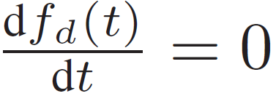



Epidemic Model
To control epidemic outbreaks
The new infection must be 0:
Further derivation shows
Notes:
Since we want to control epidemic outbreaks, the new infection must be 0. Further results are shown in the following.

Slide 7
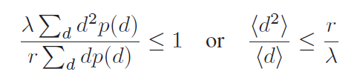


Epidemic Model
The result to control epidemic outbreak:
denotes the mean value of variable
Larger average degree and larger degree variance bring more network vulnerability to epidemics
Notes:
Here is the result to control epidemic outbreaks (first equation).
Let <> denote the mean value of the corresponding variable. Then, the result can be simplified as the second equation. The key insight is that both a larger average degree and a larger degree variance bring a more vulnerable network with respect to epidemic outbreaks.

Slide 8





Feasibility and Minimality
Let denote the degradation of
(isolation Q can control epidemic outbreaks)
Objective is to minimize
Constraint is to control epidemic outbreaks:
We focus on feasible isolations:
Notes:
(just read the slides here: the reformulation of the problem, and the definition of feasible isolations)

Slide 9
Feasibility and Minimality
Key concept of minimality:
Key observation:
Key intuition:
A minimal feasible quarantine strategy would not lead to unnecessary isolations.
Unnecessary isolations are saved once the epidemic outbreak is controlled.
Notes:
(just read the slides, the definition of minimality, key observation, and key intuition)

Slide 10
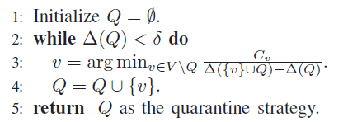
Algorithmic Design
Our problem is NP-hard
A reduction from partial set cover
Unbounded greedy can iteratively choose the lowest marginal cost-to-benefit node
Notes:
(just read the slide, NP-hard, and greedy algorithm)

Slide 11
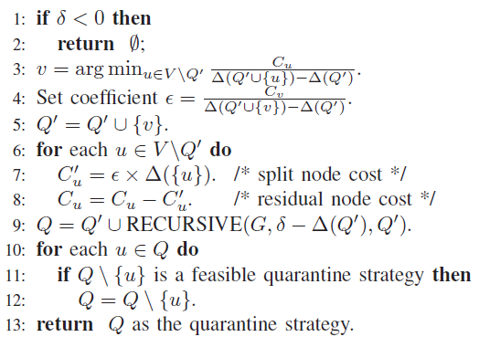
Algorithmic Design
Bounded greedy through homogeneous scaling
Notes:
The key observation of our approach is that a minimal feasible quarantine strategy would not lead to excessive isolations. Following this intuition, a homogeneous greedy solution is proposed. It is a recursive algorithm that splits the node cost through a homogeneous function. At each recursion level, it isolates the node v that can minimize the “cost-to-benefit” ratio, as implemented in lines 3 to 5. Then, in lines 6 to 9, it splits the node cost through a homogeneous function for a recursive call. Finally, in lines 10 to 12, some nodes in Q are removed to satisfy the minimality property.

Slide 12
Algorithmic Design
Approximation ratio is 2
At most double the optimal isolation cost
Insight is that a minimal feasible isolation strategy is close to the optimal isolation strategy
Time complexity is O(V²)
Notes:
(Just read the slide)

Slide 13
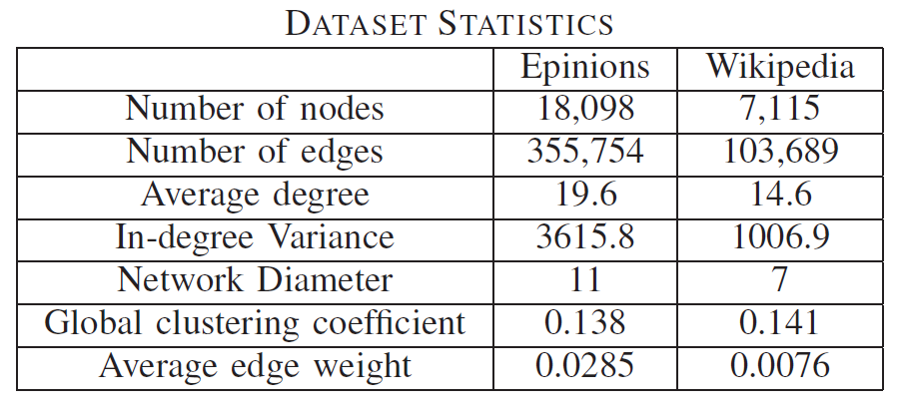
Experiments
Epidemics in online social networks
Epinions is a general consumer review site
Wikipedia is a free encyclopedia
Notes:
(just read the slide on the dataset and statistics)

Slide 14
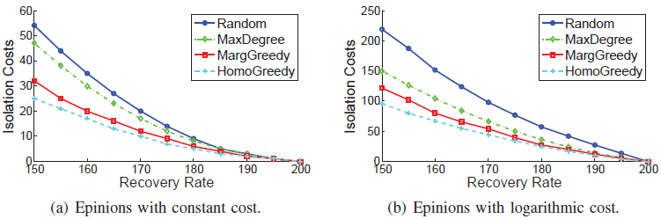
Experiments
Results on Epinions
Isolation cost depends on node degree
Notes:
It can be seen that the isolation cost decreases monotonously with respect to the recovery rate. This is because a high recovery
rate can resist epidemic spreadings. If the recovery rate is high enough, then epidemic outbreaks can be eliminated without
isolations. HomoGreedy always has the lowest isolation costs among the comparison algorithms. Another interesting
observation is that, when the cost of a node isolation is a constant, the total isolation cost is the smallest. This is because
the quarantine strategy tends to isolate large degree nodes, while their costs are relatively cheap after normalization. On
the other hand, when the cost of a node isolation scales with its degree (in a logarithmic manner or a square root manner), the
overall isolation costs become very large. This is because the isolations of large degree nodes take relatively large costs after
normalization.

Slide 15
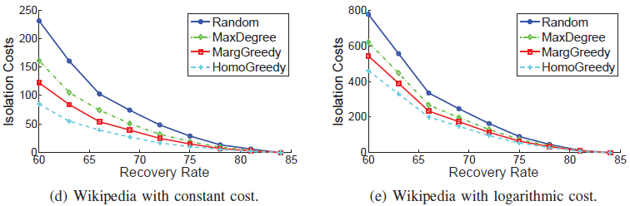
Experiments
Results on Wikipedia
Isolation cost depends on node degree
Notes:
We also find that, the total isolation costs in Epinions are smaller than those in Wikipedia. One reason is that Epinions has a much larger degree variance than Wikipedia, as shown in Table I (355,754 to 103,689). Another reason is that Epinions has more users than Wikipedia (18,098 to 7,115), bringing larger isolation costs.

Slide 16
Conclusion
Epidemic outbreak depends on both the average node degree and the degree variance
A minimal feasible quarantine can avoid unnecessary isolations, and lead to a bounded algorithm
Thank You
Notes:
(read the slide and then finish)

