Slide 1
Ferry-Based Linear Wireless Sensor Networks
December 11, 2013
Imad Jawhar¹, Mostafa Ammar², Sheng Zhang³, Jie Wu⁴, and Nader Mohamed¹
1: UAE University, UAE; 2: Georgia Institute of Technology, USA; 3: State Key Laboratory for Novel Software Technology, Nanjing University, P. R. China; 4: Temple University, USA
IEEE Globecom 2013

Slide 2
Outline
Introduction: LSNs and FLSNs
Network model
Networking technology for various links
Ferry movement algorithms
Simulation results
Conclusions and future research

Slide 3
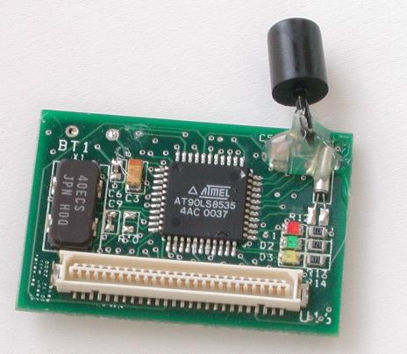
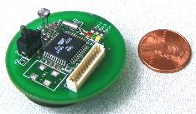
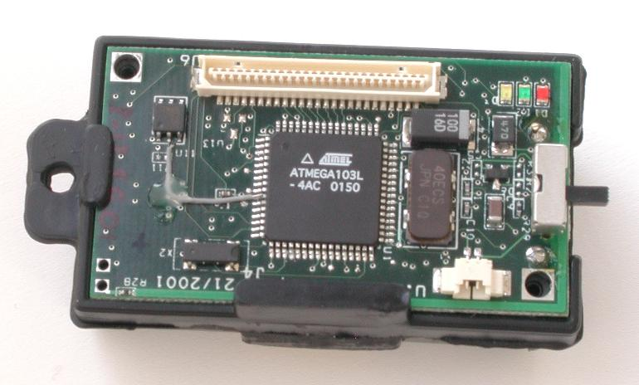
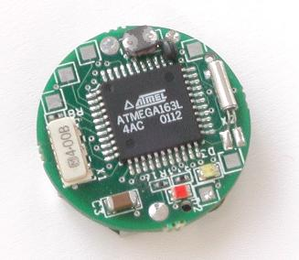
Wireless Sensor Networks
Wireless sensor networks (WSN) advancements in technology
Sensor networks application: environmental, military, agriculture, inventory control, healthcare, etc.

Slide 4
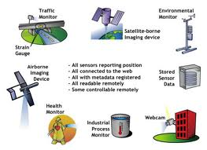
Applications of WSNs
Applications for WSNs:
  Weather monitoring
  Security and tactical surveillance
  Fault detection and diagnosis in:
    Machinery
    Large bridges
    Tall structures
  Detecting ambient conditions
  such as:
    Temperature
    Movement
    Sound
    Light
    Radiation
    Stress
    Vibration
    Smoke
    Gases
    impurities
  Presence of certain biological and chemical agents
Notes:
4

Slide 5
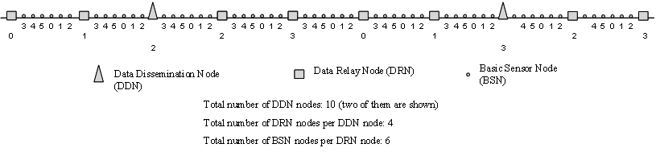
Linear Sensor Networks
Existing wireless sensor network research
Assumption that the network used for sensors does not have a predetermined linear structure.
Linear alignment of sensors can arise in many applications
Linear characteristic can be utilized for enhancing the communication quality and reliability in the such systems
We can design adapted protocols for this special kind of sensor networks.

Slide 6



Applications of LSNs
Monitoring and protection of oil, gas, and water pipeline infrastructure using wireless sensor networks.

Slide 7
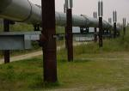
Oil, Gas, and Water Pipeline Use
UAE (2006):
  2,580 Km of gas pipelines
  2,950 Km of oil pipelines
  156 Km of refined products pipelines.
Desalinated water.
Saudi Arabia: 3,800 Km.
Use pipelines for transportation from plants to cities and populated areas.
Oil and gas industries heavily depend on pipelines for connecting shipping ports, refineries, and wells.
Types of pipelines: above ground, underground, under-water.

Slide 8
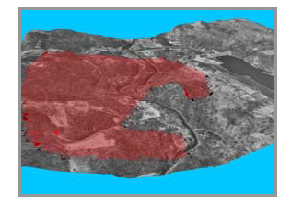
Border Monitoring
Monitoring international borders for different activities.
Illegal smuggling of goods, or drugs, unauthorized border crossings by civilian or military vehicles or persons, or any other kind of activities.
Different deployment strategies.
Deploy sensors by dropping them in a measured and controlled fashion from a low-flying airplane, installing them on a fence, etc.
Resulting topology: linear sensor network with a relatively uniform node density distribution.

Slide 9
IVC Network and Railroad/subway monitoring
IVC Network
Roadside networks used to monitor vehicular activities.
Vehicle-to-Vehicle (V2V) via infrastructure.
Vehicles-to-Infrastructure (V2I) communication.
Internet access of vehicles
Railroad/subway Monitoring
Sensors to monitor fatigue-critical components in structure of a railroad bridge.
Sensors can monitor dynamic strains caused by the passing of trains.
Other applications: River/sea cost monitoring, etc.

Slide 10
Why New Architectures and Protocols Are Needed ?
Increased routing efficiency:
  Take advantage linearity to significantly increase routing efficiency.
  Multi-dimensional routing protocols would not very efficient.
  Use flooding for route discovery and maintenance, which costs bandwidth, processing resources, delay.
  Exploit linearity to eliminate or reduce route discovery.
Increased reliability:
  With multidimensional routing protocols: node failures => route discovery or costly local repair.
  If no other alternative links are available, the connectivity of the network is compromised.
  In LSNs specialized solutions to overcome node failure. E.g. extend transmission range. Easier with LSNs predictable structure.
  Can use directional antenna technology in an efficient way to: increase range, reduce interference, avoid hidden terminal problems, and minimize power consumption.
Improved location management:
  Topology discovery can provide information about node location.
  Network can easily, and precisely locate problems and take corrective measures.
  Necessary for maintenance scheduling, surveillance, and quick emergency response.
LSN Classification:
  Thin and thick
  Multiple types of nodes/hierarchy

Slide 11
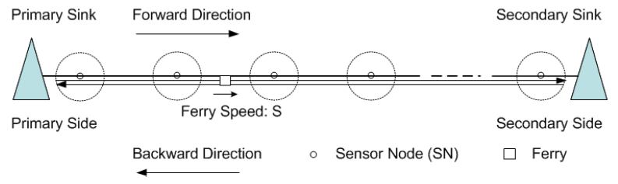
FLSN System Architecture
Pure multihop approach costly in energy
We introduce a framework for monitoring LSNs with data collection using ferries
Three types of nodes: SN, ferry, and sink
SNs transmit to the ferry which transports data to the sink

Slide 12
FLSN System Architecture – Advantages
Distance between consecutive SNs not limited by communication range
In multihop: add nodes, or increase range for connectivity
Elimination of transmission interference and hidden terminal
Solves the problem of disproportionate use of nodes near sink
Ferry can perform functions such as data aggregation, scheduling, sensor operating system and software configuration/programming/updating, localization, and synchronization

Slide 13
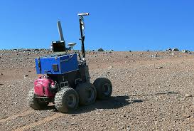
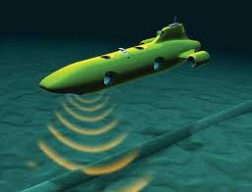
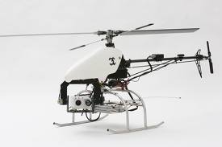
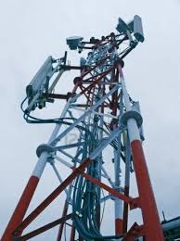

Network Model
Sensor Node (SN):
Basic sensing, placed at regular intervals
Ferry:
More capable mobile node
Can vary speed
Type depends on application
Can be an UAV, AUV, etc.
Sink:
Transmit to NCC
Uses Available technology in region (e.g. WiMAX, GPRS, cellular, etc.)
Multiple ferries/segments:
  reduce e2e data delivery delay
  Increased throughput (parallelism).
  Increased reliability
  Reduced ferry requirements

Slide 14
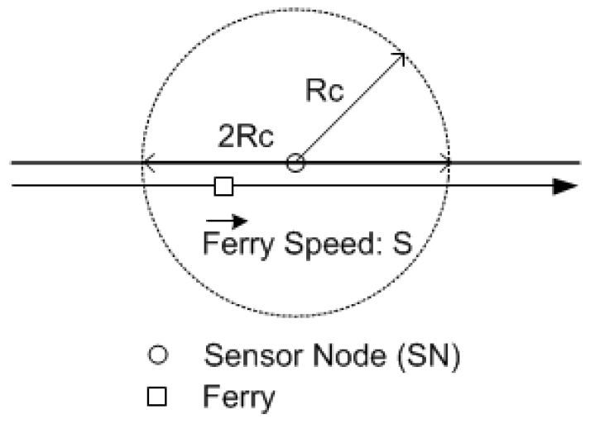
System Parameters
n: This is the number of sensor nodes
d: This the physical distance between each of two consecutive sensor nodes.
L: The length of data which is exchanged with the ferry (in bytes).
R: The bit rate for the communication between the SN and the ferry.
R_{s}: This is the sensing range of a sensor node.
R_{c}: The communication range of an SN.
Message time-out value T
Message delay: most significant delay value
Two types of data traffic are considered:
  Best effort (BE) traffic
  Priority traffic

Slide 15
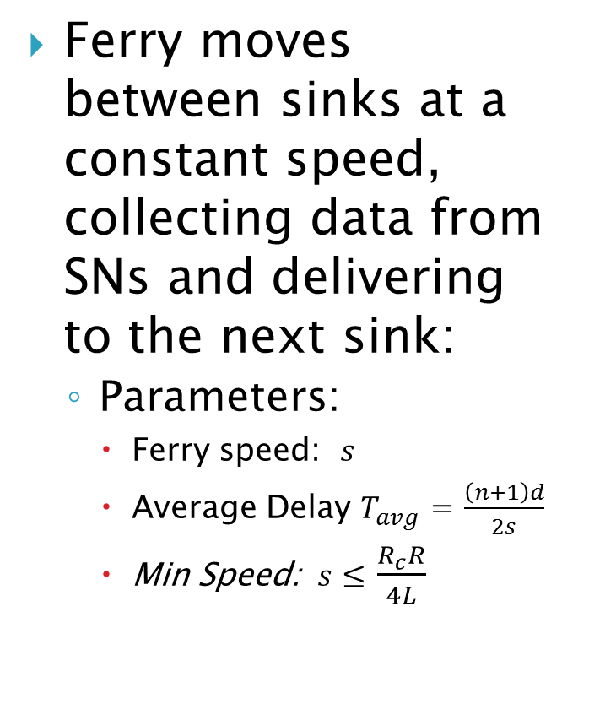
Ferry Mobility Protocols: Constant Speed Ferry (CSF) Algorithm
Ferry moves between sinks at a constant speed, collecting data from SNs and delivering to the next sink:
  Parameters:
    Ferry speed: $s$
    Average Delay $T_{avg}^{}$ = $\frac{\left(n+1\right)d}{2s}$
    Min Speed: $s≤$ $\frac{R_{c}R}{4L}$

Slide 16
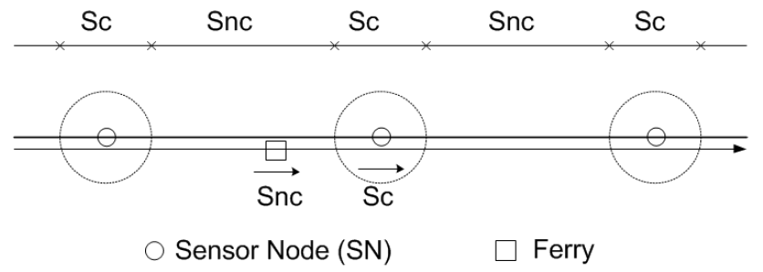
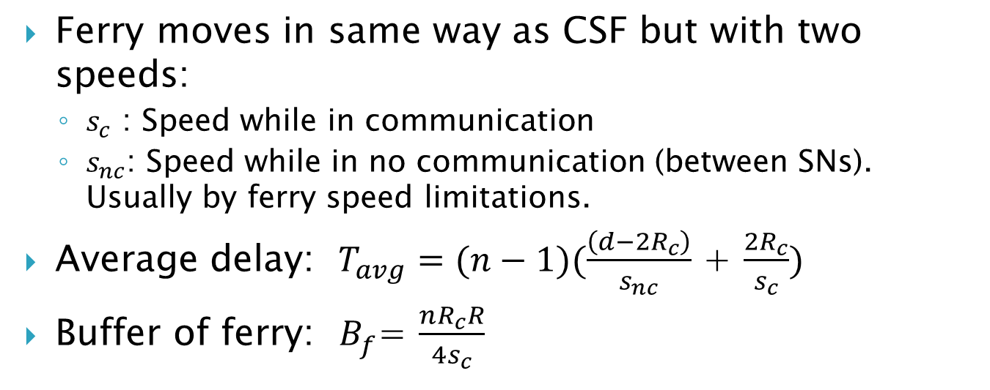
Variable Speed Ferry (VSF) Algorithm
Ferry moves in same way as CSF but with two speeds:
  $s_{c}$ : Speed while in communication
  $s_{nc}$: Speed while in no communication (between SNs). Usually by ferry speed limitations.
Average delay: $T_{avg}^{}=(n−1)(\frac{\left(d−2R_{c}\right)}{s_{nc}}$ + $\frac{2R_{c}}{s_{c}})$
Buffer of ferry: $B_{f}^{}$= $\frac{nR_{c}R}{4s_{c}}$

Slide 17
Adaptable Speed Ferry (ASF) Algorithm
For some applications: message arrival rate at the SNs is variable.
Quality and/or quality of data collection can increase with emergency or special situations (special audio/video capabilities, turned ON as needed. Response to certain events, intruder detection, high temperature, pressure, or vibration in a pipeline, etc.) – Can use push or pull.
In ASF, Ferry speed while in communication is determined by the amount of data in the SN buffer:
  s_{c}: variable (depends on SN buffer size)
  s_{nc}: constant
In CSF and VSF algorithms, delay is bounded.
In ASF, delay is un-bounded – Large data in an SN can slow down ferry in a detrimental fashion.
To bound delay: delay allocation strategy is used.

Slide 18
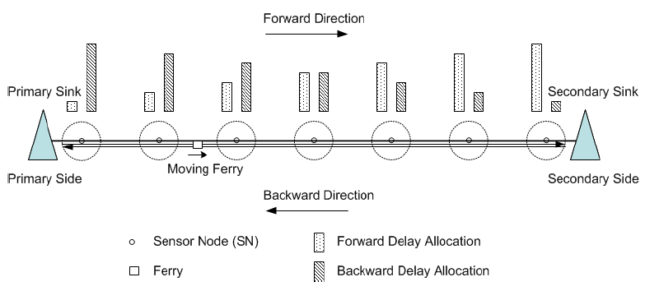
Adaptable Speed Ferry Algorithm – Cont’d
Delay allocation strategy favor collecting less data from far SNs and more data from close SNs to the destination sink in order to reduce total end-to-end delay.

Slide 19
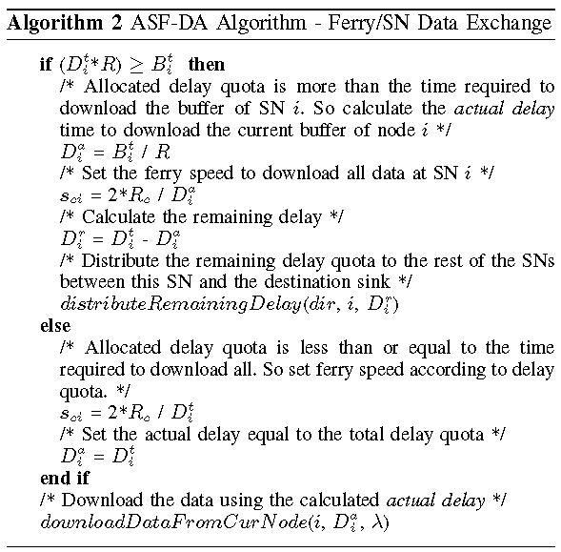
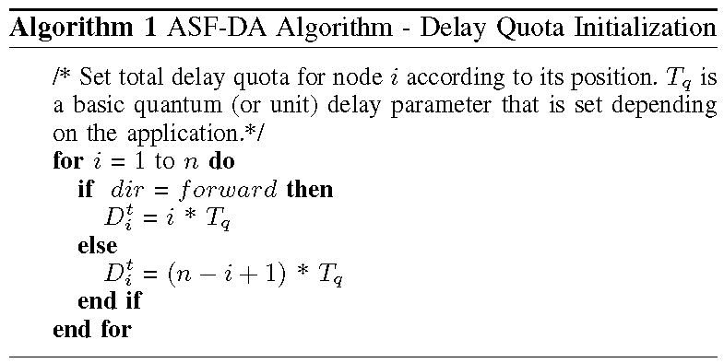
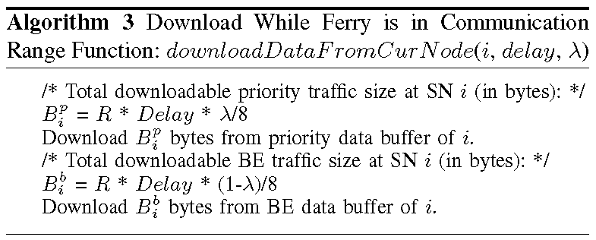
Adaptable Speed Ferry Algorithm (ARF)
Node contains two buffers: BE and priority.
We use variable λ to allocate: λ = 0.8 => 80% quota for priority traffic.

Slide 20
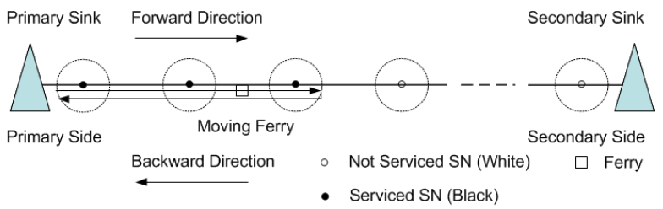
Adaptable Routing Ferry (ARF) Algorithm
Also for variable message arrival rate
Ferry moves from primary sink to secondary at NORMAL_SPEED using NORMAL_MODE.
Continues till ferry buffer reaches a critical threshold .
Then ferry switches to GO_FAST_TO_NEAREST_SINK mode at FERRY_MAX_SPEED.
At sink download and turn around and go fast past serviced SNs to un-serviced SNs, then resume NORMAL_SPEED (Flag used: white/black)
Objective: minimize delay by making the ferry deliver data fast when a threshold is reached (threshold: application-dependent).
Provide fairness in servicing SNs, and prevent SN starvation.

Slide 21
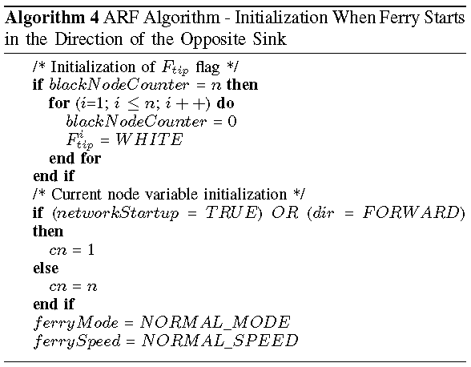
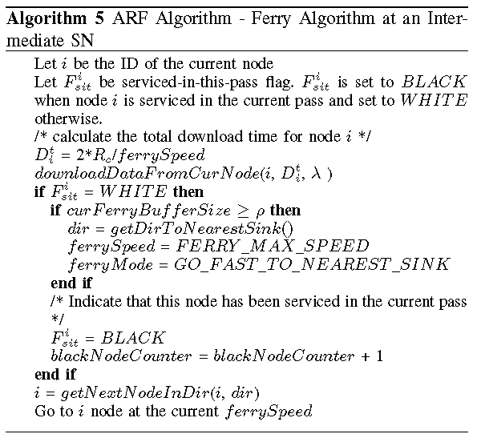
Adaptable Speed Ferry (ARF) Algorithm – Cont’d

Slide 22
Simulation
Evaluates the performance of the proposed algorithms, providing insights into the impact of various parameters.
Parameters are mainly used to verify the operation (proof of concept) and study the performance of the algorithms.
Parameters can vary considerably depending on application used.
The performance metrics used in our evaluations:
  The delivery ratio is the ratio of the successful packets received by two sinks to the overall packets generated by all SNs.
  The average delay is the average delay experienced by the successful packets.

Slide 23
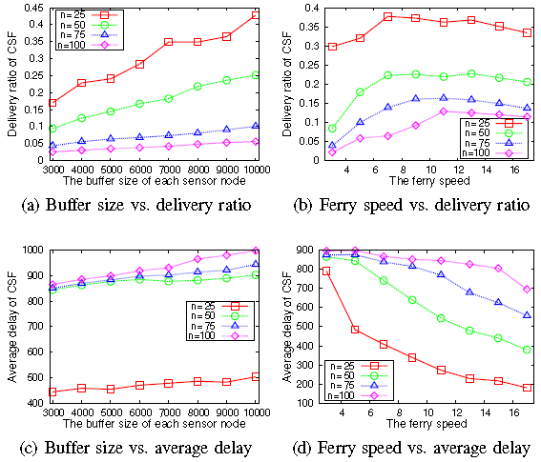
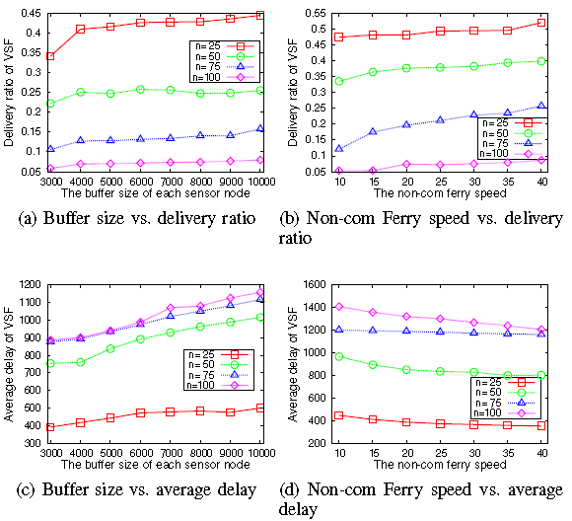
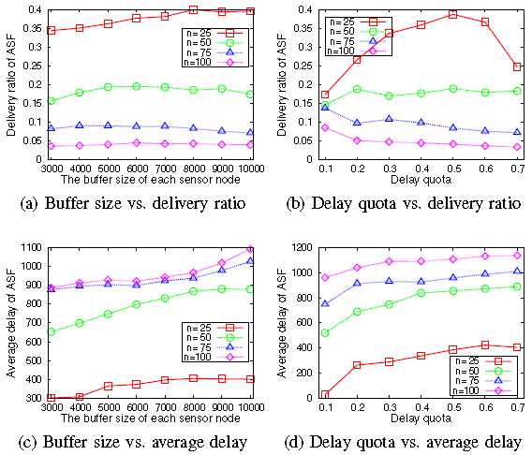
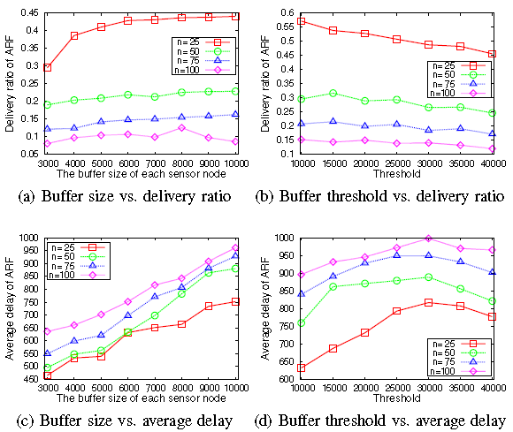
Simulation Results

Slide 24
Summary of Results
When SN buffer size increases, delivery ratio increases for all algorithms.
When SN buffer size increases, average delay increases for all algorithms.
The ferry speed, the non-com ferry speed in VSF, the delay quota in ASF, and the buffer threshold in ARF should be chosen carefully, and it may take time to find optimal values for a particular environment.
When the time-out value increases, all algorithms perform better in terms of delivery ratio, and the average delay increases.
There may exist some critical time-out values, related to the length of the time required for a ferry to travel from one sink to another.
Some challenges remain. Objective is introduction of FLSN framework with various strategies for data collection.
Simulation intended to provides some guidelines for future delay-tolerant data collecting systems.

Slide 25
Conclusions and Future Work
Motivated and presented FLSN framework for data collection in LSNs using mobile ferry.
Offered four possible ferry movement strategies.
Basic simulation experiments performed to study the effect of different design parameters on network performance
Ferry speed in and out of communication and other design parameters should be chosen carefully for a particular environmental setting
Provides a foundation for future research to further expand and tailor design depending on the application.
Future research can focus on: multiple ferries per segment, and algorithms for optimal ferry routes for certain data traffic distribution, optimal density and placement of various nodes/sinks to meet design constraints
Objectives such as increased system reliability, performance, and reduced energy consumption in different type of nodes.

Slide 26
Thank you
Questions?

