Slide 1

On Characterization of the Traffic Hole Problem in Vehicular Ad-hoc Networks
Chao Song^{+*}, Jie Wu*, and Ming Liu⁺
*School of Computer Science & Engineering, UESTC
⁺ Department of Computer &Information Sciences, Temple University

Slide 2
Outline
Overview
Taffic Light and Traffic Hole
Traffic Hole Problem
Mitigation wigh Backward Traffic
Similation Reslusts
Conclusion

Slide 3
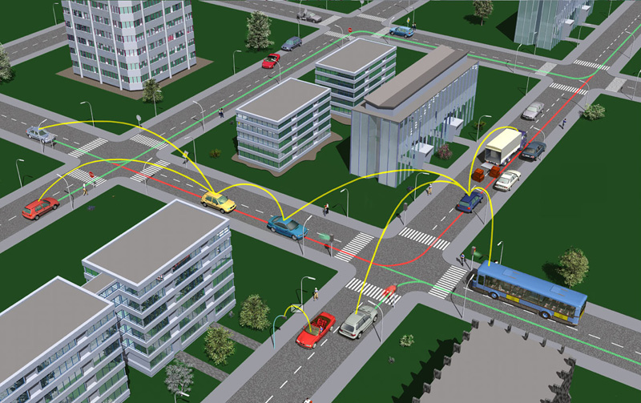
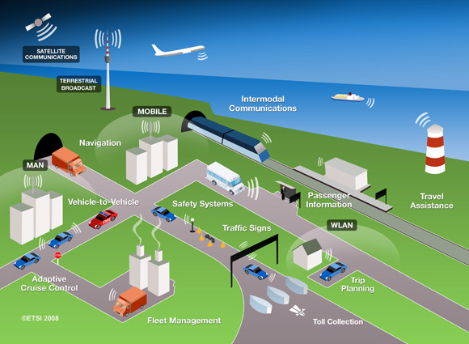
Overview
The data delivery in vehicular ad hoc networks (VANETs) is based on the wireless communication among vehicles (V2V) and infrastructures (V2I).
3

Slide 4
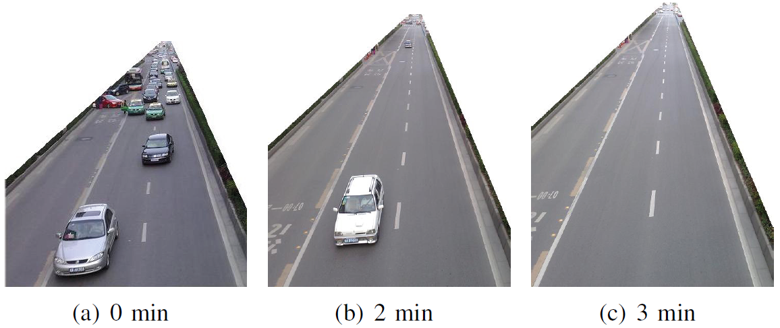
Traffic Hole
The road is Shudu Road with the heaviest traffic in Chengdu, which is a city with over 2 million vehicles in China.
The time when the photos was taken was during the rush hour in the afternoon.

Slide 5
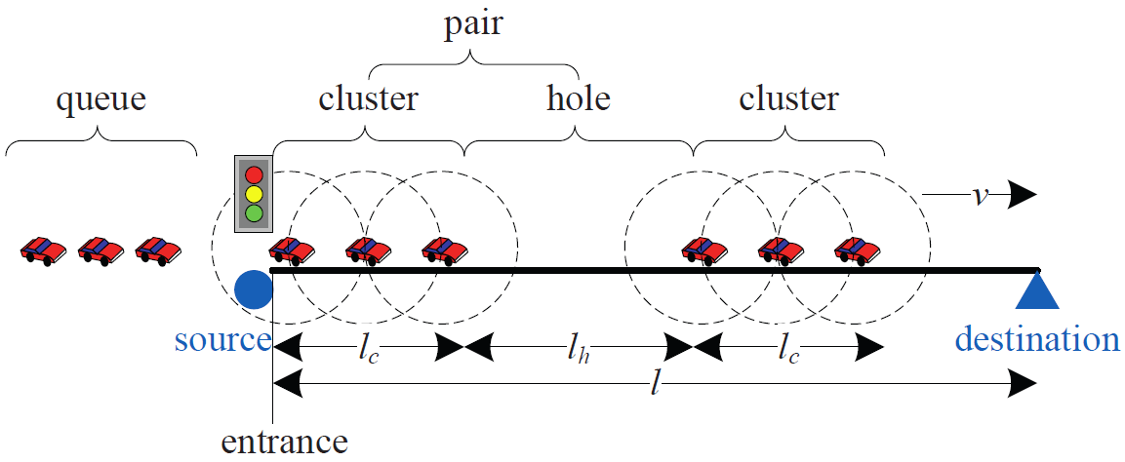
Traffic Hole
Traffic Hole: the gap in a traffic flow on the road, whose length (denoted by l_{h}) is larger than the communication range of vehicles, i.e. l_{h} > R.

Slide 6
Distribution of Traffic Hole
Cycle of traffic light: A cycle in the signal operation is defined as a complete sequence of intervals or phases. The duration of a cycle is denoted by c. A simple traffic control system has two states in a cycle, which are the green for moving, and the red for stopping. The durations of each are denoted by g and r, respectively. Thus, c = g + r.
Cycle of traffic flow: Due to the periodicity of signal operations at the intersection, the appearance of the pair of traffic hole and connected cluster is alternative and periodical. Let the cycle of traffic flow be the duration for each pair of traffic hole and connected cluster along the traffic flow past a fixed point, i.e. (l_{c}+l_{h})/v.

Slide 7
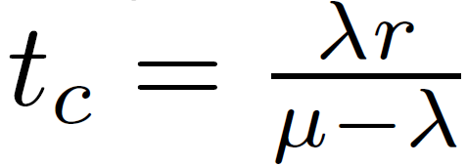
Traffic Flow
Two factors affecting the length of the traffic hole and connected cluster are as follows: (a) the arrival rate of the input traffic flow at the upstream intersection (denoted by λ); (b) the signal operation at the upstream intersection (r and g).
For the vehicular queue waiting at the signalized intersection, time to queue clearance after the start of effective green can be calculated as:

Slide 8

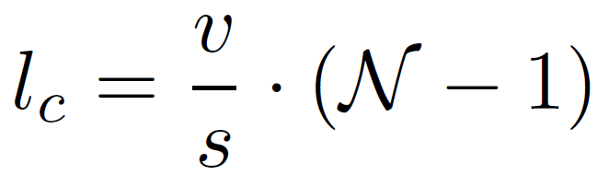
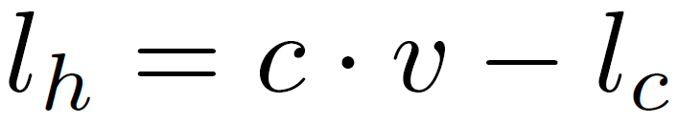
Saturated Traffic Flow
During the green time, the number of vehicles leaving from the upstream intersection is equal to the number of vehicles in a connected cluster can be calculated as:
The length of a connected cluster is:
Due to the alternative and periodical appearance of the traffic hole and connected cluster, the length of a traffic hole can be:

Slide 9
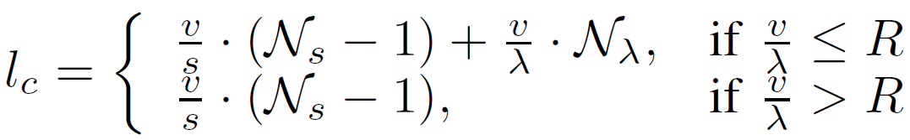
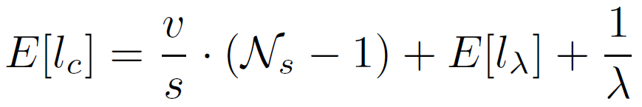
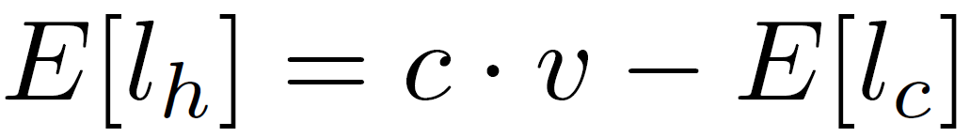
Under-saturated Traffic Flow
Under the D/D/1 queuing model, the length of a connected cluster can be calculated as:
Under M/D/1 queuing mode, the length of a connected cluster can be calculated as:
The expected length of the traffic hole can be calculated as:

Slide 10
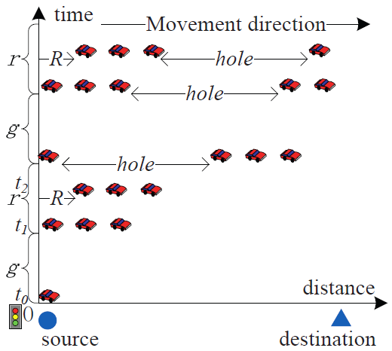
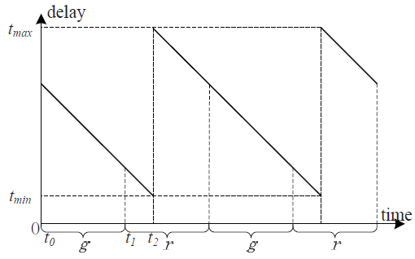
Impact of Traffic Hole
We analyze the impact of the traffic problem on routing protocols in VANETs, which includes connection-based and movement-assisted routing protocols .
Distribution of the vehicles on the road
Data delivery delay

Slide 11
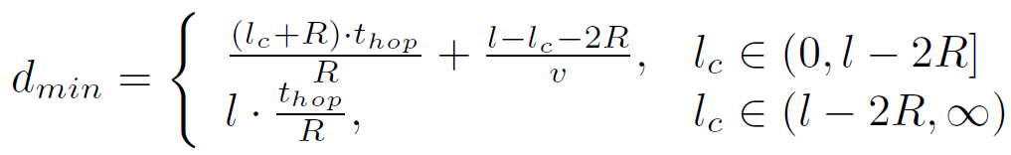
Impact of Traffic Hole
Short connected cluster: the connected cluster cannot connect to the destination (i.e. 0 < l_{c} ≤ l − 2R).
Long connected cluster: the length of the connected cluster is
long enough to simultaneously connect to both the source and destination (i.e. l_{c} > l − 2R).
The minimal data delivery delay is calculated as:

Slide 12
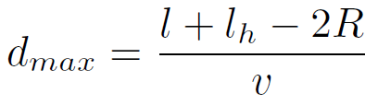
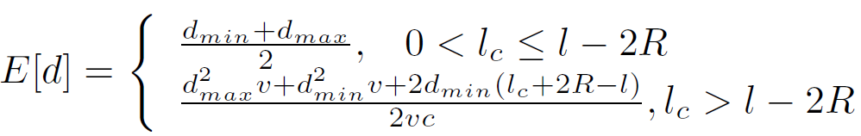
Impact of Traffic Hole
The maximal data delivery delay is as:
The expected data delivery delay along this road by the movement-assisted routing protocols can be calculated as:

Slide 13
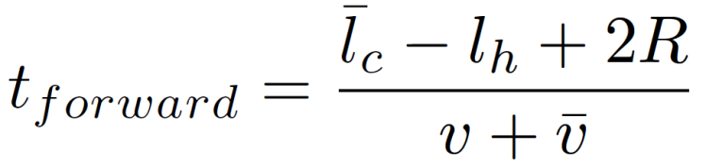
Backward Traffic
In order to mitigate the influence of traffic hole problem on data delivery, we propose an approach by utilizing the backward traffic flow.
The connected cluster and the traffic hole along the traffic flow f and its backward flow should be satisfied as follows:
For a cluster in traffic flow f, the duration of the opportunity for forwarding the packets from it to the cluster ahead by a backward traffic cluster can be calculated as:

Slide 14
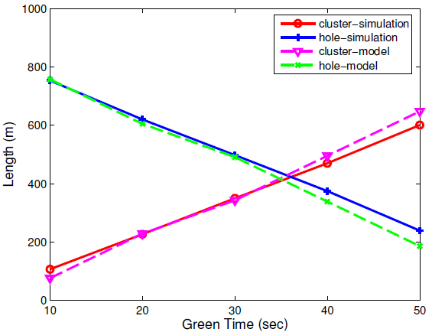
Influence of the Signal Operations on the Traffic Flow
We evaluate the influence of the duration of signal operations at the two-way intersections, which have two phases for the green and red state, on the length of the cluster and the traffic hole on the road.

Slide 15
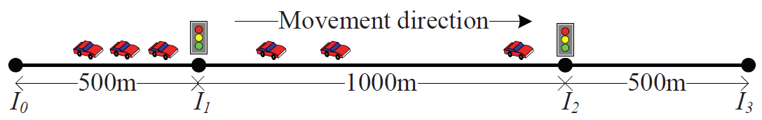
Impact of the Green Time for the Routing Protocols
We evaluate the influence of the signal operations on the performance of routing protocols under the following scenario:

Slide 16
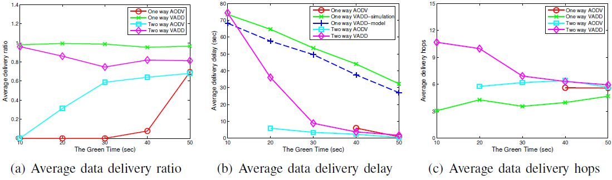
Impact of the Green Time for the Routing Protocols

Slide 17
Conclusion
Due to the traffic light or pedestrian signal, a traffic hole would appear in the road, even under heavy traffic.
We analyze the traffic hole problem, and discuss its impact on the data delivery in VANETs.
It will not only affect the forwarding opportunities in VANETs, but will also affect the performance of data delivery on the road.
We propose to utilize the backward traffic flow to mitigate the influence of traffic hole problem on the data delivery.

Slide 18

Thank You!

