Slide 1
Cyber Security Defense:
From Moving Target Defense to Cyber Deception
Jie Wu
Temple University

Slide 2
Outline
  Cyber Security Defense
  Cyber Deception
  Honeypots and Honey-X
  Moving Target Defense
  Game-Theoretic Approaches
  Challenges of Cyber Deception
  Conclusions

Slide 3
1. Cyber Security Defense
  Security: a collection of protection mechanisms
    Deny and isolation: deny unauthorized access
    Degradation and obfuscation: slow down once penetrated
    Negative info and deception: lead attackers stray
    Attributions and counter-operation: hiking back
    Cyber kill-chain
Deny & isolation
Degradation
Deception
Attribution

Slide 4

2. Cyber Deception
  The Art of War (孙子兵法)
    All warfare is based on deception
  Offense vs. Defense
    Attack is the secret of defense
    Defense is the planning of an attack

Slide 5


2. Cyber Deception
  Cyber deception
  Planned actions to mislead/confuse (i.e. trap) attackers
Goals
  Complement detection, enhance prevention, and mitigate successful attacks
Unit and layer
  Parameter, file, account, profile, …
  Network, system, application, data, …
  Life cycle of cyber deception
  Collect knowledge of attacker
  Implement deception schemes
Notes:
Concealment, camouflage, false and planted information, lies, displays, ruses, demonstrations, feints and insight
Masking, repacking and dazzling for dissimulation
Mimicking, inventing and decoying for simulation

Slide 6
Adversary Model
Kerckhoffs’ principle: system is public knowledge
It is unclear how smart an adversary can be
Traffic analysis challenge: algorithm + big data
  An adversary can use a sophisticated ML method
  An adversary can use compressive traffic analysis (CCS 2017)
  Perform traffic analysis on compressed features instead of raw data
Notes:
Asymmetric advantage over attackers: defenders know more!

Slide 7
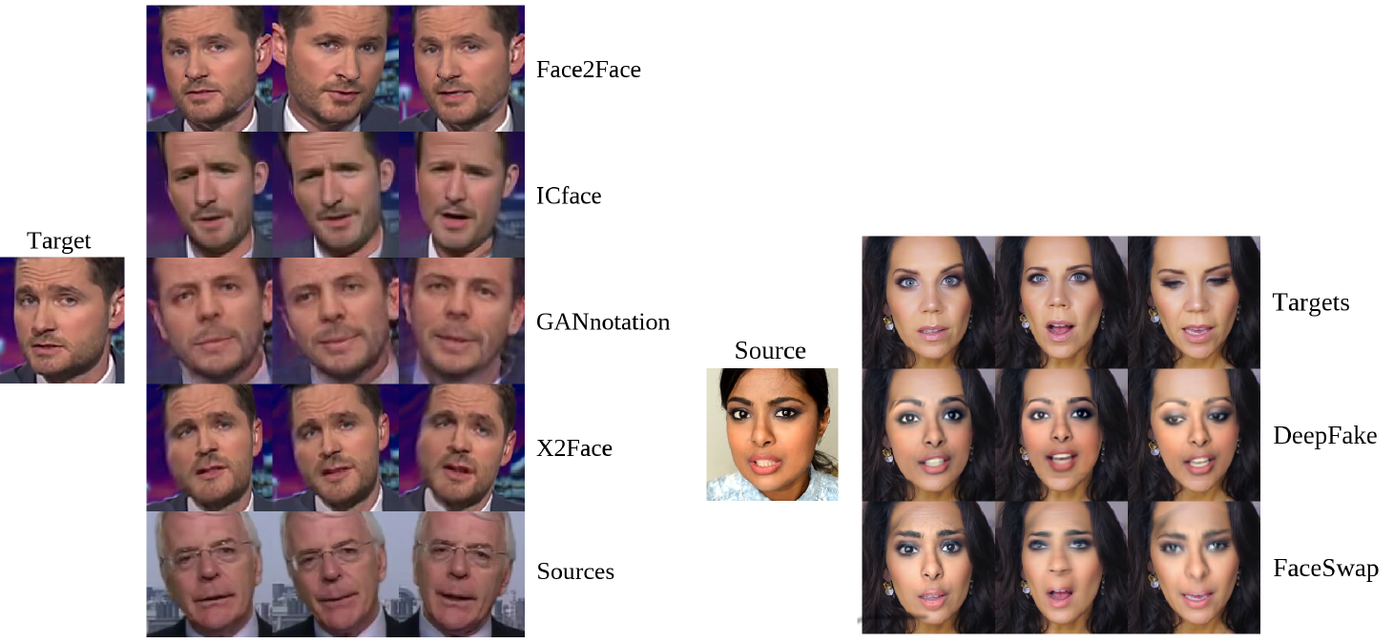
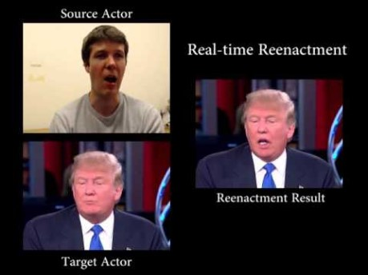
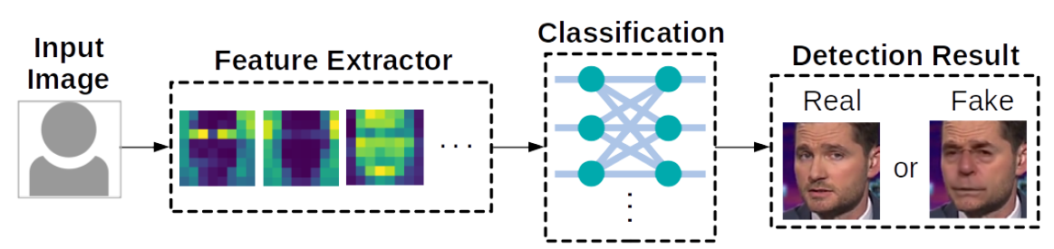
Deepfake
  Defend against facial forgery
Face reenactment
Face swapping
Face2Face, CVPR 2016
Architecture of deepfake defense systems
Notes:
Asymmetric advantage over attackers: defenders know more!

Slide 8
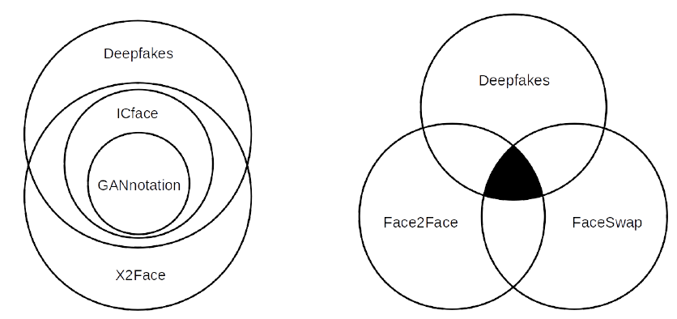
Deepfake Detection
  Limitation of current defense systems
    Cannot defend against unseen attack methods
    Features of different attack methods can be independent
Feature overlap among existing facial forgery techniques [1] (tested on MesoNet)
[1] J. Brockschmidt et al., “On the Generality of Facial Forgery Detection”, Proc of REUNS 2019 (Best Paper)
Notes:
Asymmetric advantage over attackers: defenders know more!

Slide 9
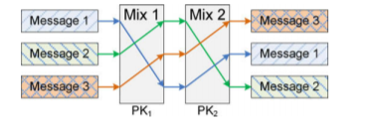
Different Types of Deception
  Perturbation
    Perturb sensitive data with noises
  Obfuscation
    Decoy targets and/or reveal useless info
  Mixing
    Prevent linkability (mixing zone)
  Honey-X
    Disguise honeypots as real systems
  Moving target defense
    Change attack surfaces

Slide 10

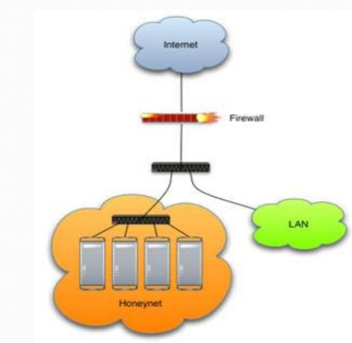

3. Honeypots and Honey-X
  Honeypots
    Bears: honey eaters
    Traps
Honey-X
  Honeynet: two ore more honeypots on a network
  Honeyfile, honeyword, …

Slide 11
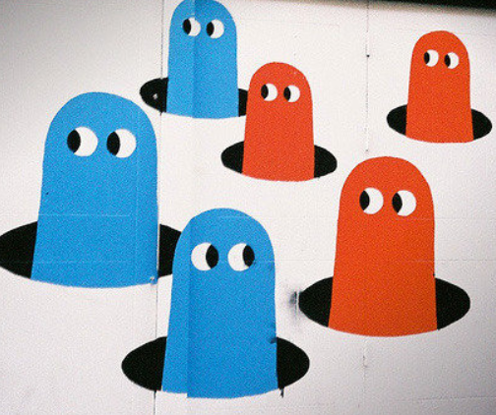
4. Moving Target Defense (MTD)
  MTD
    Controlling change across multiple system dimensions to increase uncertainty and complexity for attackers
    Network: Route change
    Firewall: Policy change
    Host: Address change
    OS: Version/release change

Slide 12
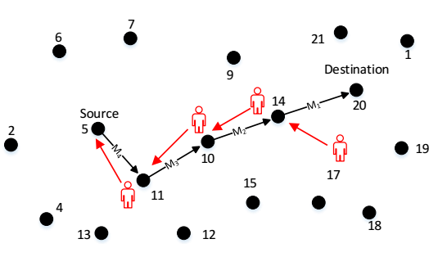
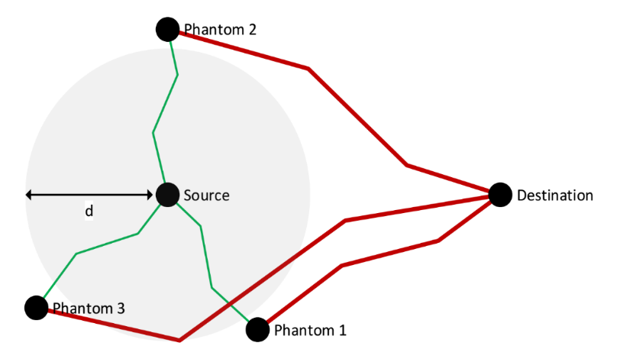
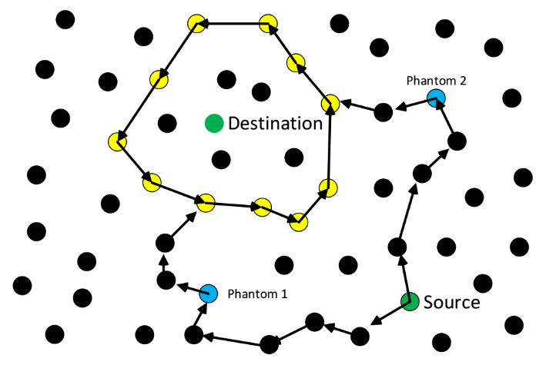
MTD vs. Deception: Intractability
Source and destination location privacy
(Panda-hunter game)
Phantom/Circular Ring Routing

Slide 13
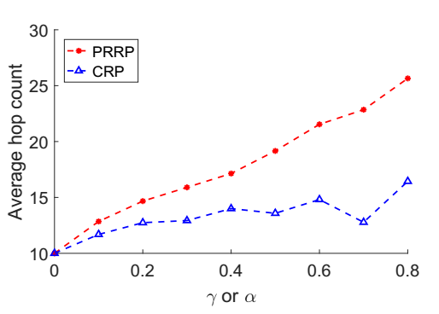
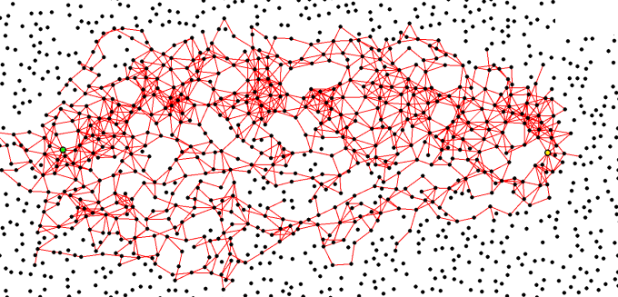
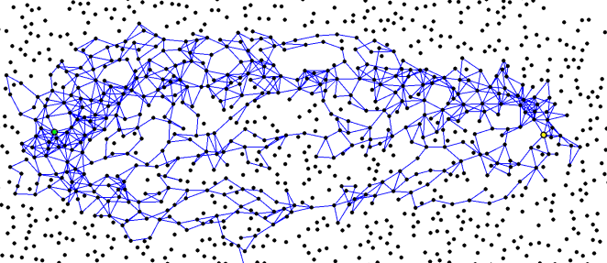
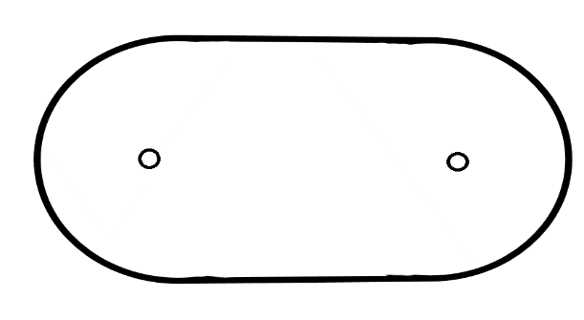
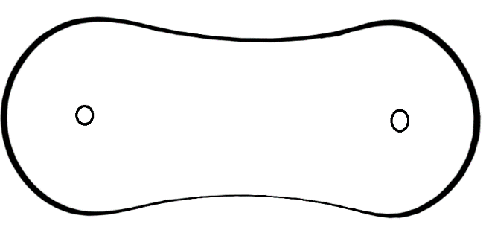
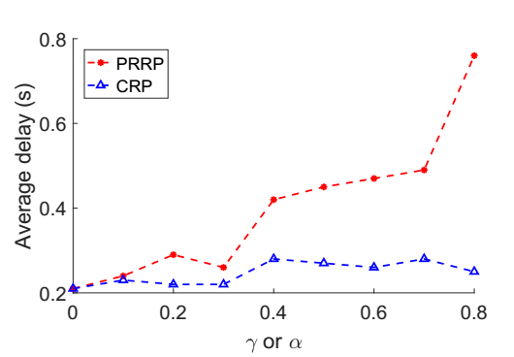
Probabilistic/Controlled Random
Performance gain ^{[2]}
[2] R. Biswas and J. Wu, "Preserving Source and Destination Location Privacy with Controlled Routing Protocol,” IJSN, 2018
Probabilistic Random Routing (PRRP)
More spread out packets
Higher hop count and delay
Controlled Random Routing (CRP)
Less spread in the middle
Lower hop count and delay
NS3 Simulation

Slide 14
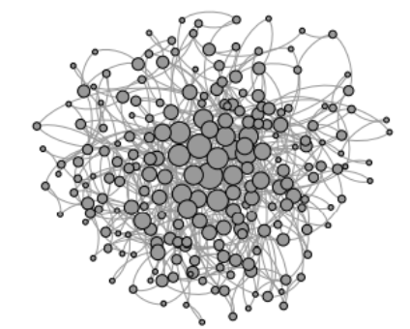
Adaptive Changes
Hierarchical military command chains
Network hierarchy
  SDN controllers: load balance and fault tolerance

Slide 15
Self-Organized Systems
Theory community
Dijkstra’s self-stabilizing system (Dijkstra, 1974)
  An illegitimate state (caused by some perturbations) can be changed back to a legitimate state in a finite number of steps
How can we handle the long convergence time that usually occurs in dynamic labeling in a distributed solution? (ICDCS 2017 ^{[2]})
  [2] J. Wu, “Uncovering the Useful Structures of Complex Networks in Socially-Rich and Dynamic Environments” Proc. of IEEE ICDCS, 2017.

Slide 16

Self-Organizing Solutions
Local decision
P2P and simple interaction (mostly local and without sequential propagation)
Global functionality
Adaptive, robust, and scalable
Principles
P₁: Local interactions with global properties (scalability)
P₂: Minimization of maintained state (usability)
P₃: Adaptive to changes (self-healing)
P₄: Implicit coordination (efficiency)
Agility

Slide 17
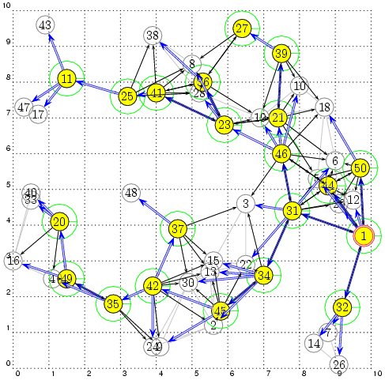
MTD Applications
Connected Dominating Set (CDS)
Local decision:
backbone nodes
based on node priority (ID, degree, …)
Global properties:
Connectivity
Coverage

Slide 18
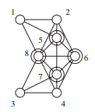
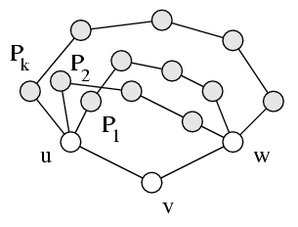
Application: Resiliency and Rotation
Redundancy: K-connected & K-dominated ^{[4]}
  Non-backbone node: K node-disjointed paths for any neighbor pairs (for multiple CDS)
  Moving target defense (MTD): CDS rotation
  [4] F. Dai and J. Wu “On Constructing k-Connected k-Dominating Set in Wireless Networks,” Proc. Of IEEE IPDPS, 2005
Notes:
CIAA: Confidentiality, Integrity, Authentication, and Availability

Slide 19
Self-Healing
How can we deal with the complexity of building a structure along with a change of topology? (ICDCS 2017)
Switched-on/off nodes
  Status changes in 1-hop/2-hop neighbors only
Seamless integration in a dynamic network
  Iterative application of a local solution
on/off
u
Notes:
Guarantees full delivery

Slide 20
5. Game-Theoretic Approaches
Nash game
  Static games and simultaneous move
  Each player chooses a move which is optimal, given the other player’s move
Stackelberg game
  Single-shot dynamic game
  The follower (attacker) moves after observing the leader’s (defender) action
Messaging game
  Single-shot dynamic game
  The sender (defender) sends a message (action) to the receiver (attacker). Message may not be the sender’s type.

Slide 21
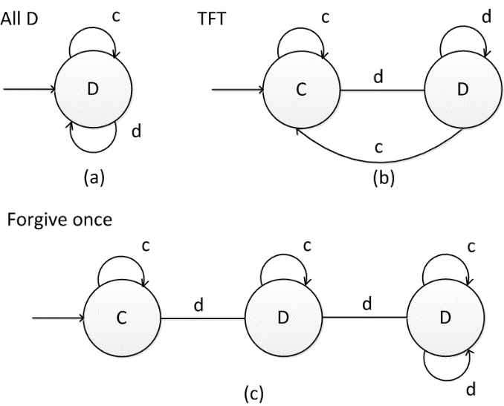

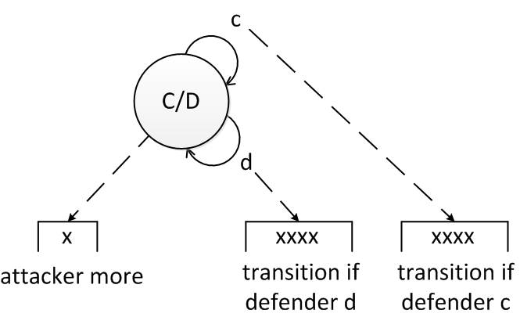
Repeated Nash Game
Repeated prisoner’s dilemma
  Cooperate (C) or Defecting (D)
  Payoff metrics between 1 and 2
Genetic algorithm (ADS 14)
  148 bits for 16 recent states: 9-bit chromosomes
  Mutation and crossover
From Moore machine to timed automata
  Adversary's learning through timing analysis
  Fitness levels with imperfect information
attacker move
Notes:
ADS: Agent Directed Simulation

Slide 22

6. Challenges of Cyber Deception
  Limited Applications
    Projected market to be $1B by 2020
  Isolation
    Fully integrated or separated
  Effectiveness
    How to measure?
  Learning
    Ability of both attackers & users

Slide 23
Limited Applications
  Still limited in cyber deception, why?
  Differences: cyber deception vs. deceptions in warfare
    Domain: cyber vs. physical, social, …
    Time: different scales, logical clock vs. physical clock (i.e., real time)
    Space: virtual space vs. physical space
    Speed: speed of light vs. physical space laws (e.g., movement of a tank)
  Do not understand the attackers well: known vs. unknown
    Know your enemies and know yourself
  How to attract attackers to interact with them in cyberspace?
    It is relatively easy to engage your enemies in a battle field

Slide 24
Isolation
Isolation
  Fake information only for attackers (assuming legitimate users won’t visit)
  Protection layer: detect suspicious users and lead them to fake information
    Feedback to attackers
  Feedback should be carefully designed in order to prevent the attacker from detecting the deception
    Increase the level of deception using return partial valuable data
    Stop deception to avoid exposure of deception schemes

Slide 25
Effectiveness
Key
  Learn the behavior of the attacker: learning theory
  Effectiveness measurement for attackers
  Rate frustration in time and cost
Effectiveness measurement for systems: dependability
  Time and place of attacker’s action
  How much attacker’s resources are wasted (e.g. num. of packets)
  How long before attacker breaks the system/ stop acting
  How much valuable data are breached
  And more…

Slide 26


Measurement
Lord Kelvin: If you cannot measure it, then we cannot improve it
Extended dependability that includes security
  Mean time between security incidents (MTBSI)
  Mean time to incident discovery (MTTID)
  Mean time to incident recovery (MTTIR)
Performability: work completed before the next security breach
Degradation
  B₁: Level 1 breach, 1,000 hrs
  B₂: Level 4 breach, 5 hrs

Slide 27

Learning: Cognitive Biases
Deception is strongly relied
on human psychology
  Cognitive biases
Cultural biases
  Power Distance Index (PDI)
  Uncertainty Avoidance (UAI)

Slide 28
Final Thoughts
Cyber-deception: friend or foe?
Misinformation vs. disinformation
  Disinformation is information that is deliberately false or misleading
  Recent events in HK, Lebanon, Chile, Spain, …
Challenges
  Identifying disinformation is not merely about the truth, but about referring the intent (to mislead)

Slide 29
7. Conclusions
Importance of cyber deception
  Complement to the existing security methods
Self-organized design for agility
  Basic principles and challenges
Future
  A better learning model for attackers/users
    Security vs. ML
  Science of security (S & P 2017)
    Induction and deduction

Slide 30

Questions

