Slide 1
Enabling Reliable and Real-Time Packet Reception
in User-Defined Overlapping LoRa Channels
Author: Fu Yu, Xudong Zhu, Cunchen Hu, Yiduo Wang, Dan Xia, Xiaolong Zheng, Jie Wu
Substitute Presenter: Hang Li
(Tsinghua University)
IEEE SECON 2026
Notes:
Thanks for your brief introduction.
I'm Hang Li from Tsinghua University.
Today I'll present the paper titled Enabling Reliable and Real-Time Packet Reception in User-Defined Overlapping LoRa Channels.
This work is mainly from China Telecom, BUPT, and Temple University.
Due to visa issues, the authors cannot attend the conference in person, so I am presenting this work on their behalf.
I will first introduce the motivation, then explain the key design of Hole, and finally show the evaluation results.

Slide 2



LoRa today
Deployed in various scenarios e.g.,
Production line management in the factory.
Intelligent meter reading in the city.
Soil moisture monitoring in the farmland.
FACTORY
CITY
FARMLAND
Notes:
Let me start with a short background on LoRa.
Nowadays, LoRa has been widely used in factories, cities, and farmland.
For example, it can support production-line management, intelligent meter reading, and soil-moisture monitoring.
Its long-range transmission and low-power design make it very attractive for wide-area IoT deployments.

Slide 3


LoRa primer
Physical layer: Chirp Spreading Spectrum (CSS)
Linear chirp in time-frequency domain.
Modulation and Demodulation
f
f
f
Fast Fourier Transform
Amp
f_{t}
$$×$$
f_{t}
$$=$$
Data
Symbol
f_{t}
t
t
t
f
Orthogonality between different Spreading Factor (SF)
f
SF6
SF7
……
Is LoRa already sufficient to support large-scale connectivity?
SF8
t (ms)
……
0
0.5
2
1
Notes:
In the physical layer, LoRa uses Chirp Spreading Spectrum, or CSS.
In the time-frequency domain, the frequency of a chirp changes linearly with time.
To modulate a symbol, LoRa shifts the initial frequency of the chirp,
so different symbols correspond to different frequency offsets.
During demodulation, LoRa multiplies the received chirp with a downchirp and converts it into a single-tone signal.
Then, by applying FFT, one significant peak appears in the frequency domain, and the peak position indicates the transmitted symbol.
Different spreading factors can provide orthogonal access in one physical channel.
(Click) However, even with this design, is LoRa already sufficient to support large-scale connectivity?

Slide 4
Problem: overlapping channel interference
Massive LoRa devices and limited uplink spectrum inevitably leads to increased packet collisions in overlapping logical channels.
OCI: the interference among multiple overlapping logical channels.
4
Notes:
The answer is no. To date, more than 125 million LoRa devices have been deployed, and this large scale has imposed pressure on the limited uplink spectrum.
In addition, LoRaWAN allows users or operators to freely configure the center frequency.
In real deployments, multiple independent networks may choose partially overlapping logical channels without coordination.
As a result, one gateway may receive collided chirps from overlapping channels.
(Click) We define this type of interference among multiple overlapping logical channels as overlapping channel interference, or OCI.

Slide 5
Problem: overlapping channel interference
OCI: the interference among multiple overlapping logical channels.
Goal: achieve reliable LoRa transmission under OCI
5
Notes:
Now let us look at why OCI is harmful.
If we still use the normal LoRa demodulation process, the target peak in the frequency domain can be masked by the interfering peak.
Once the target peak is hidden or distorted, the gateway may decode the wrong symbol or fail to decode the packet.
Therefore, the goal of this paper is to achieve reliable LoRa transmission under OCI, without requiring all networks to coordinate their channel configurations.

Slide 6
Weakness of existing methods
Category | Key Idea | Failure Cause
Concurrency Demodulation | Leveraging the arrival time of chirps to decouple | Unpredictable onset and offset times for incomplete chirp
Collision Avoidance | Schedule nodes to use single channel in different time | Cannot assign channels for different networks
Intra-channel interference
Overlapping channel interference
Predictable
Unpredictable
Notes:
Before introducing our design, let us look at why existing methods are insufficient.
Many methods focus on resolving packet collisions in LoRa,
but most of them address intra-channel interference instead of overlapping-channel interference.
Existing methods can be roughly divided into two categories.
The first category is concurrency demodulation, which uses the arrival time of chirps to group chirps from the same packet.
However, under OCI, interfering chirps may be incomplete, and their onset and offset times are unpredictable.
The second category is collision avoidance, which schedules nodes to use a single channel at different time slots.
However, when multiple independent networks coexist, it is hard to enforce a shared schedule across them.

Slide 7
Insight: different onset and offset times
Target chirp always have stable time-domain distribution but interfering chirps in partially overlapping channel are not.
Applying signal elimination
Dechirp
+FFT
Dechirp
+FFT
For target chirp, the energy loss is predictable.
For interfering chirps, the energy loss is random.
Notes:
The key insight of this work comes from the difference between target chirps and interfering chirps.
By in-depth analysis, we find that even though the time-domain distribution of all chirps cannot be accurately obtained,
it is stable for the target chirp that fully spans the demodulation window.
In contrast, the interfering chirps from partially overlapping channels are often incomplete,
so their time-domain distributions are unstable.
This difference gives us a chance to identify the target chirp from a collision.
To capture it, we design an operation called signal elimination.
(Click) We eliminate a small part of the signal within the demodulation window, and then observe how the FFT peak changes.
For the target chirp, the energy loss is predictable.
For interfering chirps, the energy loss is more random.

Slide 8
Challenge 1: how to capture target packet?
Packets in same BW confuse the detection of target packet
Frequency shift based
method (Our solution)
Correlation based method
Cannot match upchirp and downchirp for one packet
Construct frequency shift to match upchirp and downchirp
Notes:
However, it is still non-trivial to use signal elimination in practice.
The first challenge is how to capture the target packet.
Interfering packets in the same bandwidth can cause the gateway to miss the target packet during detection.
Existing methods usually use correlation-based detection to identify the preamble and SFD.
However, when packets overlap, this method cannot reliably match the upchirp and downchirp that belong to the same packet.
To address this issue, we propose a frequency-shift-based method.
For each packet candidate, we despread its upchirp and downchirp.
Then we use the peak frequency shift to determine the packet's carrier frequency offset.
If the CFO falls within the expected range, this packet is recognized as the target packet.

Slide 9
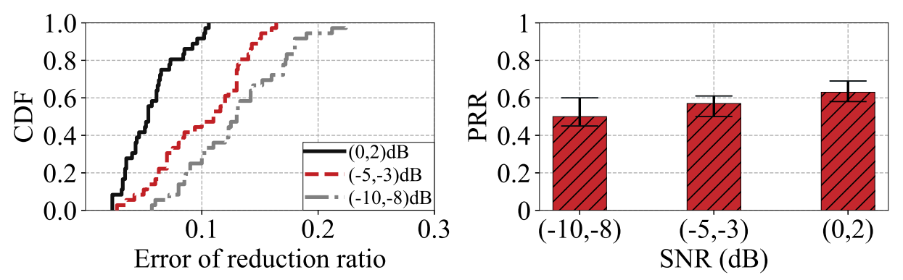
Challenge 2: which elimination is valid?
Invalid signal elimination cause demodulation failure under noise
Notes:
The second challenge is which elimination operation is valid.
Within each demodulation window, if we blindly select the elimination position, the target chirp and interfering chirp may experience similar energy losses.
In that case, their reduction ratios become similar, and channel noise can easily lead to demodulation errors.
Therefore, we need to find elimination positions that create a clear and reliable difference between the target chirp and the interfering chirp.

Slide 10


Challenge 2: which elimination is valid?
Solution: signal elimination modeling
$${\text{t}}_{\text{e}}^{\text{on}}\text{=}{\text{t}}_{\text{i}}^{\text{on}}$$
$${\text{t}}_{\text{e}}^{\text{off}}\text{=}{\text{t}}_{\text{i}}^{\text{o}\text{ff}}$$
Optimal: Signal elimination completely
overlaps with the interfering chirp
$${\text{t}}_{\text{e}}^{\text{on}}\text{\&}{\text{t}}_{\text{e}}^{\text{off}}\text{:}\text{onset} \text{and} \text{offset} \text{time} \text{of} \text{elimination}$$
$${\text{t}}_{\text{i}}^{\text{on}}\text{\&}{\text{t}}_{\text{i}}^{\text{off}}\text{:}\text{onset} \text{and} \text{offset} \text{time} \text{of} \text{interfering} \text{chirp}$$
Notes:
To cope with this challenge, we model the relationship between the position of signal elimination and the resulting energy loss of collided chirps.
Based on this model, we determine the theoretically optimal position of signal elimination.
As shown in the figure on the right, the optimal position means that the eliminated segment completely overlaps with the interfering chirp.
Under this condition, the two chirps produce more distinguishable energy-loss patterns, which helps Hole identify the target chirp.

Slide 11
Challenge 3: how to efficiently achieve valid elimination?
The optimal elimination position cannot be directly obtained
Noise estimation
Measures the SNR of target packet by using 8 upchirps in preamble.
Step size setting
Select suitable step size and interval according to the channel noise.
Candidate position searching
Search the positions used in multiple rounds of elimination.
The onset and offset time of
interfering chirp is unknown.
Our solution: use multiple rounds of elimination to approximate optimal elimination
Notes:
However, the optimal elimination position cannot be directly obtained in practice, because the onset and offset time of the interfering chirp are unknown.
To achieve efficient demodulation, we use multiple rounds of elimination to approximate the optimal elimination.
First, we estimate noise by using the eight upchirps in the preamble to measure the SNR of the target packet.
Second, according to the noise level, we select a suitable step size and search interval.
Third, we search candidate positions for multiple rounds of elimination.
With this design, Hole balances demodulation reliability and computational overhead.

Slide 12
Overview of Hole
Notes:
This slide summarizes the whole workflow of Hole.
After obtaining the I/Q samples from the radio, Hole first detects target packets in the corresponding channel using the frequency-shift-based method.
Then, for each demodulation window, Hole determines suitable positions for signal elimination.
Next, it compares the energy loss after different eliminations to identify the target chirp and recover the data symbol.
Finally, Hole outputs the demodulated data to the upper IoT application.

Slide 13
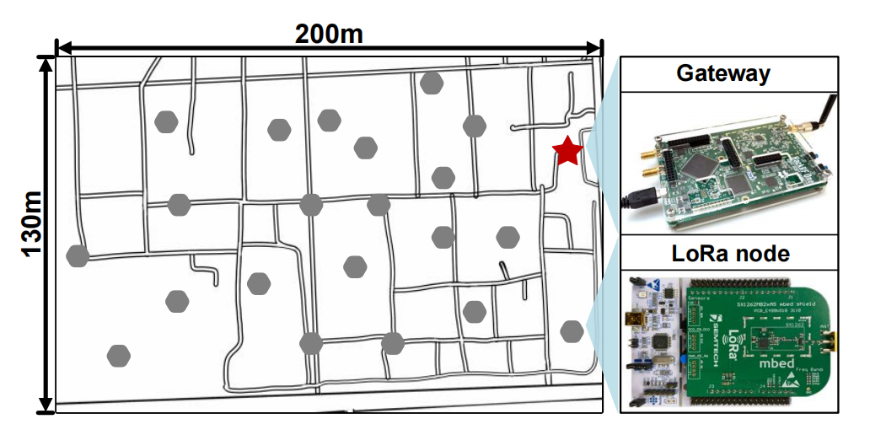
Evaluation: experimental setup
SDR based gateway:
Hardware: USRP B210+PC
Software: GnuRadio.
Commercial LoRa node:
MCU: STM32L073RZ
Transceiver: SX1262.
Baselines for comparison:
CoLoRa (INFOCOM 2020)
CIC (SIGCOMM 2022)
MLoRa (ICNP 2019)
Notes:
We implement the prototype of Hole on an SDR-based LoRa gateway and evaluate it with commercial LoRa nodes.
We use a USRP B210 as the radio front end, and the software part is implemented in GNU Radio.
The LoRa nodes use STM32L073RZ MCUs and SX1262 transceivers.
The whole network contains 20 nodes, and the gateway center frequency is configured to 490 MHz.
For comparison, we implement three representative baselines: CoLoRa, CIC, and MLoRa.

Slide 14
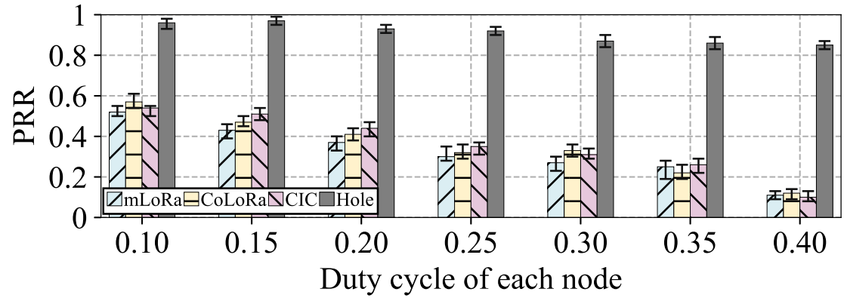
Evaluation: different duty cycle
0.85
0.12
Hole can significantly improve the transmission reliability.
Notes:
Now let us look at the evaluation results under different duty cycles. We compare Hole with three baselines as the duty cycle increases from 0.10 to 0.40.
As expected, the PRR of all four methods decreases when the duty cycle becomes higher, because higher duty cycles lead to more frequent packet collisions.
However, the degradation of the baselines is much more severe.
When the duty cycle reaches 0.40, the PRR of MLoRa, CoLoRa, and CIC drops to only 0.11, 0.12, and 0.10.
The key reason is that these methods rely on accurate timing or complete chirp features, which are difficult to obtain under OCI.
In contrast, Hole still achieves a PRR of 0.85, demonstrating much higher reliability under heavy overlapping-channel interference.

Slide 15
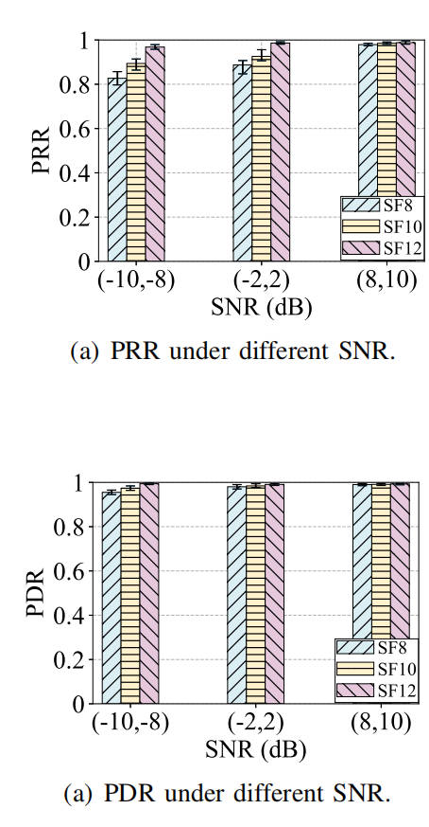
Evaluation: different SNR
Hole can achieve stable performance under different SNR.
Notes:
We further evaluate the performance of Hole under different SNR levels.
In this experiment, all LoRa nodes transmit packets with a fixed duty cycle of 0.20.
We calculate the PRR and PDR of target nodes under different spreading factors and SNR levels.
The left figure shows that Hole maintains stable demodulation performance across a wide range of SNR and SF settings.
This is important because practical LoRa deployments often experience dynamic channel conditions.
The right figure shows that Hole can maintain high packet recognition accuracy, which provides a solid foundation for the subsequent demodulation process.

Slide 16
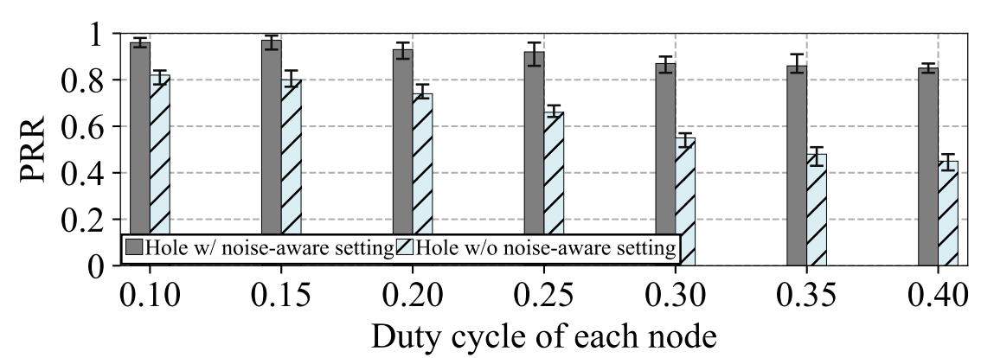
Evaluation: ablation study
The noise-aware elimination searching is efficient.
Notes:
We also conduct ablation experiments to evaluate the effectiveness of the key module in Hole.
Here we focus on the noise-aware elimination setting, which adaptively determines signal elimination positions according to dynamic channel noise.
The result shows that this module can significantly improve PRR.
This confirms that simply applying signal elimination is not enough.
The elimination strategy must be aware of the noise level, so that it can choose a proper search interval and avoid invalid positions.

Slide 17
Conclusion
The contribution of this paper is summarized as follow:
We reveal overlapping channel interference (OCI) in LoRa.
We propose Hole, which constructs the feature for decoding by the novel operation named signal elimination that can extract the differences in chirps' time-domain distributions.
Compared to state-of-the-art methods, Hole improves PRR by up to 7.5× under the impact of OCI.
Notes:
To conclude, the contributions of this paper are summarized as follows.
First, we reveal overlapping channel interference in LoRa, an important problem in dense and independently deployed LoRa networks.
Second, we propose Hole, which constructs a new decoding feature through signal elimination.
Third, compared with state-of-the-art methods, Hole improves PRR by up to 7.5 times under the impact of OCI.

Slide 18
Thanks for listening!
Q&A
Email: yufubupt@163.com
Notes:
That is all for my presentation.
Thanks for listening.
I would be happy to take questions.

