Slide 1



Federated Learning Framework with Personalized
Model Compression and Privacy Protection
Chenlin Ding¹, Mingjun Xiao¹ , Yin Xu¹, and Jie Wu²
¹University of Science and Technology of China
²Temple University
Notes:
Good afternoon, everyone. My name is Yin Xu, and I’m from the University of Science and Technology of China. It is my pleasure to present our work today, Federated Learning Framework with Personalized Model Compression and Privacy Protection

Slide 2
Outline
Background & Motivation
Related Work & System Model
PCM & OPM
Evaluation & Conclusion
Notes:
here is the outline.

Slide 3
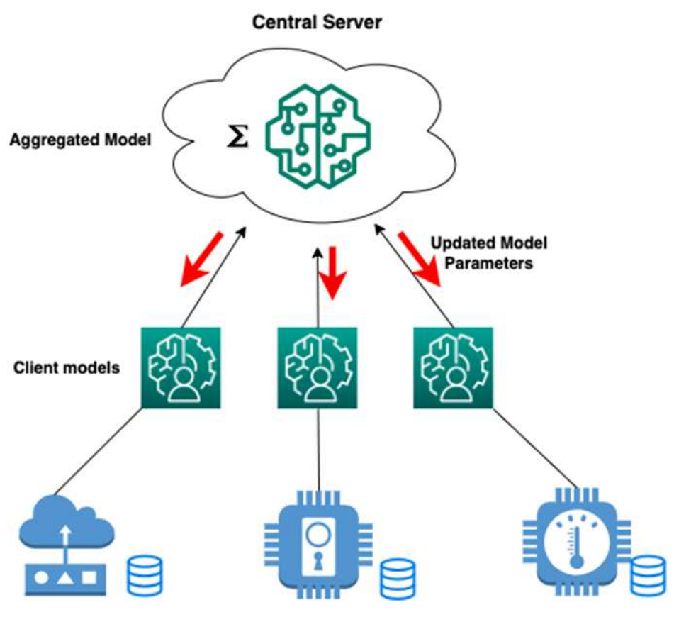
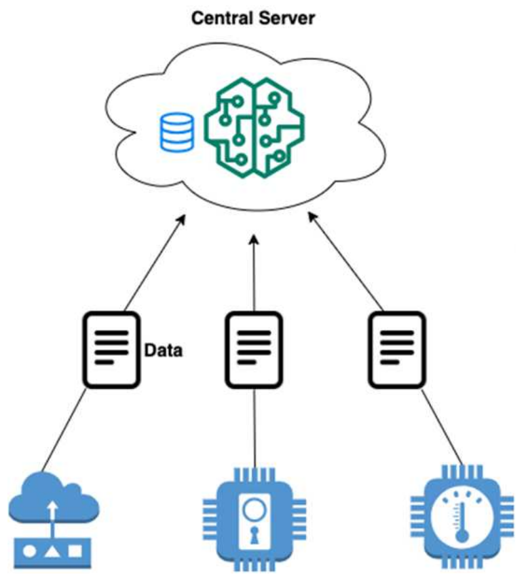
Background
Centralized learning
Federated learning
High privacy risks
High communication costs
Not suitable for heterogeneous equipment
Protect data privacy
Reduce communication overhead
Adaptable to heterogeneous equipment
3
Notes:
In recent years, the proliferation [prəˌlɪfəˈreɪʃn] of smart devices and distributed applications has led to explosive data growth, causing severe silos[ˈsaɪləʊz] across terminals and institutions. Privacy regulations further restrict data sharing, and centralized training suffers from high bandwidth use, latency issues, and single-point risk. Therefore, a distributed machine learning paradigm, federated learning, is proposed. Its core advantage lies in preserving user privacy through local data processing, and enhancing model generalization by using diverse distributed datasets.

Slide 4


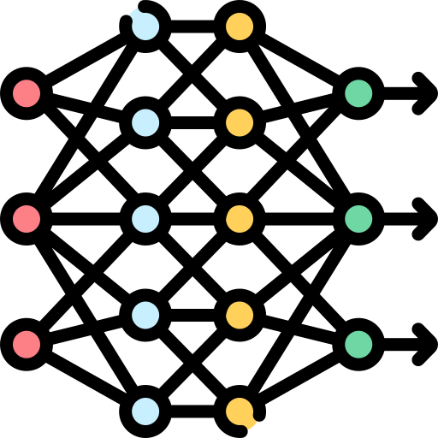
Motivation
Communication Overhead
Privacy protection
High update cost: Uploading gradients consumes significant bandwidth
Network heterogeneity: Diverse client conditions hinder unified strategies
Security risks: Updates must stay confidential despite potential attacks
Noise trade-off: Noise ensures privacy but may reduce accuracy
Fewer model parameters
Noise disturbance
Model Accuracy
How to balance?
Reduce
4
Notes:
However, FL often requires multiple rounds of communication, resulting in a lot of communication overhead. Meanwhile, Privacy protection is another crucial aspect of FL. Differential Privacy is a mainstream technique for privacy protection. By using model compression, we can cut down the amount of data that needs to be shared each round. This helps protect privacy during transmission, since there’s less information that could leak. With better privacy at this stage, we can give clients a higher privacy budget, which means stronger protection without hurting model quality. But the hard part is finding a smart way to compress that still keeps a good balance between privacy, performance, and communication costs.

Slide 5
Outline
Background & Motivation
Related Work & System Model
PCM & OPM
Evaluation & Conclusion
Notes:
Then, I will introduce related work and our system model.

Slide 6

Related Work
Goal: To find the best balance between communication overhead and model accuracy while protecting user privacy
Privacy protection
Communication Overhead
[3] WANG W, LI Y, LIU T, et al. User-level privacy-preserving federated learning: Analysis and performance optimization[C]//Proceedings of the AAAI Conference on Artificial Intelligence: Vol. 34. 2020: 7085-7092.
[4] HANG L, ZHU T, XIONG P, et al. A robust game-theoretical federated learning framework with joint differential privacy[J]. IEEE Transactions on Knowledge and Data Engineering, 2022, 35(4): 3333-3346.
[1] ERNSTEIN J, WANG Y X, AZIZZADENESHELI K, et al. signsgd: Compressed optimisation for non-convex problems[C]//International Conference on Machine Learning. PMLR,2018: 560-569.
[2] IANG Z, XU Y, XU H, et al. Heterogeneity-aware federated learning with adaptive client selection and gradient compression[C]//IEEE INFOCOM 2023-IEEE Conference on Computer Communications. IEEE, 2023: 1-10.
2
1
6
Notes:
Most existing work looks at either compression to save communication or differential privacy for security — but not both together. And very few consider how to balance between communication overhead and model accuracy while protecting user privacy

Slide 7
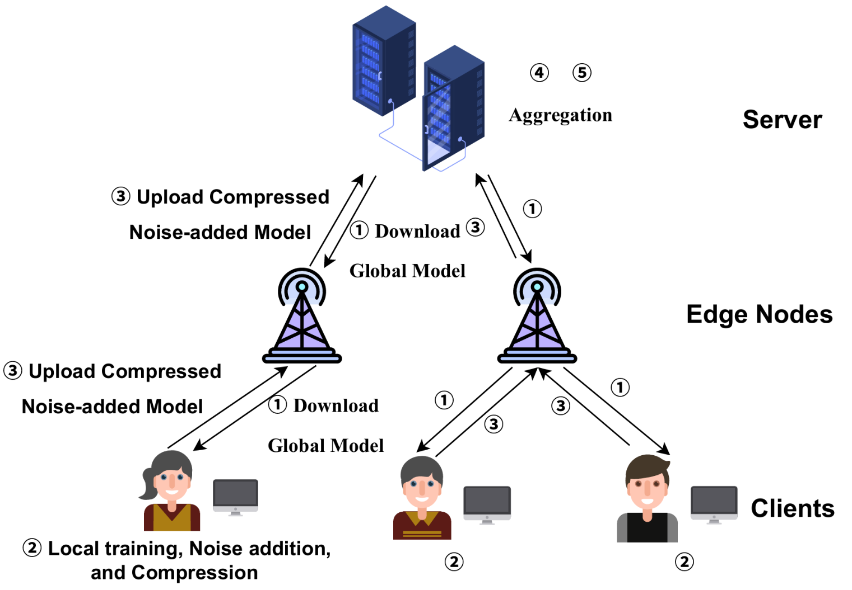

System Model
System Model
Global Model $w_{t}$
Client 𝑖: local dataset → local training
Edge Aggregation ​ ${\overset{\sim }{w}}_{j}^{t}$
Local Model $w_{i}^{t}$: Client 𝑖’s locally trained and compressed model
Noisy Model ${\overset{\sim }{w}}_{i}^{t}$: Compressed model with added differential privacy noise
Compression Rate $γ_{i}^{t}$: Dynamically adjusted compression ratio per client
Reward $R_{i}^{t}$, $R^{t}$: Incentives for clients based on contribution and privacy
7
Notes:
Considering the limitations of existing works, we propose a new framework, which consists of a server, M edge nodes, and N clients. The server collects model parameters from the N clients for model aggregation, which results in the global model. Note that, each client needs to conduct local training, noise addition and mode compression.

Slide 8

System Model
FedCP: Five Key Steps
1) Global Model Broadcast: The server broadcasts the current global model to selected clients.
2) Local Training & Model Processing: Each client trains the model on local data and applies personalized compression based on a two-stage Stackelberg game.
3) Optimized Privacy Noise Addition: Clients add noise to model updates using an optimized privacy mechanism.
4) Model Upload: Clients send the compressed and privacy-enhanced updates back to the server.
5) Global Aggregation: The server aggregates the received updates to form the new global model.
8
Notes:
More specifically, the workflow of FedCP framework includes five steps: First, The server broadcasts /ˈbrɔːdkɑːst/ the current global model to selected clients. Then, Each client trains the model on local data and applies personalized compression to obtain a compressed model. To protect privacy and prevent sensitive data leakage, the client then applies the designed mechanism to introduce noise to the compressed model. Finally, the server aggregates the received updates to form the new global model. Here, we mainly focus on Steps 2 and 3, and then I will illustrate the Personalized Compression Mechanism (PCM) and the Optimized Piecewise Noise Mechanism (OPM) in a great detail.

Slide 9
Outline
Background & Motivation
Related Work & System Model
PCM & OPM
Evaluation & Conclusion
Notes:
Next, I will introduce the two mechanisms we proposed.

Slide 10

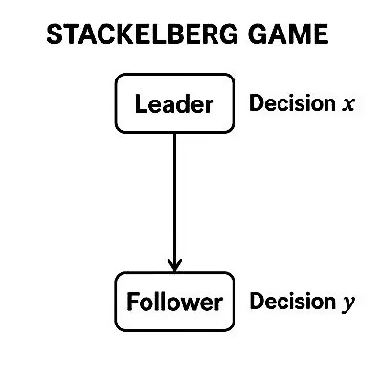


Optimized Piecewise Noise mechanism
Optimization Objectives
  Client-side objective: To balance communication cost and economic reward.
  Server-side objective: To trade off between incentive cost and model convergence speed.
Implementation Steps
  Step 1: Design utility functions for both the server and clients to characterize their optimal decision-making behavior.
  Step 2: Derive the optimal strategy functions for the server and clients based on Stackelberg equilibrium.
10
Notes:
To address the joint optimization of communication cost, privacy protection, and model accuracy, we formulate the problem as a two-stage Stackelberg game. On the client side, the goal is to balance communication overhead and reward—that is, each client aims to minimize its own resource consumption while maximizing the reward it receives. On the server side, the objective is to trade off between the payment and the speed of model convergence. To achieve the two goals, we propose a two-step design approach: Step 1: We define utility functions for both the server and the clients. These functions describe their respective preferences and trade-offs, and guide their optimal decisions. Step 2: Based on Stackelberg equilibrium theory, we derive the optimal strategy functions for both parties, where the server acts as the leader and the clients act as followers. This game-theoretic formulation ensures that both the server and the clients act rationally under their own interests, while still achieving a globally efficient, privacy-aware, and incentive-compatible /kəmˈpætəb(ə)l/ federated learning process.
In federated learning, the server and clients have different objectives: the server wants to achieve high-quality updates with minimal payment, while each client wants to minimize communication and computation costs while maximizing its reward. Modeling this interaction as a Stackelberg game captures the leader–follower dynamic, where the server (leader) first sets the payment and each client (follower) then chooses its compression rate accordingly. This game-theoretic approach forms a unique equilibrium that optimally balances both parties’ utilities.

Slide 11
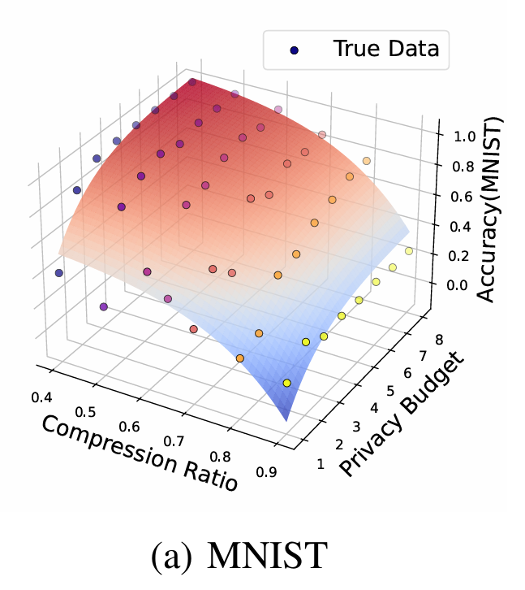
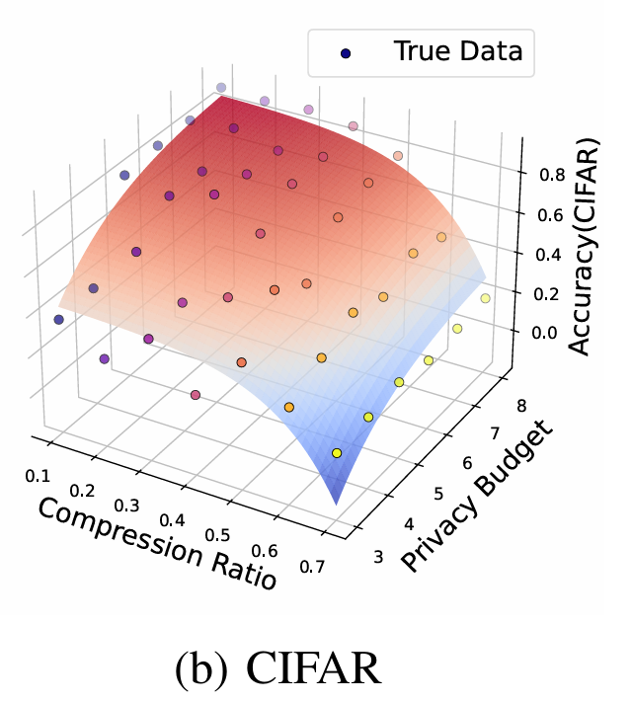

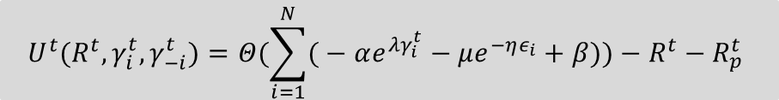
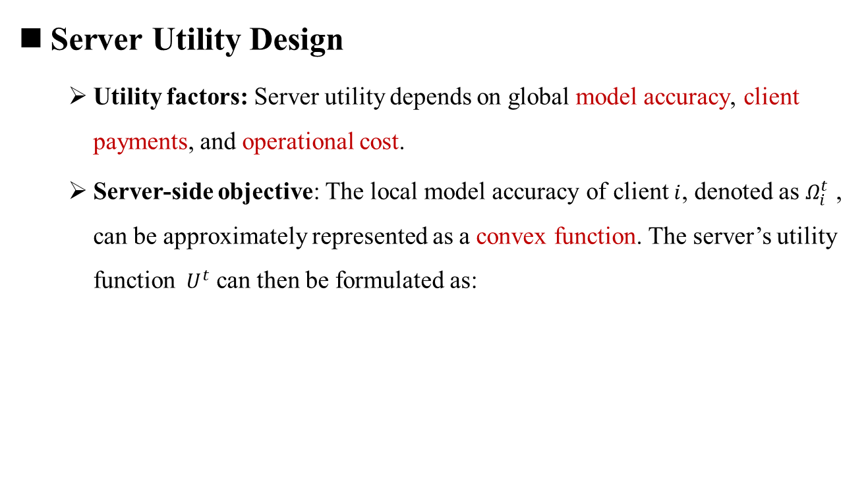
Optimized Piecewise Noise mechanism
Server Utility Design
  Utility factors: Server utility depends on global model accuracy, client payments, and operational cost.
  Server-side objective: The local model accuracy of client $i$, denoted as $Ω_{i}^{t}$​ , can be approximately represented as a convex function. The server’s utility function ${ U}^{t}$ can then be formulated as:
$$U^{t}(R^{t},γ_{i}^{t},γ_{−i}^{t})=Θ(\sum_{i=1}^{N}{(}−αe^{λγ_{i}^{t}}−μe^{−ηε_{i}}+β))−R^{t}−R_{p}^{t}$$
Model accuracy
Reward
Operating costs
11
Notes:
Specifically, the server utility is determined by global model accuracy, total payment to clients, and aggregation overhead. According to the experimental results, we model local accuracy as a convex function of the compression rate and the privacy budget.

Slide 12

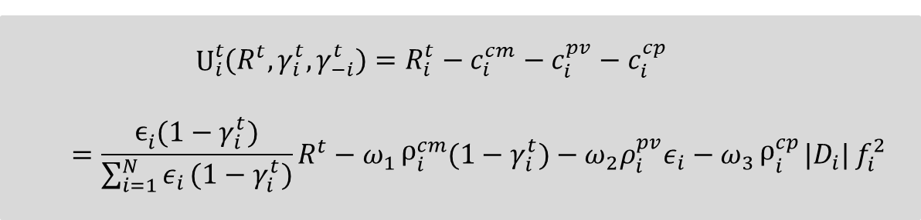

Optimized Piecewise Noise mechanism
Client Utility Design
  Utility function : The utility function ${ U}_{i}^{t}(R^{t},γ_{i}^{t},γ_{(−i)}^{t})$ of client $i$ can be defined as follows:
  Definition: $ω_{j}（j∈\left\{1,2,3\right\}）$are positive adjustment coefficients.
  $$U_{i}^{t}{(R^{t},γ_{i}^{t},γ_{−i}^{t})}=R_{i}^{t}−c_{i}^{cm}−c_{i}^{pv}−c_{i}^{cp}=\frac{ϵ_{i}{(1−γ_{i}^{t})}}{\sum_{i=1}^{N}{ε_{i}}(1−γ_{i}^{t})}R^{t}−ω_{1}ρ_{i}^{cm}{(1−γ_{i}^{t})}−ω_{2}ρ_{i}^{pv}ε_{i}−ω_{3}ρ_{i}^{cp}{|D_{i}|}f_{i}^{2}$$
The obtained reward
Communication costs
Privacy costs
Calculation costs
12
Notes:
Then, client utility considers reward, communication cost, privacy cost, and computation cost, guiding each client to choose a suitable compression rate
that maximizes its own utility under a given payment.

Slide 13


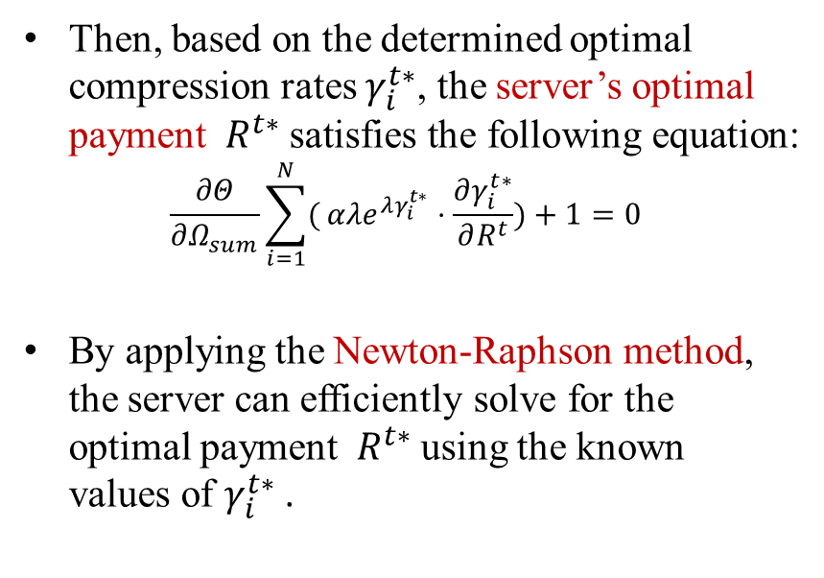
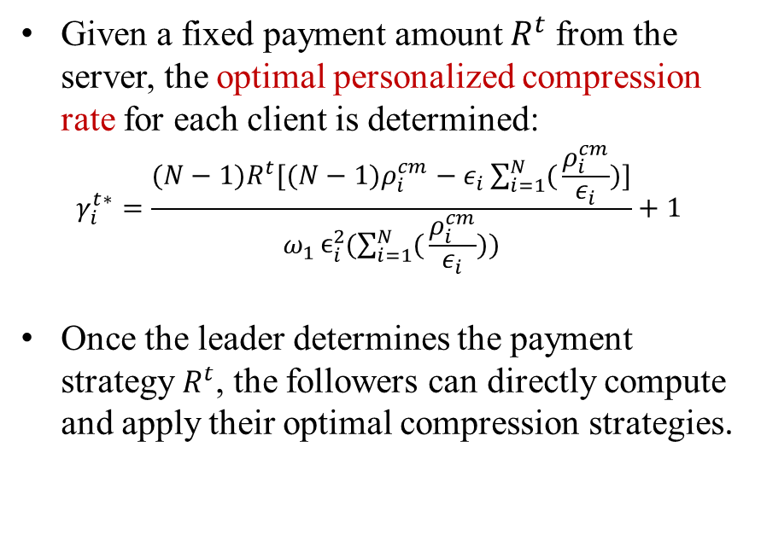
Optimized Piecewise Noise mechanism
Determination of the optimal strategy group
Server
Client
Given a fixed payment amount $R^{t}$from the server, the optimal personalized compression rate for each client is determined:
$$γ_{i}^{t∗}=\frac{(N−1)R^{t}[(N−1)ρ_{i}^{cm}−ε_{i}\sum_{i=1}^{N}{(}\frac{ρ_{i}^{cm}}{ε_{i}})]}{ω_{1}ϵ_{i}^{2}{(\sum_{i=1}^{N}{(}\frac{ρ_{i}^{cm}}{ε_{i}}))}}+1$$
Once the leader determines the payment strategy $R^{t}$, the followers can directly compute and apply their optimal compression strategies.
Then, based on the determined optimal compression rates $γ_{i}^{t∗}$, the server’s optimal payment ${ R}^{t∗}$satisfies the following equation:
$$\frac{∂Θ}{∂Ω_{sum}}\sum_{i=1}^{N}{(}αλe^{λγ_{i}^{t∗}}⋅\frac{∂γ_{i}^{t∗}}{∂R^{t}})+1=0$$
By applying the Newton-Raphson method, the server can efficiently solve for the optimal payment ${ R}^{t∗}$using the known values of $γ_{i}^{t∗}$​.
$$γ_{i}^{t∗}$$
$${ R}^{t∗}$$
13
Notes:
Next, the key is how to determine the optimal strategy set for both the server and the clients. To begin with, we assume that the server announces a fixed payment amount $R^{t}$. Under this condition, each client solves for its optimal personalized compression rate to maximize its own utility. After Theoretical Analysis, we are able to derive a closed-form expression. This means that, once the server has made its payment decision, each client can quickly compute its best response strategy. After obtaining all clients’ optimal compression rates, the server can then update its own strategy. Through this two-step process, we reach an equilibrium where both the server and the clients act optimally under their own objectives.

Slide 14
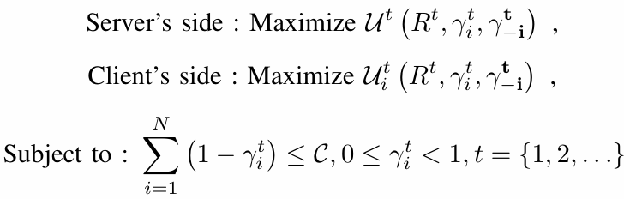
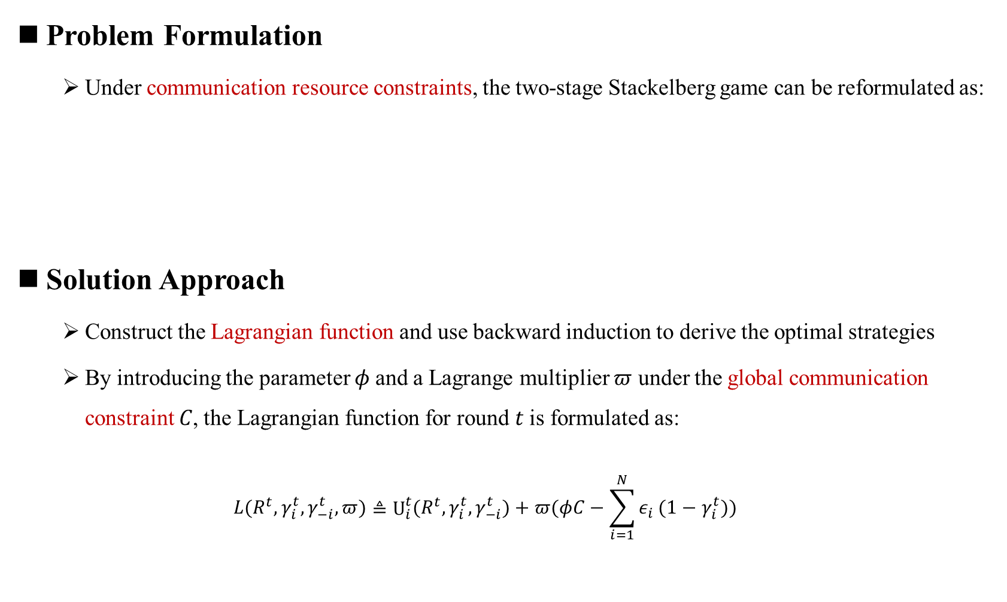
Globally communication-constrained scenario
Problem Formulation
  Under communication resource constraints, the two-stage Stackelberg game can be reformulated as:
Solution Approach
  Construct the Lagrangian function and use backward induction to derive the optimal strategies
  By introducing the parameter 𝜙 and a Lagrange multiplier $π$ under the global communication constraint 𝐶, the Lagrangian function for round 𝑡 is formulated as:
  $$L(R^{t},γ_{i}^{t},γ_{−i}^{t},π)≜U_{i}^{t}{(R^{t},γ_{i}^{t},γ_{−i}^{t})}+π(φC−\sum_{i=1}^{N}{ε_{i}}(1−γ_{i}^{t}))$$
14
Notes:
Next, we further consider a realistic federated learning scenario/səˈnærioʊ/, that is, communication resources are often limited. To solve the game under this constraint, we first construct the Lagrangian/lə'grændʒiən/ function by incorporating the communication constraint. We also introduce a tunable parameter to help balance the trade-off between model performance and communication usage.
Actually, there exists a more challenging problem to be solved. In our problem formulation, our game model assumes full-information play; that is, the parameters of the server and clients are known. However, it may be unrealistic in real-world applications. Moreover, it also may cause privacy leakage risk. Therefore, future work could extend it to the Incomplete Information Game. Moreover, we have evaluated our proposed framework FedCP in simulated environments with up to 120 clients. It still needs validation in larger-scale or unreliable network settings. We will continue to study it in the future.

Slide 15

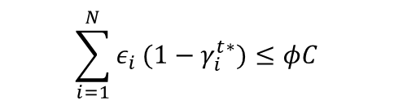

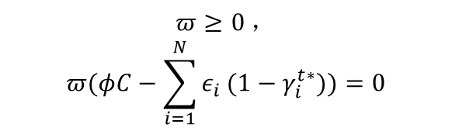

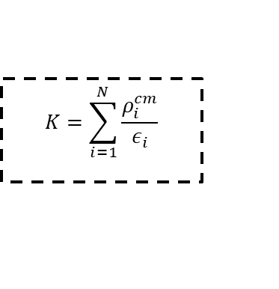
Globally communication-constrained scenario
KKT optimality conditions
Condition 2
Condition 3
Condition 1
$${(\frac{∂L}{∂γ_{i}^{t}})|}_{γ_{i}^{t}=γ_{i}^{t∗}}=0$$
$$π≥0 ，$$
$$π(φC−\sum_{i=1}^{N}{ε_{i}}(1−γ_{i}^{t∗}))=0$$
$$\sum_{i=1}^{N}{ε_{i}}(1−γ_{i}^{t∗})≤φC$$
Theorem: Under any given payment amount $R^{t}$and communication resource cap 𝐶, the optimal personalized compression ratio $γ_{i}^{t∗}$​for each client 𝑖i can be expressed as:
$$γ_{i}^{t∗}=−\frac{φC}{ε_{i}N}+\frac{φ^{2}C^{2}ω_{1}}{ε_{i}R^{t}}(\frac{ρ_{i}^{cm}}{ε_{i}}−\frac{K}{N})+1$$
$$K=\sum_{i=1}^{N}{\frac{ρ_{i}^{cm}}{ε_{i}}}$$
15
Notes:
Then, we apply backward induction /ɪnˈdʌkʃ(ə)n/ to re-derive the optimal strategy set for both the server and the clients. Here, under the KKT conditions, the client’s optimal personalized compression rate can be re-derived in the form of this expression.

Slide 16
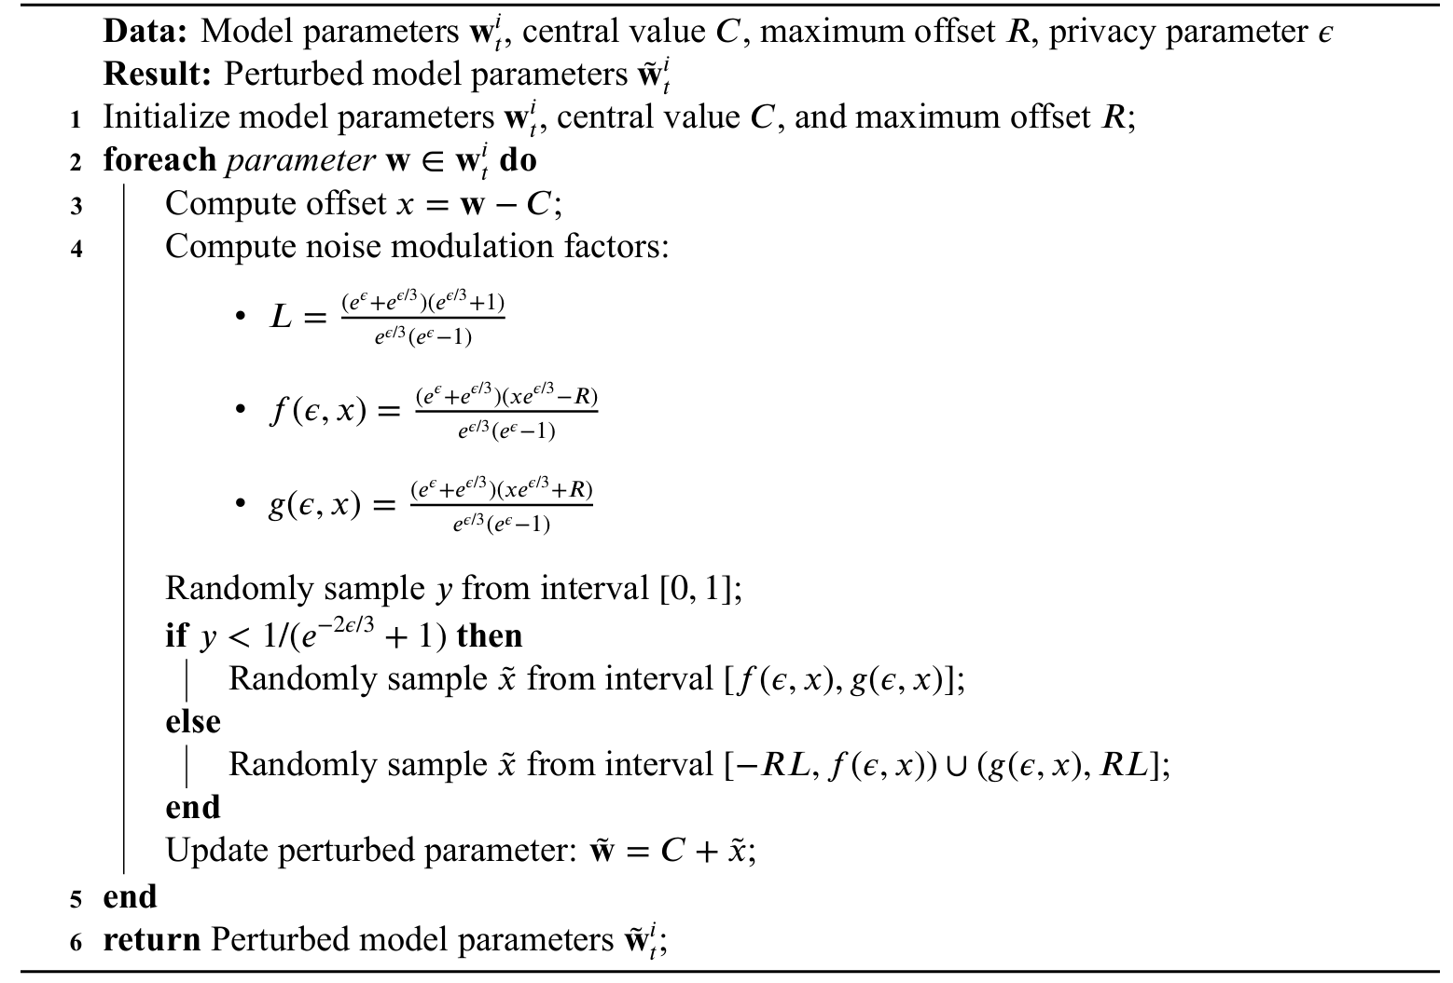
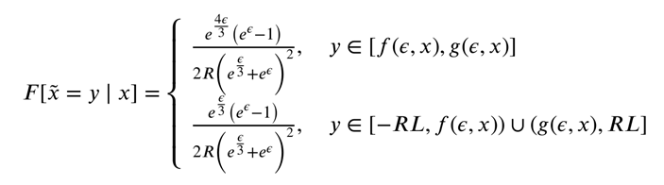

Optimized Piecewise noise Mechanism
These expressions ensure bounded variance and zero-mean noise under privacy guarantee.
High-probability region = Small, Centered Low-probability region = Large noise.
After adding perturbation, parameter becomes $\overset{\sim }{x}$:
16
Notes:
Afterwards, we design an efficient local differential privacy algorithm for clients to protect their privacy. In this process, we not only consider the impact of model compression but also consider how much noise should be added. Specifically, When the privacy budget is large, our method adds noise in smaller parts instead of all at once. We carefully spread /spred/ out the noise to keep it unbiased, but with less overall impact. This way, we get better model performance compared to standard methods.

Slide 17
Outline
Background & Motivation
Related Work & System Model
PCM & OPM
Evaluation & Conclusion
Notes:
Finally, we present the evaluation results and summarize our work.

Slide 18

Evaluation
Experimental Settings
MNIST
CIFAR10
The total number of clients N is chosen from the range [40,120]
Privacy budget is chosen from the range [1,10]
M = N⁄2, ωⱼ = 1 (j ∈ {1, 2, 3}),
and $R_{p}^{t}$ = 600
Real Dataset
Compared Algorithms
No Compression and No Privacy
PM
Laplace algorithm
Parameter settings
18
Notes:
There are some simulation settings.

Slide 19
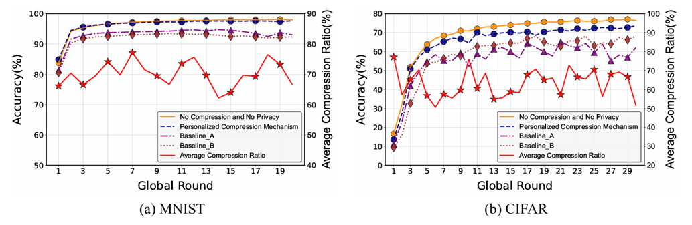
Evaluation
Simulation experiments of PCM
  Comparative Experiments
    Baseline_A: Uses average compression rate of all clients in the current round
    Baseline_B: Uses fixed global average compression rate across all rounds
Significant improvement in model performance and stability
Achieves 70% avg. compression on MNIST, 63% on CIFAR-10
Maintains accuracy with minimal loss
19
Notes:
To evaluate the effectiveness of PCM, we conducted experiments against two baselines. PCM clearly outperforms both baselines in terms of model performance and stability. More importantly, it achieves this while significantly reducing communication costs. These results demonstrate that our personalized approach allows each client to make more efficient use of communication resources without compromising ˈkɒmprəmaɪzɪŋ/
accuracy.

Slide 20
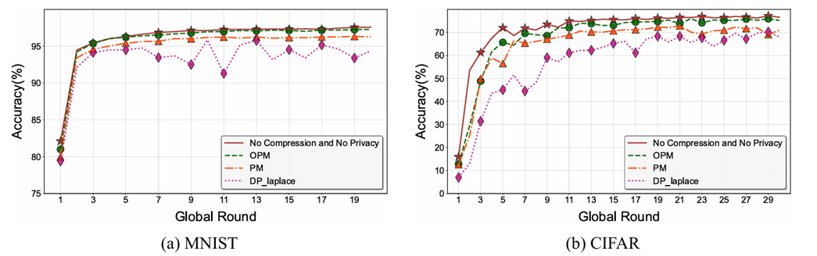
Evaluation
Simulation experiments of OPM
  Comparative Experiments (with compression strategy uniformly using PCM)
    PM: A piecewise noise injection method based on standard perturbation techniques for differential privacy.
    Laplace Mechanism: A privacy-preserving method based on Laplace noise addition.
Higher accuracy & faster convergence
Noise has lower variance, stays closer to original data
Reduces information loss, preserves model quality
20
Notes:
Then, we focus on evaluating the performance of the privacy protection mechanism. We compare OPM against two baseline approaches. Clearly, OPM also outperforms baselines in accuracy and convergence speed due to its lower noise variance. /ˈveriəns/

Slide 21
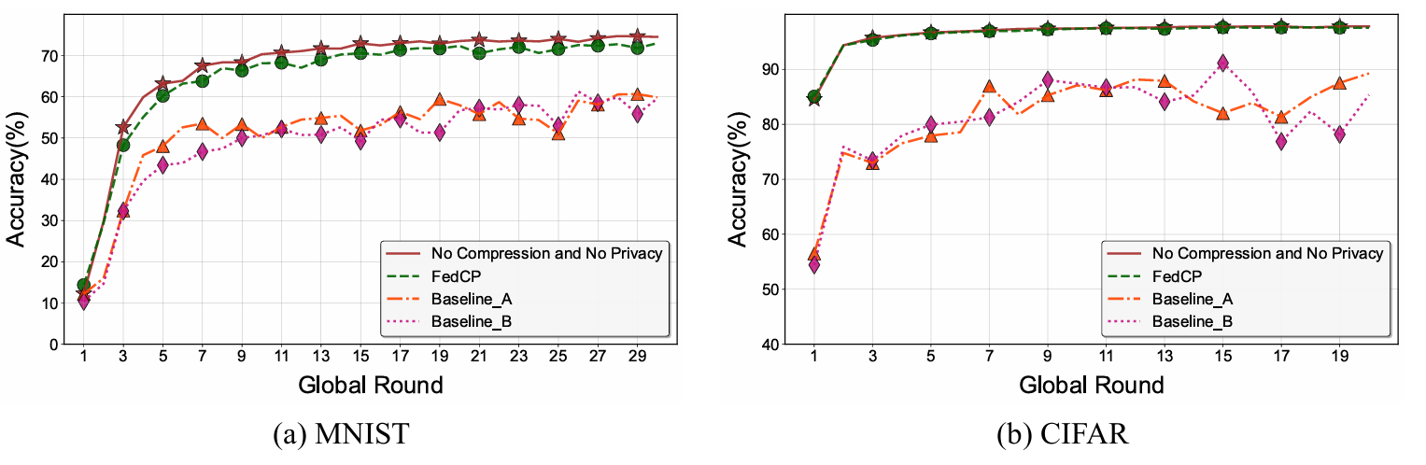
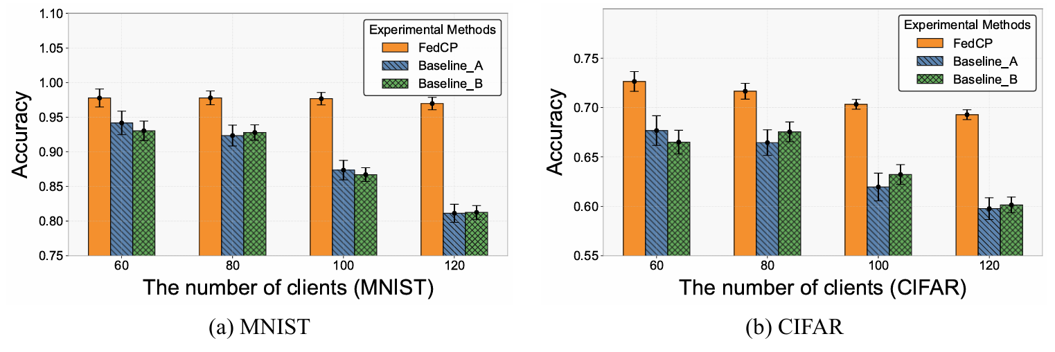
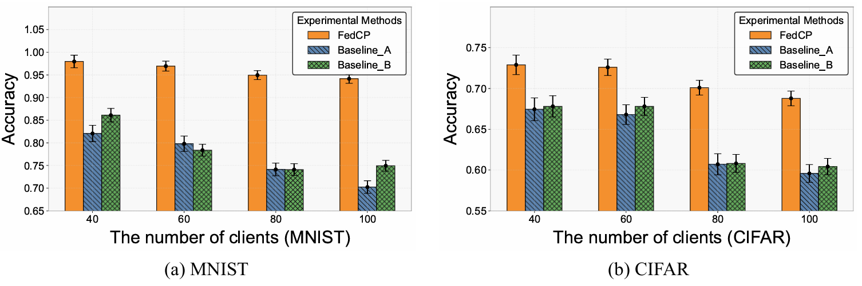
Evaluation
Simulation experiments of FedCP
FedCP improves efficiency with minimal accuracy loss
Performance gap with baseline widens as clients increase
Larger gap under non-IID, showing robustness & adaptability
Iid data
Non-iid data
21
Notes:
Next, we find that FedCP makes communication much more efficient, while keeping model accuracy almost the same as the baseline methods. As we add more clients, FedCP starts to perform better than the others. And in cases where the data isn’t evenly distributed — the non-IID setting — FedCP’s advantage becomes even clearer.

Slide 22
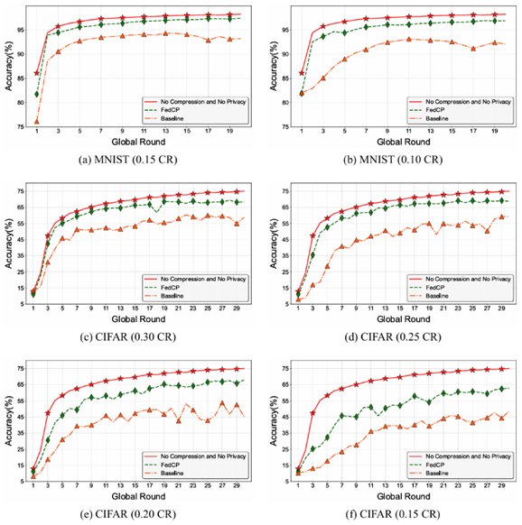
Evaluation
Simulation experiments of FedCP
Baseline: All clients use the same compression rate; PM mechanism is used for privacy.
Higher final accuracy and faster convergence vs. baseline.
Tighter communication constraints widen the performance gap.
22
Notes:
Also, when communication is limited, FedCP performs much better than the uniform compression approach. It not only converges faster but also reaches higher final accuracy — and the tougher /ˈtʌfə(r)/ the communication limits, the bigger the advantage.

Slide 23
Conclusion
Address the dual challenges in federated learning: protecting user privacy, maintaining model accuracy, and reducing communication costs.
Designed using a two-stage Stackelberg game model, allowing each client to adjust compression ratio based on local accuracy, bandwidth, and privacy needs for optimal balance.
01
02
Proposed an optimized piecewise differential privacy method for larger privacy budgets, which controls global model error while ensuring performance.
03
FedCP enables high-accuracy model training under extremely low communication overhead, demonstrating the efficiency and robustness of the framework across various scenarios.
04
23
Notes:
In summary, our work solves two challenges in federated learning: protecting user privacy and reducing communication costs. We design a two-stage Stackelberg game model that allows each client to adjust its compression rate based on local accuracy, bandwidth/ˈbændwɪdθ;, and privacy budget for an optimal balance. We also propose an optimized piecewise differential privacy method /ˈmeθəd/ for larger privacy budgets, which controls the global model error while ensuring high performance. Overall, FedCP enables high-accuracy model training under extremely /ɪkˈstriːmli/ low communication overhead, demonstrating the framework's efficiency and robustness /rəʊˈbʌstnəs/across various scenarios.

Slide 24


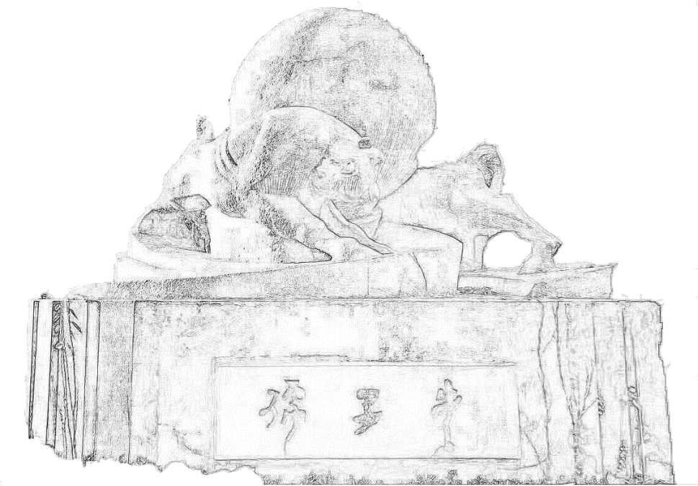
Thank you for your attention!
Question?
Notes:
Thank you for your attention. I look forward to your questions and discussions.

