Slide 1

Uncovering the Useful Structures of Complex Networks in a Socially-Rich and Dynamic Environment
Jie Wu
Center for Networked Computing
Dept. of Computer and Info. Sciences
Temple University

Slide 2
Complex Networks
A complex network (CN) is applicable in many fields
Internet, food web, metabolic networks, and social networks
CN in socially-rich and dynamic environments
Three challenging areas
Graph model
Uncovering a useful structure
Distributed and localized solutions
Different communities
Graph theory, distributed systems (e.g., ICDCS), distributed computing (e.g., PODC), and social networks

Slide 3
Graph Model
Dynamics of CN: node connections change over time, e.g., DTN
Which graph model is suitable for representing a CN?
Intersection graphs: unit disk graphs and interval graphs
Challenges
Hyperedge (ACD in above): a link connecting > 2 vertices
Interval hypergraphs and multiple interval graphs?
Edge density distributions in online social networks?

Slide 4
Graph Model (cont’d)
Time-evolving graph (EG) in (discrete) time and space
EG extends to temporal with new notion of connectivity
Path to journey (a path over time)
Diameter to dynamic diameter (flooding time)
Earliest completion path, fastest path, minimum hop path
Challenges
Macro-level vs. micro-level (probabilistic contact, edge-Markovian)
Granularity control: expressiveness vs. decision power

Slide 5
Uncovering Useful Structure
Structural trimming: trim “useless” nodes and links
Static vs. dynamic, e.g., connected dominating set (CDS)
Challenges
Dynamic trimming in EG with probabilistic contacts
Optimal routing, e.g., multi-bus riding
Forwarding set (FS)
A single-copy message is forwarded to a new contact if it belongs to the FS.
How can we design a methodology to derive an FS?
If message utility is time-sensitive, FS is time-varying.
In a multi-message deliver application, FS is copy-varying.

Slide 6
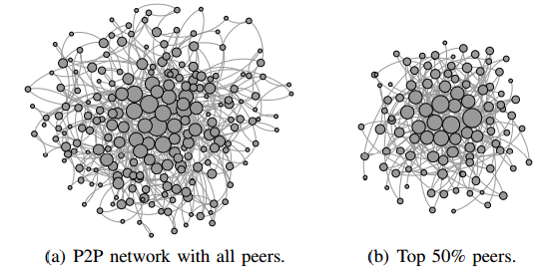
Uncovering Useful Structure (cont’d)
Structural layering
Scale-free (SF): node degree distribution follows power-law
Nested SF: SF hierarchy is done by peeling off lowest degree nodes. All subsequent subgraphs are SF and “similar.”
e.g., small-world behavior of the real world in time-and-space
Can we uncover more inherently layered structures, not
only in the space dimension, but also in time-and-space?

Slide 7
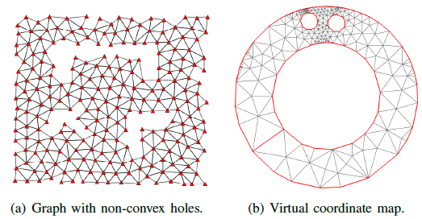
Uncovering Useful Structure (cont’d)
Structural remapping: representation
Geographic routing: conformal mapping using Ricci flow
Greedy routing without being stuck at a local minimum
Mapping from one representation to another: Euclidean space to non-Euclidean space
Can we remap a problem from one domain to another?

Slide 8
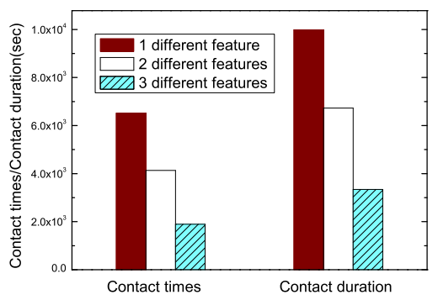
Uncovering Useful Structure (cont’d)
Structural remapping: domain
Converting a routing in a highly mobile and unstructured contact space in DTN to one in a static and structured feature space
How can we uncover the influence that social relationships
have on the structure of an underlying network?
Multi-scale and multi-layer CNs

Slide 9
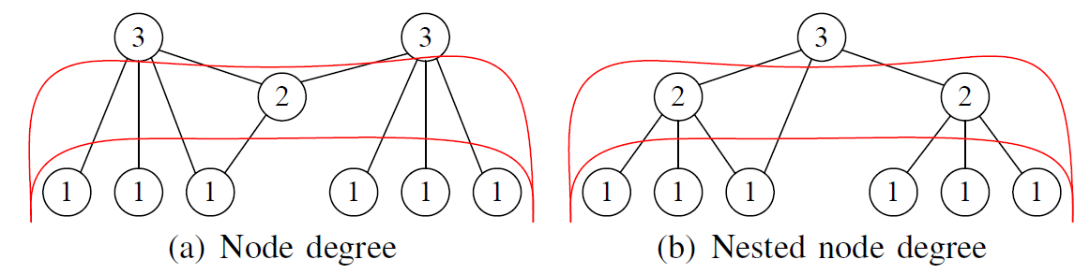
Distributed/Localized Solutions
Static labels: each node is labeled a small number of times
E.g., clustering, maximum independent set (MIS), CDS
Nested SF (single root) vs. regular SF (multiple roots)
Up-and-down routing

Slide 10
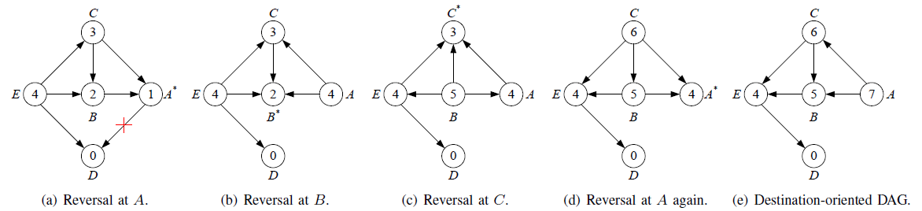
Distributed/Localized Solutions (cont’d)
Dynamic labels: a labeling process where nodes are labeled a large number of times
E.g., Bellmen-Ford algorithm, Page Rank, and HITS
Link reversal (LR): labels associated with nodes as height
Maintaining a destination-oriented DAG upon link failures
Special LR with labels associated with links, still O(n²)

Slide 11
Distributed/Localized Solutions (cont’d)
Type of solutions
Distributed solution (DS): a node’s interaction with others in a restricted vicinity, say k-hop; maintaining and propagating labels
Localized solution (LS): DS without information propagation
Challenges:
How can we deal with the complexity of building a structure along with a change of topology?
View consistency: SDN (central) vs. MANET (distributed)
How do we handle the long convergence time usually occurred in the dynamic label in a distributed solution?

Slide 12
Distributed/Localized Solutions (cont’d)
Hybrid of distributed and localized
E.g., Fault-tolerant routing and broadcasting in hypercubes
Safety levels: special coded labels
Unlike LR, safety level is decided, at most, once. Overall, O(log n)

Slide 13
Conclusions
Several key issues in complex networks
Graph model
Intersection graphs: unit disk graph and interval graph
Time-evolving graphs
Building a useful structure
Trimming, layering, and remapping
Challenges in designing distributed/localized solutions
Static labels and dynamic labels
Hybrid of distributed and localized

