Slide 1


Efficient Symbol-Level Transmission in Error-Prone Wireless Networks
Pouya Ostovari, Jie Wu, and Abdallah Khreishah
Center for Networked Computing
http://www.cnc.temple.edu

Slide 2
Agenda
Introduction
Motivation
Setting
Proposed methods
Single packet
Multiple packets
Multiple packets with network coding
Simulation results
Conclusion

Slide 3
Introduction
Broadcasting in wireless networks
Disseminating data and control messages
Error-prone wireless links
Provide reliability
ARQ
Hybrid-ARQ
Erasure codes
Fountain codes (rateless codes)

Slide 4
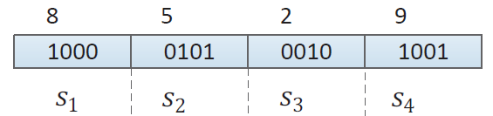
Introduction
Errors in packets
Not binary
Numeric data
Like sensed data by sensor nodes
The important of the symbols (bits) are different
The importance of the symbols should be considered
Choices
Reliable transmissions
Maximizing the expected gain with a fixed given number transmissions

Slide 5
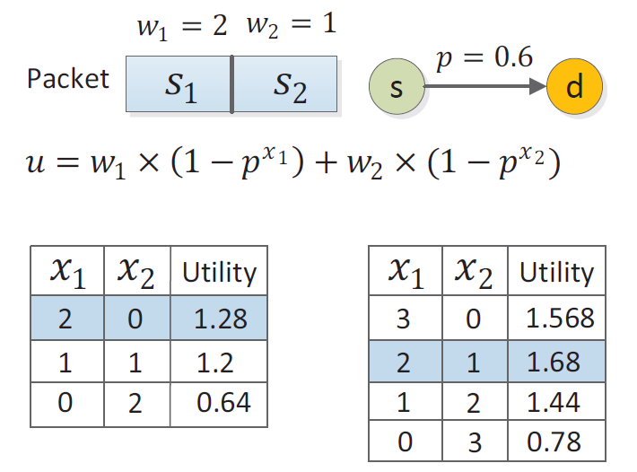
Motivation
2 transmissions
3 transmissions

Slide 6


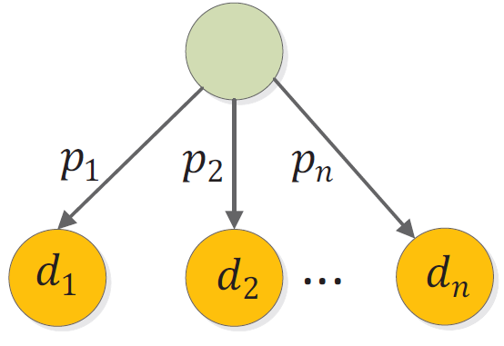
Setting and Objective
One-hop network
Lossy links
Transmission window size
t slots for a packet
Objective: maximizing the total weight of the received symbols

Slide 7
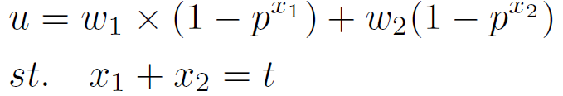
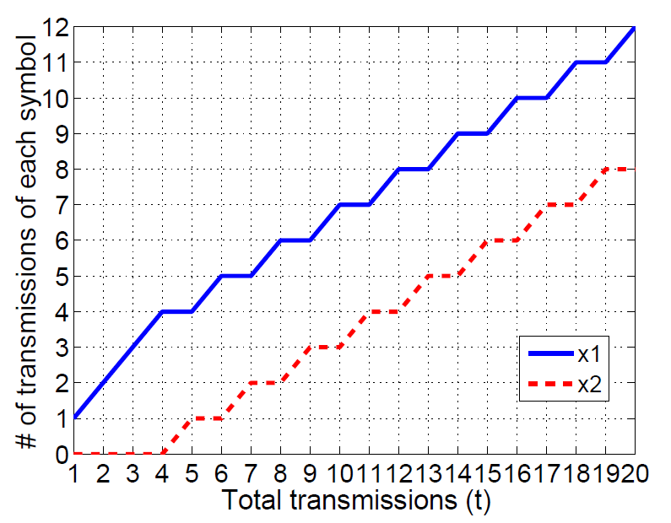


Single Packet (One Destination)
The case of a packet size equal to 2 symbols
Saturation point

Slide 8

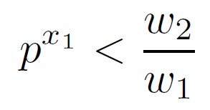
Single Packet (One Destination)
We consider the problem in rounds of transmissions
The first time we should increment is when
After the saturation point, the distribution of the transmissions has a round-robin incrementing pattern
The proof of optimality is provided in the paper

Slide 9






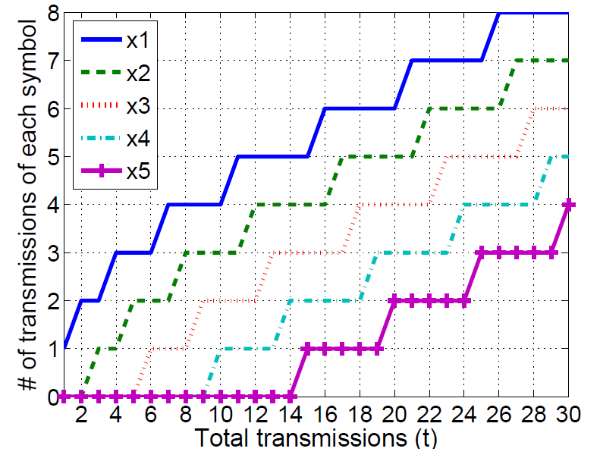



Single Packet (One Destination)
Generalizing to m symbols
We assign the transmissions to until
Then, we distribute the transmissions between and until
After this point, we continue the round-robin pattern among and
In general, we start incrementing when:
The proof of optimality: in the paper

Slide 10



Single Packet (Multiple Destinations)
In the case of different transmission error rates, the round-robin pattern does not exist
Iterative algorithm
We assign the transmissions to the symbols in t rounds
At each iteration we assign the current transmission to the symbol with maximum

Slide 11
Multiple Packets
Our model
The size of the packets are equal
The weights of the i-th symbols in different packets are the same
The problem of sending k independent packets becomes k similar problems with the same solution
We can solve the problem for a single packet, and repeat it for any packet

Slide 12


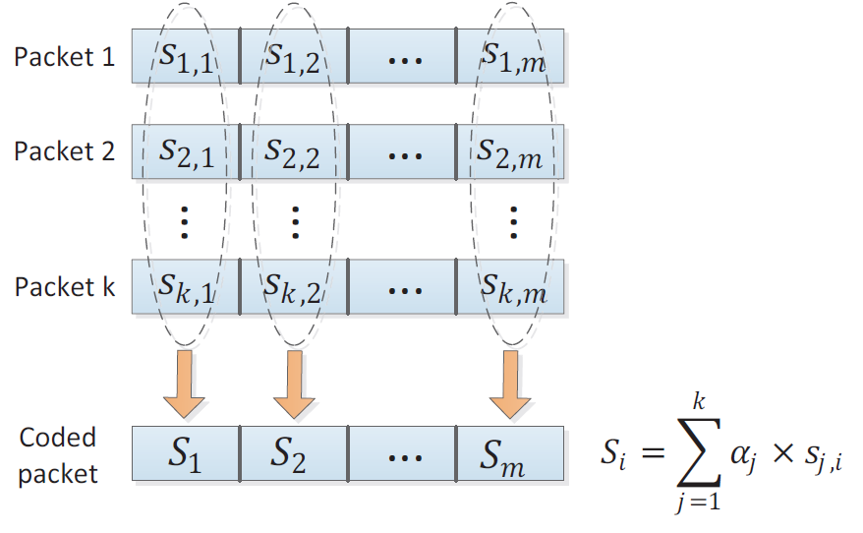
Multiple Packets- with Network Coding
We first find the optimal
We code all of the i-th symbols of the k packets together
Instead of sending the i-th symbols of each packet times, we send coded symbols

Slide 13
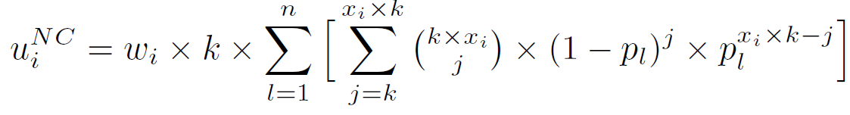
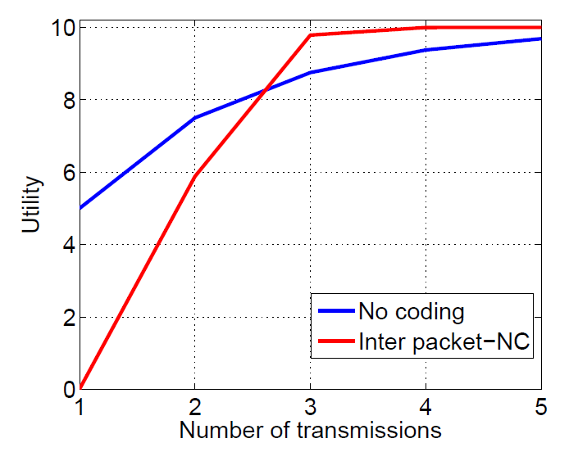

Multiple Packets- with Network Coding
Using network coding might increase or decrease the gain
Since partial decoding is not possible
For each set of the i-th symbols we compare the gain of coding and non-coding
We turn off coding if it decreases the gain

Slide 14

Simulations Setting
MATLAB environment
1,000 random topologies
Different links’ error rates
Weight of the i-th symbol:
Compare with simple retransmission method
Distribute the transmissions evenly to the different symbols of the packets

Slide 15
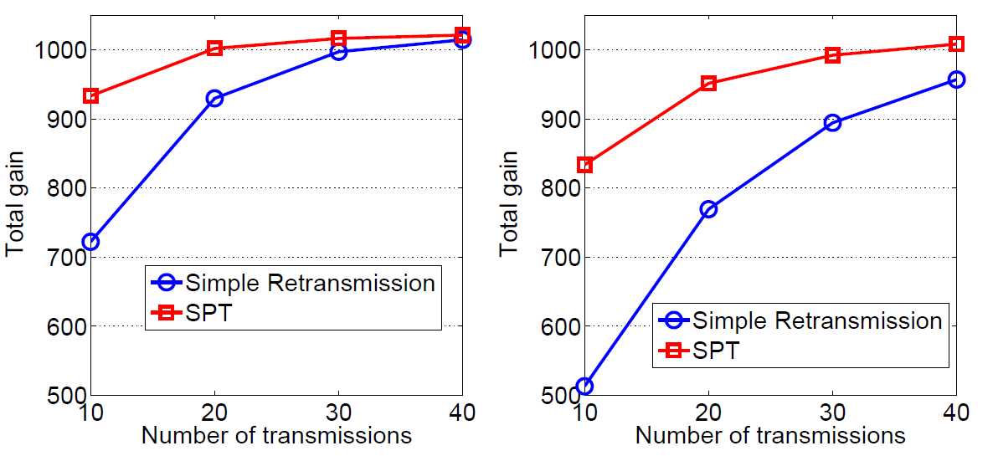


Simulations- (Single Destination)
Single packet- 10 symbols

Slide 16
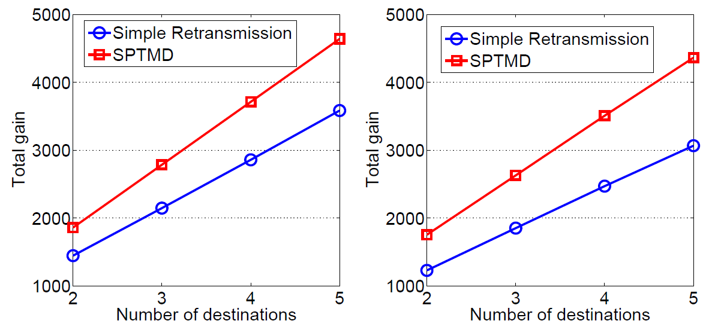


Simulations- (Multiple Destinations)
Single packet- 10 symbols
10 transmissions

Slide 17
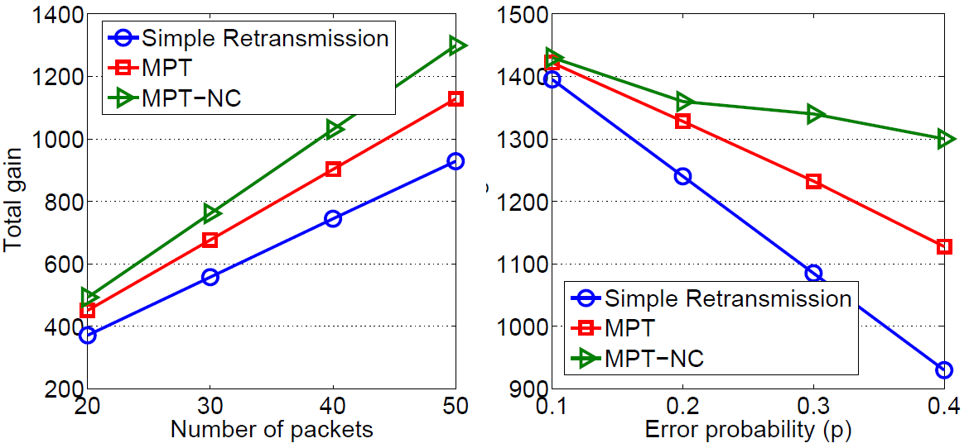

Simulations
Packet size: 5 symbols
10 transmissions
50 packets

Slide 18

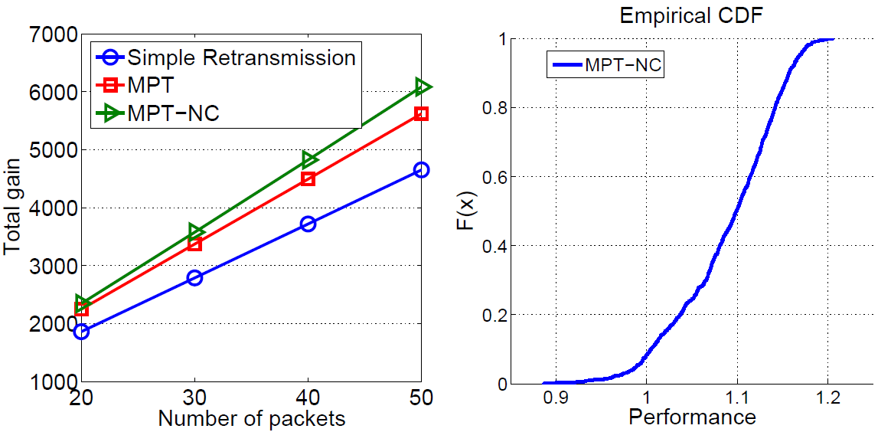
Simulations
Packet size: 5 symbols
5 destinations

Slide 19
Simulations Summary
Our proposed MPT mechanism can increase the gain up to 22% compared to that of a simple retransmission mechanism
Our network coding scheme enhances the expected total gain up to 45% compared to the simple retransmission mechanism

Slide 20
Summary
There is much work on reliable transmissions over error-prone wireless channels
We propose a novel transmission scheme which is based on the importance of the symbols (bits)
Proposed methods
Single packet
Multiple packets
Multiple packets with network coding

Slide 21
Questions

