Slide 1


Fault-Tolerant and Secure Distributed Data Storage Using Random Linear Network Coding
Pouya Ostovari and Jie Wu
Computer & Information Sciences
Temple University
Center for Networked Computing
http://www.cnc.temple.edu

Slide 2
Agenda
Introduction
  Distributed data storages
  Network coding
Setting
  Problem formulation
Fault-tolerant and secure data storage
Evaluations
Conclusions
Notes:
First I will provide an introduction and motivation for our work
Then, I will talk about the benefits on network coding in robustness and throughput enhancement,
and I will talk about our partial results and future work.
At the end, I will conclude my talk

Slide 3



Introduction
Popularity of cloud storages
  More convenient that local copies
    Access from different devices
  Fault-tolerant
    Storing data on multiple storages
    Different geographic location (data centers)
  More secure
    Encryption
    Advanced security mechanisms
  Different versions of files
Notes:
In recent days, we are witnessing a fast development in the hardware technologies of mobile devices
such as tablets and smartphones
As a result of these advances, the mobile devices are becoming very popular
Using wireless connections is more convenient than the wired connections.
Moreover, they can solve the last mile problem

Slide 4
Fault tolerance
Fault tolerance
  Storing redundant data on multiple storages
  More redundancy higher level of protection against storage failure
  More redundancy requires increases the cost
Previous work
  Finding amount of redundancy to achieve a given level of fault tolerance
  Different coding methods
Fault tolerance using network coding
Notes:
In recent days, we are witnessing a fast development in the hardware technologies of mobile devices
such as tablets and smartphones
As a result of these advances, the mobile devices are becoming very popular
Using wireless connections is more convenient than the wired connections.
Moreover, they can solve the last mile problem

Slide 5
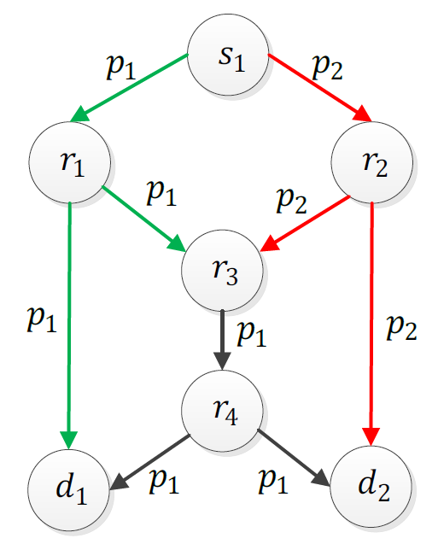
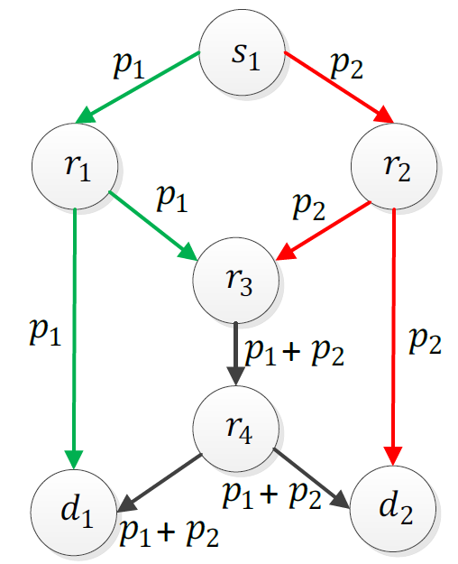
Network Coding in Wired Networks
Single multicast session
  Bottleneck problem (Ahlswede, 2000)
No coding
Coding
Notes:
Network coding first introduced for wired networks and showed that it can solve the bottleneck problem.

Slide 6



Network Coding
Random linear network coding
  Linear combinations of the packets
  3 linearly independent coded packets are sufficient for decoding
  Gaussian elimination
$$q_{1}=α_{1,1}p_{1}+α_{1,2}p_{2}+α_{1,3}p_{3}$$
$${q_{2}=α}_{2,1}p_{1}+α_{2,2}p_{2}+α_{2,3}p_{3}$$
…
$${q_{n}=α}_{n,1}p_{1}+α_{n,2}p_{2}+α_{n,3}p_{3}$$
Notes:
Network coding is a promising method in providing reliable transmissions without using feedback messages
Specifically in Random linear network coding, instead of transmitting the original packets, Linear combinations of the packets are transmitted.
For example, if we have 3 original packets, the form of coded packets will be like this
Where, alpha is a random coefficient
There is a work that shows if we select the coefficients randomly, with a very high probability, any coded packet will be linearly independent to the other coded packets
In this way, the sender keeps transmitting Linear independent coded packets until the destination nodes receive enough coded packets
This advantage of NC motivated me to study it

Slide 7
Network Coding
Applications of network coding
  Reliable transmissions
    Wireless/wired networks
  Throughput/capacity enhancement
    Distributed storage systems
    Content distribution
    Layered multicast
  Providing security
Notes:
Network coding is a promising method in providing reliable transmissions without using feedback messages
Specifically in Random linear network coding, instead of transmitting the original packets, Linear combinations of the packets are transmitted.
For example, if we have 3 original packets, the form of coded packets will be like this
Where, alpha is a random coefficient
There is a work that shows if we select the coefficients randomly, with a very high probability, any coded packet will be linearly independent to the other coded packets
In this way, the sender keeps transmitting Linear independent coded packets until the destination nodes receive enough coded packets
This advantage of NC motivated me to study it

Slide 8
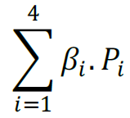

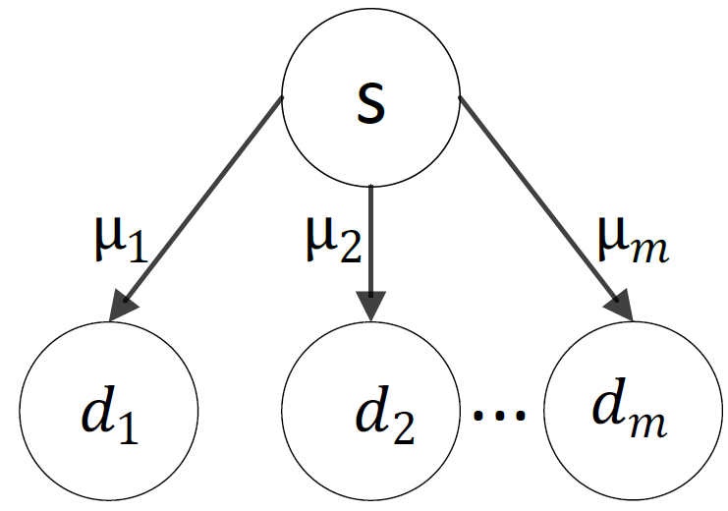
Applications of Network Coding
Transmissions in wireless networks
Intra-flow coding
  Reliability
Notes:
The reliability of the link is 2/3. The source wants to transmit 2 packets to the destination node. With coding, the source on average transmits 3 coded packets and the destination receives 2 coded packets, which are sufficient for decoding. However, without coding, feedback mechanism is required to show the lost packet.

Slide 9


System Setting
Distributed data storage system
  n storages
  Each of these data storages might fail with probability
    Due to power limitation, hardware problems, high workload,…
  Eavesdropper can access the ith data storage with probability
  Storing a file: m packets

Slide 10
System Setting
Objective:
  Providing fault-tolerance and security
  Using random linear network coding

Slide 11
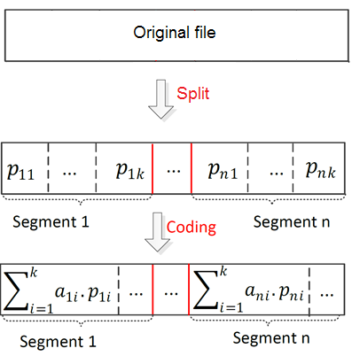
Fault-Tolerant Data Storage using NC
Splitting the original file to segments of the same size
Performing NC among the packets of the same segment
Storing x percent of each segment

Slide 12
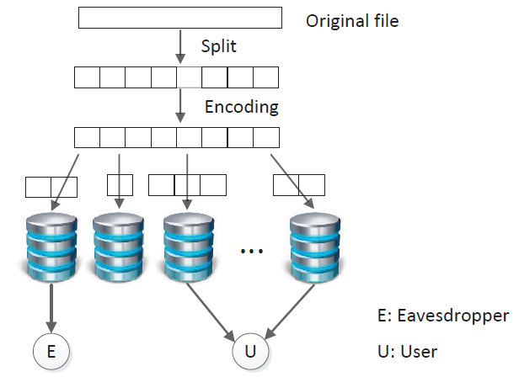
Fault-Tolerant Data Storage using NC
Fault-tolerance vs. security

Slide 13
Fault-Tolerance and Security
Fault-tolerance
  m linearly independent coded packets are sufficient for retrieving the original data
Security
  Eyedropper cannot decode the coded packets unless it has access to m linearly independent packets
Challenge
  More stored coded packets
Trade-off between security and fault tolerance
  More robust against failures
  More vulnerable against eavesdropping

Slide 14
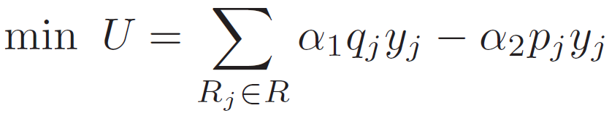

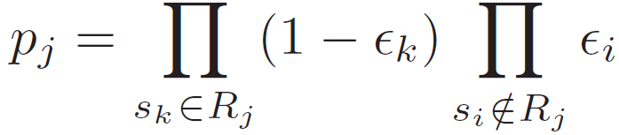
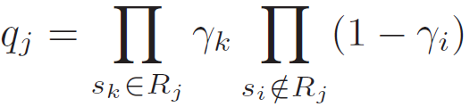
Problem Formulation
Case 1: We define the objective function as a function of fault tolerance and security.

Slide 15
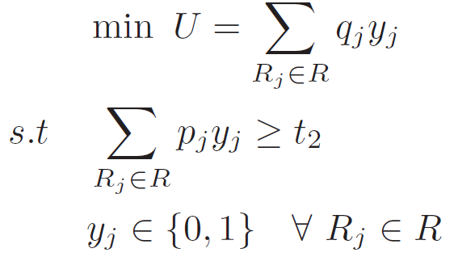
Problem Formulation
Case 2: we fix the fault tolerance into a specific threshold, and set it as a constraint of the optimization.
We then minimize the eavesdropping probability.

Slide 16
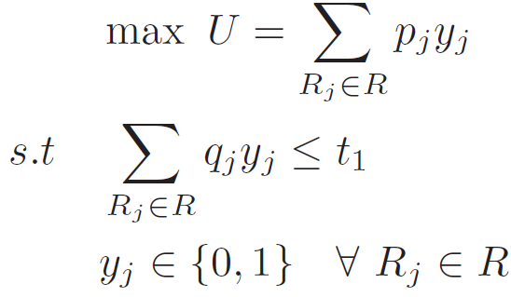
Problem Formulation
Case 3: This is the opposite of Case 2.
We define an eavesdropping probability threshold and set it as a constraint.
We maximize the fault tolerance.

Slide 17
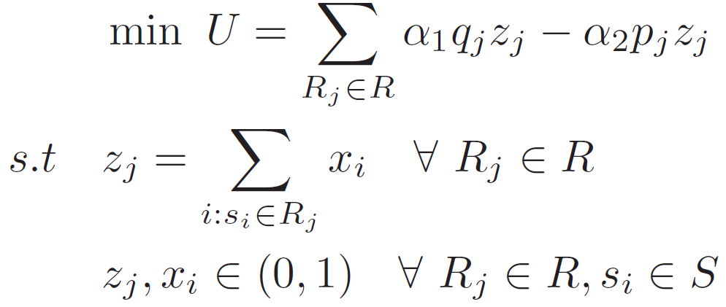
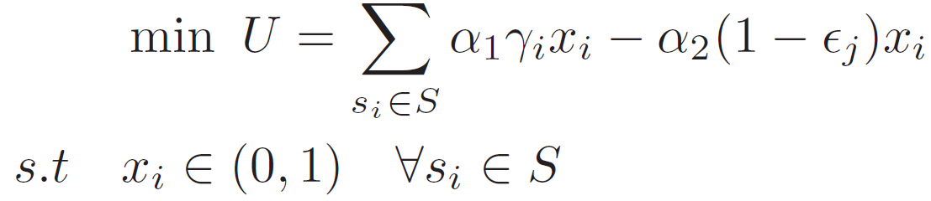
Relaxation to Linear Programming
Case 1:

Slide 18
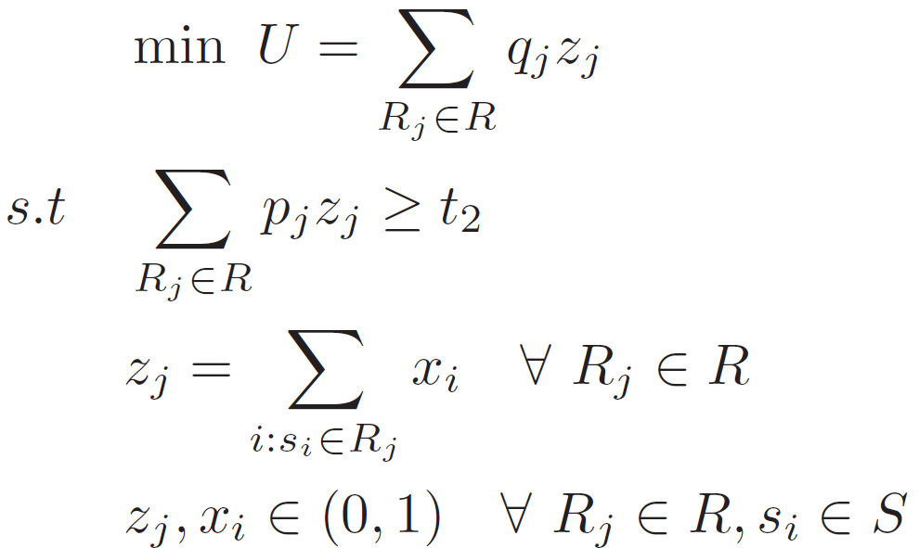
Relaxation to Linear Programming
Case 2:

Slide 19
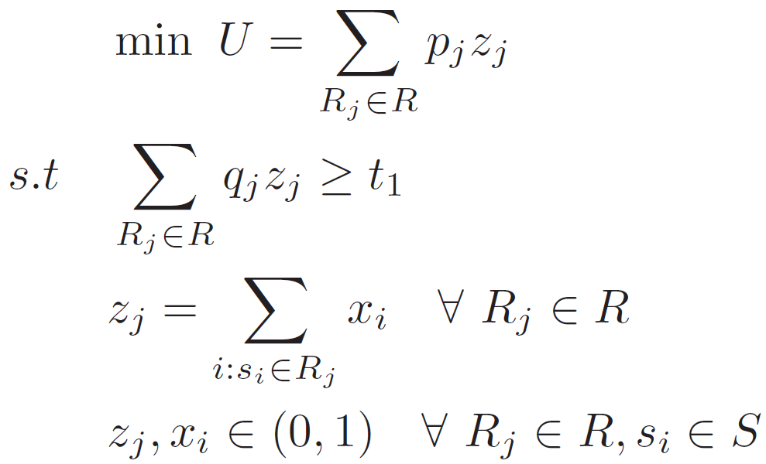
Relaxation to Linear Programming
Case 3:

Slide 20
Evaluations
Simulator in Matlab environment
We use Linprog tool of Matlab to find the solution of the optimizations
100 simulation runs

Slide 21
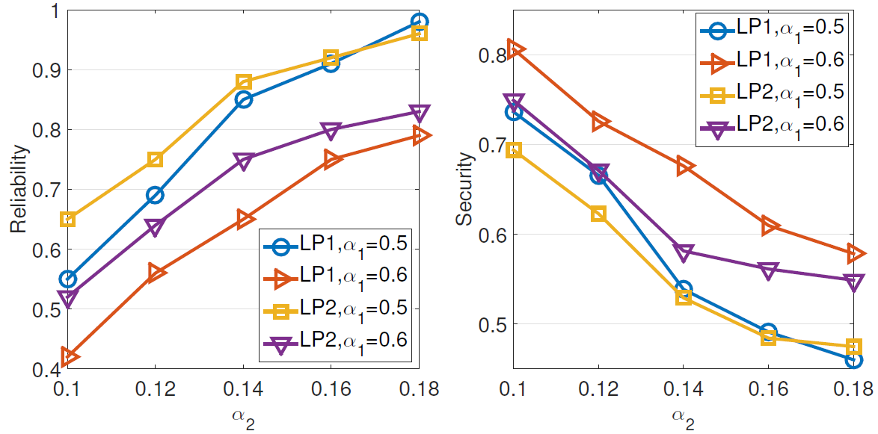
Evaluations

Slide 22
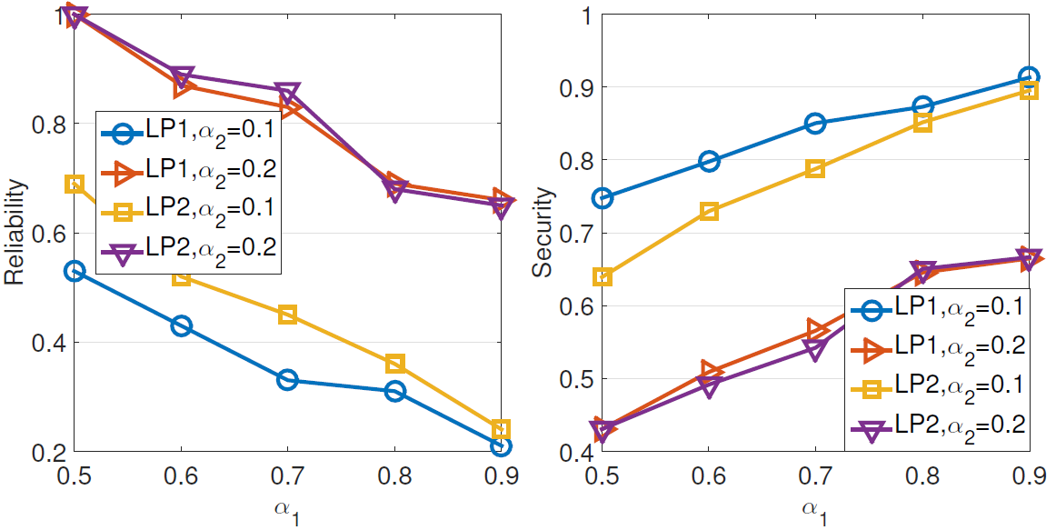
Evaluations

Slide 23
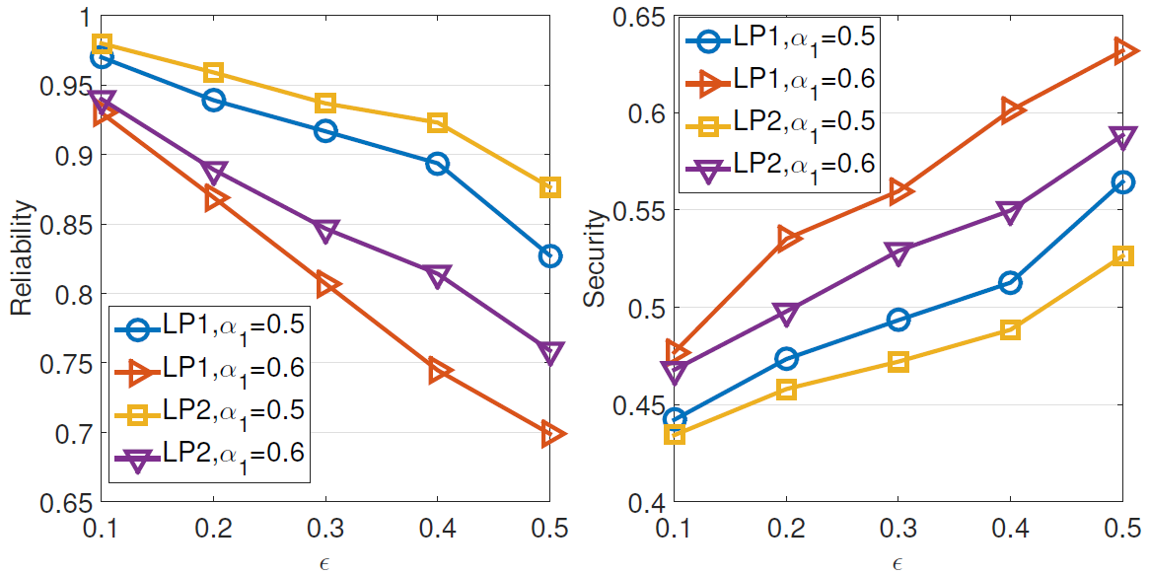
Evaluations

Slide 24
Conclusion
Fault-tolerance using network coding
  Storing redundant data on multiple storages
Security using network coding
  Preventing eavesdropper to receive sufficient coded packets
Trade-off between fault-tolerance and security

Slide 25
Thank you

