Slide 1
Opportunistic Routing Based Scheme with Multi-layer Relay Sets in Cognitive Radio Networks
Ying Dai and Jie Wu
Department of Computer and Information Sciences
Temple University

Slide 2
Motivation
Cognitive radio networks (CRNs)
  Primary users VS secondary users.
Routing challenges: stability
  Unpredictable PU activities and uncontrollable break links.
  Dynamic channel availability.
Notes:
Cognitive radio networks (CRNs) improve the efficiency of channel utilization by enabling secondary users (SUs), or nodes, to transmit data packets on channels that are assigned to primary users (PUs). However, the key constraint is that the active PU sessions cannot be interfered with by SUs. Therefore, SUs need to quit from those channels once the corresponding PUs become active.
This poses one special challenge to the routing problem in CRNs, which is the route stability. The difficulties lie on the unpredictable primary user activities and uncontrollable break links. Different from traditional wireless networks, in which the broken links are usually caused by nearby interferences or physical environments, links in CRNs face the suddenly active primary users. Even though the sender and receiver are capable of building a link, they cannot transmit data due to PUs. Moreover, there are multiple channels at each node in CRNs. This is different from the traditional multi-channel wireless networks. The available channel sets on each node in CRNs are different from each other, and are also dynamic.

Slide 3
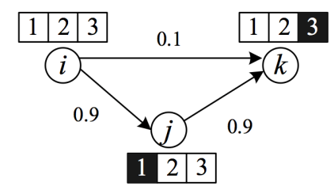
Motivation
Advantages of opportunistic routing
  Improvement of stability
Challenges of applying opportunistic routing
  Relay node set selection
Notes:
The main motivation of opportunistic routing protocols involves the improvement of data transmission reliability in wireless networks. When the data transmission between the sender and the receiver fails, other nodes that have overheard the data can help to forward the packet. With the help of relay nodes, the overall reliability is improved. Therefore, this facilitates the routing reliability in CRNs.
However, there are also challenges when applying opportunistic routing in CRNs. Firstly, the relay nodes need to listen to the same channel that the sender is using. Otherwise, it cannot overhear the packets, or help to relay the failed packets. In CRNs, the available channel set on every node varies. Therefore, the relay node selection has to be channel aware. Secondly, if primary users become active, nodes in a relay set that are using the same channels, are likely to be useless, since primary users have higher privileges to use the channels. This impairs the reliability of the relay set.
The figure here gives an example. There are three nodes. Thee total channel set is {1, 2, 3}. The available channels of each node are marked in white squares, and the unavailable channels are in black squares. Assume the link reliability from i to k is only 0.1, for all three channels. The reliability from i to j and from j to k are both 0.9, for all channels. Based on the opportunistic routing, if the transmission from i to k fails, and j overhears the packet, j can help to forward the packet. The first challenge is that if i and k are communicating on channel 1, while j listens on channel 2, j cannot help to forward the data because it cannot overhear the data on channel 1. The second challenge is that even if all three nodes work on channel 2, it is possible that some PUs become active on 2, and force all of the three nodes to quit from 2. Then, j still cannot help to forward the data.

Slide 4
Overview
We propose an efficient routing framework based on multi-layer relay sets.
We give the algorithm for the selection of relay sets and transmission channels together.
We design an adaptation approach with fewer interruptions to the data transmission when facing the suddenly-active PUs.
Notes:
The overview of our work can be summarized as three aspects.
We propose an efficient routing framework based on multi-layer relay sets, with the channel dynamics taken into account, and make the application of opportunistic routing on CRNs implementable.
Instead of selecting the transmission channel and relay sets separately, we give the algorithm for the selection of relay sets and transmission channels together, which considers both the channel quality and the potential reliability of relay sets.
In order to better suit the dynamic environment of CRNs, we present an adaptation approach with fewer interrup- tions to the data transmission when facing the suddenly active PUs.

Slide 5
Multi-layer Opportunistic Routing Framework
Framework overview:
  Information exchange
  Multi-layer relay set selection
  Routing scheme and relay set adaptation
Notes:
We propose the multi-layer opportunistic routing framework. The overview of our framework contains the following three components.
Information exchange: The sender of each link first performs spectrum sensing and sends a request to its neighbors through CCC. The neighbors of the sender reply with their location and channel information;
Multi-layer relay set selection: The sender selects two relay sets on two channels for data transmission: one is the main relay set; the other is the backup relay set. The sender notifies the nodes in the selected main relay set, assigns them priorities, and applies the opportunistic based routing protocol;
Routing scheme and relay set adaptation: Routing When the transmission fails due to the suddenly active PUs, the sender adjusts the affected main and backup relay sets, and reselects them if necessary.

Slide 6
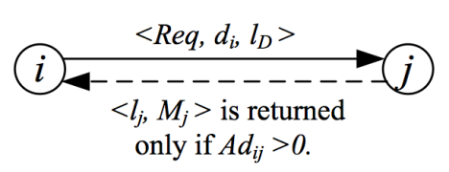
Multi-layer Opportunistic Routing Framework
Information exchange
  Goal: The sender gains the channel availabilities and the location information of its neighbors.
Notes:
The first component is the information exchange. The primary goal of information exchange is for the sender receiving the channel availabilities and the location information of the its neighbors.
The process can be described using the example in this figure.
1) Node i sends a request to nodes in its neighbor set Ni. The request message contains its distance to the destination node, di, and the location of destination;
2) Nodes in i’s neighbor set receive the request, and calculate their distances to the destination node;
3) If j ∈ Ni, and dj < di, which means j is closer to the destination than node i, j replies its location lj, and its sensing results, which is the available channel set Mj, to i.

Slide 7
Multi-layer Opportunistic Routing Framework
Multi-layer Relay Set Selection
  Multi-layer => Multi-channel
  Definition: Relay set on one layer
    For a node j in a relay set on one layer of node i, with channel m, it must satisfy two conditions: 1) Channel m must belong to both available channel sets of nodes i and j; 2) Node j is closer to the destination than node i.
Notes:
To increase the routing reliability when facing the suddenly active PUs, multi-layer relay sets are selected according to different channels.
First of all, we need to define the relay set on one layer. For a node j in a relay set on one layer of node i, with channel m, it must satisfy two conditions: 1) Chanel m must belong to both available channel sets of nodes i and j; 2) Node j is closer to the destination than node i.

Slide 8
Multi-layer Opportunistic Routing Framework
Multi-layer Relay Set Selection
  Definition: Relay node weight
    The weight of a relay node is defined by the distance advance to the destination node times the transmission rate, with a weight factor.
  Definition: Relay set weight
    The weight of a relay set is defined as the expected relay node weight, based on the successful transmission probability.
Notes:
To select the multi-layer relay set, we need to define two weight. One is the definition of the relay node weight. The weight of a relay node is defined by the distance advance to the destination node times the transmission rate, with a weight factor.
The second one is the definition of the relay set. The weight of a relay set is defined as the expected relay node weight, based on the successful transmission probability.

Slide 9
Multi-layer Opportunistic Routing Framework
Multi-layer Relay Set Selection
  Multi-layer relay set selection is based on the relay set weight.
    Main relay set: the one with the max weight
    Backup relay set: the one with the second max weight
Notes:
The multi-layer relay set selection is based on the weight of each relay set. The main relay set is one with the max weight and the backup relay set is the one with the second max weight.

Slide 10
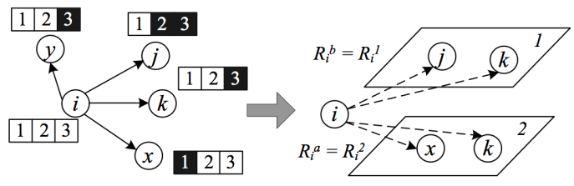
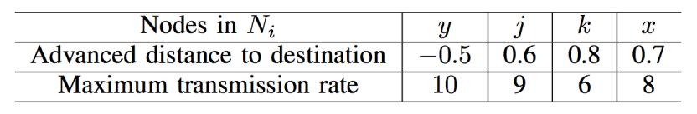
Multi-layer Opportunistic Routing Framework
Multi-layer Relay Set Selection
Notes:
Here is an example of the multi-layer relay set selection. In the left figure, the channels in black square are unavailable. With the values in the table, the selected results of the relay sets for node i are shown in the right figure. The main relay set contains nodes j and k. The backup relay set contains nodes x and k. The main relay set and the backup relay set can have overlap.

Slide 11
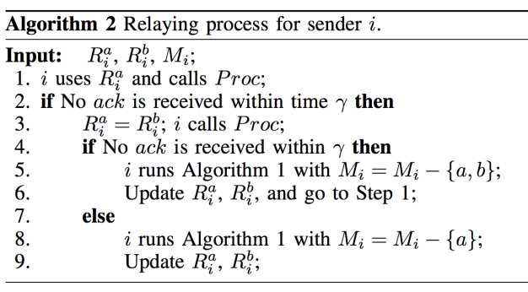
Routing Scheme and Relay Set Adaptation
  Channel dynamics make the main relay set fail.
Notes:
Due to the channel dynamics of CRNs, it is possible that all nodes in the main relay set fail to relay packets upon the suddenly active primary users. Under this situation, the sender would use the backup relay set, and make the corresponding adjustments.
The algorithm considers three underlying situations: 1) No extra work needs to be done if the main relay set succeeds; 2) If the main relay set fails, the backup relay set is used. If the backup relay set works, then i only needs to reselect both sets with Mi = Mi − {a}, after the transmission; 3) If the backup relay set also fails, then i needs to eliminate channels a and b from Mi, reselect both sets, and repeat the process. The relaying process is repeated until it reaches the destination.

Slide 12
Performance Evaluation
Simulation settings
  Network parameters:
    number of nodes, number of channels, PU off duration.
  Evaluation metrics:
    end-to-end delay, packet delivery ratio, and relay-to-sensing ratio
Notes:
We randomly distribute nodes in a 200×200 unit square. Each node’s range is randomly assigned from [30,50]. We vary the three network parameters to evaluate our algorithm. They are the number of nodes, the number of channels, and the PU OFF duration.
There are three performance metrics that are used for our evaluation, end-to-end delay, packet delivery ratio, and relay-to-sensing ratio. We also implemented two other protocols, Search and GOR, for comparison with our protocol (shortened as MOR).

Slide 13
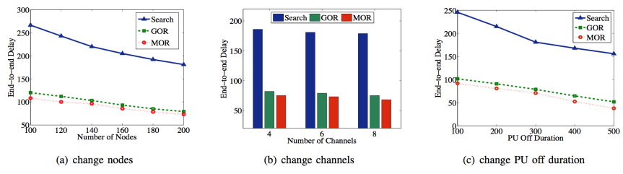
Performance Evaluation
End-to-end delay
Notes:
We first compare the end to end delay. The end-to-end delay shows that our protocol takes the lowest delay among the three

Slide 14
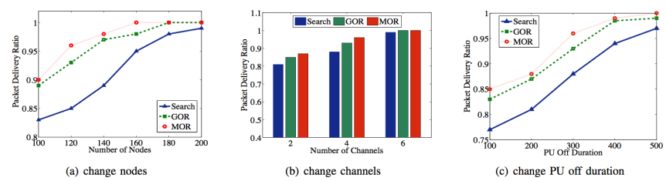
Performance Evaluation
Packet delivery ratio
Notes:
Also, we compare the packet delivery ratio. Overall, our protocol has the highest packet delivery ratio among the three.

Slide 15
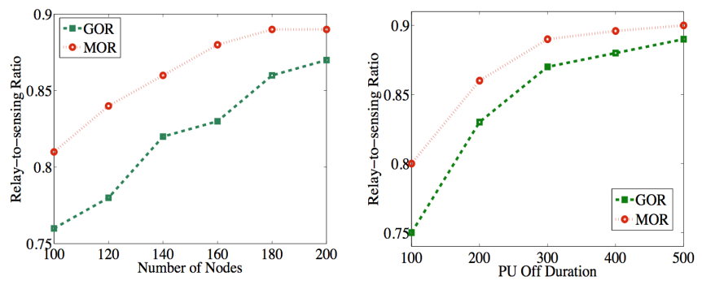
Performance Evaluation
Relay-to-sensing ratio
Notes:
We also compare the relay-to-sensing ratio, which is the number of successful relay transmissions to the total number of sensing times.
The larger value of the relay-to-sensing ratio means that the relay sets are more reliable and the reselections of relay sets are less reliable. Here, we only show the comparison results of GOR and MOR, since Search takes many more relay reselections. Here, the results show that our algorithm MOR has a better performance.

Slide 16
Conclusion
Multi-layer relay set selection
Main and backup relay set
Adaptation scheme
Performance evaluation
Notes:
We propose our opportunistic routing based scheme with multi-layer relay sets of the channel scale in CRNs. We present our algorithms for the relay set selections, which take the PU activities into consideration. Each sender retains two relay sets, which are the main relay set and the backup relay set. We also give the adaptation scheme when PUs become active on the data transmission channel. Moreover, we conduct extensive simulations for performance evaluation. The simulation results show that our protocol is very efficient and outperforms others.

Slide 17
Thank you!
Notes:
Thank you. If you have any question, please contact the authors.

