Slide 1


Robust Wireless Delivery of Scalable Videos using Inter-layer Network Coding
Pouya Ostovari and Jie Wu
Computer and Information Sciences
Temple University
Center for Networked Computing
http://www.cnc.temple.edu

Slide 2
Agenda
Introduction
Multi-layer video coding
Robustness multi-layer video streaming
Evaluations
Conclusions
Notes:
First I will provide an introduction and motivation for our work
Then, I will talk about the benefits on network coding in robustness and throughput enhancement,
and I will talk about our partial results and future work.
At the end, I will conclude my talk

Slide 3
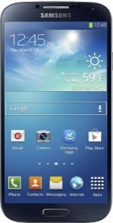
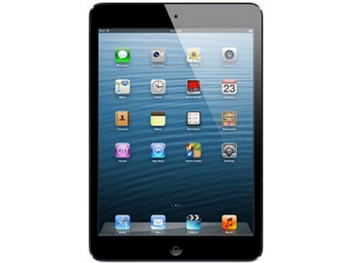


Introduction
Advances in technology
Smartphones and tablets
Internet is accessible everywhere
Video streaming is used widely and frequently
Video streaming is a dominant form of traffic on the Internet
YouTube and Netflix:
Produce 20-30% of the web traffic on the Internet
Notes:
In recent days, we are witnessing a fast development in the hardware technologies of mobile devices
such as tablets and smartphones
As a result of these advances, the mobile devices are becoming very popular
Using wireless connections is more convenient than the wired connections.
Moreover, they can solve the last mile problem

Slide 4
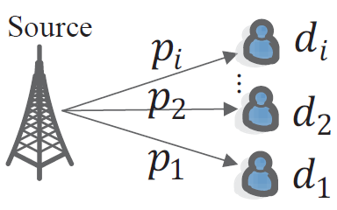
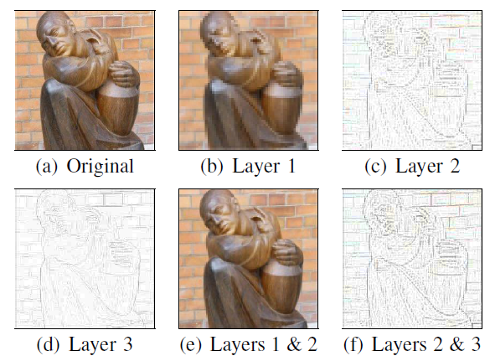
Introduction
A challenge in multicasting
Different link conditions
Loss rate, bandwidth
Scalable video coding
Delivering video stream using different resolutions to satisfy different client needs/constraints
Multi-Layer Coding
Base layer
Enhancement layers
Notes:
Scalable videos are useful in delivering video stream with different resolutions to users with different needs
There are two forms of scalable videos
Multi-layer and multi-description coding

Slide 5

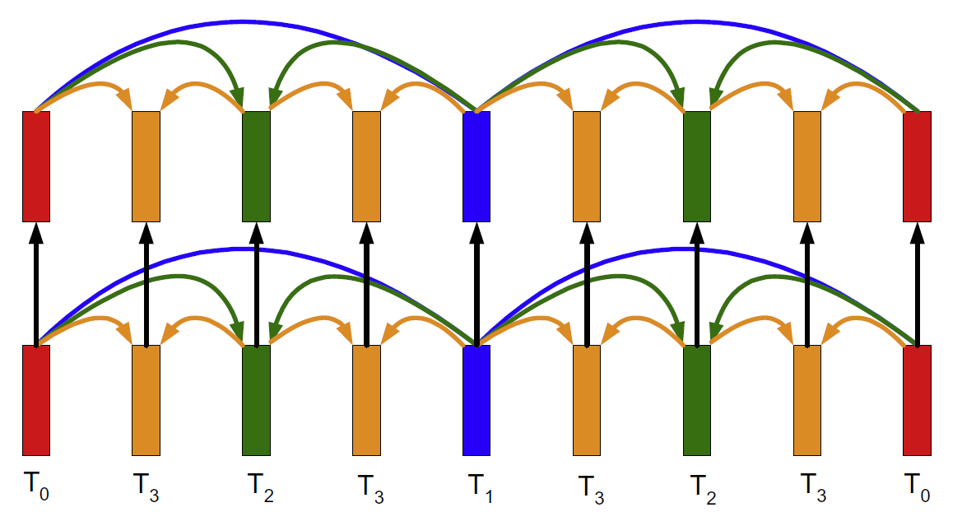
Multi-Layer Video Streaming
H.264/SVC coded
Temporal layers
Quality layers
Spatio layers
Quality layer 2
Quality layer 1
Unequal error protection
Grouping the packets of multiple GOP together
Providing different levels of protection for different groups
Intra-layer network coding
Different heuristics are proposed
They focus on measuring the effect of each layer on the video quality
Temporal
Notes:
H.264/MPEG-4 or advanced video coding (AVC) is a video compression format
It is one of the most commonly used formats for compression and distribution of video content
H.264/SVC, which is an extension of the H.264/AVC, supports spatial, temporal, and quality scalabilities
GOP is a group of successive pictures within a coded video stream

Slide 6
Inter-Layer Coding Strategies
Random linear network coding (RLNC)
Triangular coding
Prefix coding
Packets in lower layers are more important
Included in more coded layers
More chance to be decoded
Notes:
If a user receives enough coded packets, it can decode and retrive all of the layers
Otherwise, it will not be able to decode any layer.
Because of this problem, a modification on RLNC is prosed, called triangular network coding

Slide 7
Advantage of Triangular Coding
Coefficients are not shown for simplicity
6 transmissions in round-robin pattern
Blue cells are received
No coding
L1
L2
L3
L1
L2
L3
Unable to decode
Random linear coding
L1 + L2+ L3
L1 + L2+ L3
L1 + L2+ L3
L1 + L2+ L3
L1 + L2+ L3
L1 + L2+ L3
Unable to decode
Triangular coding
L1
L1 + L2
L1 + L2+ L3
L1
L1 + L2
L1 + L2+ L3
Decodes 2 layers

Slide 8
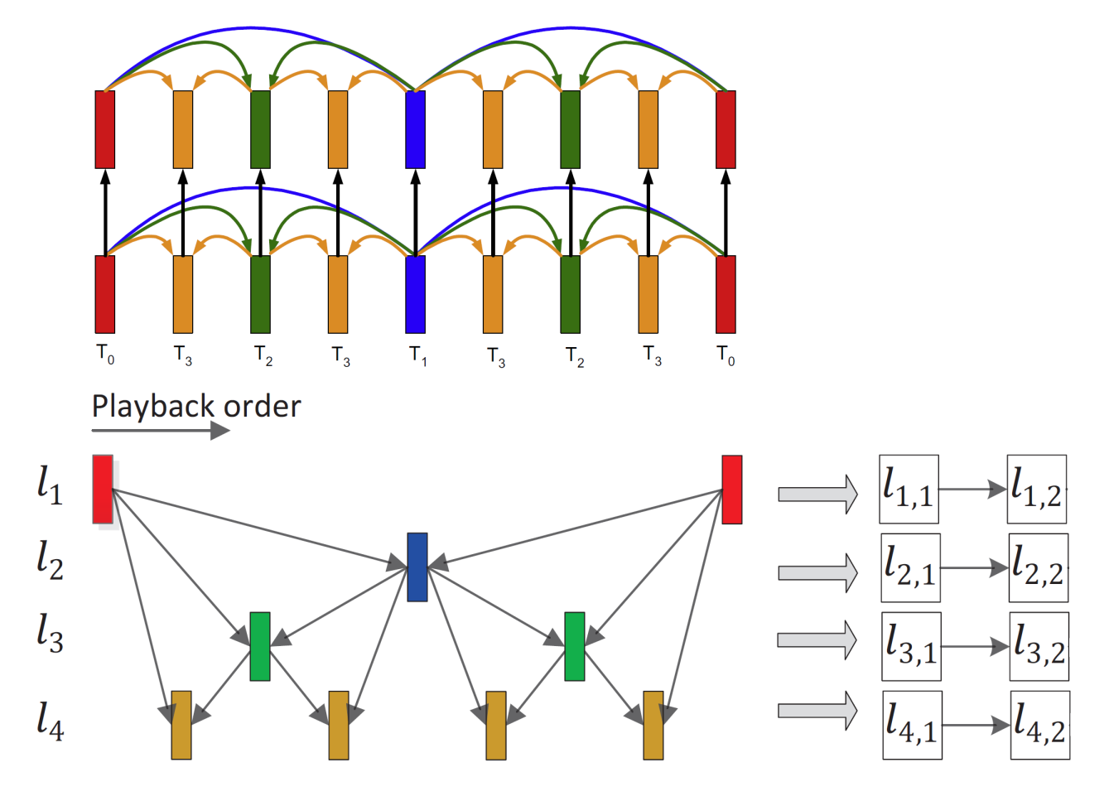
Two-Dimensional Inter-Layer NC
Performing inter-layer triangular NC on quality and temporal layers

Slide 9
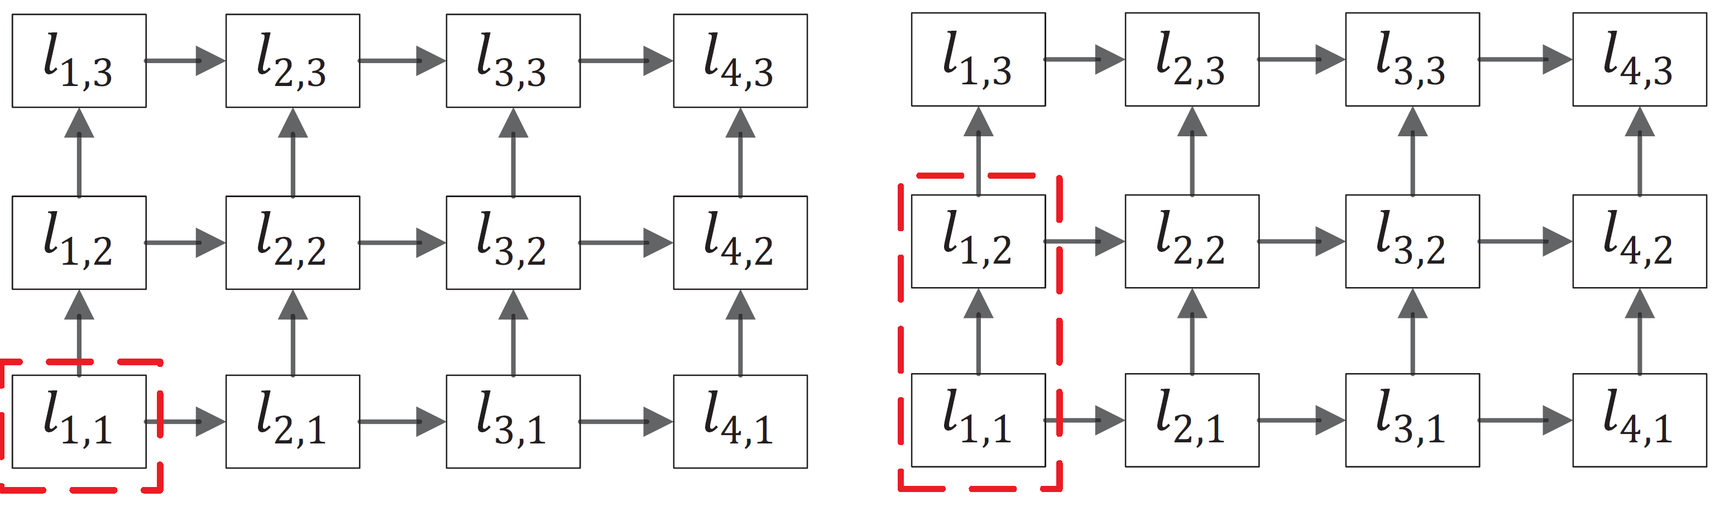
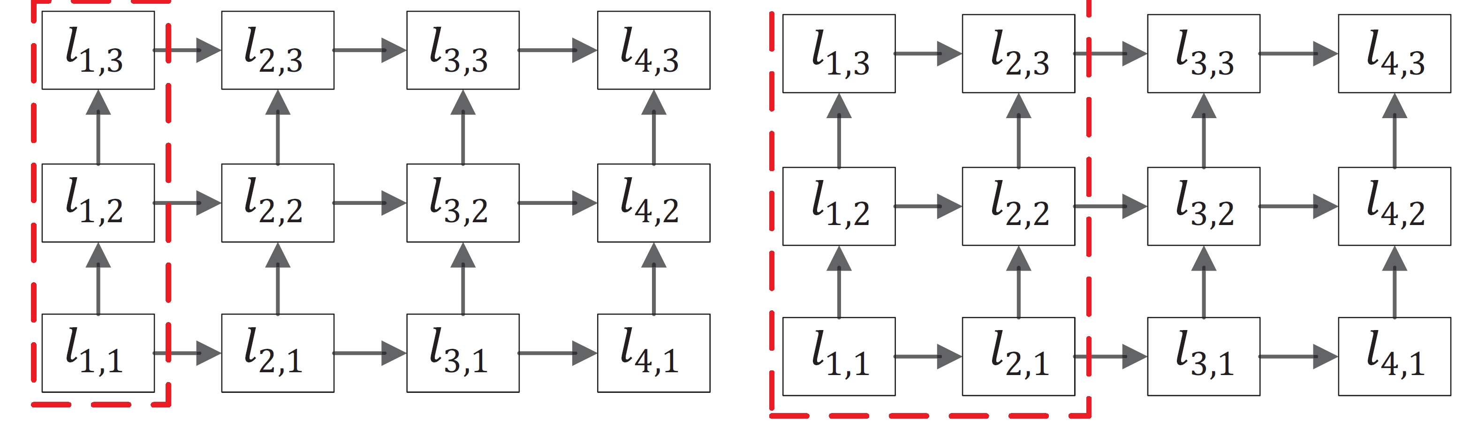
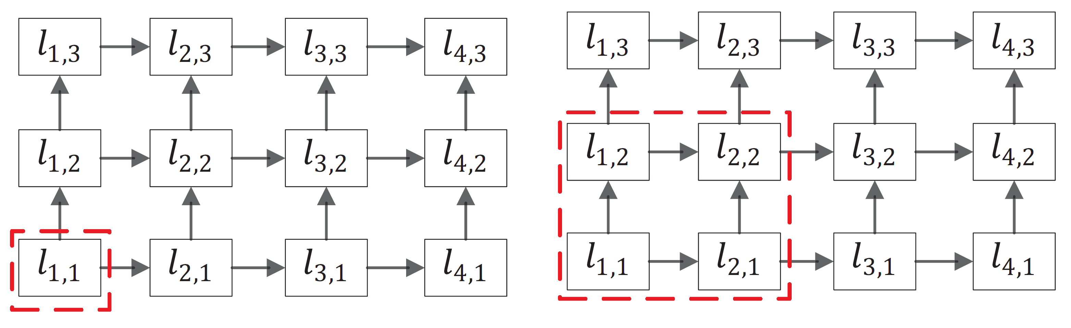
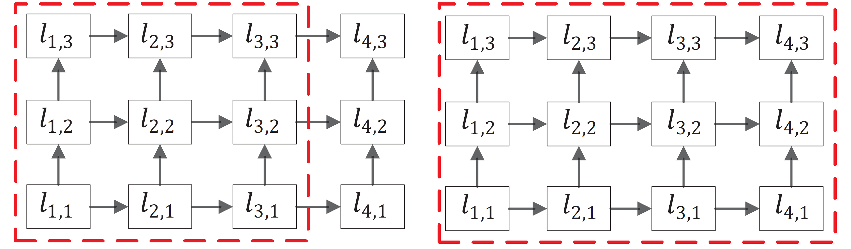
Two-Dimensional Inter-Layer NC
Vertical triangular NC
Horizontal triangular NC
Diagonal triangular NC

Slide 10
Transmissions Distribution
Fixed number of transmissions
Reference table creation
Considering all the possible distributions
Checking the possible outcomes
Calculating the layers that can be decoded
Searching in the reference table to find the best transmission distribution

Slide 11
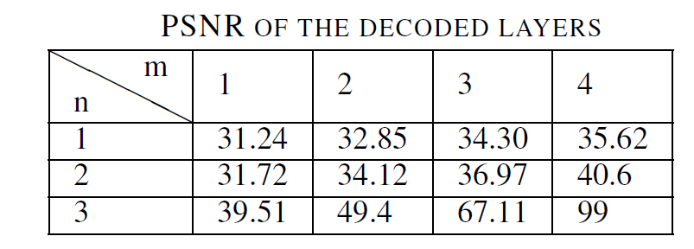
Evaluations- Setting
Comparison with Percy method
Is performed among the spatio layers
Bus video trace
352×288 pixels, 30 frames
4 temporal layer
3 spatio layers
Layer 1: 176×144
Layer 2: 320×240
Layer 3: 352×288

Slide 12
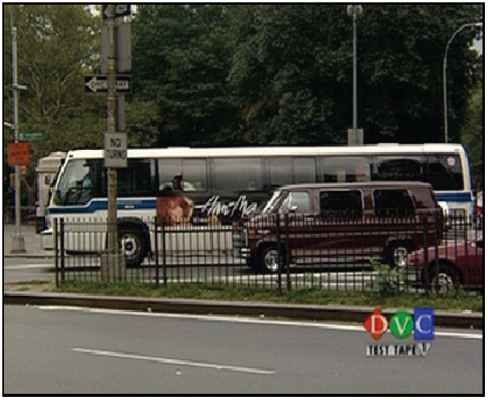
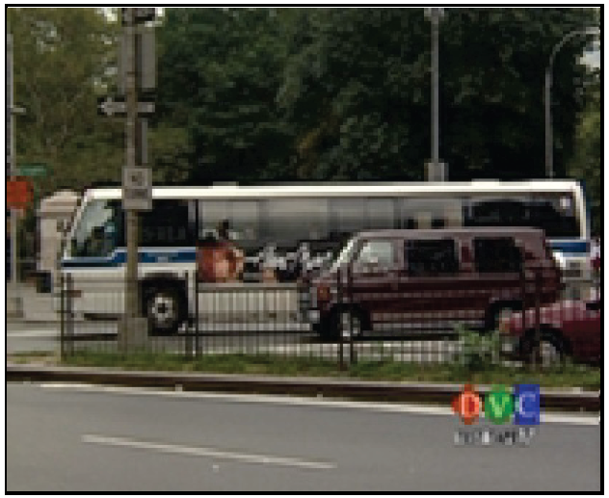
Evaluations- Setting
Original video
Base spatio layer

Slide 13
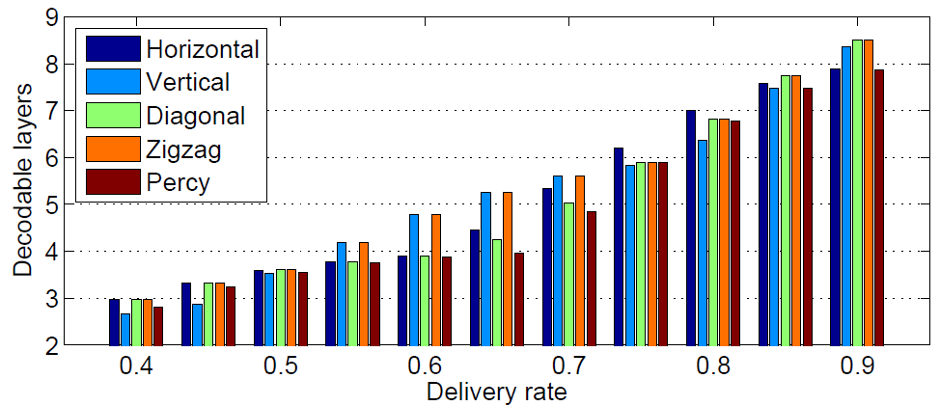
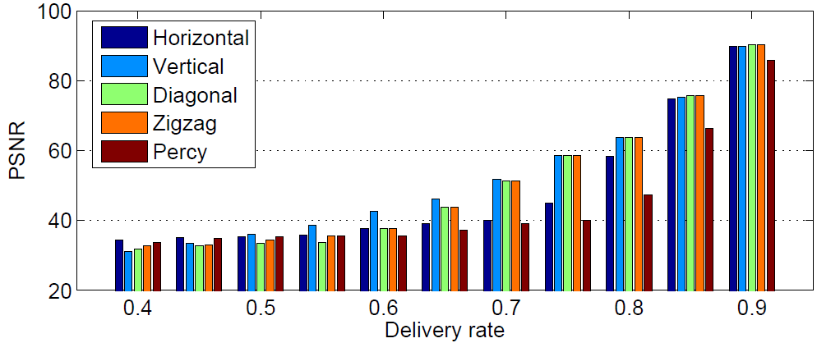
Evaluations

Slide 14
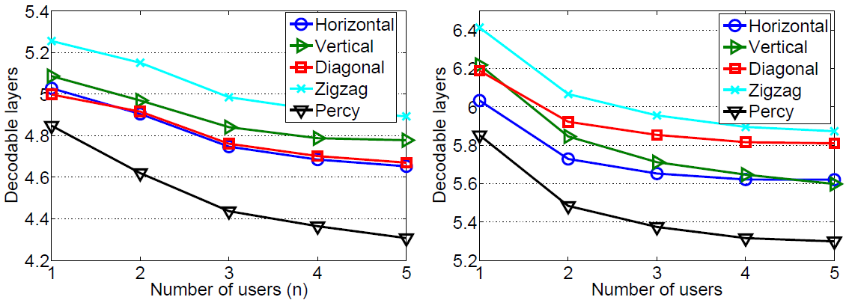
Evaluations

Slide 15
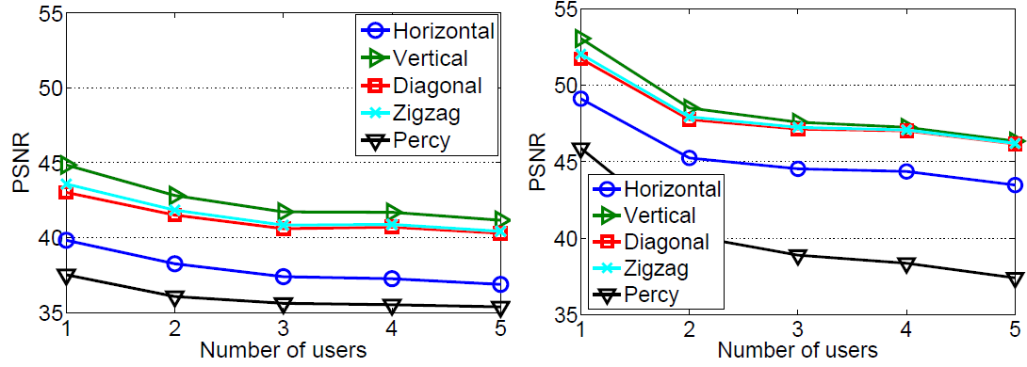
Evaluations

Slide 16
Conclusions
Challenges in multicasting
Dependency in multi-layer videos
Unequal error protection
Two-dimensional triangular network coding
Trace-driven evaluation

Slide 17
Thank you

