Slide 1
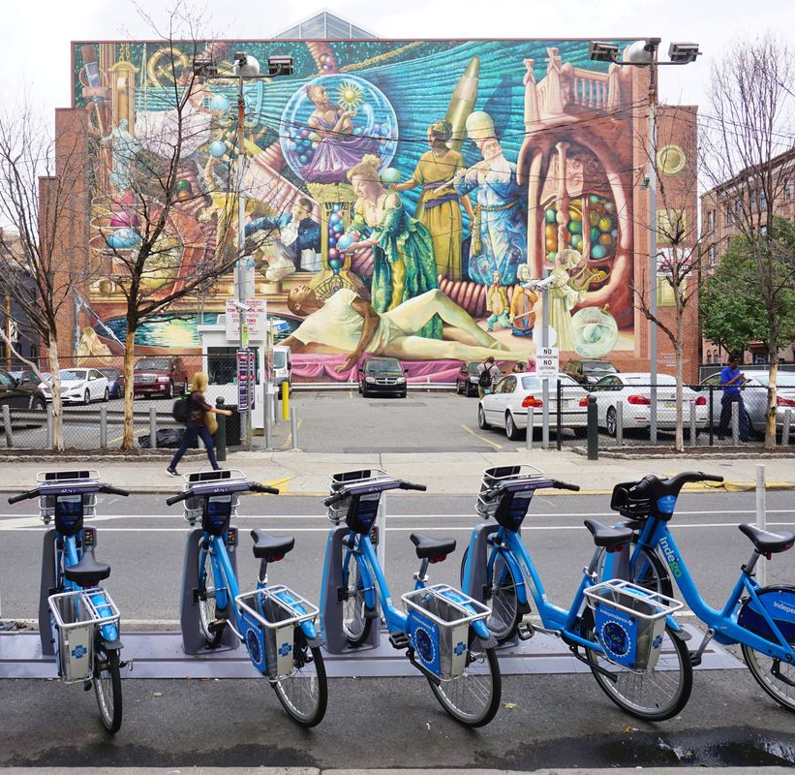
Improvements To Worker Assignment Problem
Trent Johnson
Department of Mathematics
Georgia Institute of Technology
Jie Wu
Department of Information and Computer Sciences
Temple University

Slide 2

Overview
What is Bike Sharing System?
Rebalancing
Worker Assignment Problem
Graph Matching
Algorithms
  TRM, LR, HS, GHS, IRS
Conclusions

Slide 3
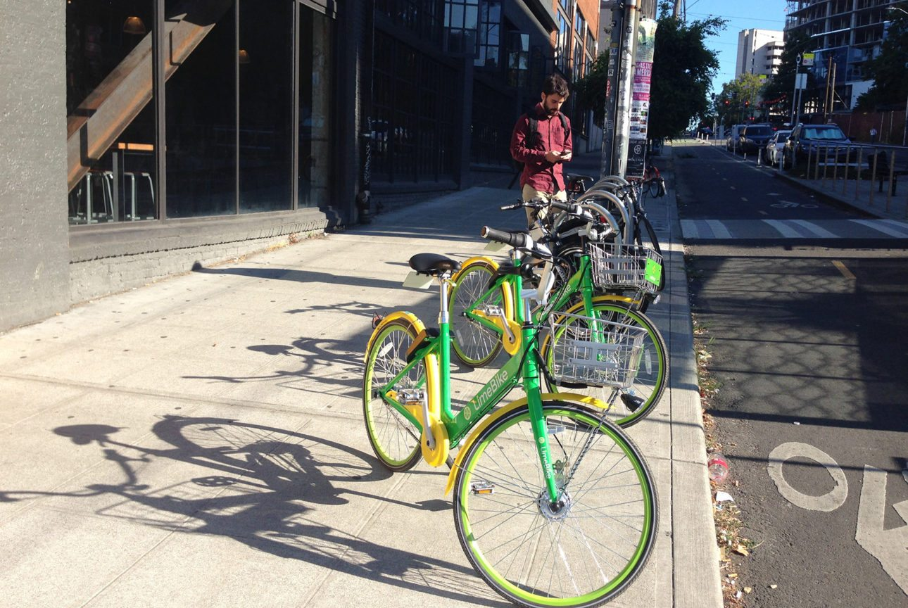
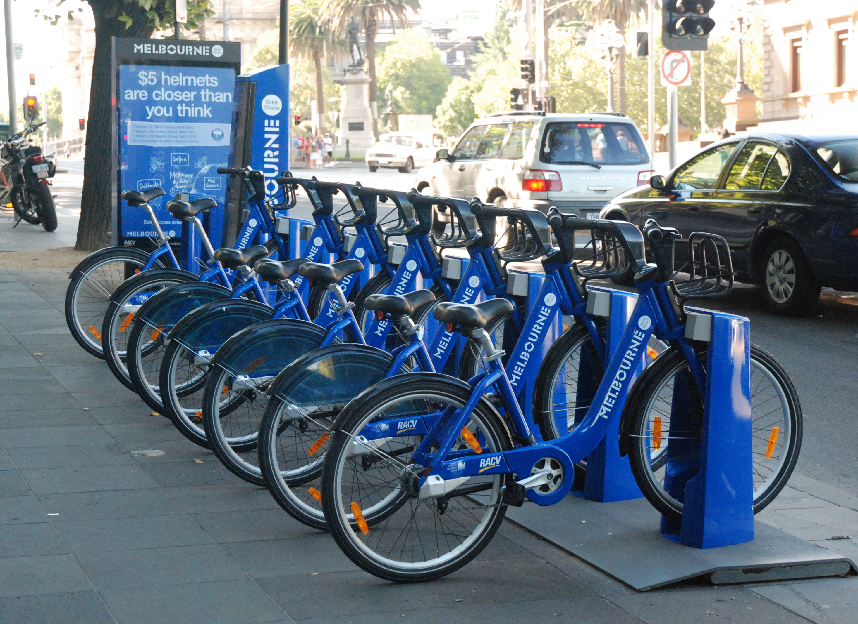
What is Bike Sharing System?
Alta Planning + Design. LimeBike in Seattle, Washington. Seattle
Bike Sharing Systems (BSS)
Docked vs Dock-less
Benefits
  Exercise
  Eco-Friendly
  Reduce Traffic
  Cheap
  Low Infrastructure
K, P. (n.d.). Melbourne City Bikes. photograph, Melbourne.

Slide 4
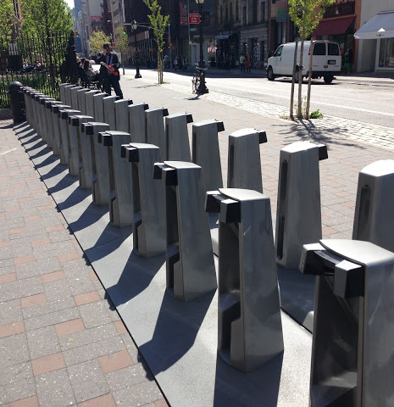
What is Rebalancing?
Variable demand at stations
  Time
  Location
Overflow/Underflow stations
  Stations with too many bikes
  Stations with not enough bikes
Gwenneth Leech. Empty bike docking station at Spring and Lafayette. New York City

Slide 5
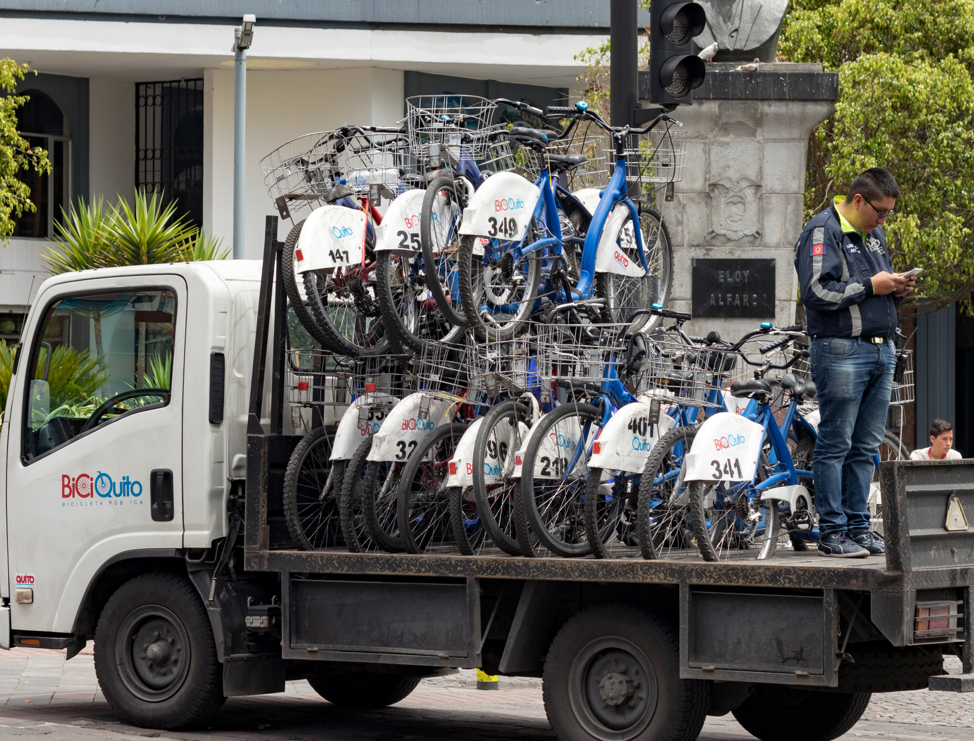
Trucks for Rebalancing
Optimal Hamiltonian Path
Traveling Salesman
Advantages
  Centralized
Disadvantages
  Expensive
  Cause Traffic
  Pollution
Ted Timmons. BiciQuito bikeshare rebalancing truck. Quito

Slide 6
Crowdsourcing with Users
Use existing users for rebalancing
Incentive model
  Rewards for stations
  Free rides, prizes, etc.
  Any user can rebalance
Assignment model
  Hire workers
  Assign stations

Slide 7


Temporal vs Spatial
Rebalancing
  Divide into spatial and temporal domains
Temporal
  Predict station usage and workers
  Divide into time slices
Spatial
  Create incentives/assignments
  Use temporal predictions
  Static problem in each time slice

Slide 8



Worker Assignment Problem
Optimal assignment of worker and stations
Partial Assignments
NP-Hard
Same number overflow and underflow targets
Any number of workers

Slide 9
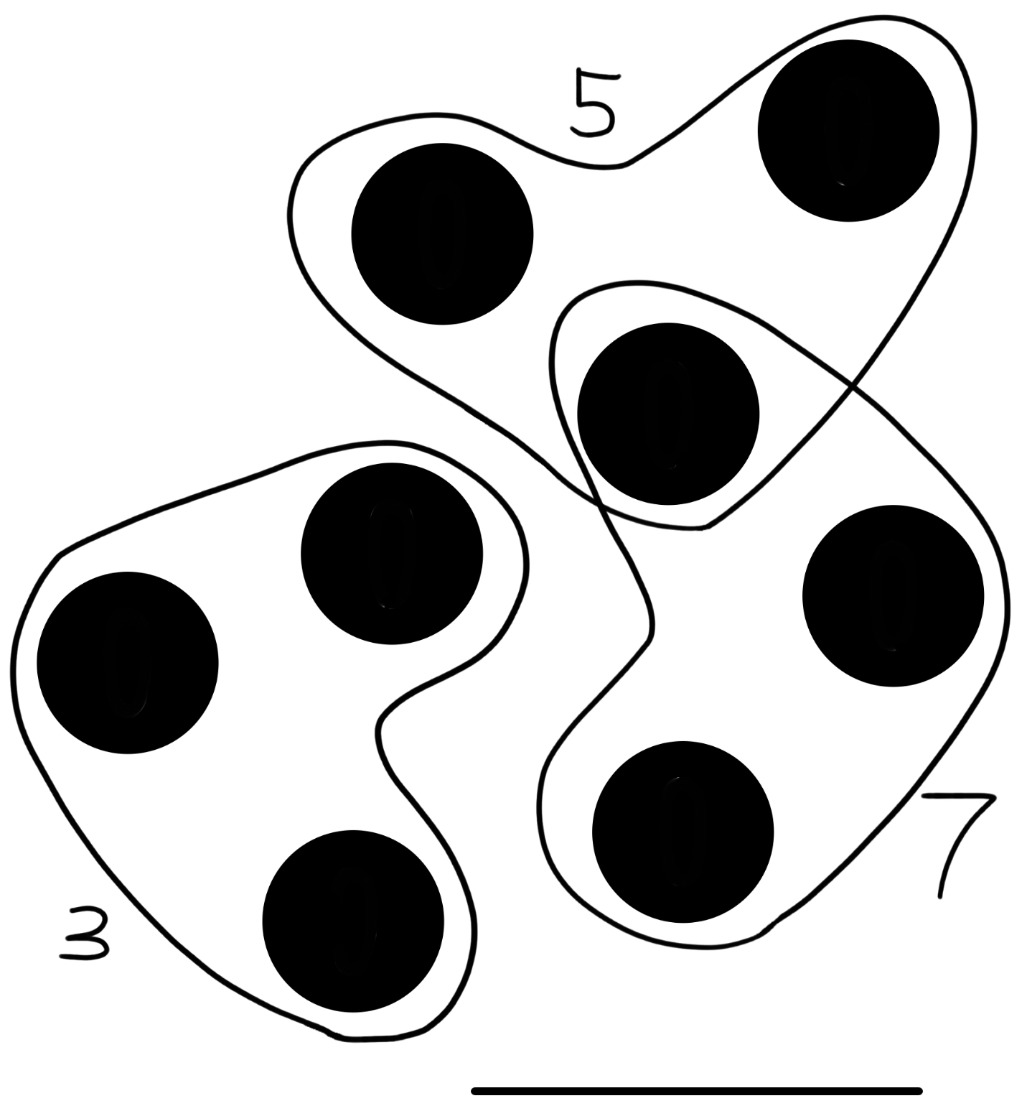

3-Dimensional Matching
7
3D hypergraph
  3 vertices per edge
Weighted 3-dimensional matching
  Find set of disjoint edges
  Maximal sum of weights
NP-complete
4
5

Slide 10
Graph Matching
Matching problem
  Pair every vertex with a neighbor
  Set of disjoint edges with all vertices
Maximal matching
  Set of disjoint edges with maximal weight
Many real-world applications
Hungarian algorithm
  O(V log(V))

Slide 11
WAP and 3D Matching
Give each station a rebalancing target
Clone stations by target
Edges
  (Worker, Overflow Target, Underflow Target)
Matching to find the best edges/assignments
Station A1
Station A2
Station A3
Station A
+5
Station A4
Station A5

Slide 12
Two Round Matching (TRM)
Round 1: Create overflow underflow matching
Round 2: Create worker station pair matching
3-approximate
Y. Duan and J. Wu, “Spatial-temporal inventory rebalancing for bike sharing systems with worker recruitment, ”IEEE Transactions on Mobile Computing, 2020.

Slide 13
Hungarian Search (HS)
Workers
Overflow Stations
Underflow Stations
Hungarian Search
  Improves a weighted matching
  Iteratively optimizes
Iteration of HS
  Fix parts of the graph
  Perform a weighted matching
Random Hungarian Search
  Random graph optimized by HS
G. Huang and A. Lim, “A hybrid genetic algorithm for three-index assignment problem,” in IEEE CEC, vol. 4, 2003, pp.2762–2768.

Slide 14
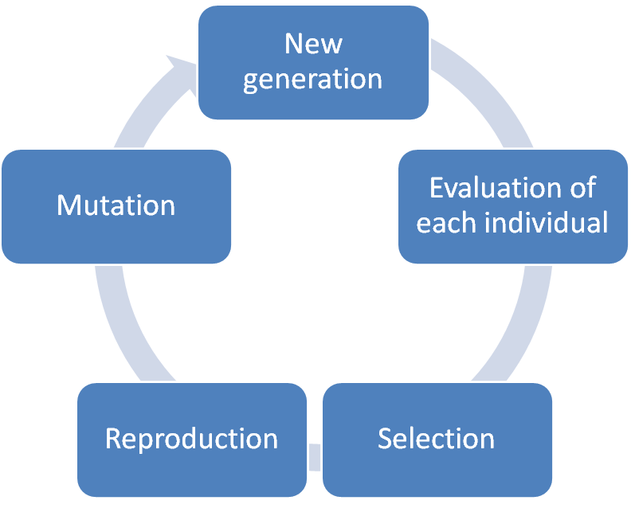

Genetic Hungarian Search
Genetic Algorithm
  Iteratively search for better graphs
  Optimize with HS
Partially Mapped Crossover
New Generation
Evaluate Individuals
HS
Reproduction
Selection
G. Huang and A. Lim, “A hybrid genetic algorithm for three-index assignment problem,” inIEEE CEC, vol. 4, 2003, pp.2762–2768.

Slide 15
Initialized Round Search (IRS) [Proposed]
Algorithm
  Run TRM
  Run HS on the results
Speed of TRM
Performance of HS
Still 3-approximate
Good Initialization
Hungarian Search

Slide 16
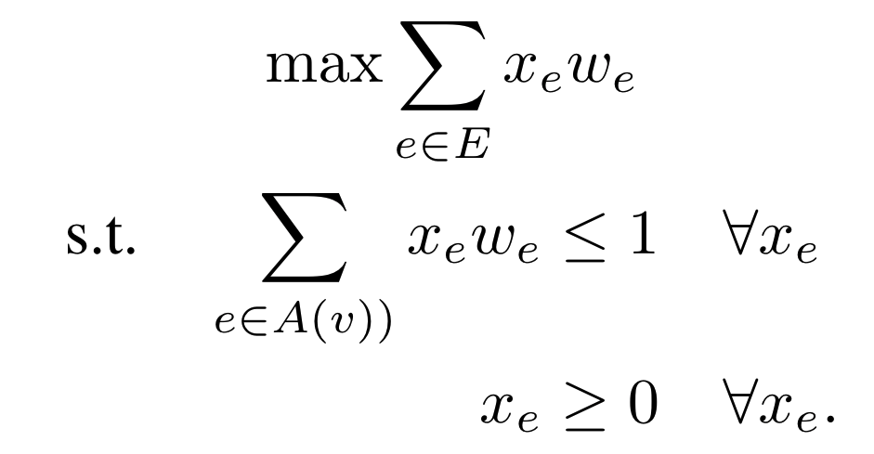
Local Ratio (LR)
Creates an order of edges
  Linear programming
Local Ratio Subroutine
  Recursive
  Prunes bad edges
  Adds first edge in ordering to matching
Y. H. Chan and L. C. Lau, “On linear and semidefinite programming relaxations for hypergraph matching,” Math. Program, vol. 135, no. 1, pp. 123–148, 2012.

Slide 17

Simulation Set Up
NYC, Boston, and Washington DC data sets
  May 2021
Random workers
  Within 500m of stations
Time slices
  100-400 nodes
Workers per overflow/underflow target
  1/5-5x
Trials per data set
  62

Slide 18
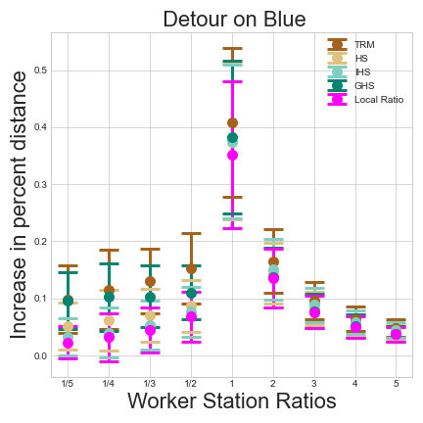
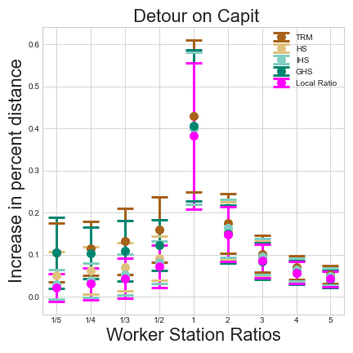
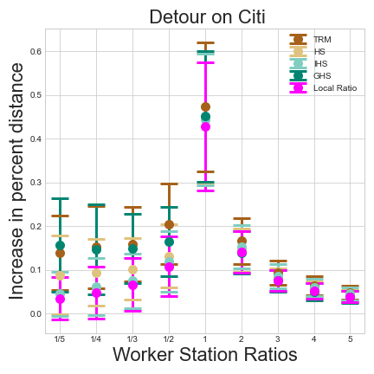
Detour Distance

Slide 19
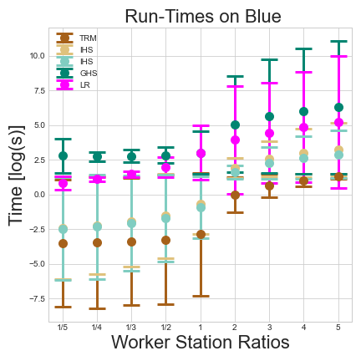
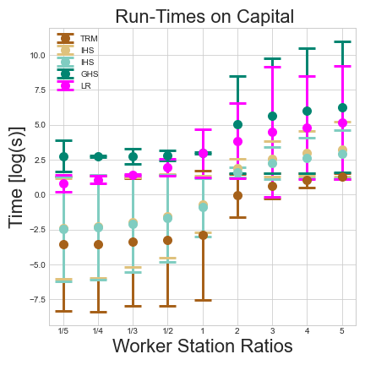
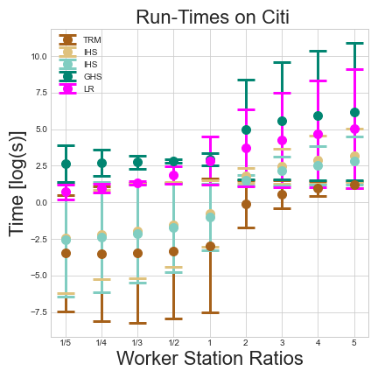
Run-Times

Slide 20


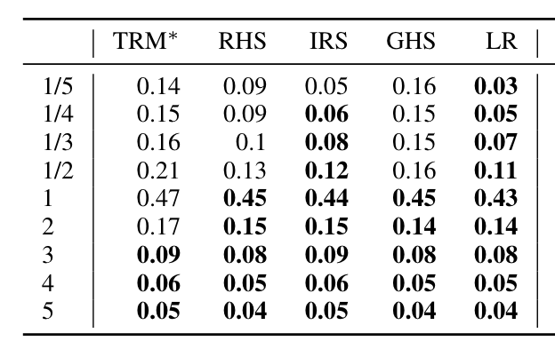
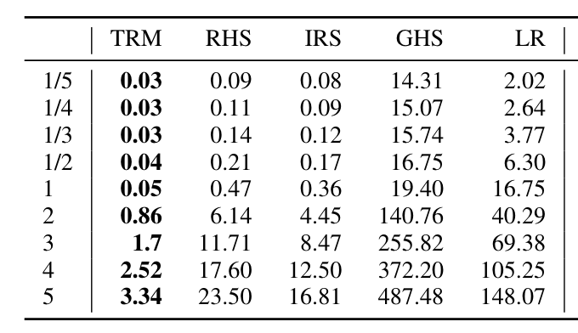
Algorithm Performance
TRM
IRS
HS
Speed
LR
GHS
Optimal
Notes:
Left too big and right too small. Possible three in one line.

Slide 21
Worker Feedback Loop
More Workers
Happier Workers
Better Assignments
Notes:
Left too large and right too small. Highlight 1 to 5 of right figure using box.

Slide 22
How Many Targets?
Too Few Workers = Poor Rebalancing
Less Detour = More Satisfaction
More workers = Better Assignments
Balance worker/target ratio

Slide 23
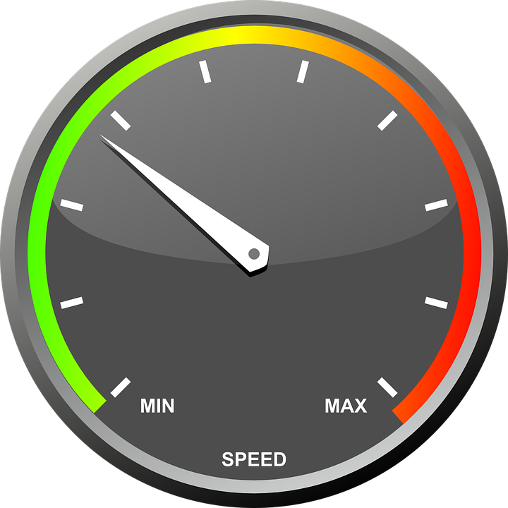
Simulation Conclusion
TRM provides speed
Local Ratio provides accuracy
IRS provides a good balance
Worker Feedback Loop
  Manage station targets

Slide 24

Conclusions
Bike sharing systems
  Rebalancing is a major issue
Graph theory solutions
Introduced algorithms to BSS
IRS: a good speed-performance trade-off

Slide 25

Questions?
Emails: tjohnson360@gatech.edu; jiewu@temple.edu
This research was supported in part by NSF REU site grant CNS 1757533.
Notes:
Move questions to top. Add jiewu@temple.edu, why not your Gatech email?

