Slide 1
The WiMAX/LTE Project:
We See You
Joshua Lloret, Robyn McCue, Jie Wu
Temple University

Slide 2
Project Overview
Cameras will be mounted on police cars
Video streams from cameras will be broadcast using wireless networks, including Wi-Fi, LTE, and/or WiMAX, to a central location for instant analysis storage
Switches between WAN and host server will be managed using OpenFlow

Slide 3

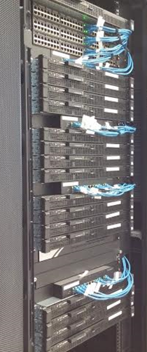

Objectives
Send multiple video streams to server
Be able to prioritize one video stream over others and allocate more network resources to it in real time
OpenFlow
Wi-Fi
LTE
WiMAX

Slide 4
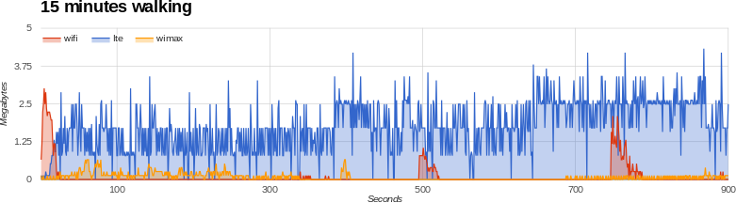
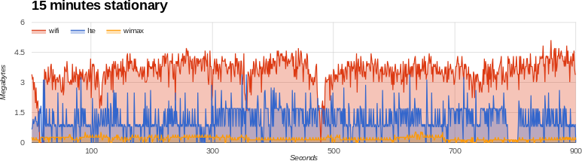
Wireless Network Tests
Notes:
walking uses two variables, time and position
the stationary tests were done for two reasons: to show there are places on campus where wifi throughput is greater than lte, and to show the variability of signals given just time
lte = good coverage, good throughput, expensive
wifi = spotty coverage, good throughput, cheap
wimax = good coverage, poor throughput, cheap (we already had an AP)

Slide 5
Wireless Network Tests
Assisted with conducting stationary and walking tests of Wi-Fi, LTE, and WiMAX around campus
Each had its own drawback at any given time
Use all three
Cheap
WiMAX
WiFi
LTE
Signal
Throughput
Notes:
Instead of n-casting, or broadcasting across all three networks at once, we use only one wireless technology at a time.
A simple python script was written on the client side to buffer data while the operating system is switching networks

Slide 6
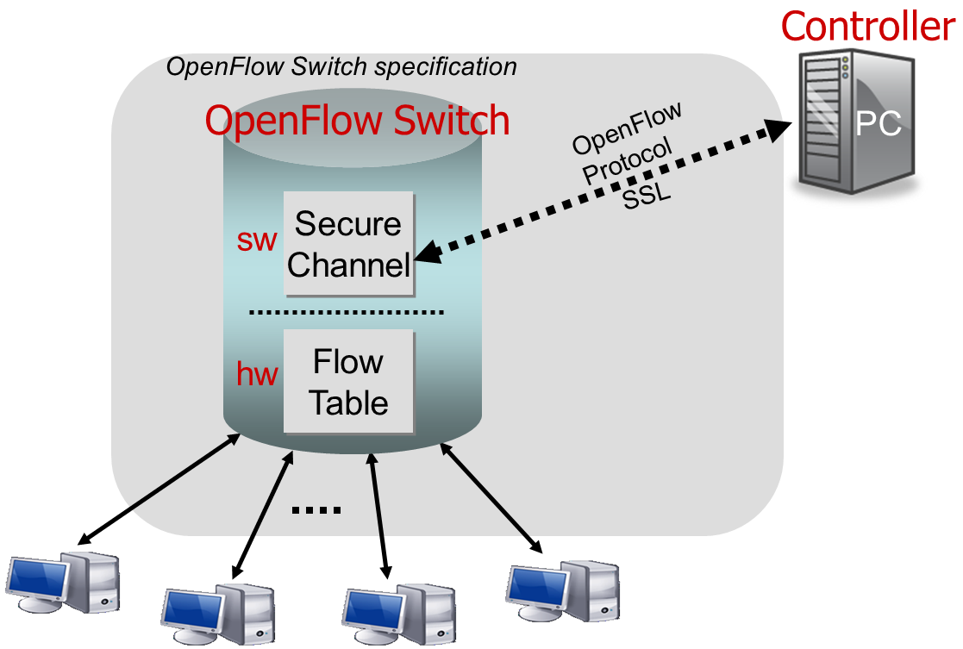


SDN and OpenFlow
and
Mininet

Slide 7
SDN and OpenFlow
Software-Defined Networking (SDN) separates the control plane from the forwarding data plane, allowing the network to be directly programmed and centrally managed
OpenFlow is a protocol to enable SDN
Can be simulated using GENI and Mininet

Slide 8
POX OpenFlow Controller
POX is a Python-based OpenFlow controller
Wrote a custom POX application that learns port numbers from incoming packets and drops packets from specified IP addresses
Mininet supports OpenFlow 1.0.0, which allows for packet dropping but not direct bandwidth management

Slide 9
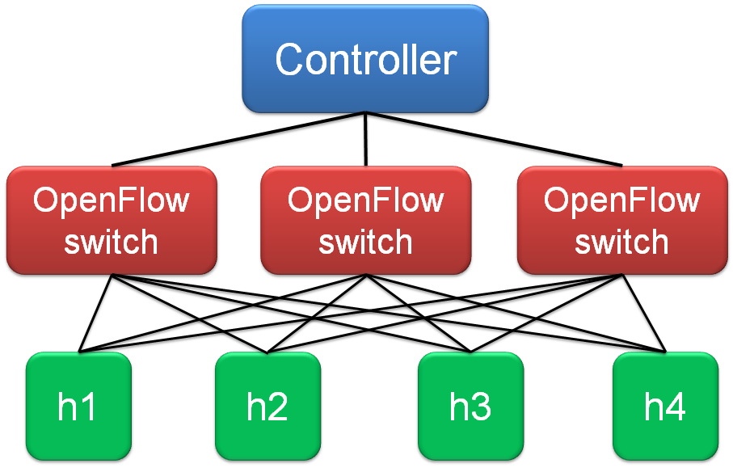
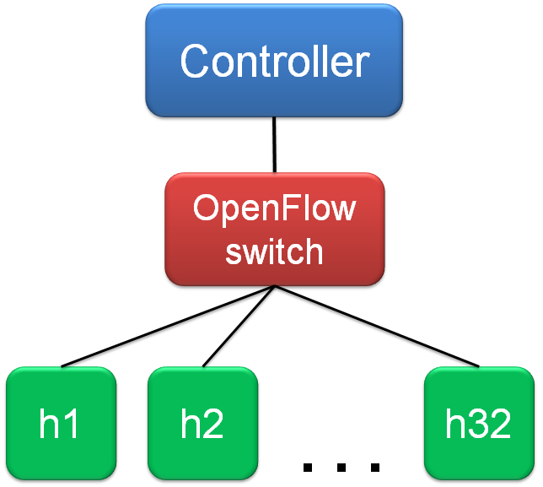
Mininet
Tested controller using Mininet with custom topologies to mimic possible physical equipment configurations

Slide 10
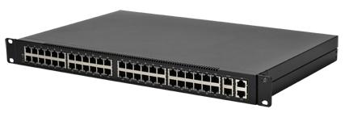

Continuing This Research
Test POX controller application using new OpenFlow-enabled switches and server
Update POX controller application to manage bandwidth, not just drop packets

Slide 11
Further Research
Use OpenFlow SDR like OpenRadio to implement our program closer to the source of data
Combine our solution with data limiting on source itself
OpenFlow
SDR
OpenFlow
Wi-Fi
LTE
WiMAX
not important
important
Notes:
Limiting data on the network in this case is helpful to keep network bandwidth free, but the optimal solution is to limit the data at the source.
Software Defined Radio (SDR) would get us closer to the source, and thus free up more of the network, but the best solution is a program on the cars themselves that limits the streaming data before it is sent over the network.

Slide 12
References
Bansal, Manu, et al. "OpenRadio: A Programmable Wireless Dataplane," in ACM First Workshop on Hot Topics in Software-Defined Networks, 2012.
Jarschel, Michael, et al. "SDN-based Application-Aware Networking on the Example of YouTube Video Streaming." in IEEE Second European Workshop on Software-Defined Networks, 2013.
OpenFlow Switch Consortium. "OpenFlow Switch Specification Version 1.0.0." 2009.
Zinner, Thomas, et al. "Dynamic Application-Aware Resource Management Using Software-Defined Networking: Implementation Prospects and Challenges," in IEEE Network Operations and Management Symposium, 2014.
Special thanks to Dr. Chiu C Tan and his research group for helping us
with tests and the GENI platform

