Slide 1
Joint Prediction and Matching for Computing Resource Exchange Platforms
Da Huo¹, Zhenzhe Zheng¹, Xiaoyao Huang², Hao Chen³, Jianfeng Hu³, Zhiyong Yan³, Fan Wu¹, Jie Wu²
¹Shanghai Jiao Tong University ²Cloud Computing Research Institute, China Telecom ³China Telecom Cloud Technology Co.Ltd., Beijing 100033
2025-9-10
Notes:
Good afternoon, everyone. Today, I will present our work titled Joint Prediction and Matching for Computing Resource Exchange Platforms.
This work is a collaboration between Shanghai Jiao Tong University and China Telecom.
And this work is to address the growing mismatch between the massive computational demands of deep learning and the underutilization of existing enterprise clusters.

Slide 2
Contents
01
Background.
02
Problem Definition.
03
System Design.
04
Experiment.
05
Conclusion.
Notes:
Here is the outline of today’s presentation.
First, I’ll introduce the background and motivation. Then, I’ll define the problem formally. After that, I will introduce the design of our system, called MFCP — Matching-Focused Cluster Performance Predictor.
Next, I’ll walk you through our experiments and evaluation results. Finally, I’ll summarize our work, including contributions and implications.

Slide 3
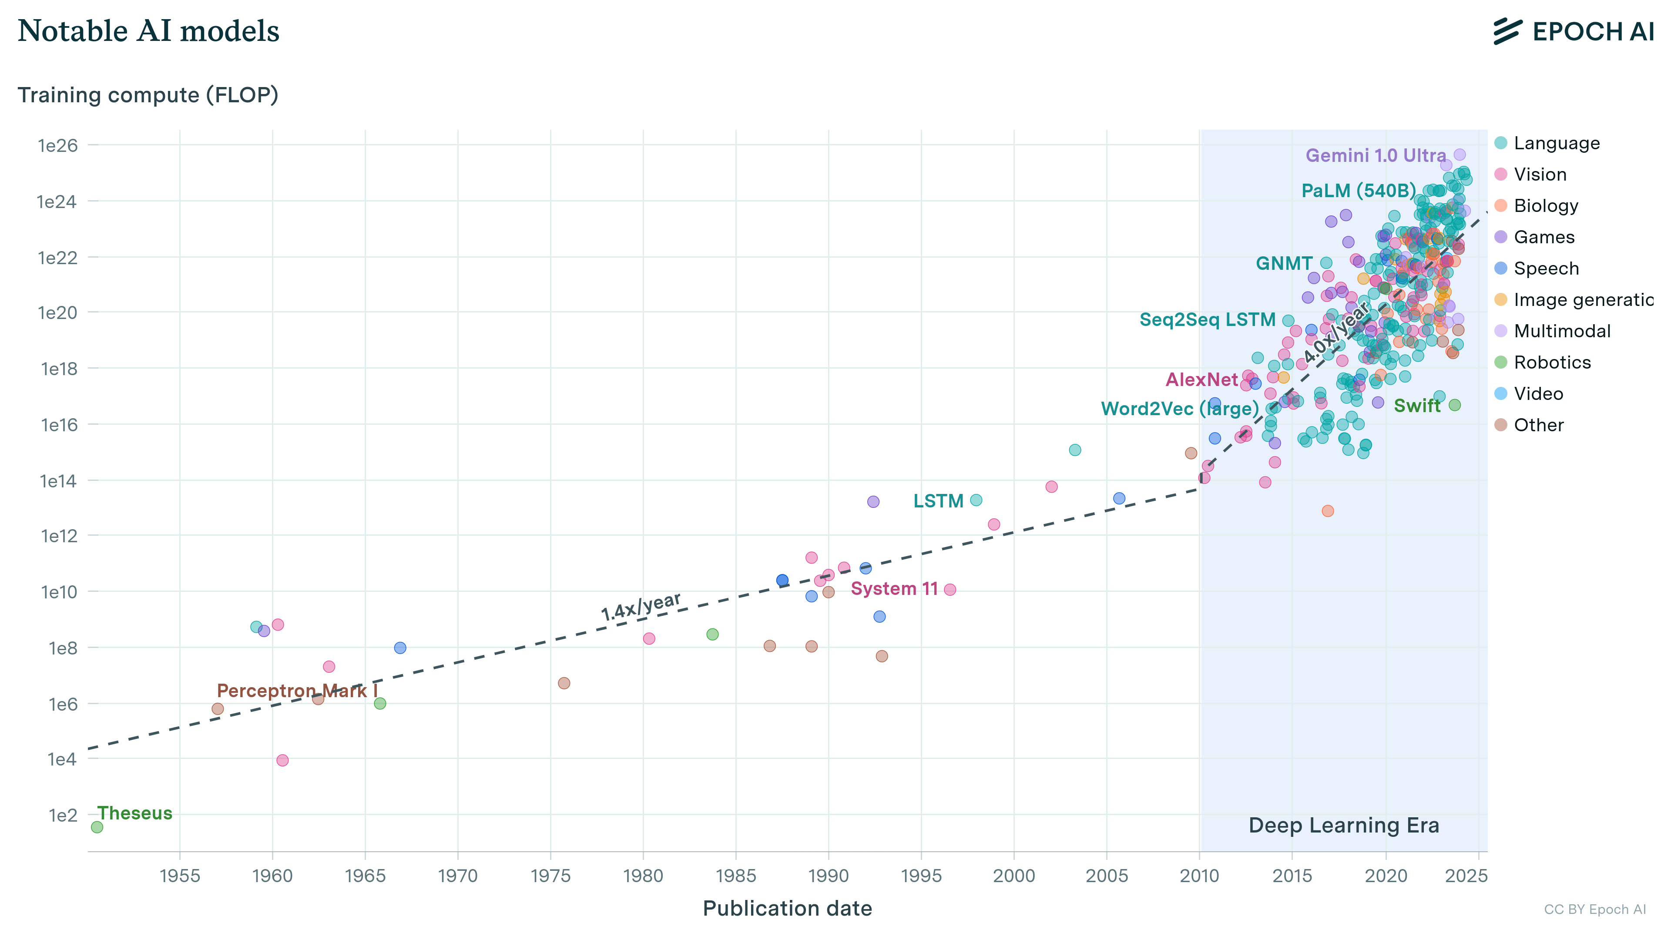
Background: AI Computing Demand
Exponential Growth in AI Compute Needs.
[1 ]J. Sevilla, L. Heim, A. Ho, T. Besiroglu, M. Hobbhahn and P. Villalobos, “Compute Trends Across Three Eras of Machine Learning,” 2022 International Joint Conference on Neural Networks (IJCNN), Padua, Italy, 2022, pp. 1-8, doi: 10.1109/IJCNN55064.2022.9891914.
Notes:
Let’s start from the background. As we all know, the demand for AI computing has been growing exponentially in recent years, especially with the emergence and development of large language models. Deep learning models are becoming larger and more complex, driven by scaling laws. This creates an unprecedented demand for computing power.

Slide 4




Background: Insufficient Computing Resources
Limitations of Centralized Cloud Services
Underutilization of Enterprise Computing Resources
The Difficulty of Resource Sharing Without Platforms
Notes:
However, centralized cloud services such as AWS or Azure cannot always keep up with this growth. The shortage of computing power has made cloud computing and services prohibitively expensive, even leading to service congestion and outages.
At the same time, many enterprise-level or institutional clusters remain underutilized. This is primarily because computational demand is highly volatile, and small to medium-sized enterprises lack a sufficient pipeline of tasks to create a stable and balanced workload. So, we wat to make better use of these idle resources.
However, resource sharing is not straightforward. Without a common platform, organizations cannot easily offer their unused clusters to external users.
This results in wasted computational power while researchers and companies still face shortages.

Slide 5
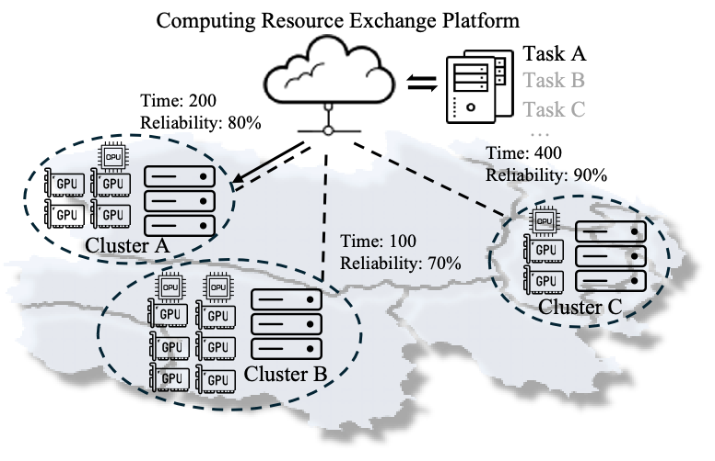
Computing Resource Exchange Platforms
Pipeline:
Cluster performance prediction: Computing tasks have varying preferences for different computing clusters, such as time and reliability.
Cluster-task matching: Based on preference predictions, the platform allocates tasks to the optimal computing cluster.
Notes:
Thus, computing resource exchange platforms have emerged. These platforms connect idle clusters with tasks that need resources, much like a marketplace.
But to work well, these platforms must solve two core problems: predicting cluster performance, and matching tasks to the right clusters.
Let me illustrate how such a platform works.
On the one hand, different from centralized cloud services, clusters here are highly heterogeneous. They differ in execution time for tasks and in reliability — meaning the probability that a task finishes without failure, which is highly dependent on the physical connection state.
On the other hand, tasks have different requirements. Some may run faster on GPU-rich clusters, while others require more serial computation and high-frequency CPUs.
So, the platform must predict the performance metrics of each cluster, and then match tasks to the most suitable clusters.
This is essentially a two-step pipeline: prediction, then matching.

Slide 6

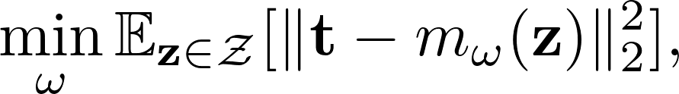
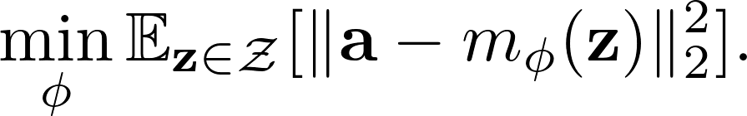
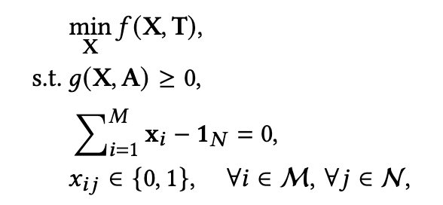


Problem Definition
This corresponds to the following two optimization problems.
Cluster performance prediction: Minimize the MSE loss between the predicted and true values on the set of tasks .
Cluster-task matching: Solve the optimal bipartite matching problem to minimize the total execution time under the reliability constraint.
Notes:
Formally, we have the following two optimization problems.
First, cluster performance prediction: we aim to minimize the error between predicted execution time and reliability and their true values. Typically, mean squared error is used.
Second, cluster-task matching: we solve an optimization problem that assigns tasks to clusters so as to minimize overall execution time, while ensuring reliability constraints.
This framework is known as predict-then-matching.

Slide 7
Predict-then-Matching Limitations
The objectives of the two optimization problems in the Predict-then-Matching framework are not aligned.
Independent predictors: Optimized for MSE.
Misalignment with downstream matching: Wrong decisions even with small prediction errors.
Notes:
However, this two-stage framework has limitations.
The predictors are trained to minimize mean squared error, but this objective is misaligned with the downstream matching goal.
Even small prediction errors can lead to incorrect task assignments, because matching is no linear and highly sensitive.
So, optimizing for accuracy alone does not guarantee good decisions.

Slide 8



Predict-then-Matching Limitations: An Example
Prediction
Matching
Independently trained with MSE loss
Cluster A
Downstream tasks can amplify the effects of prediction errors.
Predictor: Task 2 to Cluster A
Cluster B
Truth: Task 2 to Cluster B
Matching-Focused Prediction
Cluster A
Cluster B
Predictor: Task 2 to Cluster B
High weight
Low weight
Truth: Task 2 to Cluster B
Notes:
Here is a simple example.
Suppose we have two clusters and one task. The predictor, trained independently,
estimates that Cluster A is better. But in reality, Cluster B would have been the better choice.
This misalignment comes from focusing only on prediction error, not on the final decision quality.
Therefore, we need a new approach that integrates prediction and matching.
Our idea is to train predictors not only to minimize prediction error, but to directly improve matching accuracy.
We assign higher learning weights to tasks that matter more for cluster-task matching. As a result, the matching results generated by the trained model will align with the ground truth.
Here in the example, we say different loss weights are assigned to different tasks. To be more accurate and formal, we aim to align the loss function of the predictor with the matching error.

Slide 9
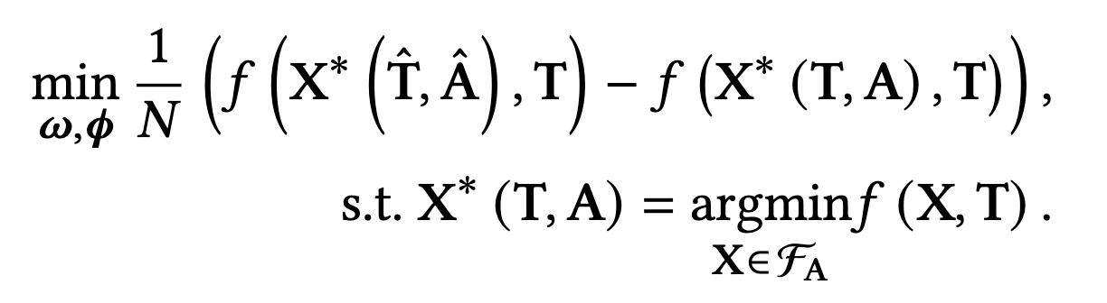
Our Solution: Joint Prediction and Matching
We integrate prediction and matching into a bi-level optimization problem.
The upper-level: Select the optimal parameters to minimize the distance between the matching solution based on predicted values and the matching solution based on true values, which we refer to as regret.
The lower-level: Select the optimal matching decision that minimizes the cost function within the feasible domain under the reliability constraint.
Notes:
By integrating prediction and matching into a unified optimization framework, we ensure that the predictor is aligned with the downstream objective.
This leads to better decisions, even if predictions are not perfectly accurate.
To formalize this, we design a bi-level optimization problem.
The upper level chooses predictor parameters to minimize the regret, which is the difference between the matching based on predictions and the matching based on ground truth.
The lower level selects the optimal matching decision given the predictions, subject to the reliability constraint.
This joint framework ensures that prediction is directly optimized for decision-making.

Slide 10







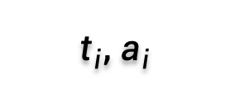


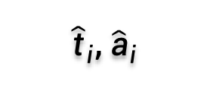




MFCP: System Overview
Matching-Focused Cluster Performance Predictor.
122
Cluster-Task
Matching
$$t_{i},a_{i}$$
Ground
Truth
Matching
Regret
Cluster
$$x^{∗}\left(T,A \right)$$
Prediction
1
$${\hat{t}}_{i},{\hat{a}}_{i}$$
$$ℒ\left({\hat{x}}^{∗},x^{∗} \right)$$
332
$$\text{Predictor}$$
$$\frac{∂{\hat{a}}_{i}}{∂φ_{i}}$$
$$\frac{∂{\hat{t}}_{i}}{∂ω_{i}}$$
$$\frac{∂x^{∗}}{∂{\hat{t}}_{i}}$$
$$\frac{∂x^{∗}}{∂{\hat{a}}_{i}}$$
$${\hat{x}}^{∗}\left(\hat{T},\hat{A}\right)$$
$$\frac{∂ℒ}{∂x^{∗}}$$
Gradient
Descent
Tasks $z$
$$t_{i},a_{i}$$
Notes:
Our proposed system is called MFCP: Matching-Focused Cluster Performance Predictor.
It has three components: the predictor, the matching algorithm, and gradient computation.
In the forward pass, we first predict the performance of each cluster. Then we run the matching algorithm using these predictions. Finally, we measure the regret by comparing the predicted-based matching with the ground-truth-based matching.
In the backward pass, we propagate gradients backward through this pipeline.
This end-to-end design aligns training with the final goal: good matching.

Slide 11
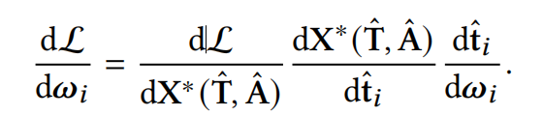
MFCP: System Overview
Matching-Focused Cluster Performance Predictor.
Forward: Prediction -> Matching -> Computing regret.
Backward: Propagate gradients through relaxed optimization.
Key challenge: Backpropagate the gradient of the second term.
Chain rule decomposition of the gradient.
Notes:
In the framework of the entire predictor training, we mainly focus on the backpropagation process. Most parts of this gradient flow follow naturally from the standard chain rule.
However, there is one key exception: the second term of the chain rule, which represents the gradient of the matching decision with respect to the predicted performance. This term cannot be directly obtained, because the matching algorithm itself involves an optimization problem.
Therefore, the central challenge of MFCP is how to compute or approximate this gradient in a meaningful and effective way, so that the entire framework remains trainable in an end-to-end manner.

Slide 12
Challenge 1: Non-differentiability
The inherent non-differentiability of the optimization problem.
Matching is discrete.
Execution time uses max, which is non-smooth.
Reliability constraints yields zero or infinite gradient.
Notes:
To compute the gradient, there are two main challenges.
The first challenge is the inherent non-differentiability of the optimization problem. It comes from three points.
First, the matching problem is discrete. The optimization problem is an integer optimization problem. This directly results in the optimal matching decision X∗ being a step function with respect to the predicted values ˆ T and ˆ A, leading to either non-differentiability or vanishing gradients.
Second, the execution time function uses a max function which is non-smooth. As a piecewise linear function, 𝑓 (X,T) exhibits unequal left and right derivatives at certain points due to the max operation.
Third, reliability constraints lead to zero or infinite gradients. We the constraint is satisfied, it yields zero gradient, and while reliability lies on the boundary of the feasible set, it results in an infinite gradient.

Slide 13
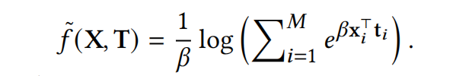
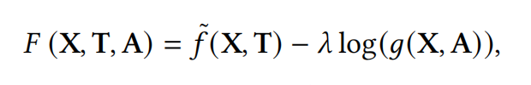
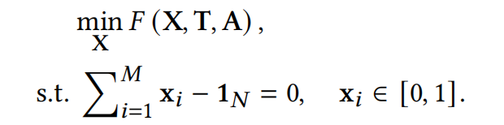
Solution to Challenge 1
Continuous relaxation (binary -> [0,1]).
Smooth approximation of max (log-sum-exp).
Interior-point method for reliability constraints.
Notes:
To handle the problem of non-differentiability, we applied three key techniques.
For the first point, we used continuous relaxation. This means we softened the strict binary matching decisions into continuous values between zero and one.
For the second point, we introduced smooth approximation. Specifically, we replaced the non-differentiable max function with a differentiable log-sum-exp function.
And third, we incorporated interior-point methods. This approach converts hard constraints into soft barrier terms, which ensures that we still get meaningful gradients even when reliability constraints are active.

Slide 14
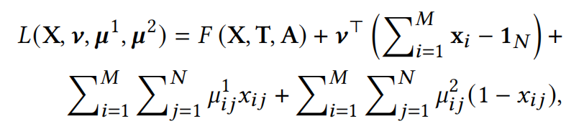
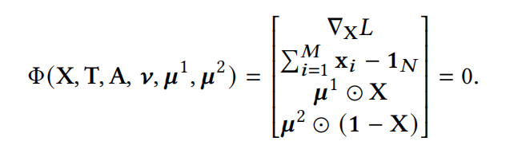
Challenge 2: Gradient Computation
As the matching optimization is convex.
The Lagrangian of the optimization is:
The optimal matching must satisfies the following KKT conditions.
Notes:
In addition to non-differentiability, the second major challenge is gradient computation.
When the matching optimization is convex, we can leverage the structure of convex optimization. Specifically, we construct the Lagrangian of the problem. The optimal matching must satisfy the Karush–Kuhn–Tucker conditions, which provide a set of equations linking the decision variables and constraints.
By analyzing these KKT conditions, we can formally describe how small changes in the predicted execution time and reliability affect the optimal matching decision. This gives us a principled way to propagate gradients through the matching module. The key point is that, unlike a black-box solver, we can differentiate through the optimization process itself using these conditions.

Slide 15
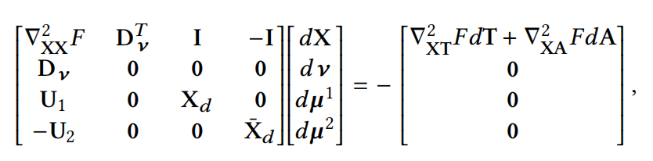
Challenge 2: Gradient Computation
As the matching optimization is convex.
Then we can obtain the analytical gradients by taking the total derivative.
Notes:
Building on the KKT formulation, we can go one step further.
By taking the total derivative of the KKT conditions, we obtain analytical gradients of the optimal matching with respect to predicted cluster performance metrics. This means the gradient of the loss with respect to the predictor parameters can be computed exactly, not approximated, in convex settings.
This analytical approach provides stable and accurate gradients, making end-to-end training feasible. In other words, when the matching problem is convex, MFCP does not need to approximate the gradient—it can compute it directly, ensuring precise backpropagation.

Slide 16
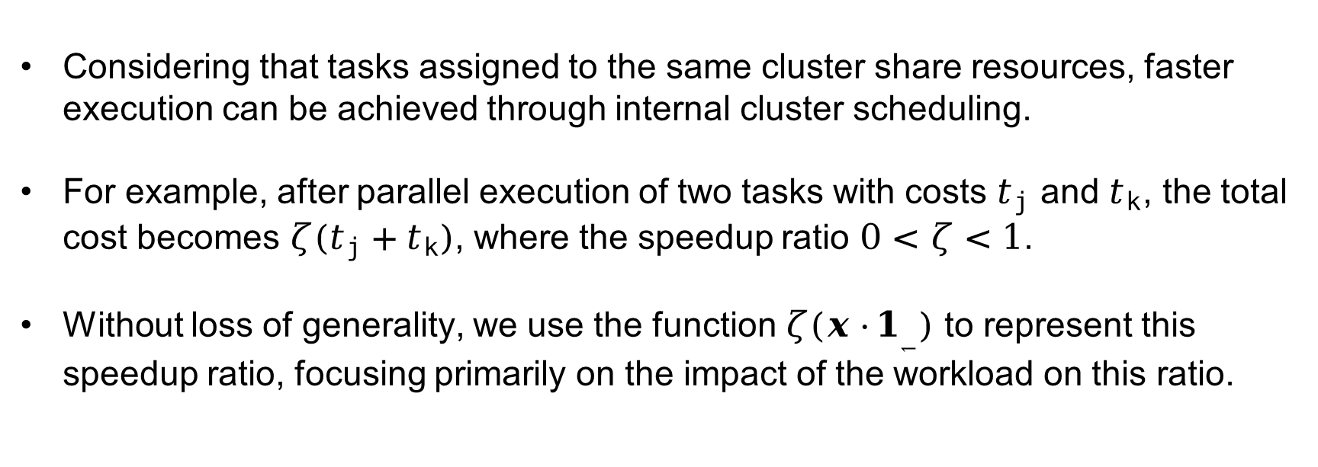
Extension: Non-Convex Matching
Considering scheduling algorithms, the execution time often does not scale linearly with the computational workload.
Considering that tasks assigned to the same cluster share resources, faster execution can be achieved through internal cluster scheduling.
For example, after parallel execution of two tasks with costs $t_{1}$ and $t_{2}$, the total cost becomes $ζ(t_{1}+t_{2})$, where the speedup ratio $0<ζ<1$.
Without loss of generality, we use the function $ζ(x⋅1_{N})$ to represent this speedup ratio, focusing primarily on the impact of the workload on this ratio.
Notes:
However, in realistic scenarios the matching problem often becomes non-convex.
For example, when multiple tasks are assigned to the same cluster, scheduling algorithms may execute them in parallel. This introduces nonlinear speedups that depend on the workload. We model this with a speedup ratio function, where the effective time is not simply additive but scaled down by a factor ζ (zeta) that decreases as more tasks are scheduled.
This captures real-world effects but destroys convexity. In these cases, the analytical gradient approach no longer applies. We need a more general method to estimate gradients without relying on convexity assumptions.

Slide 17
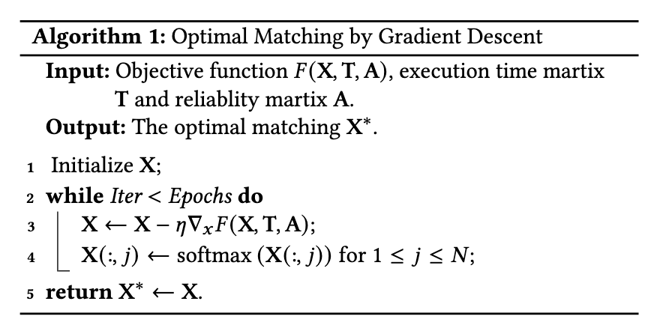
Extension: Gradient Computation
Estimate the gradient of the matching algorithm via zero-order methods.
Notes:
To handle non-convex cases, we estimate gradients using zeroth-order methods.
The idea is simple: we perturb the predicted values slightly, re-run the matching optimization, and measure how the solution changes. By aggregating these changes across random perturbations, we obtain a forward gradient estimate.
This approach treats the matching algorithm as a black box, yet still provides informative gradients for training. While approximate, zeroth-order estimation makes MFCP robust in practical non-convex scenarios, such as parallel execution. This ensures the framework can be trained end-to-end under both convex and non-convex conditions.

Slide 18
Experimental Setup
Dataset: Xirang platform logs.
Models: GNN for task features, predictors with FC layers.
Metrics: Regret, Reliability, Utilization.
Baselines: TAM, TSM, UCB, MFCP-AD, MFCP-FG.
Notes:
To evaluate our proposed MFCP method, we conducted extensive experiments using real-world data from the China Telecom Xirang computing platform.
Our testing covered a diverse set of benchmarks, including computer vision tasks like CIFAR-10 and ImageNet, as well as natural language processing models using the Europarl dataset.
In terms of methodology, we represented tasks as feature vectors using graph neural networks, and then fed these into fully connected layers for performance prediction.
We focused on three key evaluation metrics: regret, which measures decision quality; reliability, which counts successful completions; and overall cluster utilization.
Now, to put MFCP to the test, we compared it against several strong baselines.
First, TAM: a naive method that ignores task differences and just uses average cluster performance.
Second, TSM: a two-stage method that first predicts performance and then solves the matching problem.
And third, UCB: a robust method that selects matches based on upper confidence bounds to handle uncertainty.
We also included two of our own variants for ablation study:
MFCP-AD, which uses analytical differentiation for convex problems.
And MFCP-FG, which uses forward gradient propagation for non-convex scenarios.
This comprehensive comparison allows us to rigorously validate the effectiveness and versatility of our main approach, MFCP.

Slide 19
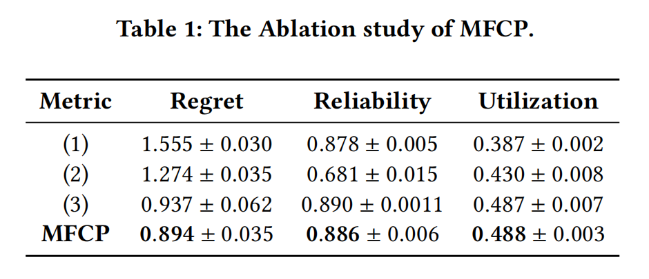
Ablation Study
Linear vs. max loss.
Hard vs. soft penalty.
Gradient computation vs. zeroth-order estimation.
Notes:
In our ablation study, we tested three aspects.
First, replacing the max loss with a linear function significantly worsened results, showing the importance of proper loss design.
Second, replacing soft penalties with hard penalties reduced reliability satisfaction.
Third, zeroth-order gradient estimation, while approximate, performed competitively with exact gradients, validating its use in non-convex scenarios.
Overall, these results confirm that each design choice in MFCP is necessary.

Slide 20
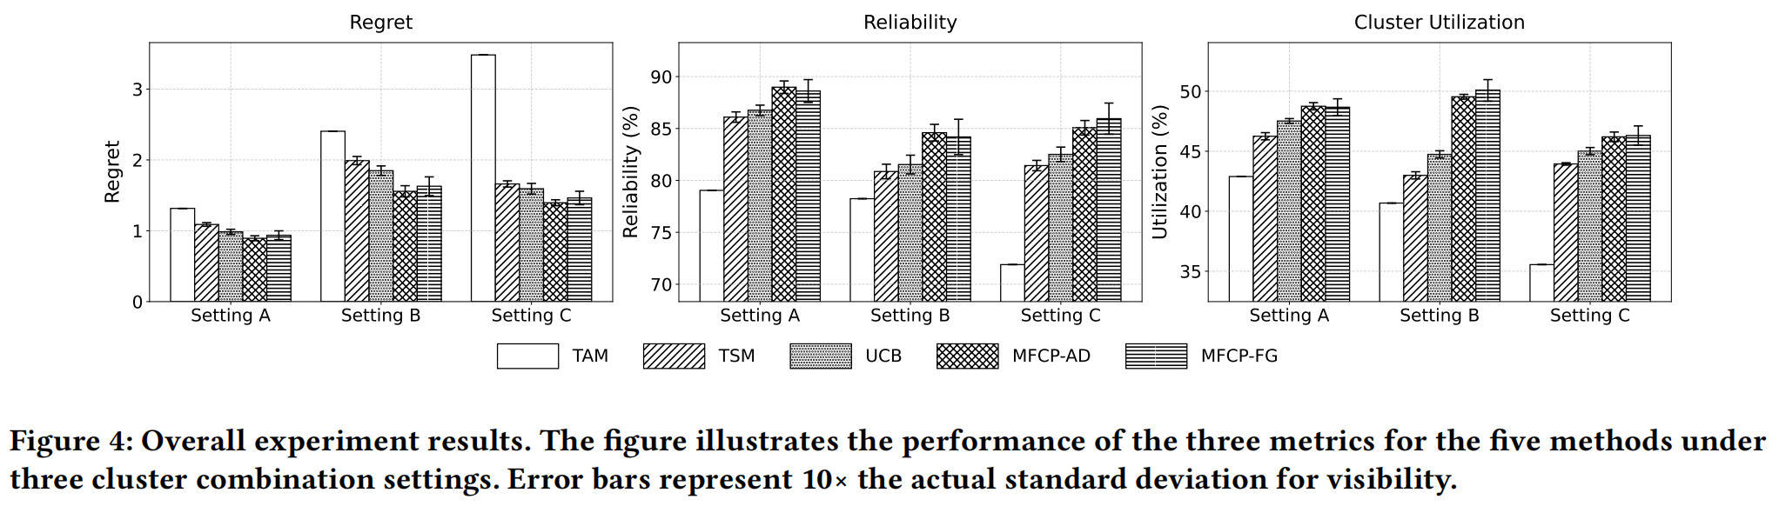
Overall Performance
Results across different cluster combination settings.
MFCP achieves lowest regret, higher utilization.
Notes:
Here we compare five methods across different cluster settings.
MFCP consistently achieves the lowest regret, meaning more accurate matching.
It also achieves higher reliability than baselines, thanks to the interior-point method.
Finally, MFCP leads to higher cluster utilization, distributing tasks more evenly and reducing total execution time.
These results demonstrate the effectiveness of our approach.

Slide 21
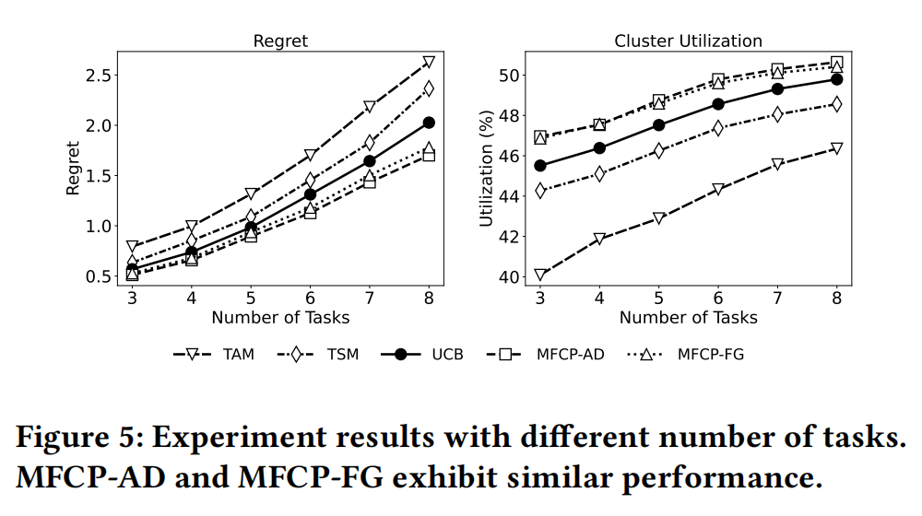
Scalability
Performance with more tasks.
MFCP remains lowest regret with higher utilization.
Notes:
We also tested scalability by increasing the number of tasks.
All methods show increasing regret as tasks grow, but MFCP remains consistently better than baselines.
In terms of cluster utilization, MFCP again achieves the highest values, showing that it scales well to larger workloads.

Slide 22
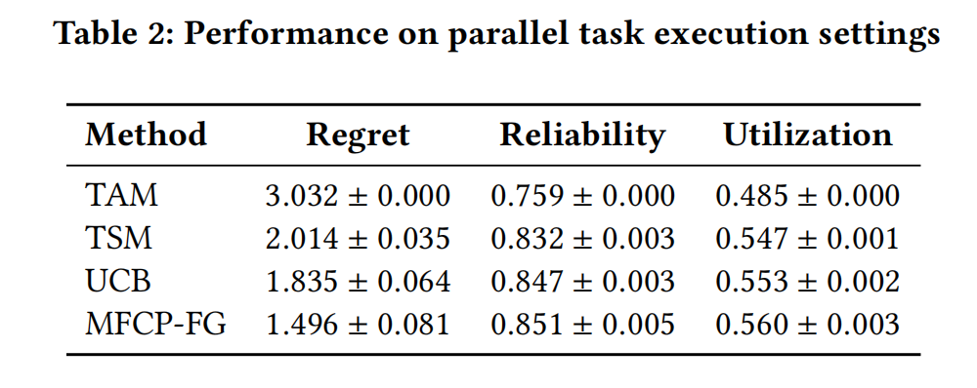
Parallel Execution Scenario
We modeled the speedup ratio in the form of an exponential decay curve to evaluate the method's performance under parallel task scenarios.
MFCP-FG outperforms baselines under non-convex conditions.
Notes:
Finally, we evaluated a more realistic setting: parallel task execution.
Here, clusters can run multiple tasks simultaneously, with diminishing speedup. This creates a non-convex optimization problem.
Even under these conditions, MFCP with forward gradient estimation outperformed all baselines, achieving lower regret and higher utilization.
This shows MFCP’s robustness to complex, real-world conditions.

Slide 23
Conclusion
MFCP integrates prediction with matching, and forms it as a bi-level optimization problem.
By computing the gradient of the optimal solution of the matching optimization problem with respect to its parameters, this lower-level optimization problem can be incorporated into the end-to-end training of the predictor.
For convex matching optimization problems, we can use the KKT conditions to compute the gradients, whereas for more complex non-convex optimization problems, we can employ zero-order gradient methods for estimation.
Notes:
To conclude:
We proposed MFCP, a framework that integrates cluster performance prediction with task matching into a bi-level optimization problem.
We solved key challenges of non-differentiability and gradient computation using relaxation, smoothing, interior-point methods, and zeroth-order estimation.
Experiments on real data show that MFCP achieves lower regret, higher reliability, and better utilization compared to baselines.
This work provides a promising solution for improving the efficiency of computing resource exchange platforms in the AI era.
Thank you for your attention, and I’d be happy to take any questions.

Slide 24
Thank you
Notes:
Thank you for your attention, and I’d be happy to take any questions.

