Slide 1
DeadDrop-in-a-Flash
Information hiding in SSD NAND Flash memory

Slide 2
Overview
Introduction
SSD background
  Flash Translation Layer
  Reference SSD and Open SSD
Design
Implementation
Experiment and results

Slide 3
Introduction
A novel attempt at information hiding at the physical layer of a Solid State Drive (SSD).
Proposed solution is filesystem and OS-independent.
Our framework takes advantage of the design complexity in SSDs and uses them as covert channel.
Proposed method is resistant to firmware updates and transparent to the OS and the user.
The only attempt to hide information in flash (Thumb drives) was by Wang et. Al. They were able to hide up to 64 MB of data on 32GB thumb drive. While utilizing our framework one can hide up to 2 GB of information in a 32 GB SSD.

Slide 4
SSD Background
A data storage device using integrated circuits and assemblies.
Better in performance than traditional hard disk drives.
Most current SSD’s utilize NAND flash cells.
Basic read and write unit is page.
Basic erase unit is a block.
A page has to be erased before write and hence the block holding the page has to be erased.
Should support the sector and track based access of the operating system.
Bank
Die
SSD
Page
Block

Slide 5
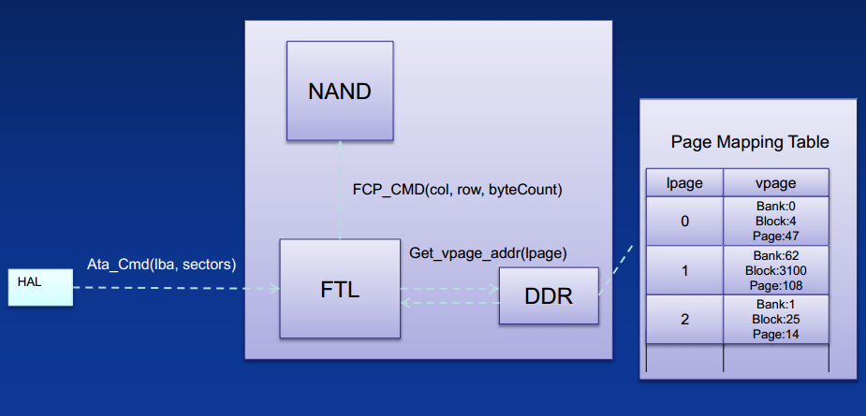
Flash Translation Layer(FTL)
Takes care of the logical to physical mapping for the operating system.
Controls the performance boosters
  Bad block management.
  Wear Leveling
  Garbage collection
Over provisioning:
  To support the inbuilt performance boosters, the solid state drives are manufactured with a size greater than advertised size.
  The additional space is never visible to the normal user.
Notes:
Source : Flash Memory Summit 2012, Robert Sykes

Slide 6
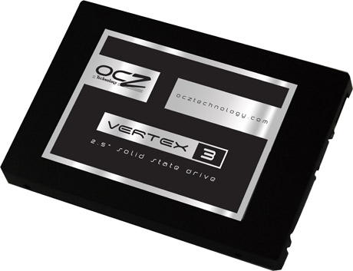
Reference SSD and Open SSD
Reference SSD
  Thirty GB OCZ Vertex series SATA II 2.5” SSD.
  Utilizes Indilinx Barefoot controller.
  Holds 8 flash memory packages with 2 dies in each, each die contains
  4096 blocks with 128 pages in each block.
Open SSD
  Created by Sungkyunkwan University in Suwon, South Korea in collaboration with Indilinx, to promote research and education on SSD technology.
  Provides the firmware implementation for Indilinx Barefoot controller utilized by several SSD manufacturers including OCZ, Corsair, Mushkin and Runcore IV.
Notes:
Source: http://ocz.com/

Slide 7
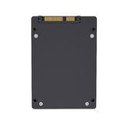

Design
SSD
Retrieve Algorithm
Input
Map-File
?
Generate
Map File
Hiding Algorithm
SSD
Secret
Secret
Bob
Alice
Map-File

Slide 8
Design
Framework to hide and retrieve information.
Utilizes Bad Block Management, which is part of firmware.
Bad block management is handled through a bad block list, holding the
list of blocks identified to be bad.
Add a set of blocks to the existing bad block list and utilize them to
hide information.
Problem: Can’t exceed the maximum allowed bad blocks.
Page 0
Block0
12
13
25
32
46
Bad Block List

Slide 9
Implementation
Command line interface with functionalities to
  Allocate bad blocks prior to hiding and retrieving information.
  Uniquely identify the blocks added by us with the erase count added to
  the first byte of each added block.
  Generate Map file to uniquely identify the hidden data.
  Retrieve information with or without erasing the data.
Significance of Erase count
  Differentiates blocks added by us from original bad blocks.
  Blocks wear out and become unusable over continuous erase and write.
  Increment the erase count before write as the blocks are erased before write.
  Pick the block with least erased count each time when information is to be hidden.
0
Data
Bad Block

Slide 10
Research implications
Bad block management is part of overprovisioning.
Adding bad blocks will never result in change in the logical size of the SSD.
The information can be retrieved with the mentioned changes to the SSD:
  Firmware reinstallation
  NTFS format on the drive
  Partitioning the drive
  Populating the drive to its full capacity
None of the existing Anti-forensics can reveal the existence of hidden information tested with
WinHex and FTK imager.

Slide 11
Questions?

Slide 12
Thank You

