Slide 1
Universal Opportunistic Routing Scheme using Network Coding
Abdallah Khreishah, Issa Khalil, and Jie Wu

Slide 2
Enhancing the Performance of Wireless Networks
Why to study the problem?
Wireless multihop networks are becoming integral part of our lives. (Mesh networks, sensor networks, etc..)
The unique features of these networks.
Interference.
Lossy behavior.
Broadcast nature.
Correlation among the links.

Slide 3
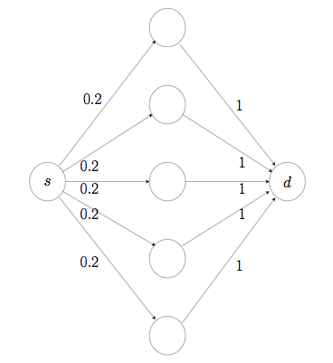
Opportunistic Routing

Slide 4
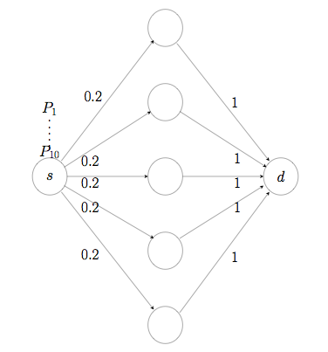
Opportunistic Routing

Slide 5
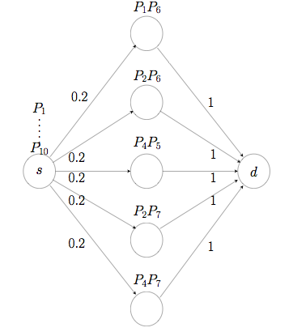
Opportunistic Routing

Slide 6
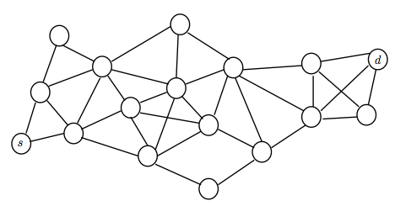
Global Scheduling

Slide 7
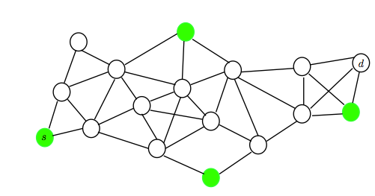
Global Scheduling

Slide 8
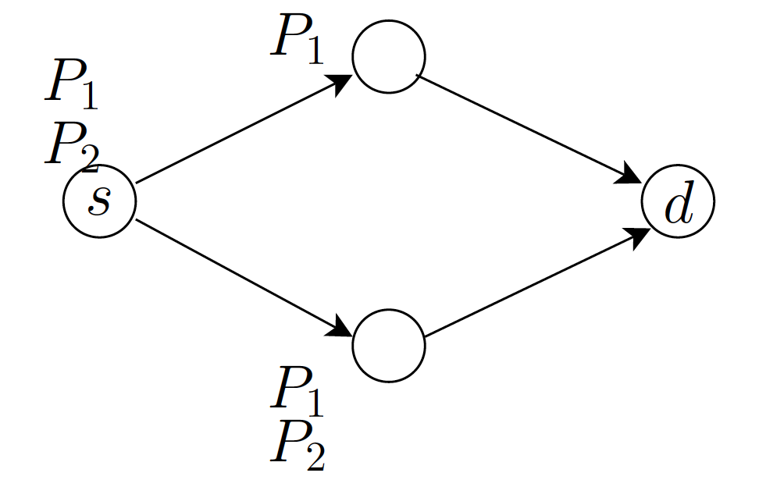
Network Coding

Slide 9
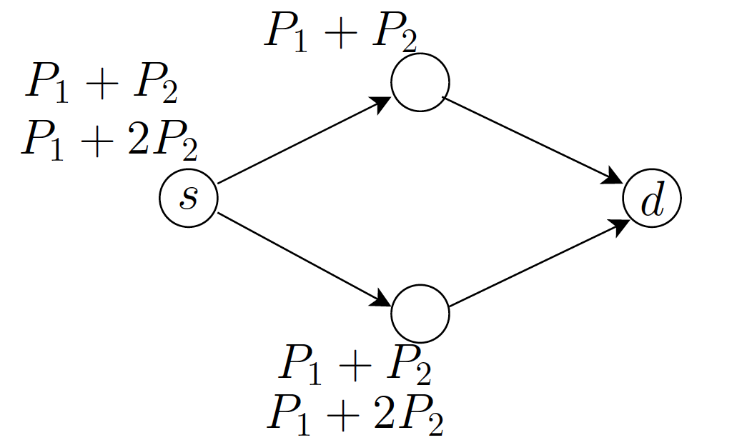
Network Coding

Slide 10
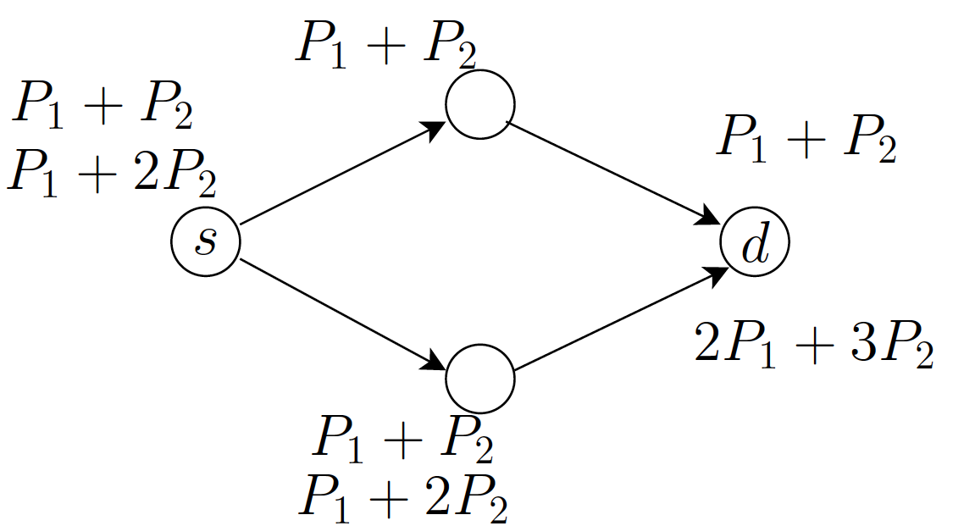
From Which & How many to How many.

Slide 11
How many packets should each node forward?
Assuming independent links: [Chachulski et al., 2007].
Depends on many factors:
The Loss rate of the links.
The fraction of time a node is scheduled.
The correlation among the links. [Srinivasan et al., 2010]

Slide 12
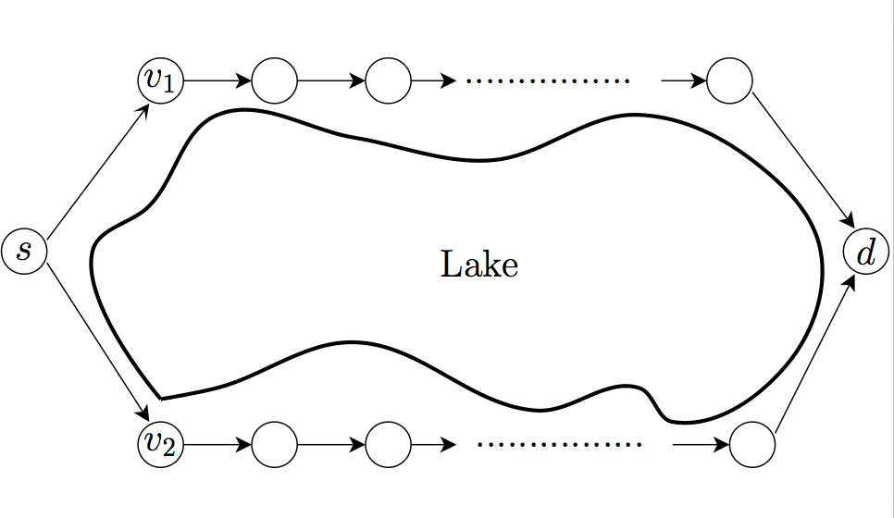
Correlation example

Slide 13
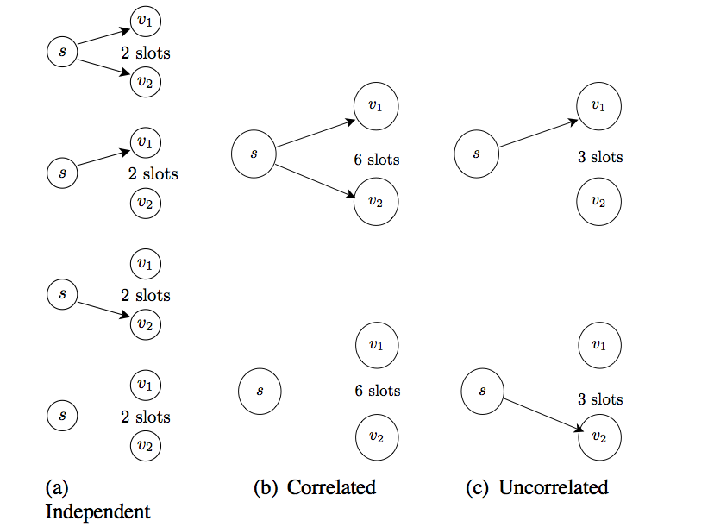
Cont.

Slide 14
Settings

Slide 15
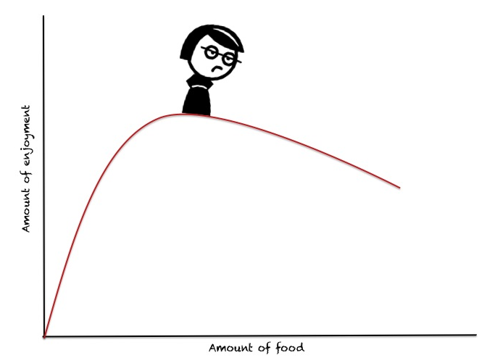
Law of Diminishing Returns

Slide 16
Formulation

Slide 17
The Lagrange

Slide 18
The Lagrange

Slide 19
Distributed algorithm

Slide 20
Virtual Queues Updates

Slide 21
Practical problems
If a node is scheduled to send packets, from which session it should send?
When and how to assign credits to next-hop nodes?

Slide 22
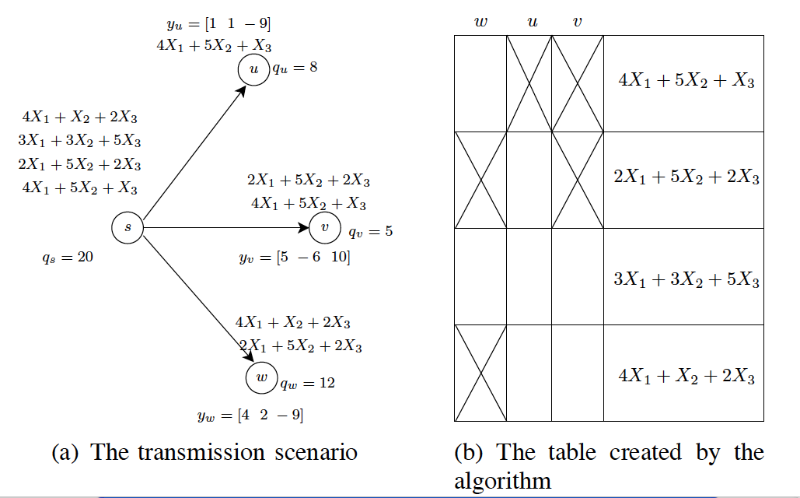
Coded-feedback

Slide 23
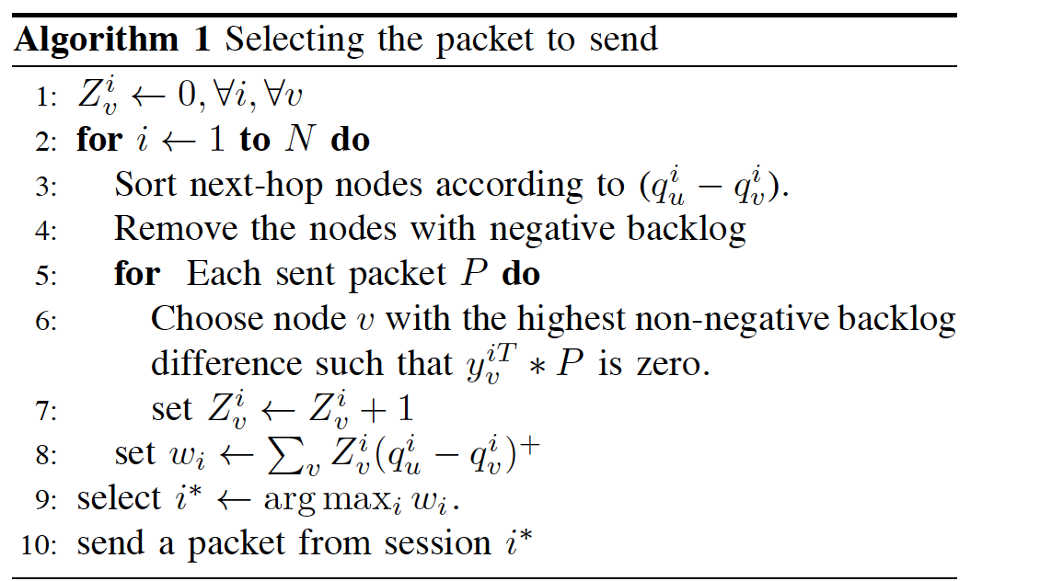
Deciding the packet to send

Slide 24
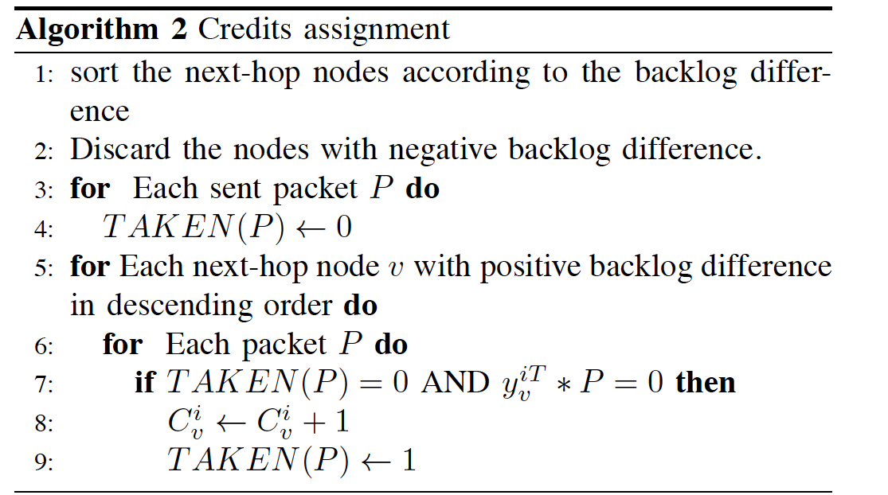
Credit assignment

Slide 25
Convergence

Slide 26
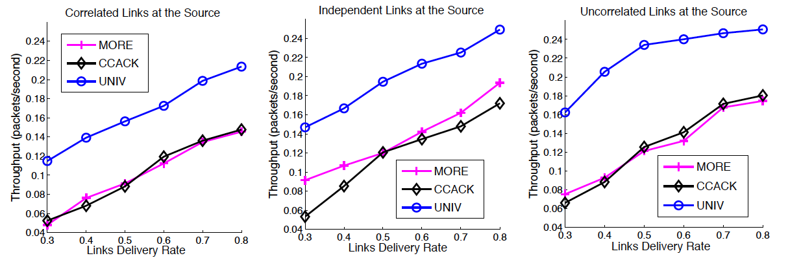
Results

Slide 27
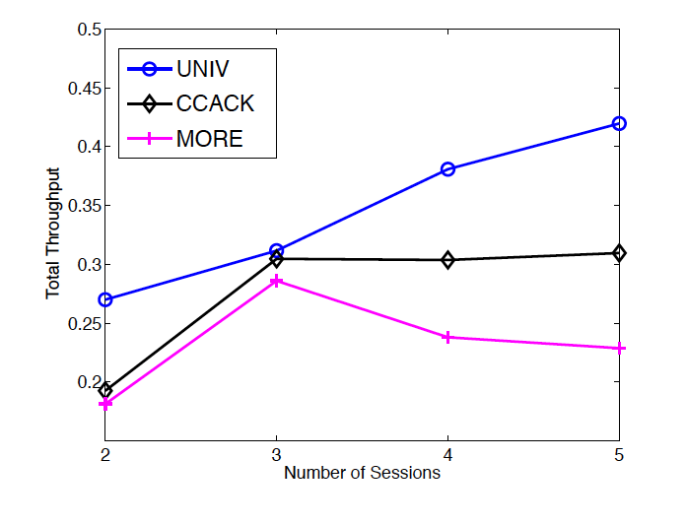
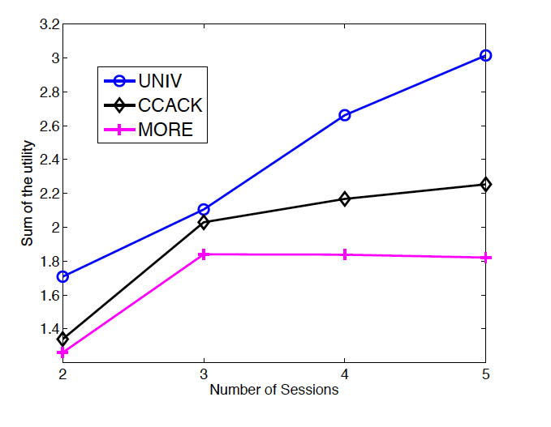
Simulation on Large Topologies

Slide 28
Conclusion
A simple distributed algorithm that achieves the optimal unicast rate in wireless networks.
It is a combination of:
Opportunistic routing.
Intrasession network coding.
Convex optimization.
Coded-feedback.
Arbitrary delivery rates and correlations among the links.

Slide 29
Some Future Directions
Studying Intersession Network Coding.
Studying the Multicast case MobiHoc’12.
Inter-batch coding.
The relationship between interference and correlations among the links.

Slide 30
Thanks
Questions?

