Slide 1
Ryan Houlihan, Xiaojiang Du, Chiu C. Tan, Jie Wu
Temple University
Mohsen Guizani
Qatar University

Slide 2
Introduction
A Service Level Agreement (SLA) is a contract formed between a cloud service provider (CSP) and a user which speciﬁes,
  in measurable terms, what resources the CSP will provide the user. (e.g. CPU speed, storage size, network bandwidth)

Slide 3
Introduction Cont.
CSP is a proﬁt driven enterprise, there is a great incentive for the CSP to cheat on the SLA.
CSP can not guarantee to audit the SLA and to verify that the SLA is being met.

Slide 4
Introduction Cont.
Third Party Auditor (TPA) [1][2] is a framework that is highly beneﬁcial for three reasons:
  Highly ﬂexible and scalable: easily extended to cover a variety of metrics (e.g. memory allocation, CPU usage.
  Support testing for multiple users: increase the accuracy of the cloud testing.
  Remove the auditing and veriﬁcation burden from the user.

Slide 5
Contributions
Develop a novel algorithm for auditing CPU allocation using a TPA framework to verify the SLA is met.
Use real experiments to demonstrate the effectiveness of our algorithm for detecting CSP cheating on the SLA metric of CPU speed.

Slide 6
Threat Model - CSP
CSP has complete control over all its own resources which include physical machines, VMs, hypervisor, etc.
CSP is able to access and modify any data held on the VM (e.g. timestamp)
CSP will only perform cheating if the beneﬁt is greater than the cost.

Slide 7
Threat Model - TPA
The TPA can be trusted by the user to properly carry out the auditing functions while auditing the CSP and verifying the SLA.
TPA can obtain hypervisor source code from CSP to ensure that it does not exhibit malicious behavior.
The TPA must be able to ensure the integrity of the hypervisor. This is provided by Trusted Platform Group (TCG) [3]. The framework for ensuring hypervisor integrity is provided by Hypersentry [4].
Communication time between the cloud system and the TPA is 200 ms or less.

Slide 8
Auditing Test Requirement
Run generic computational task: not easily detected as an audit.
Perform redundant time recording: able to detect the modification of input/output by the cloud system.
Assure the execution of computational task: compute the SHA-1 hash [5] of a NxN matrix.

Slide 9
Implementation
Initialization:
  VM mirroring: create a VM on auditing system that mirrors the specifications of the one on the cloud system.
  NxN matrix creation and upload: create two NxN matrices for multiplication on the TPA, then upload onto the VM on the cloud system.

Slide 10
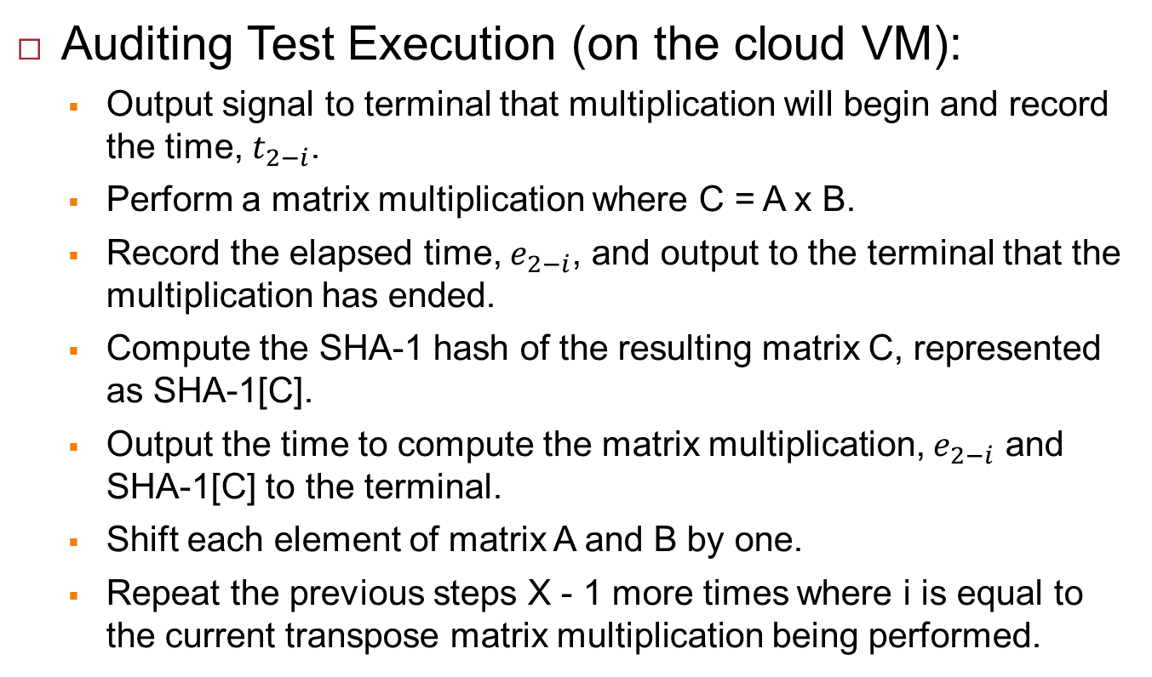
Implementation
Auditing Test Execution (on the cloud VM):
  Output signal to terminal that multiplication will begin and record the time, $t_{2−i}$.
  Perform a matrix multiplication where C = A x B.
  Record the elapsed time, $e_{2−i}$, and output to the terminal that the multiplication has ended.
  Compute the SHA-1 hash of the resulting matrix C, represented as SHA-1[C].
  Output the time to compute the matrix multiplication, $e_{2−i}$ and SHA-1[C] to the terminal.
  Shift each element of matrix A and B by one.
  Repeat the previous steps X - 1 more times where i is equal to the current transpose matrix multiplication being performed.

Slide 11
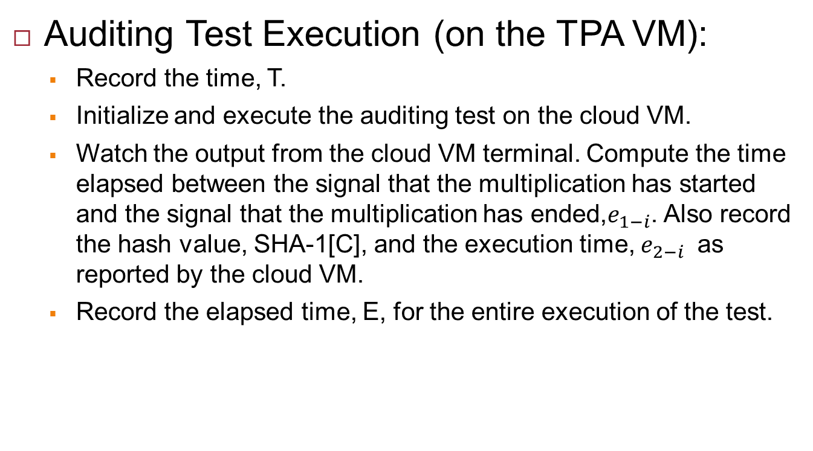
Implementation
Auditing Test Execution (on the TPA VM):
  Record the time, T.
  Initialize and execute the auditing test on the cloud VM.
  Watch the output from the cloud VM terminal. Compute the time elapsed between the signal that the multiplication has started and the signal that the multiplication has ended,$e_{1−i}$. Also record the hash value, SHA-1[C], and the execution time, $e_{2−i}$ as reported by the cloud VM.
  Record the elapsed time, E, for the entire execution of the test.

Slide 12
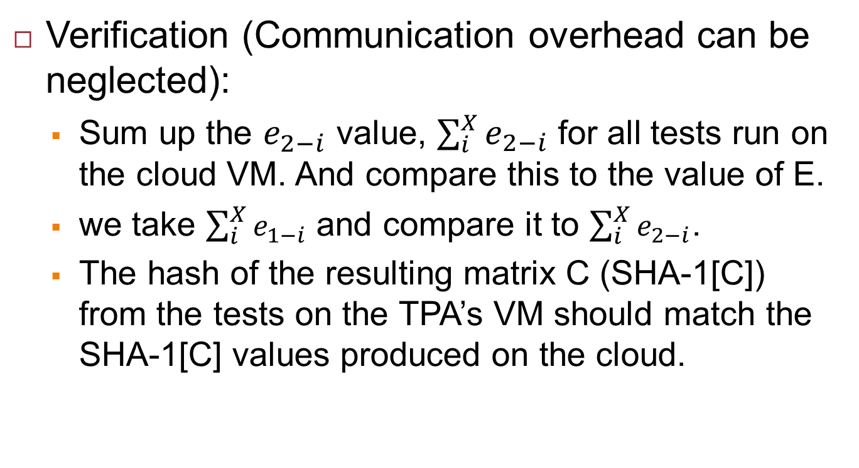
Implementation
Verification (Communication overhead can be neglected):
  Sum up the $e_{2−i}$ value, $\sum_{i}^{X}{e_{2−i}}$ for all tests run on the cloud VM. And compare this to the value of E.
  we take $\sum_{i}^{X}{e_{1−i}}$ and compare it to $\sum_{i}^{X}{e_{2−i}}$.
  The hash of the resulting matrix C (SHA-1[C]) from the tests on the TPA’s VM should match the SHA-1[C] values produced on the cloud.

Slide 13
Testing
Background:
  Ubuntu Server 12.04 LST with Xen DOM-0 Hypervisor 4.1 x64.
  4 Gigs of ram and a Intel Q6600 Quad Core processor.
  The VM used was given one processor with a clock of 1.0 Ghz as well as 1 Gigabyte of RAM.
  1000x1000 matrix of doubles.

Slide 14
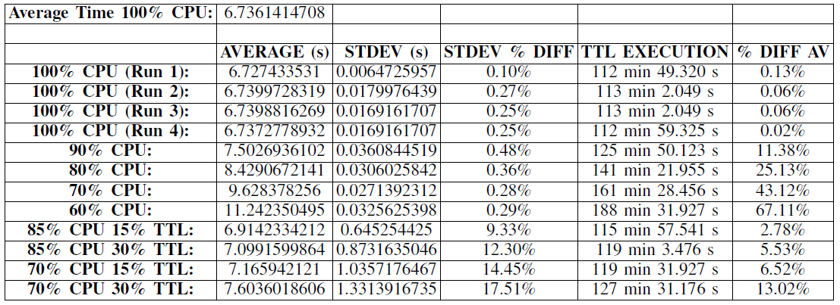
Testing
Results:

Slide 15
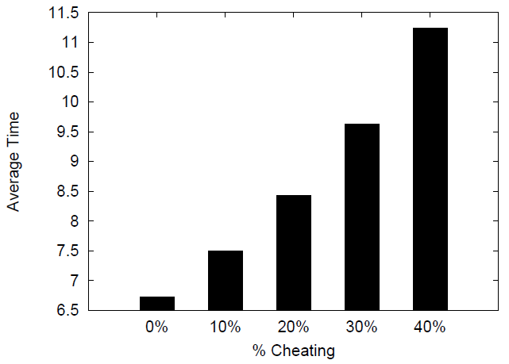
Testing
Results:
  The average time to run a single transpose matrix multiplication based on the percent cheating (100%-CPU Cap %). As the % cheating increases the average run time increases linerealy, as expected.

Slide 16
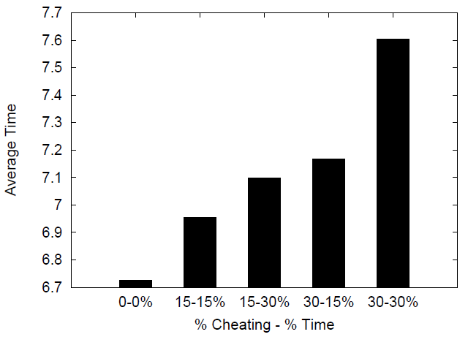
Testing
Results:
  The average time to run a single transpose matrix multiplication based on the percent cheating (100%-CPU Cap %) and the % time the cheating lasts. As the % cheating or the % time of cheating increases the average run time increases as expected.

Slide 17
References
[1] H. Zhang, L. Ye, J. Shi, X. Du. “Veriﬁng Cloud Service-Level Agreement By a Third-Party Auditor,” Security and Communication Networks, 2013.
[2] L. Ye, H. Zhang, J. Shi, X. Du. “Verifying Cloud Service Level Agreement,” Proceedings of IEEE Global Communications Conference (GLOBECOM), pp. 777-782, 2012
[3] Trusted Computing Group. TPM speciﬁcations version 1.2. https://www.trustedcomputinggroup.org/downloads/speciﬁcations/tpm, July 2005.
[4] A. M. Azab, P. Ning, Z. Wang, X. Jiang, X. Zhang, N. C. Skalsky. “HyperSentry: Enabling Stealthy In-context Measurement of Hypervisor Integrity.” Proc. of the 17th ACM Conference on Computer and Communications Security, pp. 38-49, 2010.
[5] Department of Commerce National Institute of Standards and Technology. Secure Hash Signature Standard (SHS) (FIPS PUB 180-2). February 2004

Slide 18
The End
Thank You
Q&A

