Slide 1


Multi-Layer Video Streaming with Helper Nodes using Network Coding
Pouya Ostovari, Abdallah Khreishah, and Jie Wu
Computer and Information Sciences
Temple University
IEEE MASS 2013
Center for Networked Computing
http://www.cnc.temple.edu

Slide 2
Agenda
Introduction
  Network Coding Background
  Priority-Based Network Coding
Layered Video Streaming
  Linear Programming
  Distributed Solution
Conclusions and Future Work

Slide 3
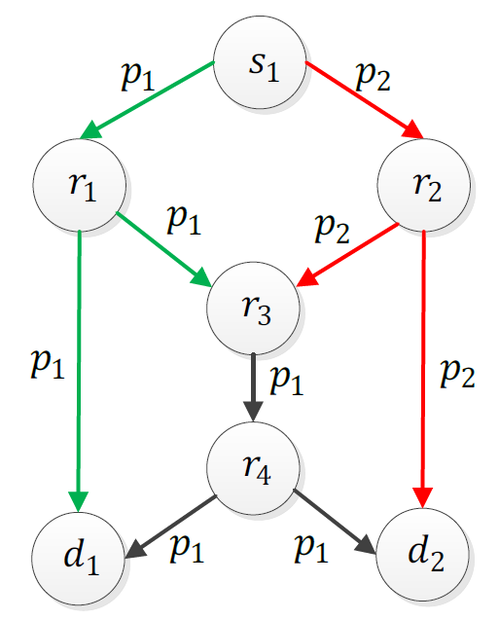
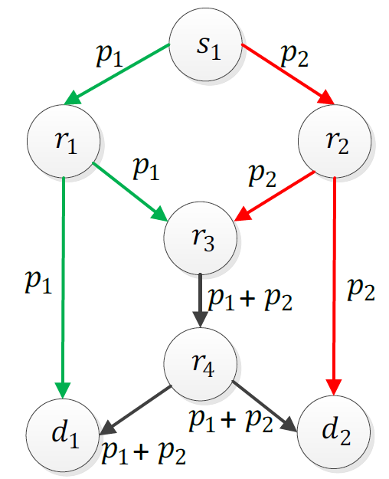
Network Coding in Wired Networks
Single multicast session
  Bottleneck problem (Ahlswede’00)
No coding
Coding
Notes:
Network coding first introduced for wired networks and showed that it can solve the bottleneck problem.

Slide 4
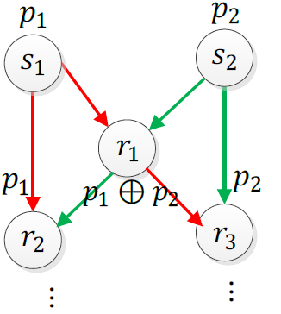
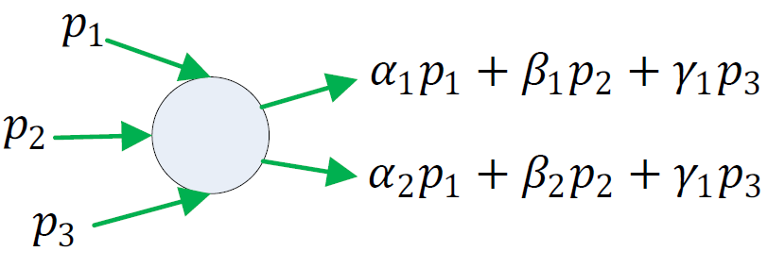
Network Coding Classification
Local
  Hop-by-hop decoding
  XOR operation
Global
  Decoding at the destination
  Linear network coding
  (on a finite field)
Decoding
Decoding
Recoding

Slide 5
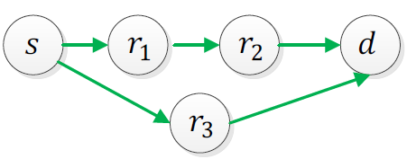
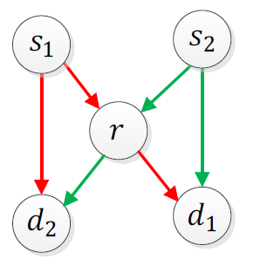
Network Coding Classification
Intra-flow
  Within a flow
  Robustness enhancement
Inter-flow
  Between different flows
  Throughput/capacity enhancement
Joint inter- and intra-flow
  Within flow and between flows

Slide 6
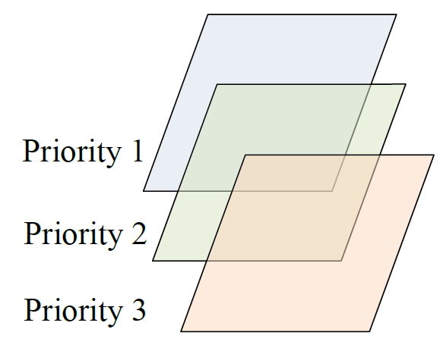
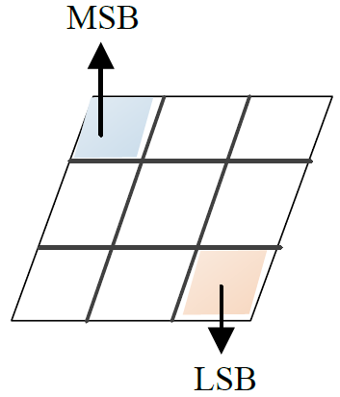
Priority-Based Approaches
  New twist on the classic unequal error protection
  Symbol-Level NC Video Streaming NC

Slide 7
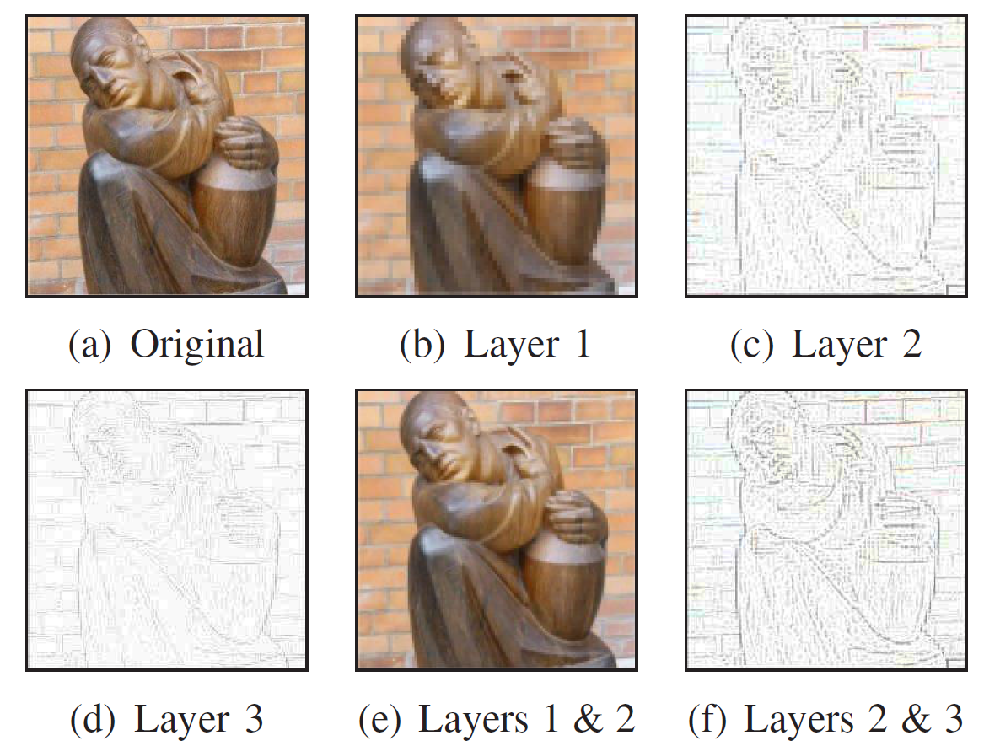
Video Streaming
Delivering video stream using different resolutions to satisfy different client needs/constraints
Multi-Layer Coding
(Multi-resolution)
  Base layer
  Enhancement layers
Multiple Description Coding (MDC)
  Multiple independent video substreams
  Receiving more substreams increases the video quality
Substream_1 | Resolution_1
Substream_2 | Resolution _2
Substream_N | Resolution _N

Slide 8
Inter-Layer Coding Strategies
Random linear network coding (RLNC)
Triangular coding
  Prefix coding
Packets in lower layers are more important
  Included in more coded packets
  More chances to be decoded

Slide 9
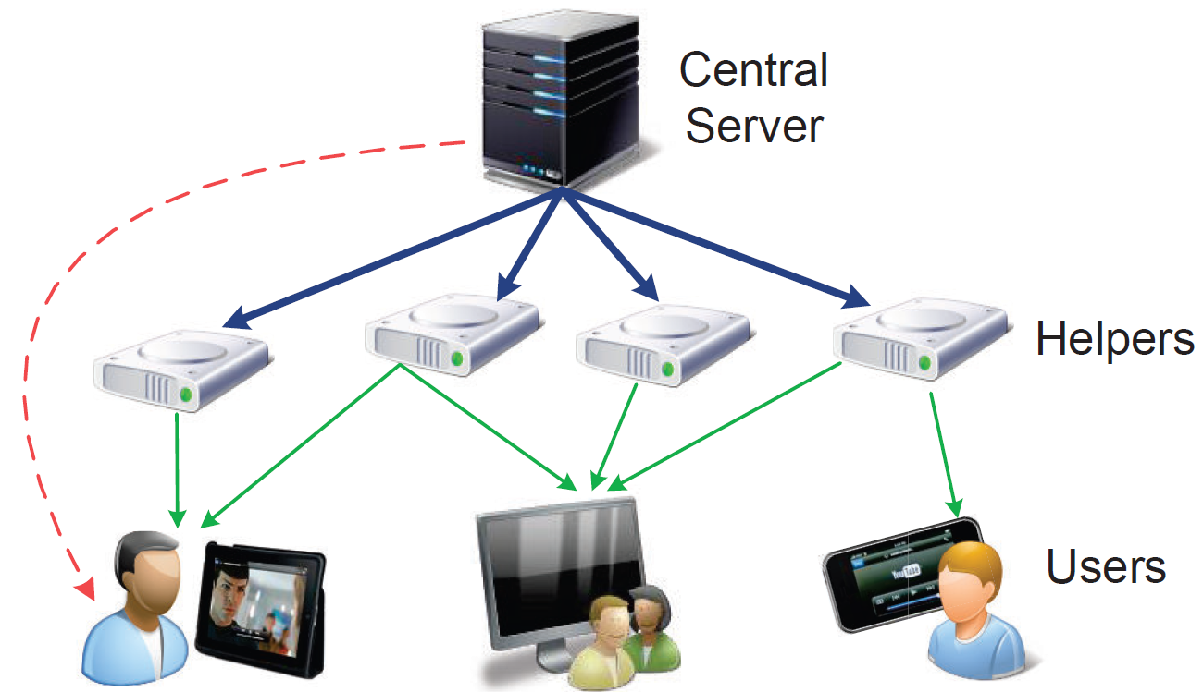
Multi-Layer Video Streaming with Helpers
Links
  Cost: direct download from the server
  Reliable links
Link capacity
  High capacity links: server to helpers
  Low capacity links: helpers to users
Use of helpers
  System scalability for more users
  Helpers: limited capacity and bandwidth

Slide 10
Resource Management
Optimal resource management
Questions:
  Content placement: Which packets of each video should a helper node store?
  Bandwidth allocation: Which packets, and to which users, should each helper serve?
NP-complete
Notes:
The helpers might not be able to store the videos in full.

Slide 11
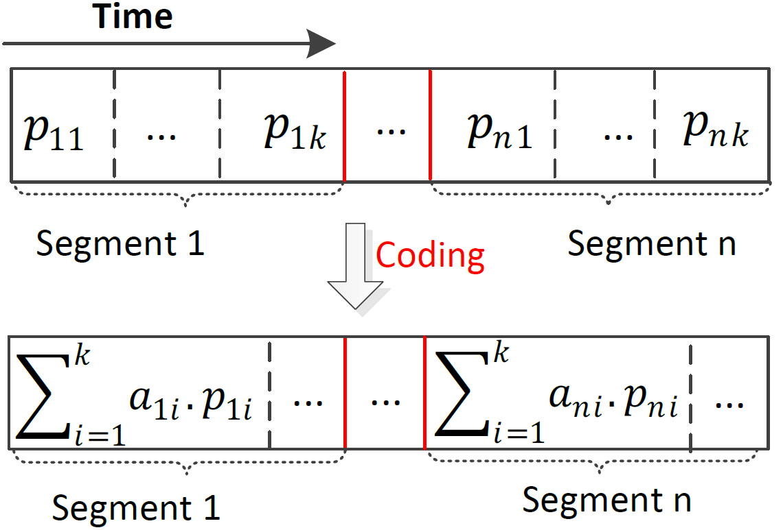
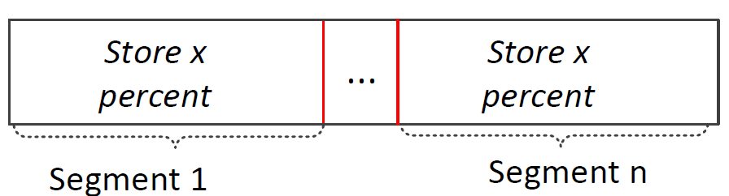
Resource Management (Network Coding)
Network coding changes the problem to a linear programming
Storing x percent of each segment
Movie m
Coded Movie m
No longer NP-complete
  Flow-based model using network coding
Notes:
We partition the video into different segments and code the packets of each segment together.
Using this scheme, we just need to find the optimal rate of the video that should be stored on a helper node.
We find the optimal rate x of each movie that should be stores on each helper node. Then, we store x percent of each segment
Of the movie on the helper node

Slide 12
Multi-Layer Video
Benefits of multi-layer
  Provides smooth playback for the users
  Reduces the load on the server with a fixed number of users
  More layers increases system scalability
Notes:
The users can switch to a lower quality

Slide 13
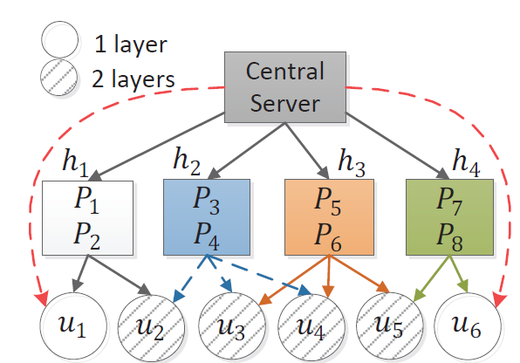
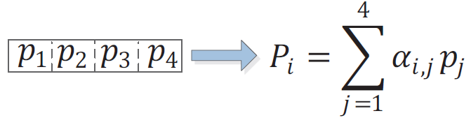
Motivation
Single video with 4 packets
No-layer approach
(Hao et al. 2011)
  4 packets in the same layer
  Load on the server: 4
Notes:
The video contains 4 packets p_1 to p_4. Packets P_1 to P_8 are random linear coded packets.
Users u_1 and u_6 requested 1 layer. However, without layer approach, the helpers can only provide both layers.

Slide 14

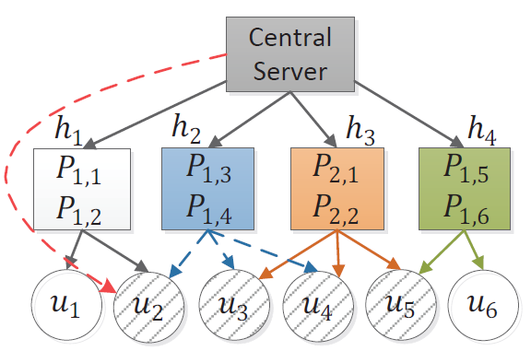
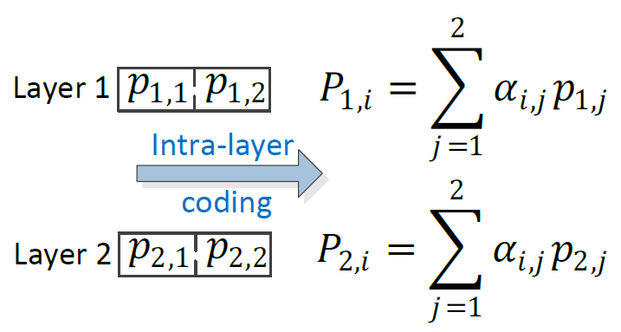
Motivation
Single video with 4 packets
Intra-layer approach
(Ostovari, Khreishah, and Wu, 2013)
  2 packets per layer
  Load on the server: 2

Slide 15
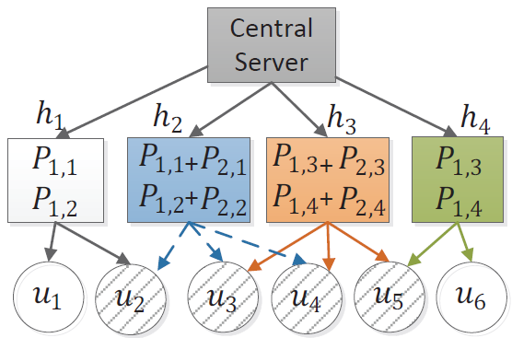
Motivation
Single video with 4 packets
Inter- and intra-layer coding
(Ostovari, Khreishah, and Wu, 2013)
  Prefix coding (Triangular)
  2 packets per layer
  Load on the server: 0
Triangular coding

Slide 16
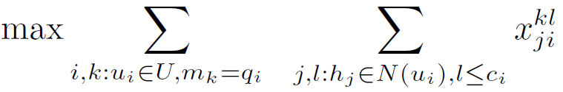










VoD with Intra-Layer NC
Objective function (maximize upload rate from helpers to users)
The upload rate of a helper cannot exceed the rate of the stored videos
: Upload rate of link from helper to user over layer of video
: Fraction of the layer of video that is stored on helper
: Rate of each layer of video
: Adjacent helpers to user
’s request: ( , ) = (quality level, video)

Slide 17
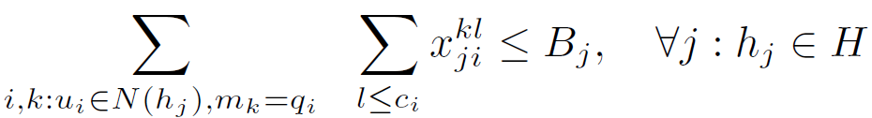
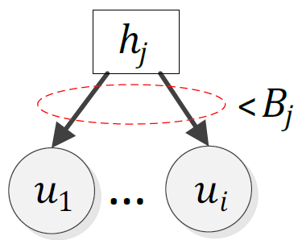
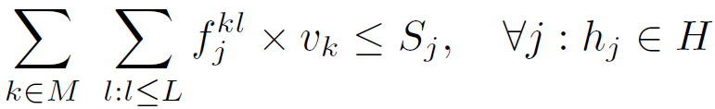
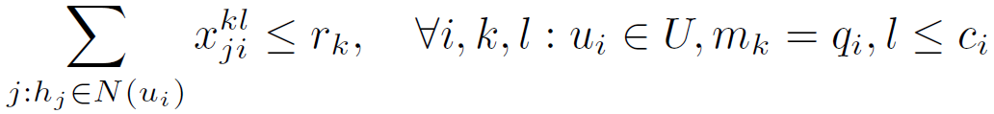



VoD with Intra-Layer NC
Bandwidth constraint from each helper to users
Storage constraint for each helper
Limits the total download of a user to the rate of the video
: The bandwidth limit of helper
: The capacity limit of helper
: Set of videos
L : Maximum number of layers
Notes:
Even in the case that 2 users watch the same movie and they are connected using wireless connection to the same helper node, the helper needs to provide separate bandwidth for the users. The reason is that in VoD applications, these users have a different playback time (they watch different part of the movie)

Slide 18
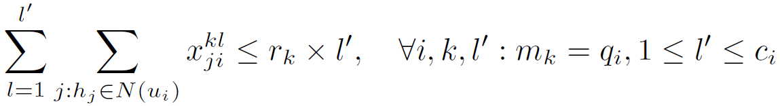
VoD with Inter- and Intra-Layer NC
The difference is in the last constraint
: variable for the prefix relation
The objective function and other constraints are the same
Prefix limit on the download rate of each layer
Intra-layer coding
Inter and Intra-layer coding
Layer 1
< r
Layer 1
< r
Layer 2
< r
Layer 1+2
< 2r
Layer 3
< r
Layer 1+2 +3
< 3r
Notes:
Even in the case that 2 users watch the same movie and they are connected using wireless connection to the same helper node, the helper needs to provide separate bandwidth for the users. The reason is that in VoD applications, these users have a different playback time (they watch different part of the movie)

Slide 19
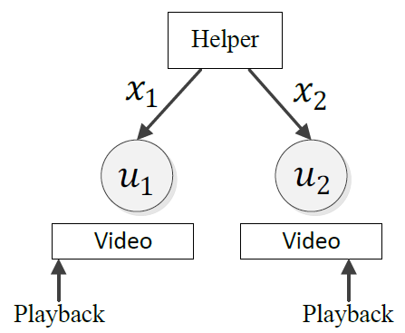
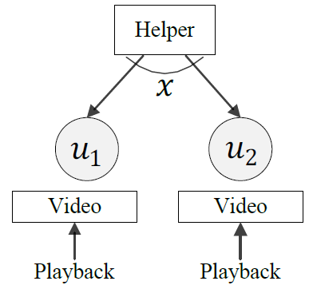



Live Streaming (TV)
Videos are broadcast to the users
Synchronous playback
  Helpers do not need to allocate separate bandwidths to adjacent users that are watching the same video
Total bandwidth:
Total bandwidth:

Slide 20
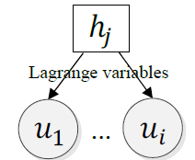
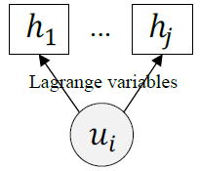
Distributed Algorithm
Dual optimization
  Solving Lagrange dual using the gradient method
Helper
  Start from empty storage and dynamically adjust the amount of stored videos
  Update and transmit Lagrange variables to adjacent users
User
  Update and transmit Lagrange variables to adjacent helpers
Step control
  Slope of changes: fast convergence vs. oscillation

Slide 21
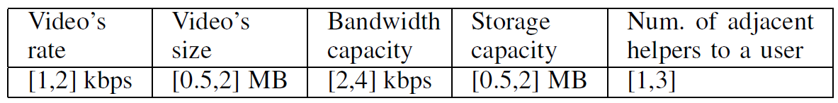
Simulations Setting
MATLAB environment
100 random topologies
  Random connections of helpers and users
  Helpers: random bandwidth and capacity limit
  Users: random requests
Comparing with the optimal non-layer approach
Measuring
  Load on the server
  Convergence to optimal solution in dynamic environments
Notes:
We implemented a simulator in MATLAB environment
We run the simulations on 1,000 random topologies with different links’ error rates
The weight of the i-th symbol are assumed to be…….(in the slide)
We compare the proposed methods with a simple retransmission method, in which the transmissions are evenly distribute among the different symbols of the packets

Slide 22
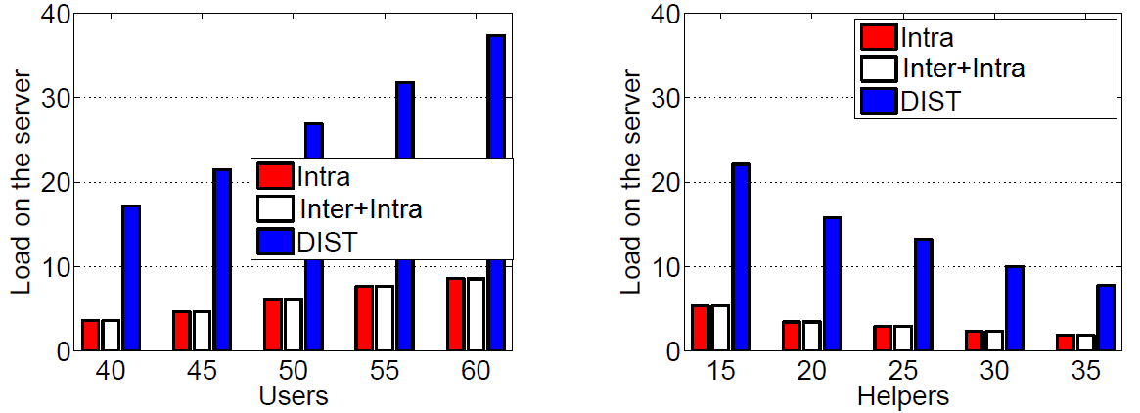


Simulation Results (Load)
VoD
Number of videos: 5
Number of layers: 5
DIST: a non-layer approach with intra-layer coding ( Hao et al. 2011)

Slide 23
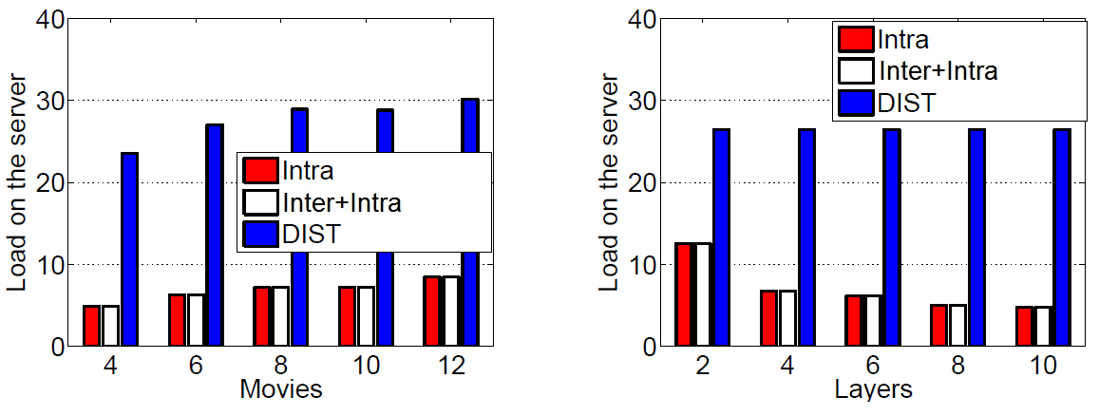


Simulation Results (Load)
VoD
Number of users: 50
Number of helpers: 20

Slide 24
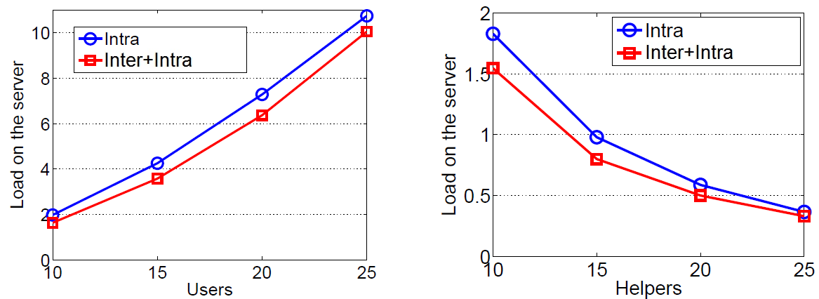


Simulation Results (Load)
VoD
Number of layers: 4
Single video

Slide 25
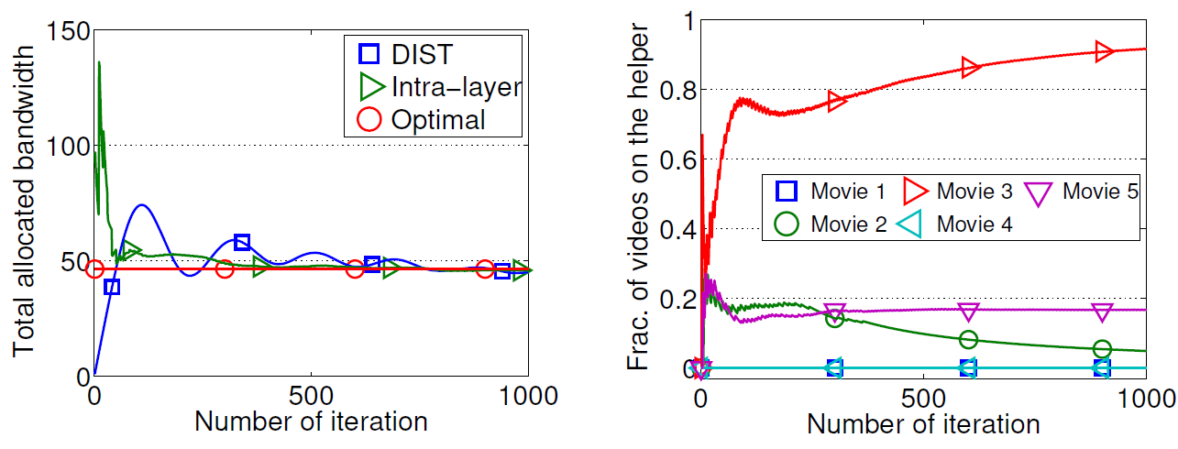
Simulation Results (Convergence)
Users: 50
Helpers: 20
VoD
Layers: 4
Videos: 5
Convergence to the optimal solution (LP)
The fraction of each video on helper h5

Slide 26
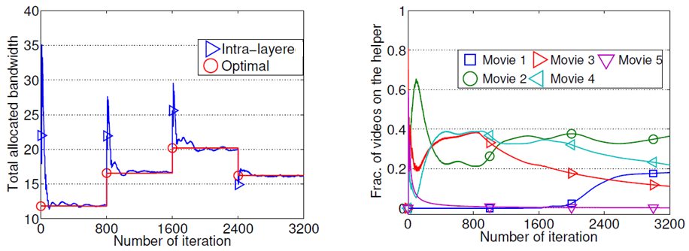
Simulation Results (Dynamic Users)
Initial Users: 10
Helpers: 10
VoD
Layers: 4
Videos: 5
Adding 5 users
Adding 5 users
Removing 5 users
Adding 5 users
Adding 5 users
Removing 5 users
Convergence to the optimal solution (LP)
The fraction of each video on helper h8

Slide 27
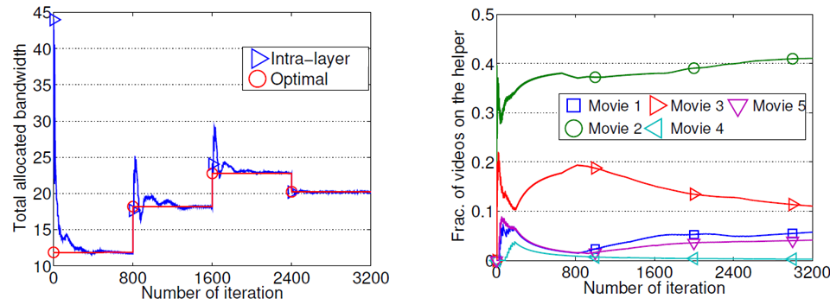
Simulation Results (Dynamic Helpers)
Users: 20
Initial helpers: 6
VoD
Layers: 4
Videos: 5
Adding 3 helpers
Adding 3 helpers
Removing 3 helpers
Adding 3 helpers
Adding 3 helpers
Removing 3 helpers
Convergence to the optimal solution (LP)
The fraction of each video on helper h3

Slide 28
Future Work and Challenges
Other objectives
  Fairness, layers with different weights, …
Extension of layered VoD with unreliable links
  Using symbol-level transmission work in layered VoD
Cost-efficient helper provisioning
  Based on user demands and resource availability
Real implementation

Slide 29
Conclusions
Priority-Based Network Coding
Data transmission
  Transmitting the more important data with more redundancy
Triangular coding in multi-layer video streaming
  Increasing the number of received layers
VoD and live streaming using helper nodes in multi-layer video streaming
  Minimizing the load on the server

