Slide 1


RESILIENT Priority-Based Data Transmission Using NETWORK CODING
Jie Wu
Computer and Information Sciences
Temple University
Center for Networked Computing
http://www.cnc.temple.edu

Slide 2


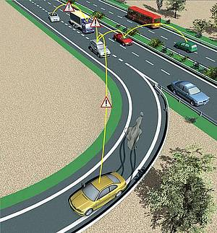



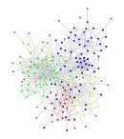


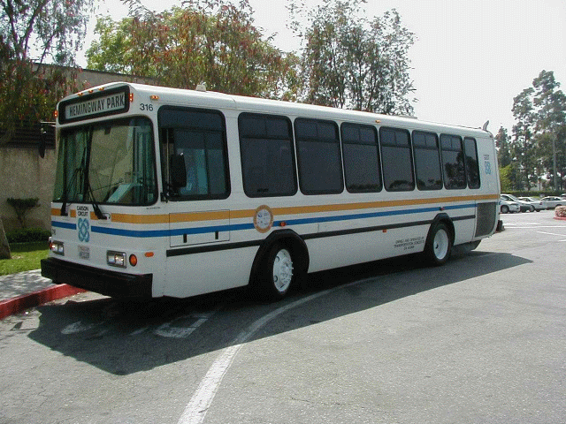





Center for Networked Computing
Dr. Jie Wu
Computer and Information Sciences, Temple University
Wireless and mobile networks
Mesh networks (CRI and GENI grants)
Sensor networks (NeTS and TF grants)
Content sharing networks (NeTS medium grant)
Network coding (CCSS grant)
Vehicle networks
Network security and privacy
High performance computing
Wireless networks (ARO and CCSS grants)
Cloud comp. (Microsoft and Amazon grants)
Medical applications (Tobacco fund)
NSF GPU/CPU supercomputer (MRI grant)
Economic development
Urban Maps & Apps Studio (EDA grant)
Social networks
Online social networks
Mobile Infostation
Opportunistic
High-Speed Link
(MB/s)
Roadway Sensors
Center for Networked Computing

Slide 3
Agenda
Network Coding Background
Priority-Based Network Coding
  Symbol-level transmission
  Layered video streaming
Conclusions
Other Recent Works

Slide 4
Network Coding Background

Slide 5
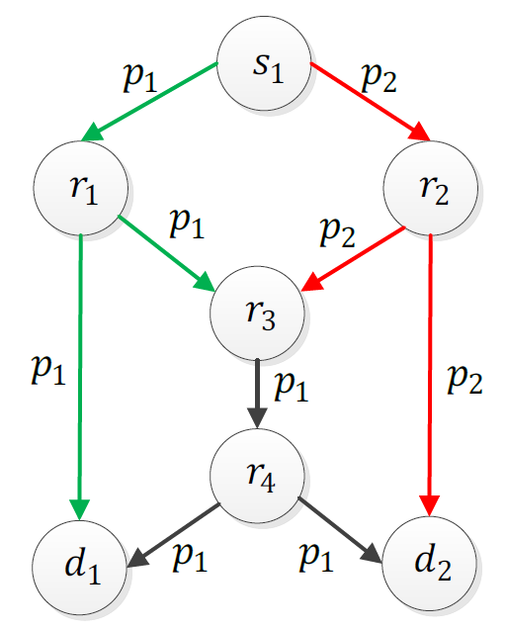
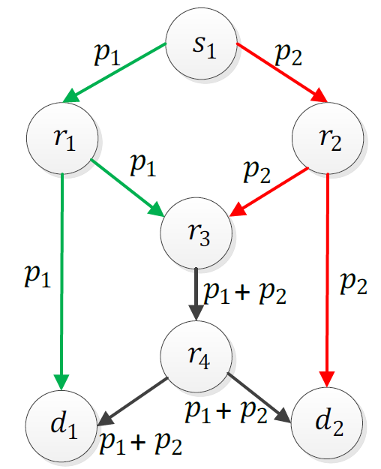
Network Coding in Wired Networks
Single multicast session
  Bottleneck problem (Ahlswede’00)
No coding
Coding
Notes:
Network coding first introduced for wired networks and showed that it can solve the bottleneck problem.

Slide 6
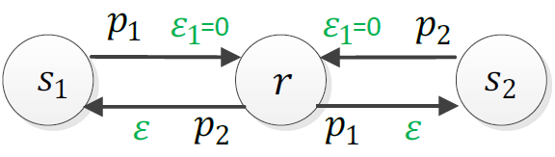

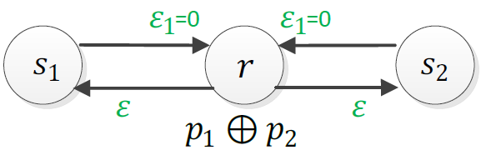







Network Coding in Wireless Networks
No coding
  4 transmissions
  delivery rate =
COPE (coding, Katty’06)
  3 transmissions (broadcast channel)
  delivery rate =
COPE-dup (double transmission by relay, Rayanchu’08)
  4 transmissions
  delivery rate =
$$ε$$
$$ε$$
$$ε$$
$$ε$$
$$ε$$
Scheme | =0 | =0.1 | =0.3 | =0.5 | =0.7
No coding | 0.25 | 0.225 | 0.175 | 0.125 | 0.075
COPE | 0.333 | 0.3 | 0.233 | 0.167 | 0.1
COPE-dup | 0.25 | 0.247 | 0.227 | 0.187 | 0.127
Notes:
The wireless nature of the medium makes network coding more attractive in wireless networks.

Slide 7
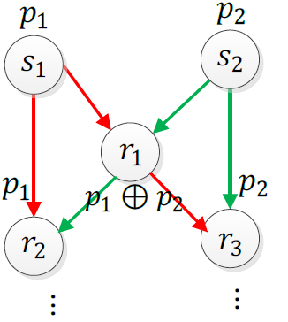
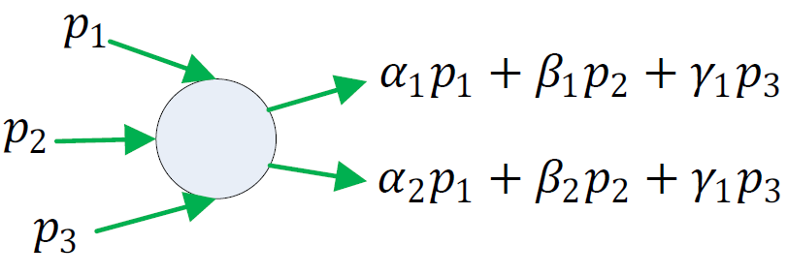
Network Coding Classification
Local
  Hop-by-hop decoding
  XOR operation
Global
  Decoding at the destination
  Linear network coding
  (on a finite field)
Decoding
Decoding
Recoding

Slide 8
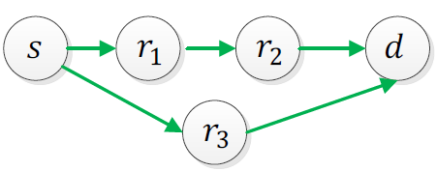
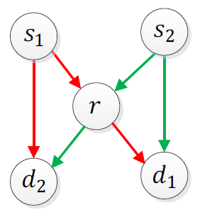
Network Coding Classification
Intra-flow
  Within a flow
  Robustness enhancement
Inter-flow
  Between different flows
  Throughput/capacity enhancement
Joint inter- and intra-flow
  Within flow and between flows

Slide 9
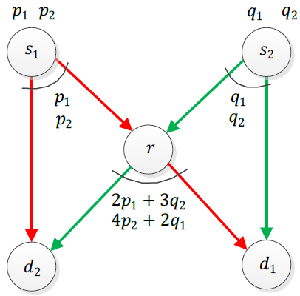
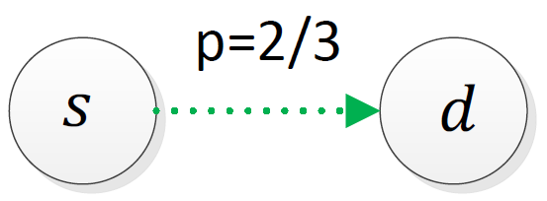
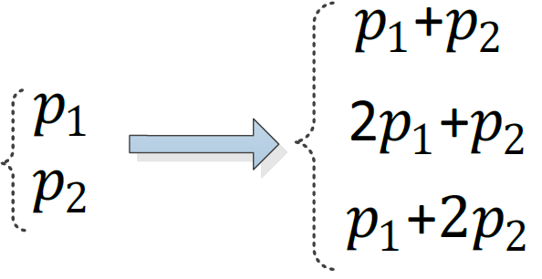
Network Coding in Wireless Networks
Intra-flow coding
Inter-flow coding
Reliability=2/3
3 transmissions
Reliable links
2 transmissions by the relay

Slide 10


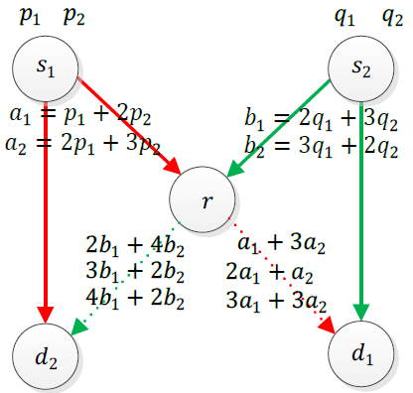
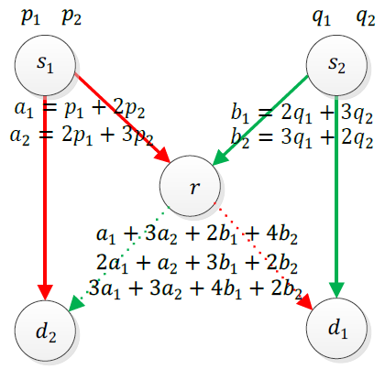
Network Coding in Wireless Networks
Reliability from r to and is 2/3
Other links are reliable
Intra- flow coding
Joint inter- and intra-flow coding
6 transmissions by the relay
3 transmissions by the relay

Slide 11
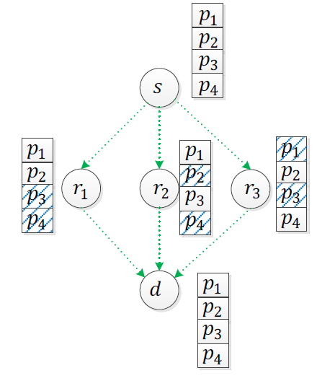
Opportunistic Routing (OP)
OP: no fixed path
  Relays jointly having all packets
  Coordination needed among relays
  Which packets should be sent?
  (coupon collection problem)
OP with network coding
  Linear coded transmissions at relays
  No coordination needed among relays

Slide 12
Network Coding Applications
Robustness Enhancement
  Error correcting code
    Physical layer: improving error performance on wireless link using intra-packet coding
  Erasure correction
    Spatial redundancy: handle lost packets on the end-to-end connection level using inter-packet coding
  Joint error and erasure correction
  Robust linear network coding for link failures
  (Koetter and Medard 2003)

Slide 13
Network Coding Applications
Throughput/Capacity Enhancement
  Overlay networks
    Distributed storage systems
    Content distribution
    Layered multicast
  Wireless networks
    Throughput enhancement
    Broadcast storm problem
Network Tomography: infer network characteristics
  Link loss rate inference
  Topology inference

Slide 14
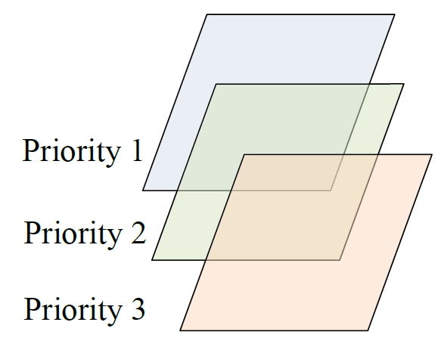
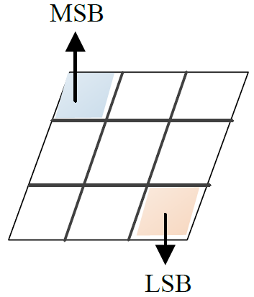
Priority-Based Approaches
  New twist on the classic unequal error protection
  Symbol-Level NC Video Streaming NC

Slide 15
Priority-Based Network Coding
Symbol-Level Transmission

Slide 16

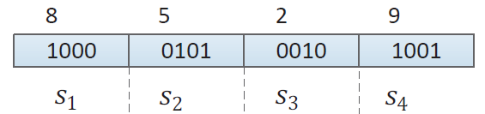
Priority-Based Transmission
Numeric data
  Sensed data by sensors
  Different priorities (utility values) for symbols
Approaches
  Reliable transmissions
  Maximizing the expected utility with a given number of transmissions
MSB
Binary coded decimal
LSB
Notes:
All of the mentioned methods assume binary errors in the packets, which means each packet will be received error-free or totally corrupted. However, the errors in reality are not binary. It means that even in the case of failures, some parts of the packets might be received correctly.
In the case of numeric data, e.g., the captured information by sensor nodes, the importance of the data (numbers) decreases from the left (most significant bit) to the right (less significant bit). Therefore, any mechanism that addresses numeric data transmissions in lossy environment should consider the weights of the bits.
For example the figure shows the Binary Coded Decimal (BCD) representation of number 8529, in which every number (0-9) is represented with 4 binary digits. In this number, 8 is more important to be received correctly than the other numbers, and 9 is the less important one.
We have two choices:
Providing 100% reliability.
With a given number of transmissions, trying to increase the gain of the destination nodes.

Slide 17
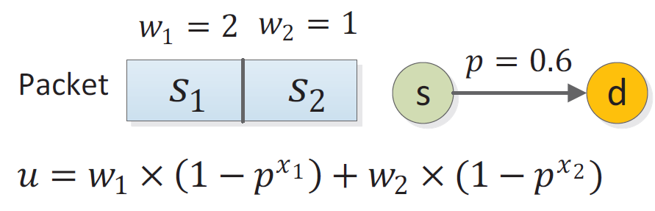





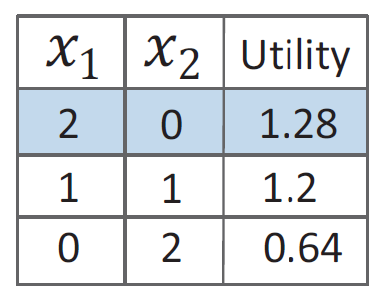
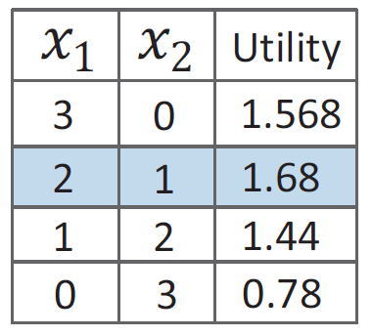
Motivation
: utility
: loss rate
: weight of
: number of transmissions of
2 transmissions
3 transmissions
Notes:
We refer to a set of bits as symbols. Consider a packet with two symbols. Assume that the weight (importance) of symbol s1 and s2 are 2 and 1, respectively. Also, the error rate of the link is 0.6.
We show the number of times we transmit s1 and s2 as x1 and x2. The probability of receiving the first symbol correctly is (1-p^x1). Therefore the utility function is…..
With 2 symbol transmissions there are 3 cases that are shown in the left table. We computed the utility for each case. The table shows that in this case assigning both of the transmissions to the first symbol is more efficient.
The right table shows the possible cases with 3 transmissions. Assigning 2 transmissions to the first symbol and 1 to the second symbol, which is less important, is the optimal solution.

Slide 18


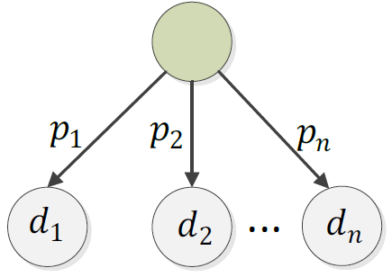



Setting and Objective
One-hop wireless (WiFi) network
  One source with multiple destinations
Lossy links (randomness in wireless)
  , , …,
Transmission window size
  X slots for a packet
Objective: maximizing the total expected utility
of the received symbols
Notes:
Setting: One-hop network, the links are lossy and independent.
t slots are assigned to each packet, which is sufficient to transmit t symbols.
Weight (importance) of si> i+1
Objective: maximizing the total weight of the received symbols

Slide 19
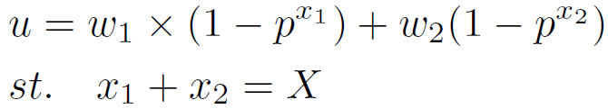
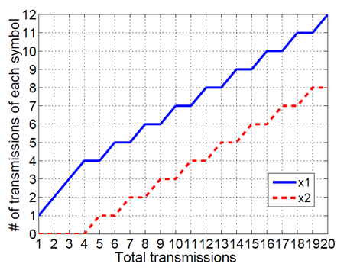


Single Packet (Homogenous Destinations)
The case of a packet with 2 symbols
Saturation point
Notes:
Intuition: for different number of transmissions we draw the plot of optimal distribution for a packet with 2 symbols.
The plot shows that before a specific point, which we refer to it as saturation point, all of the transmissions should be assigned to s1. For example if t is equal to 3, all of the transmissions should be assigned to s1.
After the saturation point, the remaining transmissions should be distributed between s1 and s2 in a round-robin pattern.

Slide 20






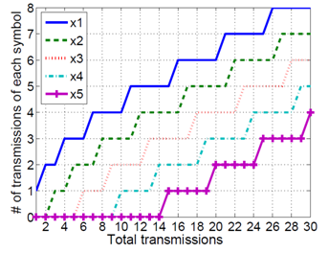



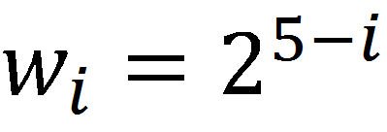
Single Packet (Homogeneous Destinations)
m symbols
  Assign the transmissions to while
  Then, distribute the transmissions between and while
  Assign round-robin pattern among and
  Start increasing while
Notes:
The figure shows that the same pattern exist for a packet with more symbols. However, here we have multiple saturation points.
You can read the rest from the slide.

Slide 21






Single Packet (Heterogeneous Destinations)
The round-robin pattern does not exist
Iterative algorithm
  : utility changes for increasing to
At each iteration, assign the current transmission to the symbol with the maximum
Notes:
In the case of multiple destinations with the same error rate, the problem becomes similar to the case of single destination. Therefore, the same solution can be used.
However, in the case of different transmission error rates, the round-robin pattern does not exist.
Therefore, in each iteration we compute delta_xi which is the increase in the gain as we increase xi to xi+1. We assign the current transmission to the xi with the largest delta_xi.

Slide 22




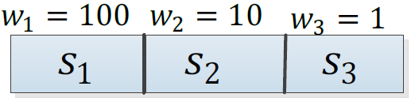





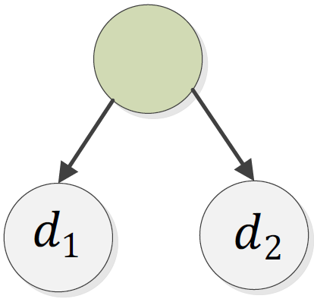














Single Packet (Heterogeneous Destinations)
Iteration 1
Iteration 2
Iteration 3
Binary coded decimal
 | 0
 | 0
 | 0
=140
 | 1
 | 0
 | 0
=14
=1.4
 | 1
 | 0
 | 0
=40
 | 2
 | 0
 | 0
=0.2
=0.4
=14
=1.4
 | 2
 | 0
 | 0
=12.8
 | 2
 | 1
 | 0
=14
=1.4

Slide 23
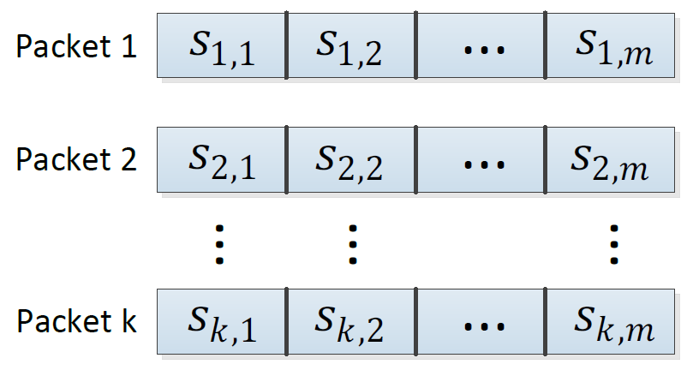
Multiple Packets (No Coding)
Our model
  The size of the packets is equal
  Each packet has the same weight
k independent packets with no coding
Notes:
Until now we talked about single packet transmission. Now we consider multiple packets.
In our model the size of the packets are equal. Moreover, the weight of the i-th symbols in different packets are the same.
As a result, the problem of sending k independent packets becomes k similar problems with the same solution.
Therefore, we can solve the problem for a single packet, and repeat it for any packet.

Slide 24


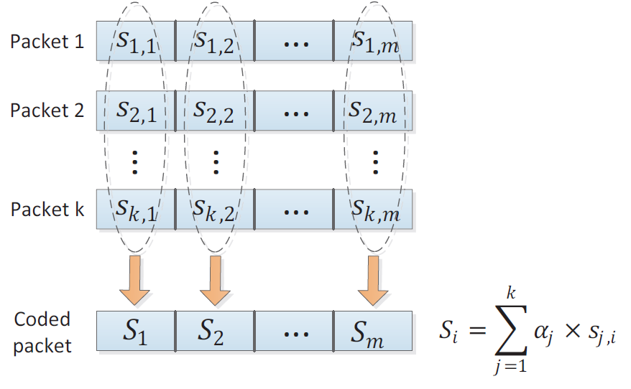
Multiple Packets (with Network Coding)
Heuristic
  First find the optimal
  Code all of the k packets together
  Send coded symbols
Notes:
We can also benefit from random linear network coding. In random linear coding, k packet are linearly coded together using random coefficient (like the equation at the bottom of the page). A destination node is able to decode the coded packets using Gaussian elimination once it receives k linearly independent coded packets.
The benefit of network coding is that all of the coded packets (in our case symbols) contribute the same amount of information to the destination.
As shown in the figure, we code all of the first symbols of the packets together. We do the same thing for the i-th symbols….
When we code k symbols together, a destination node will be able to decode the coded packets once in receives k linearly independent coded symbols.
Assume the case of non-coding. If a destination node receives a symbol s1,1 twice, this redundant delivery is useless. But in the case of linear coding, each coded symbol contributes the same amount of information. As a result, all of the delivered coded symbols will be useful.

Slide 25
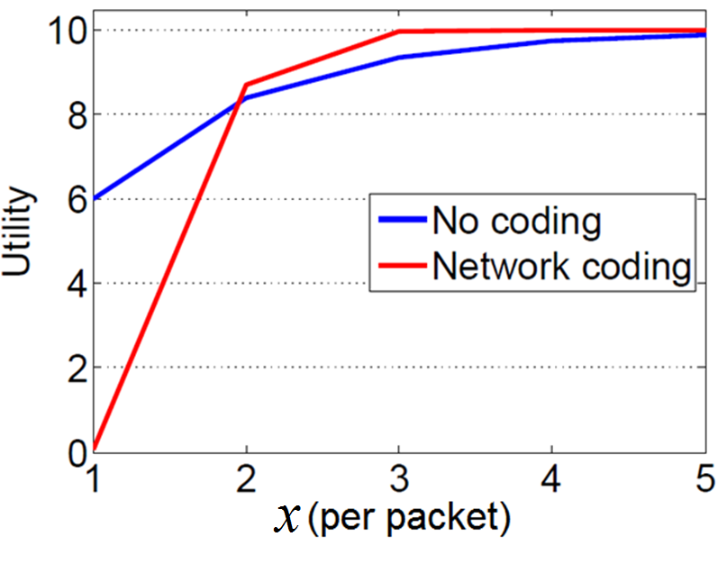
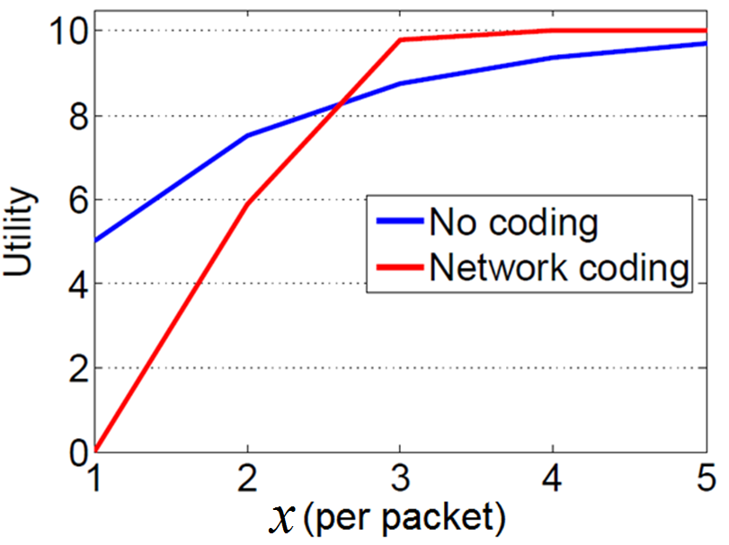
Multiple Packets (with Network Coding)
Network coding may or may not improve the utility
  Since partial decoding is not possible
Compute utility of coding/non-coding
  Decision for coding/non-coding at each symbol
10 packets
Error rate: 0.4
10 packets
Error rate: 0.5
Notes:
However, network coding might increase of decrease the gain, depending on the number of transmissions. The reason is that in network coding the destination node can decode all of the i-th symbols that are coded together or none of them. In other words, there is no way to receive partial number of symbols.
The up equation shows the gain when we use network coding. The gain of non-coding can be calculated using the down equation.
As the plot shows, in this example, the linear coding is useless for less than 3 transmissions.
In our Multiple Packets Transmissions with Network Coding (MPT-NC), we compute the gain in the case of coding and non-coding. If the gain of non-coding is more than coding, we turn off coding.

Slide 26

Simulations Setting
MATLAB environment
1,000 rounds
  Different error rates for links
Weight of :
Comparing with simple retransmission method
  Distribute transmissions equally to the different
Notes:
We implemented a simulator in MATLAB environment
We run the simulations on 1,000 random topologies with different links’ error rates
The weight of the i-th symbol are assumed to be…….(in the slide)
We compare the proposed methods with a simple retransmission method, in which the transmissions are evenly distribute among the different symbols of the packets

Slide 27
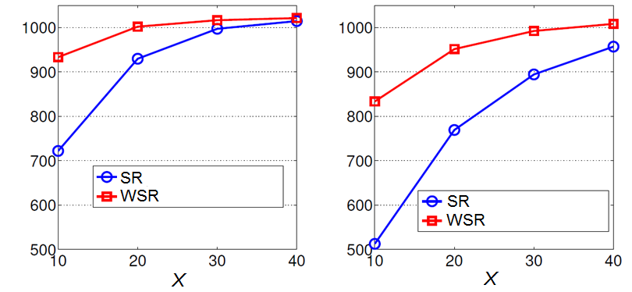



Simulations (Homogenous Destinations)
Single packet: 10 symbols
SR: simple retransmission
WSR: weighted symbol retransmission
Notes:
These figures compare our single packet transmission method to one destination nodes with the simple retransmission.
Left: the error rate is equal to 0.3. The figure shows that the gain of our method is more than that of the simple retransmission. The difference decreases as we increase the number of transmissions since, with so many transmission both of the methods almost achieve 100% reliability.
Right: we increase the error rate to 0.5. The figure shows that the performance of our method over simple retransmission increase as we increase the error rate of the link.

Slide 28
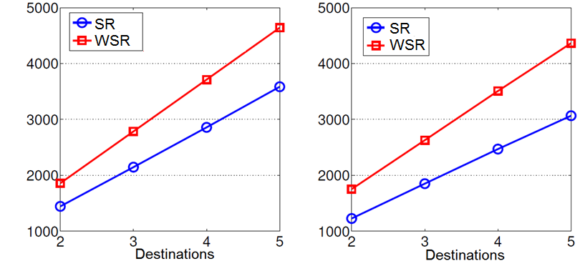


Simulations (Heterogeneous Destinations)
Single packet- 10 symbols
10 transmissions
Variable destinations and error rates
Notes:
Single packet to multiple destinations
The range of error rates in the left plot is [0.2,0.4]. The difference between our approach and simple retransmission increase as we increase the number of destination nodes.
In the right plot we increased the error rates to the range of [0.2,0.6]. The less reliable links decreases the gain of the methods, but increases the efficiency of our method over simple retransmission.

Slide 29
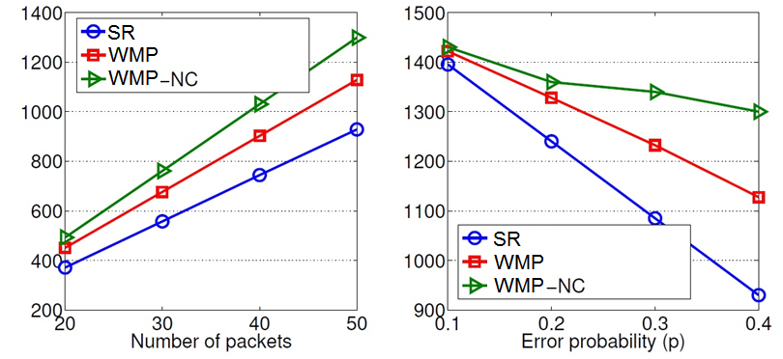

Simulations (Homogenous Destinations)
Packet size: 5 symbols
WMP: weighted multiple packets
WMP-NC: weighted multiple packets with network coding
10 transmissions
50 packets
Notes:
In the left plot we compare the multiple packet transmission (MPT) and MPT-NC methods with simple retransmission. As it is expected, the MPT-NC has the highest gain. Also, as we increase the number of packets, the efficiency of the MPT-NC method increases.
The right plot shows the effect of links error rate on the total gain of the methods. The plot shows that the MPT-NC is more robust against the error rate, which is due to using network coding.

Slide 30
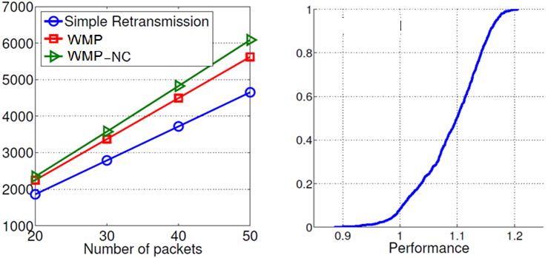


Simulations (Heterogeneous Destinations)
Packet size: 5 symbols
5 destinations
CDF of WMP-NC’s utility divided by WMP’s utility
Number of packets=50
Notes:
The left plot shows the gain of the methods in the case of transmitting multiple packets to 5 destinations. Again, MPT-NC has the highest gain.
We compare the performance of the MPT-NC mechanism over the MPT in the right plot. For this purpose, we divide the gain of the MPT-NC mechanism by that of the MPT mechanism, and plot its CDF. This figure shows that in less than 5% of the cases, the gain of the MPT-NC mechanism is less than that of the MPT method. Moreover, in more than 50% of the cases, the gain of the MPT-NC protocol is more than 10% higher than that of the MPT mechanism.

Slide 31
Simulations Summary
WMP increases utility up to 22% compared to SR
Utility of WMP-NC is up to 45% more than SR
In 50% of the cases the utility of WMP-NC is 10-20% more than WMP
As error rate increases, the performance of WMP-NC over the other methods increases

Slide 32
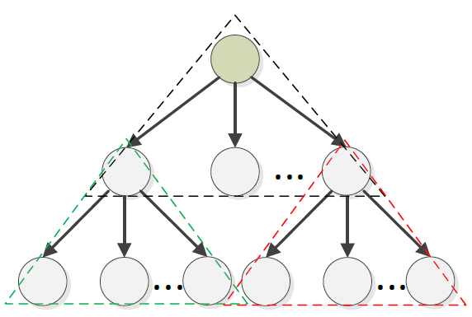

Current and Future Work
Current Work
Optimal solution for network coding with multiple packets
Multiple-hop network extensions with weighted destinations (based on the number of leaf nodes)
Future Work
Extensions to DAG
Real implementation

Slide 33
Priority-Based Network Coding
Layered Video Streaming

Slide 34
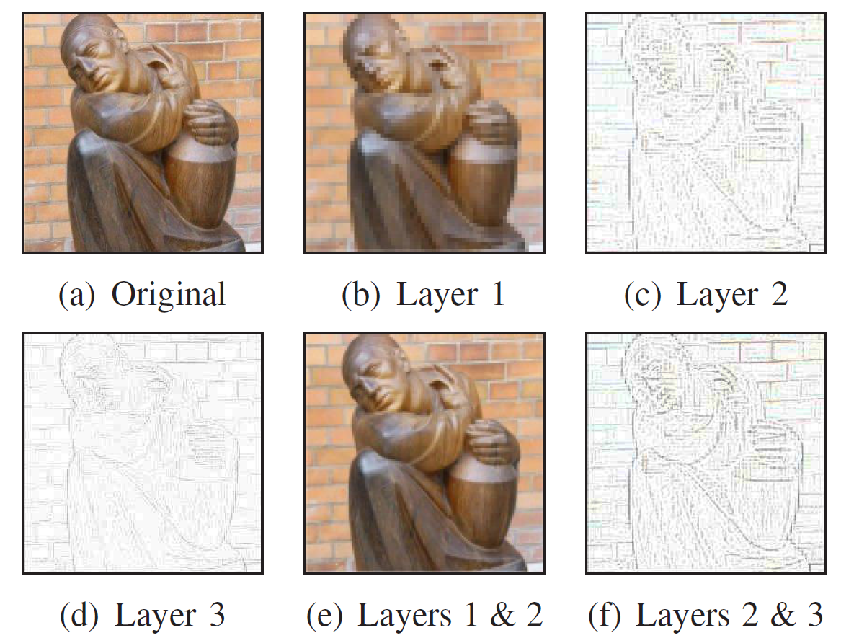
Video Streaming
Delivering video stream using different resolutions to satisfy different client needs/constraints
Multi-Layer Coding
(Multi-resolution)
  Base layer
  Enhancement layers
Multiple Description Coding (MDC)
  Multiple independent video substreams
  Receiving more substreams increases the video quality
Substream_1 | Resolution_1
Substream_2 | Resolution _2
Substream_N | Resolution _N

Slide 35
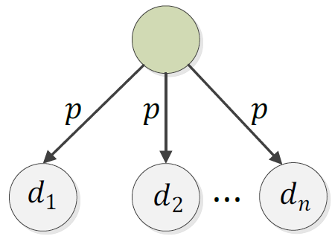
Setting and Objective
One-hop WiFi networks
Video stream: sequence of packets
Packet deadline: X transmissions
Layered streams : L layers
Objective: maximizing throughput in terms of the total number of received layers by the users
Intra-layer coding: linear coding
Inter-layer coding: triangular coding
Lossy Bernoulli channel

Slide 36
Inter-Layer Coding Strategies
Random linear network coding (RLNC)
Triangular coding
  Prefix coding
Packets in lower layers are more important
  Included in more coded packets
  More chance to be decoded

Slide 37
Advantage of Triangular Coding
Coefficients are not shown for simplicity
6 transmissions in round-robin pattern
  Blue cells are received
No coding
L1
L2
L3
L1
L2
L3
Unable to decode
Triangular coding
L1
L1 + L2
L1 + L2+ L3
L1
L1 + L2
L1 + L2+ L3
Decodes 2 layers
Random linear coding
L1 + L2+ L3
L1 + L2+ L3
L1 + L2+ L3
L1 + L2+ L3
L1 + L2+ L3
L1 + L2+ L3
Unable to decode

Slide 38
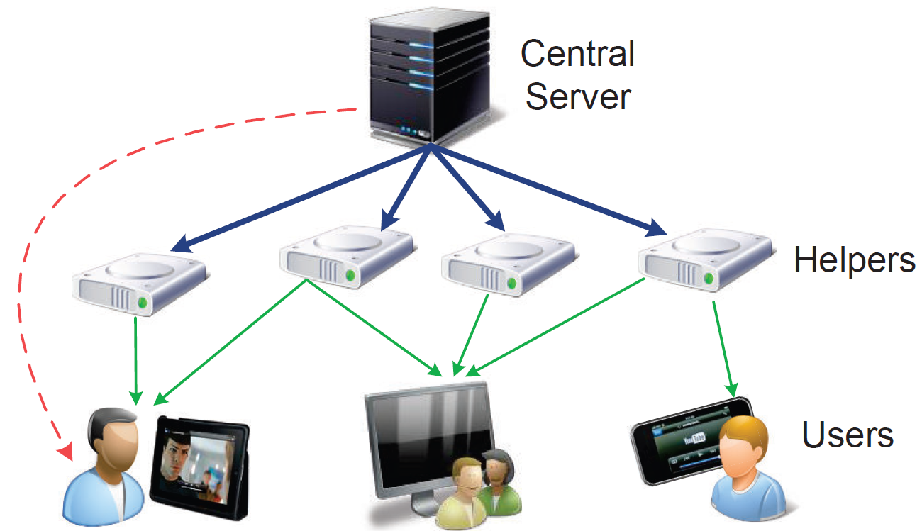
Multi-Layer Video Streaming with Helpers
Links
  Cost: direct download from the server
  Reliable links
Link capacity
  High capacity links: server to helpers
  Low capacity links: helpers to users
Use of helpers
  System scalability for more users
  Helpers: limited capacity and bandwidth

Slide 39
Resource Management
Optimal resource management
Questions:
  Content placement: Which packets of each video should a helper node store?
  Bandwidth allocation: Which packets, and to which users, should each helper serve?
NP-complete
Notes:
The helpers might not be able to store the videos in full.

Slide 40
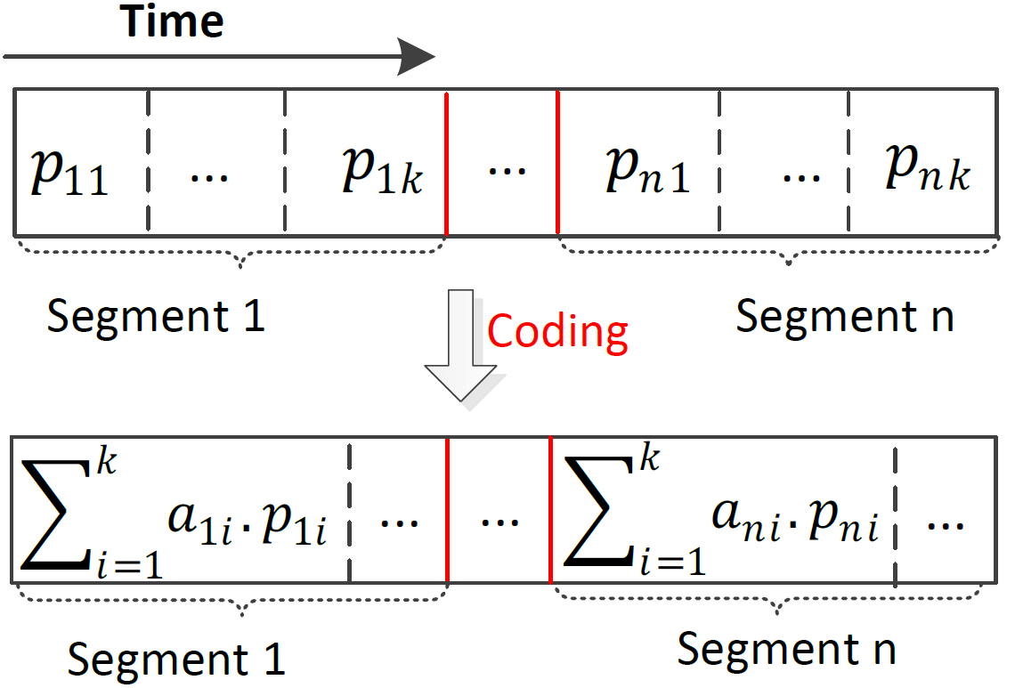
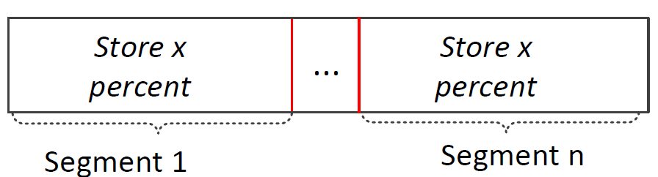
Resource Management (Network Coding)
Network coding changes the problem to a linear programming
Storing x percent of each segment
Movie m
Coded Movie m
No longer NP-complete
  Flow-based model using network coding
Notes:
We partition the video into different segments and code the packets of each segment together.
Using this scheme, we just need to find the optimal rate of the video that should be stored on a helper node.
We find the optimal rate x of each movie that should be stores on each helper node. Then, we store x percent of each segment
Of the movie on the helper node

Slide 41
Multi-Layer Video
Benefits of multi-layer
  Provides smooth playback for the users
  Reduces the load on the server with a fixed number of users
  More layers increases system scalability
Notes:
The users can switch to a lower quality

Slide 42
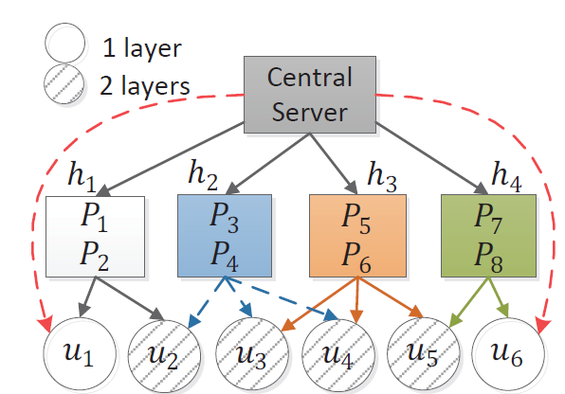
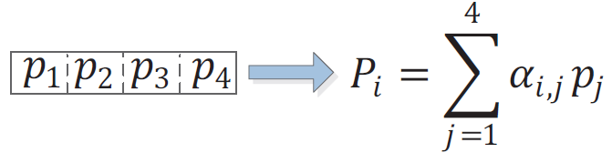
Motivation
Single video with 4 packets
No-layer approach
(Hao et al. 2011)
  4 packets in the same layer
  Load on the server: 4
Notes:
The video contains 4 packets p_1 to p_4. Packets P_1 to P_8 are random linear coded packets.
Users u_1 and u_6 requested 1 layer. However, without layer approach, the helpers can only provide both layers.

Slide 43

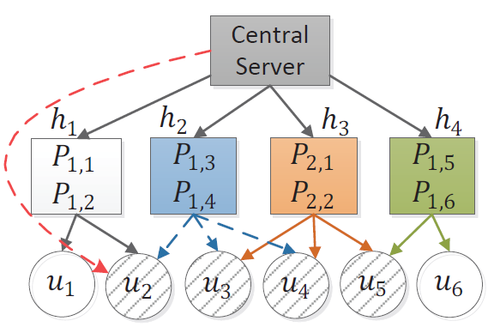
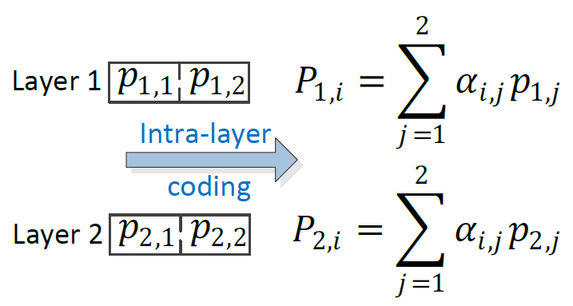
Motivation
Single video with 4 packets
Intra-layer approach
(Ostovari, Khreishah, and Wu 2013)
  2 packets per layer
  Load on the server: 2

Slide 44
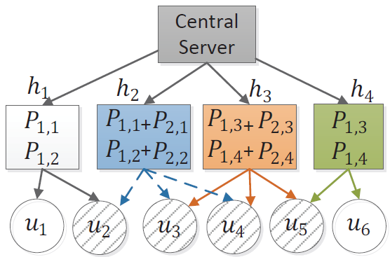
Motivation
Single video with 4 packets
Inter- and intra-layer coding
(Ostovari, Khreishah, and Wu 2013)
  Prefix coding
  2 packets per layer
  Load on the server: 0
Triangular coding

Slide 45
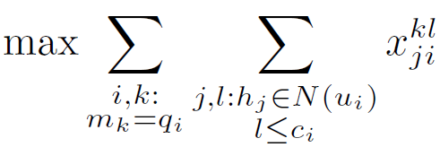











VoD with Inter- and Intra-Layer NC
Objective function (maximize upload rate from helpers to users)
The upload rate of a cache cannot exceed the rate of the stored videos
: Upload rate from helper to user over layer of video
: Fraction of the layer of video that is stored on helper
: Rate of video
: Number of layers of a video
: Adjacent helpers to user
’s request: ( , ) = (quality level, video)

Slide 46





VoD with Inter- and Intra-Layer NC
Bandwidth constraints
Storage constraints
Limits the total download of a user to the rate of the video
: The bandwidth limit of helper
: The capacity limit of helper
Notes:
Even in the case that 2 users watch the same movie and they are connected using wireless connection to the same helper node, the helper needs to provide separate bandwidth for the users. The reason is that in VoD applications, these users have a different playback time (they watch different part of the movie)

Slide 47

VoD with Intra-Layer NC
The difference is in the last constraint
U: the set of users
The objective function and other constraints are the same
Limits the total download of a user to the rate of the video
Notes:
Even in the case that 2 users watch the same movie and they are connected using wireless connection to the same helper node, the helper needs to provide separate bandwidth for the users. The reason is that in VoD applications, these users have a different playback time (they watch different part of the movie)

Slide 48





Live Streaming (TV)
Videos are broadcast to the users
Synchronous playback
  Helpers do not need to allocate separate bandwidths to adjacent users that watch the same video
Total bandwidth:
Total bandwidth:

Slide 49


Distributed Algorithm
Dual optimization
  Solving Lagrangian dual using gradient method
Helper
  Start from empty storage and dynamically adjust the amount of stored videos
  Update and transmit Lagrange variables to adjacent users
User
  Update and transmit Lagrange variables to adjacent helpers
Step control
  Slope of changes: fast convergence vs. oscillation

Slide 50

Simulations Setting
MATLAB environment
100 random topologies
  Random connections of helpers and users
  Helpers: random bandwidth and capacity limit
  Users: random requests
Comparing with optimal non-layer approach
Measuring
  Load on the server
  Convergence to optimal solution in dynamic environments
Notes:
We implemented a simulator in MATLAB environment
We run the simulations on 1,000 random topologies with different links’ error rates
The weight of the i-th symbol are assumed to be…….(in the slide)
We compare the proposed methods with a simple retransmission method, in which the transmissions are evenly distribute among the different symbols of the packets

Slide 51



Simulation Results (Load)
VoD
Number of videos: 5
Number of layers: 5
DIST: a non-layer approach with intra-layer coding ( Hao et al. 2011)

Slide 52



Simulation Results (Load)
VoD
Number of users: 50
Number of helpers: 20

Slide 53



Simulation Results (Load)
VoD
Number of layers: 4
Single video

Slide 54

Simulation Results (Convergence)
Users: 50
Helpers: 20
VoD
Layers: 4
Videos: 5
Convergence to the optimal solution (LP)
The fraction of each video on helper h5

Slide 55

Simulation Results (Dynamic Users)
Initial Users: 10
Helpers: 10
VoD
Layers: 4
Videos: 5
Adding 5 users
Adding 5 users
Removing 5 users
Adding 5 users
Adding 5 users
Removing 5 users
Convergence to the optimal solution (LP)
The fraction of each video on helper h8

Slide 56

Simulation Results (Dynamic Helpers)
Users: 20
Initial helpers: 6
VoD
Layers: 4
Videos: 5
Adding 3 helpers
Adding 3 helpers
Removing 3 helpers
Adding 3 helpers
Adding 3 helpers
Removing 3 helpers
Convergence to the optimal solution (LP)
The fraction of each video on helper h3

Slide 57
Future Work and Challenges
Other objectives
  Fairness, layers with different weights, …
Extension of layered VoD with unreliable links
  Using symbol-level transmission work in layered VoD
Cost-efficient helper provisioning
  Based on user demands and resource availability
Real implementation

Slide 58
Conclusions

Slide 59
Conclusions
Priority-Based Network Coding
Data transmission
  Transmitting the more important data with more redundancy
Triangular coding in multi-layer video streaming
  Increasing the number of received layers
VoD and live streaming using helper nodes in multi-layer video streaming
  Minimizing the load on the server

Slide 60
References
P. Ostovari, J. Wu, and A. Khreishah, "Efficient Symbol-Level Transmission in Error-Prone Wireless Networks With Network Coding," Proc. of IEEE WoWMoM, 2013.
P. Ostovari, A. Khreishah, and J. Wu, "Multi-Layer Video Streaming with Helper Nodes using Network Coding," Proc. of IEEE MASS, 2013.
H. Hao, M. Chen, A. Parekh, and K. Ramchandran, "A Distributed Multichannel Demand-Adaptive P2P VoD System with Optimized Caching and Neighbor-Selection," Proc. of SPIE, 2011.

Slide 61
Other Recent Works

Slide 62


Other Works
S. Yang, J. Wu, and M. Cardei, "Efficient Broadcast in MANETs Using Network Coding and Directional Antennas," Proc. of IEEE INFOCOM, 2008.
  Network coding in multiple broadcast in a wireless network.
  Using dominating set as relays and for inter-session coding. (combine routing and coding)
  Using both dominating set and directional antennas to reduce contention.

Slide 63

Other Works
P. Ostovari, A. Khreishah, J.Wu, and W. –S. Yang, "Trade-off between Redundancy and Feedbacks in Wireless Network Communication," accepted to appear in Ad-Hoc & Sensor Wireless Networks, 2013.
  One-hop broadcasting using XOR coding
  Minimum-cost reliable broadcast considering the cost of feedback messages
  Multiple retransmissions before receiving feedback
  How many retransmissions are required?

Slide 64








Other Works
A. Khreishah, I. M. Khalil, and J. Wu, "Universal Opportunistic Routing Scheme using Network Coding," Proc. of IEEE SECON, 2012.
  Distributed opportunistic routing algorithm
  The correlation of the links through network tomography
  Coded feedback (for source to determine the type of link failure)
  Unicast (and multicast in ACM MobiHoc 2012)
Independent
Correlated
Negatively correlated

Slide 65


Other Works
P. Ostovari, J. Wu, and A. Khreishah, " Network Coding Techniques for Wireless and Sensor Networks," accepted to appear in The Art of Wireless Sensor Networks, H. M. Ammari (ed), Springer.
  Unicast
  Multicast
  Broadcast

Slide 66

Acknowledgment
Shuhui Yang
  Purdue University Calumet
Abdallah Khreishah
  New Jersey Institute of Technology
Pouya Ostovari
  Temple University
CCSS: An Architecture for Joint Integration of Inter and Intrasession Network Coding in Lossy Multihop Wireless Networks

