Slide 1

Towards Analysis of the Performance of IDSs in Software-Defined Networks
IoTEF 2022
Nadia Niknami, Emily Inkrott, and Jie Wu
Temple University

Slide 2
Intrusion detection System
Intrusion : Attempting to break into or misuse the system.
Intruders may be from outside the network or legitimate users of the network.
Intrusion can be a physical, system or remote intrusion.
Intrusion Detection Systems look for attack signatures, which are specific patterns that usually indicate malicious or suspicious intent

Slide 3
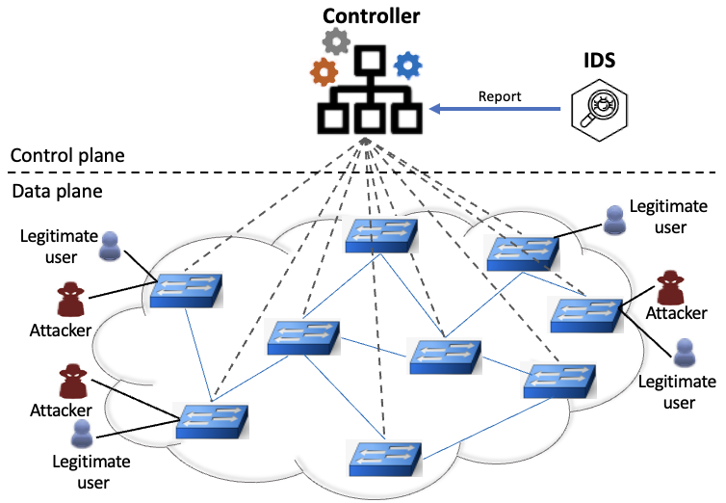
Performance of IDSs in SDN

Slide 4
Detection engine
Number of rules
Traffic load on the network
Speed of network and machine
Efficiency of detection algorithm

Slide 5

Intrusion Detection Systems (IDS)
Different ways of classifying an IDS
  Anomaly detection
    Trace deviation from a normal state of the system
  Signature based misuse
    Detects an attack from its fingerprints
  Host-based (HIDS)
    Monitor internal components
  Network-based (NIDS)
    Monitor network packets by some sensors

Slide 6

Snort
  Signature-based detection engine
  A multi-mode packet analysis tool
    Sniffer
    Packet Logger
    Forensic data analysis tool
Snort is based on library packet capture (libpcap)
Two modes: IDS and IPS
Snort does not evaluate the rules in the order that they appear in the snort rules file. In default, the order is :
    Alert rules
    Pass rules
    Log rules

Slide 7

Bro/Zeek IDS
Anomaly detection IDS
It reads all traffic passing through the network and generates quite a number of logs in tab-delimited columns.
It has an extensive set of logs describing network activity. These logs include not only a comprehensive record of every connection seen on the wire, but also application-layer transcripts.
It is not like a firewall or intrusion prevention system. Rather, Zeek sits on a “sensor,” a hardware, software, virtual, or cloud platform that quietly and unobtrusively observes network traffic.

Slide 8
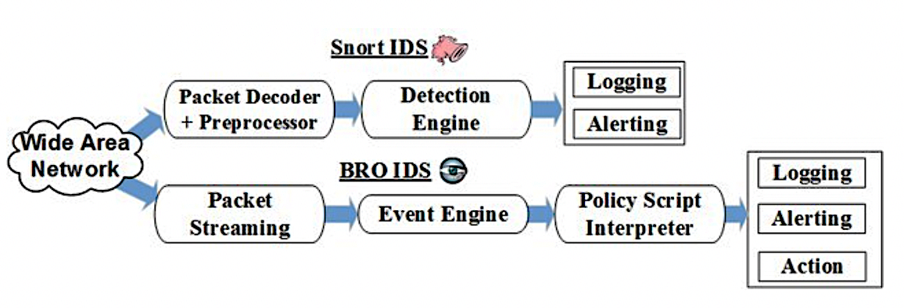
Signature-based vs Anomaly-based

Slide 9

Attacks
ICMP
Port Scanning
SYN
UDP

Slide 10
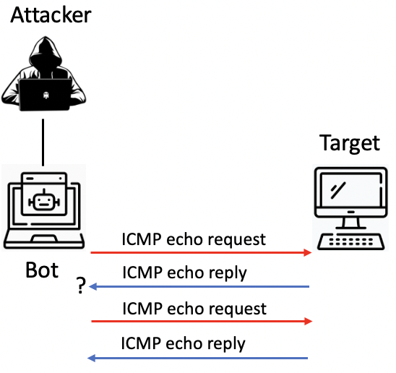
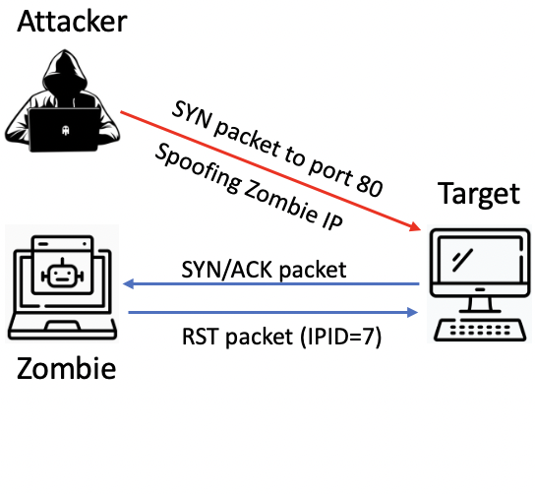
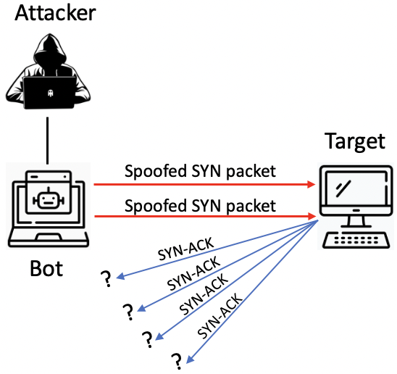
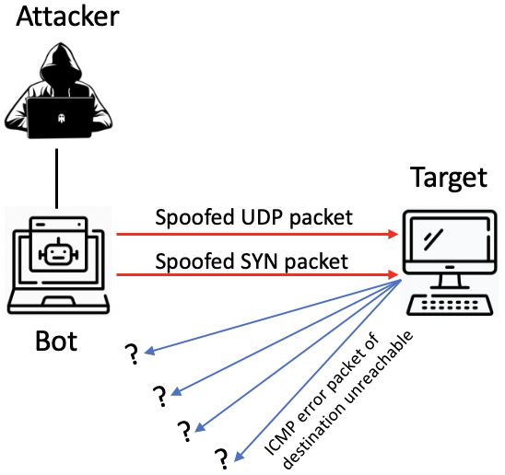
ICMP Attack
Port Scanning Attack
Syn Attack
UDP Attack

Slide 11
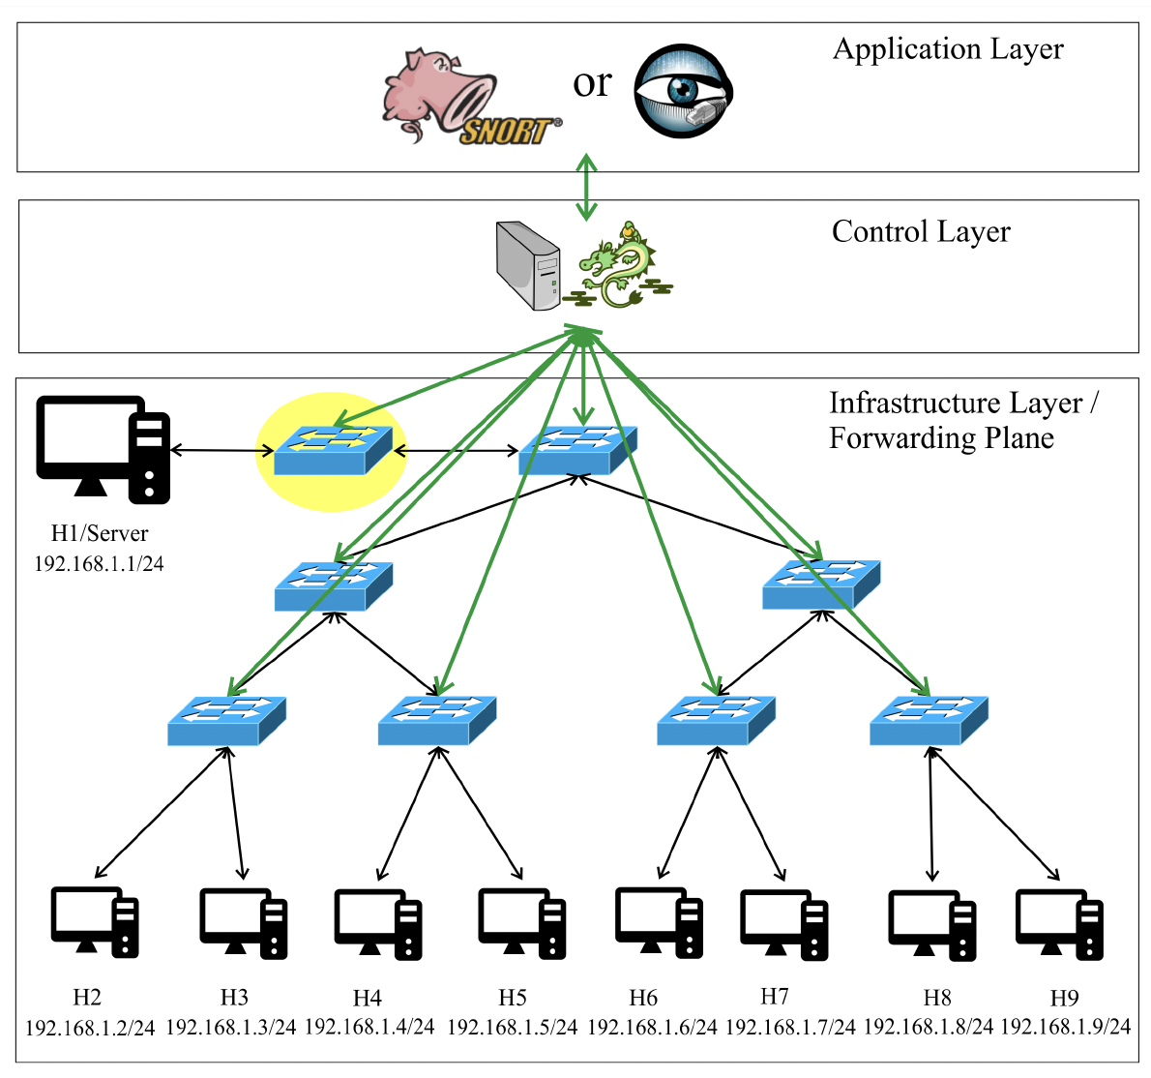
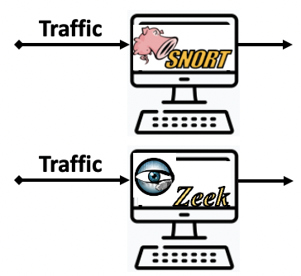

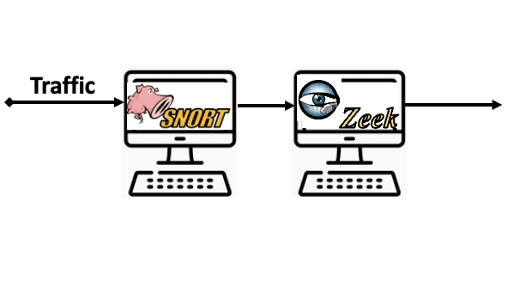
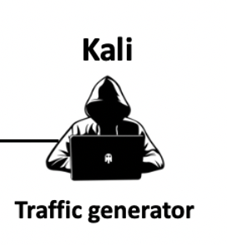
Testbed setup for IDS mode
Control Links
Data Layer

Slide 12
Evaluation
Detection rate
Dropping rate
Delay

Slide 13
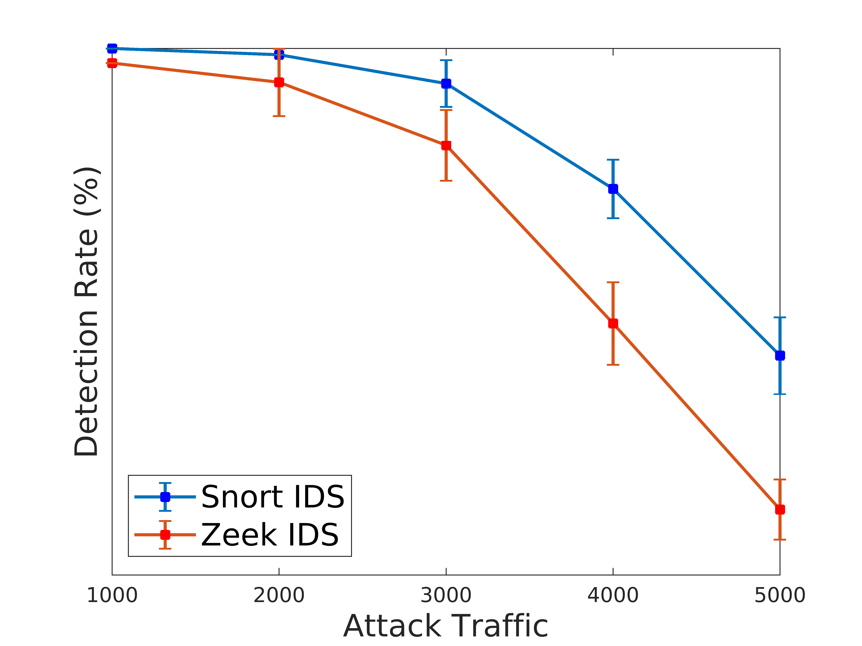
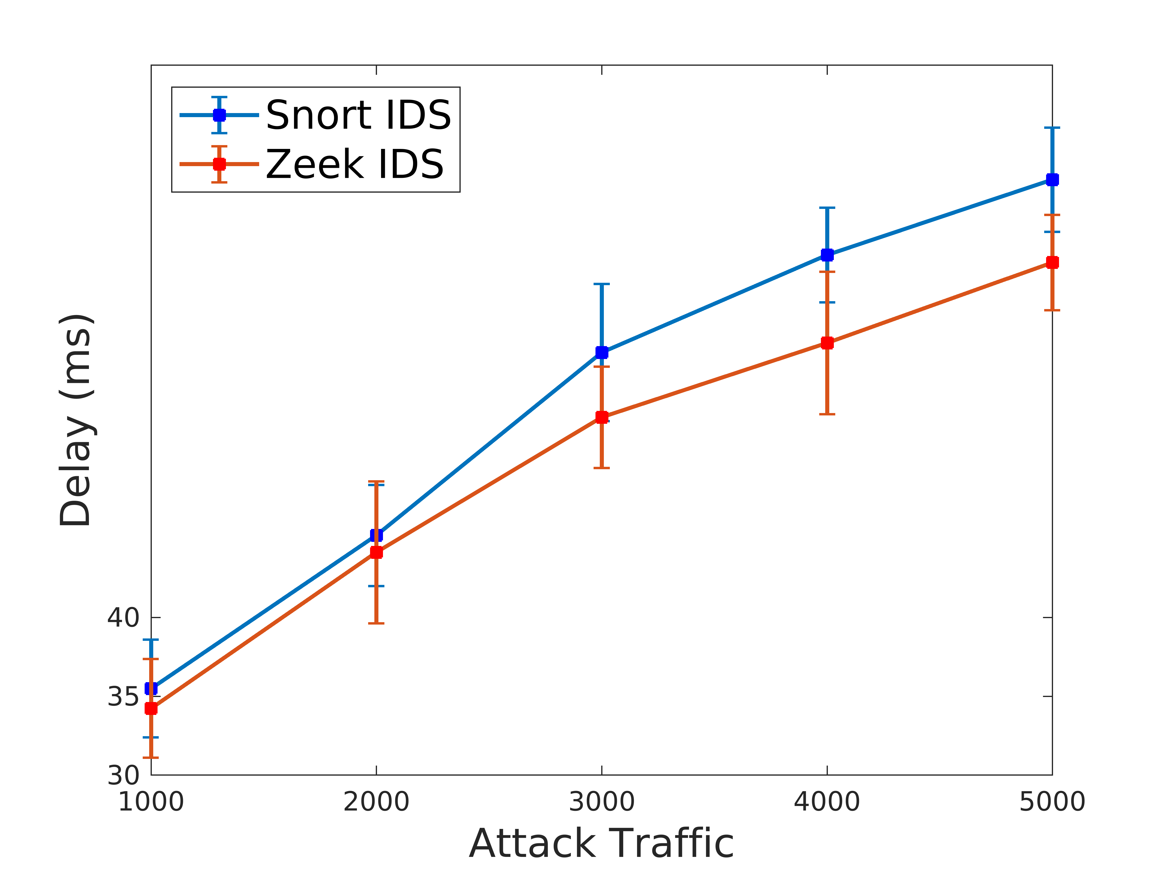
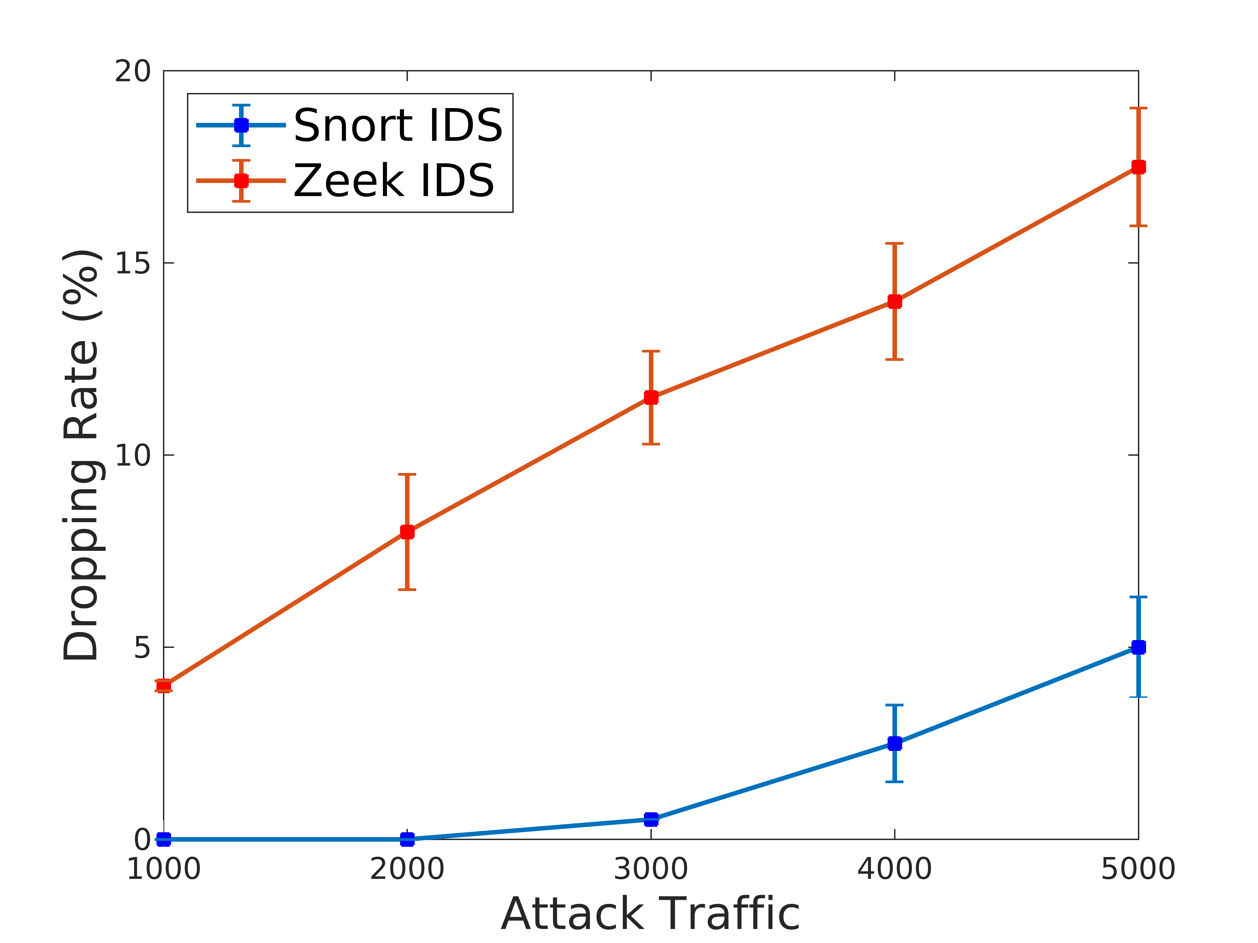
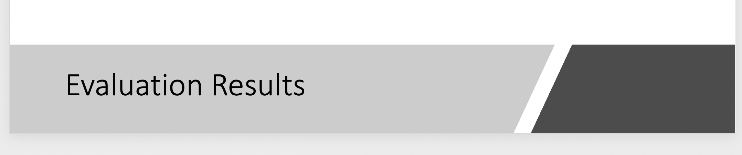
Evaluation Results

Slide 14
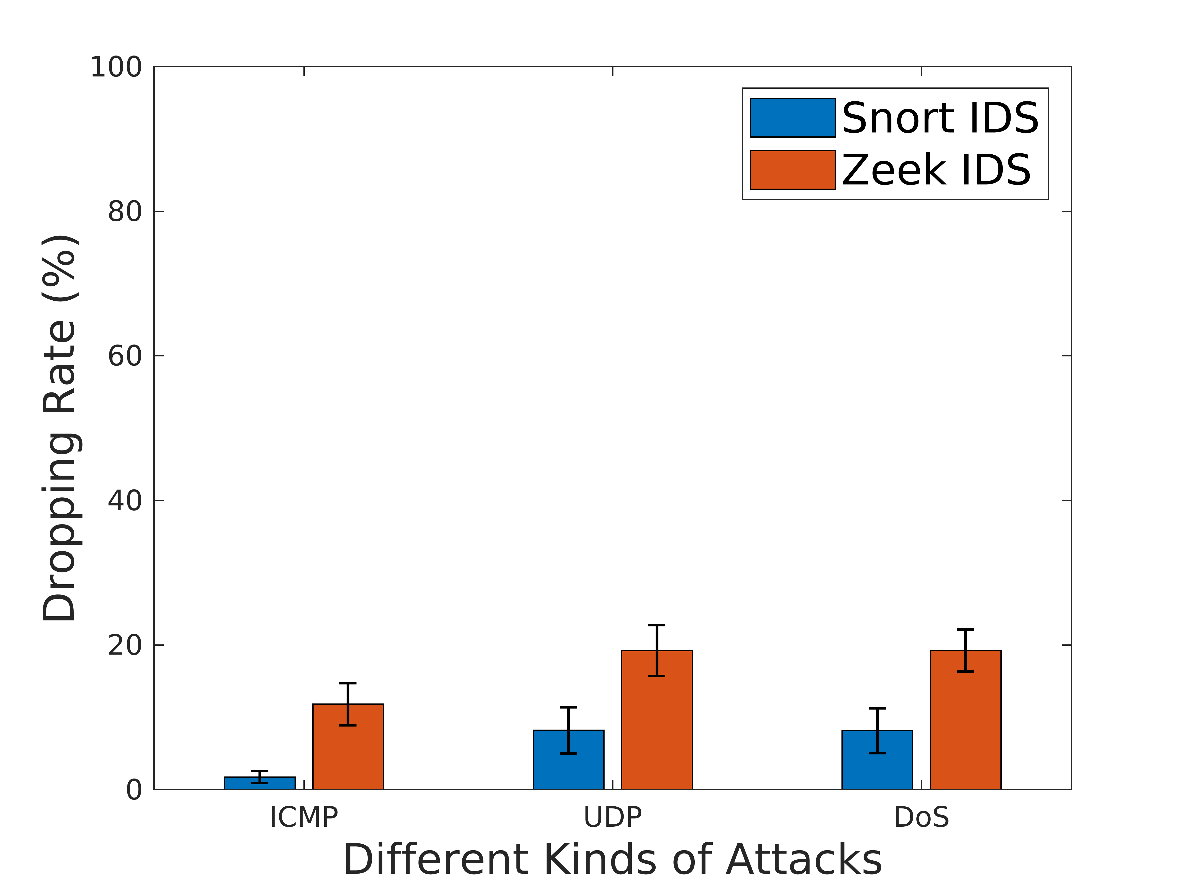
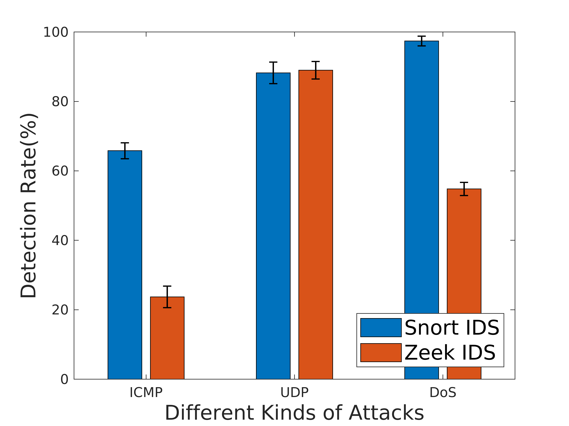
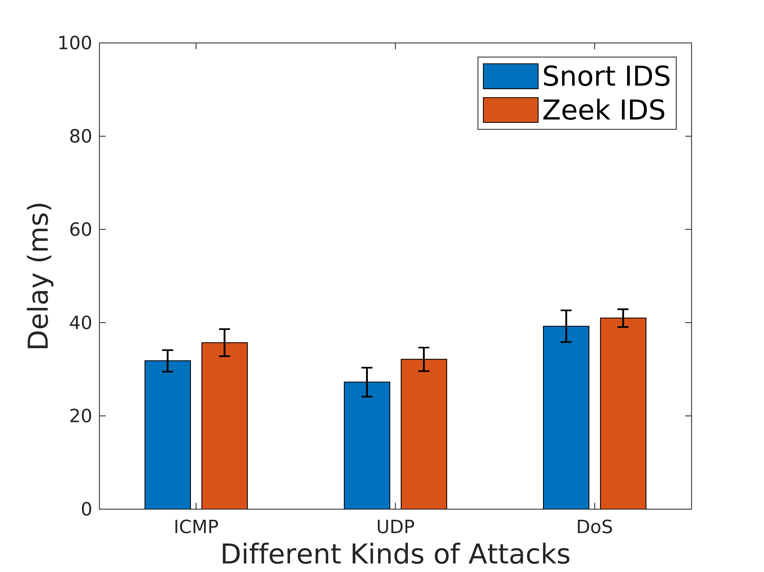
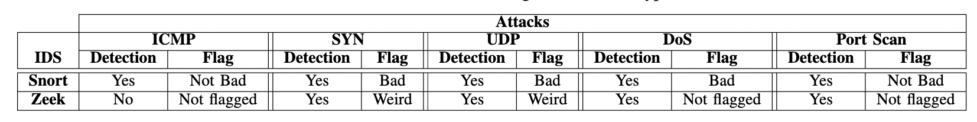
Evaluation Results

Slide 15
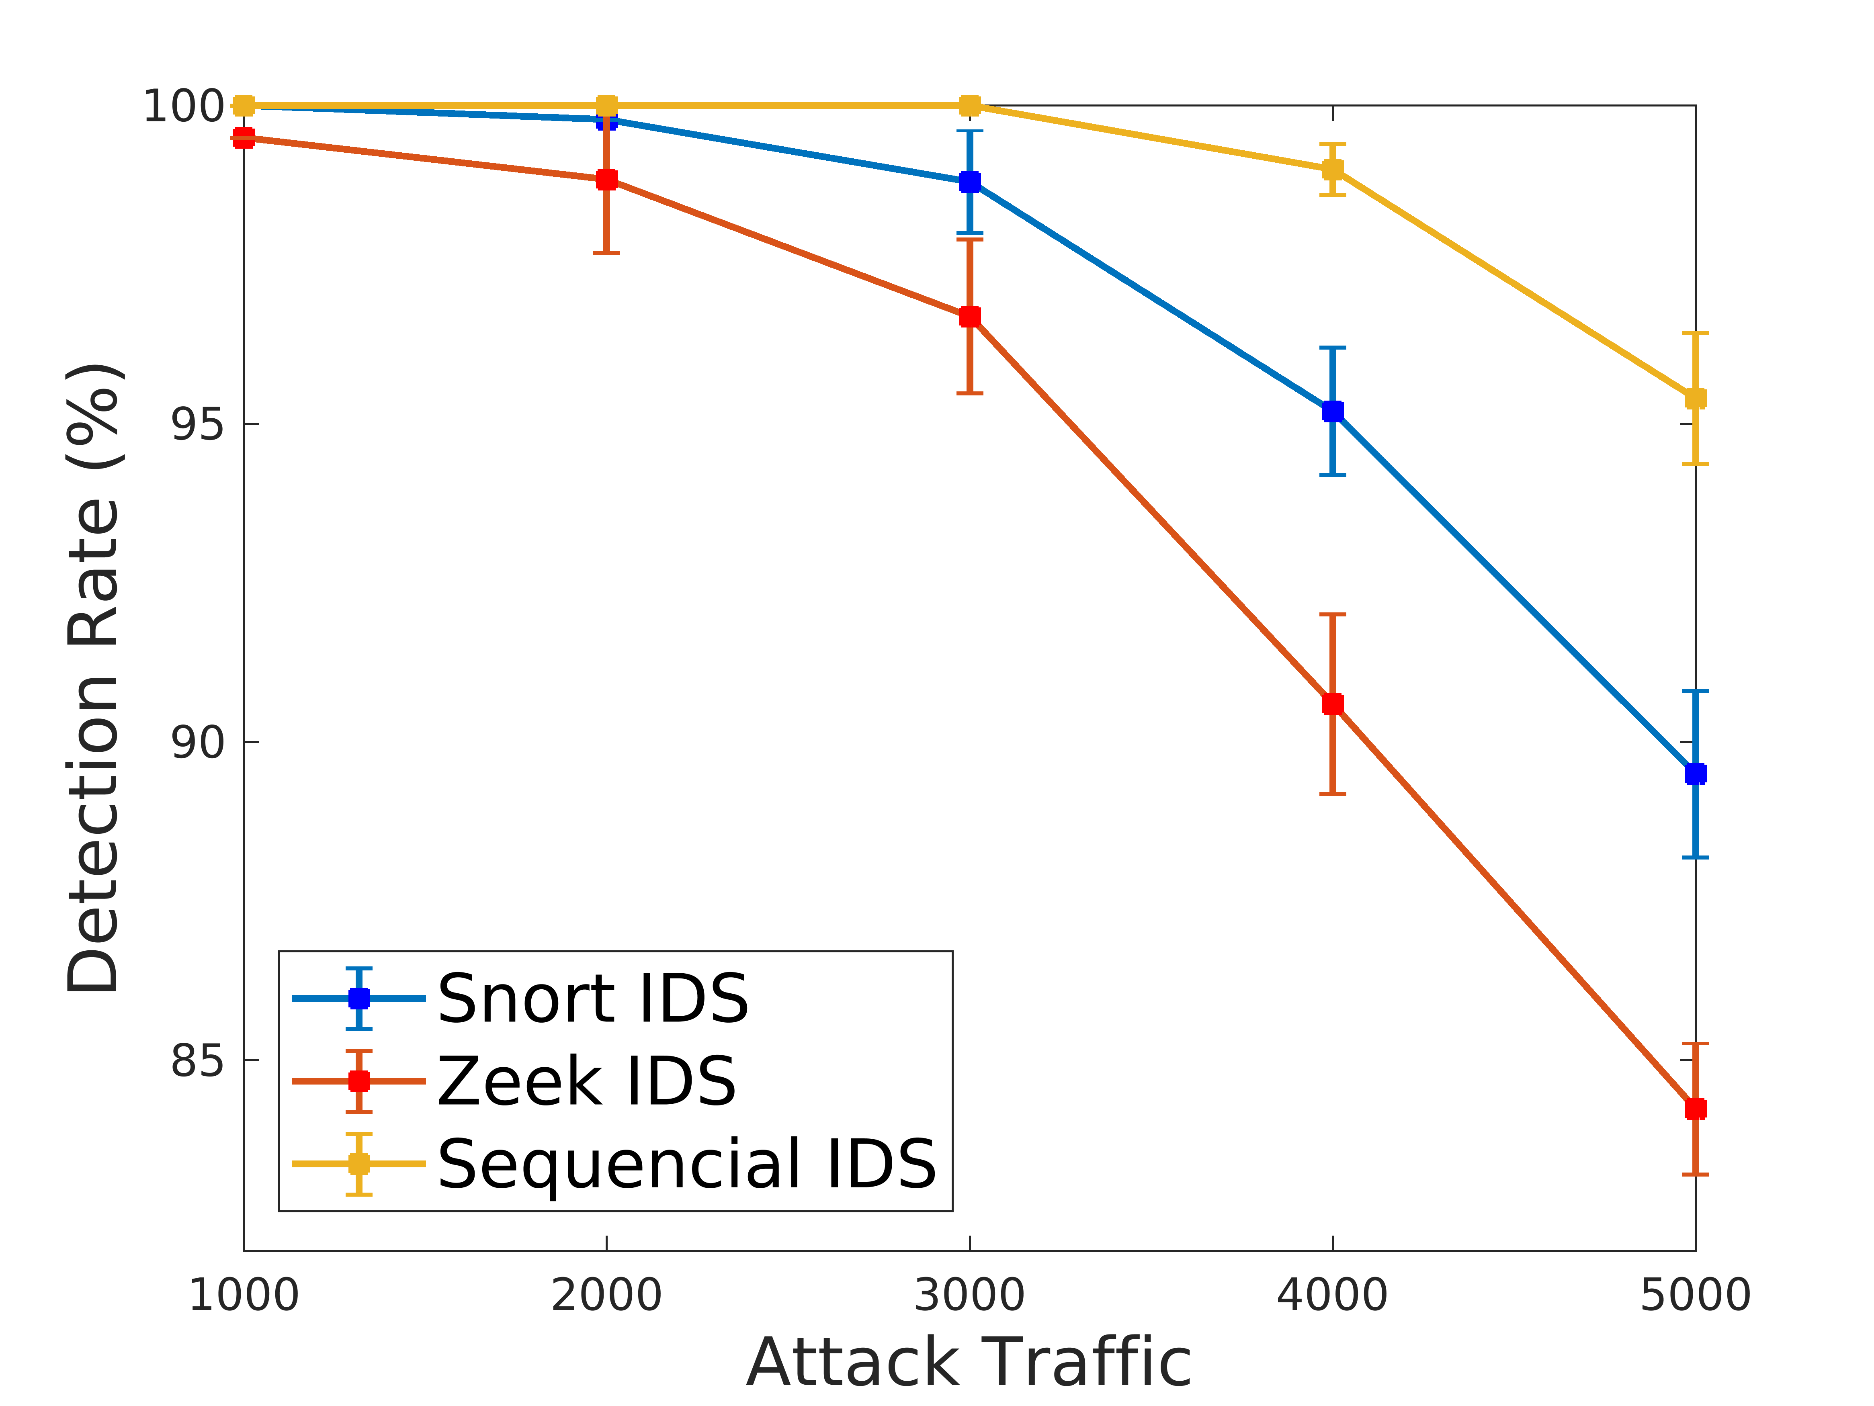
Evaluation Results

Slide 16
Conclusion
The analysis regarding attacks is primarily done outside of Zeek and the focus for Zeek is on collecting detailed information about the traffic
Classical signature based IDS like Snort is instead more used as actual IDS, i.e the focus is on matching specific attack signatures .
In the case of having single IDS, Snort IDS can be said to be above Zeek IDS in the case of detection rate, dropping rate, but not for delay.
Under default configuration, neither Snort IDS nor Zeek IDS detect the port scanning attack.

