Slide 1
Qute: Quality-of-Monitoring Aware Sensing and Routing Strategy in Wireless Sensor Networks
Shaojie Tang Jie WU
Temple University

Slide 2
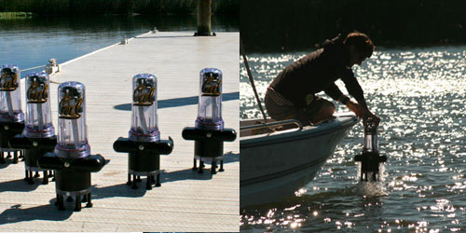
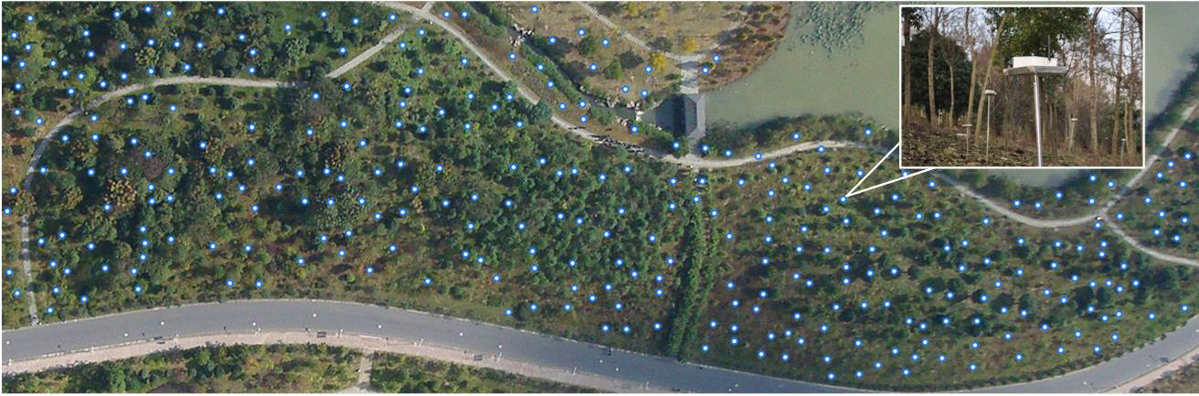
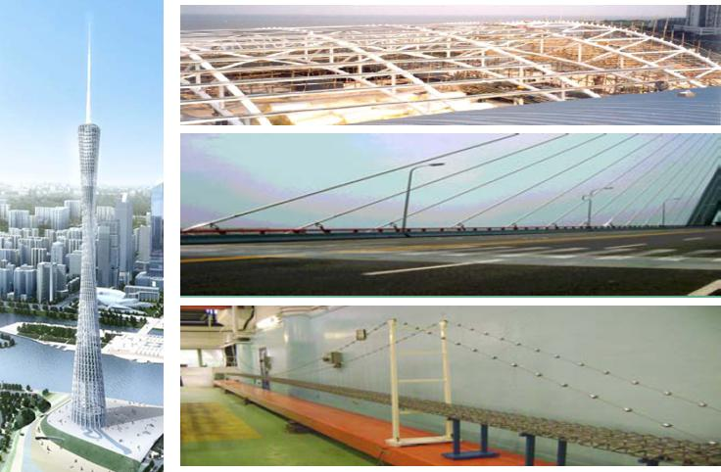
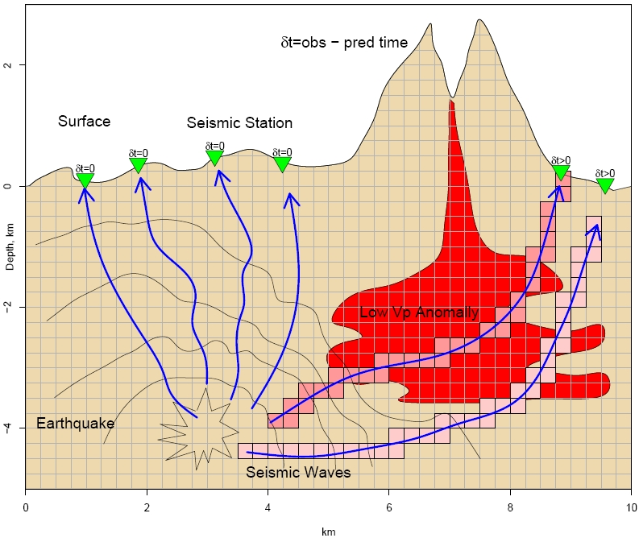
Examples of WSNs
Wireless Sensor Networks (WSNs) are widely used to monitor the physical environment.
Notes:
Environmental and Habitat Monitoring, Precision Agriculture, Indoor Climate Control, Military Surveillance, Treaty Verification, Intelligent Alarms
Fig1: The Floating Sensor Network is a project by researchers at UC Berkeley that provides real-time, high-resolution data on waterways via a series of mobile sensing 'drifters' that are placed into the water and monitored by cell networks and short-range wireless radios.
Fig2: GreenObs: A Long-Term Kilo-Scale Wireless Sensor Network System in the Vast Forest. for forest monitoring
Fig3: A versatile WSN platform for structural health monitoring
Fig4: This project will create a new paradigm, VolcanoSRI (Volcano Seismic Realtime Imaging), for imaging 4D (four-dimensional) tomography of an active volcano in real-time.

Slide 3
Comparison with Traditional Networks
Unlike traditional networks, wireless sensor networks are often resource limited
  Limited power supply
  Limited computational capability
  Limited communication capability
Developing an effective sensor network must take into account its Quality-of-Monitoring (QoM)
  Avoid redundant sensor readings
  Leverage the statistical correlations among sensor nodes
Notes:
Each sensor node periodically measures several signal values (such as temperature, humidity, illuminance, and CO2) from the environment, and continuously transmits them back to the base station through multi-hop relay. To achieve satisfactory quality of monitoring, typical WSN applications require spatially dense sensor deployment [6]. As a result, the readings among neighboring nodes are often spatially correlated. The degree of correlation depends on the internode separation [19].

Slide 4
System Overview
Quality of Monitoring
Sensing
Networking
Sensing rate allocation
Routing plan
Notes:
In order to achieve satisfied QoM, we jointly considering both sensing rate allocation and routing design, they should satisfy the energy constraint on each node and flow conservation through the network.

Slide 5
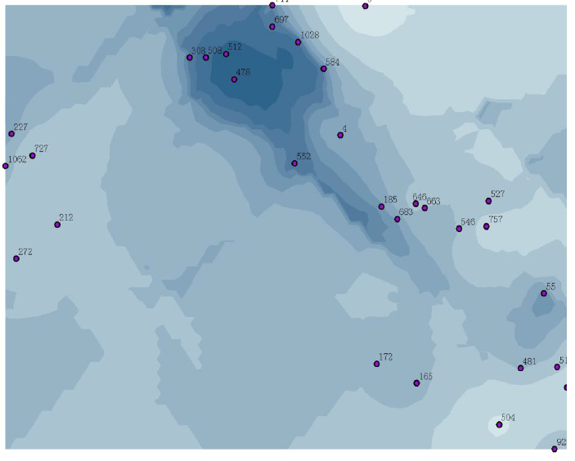
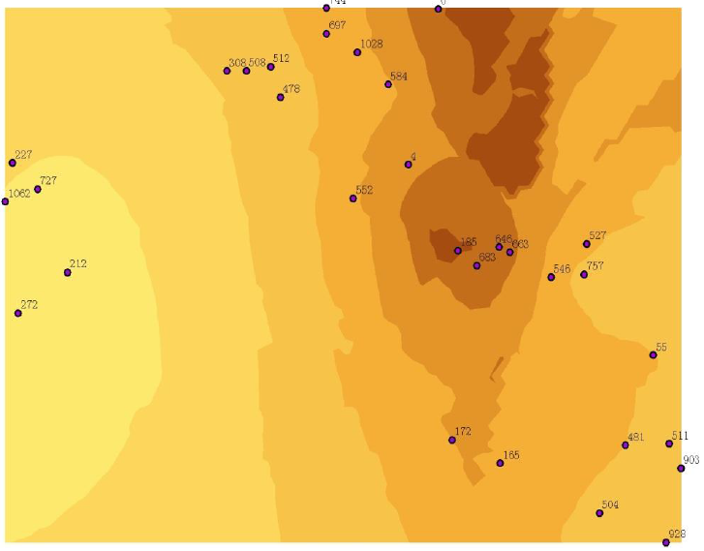
Statistical Correlations
The readings among neighboring nodes are often spatially correlated.
  The degree of correlation depends on the internode separation
  Those sensors with similar readings naturally form a component or cluster.

Slide 6
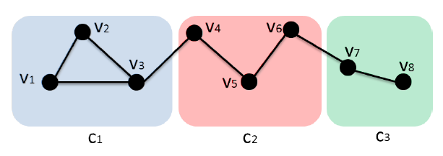
Correlation Model
A correlation component is a subset of sensors where the sensor nodes within one component have similar sensing values.
Communication graph and correlation components.
Notes:
(CORRELATION COMPONENT). A correlation component is a subset of sensors where the sensor nodes within one
component have similar sensing values. Thus, the sensing value reported by any sensor can be approximated or estimated by the
readings of any sensor node within the same correlation component.
As an example, Figure illustrates a typical communication graph and correlation component. Sensor nodes within the same block belong to one correlation nodes within the same block belong to one correlation
component. There is an edge between two nodes if they can communicate with each other.

Slide 7
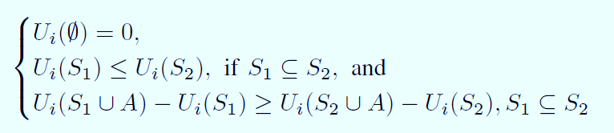
How to Represent Quality of Monitoring?
We define a general submodular function to quantify the Quality-of-Monitoring (QoM) under different sensing rate allocations.
We say a function is submodular if it satisfies a natural “diminishing returns” property
Notes:
Specifically, for a single component, the contribution of an additional sampling to the QoM crucially depends on the current sensing rate of that component. As pointed out in the literature [1] [8] [25], due
to spatial-temporal correlation among sensor readings, the utility function of total sensing rate exhibits diminishing marginal returns.

Slide 8
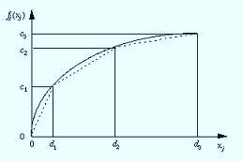
How to Represent Quality of Monitoring?
We define a general submodular function to quantify the Quality-of-Monitoring (QoM) under different sensing rate allocations.
We say a function is submodular if it satisfies a natural “diminishing returns” property
Notes:
Specifically, for a single component, the contribution of an additional sampling to the QoM crucially depends on the current sensing rate of that component. As pointed out in the literature [1] [8] [25], due
to spatial-temporal correlation among sensor readings, the utility function of total sensing rate exhibits diminishing marginal returns.

Slide 9

How to Represent Quality of Monitoring?
We define a general submodular function to quantify the Quality-of-Monitoring (QoM) under different sensing rate allocations.
Let pj be the probability that the sensor vj will detect a certain event happened at a component. Then the utility function gained from that component can be defined as
Notes:
Specifically, for a single component, the contribution of an additional sampling to the QoM crucially depends on the current sensing rate of that component. As pointed out in the literature [1] [8] [25], due
to spatial-temporal correlation among sensor readings, the utility function of total sensing rate exhibits diminishing marginal returns.

Slide 10

How to Represent Quality of Monitoring?
The overall utility is defined by summing utilities over all correlation components:

Slide 11
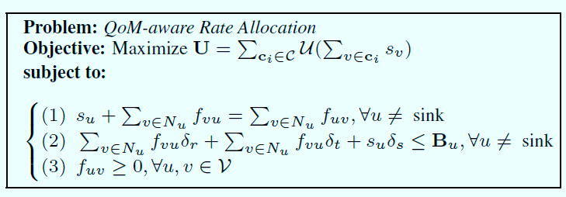
Problem Formulation
We assume that there is a set of sensor nodes deployed over a two-dimensional area.
In addition, there is one sink node to collect all sensing data from the network.
Notes:
In the above formulation, N_v represents the set of v’s neighbors
in the communication graph. Constraint 1 specifies the flow conservation:
total amount of inflow plus self-generated data is equal
to that of outflow. Constraint 2 specifies that the total energy consumption
on each node should not exceed its energy budget. The
general objective of this work is to decide an appropriate sensing
rate s_v for each node v \in V and associated flow assignment f_uv on
each link uv in order to maximize the overall utility while satisfying
both the energy constraint and flow conservation.

Slide 12
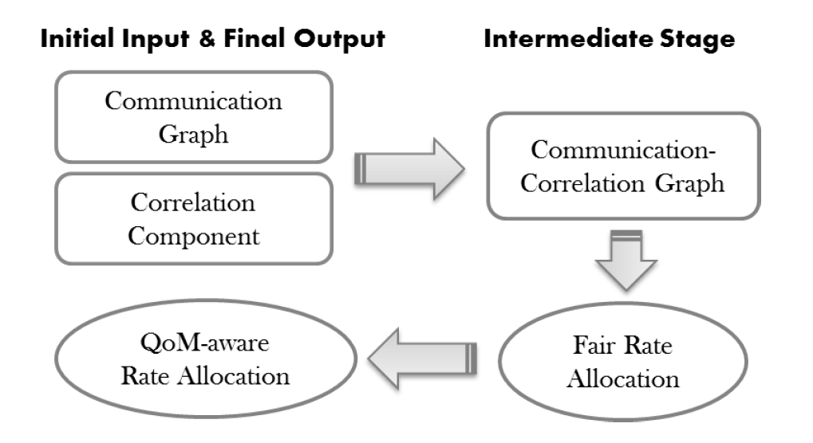
System Flow
Notes:
Figure illustrates the system flow of Qute. We first introduce
a two-layered Communication-Correlation Graph (CCG) by integrating
the information from both communication graph and correlation
component. Based on CCG, we introduce and study a
new problem called fair rate allocation problem, which shares the
same optimal solution with the original QoM-aware rate allocation
problem in some scenarios. We propose an efficient algorithm
to find the optimal fair rate allocation, which is also the optimal
QoM-aware rate allocation under some settings.

Slide 13
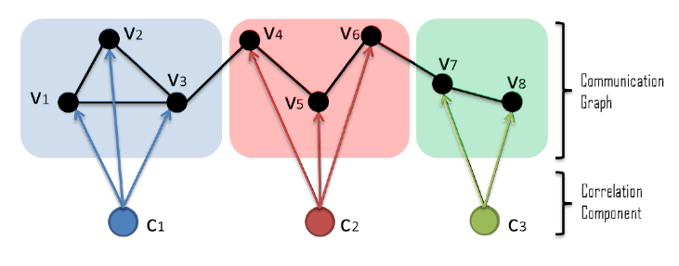
Two-layered Communication-Correlation Graph
Two-layered Communication-Correlation Graph based on the example in Figure 2.
Notes:
We first introduce a two-layered Communication-Correlation Graph (CCG) by integrating the information from both communication
graph and correlation component.

Slide 14
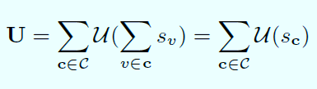
CCG-based Formulation
Let sc represent the total sensing rate from component c.
Therefore, the overall utility function can be rewritten as:

Slide 15
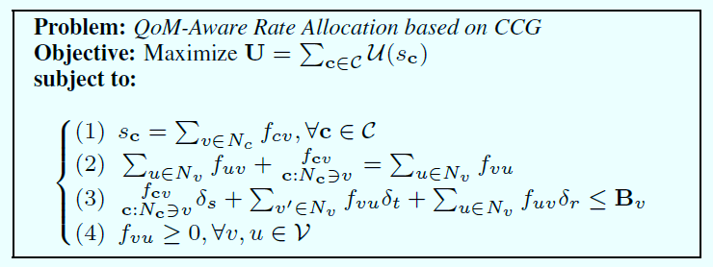
CCG-based Formulation
The new problem formulation is similar to the original one, except for some additional constraints on the virtual node.
Notes:
In fact, this problem is equivalent to the original problem in the sense that (1)
any solution of the above problem can be converted to that of the
original problem without utility degradation, and (2) both problems
share the same objective function.

Slide 16
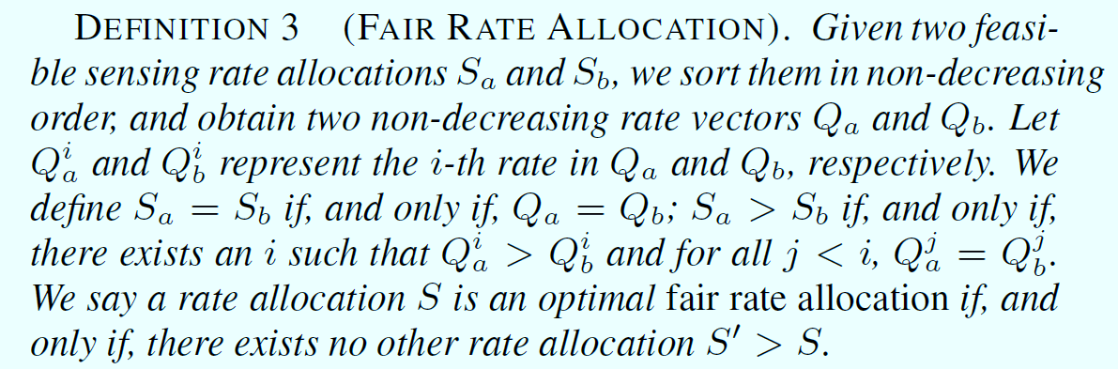
Optimal Fair Rate Allocation
Fair rate allocation problem seeks a rate allocation which can maximize the minimum sensing rate among all components.
We show that both problems share the common optimal solution under some settings.

Slide 17
Optimal Fair Rate Allocation
We modify a classic two phase approach to solve this problem
  (1) Maximum Common Rate Computation: compute a maximum common rate s that satisfies all energy constraints and flow conservation; and
  (2) Maximum Individual Rate Computation: calculate the maximum rate for each component by assuming the sensing rate of all the other components is s.

Slide 18
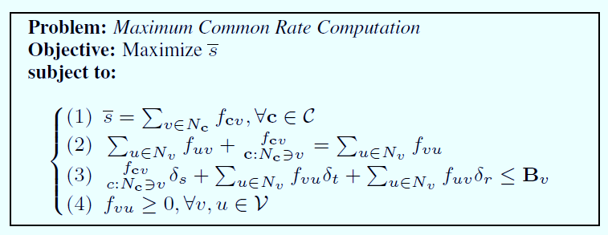
Maximum Common Rate Computation
To compute the maximum common rate, we formulate it as a linear programming problem.
Notes:
To compute the maximum common rate, we formulate
it as a linear programming problem. In this problem, most constraints
are the same as those listed in QoM Aware Rate Allocation
based on CCG, except that (1) we use the same sensing rate s for
all correlation components in Constraint 1, and (2) the objective
is to find the maximum s. This is a standard linear programming
problem which was well-studied before;We can use any linear programming
solver, such as simplex methods, to efficiently solve this
problem and obtain the maximum common sensing rate s.

Slide 19
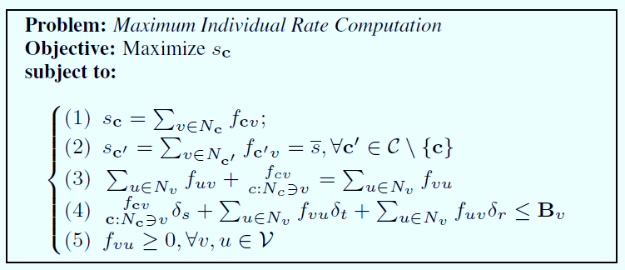
Maximum Individual Rate Computation
Compute the maximum individual sensing rate that can be achieved for each component by assuming all the other components take the same sensing rate.
Notes:
After the maximum common rate s is computed, the second
step is to compute the maximum individual sensing rate that can
be achieved for each component by assuming all the other components
take the same sensing rate s. For each component c, we
formulate the maximum individual rate problem as a linear programming
problem. Its formulation is similar to the one defined in
the previous phase, except that the first condition is replaced by two
Constraints. This problem can still be solved efficiently
through linear programming. After obtaining the maximum individual
rate for each component, there must exist at least one component,
say c, whose maximum individual rate is the same as the
maximum common rate. We find all such components, and
set their final sensing rate to s, and those components will no
longer participate in the following iterations.

Slide 20
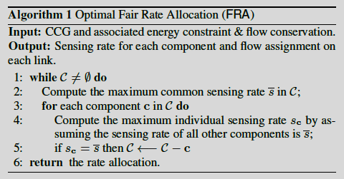
Optimal Fair Rate Allocation
This algorithm returns the optimal fair rate allocation.

Slide 21
QoM-aware Rate Allocation
If the per unit data sensing cost is no less than the per unit data receiving cost, then the optimal fair rate allocation is also an optimal QoM-aware rate allocation.
Fair Rate Allocation
QoM-aware Rate Allocation
Notes:
So far, we successfully demonstrated that Algorithm 1 returns
the optimal solution in terms of fair rate allocation problem; however,
there is still a gap between the optimal fair rate allocation and
optimal QoM-aware rate allocation. To fill this gap, we show in
the following theorem that if the per unit data sensing cost is no less
than the per unit data receiving cost, then the optimal fair rate allocation
is also an optimal QoM-aware rate allocation. It implies
that, when s r, Algorithm 1 returns the optimal QoM-aware
rate allocation, which achieves the maximum total utility.

Slide 22
QoM-aware Rate Allocation
Given any feasible rate allocation, in order to increase the sensing rate of some component by c, we only need to decrease the total sensing rate of the other components by at most c.
  This can be shown through construction.
  For any given feasible rate adjustment, we can always modify it to achieve this goal without violating the energy budget constraint.

Slide 23
QoM-aware Rate Allocation
Given any optimal fair rate allocation, we cannot increase the sensing rate of a correlation component without reducing the sensing rate of another component with a lower sensing rate.
  this can be shown through contradication

Slide 24
QoM-aware Rate Allocation
Any optimal QoM-aware rate allocation must also be an optimal fair rate allocation if the sensing cost is no less than the receiving cost.
  Given any feasible rate allocation, in order to increase the sensing rate of some component by c, we only need to decrease the total sensing rate of the other components by at most c.
  Given any optimal fair rate allocation, we cannot increase the sensing rate of a correlation component without reducing the sensing rate of another component with a lower sensing rate.

Slide 25
QoM-aware Rate Allocation
If optimal fair rate allocation is not an optimal QoM-aware rate allocation, we can increase the sensing rate of some component while decreasing the total sensing rate of some other components with a higher rate by at most the same amount.
This leads to a better QoM-aware rate allocation due to its submodularity.
  It contradicts to the assumption that the original rate allocation is optimal.

Slide 26
QoM-aware Rate Allocation
This algorithm also returns the optimal QoM-aware rate allocation.

Slide 27
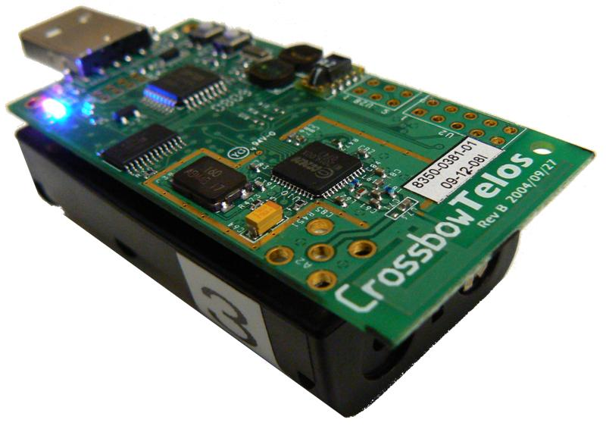
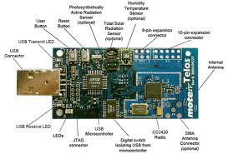
Experimental Results
We adopt the TelosB Mote with a MSP430 processor and CC2420 transceiver.
Each mote is equipped with 2 AA batteries.

Slide 28
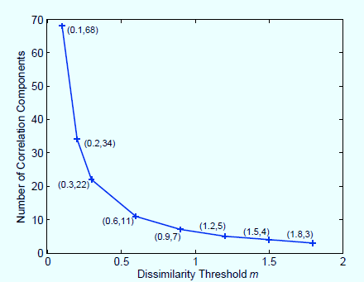
Experimental Results

Slide 29
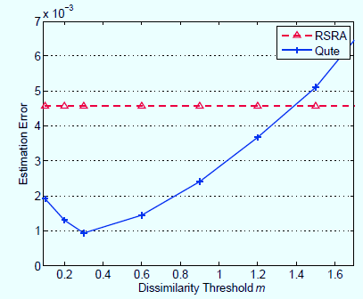
Experimental Results

Slide 30
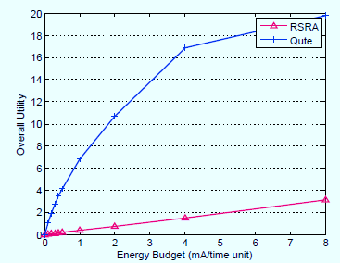
Experimental Results

Slide 31
Future Work
The per unit data sensing cost is less than the per unit data receiving cost.
The utility function U() is heterogeneous to different correlation components.
Taking wireless interference into account.
Distributed implementation.
Notes:
1. So far we assume that that the per unit data sensing cost is
no less than the per unit data receiving cost. This requirement may
not always be satisfied in practice, especially for those low energy
cost sensors e.g., accelerometer or gyro sensors. One interesting
direction for future work is to develop a new rate allocation scheme
whose performance can be bounded for the general case.
2. In this paper, we assume that the utility function U() is identical
to all correlation components; the other possible direction for
future research is to generalize existing studies to heterogeneous utility
functions, e.g., different components may have different submodular
utility functions. In this case, the current approach may
fail to achieve the maximum QoM, even under the assumption that
the per unit data sensing cost is no less than the per unit data receiving
cost.
3. Another interesting extension is to study the rate allocation
problem in multi-application networks. In reality, one node may
be involved in many applications [1] [26], such as temperature, humidity,
and illuminance monitoring. For different applications, we
may partition the network into different correlation components.
As a result, one node may belong to multiple components under
a multi-application network. Then one interesting problem is to
study how to find a rate allocation among sensors and applications,
which can achieve the maximum utility across all applications.
One possible approach is to add additional virtual nodes for all new
added components, and then apply similar approaches as proposed
in this work.

Slide 32
Thanks!

