Slide 1
HAEP: Hospital Assignment for Emergency Patients in a Big City
Peng Liu¹, Biao Xu¹, Zhen Jiang^{2,3}, Jie Wu²
¹Hangzhou Dianzi University, China
²Temple University
³West Chester University

Slide 2





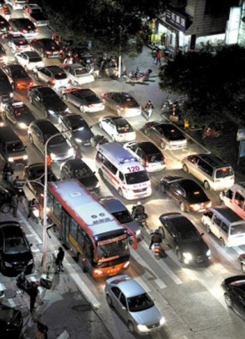

Hospital assignment in a big city
Process of emergent patient caring

Slide 3
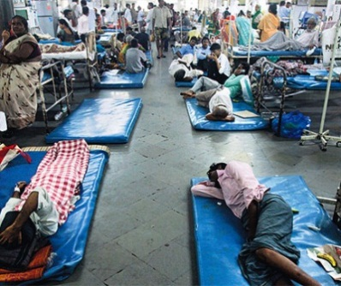
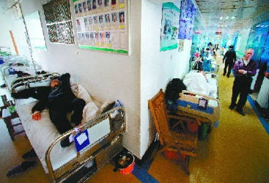
Major delay
But …
What it happens when arriving the hospital
Notes:
we assume there’s no extra delay in taking patient to hospitals, so that the delay can be calculated based on the distance and pre-consultation for any hospitals. Also, the resource allocation problem inside the hospitals are addressed in many literature, such as operation room planning, admission arrangement, improving use of Computed Tomography Facilities, and surgery scheduling, which enables us to study historic records and model capability of available beds.

Slide 4





Delayed in a hospital
Death of the patient
Poor doctor-patient relationship

Slide 5
Traditional greedy patient-hospital assignment
First-come-first-serve (FCFS)
Send the patient to a hospital with the shortest path
Sound good,
But
A life-critical patient may not obtain the slot at that hospital when…
A non-critical patient comes from a closer place, or
A non-critical comes earlier
Notes:
the service encountering a catastrophe may hold hundreds of people on their way to the hospital and require sickbeds be reserved in advance.
This is either because non-critical patients have smaller delay, or due to their earlier appearances before life-critical patients.vance.

Slide 6
Problem
In our system, there are three kinds of patients
Life-critical (e.g., massive haemorrhage, heart attack…)
Serious (e.g., detached limbs, food allergy…)
Cared (e.g., broken arm, stomach ache…)
In our system, there are two kinds of hospitals
Premium hospital (treat all patients)
primitive hospital (treat non-critical patients)
How to assign n patients to m hospitals with capacity C
and across time scale
Minimize total delay
Notes:
In this paper, we propose a hospital assignment for emergent patients in a big city, denoted by HAEP, to minimize the average delay for sending a patient to a hospital.
We take advantage of the recent technical advances in wireless networks and vehicular networks to collect the real time information from hospitals and patients, and to solve the above optimization.
Furthermore, the occupied bed is not preemptable regardless life-critical or not, due to patient-doctor dispute

Slide 7
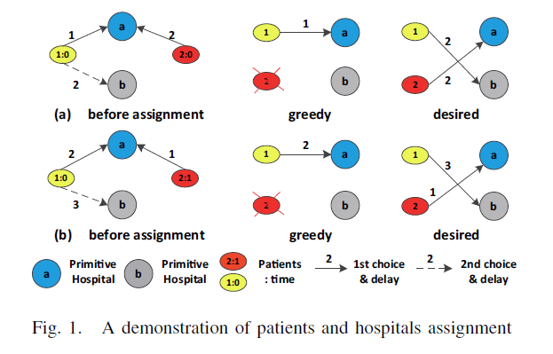
Existing solution (better use animation)
difficult to predict the assignment without accurate info.
Notes:
As demonstrated in Fig. 1, there are two hospitals, in which a is premium hospital and b is primitive hospital. There are also two patients in which 1 is a non-critical patient and 2 is a life-critical patient. We use number:time in the patient ellipse to show patient number and his appearance time. The weight in the arrow denotes the delay. Assume available capacity in each hospital is 1, requests are submitted from patient 1 and 2 at time 0 as seen in Fig.1(a). They will compete for a, according to the FCFS greedy algorithm, 1 will be assigned to a since it has smallest delay, leaving 2 no place to go. As the resource is enough for both patients, the best solution is to assign 1 to b, and 2 to a. In Fig.1(b), when two patients raise requests one after another, FCFS results 1 occuping a although delay of 1 is greater than that of 2, and 2 has no hospital to go. The desired assignment is indicated in Fig.1(b).

Slide 8
Insight

Slide 9
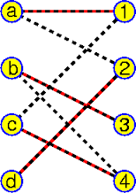
When we have enough occupancy for demand
Solution: Max-weight bipartite matching (Hungarian algorithm based K-M algorithm [J. Bondy’76])
n patients, m hospital, extension
n is not equal to m
more than one node could be assigned to the same hospital
Notes:
KM algorithm can get the optimal solution of resource allocation in O(n^3). Here needs some extension which is “n is not equal to m” and “many to one assignment”
Our solution is based on K-M but improve it via introducing time facts by reservation.

Slide 10

Key of the K-M algorithm
Using labeling function L to find possible matching
$$L\left(x\right)+L\left(y\right)=R(x,y)$$
Each step will find a local max-weight matching, if there’s not enough resources, extend possible match by increasing and decreasing L by a small difference.
If any better matching be found, could do assignment switching to correct results.
1
2
A
1
A
1
A
3
1
3
1
B
6
3
6
B
2
B
2
0
2
0
Notes:
But even the average delay is minimized, the results might not be good since some life-critical patients may have died. We must balance the need of both patients as well as remain a low average delay.

Slide 11
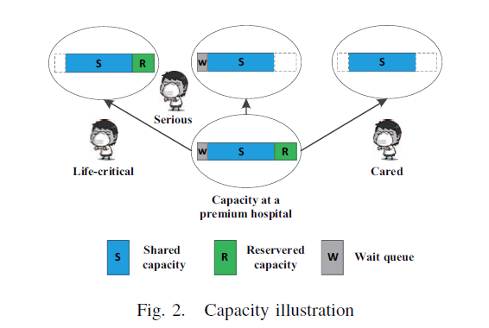
Our Solution
Deal with multi-kind multiple requests and multi-kind resources
Partition hospital capacity into three parts
Notes:
When a hospital could have multiple capacities and more than one type of patients, the problem becomes complicated, since the current optimal does not mean global optimal. As shown in Fig. 2, different patients have different view of capacity of a premium hospital. In our method, we first consider the extension of capacity to bipartite matching, then the optimization across adjacent time periods. Based on the estimated rate of critical patients that will enter the hospital in the near future, we set up reservation in our algorithm HAEP (indicated as R in Fig. 2) to optimize allocation across time periods. Furthermore, for patients in serious condition, we arrange a special waiting room to have them stay rather than ask them to go (indicated as w in Fig. 2, capacity is based on the number of patients leaving the hospital and time cost to another nearest hospital).

Slide 12
Our Solution
Deal with multi-kind multiple requests and multi-kind resources
Partition hospital capacity into three parts
Optimization allocation across time period by
Preservation for life-critical patients ?
Waiting room for serious patients
Notes:
When a hospital could have multiple capacities and more than one type of patients, the problem becomes complicated, since the current optimal does not mean global optimal. As shown in Fig. 2, different patients have different view of capacity of a premium hospital. In our method, we first consider the extension of capacity to bipartite matching, then the optimization across adjacent time periods. Based on the estimated rate of critical patients that will enter the hospital in the near future, we set up reservation in our algorithm HAEP (indicated as R in Fig. 2) to optimize allocation across time periods. Furthermore, for patients in serious condition, we arrange a special waiting room to have them stay rather than ask them to go (indicated as w in Fig. 2, capacity is based on the number of patients leaving the hospital and time cost to another nearest hospital).

Slide 13
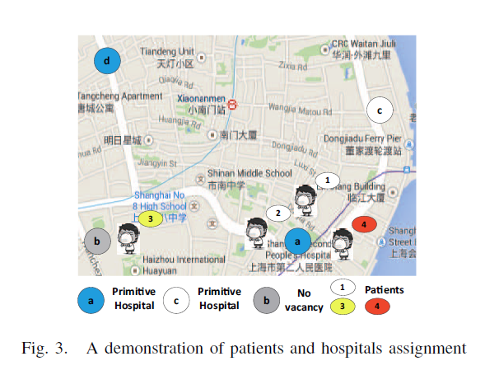
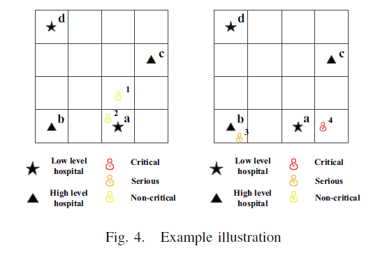
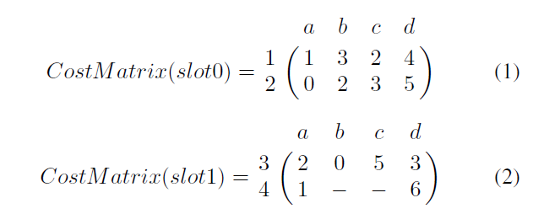
Example
Notes:
Explain the example in a short, simple way

Slide 14
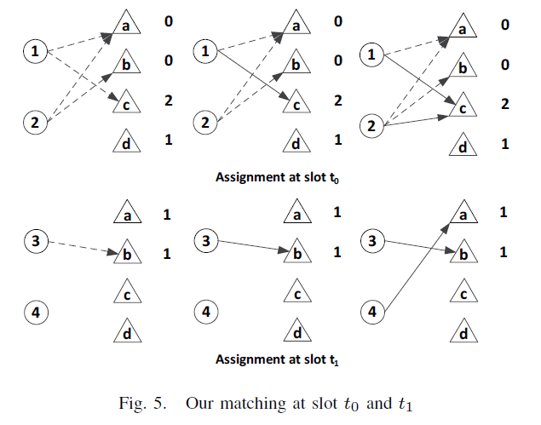
Example

Slide 15

Calculation of parameters
Size of preservation
last three data sets as history to estimate the future
α and β are constant coefficient where α + β = 1
γ is is a compensatory factor
Notes:
The waiting capacity of a hospital, i.e., wk, is very important to serious patients, since they could make sure they would have beds after waiting, and get some basic treatment while waiting. It takes extra traffic time (may be greater than the delay cost
of waiting) to get to the next hospital. The parameter wk is related to the hospital-leaving rate and the time to the furthest
hospital. Where Min{Tk} denotes the distance (represented by time) of nearest hospital to hospital yk. Ck and dk denote the capacity and average in-patient time of yk respectively. Namely, we hope the total possibility of leaving wk patients in Min{Tk}
time is larger than 80%. The larger the Min{Tk} is, the larger the wk. It is normal that patients would want to wait at the
closer hospital, as opposed to going to the further one.
Since the reservation depends on the distribution of in-patient possibility, a concrete method could be adopted according to a
different realistic model. Here, we assume that the number of critical patients in a region is always smaller than the capacity
of a premium hospital. The idea is simple, if we observe a waste of additional reservation beds, we cut the budget. If we continually encounter insufficient reservations, we increase the budget.

Slide 16
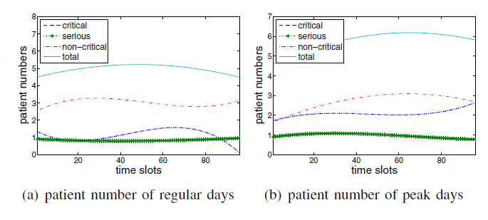
Simulations
Patient number varies along time
4x4 grid with distance 5 min, Poisson dist. to generate patients
4 hospitals in total (two premium, 2 primitive), each 120 beds
Competitors
Nearest-first(FCFS) and with reservation (FCFS-res)
K-M algorithm extended with capacity(K-M)

Slide 17
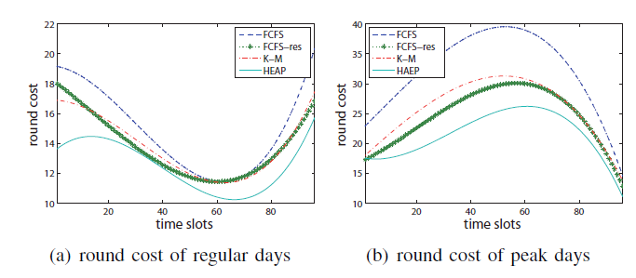
Total delay
The costs vary since there are different patient requests in each round.
K-M and FCFS-res will give more benefit to serious and critical patients so that some noncritical patients will be affected

Slide 18
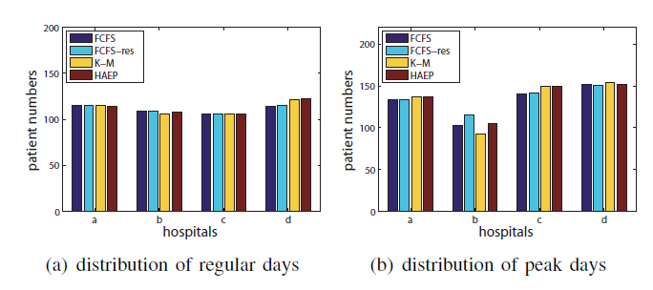
Distribution of patients
FCFS − res and HAEP consider the requirements from critical patients so that premium hospital a and d gets more patients in.
HAEP uses the reservation so that some noncritical patients will go further, and primitive hospital will get more patients.

Slide 19
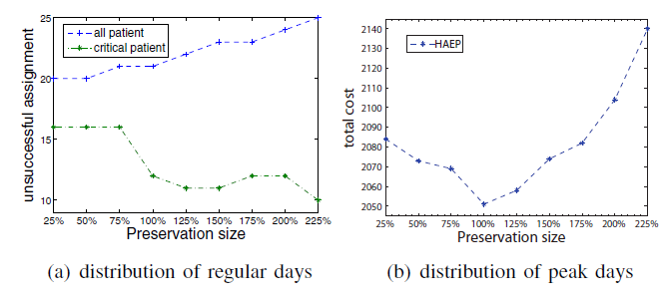
Extension work with different preservation size
The experiment is based on one extremely completive test instance of 96 rounds.
It is obviously a tradeoff between total cost and benefit of critical patients to find best point of preservation size.

Slide 20
Conclusion
we propose a novel emergent patient assignment to minimize the average delay of patients, as well as the amount of failure-of-assignment for critical patients in the large city, denoted by HAEP.
The solution is built on the Hungarian algorithm, with the prediction and time scale, applied on a multi- imension resource and requesters.

Slide 21
Thank you!

