Slide 1

RAN–IDS: Adaptive Continual Learning for Intrusion Detection in Open RAN
International Conference on Computing, Networking and Communications (ICNC 2026)
Nadia Niknami Jie Wu
Villanova University Temple University
Notes:
Today I will present our work on RAN–IDS: Adaptive Continual Learning for Intrusion Detection in Open RAN.
This work addresses a fundamental mismatch between how O-RAN behaves and how traditional IDS systems are designed

Slide 2
Outline
Background & Motivation
Key Idea
Idea Overview
Evaluation & Conclusion
Notes:
I will briefly introduce O-RAN and the problem setting,
then explain our key idea and architecture,
and finally present experimental results

Slide 3
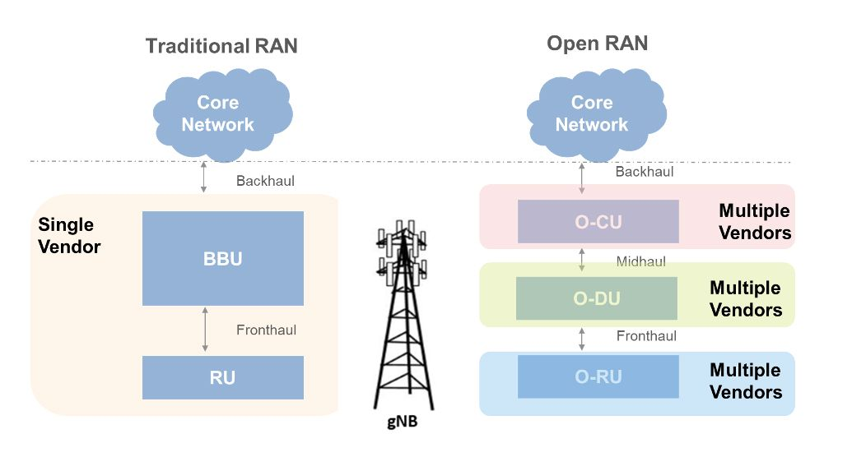
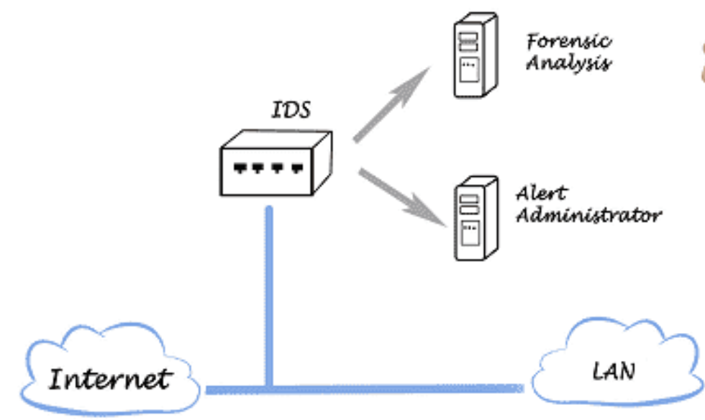
Background
Intrusion Detection System (IDS)
  Monitor network traffic for malicious behavior
  Typically trained offline on historical data
  Designed under relatively stable traffic distributions
Open-RAN
  Disaggregated RU / DU / CU architecture
  Near-RT and non-RT RIC control
  Multi-vendor, software-defined deployment
Notes:
Let me briefly provide background on both O-RAN and intrusion detection systems.
O-RAN disaggregates the traditional RAN into RU, DU, and CU components, and introduces programmable control through the near-RT and non-RT RIC.
This enables multi-vendor and software-defined deployments, increasing flexibility and innovation.
Now, traditional intrusion detection systems (IDS) monitor network traffic to detect malicious behavior.
They are typically trained offline using historical data and deployed assuming relatively stable traffic distributions.
They are designed under relatively stable traffic distributions.
RU = Radio Unit
DU = Distributed Unit
CU = Centralized Unit
RIC = RAN Intelligent Controller

Slide 4
Motivation
Why O-RAN Breaks IDS?
Frequent RIC policy updates
Dynamic slice scaling and reconfiguration
Vendor-specific functional variations
Continuous concept drift in control and data planes
Why Existing IDS Cannot Cope?
Designed for stationary distributions
Centralized retraining is too slow
Naïve online updates → catastrophic forgetting
How can we design an IDS that adapts continuously without losing past knowledge for O-RAN?
Notes:
However, O-RAN introduces continuous behavioral changes.
RIC policies update frequently.
Network slices scale dynamically.
Vendor configurations evolve.
As a result, both control-plane and data-plane traffic experience continuous concept drift.
Static IDS models quickly become outdated.
But naïve online updates cause catastrophic forgetting.
This creates a central question:

Slide 5
Key Idea: RAN–IDS
A Continual Learning Framework Designed for O-RAN
Detect zero-day and evolving attacks
Adapt continuously without catastrophic forgetting
Slice-aware and interface-aware detection
Hierarchical teacher–student architecture
Operates under O-RAN latency constraints
Key Idea:
Transforms IDS from static classification to architecture-aware adaptive learning
Notes:
The key idea behind RAN-IDS is to redesign intrusion detection as a continual learning system aligned with O-RAN architecture.
Instead of periodic retraining, the IDS adapts incrementally to evolving traffic patterns.
It is slice-aware and interface-aware, recognizing that different parts of O-RAN exhibit distinct dynamics.
We introduce a hierarchical teacher–student structure that mirrors the O-RAN functional split, enabling both global stability and local responsiveness.
In short, we transform IDS from static classification into architecture-aware adaptive learning

Slide 6
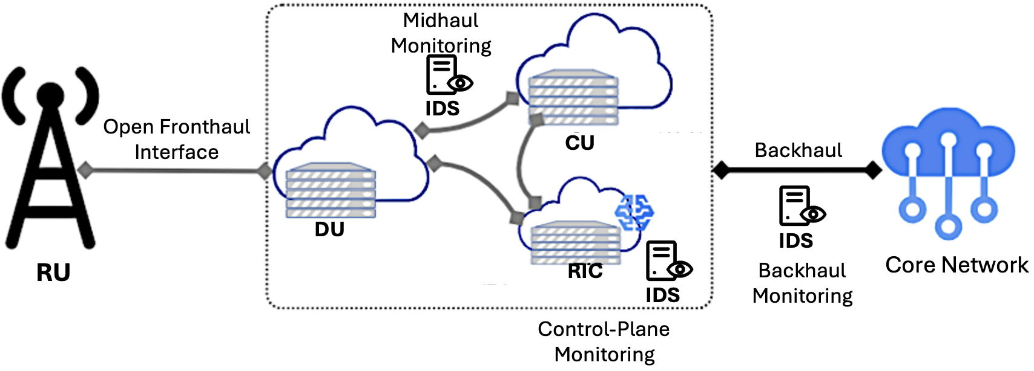
IDS Placement in O-RAN
Near-RT RIC: control-plane monitoring
  DU–CU midhaul: data-plane visibility
  Backhaul: traffic toward core network
Different interfaces exhibit distinct traffic dynamics and drift patterns
Notes:
Different O-RAN interfaces — fronthaul, midhaul, backhaul — exhibit different traffic characteristics and drift patterns.
Therefore, detection must consider interface-specific behavior rather than treating the network as homogeneous.

Slide 7
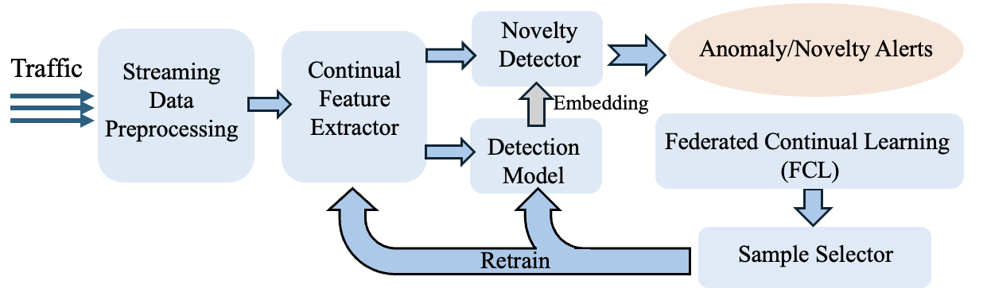
Idea Overview
Designed to align continuous traffic drift with controlled model adaptation.
Combines streaming detection, replay-based CL, and hierarchical knowledge transfer.
Notes:
So the key idea behind RAN–IDS is to stop treating intrusion detection as a static classification problem.
In fact, RAN–IDS is not just continual learning applied to IDS. It is an IDS architecture designed specifically for O-RAN dynamics.
Let me briefly walk through the architecture.
Incoming traffic is processed in a streaming manner — there is no fixed train-test split.
A continual feature extractor generates embeddings that feed both a detection model and a novelty detector.
The novelty detector identifies previously unseen behaviors, enabling zero-day detection.
Meanwhile, a replay-based continual learning loop updates the model using both new samples and representative past samples to mitigate catastrophic forgetting.
Federated continual learning aggregates updates across distributed nodes without sharing raw traffic.
This architecture enables real-time adaptation while preserving stability.

Slide 8
Idea Overview (Streaming & Novelty)
Streaming preprocessing (no train/test split)
  Continual feature extractor
  Detection model and novelty detector
Novelty Detector
  Uses embeddings and confidence scores
  Detects unseen and zero-day attacks
  Slice-specific drift awareness
Operates fully online to match dynamic slice reconfiguration
Notes:
Incoming traffic is first processed through a streaming preprocessing module.
There is no fixed train-test split — the system operates continuously.
Then a continual feature extractor generates compact embeddings.
These embeddings feed two components: a detection model and a novelty detector.
Now point to novelty detector → Novelty detection operates on embedding distributions and confidence signals.
It allows the system to flag unseen attacks without requiring labeled examples

Slide 9
Idea Overview (Detection & FCL)
FCL enables distributed adaptation without sharing raw traffic across vendors.
Aggregates drift information across heterogeneous O-RAN nodes
Notes:
However, detection alone is not sufficient in O-RAN, because traffic continuously drifts
So we introduce a continual learning loop.
Representative samples are selected and stored in a replay buffer.
The detection model is periodically retrained using both new data and selected past samples
This mitigates catastrophic forgetting.
Additionally, we incorporate federated continual learning.
Each distributed O-RAN node contributes model updates — without sharing raw traffic.
In short, the system learns continuously while operating under O-RAN latency and resource constraints.
So instead of retraining occasionally, RAN–IDS is always learning — but in a controlled, stable way.

Slide 10
Continual Learning Loop
Federated continual learning (no raw traffic sharing)
  Replay buffer with sample selection
  Mitigates catastrophic forgetting
Replay and sample selection ensure stability under non-stationary traffic.
Enables separation of global stability and local responsiveness.
Essential under slice scaling and RIC policy drift.
Notes:
The replay buffer and sample selection mechanism ensure stable adaptation under non-stationary traffic.
This prevents catastrophic forgetting while enabling forward transfer to new tasks

Slide 11
Teacher–Student
The teacher–student hierarchy mirrors the O-RAN functional split (non-RT RIC → near-RT RIC / DU-CU)
Teacher captures long-term global behavior
  Students ensure low-latency inference
  Separates learning capacity from deployment constraints
Notes:
The teacher model, located at higher-capacity nodes, maintains global knowledge.
Students provide low-latency detection locally.
This separation mirrors the O-RAN functional split and balances global stability with local responsiveness.

Slide 12
Experimental Setup
Dataset:
5G-NIDD (realistic 5G traffic)
  9 sequential attack tasks
  Streaming continual learning setting
  Metric: F1 score
Baselines for Comparison
ER, AGEM, LwF, EWC
  AOC-IDS
  Static non-adaptive model
Notes:
We evaluate using the 5G-NIDD dataset under a sequential continual learning setting with nine attack sessions.
Performance is measured using F1 score, forward transfer, and backward transfer.
Experience Replay, Averaged Gradient Episodic Memory, Learning without Forgetting, Elastic Weight Consolidation

Slide 13
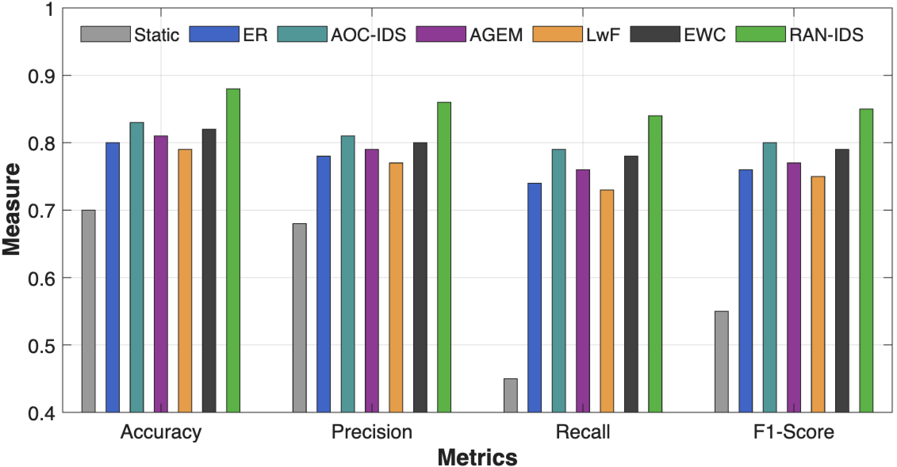
Evaluation: Overall Performance
RAN–IDS achieves highest F1, precision, recall
  Static and naive CL degrade under drift
  Hierarchical CL shows strongest robustness
Notes:
RAN-IDS consistently achieves the highest F1 score compared to static and standard continual learning baselines

Slide 14
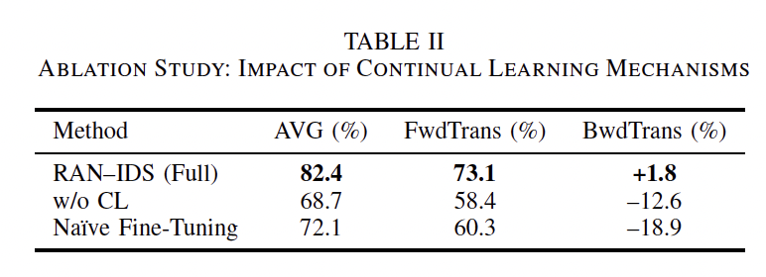
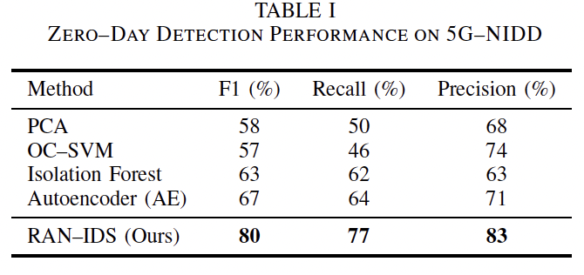
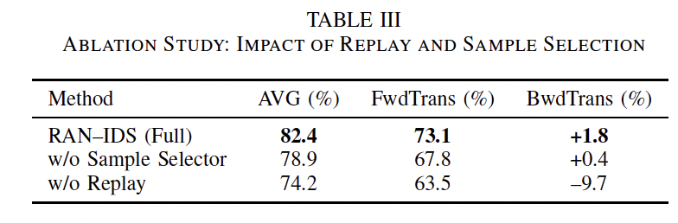
Evaluation: Performance and Ablation Study
Compared with PCA, OC-SVM, IF, AE
  RAN–IDS achieves 80% F1
  Significant improvement over baselines
Removing CL causes major degradation
  Replay is critical for memory retention
  Sample selection improves forward transfer
Forward Transfer reflects zero-day generalization under evolving traffic.
Notes:
Our approach significantly improves zero-day detection performance, reflecting better generalization under evolving traffic.
In continual learning, we care about two things:
(1) Does learning new tasks help with future tasks?
(2) Does learning new tasks damage performance on old tasks?
That’s it.
FwdTrans answers (1).
BwdTrans answers (2).
Forward transfer measures whether previously learned attack knowledge improves detection of future unseen attack sessions.
Positive forward transfer indicates better zero-day generalization.
Backward transfer measures how learning new attack sessions affects performance on previously learned sessions.
Negative backward transfer indicates catastrophic forgetting.

Slide 15
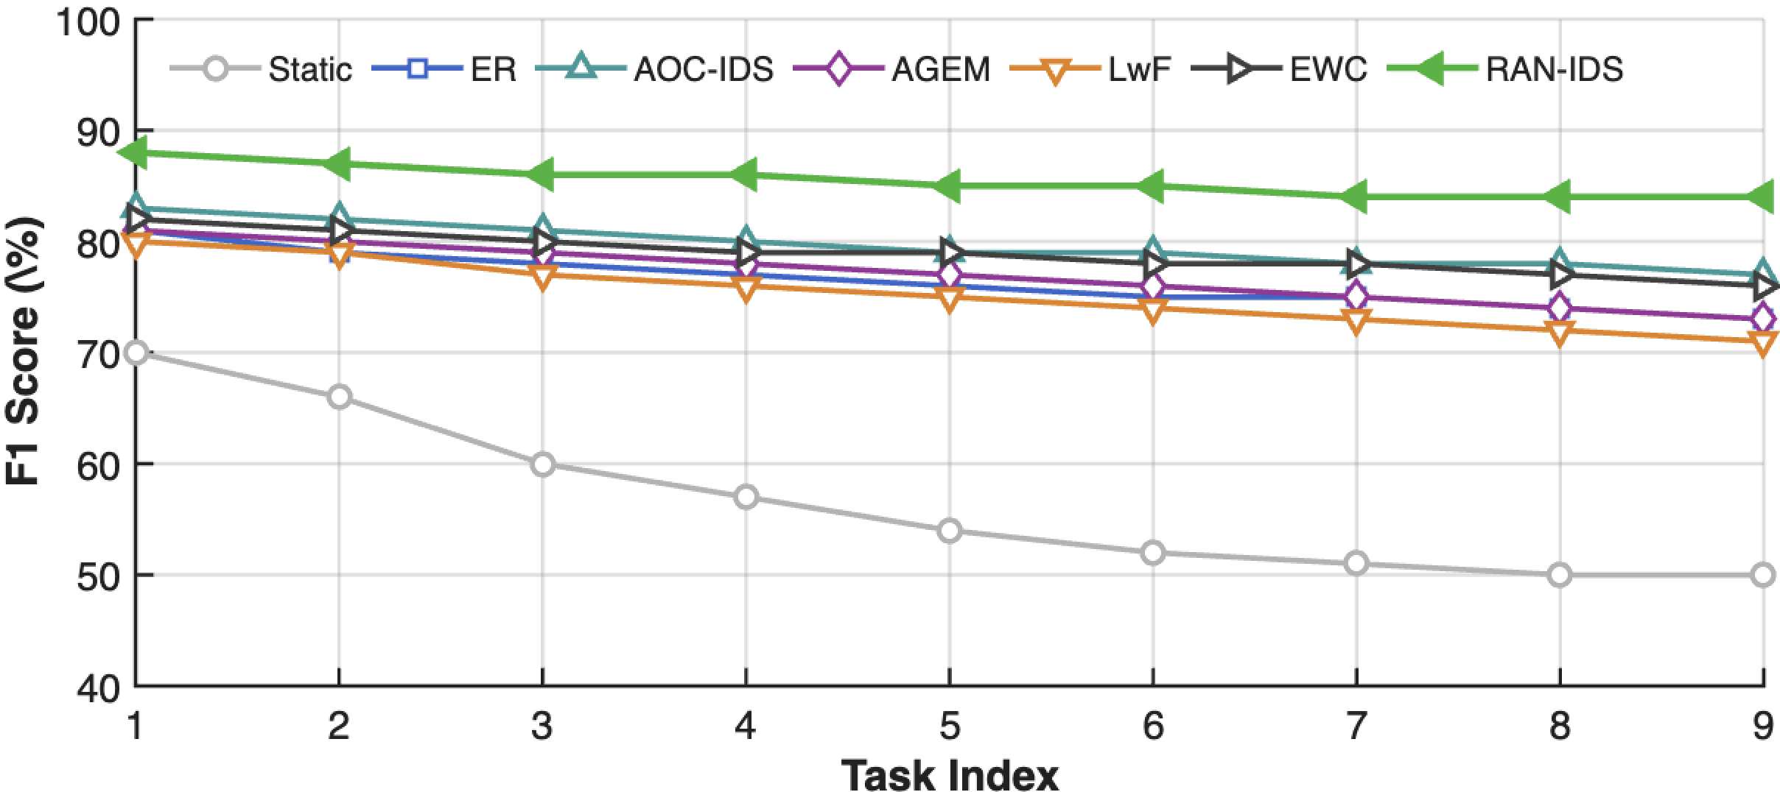
Evaluation: Task-wise Stability
Baselines show gradual forgetting
  RAN–IDS maintains stable performance
  Effective adaptation across all tasks
Demonstrates resistance to catastrophic forgetting.
Notes:
Unlike baselines, performance remains stable across tasks, demonstrating resistance to catastrophic forgetting

Slide 16
Conclusion
First architecture-aware continual IDS for O-RAN
Mitigates catastrophic forgetting under interface drift
Achieves superior zero-day detection with federated adaptation
Future Work:
Integration with RIC closed-loop mitigation
Notes:
To summarize, we propose the first architecture-aware continual IDS framework tailored for O-RAN.
It mitigates catastrophic forgetting under interface drift.
It improves zero-day detection through hierarchical and federated adaptation.
Future work includes integration with RIC-based mitigation policies

Slide 17
Thank you!
For questions this please email: nadia.niknami@villanova.edu

