Slide 1

InterestSpread: An Efficient Method for Content Transmission in Mobile Social Networks
Ning Wang and Jie Wu
Temple University
Notes:
Good morning, every one. Thank you for your attention. Today, I will present my paper, Interestspread: an efficient method for content transmission in mobile social networks.

Slide 2
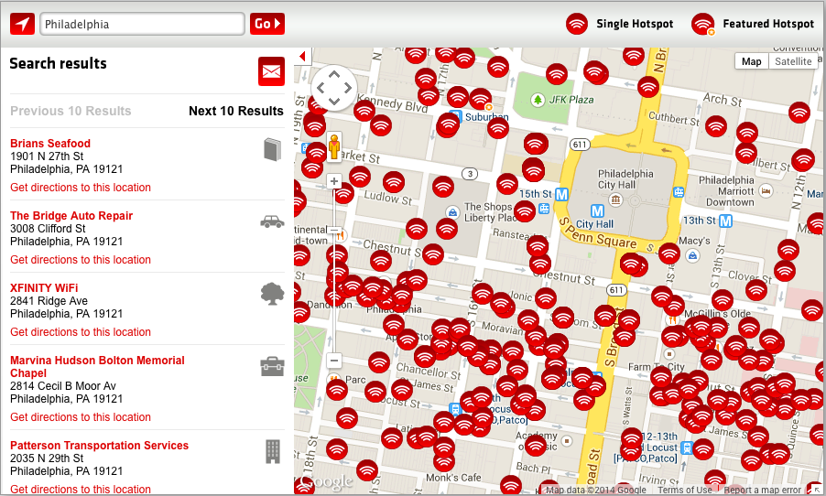
Background
The large coverage of Wi-Fi
Notes:
This is the web snapshot when I search the wifi hotpoint provided by a local internet provider. As you can see, people can access the wifi easily in the center city of Philadelphia. If we calculate the total amount of wifi hotpoint in this area, We should add more wifi hotpot. Let’s see, the wifi hotpot provided by other internet provider and the dealers in their store. it should be a much large number. It is safe to say that wi-fi has coverage most area.

Slide 3
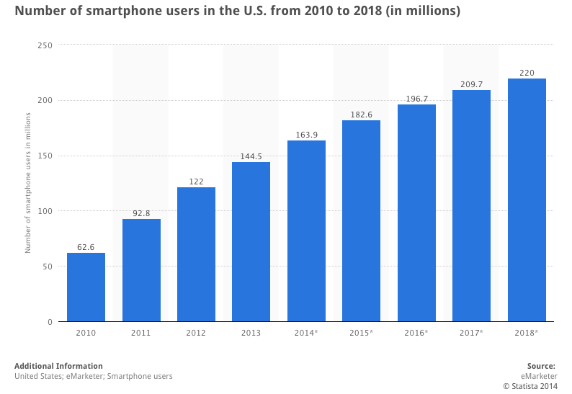
Background
The widespread usage of smartphone
Notes:
Also, according to the statistical data, the number of smart phone users increases from 62 millions to about 160 million in the past four years in the US. Now, every one out of two American people use smartphone. We can conclude that the smartphone is widely used in our daily life. At the same time, it is reported the estimated number of mobile phone users are 3.3 billion worldwide.

Slide 4
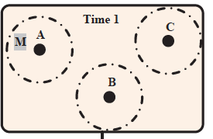
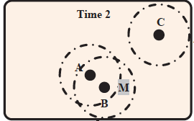
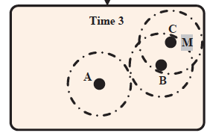
Mobile Social Networks
Concept of mobile social networks (MSNs):
  People walk around with smartphones and communicate with each other via Bluetooth or Wi-Fi when they are in the transmission range of each other.
Characters:
  No end-to-end connectivity
  Using store-carry-forward fashion
  Exploiting node’s mobility
Notes:
OK. Now，let’s introduce the concept of mobile social network. Currently, the widespread use and availability of wifi and smartphone create a huge number of contact opportunities among humans. That means people can walk around with smartphones and communicate with each other via Bluetooth or Wi-Fi when they are in the transmission range of each other. Let me explain it by using the example in this slide. If we regard a person as a dark point in this figure, and the dotted circle as the transmission range of smartphone, and once two nodes come into each other’s transmission range, they can contact with each other. In the first picture, no nodes can contact with each other. In the middle picture, node a can contact with node b. Then, at time 3. node b can contact with node c. The message is gradually forwarded from node a to node c.

Slide 5
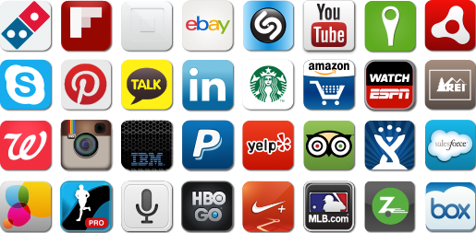
Content dissemination in MSNs
Characters:
  Personalized content dissemination
  Increasing content size
Publish/Subscribe (Pub/sub) paradigm is an excellent method for this type of content dissemination
Notes:
Because most content are user generated content in MSNs. the content dissemination in MSNs shows two trends. First, an enormous amount of content is generated in MSNs, but only a very small portion of users will be interested in receiving any of it. That is, some people are interested in a topic, however, other people are not interested in this topic. Second, the size of content increase greatly. We hope the audio, video, and high resolution images can be transmitted in MSNs. Publish/ Subscribe or (Pub/Sub) paradigm is an excellent method of this type of content dissemination.

Slide 6


Pub/Sub paradigm
Publisher
Broker
Subscriber
Notes:
Let’s introduce the pub/sub implementation in mobile social networks. There are three kinds of nodes, publisher, broker, and subscriber. Publisher are nodes who generate the message. Subscriber are nodes who are interested in receiving the messages. The brokers the relay nodes. Publisher do not need to calculate the routing path to specific receivers, called subscribers. Instead, send messages to brokers, without knowledge of where subscribers are. Similarly, subscribers express interest in one or more topics, and only receive messages that are of interest, without knowledge of what publishers there are.

Slide 7
Pub/Sub paradigm
Publisher
Broker
Subscriber
Notes:
To implement this type of paradigm, the subscribers first provide which kind of messages that they are interested to the brokers.

Slide 8
Pub/Sub paradigm
Publisher
Broker
Subscriber
Notes:
Could it be better, if you just use one arrow? Later, once any node want to publish some information, it becomes a publisher. And this message is sent to the broker first, when the publisher node encounter with broker nodes.

Slide 9
Pub/Sub paradigm
Publisher
Broker
Subscriber
Notes:
Then, later, once brokers encounter with subscriber nodes, the message are forwarded to the subscribers. And the communication is done.

Slide 10
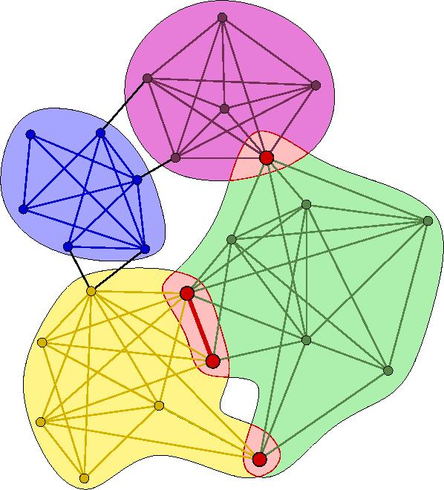
Network model
Bandwidth (denoted by B_{ij}) between node i and node j in MSNs can be calculated by :
  The average contact duration between nodes i and j,
  The average meeting time of nodes i and j,
Notes:
OK. Now, let’s introduce the network model used in this paper. In mobile social network, the nodes are not always connected with each other, but contact opportunistic. The average contact duration and the inter-meeting time between two nodes can be used to calculate the bandwidth between these two nodes. Basically, the longer average contact duration, and the shorter inter-meeting time will cause the larger bandwidth.

Slide 11
Network model
Evaluating the node’s ability as relay:
  The expected performance contribution (defined by E_{i}) of node i is defined by its bandwidth summation.
  Popular nodes and unpopular nodes:
  Popular nodes: E ≥
  Unpopular nodes: E <
Notes:
After we have the concept of bandwidth of nodes in MSNs, we can evaluate the node’s ability as relay. Without the global view of the whole network, it is hard to know how much contribution a node can provide, so we define a metric called the expected performance contribution to represent a node’s ability as the relay. The expected performance contribution is calculated by the bandwidth summation of this node. After we have the concept of expected performance contribution, we further define the popular and unpopular nodes as follows. The popular nodes are nodes whose expected performance contribution is same or larger than a presetting threshold beta. And the unpopular nodes are nodes whose expected performance contribution is smaller than beta, respectively.

Slide 12
Network model
Social characters of MSNs:
  Interested nodes (nodes subscribe the topic):
    nodes who are interested in receiving the message, and they would like to deliver the message without cost.
  Uninterested nodes (nodes do not subscribe the topic)
    nodes who are not interested in receiving the message, they can help to deliver the message with certain costs.
Notes:
Also, as we have mentioned in the introduction, the nodes in MSNs show some social characters. In this paper, we consider there exist two kinds of nodes in the network. The first type is called interested nodes, who are interested in receiving the message and they would like to deliver the message without cost. Another type of node is uninterested nodes, who are not interested in receiveing the message, but they can help to deliver the message with certain costs.

Slide 13
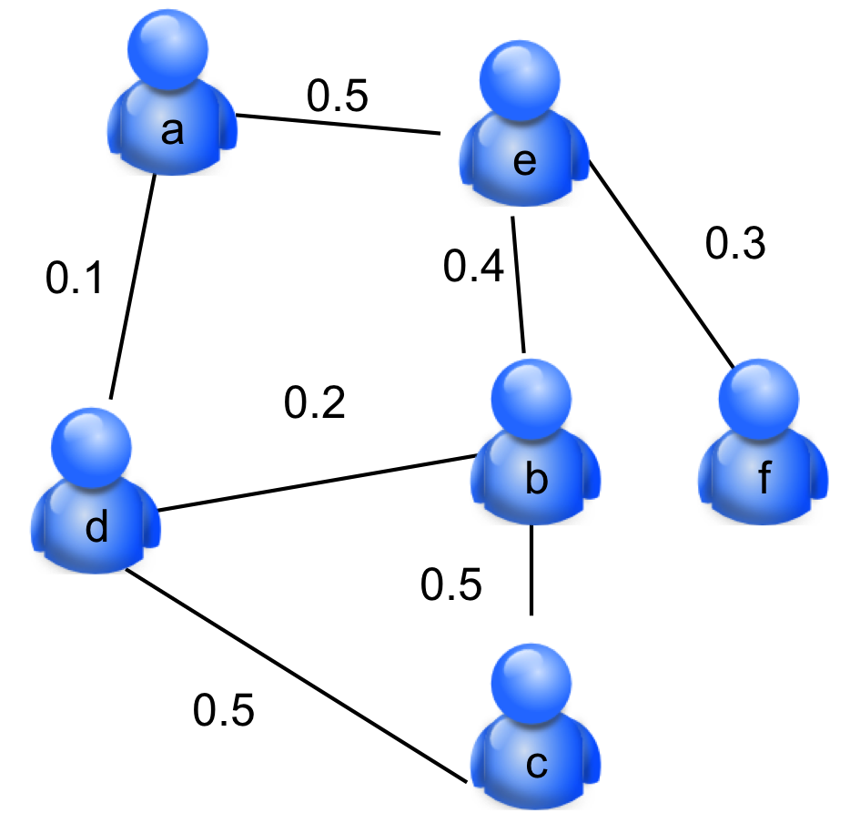
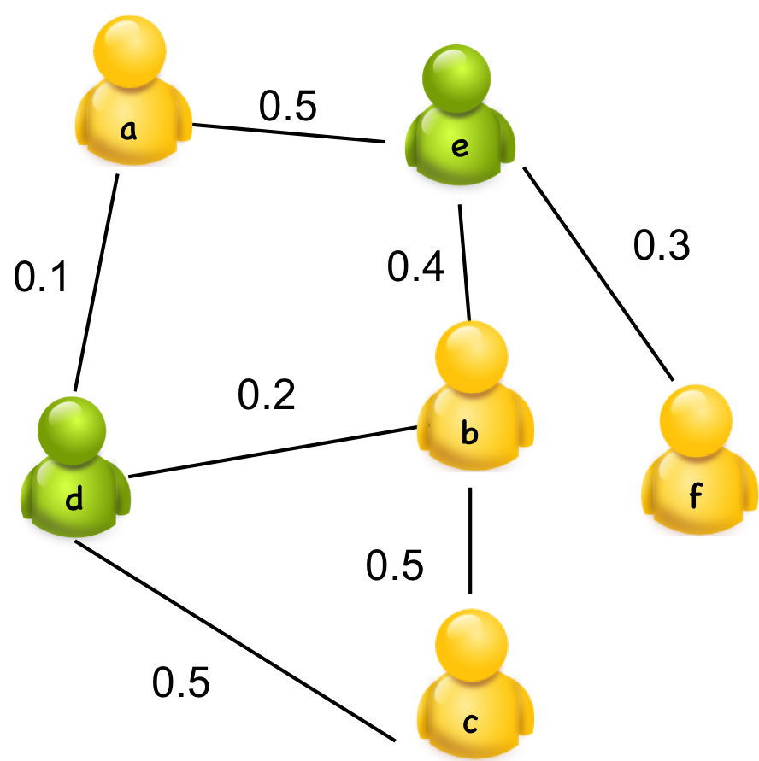
Network model
Combine the contact and social character together
    Contact character: heterogeneous bandwidth
    Social character: heterogeneous interest
      Different interests are represented by different colors
Contact graph
Combined graph
Notes:
As I have mentioned just now, the mobile social networks have information in two dimensions. First, nodes in mobile social network show heterogeneous bandwidth information. Second, nodes in mobile social networks show heterogeneous interest information. In the following of my presentation, I define the combined graph to represent the 2-dimension information in MSNs.
From the left picture, the value in the edge is the bandwidth information between two node. Then we add the social characters into the contact graph, and get the combined graph. As you can see from the slide, the nodes in yellow are interested in one topic, the nodes in green are interested in another topic.

Slide 14
Problem formulation
Mobile Pub/Sub content dissemination:
  Suppose a node (publisher) holds a message for many interested nodes (subscribers), how should we design a multicast scheme with local information so that:
    The message can be delivered to all the interested nodes.
    The usage of uninterested nodes is limited.
    The throughput of interested nodes is maximized.
Notes:
After I explain the network model, I will explain the problem in this paper. The problem in this paper is a mobile pub/sub content dissemination problem. Suppose a node holds a message for many interested nodes, how should we design a multicast scheme with local information so that the message can be delivered to all the interested nodes, and the usage of uninterested nodes is limited. At the same time, the throughput of interested nodes is maximized.

Slide 15

Problem illustration
An illustration to the mobile Pub/Sub content dissemination
0.5
a
e
Publisher:
Interest nodes : b and c, and f;
Uninterested nodes : d and e;
0.4
0.3
0.1
0.2
b
d
f
0.5
0.5
c
Notes:
This is an illustration of the network model, the node a is the publisher, and it would like to send messages to node b, c, and f who are interested in receiving messages from node a.

Slide 16
Problem illustration
An illustration to the mobile Pub/Sub content dissemination
0.5
a
e
Popular nodes: b, d and e;
Publisher:
Interest nodes : b and c, and f;
Uninterested nodes : d and e;
0.4
0.3
0.1
0.2
b
d
f
0.5
0.5
c
Notes:
Of course, we can use all the nodes as the relay to deliver message to the interested node, and its performance is the best. However, it also have the biggest costs, that two uninterested nodes are used.

Slide 17
Problem illustration
An illustration to the mobile Pub/Sub content dissemination
0.5
a
e
Popular nodes: b and e;
Publisher:
Interest nodes : b and c, and f;
Uninterested nodes : d and e;
0.4
0.3
0.1
0.2
b
d
f
0.5
0.5
c
Notes:
Another strategy is to merely use one uninterested nodes. In this example, we can just use one uninterested node e to send message to all interested node. It performance decrease a little, but only half uninterested node is used.

Slide 18
Challenges and ideas
Challenges:
    How can we use the local information to guarantee the delivery of message to all the interested nodes?
    How can we balance the performance and the cost?
Ideas:
    Locally construct a backbone (as the broker) for the publishers/subscribers.
    Interested nodes and popular nodes have higher priorities for constructing the backbone.
Notes:
So this challenges of our mobile pub/sub content dissemination problem are that how can we use the local information to guarantee the delivery of message to all the interest nodes, and how can we balance the performance and the resource consumption. To overcome these challenge, our ideas in this paper is to construct a backbone as the broker for the publishers and subscribers locally. The interested nodes and popular nodes have higher priorities for constructing the backbone. By adjust the threshold beta, we can adjust the resource consumption.

Slide 19
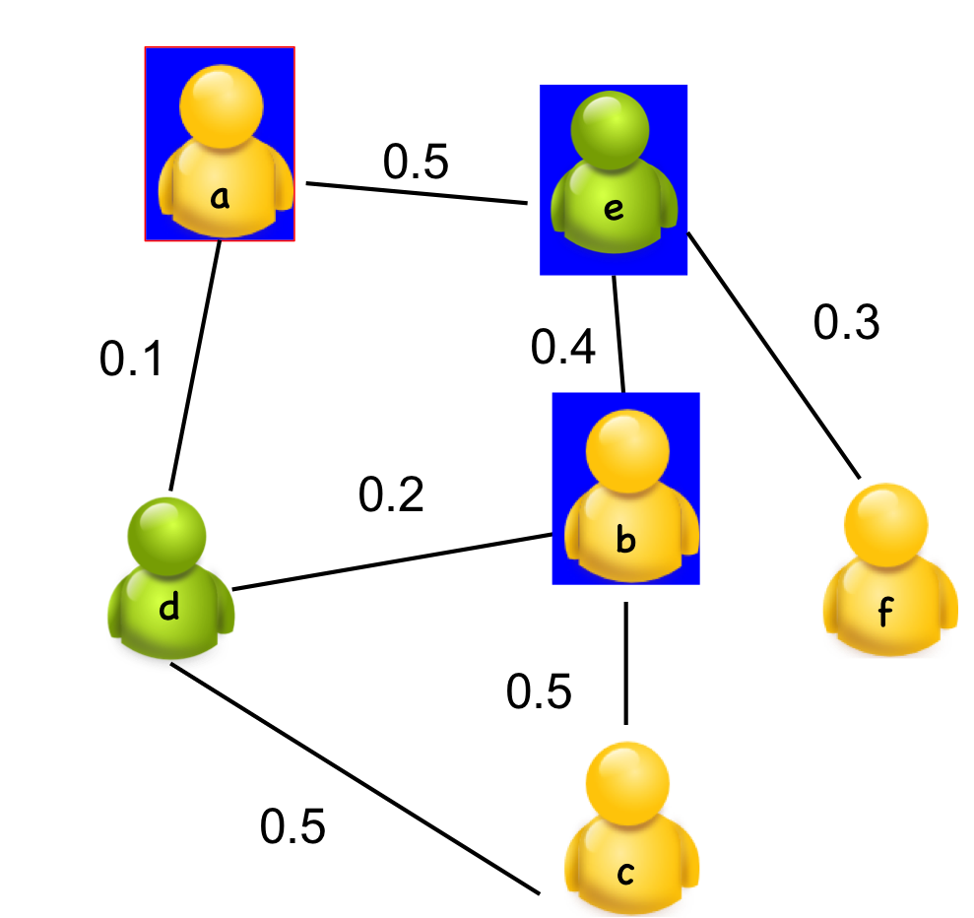
Connected dominating set
  The connected dominating set (CDS) is an efficient method to build the virtual backbone, which keeps the connectivity of the graph.
  A connected dominating set of a graph G is a set D of vertices with two properties:
Any node in D can reach any other node in D by a path that stays entirely within D. That is, D induces a connected subgraph of G.
Every vertex in G either belongs to D or is adjacent to a vertex in D. That is, D is a dominating set of G.
Notes:
The backbone should be able to reach all the nodes in the networks. The Connected dominating set or called CDS in the graph theory has the property to reach all the nodes in the network, and thus, we use the connected dominating set as the virtual backbone. An example of connected dominating set is shown in this the figure. The nodes in the blue rectangle are a connected dominating set. As you can see, any node in the network is either belongs to the CDS or is adjacent to a node in CDS.

Slide 20
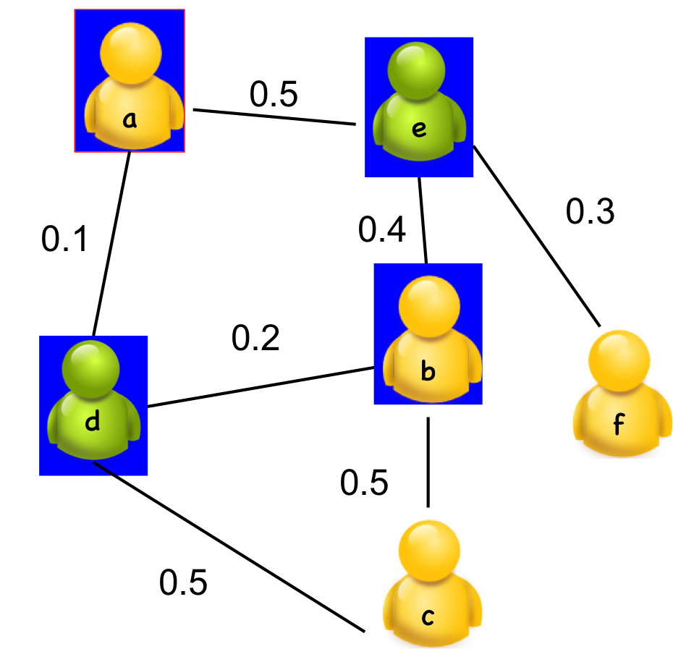
Build a CDS
Marking principle
  All the nodes in the network are unmarked initially, then through neighbor exchange about node’s neighbor set, The node which exists two unconnected neighbors are marked. and the marked nodes form a connected dominating set.
  Mark all the interested nodes and popular nodes.
Node | Neighbor set | Marking
a | d, e | Yes
b | c, d, e | Yes
c | b, d | No
d | a, b, c | Yes
e | a, b, f | Yes
f | e | No
a
b
c
d
e
Notes:
How can we build a CDS? Here, we introduce the marking principle to find a CDS locally. All the nodes in the network are unmarked initially, then through neighbor exchange about node’s neighbor set, the node which exists two unconnected neighbors are marked. and the marked nodes form a connected dominating set. Also, we will mark all the interested nodes and popular nodes in the end. As you can see, the neighbors od node d is node a, b, c ,which are not connected with each other. So node d is marked. The neighbors of node c is node d and b, and node d is connected with node b, so node c is not marked.

Slide 21
Prune the CDS
    Reduce the usage of the uninterested nodes
    Priority setting
  Interested nodes > uninterested nodes
  Nodes with higher expected bandwidth contribution has higher priority.
Rule k
  If all the neighbors of a node are covered by the neighbors set of a connected set of nodes with higher priorities, then this node can be pruned (Rule k needs only 3 hops local information).
  We never prune the interested nodes and popular nodes.
Notes:
Through marking, the size of CDS that we get might be large in general. So we want to further reduce the size of CDS by pruning principle. If we want to prune the CDS, we have to decide which node should be deleted by comparison. So we assign different priority to the nodes. In our method, we have two rules， first， the interest node have higher priority than uninterested node, the nodes with higher expected bandwidth contribution has higher priority than those with lower expected bandwidth contribution.
Then, we use Rule k to prune the uninterested nodes in the CDS. The idea of Rule k is If all the neighbors of a node are covered by a connected set of nodes with higher priorities, then this node can be pruned. By using rule K, we can get a CDS with only 3 hops local information. On the other hand, we never prune the interested nodes and popular nodes.

Slide 22
An illustration of pruning
When is larger than 0.8
0.5
0.5
0.5
A
A
E
A
E
E
0.3
0.4
0.3
0.3
0.1
0.4
0.1
0.1
0.4
0.2
0.2
0.2
B
B
B
F
D
F
D
F
D
0.5
0.5
0.5
0.5
0.5
0.5
C
C
C
Before pruning
After pruning
Notes:
This is an example for using rule k. Node d is not a popular node, and its neighbor set is node a, b, and c, which is covered by the node set, {a, e, b}. So node d is pruned from the connected dominating set built by marking principle. In this simple example, rule k reduce a half uninterested nodes.

Slide 23
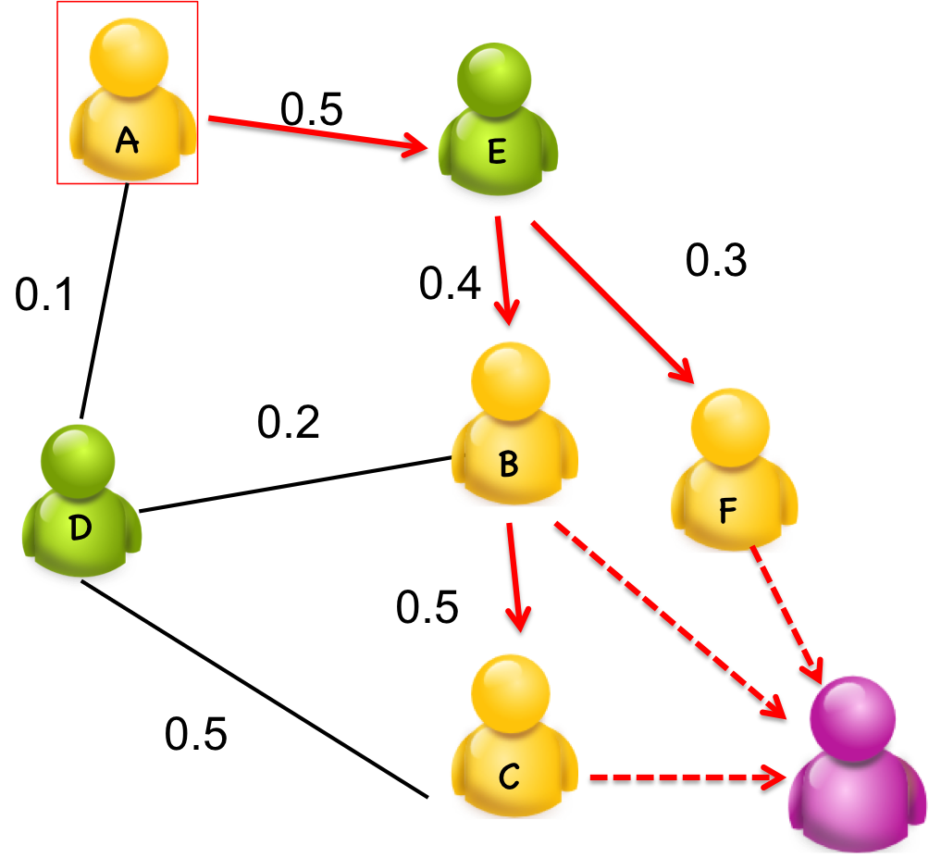
Extension
Through backbone information exchange, we can get a picture of the whole network.
The network throughput is defined by the max flow from the publisher to the virtual sink.
0.5
A
E
0.4
0.3
0.1
Publisher:
Interest nodes : : B and C, and F;
Uninterested nodes : : D and E;
Virtual sink:
0.2
B
D
F
0.5
0.5
∞
C
∞
∞
Notes:
(Should I add some thing here?) We can do a simple extension to our CDS. Through backbone information exchange, we can get a picture of the whole network. Then, we can calculate the max throughput from the publisher to all the subscribers in selected backbone. To do this, we can add a virtual think in the combined graph and create a edge between the subscriber and virtual sink. The bandwidth in these added edges are set to infinite. In this way, the network throughput is the same with the max flow from the publisher to the virtual sink. A classical max-flow algorithm can be used to solve it.

Slide 24
Simulation setting
Real trace:
    Infocom2006
      78 nodes
      The interest information is included in the questionnaire.
Synthetic dataset
      100 nodes
      The contact, bandwidth and interest information is generated randomly for 100 rounds.
Notes:
In the experiment, we use the Infocom2006 trace, which is widely used in MSNs to do simulation. Also, we generate synthetic dataset by ourselves. In Infocom2006 trace, the participants carry the homogenous devices called imote, and are asked to fill a questionnaire. The interest information can be get from the questionnaire. In our synthetic dataset, we just randomly generate the contact, bandwidth ,and interest information.

Slide 25
Algorithm comparion
Four algorithms:
  InterestSpread: consider the contact and social character:
  ContactOnly: only consider the contact character
  InterestOnly: only consider the social character
  Rand: randomly select the brokers

Slide 26
Real trace
The network throughput
The cost
The threshold
The threshold
In increase of , the performance decrease.
In the same , our algorithm achieve highest performance with the least consumption of uninterested nodes
Notes:
We compare our algorithm with three other algorithms, that is randomly selecting the nodes as virtual backbone. only using the interested node as the backbone, and only considering the contact information to selected the backbone. From the simulation, we find that along with the decrease of threshold beta, we prune more uninterested node, and the network throughput decrease. On the other hand, the percentage of interested node in the virtual backbone increase. When the beta is determined, our algorithm achieve better performance and consume fewer uninterested node at the same time.

Slide 27
Synthetic dataset
The network throughput
The cost
The threshold
The threshold
In increase of , the performance decrease.
In the same , our algorithm achieve highest performance with least consumption of uninterested nodes
In decrease of , the performance decrease.
In the same , our algorithm achieve highest performance with least consumption of uninterested nodes
Notes:
We get the similar result from the synthetic data. The results also show that our algorithm achieve better performance with fewer uninterested nodes.

Slide 28
Conclusions
We investigate a mobile pub/sub content dissemination problem in MSNs that exploits information about nodes’ contact and social characters.
A novel localized virtual backbone building method is proposed to balance the performance and cost.
Limiting the relay selection into the virtual backbone achieves a good trade-off between performance and cost.
Notes:
Here, let’s conclude my paper.

Slide 29
Thank you and Question
Ning Wang
ning.wang@temple.edu

