Slide 1

A General Data and Acknowledgement Dissemination Scheme in Mobile Social Networks Ning Wang and Jie Wu Temple University
Notes:
Good morning, every one. Thank you for your attention. Today, I will present my paper, Interestspread: an efficient method for content transmission in mobile social networks.

Slide 2
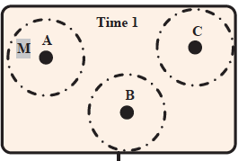
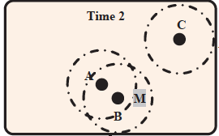
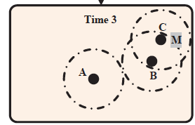
Mobile Social Networks
Concept of mobile social networks (MSNs):
People walk around with smartphones and communicate with each other via Bluetooth or Wi-Fi when they are within transmission range of each other.
Characters:
No end-to-end connectivity
Using store-carry-forward design
Exploiting node’s mobility
Notes:
OK. Now，let’s introduce the concept of mobile social network. Currently, the widespread use and availability of wifi and smartphone create a huge number of contact opportunities among humans. That means people can walk around with smartphones and communicate with each other via Bluetooth or Wi-Fi when they are in the transmission range of each other. Let me explain it by using the example in this slide. If we regard a person as a dark point in this figure, and the dotted circle as the transmission range of smartphone, and once two nodes come into each other’s transmission range, they can contact with each other. In the first picture, no nodes can contact with each other. In the middle picture, node a can contact with node b. Then, at time 3. node b can contact with node c. The message is gradually forwarded from node a to node c.

Slide 3


Content dissemination in MSNs
Two main problems:
Information dissemination
Mobile ad, News, Twitter, ……
Acknowledgement dissemination
Mobile trade, incentive mechanism
Notes:
Because most content are user generated content in MSNs. the content dissemination in MSNs shows two trends. First, an enormous amount of content is generated in MSNs, but only a very small portion of users will be interested in receiving any of it. That is, some people are interested in a topic, however, other people are not interested in this topic. Second, the size of content increase greatly. We hope the audio, video, and high resolution images can be transmitted in MSNs. Publish/ Subscribe or (Pub/Sub) paradigm is an excellent method of this type of content dissemination.

Slide 4

Content dissemination in MSNs
A scenario (mobile ad dissemination)
Information dissemination:
The merchant node would like to send the message (ads) to the potential receivers (customers) soon.
Acknowledgement dissemination:
After the receiver gets the message, it would send back a receipt (ack.) to the sender. If the merchant receives this ack., it might pay some money for relays.
The relay nodes would like to send the ack. to the merchant node soon.
Notes:
Because most content are user generated content in MSNs. the content dissemination in MSNs shows two trends. First, an enormous amount of content is generated in MSNs, but only a very small portion of users will be interested in receiving any of it. That is, some people are interested in a topic, however, other people are not interested in this topic. Second, the size of content increase greatly. We hope the audio, video, and high resolution images can be transmitted in MSNs. Publish/ Subscribe or (Pub/Sub) paradigm is an excellent method of this type of content dissemination.

Slide 5
Content dissemination in MSNs
A scenario (mobile ad dissemination)
Data and ack. dissemination problem:
We hope to find a scheme so that the ads can soon be sent to the receiver. At the same time, the relay can get the reward soon.
Notes:
Because most content are user generated content in MSNs. the content dissemination in MSNs shows two trends. First, an enormous amount of content is generated in MSNs, but only a very small portion of users will be interested in receiving any of it. That is, some people are interested in a topic, however, other people are not interested in this topic. Second, the size of content increase greatly. We hope the audio, video, and high resolution images can be transmitted in MSNs. Publish/ Subscribe or (Pub/Sub) paradigm is an excellent method of this type of content dissemination.

Slide 6
Network model
Message (data and acknowledgement):
Single-copy unicast scenario.
Time-to-live (TTL) is assigned.
Nodes:
Buffer is limited.
Notes:
OK. Now, let’s introduce the network model used in this paper. In mobile social network, the nodes are not always connected with each other, but contact opportunistic. The average contact duration and the inter-meeting time between two nodes can be used to calculate the bandwidth between these two nodes. Basically, the longer average contact duration, and the shorter inter-meeting time will cause the larger bandwidth.

Slide 7
Problem formulation
Priority buffer exchange problem:
Suppose two nodes encounter with limited contact opportunity: how should we design a buffer exchange scheme with local information so that:
It can satisfy the data and ack. delivery objective.
For example:
maximize the delivery ratio of data and ack.
minimize the delivery delay of data and ack.
Notes:
After I explain the network model, I will explain the problem in this paper. The problem in this paper is a mobile pub/sub content dissemination problem. Suppose a node holds a message for many interested nodes, how should we design a multicast scheme with local information so that the message can be delivered to all the interested nodes, and the usage of uninterested nodes is limited. At the same time, the throughput of interested nodes is maximized.

Slide 8
Challenges
How can we use the local information to evaluate each node’s ability?
keeping the message vs. exchanging the message
What’s the buffer exchange priority each time?
Which one should be exchanged first?
Data and ack. have different priorities.
Notes:
So this challenges of our mobile pub/sub content dissemination problem are that how can we use the local information to guarantee the delivery of message to all the interest nodes, and how can we balance the performance and the resource consumption. To overcome these challenge, our ideas in this paper is to construct a backbone as the broker for the publishers and subscribers locally. The interested nodes and popular nodes have higher priorities for constructing the backbone. By adjust the threshold beta, we can adjust the resource consumption.

Slide 9
Ideas
Relay selection criteria:
Strongly connected relationship with destination.
Weakly connected relationship with destination.
Priority buffer exchange:
Message should reach the destination before the deadline.
Combine the expected delivery time and TTL to assign priority.
Assign data and ack. different priorities.
Notes:
So this challenges of our mobile pub/sub content dissemination problem are that how can we use the local information to guarantee the delivery of message to all the interest nodes, and how can we balance the performance and the resource consumption. To overcome these challenge, our ideas in this paper is to construct a backbone as the broker for the publishers and subscribers locally. The interested nodes and popular nodes have higher priorities for constructing the backbone. By adjust the threshold beta, we can adjust the resource consumption.

Slide 10
Agenda
Relay selection criteria
Priority buffer exchange
Simulation

Slide 11
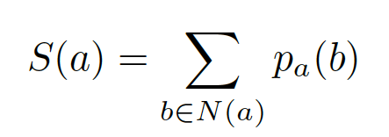

Relay selection Criteria
Two kinds of relationships:
Contact probability:
The encounter probability between node a and b is denoted as p_{a}(b). (One-hop information).
Social status:
The centrality of a node in the network.
(Multi-hop estimation) .
N(a) denotes node a ‘s neighbor set
Notes:
The backbone should be able to reach all the nodes in the networks. The Connected dominating set or called CDS in the graph theory has the property to reach all the nodes in the network, and thus, we use the connected dominating set as the virtual backbone. An example of connected dominating set is shown in this the figure. The nodes in the blue rectangle are a connected dominating set. As you can see, any node in the network is either belongs to the CDS or is adjacent to a node in CDS.

Slide 12
Relay selection Criteria
Is node b better than node a as a relay?
Contact probability: p_{a}(d) < p_{b}(d)
Transitive contact probability: p_{a}(c) p_{c}(d) > p_{b}(d)
Two-hop probability: 0.75 > 0.6
Multi-hop probability: larger than 0.75 > 0.6
Contact probability alone is not enough!
Notes:
Let’s introduce the pub/sub implementation in mobile social networks. There are three kinds of nodes, publisher, broker, and subscriber. Publisher are nodes who generate the message. Subscriber are nodes who are interested in receiving the messages. The brokers the relay nodes. Publisher do not need to calculate the routing path to specific receivers, called subscribers. Instead, send messages to brokers, without knowledge of where subscribers are. Similarly, subscribers express interest in one or more topics, and only receive messages that are of interest, without knowledge of what publishers there are.

Slide 13
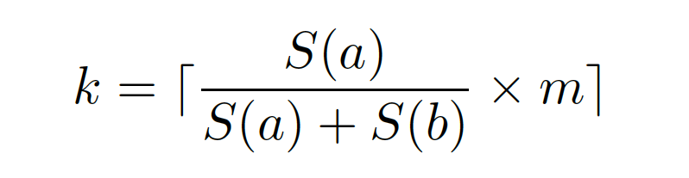
Relay selection Criteria
Compare operation:
Idea: social status has an influence on relay selection.
Order the messages based on the contact probability.
Only the m-k messages can be exchanged in each contact.
The higher the social status, the less the contact probability matters
m is the number of messages in node a’s butter
Notes:
How can we build a CDS? Here, we introduce the marking principle to find a CDS locally. All the nodes in the network are unmarked initially, then through neighbor exchange about node’s neighbor set, the node which exists two unconnected neighbors are marked. and the marked nodes form a connected dominating set. Also, we will mark all the interested nodes and popular nodes in the end. As you can see, the neighbors od node d is node a, b, c ,which are not connected with each other. So node d is marked. The neighbors of node c is node d and b, and node d is connected with node b, so node c is not marked.

Slide 14
Relay selection Criteria
Compare operation (cont’d)
An illustration about compare operation
encounter
a
b
Destination set | {d₁, d₂, …, d_{m}}
Contact probability | {p_{a}(d₁) , p_{a}(d₂) ,…, p_{a}(d_{m}) } | {p_{b}(d₁) , p_{b}(d₂) ,…, p_{b}(d_{m}) }
Probability difference vector | {∆₁, ∆₂,…, ∆_{m}} ∆_{i} = p_{a}(d_{i}) – p_{b}(d_{i})
kth element partition
Destination set | {d₁’ , d₂’,…, d_{k}’} | {d_{(k+1)}’, d_{(k+2)}’,…, d_{m}’}
Notes:
Through marking, the size of CDS that we get might be large in general. So we want to further reduce the size of CDS by pruning principle. If we want to prune the CDS, we have to decide which node should be deleted by comparison. So we assign different priority to the nodes. In our method, we have two rules， first， the interest node have higher priority than uninterested node, the nodes with higher expected bandwidth contribution has higher priority than those with lower expected bandwidth contribution.
Then, we use Rule k to prune the uninterested nodes in the CDS. The idea of Rule k is If all the neighbors of a node are covered by a connected set of nodes with higher priorities, then this node can be pruned. By using rule K, we can get a CDS with only 3 hops local information. On the other hand, we never prune the interested nodes and popular nodes.

Slide 15
Agenda
Relay selection criteria
Priority buffer exchange
Simulation

Slide 16
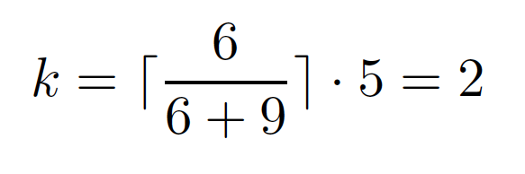
Relay selection Criteria
An example about the compare operation
From node a’s view:
Destination set | {d₁, d₂, d₃, d₄, d₅}
Social status | 6 | 9
Destination set | {d₁, d₂, d₃, d₄, d₅}
Social status | 6 | 9
Contact probability | {0.6, 0.2, 0.7, 0.4, 0.7} | {0.4, 1, 0.4, 0.5, 0.6}
Probability difference vector | {0.2, -0.8, 0.3, -0.1, 0.1}
Partition | {1, 3} | {2, 4, 5}
Notes:
Through marking, the size of CDS that we get might be large in general. So we want to further reduce the size of CDS by pruning principle. If we want to prune the CDS, we have to decide which node should be deleted by comparison. So we assign different priority to the nodes. In our method, we have two rules， first， the interest node have higher priority than uninterested node, the nodes with higher expected bandwidth contribution has higher priority than those with lower expected bandwidth contribution.
Then, we use Rule k to prune the uninterested nodes in the CDS. The idea of Rule k is If all the neighbors of a node are covered by a connected set of nodes with higher priorities, then this node can be pruned. By using rule K, we can get a CDS with only 3 hops local information. On the other hand, we never prune the interested nodes and popular nodes.

Slide 17
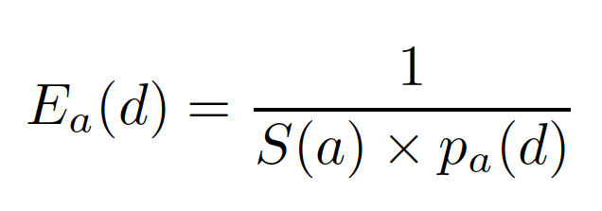
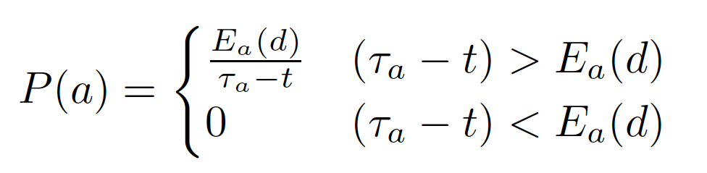
Priority buffer exchange
Within one type of message:
Estimate the expected delay
The effect of contact probability and social status:
Priority setting
Balance the expected delay and remaining time.
Notes:
Through marking, the size of CDS that we get might be large in general. So we want to further reduce the size of CDS by pruning principle. If we want to prune the CDS, we have to decide which node should be deleted by comparison. So we assign different priority to the nodes. In our method, we have two rules， first， the interest node have higher priority than uninterested node, the nodes with higher expected bandwidth contribution has higher priority than those with lower expected bandwidth contribution.
Then, we use Rule k to prune the uninterested nodes in the CDS. The idea of Rule k is If all the neighbors of a node are covered by a connected set of nodes with higher priorities, then this node can be pruned. By using rule K, we can get a CDS with only 3 hops local information. On the other hand, we never prune the interested nodes and popular nodes.

Slide 18



Priority buffer exchange
Between two types of messages:
The relative important factor is considered as .
In different scenarios, we have different
The delivery cost, such as message size, can also be embedded into
Two typical scenarios:
Data-first:
Acknowledgement-first:
Notes:
Through marking, the size of CDS that we get might be large in general. So we want to further reduce the size of CDS by pruning principle. If we want to prune the CDS, we have to decide which node should be deleted by comparison. So we assign different priority to the nodes. In our method, we have two rules， first， the interest node have higher priority than uninterested node, the nodes with higher expected bandwidth contribution has higher priority than those with lower expected bandwidth contribution.
Then, we use Rule k to prune the uninterested nodes in the CDS. The idea of Rule k is If all the neighbors of a node are covered by a connected set of nodes with higher priorities, then this node can be pruned. By using rule K, we can get a CDS with only 3 hops local information. On the other hand, we never prune the interested nodes and popular nodes.

Slide 19
Priority buffer exchange
An example
Buffer size of a node is 4. The number under the destination is the number of messages for that destination respectively.
Destination set | {d₁, d₂, d₃, d₄, d₅}
Partition | {1, 3} | {2, 4, 5}
Priority of the data | {5, 4, 3, 2, 1}
Priority of the acknowledgement | {0, 0.5, 1, 1.5, 0}
Notes:
This is an example for using rule k. Node d is not a popular node, and its neighbor set is node a, b, and c, which is covered by the node set, {a, e, b}. So node d is pruned from the connected dominating set built by marking principle. In this simple example, rule k reduce a half uninterested nodes.

Slide 20
Priority buffer exchange
An example (cont’d)
Sum of delivery probability
Node a: 1.4
Node b: 1.9
Sum of delivery probability
Node a: 2.2
Node b: 2.6
Notes:
This is an example for using rule k. Node d is not a popular node, and its neighbor set is node a, b, and c, which is covered by the node set, {a, e, b}. So node d is pruned from the connected dominating set built by marking principle. In this simple example, rule k reduce a half uninterested nodes.

Slide 21
Extension
Multiple-copy single destination
Difference: A node can see the duplicated message many times.
Idea: Priority decreases as the encounter time increases.
Solution: The priority of data i is determined by a tuple <times, P(i)>.
Notes:
In the experiment, we use the Infocom2006 trace, which is widely used in MSNs to do simulation. Also, we generate synthetic dataset by ourselves. In Infocom2006 trace, the participants carry the homogenous devices called imote, and are asked to fill a questionnaire. The interest information can be get from the questionnaire. In our synthetic dataset, we just randomly generate the contact, bandwidth ,and interest information.

Slide 22
Agenda
Relay selection criteria
Priority buffer exchange
Simulation

Slide 23
Simulation setting
Synthetic dataset
20 nodes
Uniform mobility distribution
5 source nodes and 5 destination nodes.
Real trace (Infocom2006):
78 mobile nodes + 20 stable nodes
10 source nodes and 10 destination nodes.
Notes:
In the experiment, we use the Infocom2006 trace, which is widely used in MSNs to do simulation. Also, we generate synthetic dataset by ourselves. In Infocom2006 trace, the participants carry the homogenous devices called imote, and are asked to fill a questionnaire. The interest information can be get from the questionnaire. In our synthetic dataset, we just randomly generate the contact, bandwidth ,and interest information.

Slide 24
Algorithm comparison
Algorithms:
As for relay selection, we compare our algorithm with 1-hop and 2-hop routing.
As for the priority, we compare our method with the deadline
The combination from above is 6 algorithms.

Slide 25
Synthetic dataset
Delivered # of data
Delivered # of ack.
The alpha
The alpha
Along with the increase of alpha, the message delivery ratio decreases, and the ack. delivery ratio increases.
Our proposed algorithm achieves the highest delivery ratio
Notes:
We get the similar result from the synthetic data. The results also show that our algorithm achieve better performance with fewer uninterested nodes.

Slide 26
Real trace
Delivered # of data
Delivered # of ack.
The alpha
The alpha
Along with the increase of alpha, the message delivery ratio decreases, and the ack. delivery ratio increases.
Our proposed algorithm achieves the highest delivery ratio
Notes:
We get the similar result from the synthetic data. The results also show that our algorithm achieve better performance with fewer uninterested nodes.

Slide 27
Simulation summary
Simulation results:
Delivered ratio increase with TTL.
The factor alpha can adjust the priority well.
Algorithm:
Relay selection
Proposed scheme > 2-hop > 1-hop
Priority setting
Proposed scheme > deadline driven scheme
Notes:
Here, let’s conclude my paper.

Slide 28
Conclusions
We investigate a general scheme for the message dissemination problem in MSNs, considering the time constraint and buffer constraint.
A novel localized buffer exchange scheme is proposed to maximize the achievable objective.
Two dimensions are jointly considered to evaluate the relay
The message type, expected delivery time, and deadline are considered to assign priority.
Notes:
Here, let’s conclude my paper.

Slide 29
Thank you, any Questions?
Ning Wang
ning.wang@temple.edu

