Slide 1

Opportunistic WiFi Offloading in a Vehicular Environment: Waiting or Downloading Now?
Ning Wang and Jie Wu
Temple University
Notes:
Good afternoon, every one. My name is Ning Wang. From the Temple University. Today, I will present my paper, Opportunistic WiFi Offloading in a Vehicular Environment: Waiting or Downloading Now?

Slide 2
Agenda
Motivation
Model and problem formulation
Theoretical analysis
The idea of the proposed algorithm
Performance evaluations
Notes:
My talk will be mainly divided into five parts. First, I would like to provide some motivation about our research. Why we conduct research in this topic. Then, I will briefly talk about the novelty of our work. Then I will introduce the model and problem formulation. After that, it is the basic idea about the proposed algorithms in this paper. The last part is the performance evaluation

Slide 3
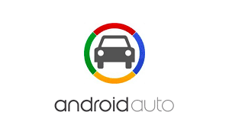
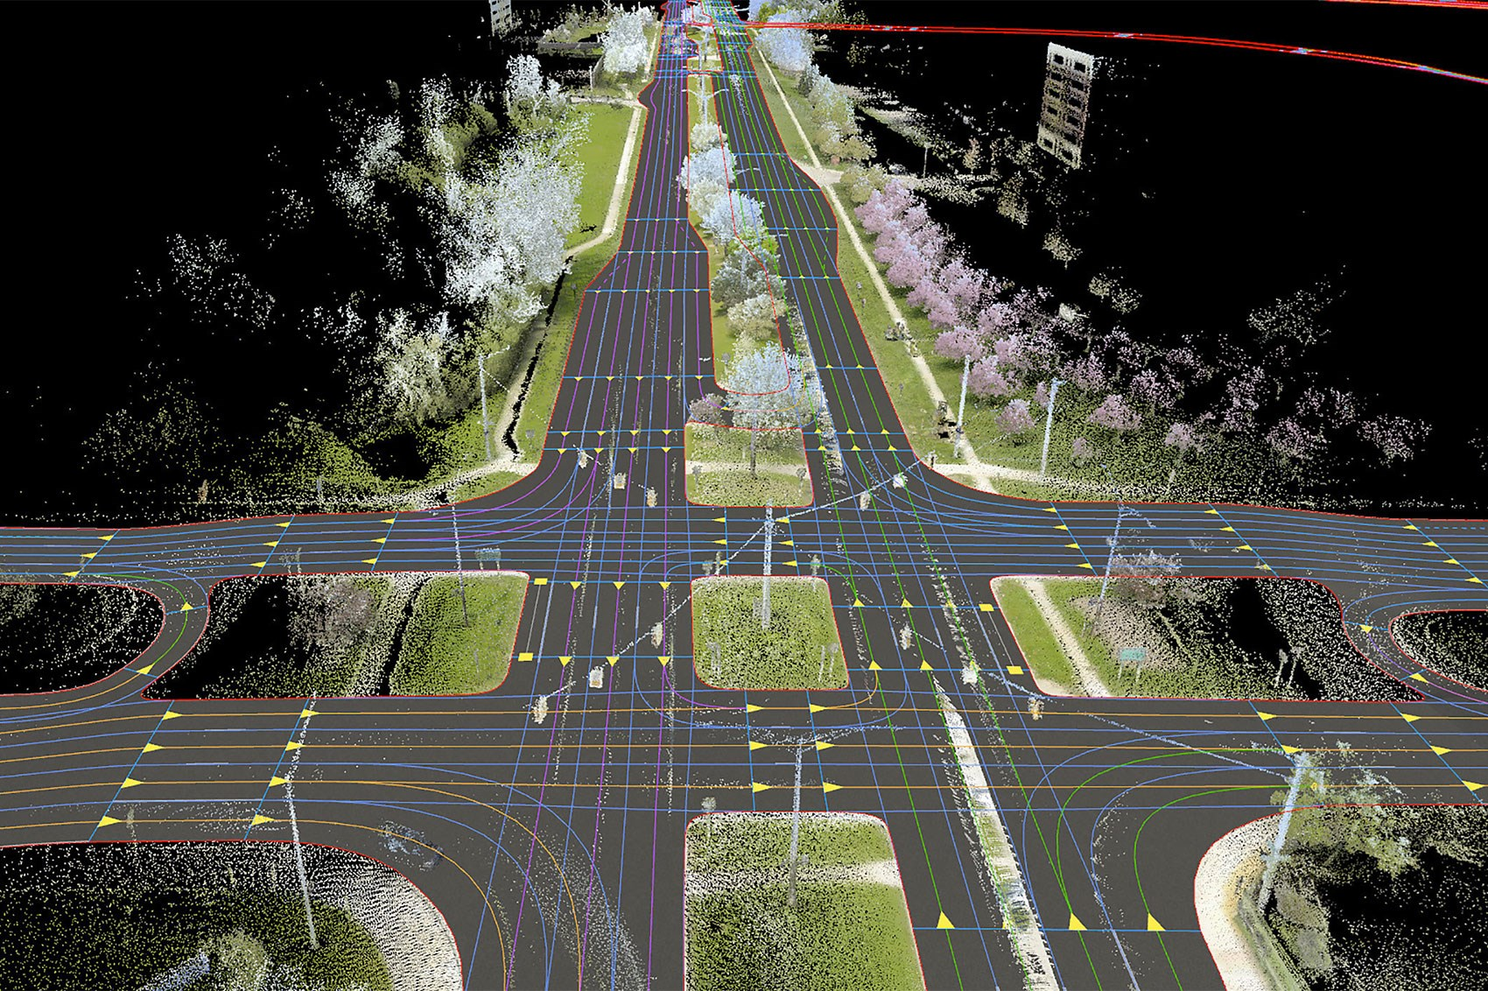
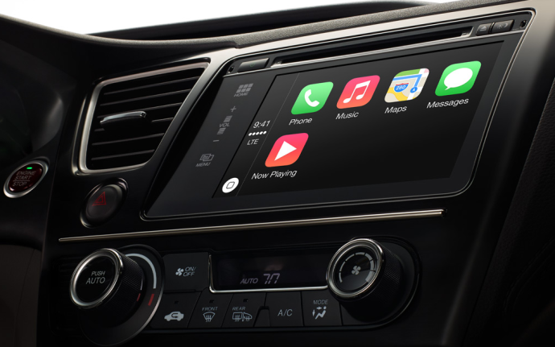
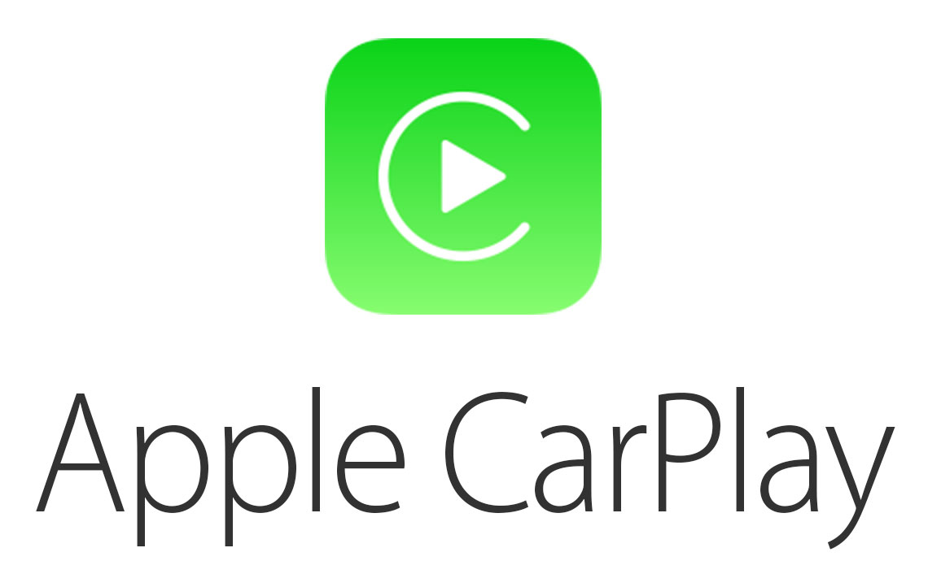
Motivation
  Data downloading during the driving
    Self-driving vehicles
      Traffic and safety information
      High-resolution digital maps
    On boarding applications
      Video, music, social networks
      ……
Notes:
In recent years, the demand for high-speed mobile Internet services has increased dramatically. People expect to connect to the Internet anywhere and anytime, including within their own cars.
Therefore, content distribution to vehicular users through wireless network access is very important topic. It can greatly improve the road safety and enhance driving experience.
The following are two major motivational examples.
First, the self-driving car. The self-driving car might need to communicate with center server frequently to retrieve the traffic and safety information in the coming trajectory to further optimize the route. Besides, the self-driving car relies on the high-resolution digital maps to guide the driving in the new place.
The another example. The driving entertainment. Take myself as an example, If I cannot check my email or the updates in my social websites, I will feel stressful. Basically, the contents in driving include electronic newspapers, advertisements, movie clips, etc. Leading technology companies like Google and Apple all developed the standards for automobile applications. Some current research includes the streaming video and video call or video conference.

Slide 4
Related works
Opportunistic offloading
  Mobile Data Offloading through Opportunistic Communications and Social Participation. (TMC 2012)
User’s satisfaction decay with time
  Toss: Traffic offloading by social network service-based opportunistic sharing in mobile social networks (INFOCOM 2014)
Roadside Units deployment
  On-road ads delivery scheduling and bandwidth allocation in vehicular cps (INFOCOM 2013)
Notes:
Before talking about our work, let me introduce some related works. It has been a while that people try to use the opportunistic contact opportunity to send and download data. This research field is called Delay Tolerant network, or opportunistic network. However, in these work, they only use the opportunistic contact without using the cellular network.
The latter research (TOSS Infocom 2014) found that user might be unhappy for the delay. They propose the idea to minimize the network resource consumption, however the data can be delivered to the user just before the user would like to get it.
In the vehicle network, some research propose problem about the RSUs deployment. Therefore, the RSUs can send the data to the passing-by vehicles. However, deploying RSUs takes money. And there are many existing wifi access points deployed in the reality. In additions, in the RSUs deployment problem, they assume that the RSUs can always have enough bandwidth, so that they can send the whole data to the vehicles. This assumption might not be true, if we considering the increasing size of data, and the future video stream in the vehicle network.

Slide 5
Motivation
A hybrid network
    Roadside Units with WiFi (RSUs).
      Limited coverage, high bandwidth, cheap
    Cellular network
      Full coverage, low bandwidth, expensive.
Delay-sensitive data downloading
    Delay sensitive data
      Incoming call, safety information update
    Delay non-sensitive data
      Music, social network update, etc.
Notes:
To address the aforementioned content dissemination problem, first, we should have a practical network model. Currently, the most promising network model is that the vehicles are in a hybrid network, where there are two different interfaces, WiFi and cellular . The roadside units, also called (RSUs), which can provide the WiFi access to the nearby vehicles. It has a relatively high bandwidth, and the price for wifi is cheap. In reality, we do not pay at most of times. The disadvantage of the RSU is that its coverage is limited. Therefore, if the vehicle would like to retrieve data from the RSUs, it may need to wait for a while.
On the other hand, the vehicle can retrieve the data from the cellular network from anywhere an anytime. The cellular network provide the full coverage . However, it has its disadvantage. Compared with the RSUs, its bandwidth is limited. And it is expensive.
Then, let us talk about the data downloading in a real scenario. There are many different apps in your smartphones. Some of the data must be downloaded to the vehicle right away, such as the incoming call, safety information update and so on. However, some other data can be delayed for a while without having an influence about the user’s experience. Such applications are like music , social network updates, and so on.
Since the vehicle faces such a hybrid network, and the different apps have different delay requirements. A fundamental problem is that how can we take advantage of the hybrid network, while considering the delay requirement of different apps.
To our best knowledge, we are the first to considering the the data downloading strategy in the vehicle network.

Slide 6
Network model and Problem
    With the increasing of data size
      A trade-off between the cost and delay
      from the Cellular network: No risk but lead to a high cost.
      from the RSUs network : Risk, high delay, but cheap
Notes:
OK, let me summarize the challenge of the proposed problem. There exists a trade-off between the cost and delay. If we always download data from the cellular network, there is no risk, but we might need to pay a lot of money. On the other hand, if we always download data from the opportunistic encountered RSUs, there exists risk and delay. However, we might be able to save money.
Then, what should we do to balance the cost and delay. A natural idea is that we can download a part of data, after we get the data downloading request. The size of this part of data is related to the delay requirement of the apps. Then, we can wait for the RSUs to download the remaining data. However, sometimes, we cannot meet a RSU after a certain time period. Then we might need to re-download part of data from the cellular.

Slide 7
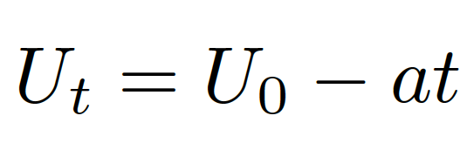
Network model and Problem
Maximize the user’s satisfaction
    If the cost is high, the user’s satisfaction will be low.
    If the delay is large, the user’s satisfaction will be low.
  Utility model
  Cost model
    The price of downloading from cellular networks is c higher per bit than the price of downloading from RSUs.
The sensitivity to the delay
Notes:
How to balance the delay and cost trade-off. In this paper, we unify the delay and the cost as unity, it represents the user’s satisfaction. Therefore, if the cost is high, the user’s satisfaction will be low. On the other hand, if the delay is large, the user’s satisfaction will be low.
Here, we assume that data’s utility decays in a linear manner. The decay speed is decided by the parameter a. Therefore, for a safety-related apps, the value of a should be large. On the other hand, for the social apps, the value of a should be small. Besides, we assume that the price of downloading from cellular network cost c more per bit than that of the RSUs.

Slide 8
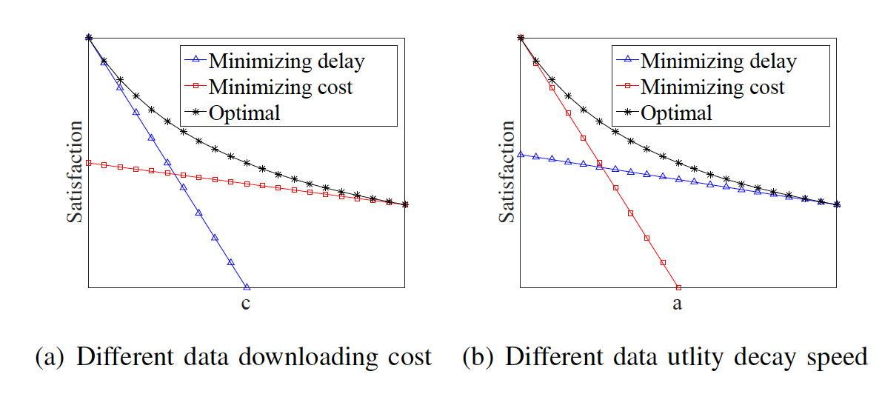
Challenges
Simple downloading strategies.
  only get good result in certain scenarios.
Notes:
Here, we did some experiments in different scenarios,. Where we have three different strategies. The first one is called minimizing delay strategy, in this strategy, the vehicle will keep downloading data from the cellular network. The second strategy is that the vehicle only downloads data through RSUs. The optimal strategy is got by use the brute-force search.

Slide 9
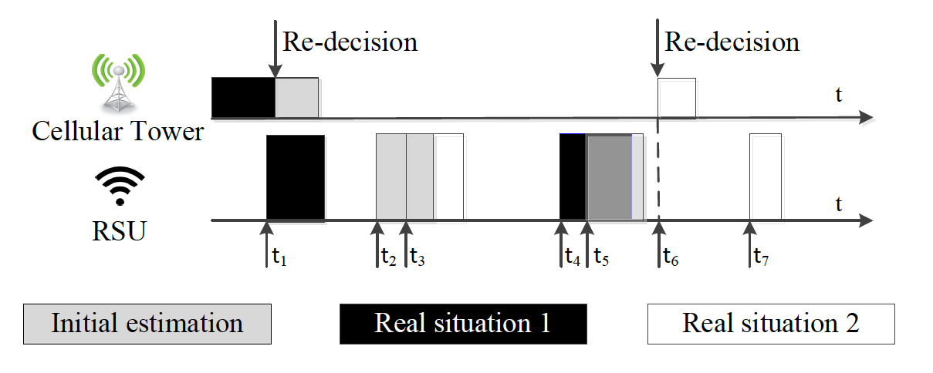
Challenges
How to predict the expected utility through RSUs?
When to adjust your downloading strategy?
Notes:
After talking about the problem and the model, we can talk about the challenges of it.
The major challenge is that how can we predict the expected utility through RSUs, since it is opportunistic encountered. Another challenge is that if the real situation is not the same as the original prediction, how to adjust our downloading strategy. Here is some example.

Slide 10
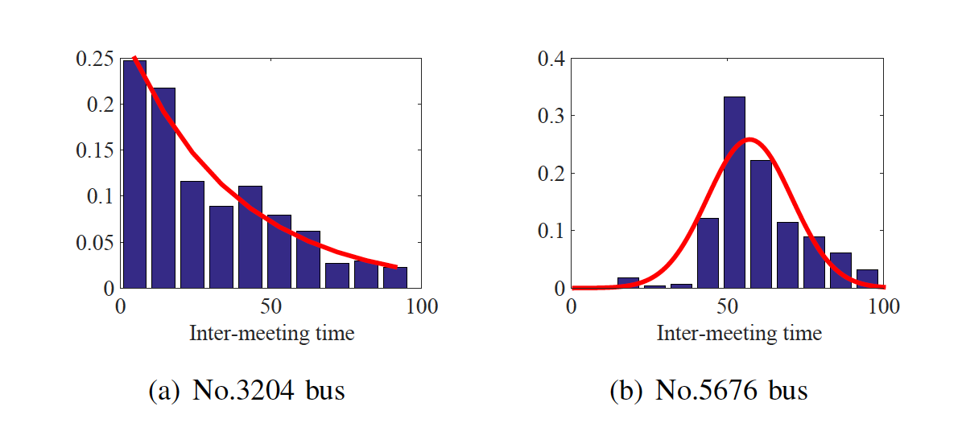
Real trace
Inter-meeting distribution between a vehicle and RSUs in Diesel Bus Dataset:
Notes:
First, we try to analysis the inter-meeting distribution in a real data set. This slide shows the results from the two buses in this data set. From the left figure, we can find out that sometimes, the longer we wait, the lower probability that we can meet a RSU. From the right figure, we can find out that sometimes, we need to wait for a while, then, we might have a high probability to meet a RSU.
To model these two cases, we use the exponential distribution between the vehicle and RSUs and the Gaussian distribution.

Slide 11
One RSU
Exponential inter-meeting distribution
  Memoryless property
Theorem: For exponential distribution of the encountering time between the vehicle and RSUs, the vehicle only needs to do the decision once: download from the cellular network right now, or never. The criterion of choosing the cellular network right now is a/2λ > c.
Notes:
For the first situation, we model the RSUs inter-meeting as the exponential inter-meeting distribution. That is, the vehicle has a high probability to meet a RSU in a short period. However, the vehicle has a low probability to meet a RSU, if it has wait for a long time.
It might be the situation, when a vehicle is driving out of the center city. In such a case, we only need to do decision once.

Slide 12
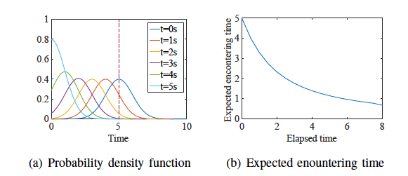
One RSU
Gaussian inter-meeting distribution
  Theorem: For Gaussian distribution of the encountering time between the vehicle and RSUs, the criterion for choosing the cellular network right now is
Notes:
In the Gaussian inter-meeting distribution, along with the time, the probability that the vehicle meets the RSU increases. As you can see here.

Slide 13
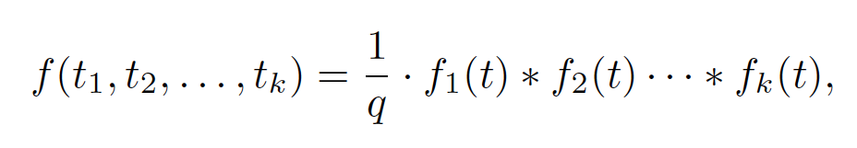
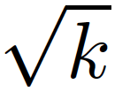
multiple RSUs
Dependent inter-meeting time in RSUs
  Meet one RSU earlier (later), high probability to meet the following RSUs earlier (later)
Theorem: the expected meeting time with kth RSUs will not change, however the estimation uncertainty will increase times.
Notes:
Besides, in the reality, there are multiple RSUs, how should we model the

Slide 14
Proposed solution
Adaptive algorithm
  RSUs meeting prediction by historical information.
  Jointly consider the expected meeting time with RSUs and the uncertainty to do downloading strategy.
  Re-decision based on the actual situation.
Notes:
Based on the

Slide 15
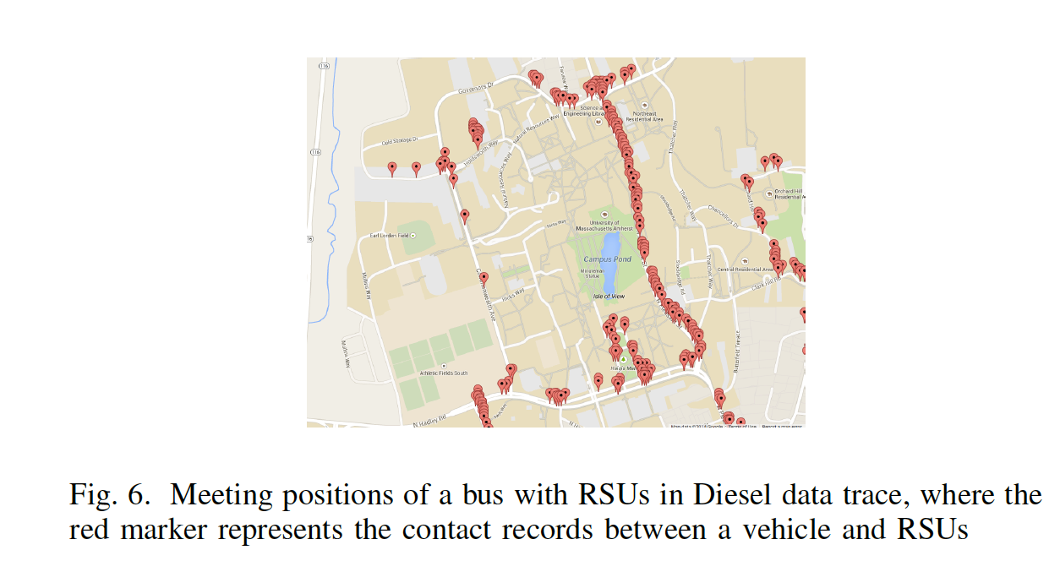
Performance evaluation
Trace information
  Synthetic trace
  UMass Diesel Trace
          40 Buses
          47 RSUs
Experiment setting
    Average data size 6MB
    Different cost setting
    Different decay speed
Meeting positions of a bus with RSUs in Diesel data trace, where the red marker represents the contact records between a vehicle and RSUs
bandwidth | Cellular | RSUs
Kbps | 20 | 100
Notes:
The reason that we use such a low speed is that the wireless connection is usually poor in the moving scenario.

Slide 16
Algorithm comparison
Algorithms:
  Minimizing delay: Keep downloading data from cellular network.
  Minimizing cost: Always wait for the RSUs
  Optimal solution through brute-force
  Proposed algorithm

Slide 17
Experiment result
Notes:
We get the similar result from the synthetic data. The results also show that our algorithm achieve better performance with fewer uninterested nodes.

Slide 18
Experiment result
Notes:
We get the similar result from the synthetic data. The results also show that our algorithm achieve better performance with fewer uninterested nodes.

Slide 19
Experiment result
Notes:
We get the similar result from the synthetic data. The results also show that our algorithm achieve better performance with fewer uninterested nodes.

Slide 20
Conclusions
We investigate the data downloading strategy from a hybrid network (RSUs and Cellular networks), considering the downloading cost and delay.
We analyze two theoretical meeting distributions and propose an adaptive scheme.
RSUs inter-meeting prediction.
  Inter-meeting time and uncertainty
Future work: the content sharing between vehicles
Notes:
Here, let’s conclude my paper.

Slide 21
Thank you!
Ning Wang
ning.wang@temple.edu

