Slide 1

The 21st Annual IFIP International Conference on Network and Parallel Computing（NPC 2025）
Cloud-Guided LLM Quantization for Resource-Constrained Edge Devices
Qinxiao Deng¹, Tianfu Pang¹, Benteng Zhang¹,Nie Bingbing², Xiaoming He³, Yingchi Mao¹,Jie Wu⁴
¹ College of Computer Science and Software Engineering, Hohai University, Nanjing, China
² Huaneng Lancang River Hydropower Inc., China
³ College of Internet of Things, Nanjing University of Posts and Telecommunications,
Nanjing, China
⁴ Center for Networked Computing, Temple University, Philadelphia, USA
November 15, 2025
Notes:
Good afternoon, everyone. Thank you for being here.
My name is [ ], and on behalf of my co-authors from Hohai University, Huaneng Lancang River Hydropower, Nanjing University of Posts and Telecommunications, and Temple University,
I am pleased to present our paper: 'Cloud-Guided LLM Quantization for Resource-Constrained Edge Devices.’
Our work focuses on a critical challenge: enabling powerful Large Language Models to run efficiently on small, low-power devices.

Slide 2



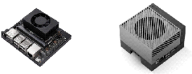
1.1 Background
Dialogue Generation
Information Retrieval
Intelligent Decision-Making
Edge device (ED)
Large Language Model (LLM)
GPT3 (175B)
Storage:350 GB(FP16)
Insufficient Computing Power
Storage Capacity Limitations
Model Compression
Edge Deployment
Solution
Jetson AGX Orin
Jetson Orin NX
Notes:
Large Language Models, or LLMs like GPT-3, are incredibly powerful. They can generate dialogue, retrieve information, and assist in intelligent decision-making.
However, their size is a major bottleneck. A model like GPT-3 has 175 billion parameters and requires about 350 gigabytes of storage.
This makes it impossible to deploy them directly onto edge devices such as NVIDIA's Jetson series, which have insufficient computing power and limited storage.
Our goal is to bridge this gap through model compression, enabling effective edge deployment.

Slide 3
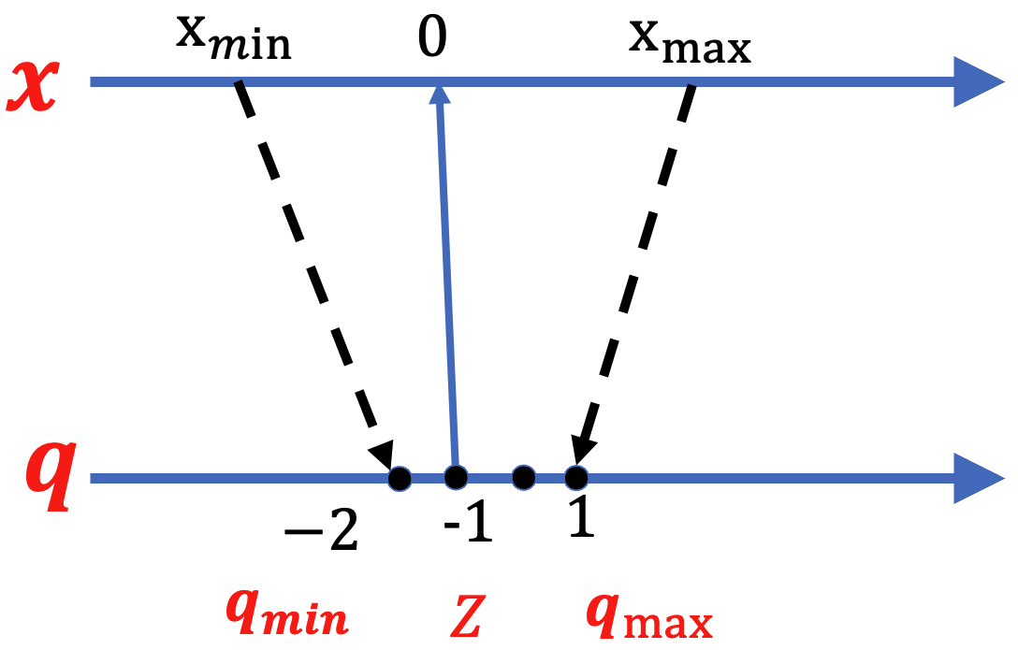
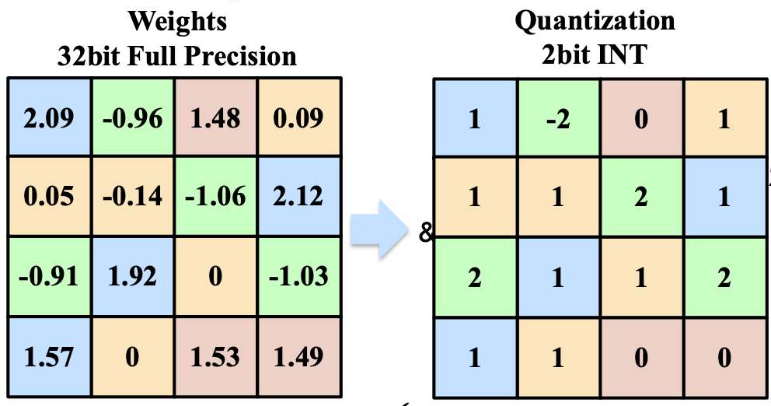


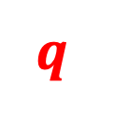


1.2 What is Quantization?
Model Compression
Pruning
Distillation
Quantization
Post-Training Quantization(PTQ)
Pruning
Eliminate the unimportant weights
Requires Retraining the Model(High Cost)
Distillation
Transfer large-model knowledge to student model
The student model will still exceed the device's burden
Quantization
Quantization-Aware Training(QAT): Requires Retraining the Model (High Cost)
Post-Training Quantization(PTQ): Quantize pre-trained floating-point models
❌
$$x$$
Float
❌
$$q=clamp\left(\left[\frac{x}{s_{x}}\right]+z,{0,2}^{N}−1\right)$$
$$X=s_{x}\left(q−z\right)$$
❌
$$s_{x}=\frac{q_{max}−q_{min}}{2^{N}−1}$$
$$q$$
Quant
✔
Notes:
Pruning and distillation are effective but often require expensive retraining of the model.
We focus on a more efficient method: Quantization.
Quantization reduces model size by converting high-precision numbers, like 32-bit floating points, into low-precision integers, such as 2-bit integers.
Specifically, we utilize Post-Training Quantization (PTQ), which operates on an already-trained model. This avoids the high cost and time of retraining, making it a highly practical approach for real-world applications.

Slide 4

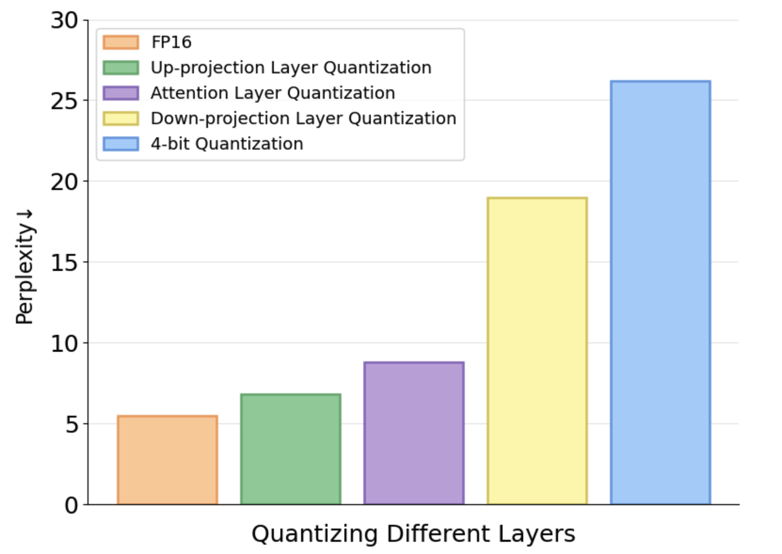
1.3 The Challenges of PTQ(Post Training Quantization)
Challenge1: Quantization below 8-bit causes severe accuracy loss
Challenge2: Outliers across channels and tokens in KV cache quantization
Challenge3: Different modules exhibit varying sensitivity to quantization
They rely on global static equivalent transformation.
Inability to precisely adapt to diverse channel distributions → unhandled outliers in some channels.
4-bit LLM quantization: severe accuracy loss.
Outliers cause severe accuracy degradation in low-bit quantization
ZeroQuant[1]、SmoothQuant[2]、
AWQ [3]、OS+[4] perform special handling for outliers
KVquant[5]、IntactKV[6] smooth key-value outliers via static equivalent parameters
Fail to capture dynamic token/channel distributions.
[1] Yao Z, Yazdani Aminabadi R, Zhang M, et al. Zeroquant: Efficient and affordable post-training quantization for large-scale transformers. In: NeurIPS, pp. 35: 27168-27183 (2022).
[2] Xiao G, Lin J, Seznec M, et al.: Smoothquant: Accurate and efficient post-training quantization for large language models. In: PMLR, pp. 38087-38099 (2023).
[3] Ji Lin, Jiaming Tang , et al. AWQ: activation-aware weight quantization for LLM compression and acceleration. CoRR, abs/2306.00978.
[4] Xiuying Wei, Yunchen Zhang, Yuhang Li, et al.: Outlier suppression+: Accurate quantization of large language models by equivalent and effective shifting and scaling. In: Empirical Methods in Natural Language Processing, pp. 1648–1665 (2023).
[5] Hooper C, Kim S, Mohammadzadeh H, et al. Kvquant: Towards 10 million context length llm inference with kv cache quantization. In NeurIPS, pp. 37: 1270-1303(2024).
[6] Liu R, et al. IntactKV: Improving Large Language Model Quantization by Keeping Pivot Tokens Intact. In: ACL 2024.
Notes:
PTQ faces significant challenges, especially at very low bit-widths like 4-bit.
Firstly, quantization below 8-bit can cause severe accuracy loss. This is largely due to 'outliers'—a few extreme values in the weights that disrupt the quantization process.
Secondly, these outliers also appear in the KV cache, which is vital for the model's attention mechanism.
Finally, different layers of the model react differently to quantization, as shown in the chart. Existing methods attempt to solve these issues, but they often rely on static transformations and fail to adapt to dynamic data distributions, leaving performance gaps.

Slide 5
Outline
1. Introduction
2. Approach
3. Experimental Evaluation
4. Conclusion

Slide 6
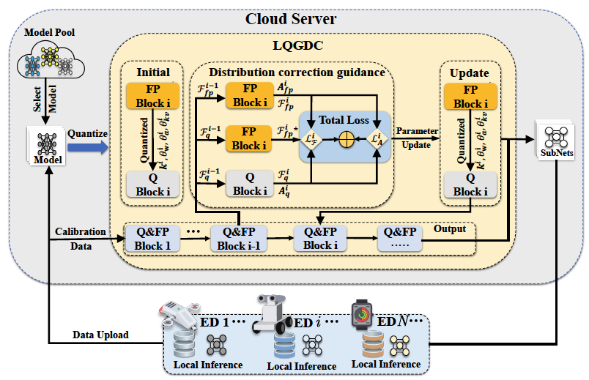
2.1 Approach: LQGDC(Learnable Quantization Guided by Distribution Correction)
Phase 1:
Model Selection and Data Upload.
Phase 2:
Cloud-Side Quantization and Optimization
1. Learnable Transformation
2. Loss Calculation and Optimization
Phase 3:
Model Distribution and Local Inference
Notes:
To address these challenges, we propose LQGDC: Learnable Quantization Guided by Distribution Correction. This is a cloud-edge collaborative framework.
It operates in three phases:
First, an edge device uploads calibration data.
Second, the cloud server performs our advanced quantization and optimization.
Finally, the optimized, compact model is sent back to the edge for efficient local inference.
The core idea is to leverage the cloud's power to create a highly optimized model for the edge.

Slide 7
2.1 Approach: LQGDC(Learnable Quantization Guided by Distribution Correction)
Challenge2: Quantization below 8-bit causes severe accuracy loss
Challenge3: Outliers across channels and tokens in KV cache quantization
Challenge4: Different modules exhibit varying sensitivity to quantization
Transformer Block Parameter & Inference
Challenge4
Learnable Transformation
LWAS: Learnable weights-activations smooth
LWAC: Learnable Weight-Activation Clipping
Parameter Initial
Challenge2
Optimization Module
DCG: Distribution Correction-Guided
Parameter Update
Learnable Scale and Offset Quantization for KV Cache
LKVTS: Learnable KV Cache Transformation and Smoothing
HKVQ:Historical KV Quantization
Challenge3
Notes:
As shown on the slide, LQGDC addresses each challenge with a specific module.
To combat general accuracy loss (Challenge 2), we introduce LWAS and LWAC
To handle outliers in the KV cache (Challenge 3), we use LKVTS and HKVQ.
To address Challenge 4, varying sensitivity, our Distribution Correction-Guided (DCG) optimization module intelligently fine-tunes the parameters for each part of the model.

Slide 8
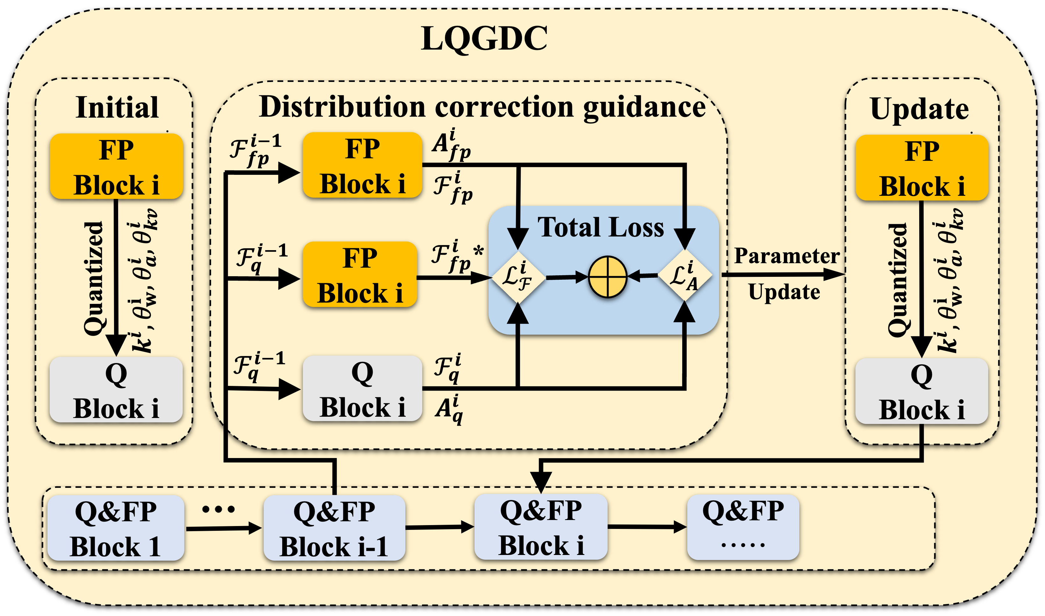
2.1 Approach: LQGDC(Learnable Quantization Guided by Distribution Correction)
Outliers across channels and tokens in KV cache quantization
Address accuracy degradation of low-bit quantized models caused by static quantization parameters
LKVTS
LWAC
LWAC
LWAS
DCG
Mitigate the issue of varying quantization sensitivity across different modules
Notes:
LWAS, LWAC, and LKVTS are our learnable modules that directly tackle the outlier problems in both the main model and the KV cache.
The entire optimization is orchestrated by our DCG module, which uses 'distribution correction guidance' to ensure the quantized model behaves as closely to the original full-precision model as possible.

Slide 9
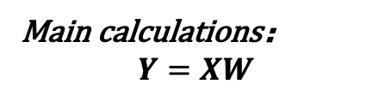
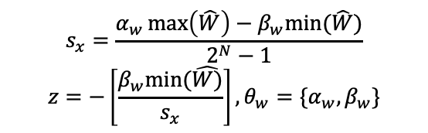


2.2 Learnable Transformations
Even after smoothing, residual outliers may persist
Balance difficulty of quantization between weights and activations
Dynamically adjusts the distribution of weights and activation
Quantization Target
1.LWAS: Learnable weights-activations smooth
smooth activation weights
$$Y=\left(X⋅diag{\left(k\right)}^{−1}\right)\left(diag\left(k\right)⋅W\right)+B=\hat{X}⋅\hat{W}+B$$
Main calculations：
$$Y=XW$$
Learnable per-channel factors $k$ mitigate outliers
challenge
$$W_{q}=clamp(\left[\frac{\hat{W}}{s_{x}}\right]+z,{0,2}^{N}−1)$$
Preventing residual outliers from consuming low-bit width representation
outliers
low precision
Even after smoothing, residual outliers may persist
Various parameter distributions
2. LWAC: Learnable Weight-Activation Clipping
solution
$$s_{x}=\frac{α_{w}\max\left(\hat{W}\right)−β_{w}min⁡(\hat{W})}{2^{N}−1}$$
$$z=−\left[\frac{β_{w}min⁡(\hat{W)}}{s_{x}}\right],θ_{w}=\{α_{w},β_{w}\}$$
Learnable Transformations
Even after smoothing, residual outliers may persist
Dynamically adjusts the quantization range
Learnable parameters
Based on
smooth activation and weights
adjust the quantization clipping range
summary
distribution
Notes:
引入：
Now, let's dive into the core of our solution for handling outliers: Learnable Transformations. The main challenge, as shown, is that outliers in either weights (W) or activations (X) can severely degrade the precision of the main Y = XW calculation after quantization.
我们的方法（LWAS、LWAC）
First, LWAS (Learnable Weights-Activations Smooth) rebalances the quantization difficulty. It uses a learnable, per-channel scaling factor k to strategically transfer the dynamic range between weights and activations. Our framework learns the optimal k for each channel, making both tensors easier to quantize without changing the mathematical output.
Second, for any residual outliers, LWAC (Learnable Weight-Activation Clipping) provides an adaptive solution. Instead of using static min/max values, which are sensitive to outliers, LWAC learns the optimal clipping range using parameters αw and βw. This dynamically sets the quantization boundaries, effectively ignoring extreme outliers and preventing them from consuming the limited bit-width representation.
总结
In short, LWAS rebalances the task, and LWAC adaptively clips outliers. Together, these data-driven transformations are key to preserving accuracy in low-bit quantization."

Slide 10

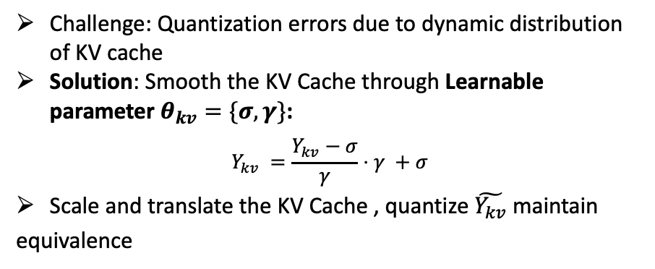
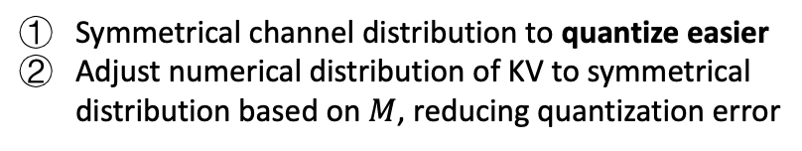

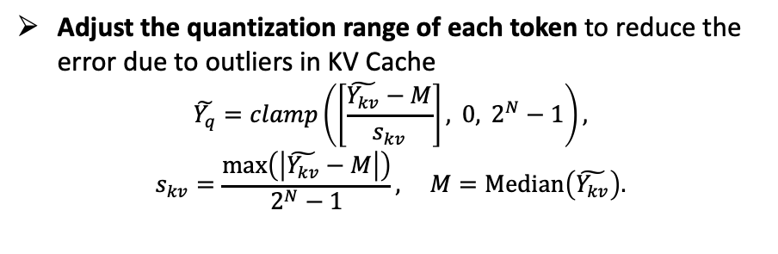
2.3 Learnable Scale and Offset Quantization for KV Cache
3. LKVTS:Learnable KV Cache Transformation and Smoothing
Quantization challenge
Demand for long-text inference
Adjust the quantization range of each token to reduce the error due to outliers in KV Cache
$$\tilde{Y_{q}}=clamp\left(\left[\frac{\tilde{Y_{kv}}−M}{s_{kv}}\right], 0, 2^{N}−1\right),$$
$$s_{kv}=\frac{\max\left(\left|\tilde{Y_{kv}}−M\right|\right)}{2^{N}−1}, M=\text{Median}\left(\tilde{Y_{kv}}\right).$$
Solution
Learnable KV Cache Transformation and Smoothing (LKVTS)
3. LKVTS:Learnable KV Cache Transformation and Smoothing
Challenge: Quantization errors due to dynamic distribution of KV cache
Solution: Smooth the KV Cache through Learnable parameter $θ_{kv}=\{σ,γ\}$:
$$Y_{kv} =\frac{Y_{kv}−σ}{γ}⋅γ +σ$$
Scale and translate the KV Cache , quantize $\tilde{Y_{kv}}$ maintain equivalence
Symmetrical channel distribution to quantize easier
Adjust numerical distribution of KV to symmetrical distribution based on $M$, reducing quantization error
$$\tilde{Y_{kv}}$$
Notes:
困境：
The same outliers exist in the KV cache
For channel outliers, learnable shift and scaling factors are introduced.
For outliers between tokens, we adjust the numerical distribution of the shifted, scaled matrix to a symmetric distribution based on the median.
This shift-based distribution centering operation significantly suppresses the impact of outliers on quantization.
Then, we calculate the scaling factor for each token quantization, and by calculating the maximum deviation, we expand the quantization representation range (allowing outliers to be reasonably quantized without truncation).

Slide 11
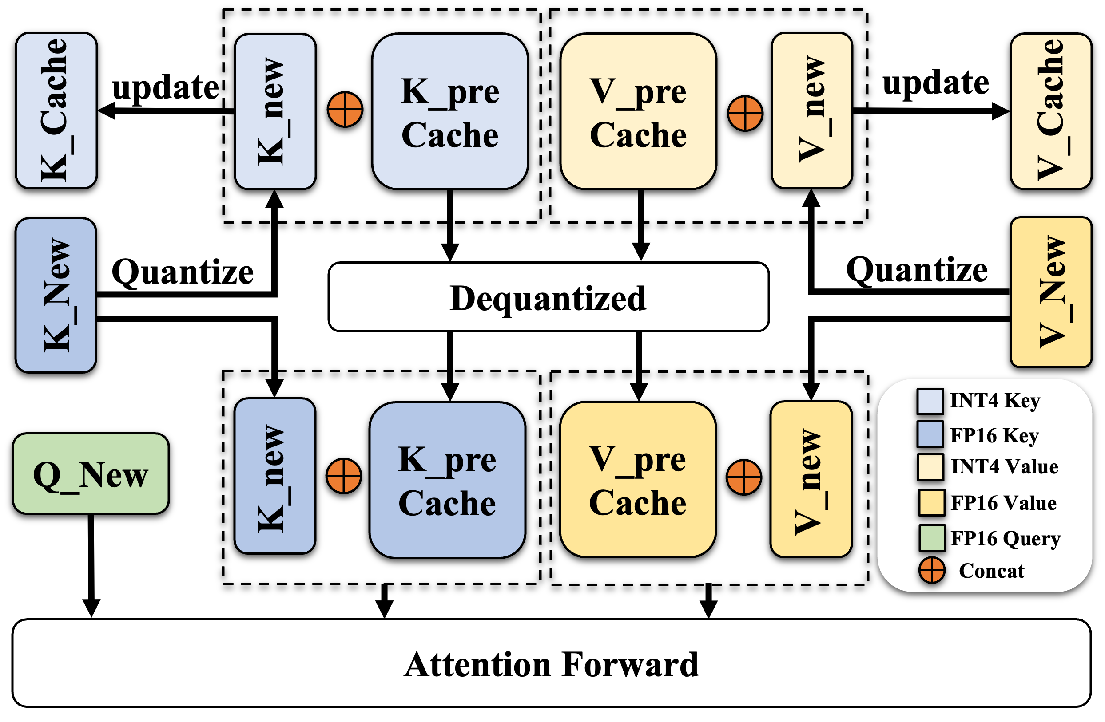

2.3 Learnable Scale and Offset Quantization for KV Cache
Inference in LLM:
Pre-fill stage
$$X_{K}=XW_{K},X_{V}=XW_{V}$$
Decoding stage
$$t_{K}=tW_{K},t_{V}=tW_{V},X_{K}←Concat(X_{K},t_{K}),X_{V}←Concat(X_{V},t_{V})$$
$$t_{Q}=tW_{Q},A=Softmax\left(t_{Q}X_{K}^{Τ}\right),t_{O}=AX_{V}$$
Introduce quantization errors and reducing the accuracy of attention calculations
Traditional KV Quantization
4. HKVQ:Historical KV Quantization
Only quantize past key-values; current key-values participate directly in forward computation.
Eliminate redundant phase errors between quantization and dequantization of current key-values, improving KV cache quantization accuracy.
Quantize both the current and historical key-values simultaneously, then perform dequantization.
Introduce redundant truncation errors in Attention computation.
Notes:
These are the two stages of inference in LLM:
- the prefill stage and the decoding stage.
- Key-value quantization occurs during the decoding stage.
Because key-value quantization affects the accuracy of attention calculations, traditional key-value caching quantization requires directly concatenating the quantized key-value pairs and then performing dequantization to complete the remaining forward computation; however, this reduces the accuracy of attention calculations.
The historical key-value caching method only quantizes past key-value pairs, with the current key-value pair directly participating in the forward computation. This eliminates the unnecessary truncation error between quantizing and dequantizing the current key-value pair, thus improving the accuracy of key-value caching quantization.

Slide 12
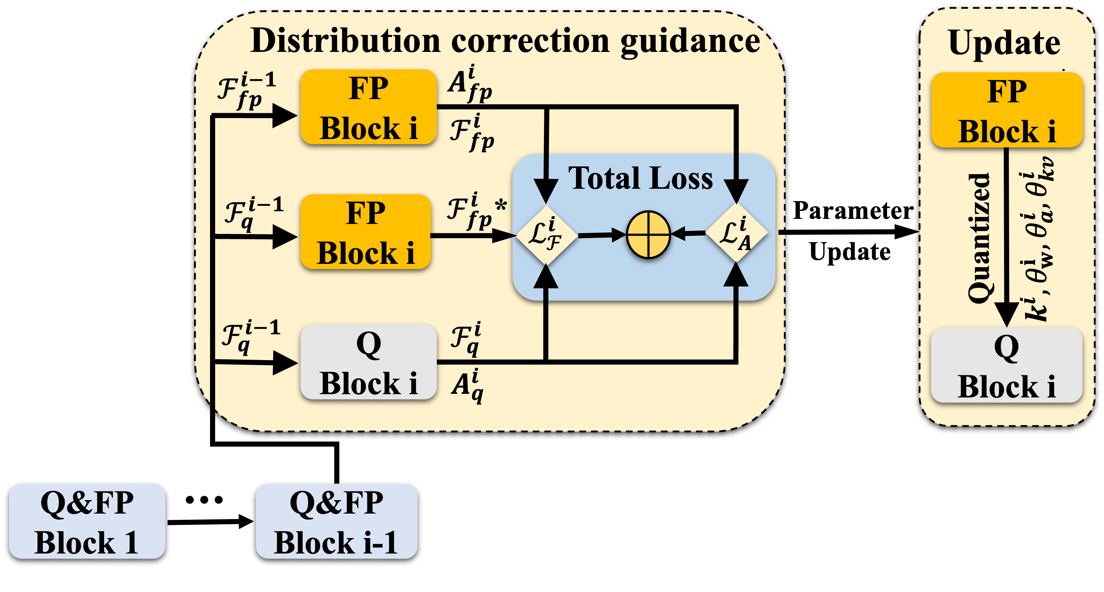
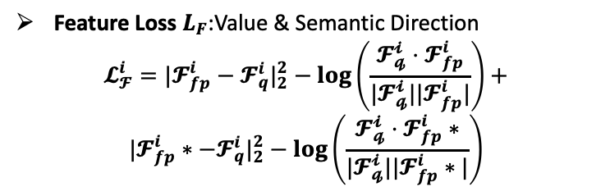
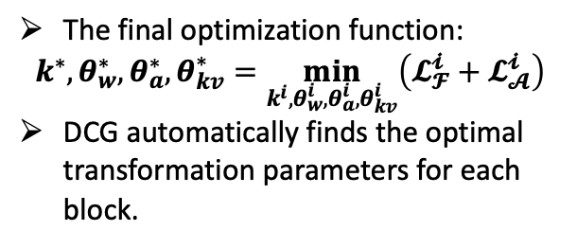
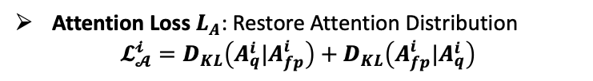
2.4 Distribution Correction-Guided Parameter Update
Value& Semantic : MSE & Cosine Similarity
Mitigates inter-layer error accumulation by aligning with an ideal output based on the previous block's quantized input.
Feature Loss $L_{F}$:Value & Semantic Direction
$$𝓛_{𝓕}^{i}=|𝓕_{fp}^{i}−𝓕_{q}^{i}|_{2}^{2}−\log\left(\frac{𝓕_{𝓺}^{𝓲}⋅𝓕_{fp}^{i}}{|𝓕_{𝓺}^{𝓲}||𝓕_{fp}^{i}|}\right)+$$
$$|𝓕_{fp}^{i}∗−𝓕_{q}^{i}|_{2}^{2}−\log\left(\frac{𝓕_{𝓺}^{𝓲}⋅𝓕_{fp}^{i}∗}{|𝓕_{𝓺}^{𝓲}||𝓕_{fp}^{i}∗|}\right)$$
Loss function 1
Symmetric Kullback-Leibler (KL) Divergence loss
Performs a bidirectional correction, pulling the quantized attention distribution closer to the original and vice-versa for a more robust alignment.
Loss function 2
The final optimization function:
$$k^{∗},θ_{w}^{∗},θ_{a}^{∗},θ_{kv}^{∗}=\min_{k^{i},θ_{w}^{i},θ_{a}^{i},θ_{kv}^{i}}\left(𝓛_{𝓕}^{𝓲}+𝓛_{𝓐}^{𝓲}\right)$$
DCG automatically finds the optimal transformation parameters for each block.
Attention Loss $L_{A}$: Restore Attention Distribution
$$𝓛_{𝓐}^{𝓲}=D_{KL}\left(A_{q}^{i}|A_{fp}^{i}\right)+D_{KL}\left(A_{fp}^{i}|A_{q}^{i}\right)$$
Notes:
To update the previously learnable parameters, we design two loss functions:
- Attention Loss and Feature Loss.
For Feature Loss：
We use MSE & Cosine Similarity to mistigate inter-layer error accumulation by aligning with an ideal output based on the previous block's quantized input.
For Attention Loss:
We use Symmetric Kullback-Leibler (KL) Divergence loss to perform a bidirectional correction, pulling the quantized attention distribution closer to the original and vice-versa for a more robust alignment.
Combining the two, DCG finds the optimal transformation parameters for each block.

Slide 13

2.4 Distribution Correction-Guided Parameter Update
Parameters are updated via DCG
Step1:Initialize & Transform
Initialize learnable parameters
Apply transformations and quantize Block $i$
Step2:Loss Calculation via DCG Module
Calculate Feature Loss /Attention Loss
Setp3:Parameter Update & Progression
Update parameters using the Total Loss.
Finalize optimal parameters for Block $i$
Proceed to Block $i+1$with the calibrated output and the entire process repeats
Notes:
This slide summarizes the iterative optimization process.
For each block in the model, we first initialize and apply our learnable transformations.
Then, the DCG module calculates the loss. Based on this loss, we update the transformation parameters. Once a block is optimized, we proceed to the next, repeating this process until the entire model is quantized.

Slide 14
Outline
1. Introduction
2. Approach
3. Experimental Evaluation
4. Conclusion

Slide 15
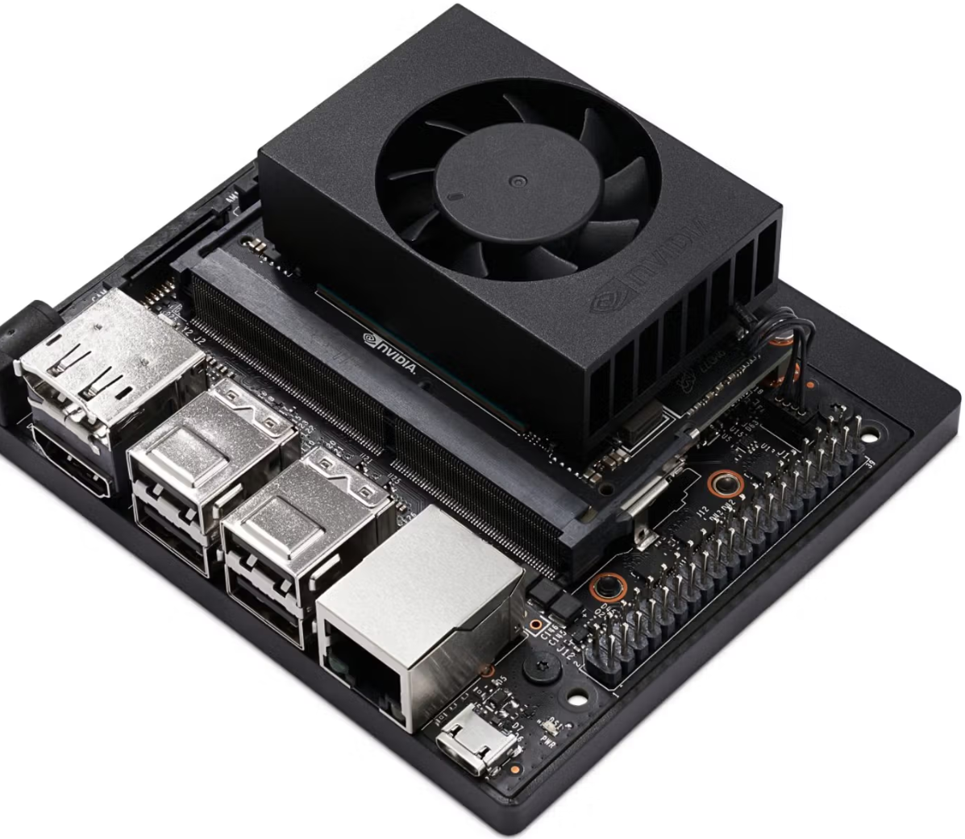
3.1 Experimental Environment and Search Space
Experimental Environment
Cloud Server | NVIDIA A100 GPUs with 80GB memory and 128GB RAM
Edge Devices(EDs) | NVIDIA Jetson AGX Orin 64G NVIDIA Jetson Orin NX 16G
Datasets | WikiText-2 C4 ARC-e & ARC-c HellaSwag PIQA Winogrande
Models | LLaMA-7B LLaMA-13B LLaMA-2-7B
Language generation
zero-shot reasoning
NVIDIA Jetson Orin NX 16G
Notes:
We conducted our experiments using a cloud server with NVIDIA A100 GPUs and two edge devices: the Jetson AGX Orin and NX Orin.
We evaluated our method on several LLaMA models and used a range of datasets for both language generation and zero-shot reasoning tasks.

Slide 16
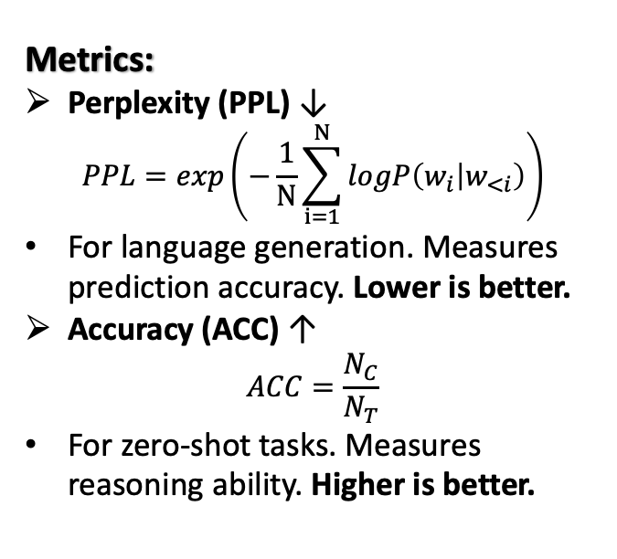
3.2 Baseline and Metrics
Predict the probability of the current word given the preceding context.
Metrics:
Perplexity (PPL) ↓
$$PPL=exp\left(−\frac{1}{N}\sum_{i=1}^{N}{logP\left(w_{i} | w_{<i}\right)}\right)$$
For language generation. Measures prediction accuracy. Lower is better.
Accuracy (ACC) ↑
$$ACC=\frac{N_{C}}{N_{T}}$$
For zero-shot tasks. Measures reasoning ability. Higher is better.
Baseline:
SmoothQuant
An INT8 method that balances outliers between weights and activations.
OS+
An INT4 method using channel-wise shifts to handle asymmetry.
OminiQuant
An advanced INT4 method using block-wise MSE minimization.
Notes:
We compared LQGDC against strong baseline methods, including SmoothQuant, OS+, and OmniQuant. To measure performance, we used two key metrics.
For language generation, we used Perplexity, where a lower score is better.
For reasoning tasks, we used Accuracy, where a higher score is better.

Slide 17
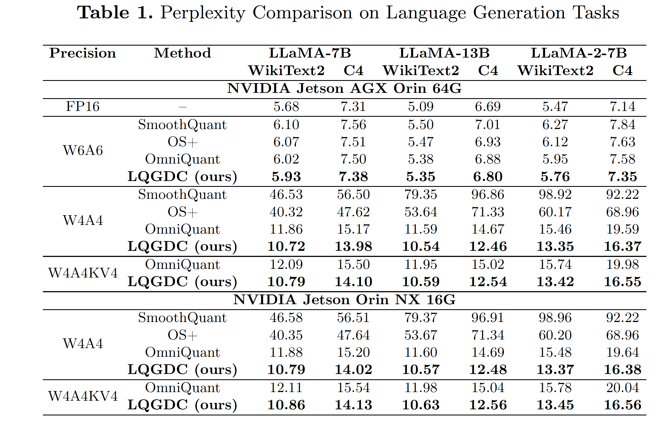
3.3 Language generation
For language generation tasks (Wiki, C4) on AGX edge devices, LQGDC outperforms all baseline methods.
W4A4KV4: Average perplexity reduced by 1.35, 1.92, and 2.88 respectively.
W4A4 Quantization: Average perplexity reduced by 1.17, 1.63, and 2.67 respectively.
On NX edge devices, the model quantized with LQGDC achieves an average perplexity that outperforms the best baseline.
Notes:
In language generation tasks, Table 1 shows that LQGDC consistently achieves the lowest perplexity, meaning the highest quality, across all models and bit-widths.
For example, on the AGX device with 4-bit quantization, our method significantly outperforms all baselines. This proves our ability to preserve the model's fluency even after aggressive compression.

Slide 18
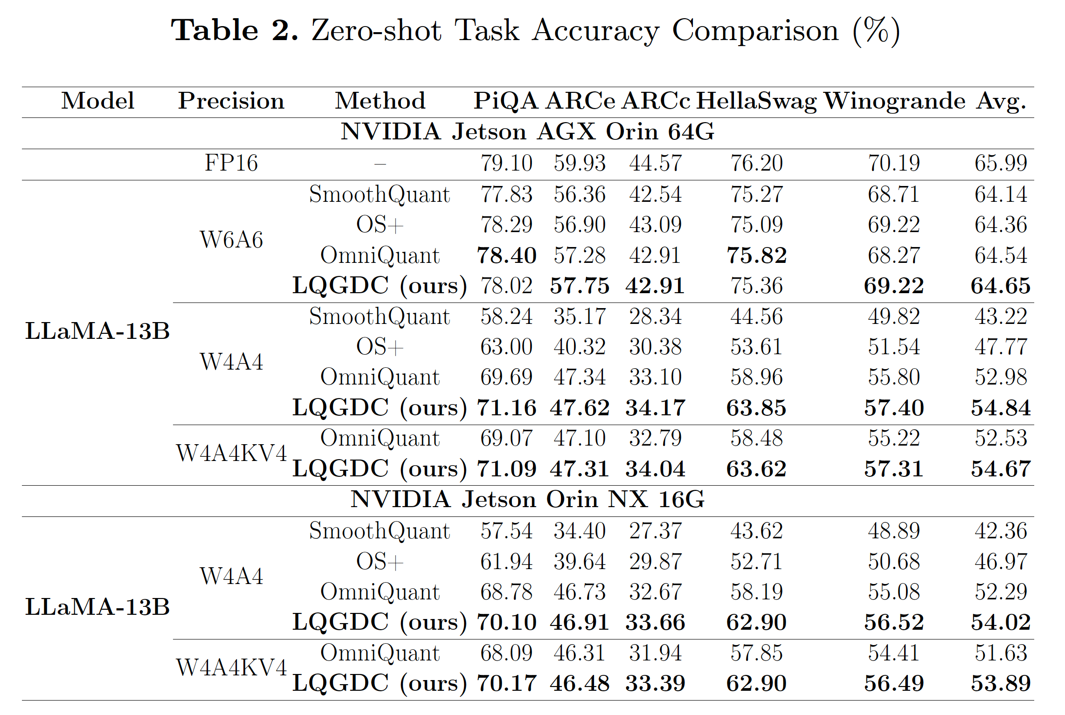
3.4 zero-shot reasoning
Superior Accuracy:
LQGDC achieves the highest average accuracy on a suite of five reasoning tasks.
Dominance at 4-bit Precision:
LQGDC achieves the highest ACC across all models and settings.
+2.14% improvement over OmniQuant on AGX Orin (W4A4KV4).
+2.26% improvement on NX Orin, proving its real-world effectiveness.
Enables Powerful Reasoning on the Edge: Preserves complex reasoning abilities after low-bit quantization, making deployment on EDs practical and reliable.
Notes:
In zero-shot reasoning tasks, LQGDC again demonstrates superior performance. Table 2 shows that our method achieves the highest average accuracy.
We see a significant improvement of over 2.1% on AGX Orin and 2.2% on NX Orin compared to the best baseline at 4-bit.
This shows that LQGDC has little impact on the quantization error caused by 4-bit quantization and has a significant advantage in balancing model performance and deployment capability.

Slide 19
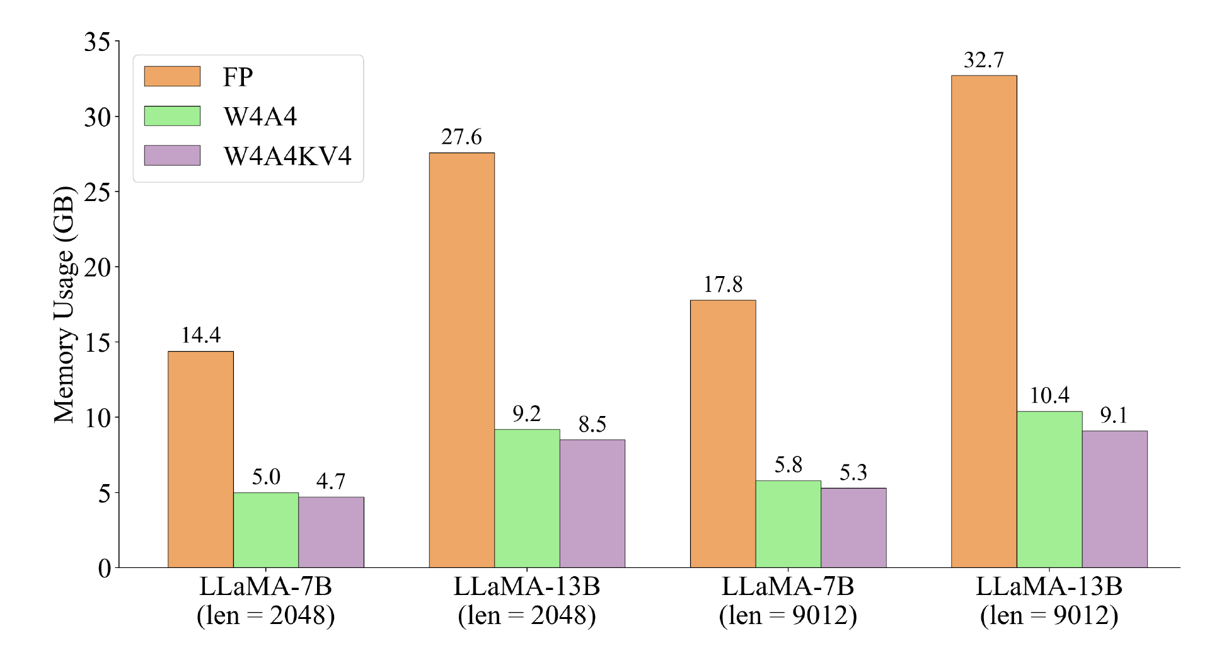
3.5 long-context inference
Test compression efficiency of LQGDC-quantized models on AGX 64G With batch size = 1 and context length = 9012:
LLaMA-13B (W4A4KV4): Inference memory footprint reduced by 12.50% vs. W4A4.
Compression ratio reaches 72.17% vs. original FP16 precision model.
This makes deploying LLMs for long-context inference feasible on resource-constrained EDs.
Notes:
For long-context inference, we achieved a memory compression ratio of over 72% compared to the original model, making large-scale tasks feasible on the edge.

Slide 20
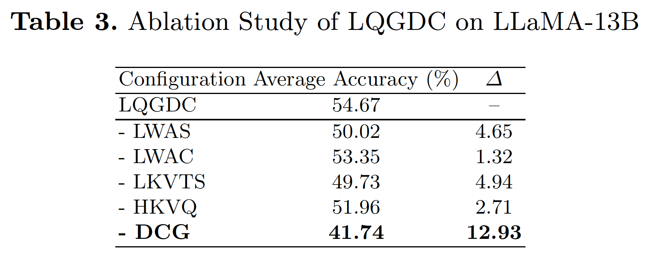
3.6 Ablation studies
DCG is the most critical component
Handling Outliers is Crucial
smoothing activations (-LWAS, -4.65%) and KV cache (-LKVTS, -4.94%)
Notes:
To understand the contribution of each component, we conducted an ablation study. The results in Table 3 are clear: the Distribution Correction-Guided module (DCG) is the most critical component ；Removing it leads to a massive 12.9% drop in accuracy. This confirms that our guided optimization strategy is the key to LQGDC's success.
Handling Outliers is Crucial

Slide 21
Outline
1. Introduction
2. Approach
3. Experimental Evaluation
4. Conclusion

Slide 22
Conclusion
Learnable Transformations and long-text reasoning optimizations:
LWAS、LWAC、LKVTS introduce learnable parameters for weights, activations, and KV cache.HKVQ preserves critical attention accuracy while significantly compressing memory usage.
Intelligent, Guided Optimization
DCG module uses a multi-objective loss function (MSE, Cosine Similarity, KL Divergence) to find the optimal parameters for each block.
LQGDC successfully maintains model precision at low bit-widths, significantly enhancing the capability for complex, long-text inference on resource-constrained edge devices.
Thank you!
Notes:
In conclusion, we introduced LQGDC, a cloud-guided quantization framework that effectively deploys LLMs on resource-constrained edge devices.
Through a combination of learnable transformations and a novel distribution correction-guided optimization, our method successfully maintains high precision at very low bit-widths.
It significantly enhances the capability for complex, long-text inference on the edge. This work represents a significant step towards making powerful, large-scale AI truly ubiquitous.

