Slide 1
Spectral Graph Multisection Through Orthogonality
Huanyang Zheng and Jie Wu
CIS Department, Temple University

Slide 2
Outline
Motivation
Preliminary
Algorithm
Evaluation
Future work

Slide 3
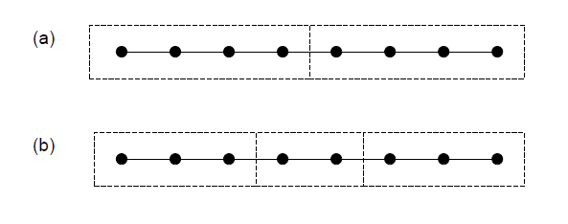
Motivation
Traditional graph spectral clustering algorithm is based on recursive bisection.
Recursive bisection: 4/2/2 nodes
Optimal partition: 3/3/2 nodes

Slide 4
Motivation
Can we cut the graph into multisections directly?
Yes, but former approaches on graph multusection have a high time complexity and a low partition accuracy.
We propose a multisection algorithm with a low time complexity and a competitive partition accuracy.

Slide 5


Preliminary
Spectral bisection algorithm by Dr. Newman
Let s_{i} denote the group allocation of node i.
We can use s_{i} and s_{j} to indicate whether node i and j belong to the same group or not:

Slide 6


Preliminary
Modularity is the partition metric, if node i and j belong to the same community, then the modularity gain is B_{ij}.
So the total modularity (or quality) is
Since

Slide 7
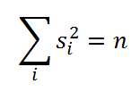

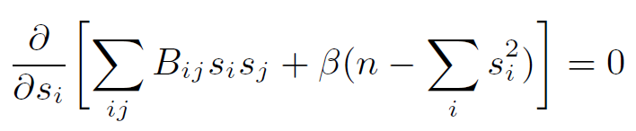
Preliminary
Relax the constraint to , if there are n nodes in total.
This is a classic optimization (maximize the modularity under the above constraint), which can be solved by Lagrange multiplier

Slide 8

Preliminary
Then (use a vector s to denote [s₁ s₂ … s_{n}])
This implies that the vector s should be an eigenvector of B.
Recall the modularity Q

Slide 9
Preliminary
To maximize Q, the vector s should be the eigenvector corresponding to the largest eigenvalue of the modularity matrix.
Each element in this eigenvector stands for the group allocation of the corresponding node.
Round each element in the eigenvector to
  {-1,+1}, then we obtain the partition result.

Slide 10

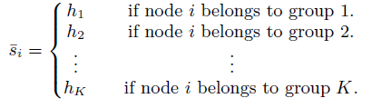

Algorithm
Basic idea: use a vector to present the group allocation, instead of (we use more than one bit to present group allocation).
Our algorithm:
Classic approach:

Slide 11






Algorithm
These vectors are mutually orthogonal to each other, which are produce by Hadamard matrix (h_{i} is the i-th row of it):
H₁=[1], ,
Our approach vs classic
For example, and

Slide 12


Algorithm
Basic idea: use a self-defined operation, matrix inflation, to present the modularity.
Our approach:
Classic approach:
Then the following process is the same as the classic approach, but now we can do multisection directly.

Slide 13
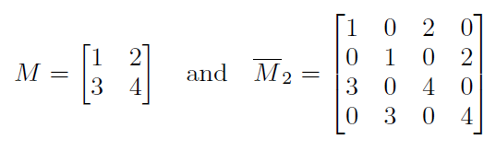
Algorithm
Self-defined operation: matrix inflation
Definition: the Kronecker product of the matrix M and a K*K identity matrix.
Example

Slide 14
Algorithm
Additional issue: we use a randomized matrix inflation to keep relaxation effective.
Time complexity (the graph has n nodes):
  Our method: O(K⁴n²), where K is the estimated number of communities.
  Recursive bisection algorithm: O(n²logn).

Slide 15


Evaluation
Our evaluations are based on the LFR benchmark, where the node degree and the community size follow power-law, with exponents and , respectively.
Links between nodes in the same (different) community are called internal (external) links. A mixing parameter, u, is the ratio of the external node degree to the total degree.

Slide 16
Evaluation
Algorithms in comparison:
  The recursive bisection algorithm (denoted as RBS) by Dr. Newman.
  The Markov Cluster algorithm (MCL).
  Proposed algorithm is denoted as PMS.

Slide 17
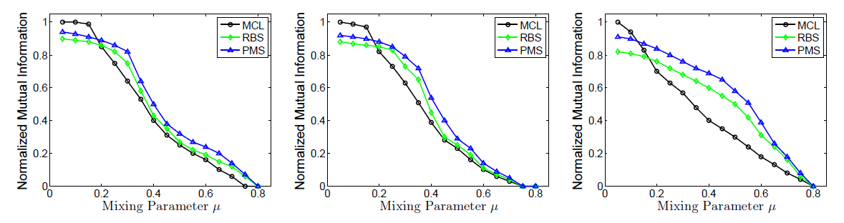
Evaluation
LFR benchmark with N=128 nodes

Slide 18
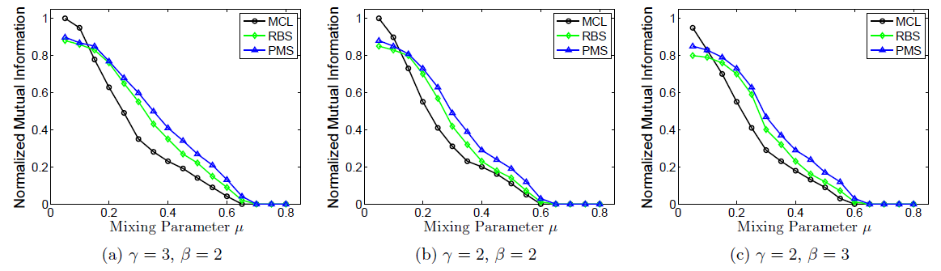
Evaluation
LFR benchmark with N=256 nodes

Slide 19
Evaluation
Simulation summery:
Our algorithm outperforms recursive bisection algorithm. This is because our algorithm has “global” view of the partition, and recursive bisection is based on the “local” view.
Our algorithm has a competitive performance with a low time complexity.

Slide 20
Future work
Real data evaluation.
Tests in large-scale networks.

Slide 21
Thank you !
Q & A

