Slide 1





Dynamic Mobile Charger Scheduling in
Heterogeneous Wireless Sensor Networks
Hua Huang$^{1}$, Shan Lin$^{1}$, Lin Chen$^{2}$, Jie Gao$^{1}$, Anwar Mamat$^{3}$, Jie Wu$^{4}$
Presenter: Hua Huang
1 Stony Brook University
2 Univ. Paris-Sud 11
3 University of Maryland College Park
4 Temple University

Slide 2
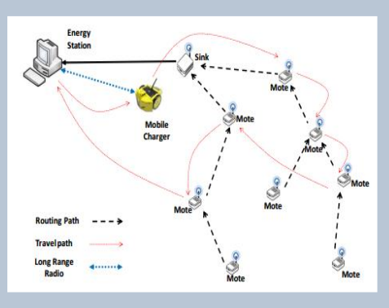

Problem Description
Network Model
  Sensor set:$V$, mutual distance matrix: $D$
  battery capacity: $E_{max}$, energy consumption rate: $r_{i}(t)$
Charger Model
  single mobile charger
  zero charging time
Optimization Goal
  Coverage Ratio $B_{C}$
  Energy Storage $B_{E}$

Slide 3
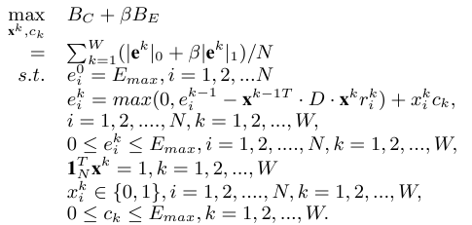
Problem Formulation
Maximizing a convex function, discrete constraints
NP complete
  proved by reducing the Traveling Salesman Problem ( TSP) to it

Slide 4
Related Work
Zhang, Sheng, Jie Wu, and Sanglu Lu. "Collaborative mobile charging for sensor networks." Mobile Adhoc and Sensor Systems (MASS), 2012 IEEE 9th International Conference on. IEEE, 2012.
He, Liang, et al. "Esync: An energy synchronized charging protocol for rechargeable wireless sensor networks." Proceedings of the 15th ACM international symposium on Mobile ad hoc networking and computing. ACM, 2014.
Xie, Liguang, et al. "On traveling path and related problems for a mobile station in a rechargeable sensor network." Proceedings of the fourteenth ACM international symposium on Mobile ad hoc networking and computing. ACM, 2013.

Slide 5


Challenge
Shortest Route (TSP) Scheduler
  charges along shortest route
  Fail to consider about node urgency

Slide 6
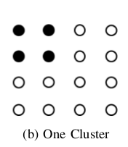
Challenge
Earliest Deadline First (EDF) Scheduler
  charges most urgent node
  Fail to consider about traveling cost

Slide 7
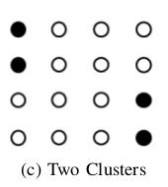
Challenge
Both traveling cost and node urgency are essential

Slide 8
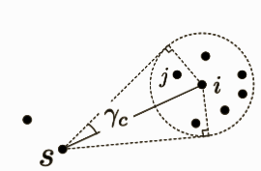
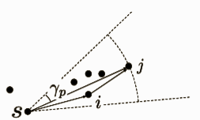
Spatial Dependent Model
Cluster Dependency:
  When charging i, traveling costs for nearby nodes are reduced.
Path Dependency:
  When traveling to i, nodes near the path are recharged without much detour

Slide 9
Spatial Dependent Task (SDT) Scheduler
Idea:
  Searches for the most urgent node cluster
  charges nearby nodes along the path
Solution Overview
  Search the cluster to recharge
  Construct the directed acyclic travel graph
  Searches for the route to travel using critical path algorithm

Slide 10


Spatial Dependent Task (SDT) Scheduler
Cluster Priority:
Path Priority:
Weighted sum of urgency
Distance
Extra gain
detour cost

Slide 11

Spatial Dependent Task (SDT) Scheduler (cont’d)
Traveling graph definition
Given the distance $j$
Directed Edge $\overline{si}$ exists if:
$∠jsi<γ_{p}$
$d_{si}$<$d_{ij}$

Slide 12
Evaluation
Baseline algorithms
  Shortest Route (TSP) scheduler
  Earliest Deadline First (EDF) scheduler
  Maximum Response Ratio First (MRF) scheduler
  EDF with node insertion (EDF-I)
Simulation set-up
  energy consumption rate modeling real traces
  225 nodes in square area
  different sizes and workloads

Slide 13
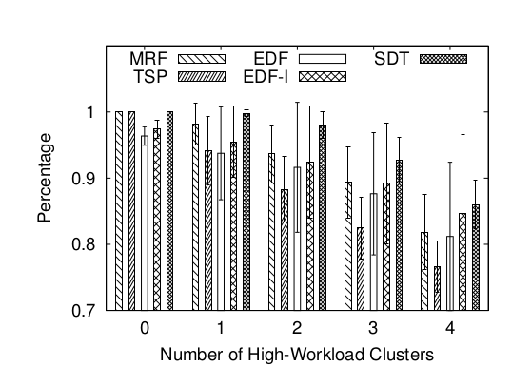
Evaluation
Influence of work loads
SDT performs well when energy consumption rates
  3 clusters, SDT10% better than TSP, 5% better than EDF

Slide 14
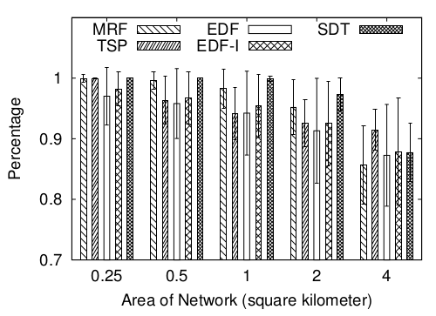
Evaluation
SDT degrades gracefully. 5% better than EDF
TSP performs well when network area 4% better than others

Slide 15
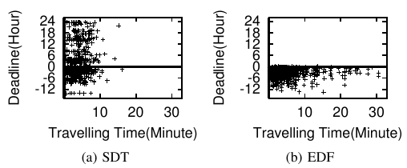
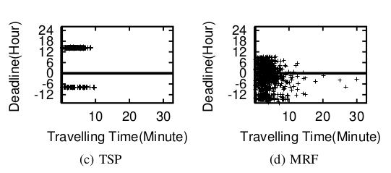
Evaluation (cont’d)
Trade-off between traveling time and urgency
SDT scheduler spends most of the time charging urgent nodes

Slide 16
Conclusion
Problem Definition
  Models and optimization goal
Challenge
  NP-Complete
  Consider both Spatial and temporal constraints
SDT Scheduler
  Select cluster
  Search best path
Evaluation
  SDT scheduler Achieves better performance
  TSP works well in large networks

Slide 17
Future Work
Design algorithms with performance bounds

Slide 18
Questions?

