Slide 1

Collaborative Mobile Charging and Coverage in WSNs
Jie Wu
Computer and Information Sciences
^{Temple University}

Slide 2
1. Introduction
Theory vs. Practice
… adoption in industry… do not be afraid of failure
(Victor Bahl, Mobicom 2013 keynote)
… practical things are mostly low-ends in theory while high-ends are usually not adopted in practice
(Yunhao Liu, MASS 2013 keynote)

Slide 3
Wise Men
John F. Kennedy
… progress in technology depends on progress in theory… The vitality of a scientific community springs from its passion to answer science’s most fundamental questions.
Ronald Reagan
… although basic research does not begin with a particular practical goal …, it ends up being one of most practical things government does.

Slide 4

My Approach
How to select a research problem
Simple definition
Elegant solution
Room for imagination

Slide 5
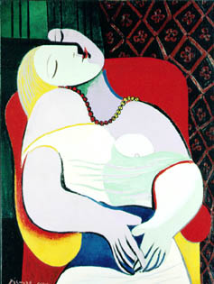
Picasso & Matisse Le Rêve (the Dream)
Know how to make
appropriate abstractions –
ask the right questions
Many CS students use
excessive amounts of math
to explain simple things
The Art of Living, Time, Sept. 23, 2012
Senior people can be creative without worry
the “utility” of their work
Notes:
K. Batcher , Cray award winner, attended ICPP every year, until the conf. was moved around. He refused to miss any class.
S. Sahni , CS chair at UF, drove to Boca Raton early morning (staring at 5 am) as he did not want to miss a class the day before.

Slide 6
ENERGY: A Special Utility
Limited lifetime of battery-powered WSNs
Possible solutions
Energy conservation
Cannot compensate for energy depletion
Energy harvesting (or scavenging)
Unstable, unpredictable, uncontrollable …
Sensor reclamation
Costly, impractical (deep ocean, bridge surface …)

Slide 7
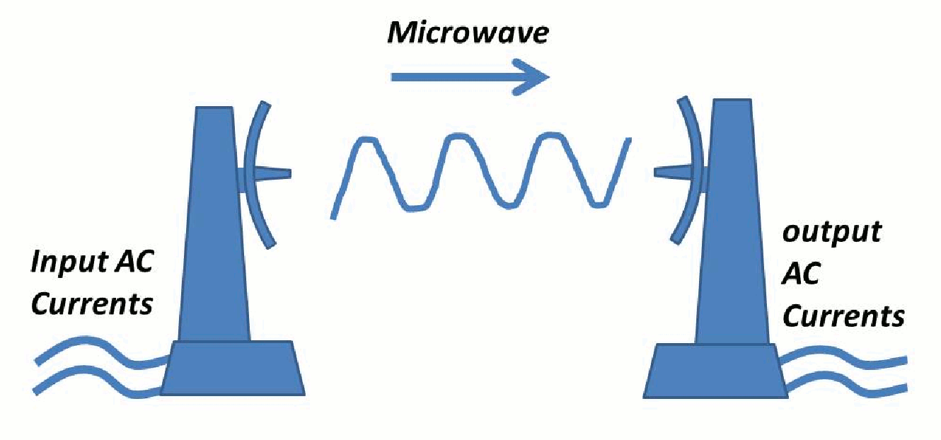
2. Mobile Chargers
The enabling technology
Wireless energy transfer (Kurs ’07)
Wireless Power Consortium
Mobile chargers (MC)
MC moves from one location to another for wireless charging
Extended from mobile sink in WSNs and ferry in DTNs
Energy consumption
The movement of MC
The energy charging process

Slide 8
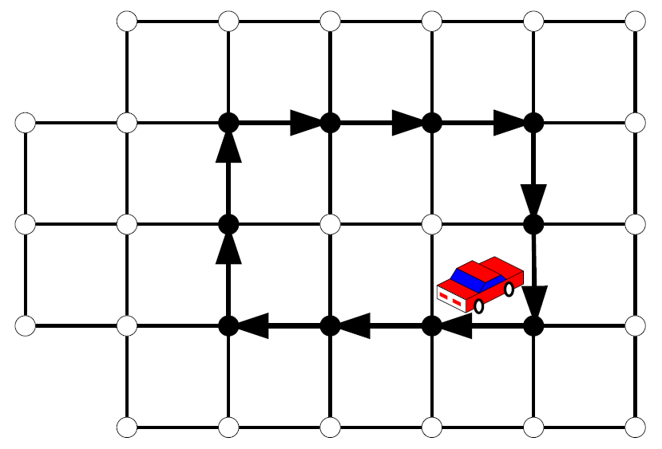
3. State of the Art
Traveling-Salesmen Problem (TSP)
A minimum cost tour of n cities: the salesman travels from an origin city, visits each city exactly one time, then returns to the origin
Covering Salesman Problem (CSP, Ohio State ’89)
The least cost tour of a subset of cities such that every city not on the tour is within some predetermined covering distance
Extended CSP
Connected dominating set (FAU ’99)
Qi-ferry (UDelaware ’13)

Slide 9
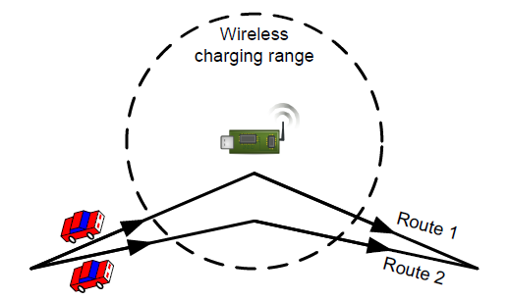
Charging Efficiency
Location of charging
Bundle and rotation (Kurs ’10)
Charging multiple devices that are clustered together

Slide 10
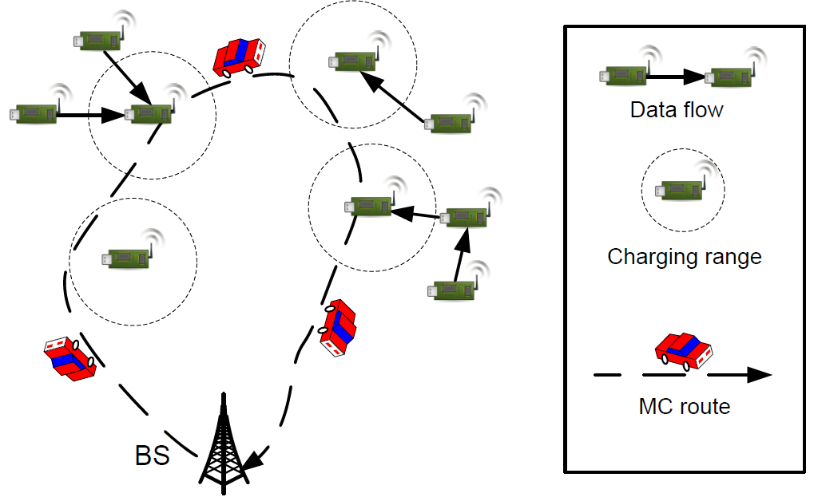
Mobile Sinks and Chargers
Local trees
Data collections at all
roots
Periodic charging to all
sensors
Base station (BS)
Objectives
Long vocation at BS (VT ’11-13)
Energy efficiency with deadline (Stony Brook ’13)

Slide 11
4. Challenges
Most existing methods
An MC is fast enough to charge all sensors in a cycle
An MC has sufficient energy to replenish an entire WSN (and return to BS)
Collaborative approach using multiple MCs
Problem 1: MCs with unrestricted capacity but limitations on speed
Problem 2: MCs with limited capacity and speed, and have to return to BS

Slide 12
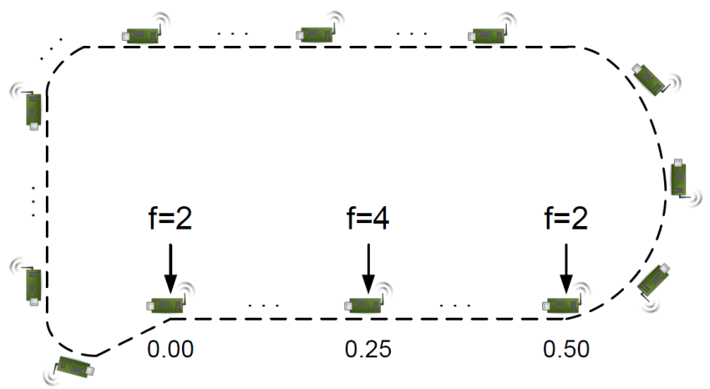
5. Collaborative Coverage & Charging
Problem 1: Determine the minimum number of MCs (unrestricted capacity but limitations on speed) to cover a line/ring of sensors with uniform/non-uniform recharge frequencies
A toy example
A circle track with circumference 3.75 densely covered with sensors with frequency f=1 for recharge
A sensor with f=2 at 0 and 0.5
A sensor with f=4 at 0.25
(MC’s max speed is 1)
What is the trajectory planning
of these MCs?

Slide 13
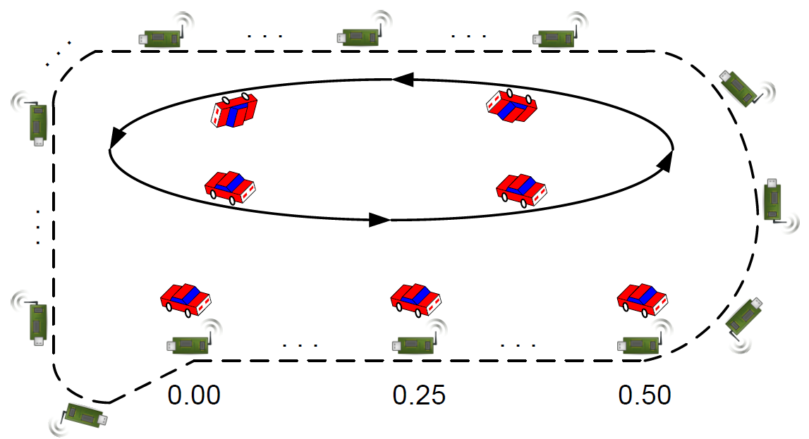
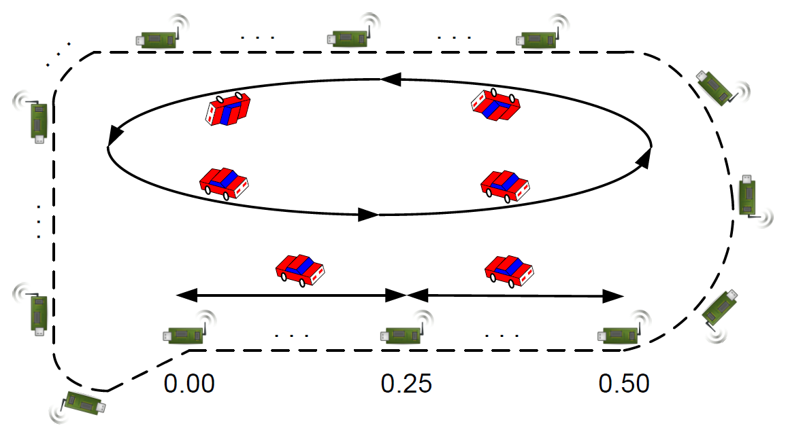
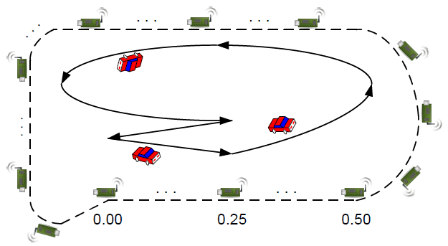
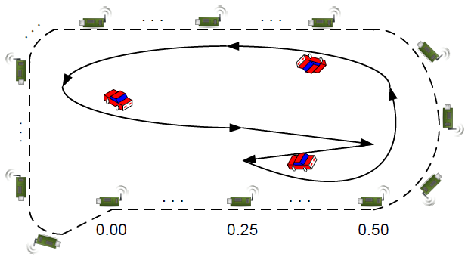
Possible Solutions
Assigning cars for sensors with f>1 (a) fixed and (b) moving
Combining odd and even car circulations (c)
(a)
(b)
(c)

Slide 14
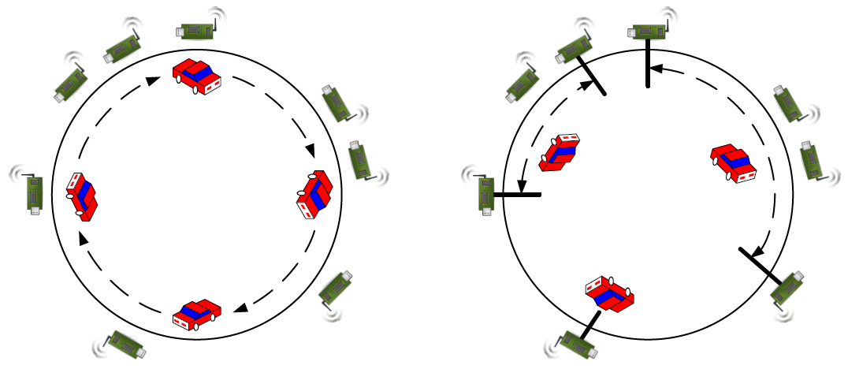
Optimal Solution (uniform frequency)
M₁: There are C₁ MCs moving continuously around the circle
M₂: There are C₂ MCs moving inside the fixed interval of length ½ so that all sensors are covered
Combined method: It is either M₁ or M_{2,} so C = min {C₁, C₂}

Slide 15
Properties
Theorem 1: The combined method is optimal in terms of the minimum number of MCs used
Scheduling
Find an appropriate breakpoint to convert a circle to a line; M₂ in the optimal solution is then followed
A linear solution is used to determine the breakpoint

Slide 16
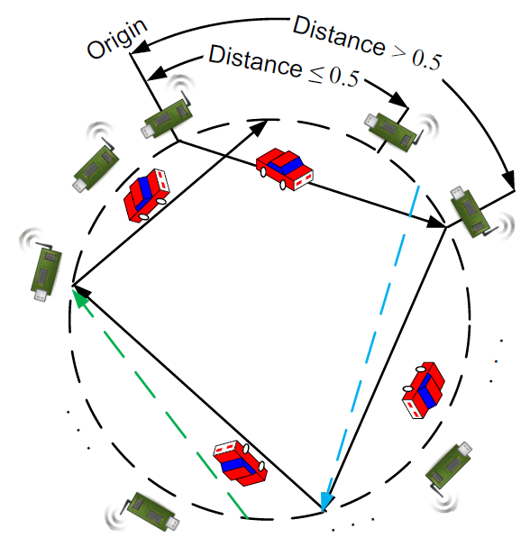
Linear Solution
Directed Interval Graph
Each directed link points from the start to the end of an interval (i.e., the first sensor beyond distance 0.5)
The number of intervals in two
solutions differ by one
Each sensor has one outgoing and
multiple incoming links
The process stops when a path
with fewer or more intervals is
found or all sensors (with their outgoing links) are examined

Slide 17
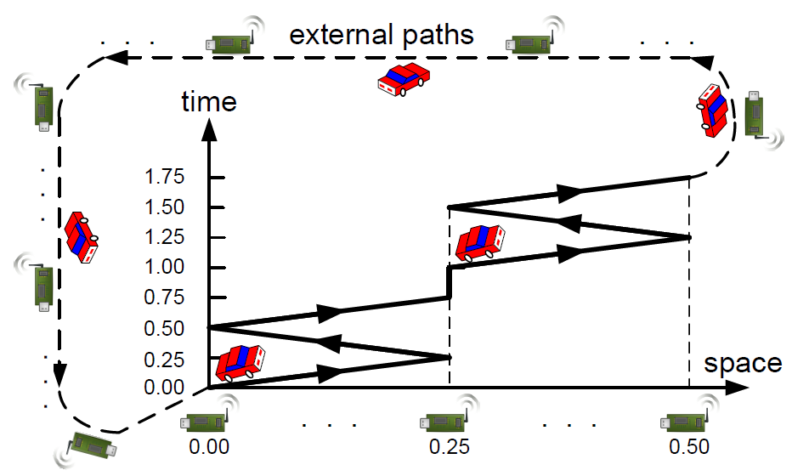
Solution to the Toy Example
5 cars only, including a stop at 0.25 for 15 seconds
Challenges: time-space scheduling, plus speed selection

Slide 18
Greedy Solution (non-uniform frequency)
Coverage of sensors with non-uniform frequencies
serve(x₁,...,x_{n}; f₁,...,f_{n}):
When n ≠ 0, generate an MC that goes back and forth as
far as possible at full speed (covering x₁, …, x_{i-1});
serve(x_{i},...,x_{n}; f_{i},...,f_{n})
Theorem 2: The greedy solution is within a factor of 2 of the optimal solution

Slide 19




The Ant Problem: An Inspiration
Ant Problem, Comm. of ACM, March 2013
Ant Alice and her friends always march at 1 cm/sec in whichever direction they are facing, and reverse directions when they collide
Alice stays in the middle of 25 ants on a 1 meter-long stick
How long must we wait before we are sure Alice has fallen off the stick?
Exchange “hats” when two ants collide

Slide 20
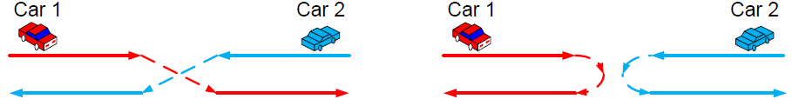
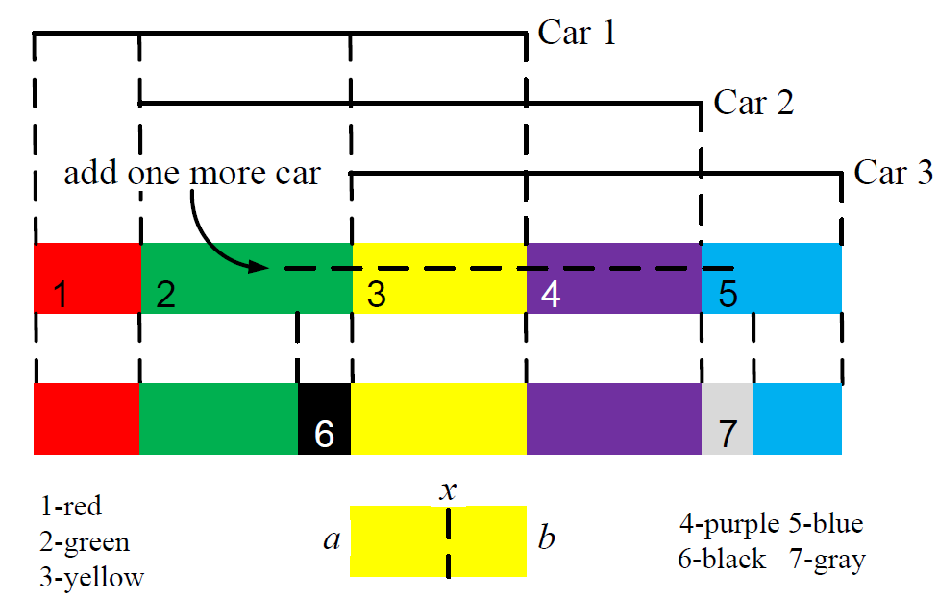
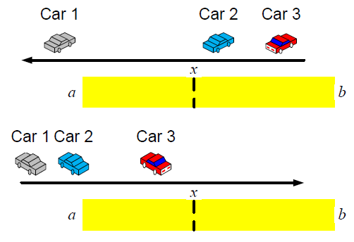
Proof of Theorem 2
Two cars never meet or pass each other
Partition the line into 2k-1 sub-regions based on different car coverage (k is the optimal number of cars)
Each sub-region can be served by one car at full speed
One extra car is used when a circle is broken to a line

Slide 21
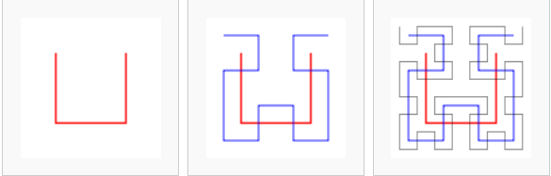
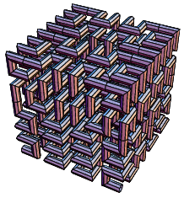
Imagination
Hilbert curve for k-D
Mapping from 2-D to 1-D for preserving locality fairly well
Charging time: converting to distance
Limited capacity: using cooperative charging
BS to MC
MC to MC

Slide 22
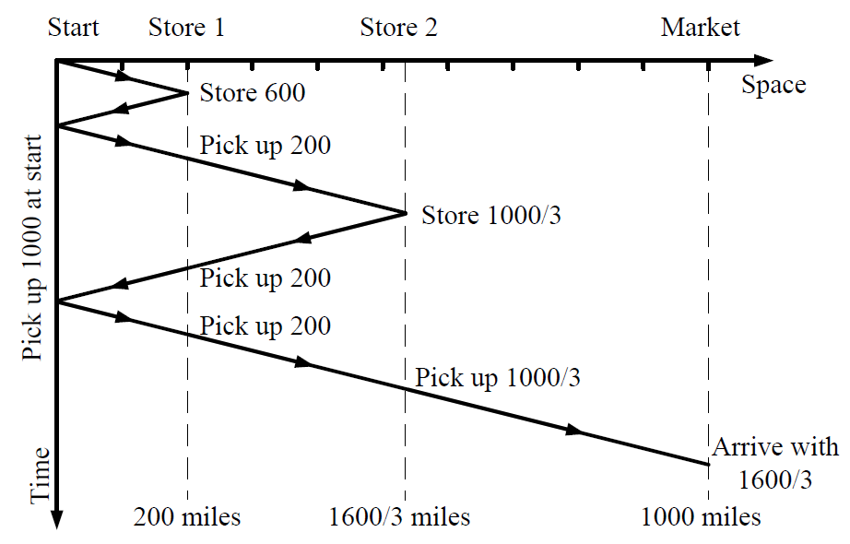
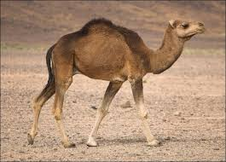
Bananas and a Hungry Camel
A farmer grows 3,000 bananas to sell at market 1,000 miles away. He can get there only by means of a camel. This camel can carry a maximum of 1,000 bananas at a time, but needs to eat a banana to refuel for every mile that he walks
What is the maximum number
of bananas that the farmer
can get to market?

Slide 23
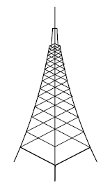
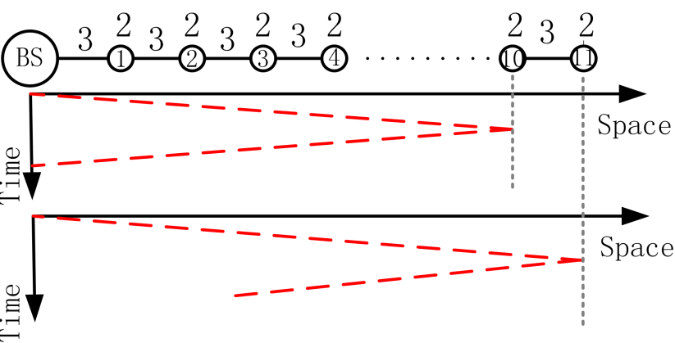
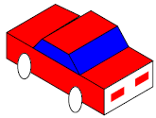
Charging a Line (with limited capacity)
Charge battery capacity: 80J; charger cost: 3J per unit traveling distance; sensor battery capacity: 2J
One MC cannot charge more than 10 sensors
Even a dedicated MC cannot charge the 14th sensor, since
14 * 3 + 2 + 14 * 3 = 86 > 80

Slide 24
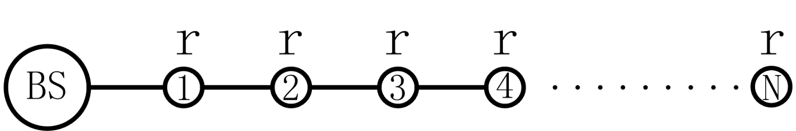
Problem Description
Problem 2 (IEEE MASS’12): Given k MCs with limited capacity, determine the furthest sensor they can recharge while still being able to go back to the BS
WSN
N sensors, unit distance apart, along a line
Battery capacity for each sensor : b
Energy consumption rate for each sensor: r
MC
Battery capacity: B
Energy consumption rate due to travelling: c

Slide 25
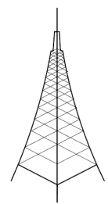
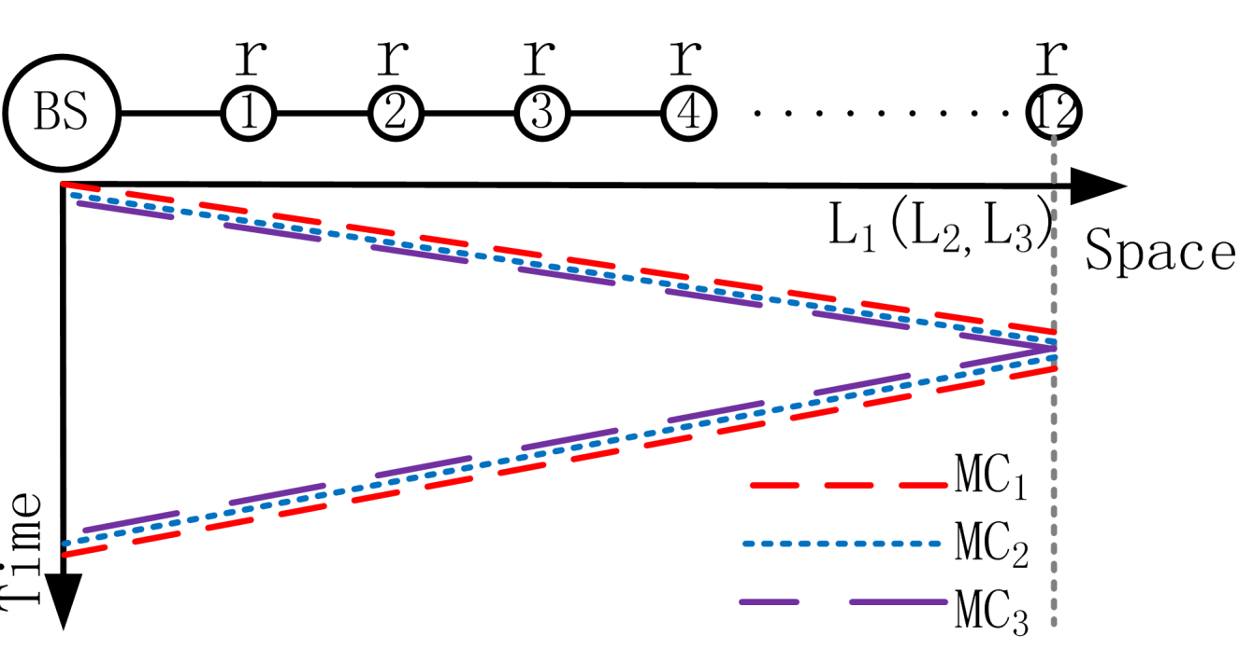
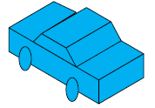
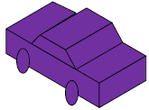
Motivation Example (1)
B=80J, b=2J, c=3J/m, K=3 MCs
Scheme I: (equal-charge) each MC charges a sensor b/M J
Conclusion: covers 12 sensors, and max distance is < B/2c
(as each MC needs a round-trip traveling cost)

Slide 26
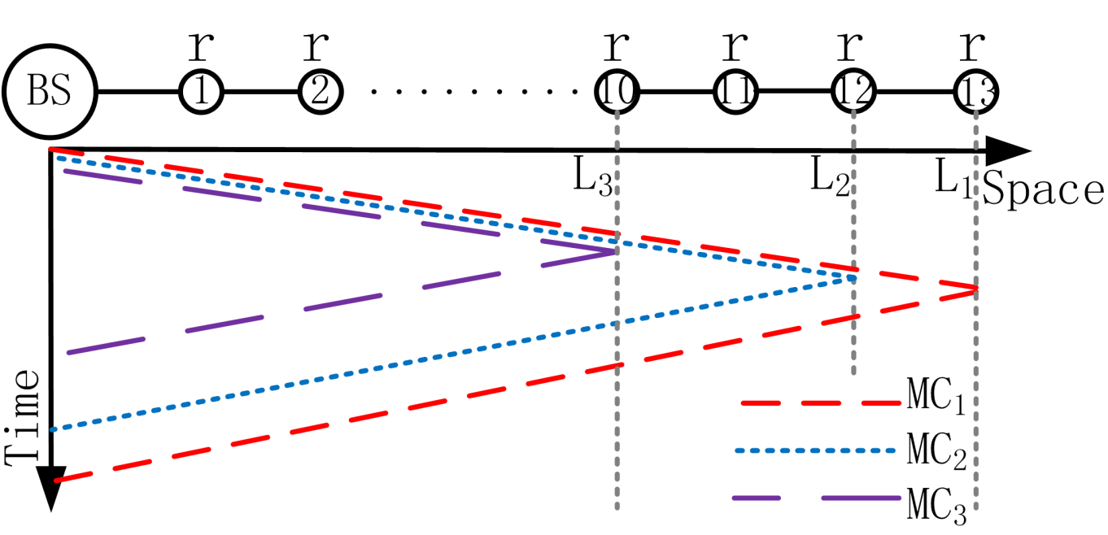
Motivational Example (2)
B=80J, b=2J, c=3J/m, K=3 MCs
Scheme II: (one-to-one) each sensor is charged by one MC
Conclusion: covers 13 sensors, and max distance is still < B/2c
(as the last MC still needs a round-trip traveling cost)

Slide 27
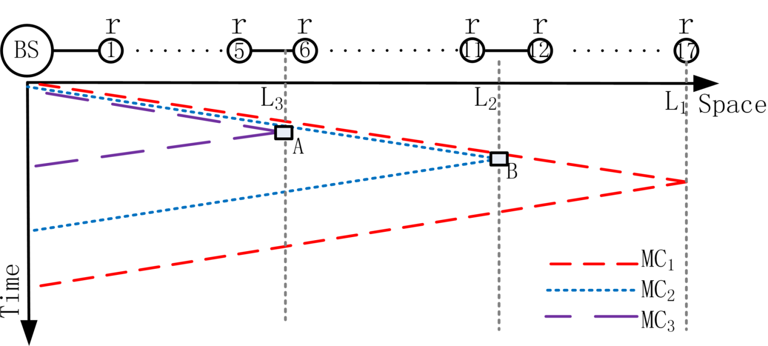
Motivational Example (3)
B = 80J, b=2J, c=3J/m, K=3 MCs
Scheme III: (collaborative-one-to-one-charge) same as Scheme II, except each MC transfers some energy to other MCs at rendezvous points (A and B in the example)
Conclusion: covers 17 sensors, and max distance is < B/c
(Last MC still needs a return trip without any charge)

Slide 28
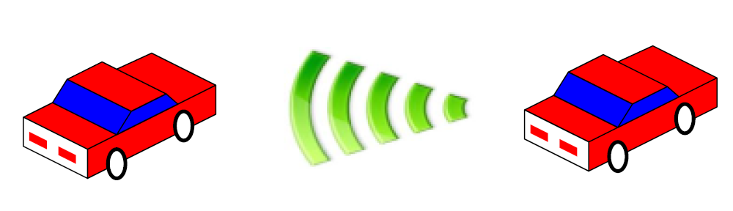
Details on Scheme III
MC_{i} charges battery to all sensors between L_{i+1} and L_{i}
MC_{i} (1 ≤ i ≤ K) transfers energy to MC_{i-1,} MC_{i-2, …} MC₁ to their full capacity at L_{i}
Each MC_{i} has just enough energy to return to the BS

Slide 29
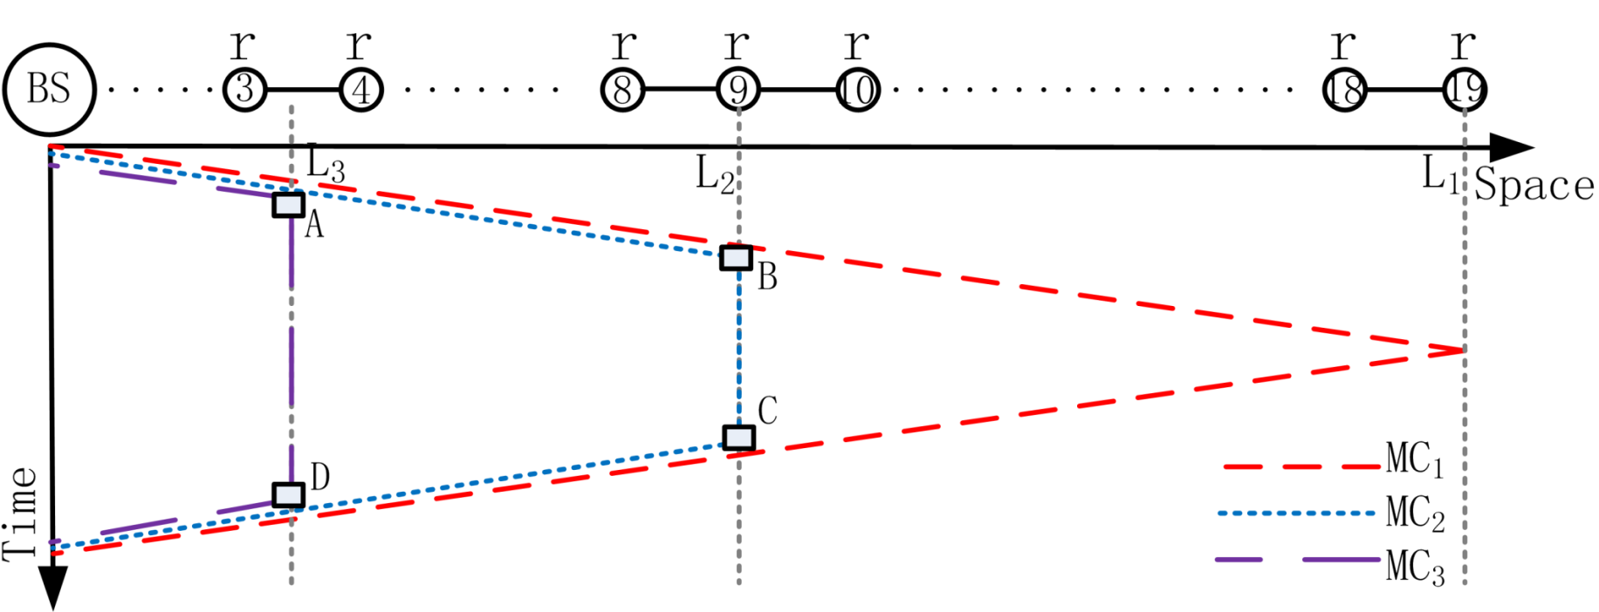
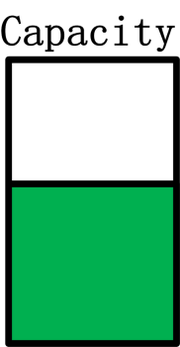
Motivational Example (4): GlobalCoverage
B = 80J, b=2J, c=3J/m, K=3 MCs
“Push”: limit as few chargers as possible to go forward
“Wait”: efficient use of battery “room” through two charges
Conclusion: covers 19 sensors, and max distance is ∞

Slide 30
Details on GlobalCoverage
MC_{i} charges battery to all sensors between L_{i+1} and L_{i}
MC_{i} (1 ≤ i ≤ K) transfers energy to MC_{i-1}, … MC₁ to their full capacity at L_{i}
MC_{i} waits at L_{i}, while all other MCs keep moving forward
After MC_{i}, MC_{i-1,} … MC₁ return to L_{i}, MC_{i} evenly balances energy among them (including itself)
Each Mc_{i,} MC_{i-1,} … MC₁ has just enough energy to return to L_{i+1}

Slide 31
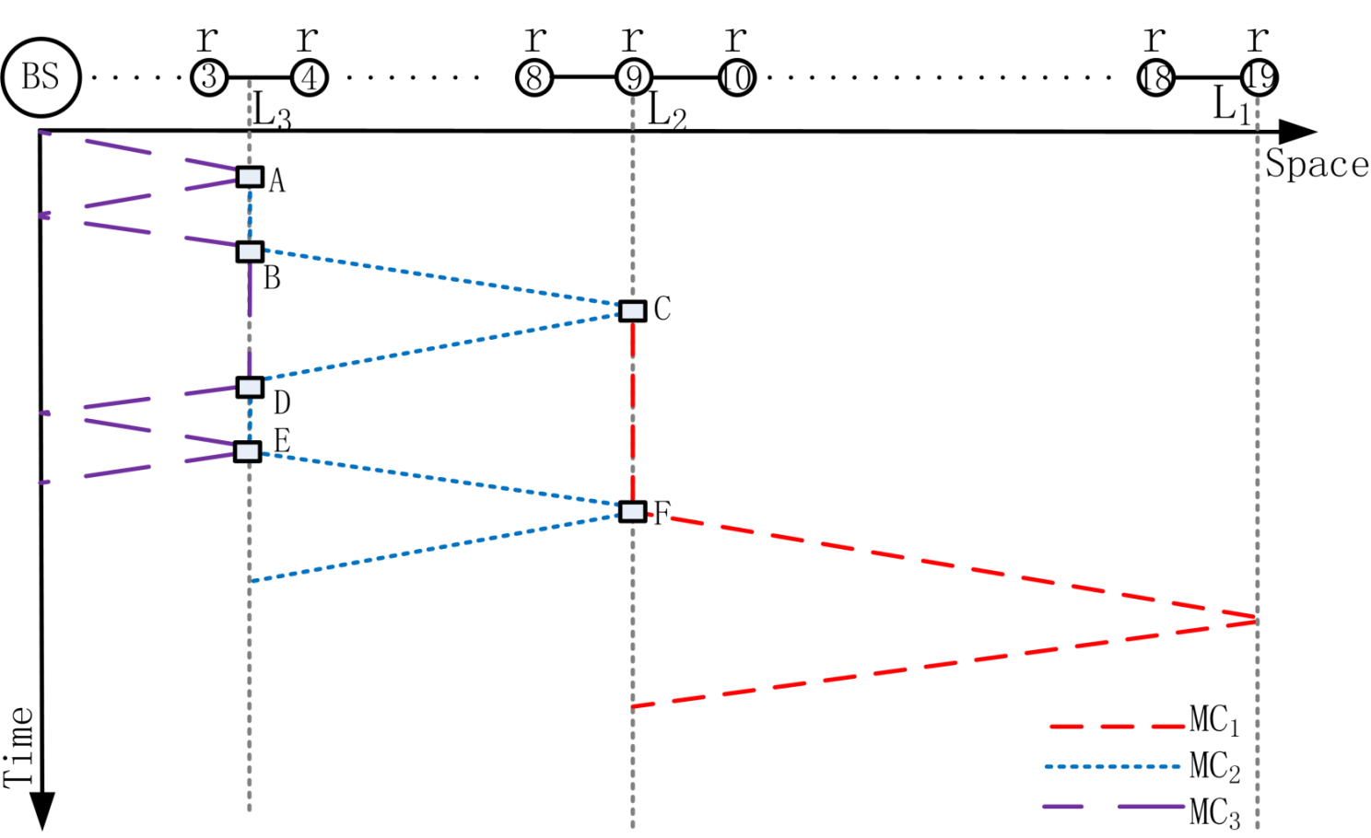
LocalCoverage
Each MC moves and charges (is charged) between two adjacent rendezvous points
Imagination: MC_{i} of LocalCoverage “simulates” MC_{i}, MC_{i-1}, …, MC₁ of GlobalCoverage

Slide 32
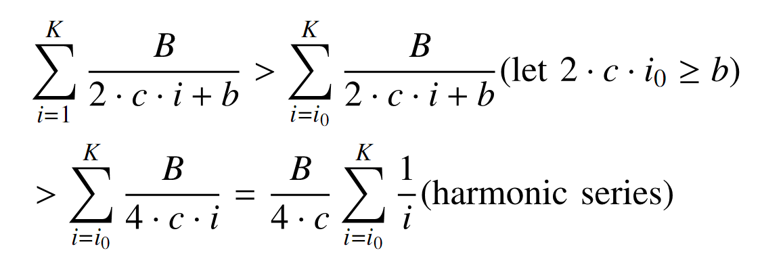
Properties
Theorem 3 (Optimality): GlobalCoverage has the maximum ratio of payload energy to overhead energy
Theorem 4 (Infinite Coverage): GlobalCoverage can cover an infinite line
Summation of segment length (L_{i} – L_{i+1})

Slide 33
Imagination: extensions
Simple extensions (while keeping optimality)
Non-uniform distance between adjacent sensors
Same algorithm
Smaller recharge cycle (than MC round-trip time)
Pipeline extension
Complex extensions
Non-uniform frequency for recharging
Two- or higher-dimensional space

Slide 34
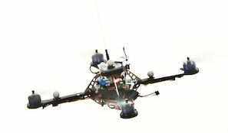
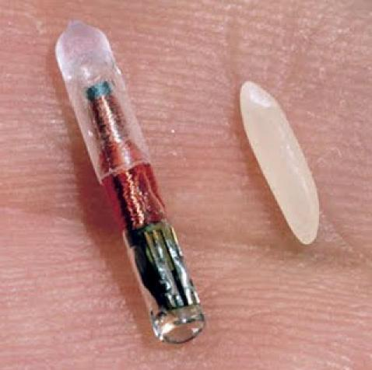
Imagination: applications
Robotics
Flying robots
WSNs
Sensor repairs with spares
Passive RFID
Energy transfer through readers

Slide 35
6. Conclusions
Wireless energy transfer
Collaborative mobile charging & coverage:
Unlimited capacity vs. limited capacity (with BS)
Charging type: BS-to-MC, MC-to-MC, and MC-to-Sensor
Other extensions
Charging efficiency, MCs as mobile sinks for BS…
Simplicity + Elegance + Imagination = Beauty

Slide 36

Acknowledgements
Richard Beigel
Sheng Zhang
Huanyang Zheng

