Slide 1


MobiQuitous 2013
Focus and Shoot: Efficient Identification over
RFID Tags in the Specified Area
Yafeng Yin¹, Lei Xie¹, Jie Wu², Athanasios V. Vasilakos³, Sanglu Lu¹
¹State Key Laboratory for Novel Software Technology, Nanjing University, China
²Department of Computer and Information Sciences, Temple University, USA
³University of Western Macedonia, Greece

Slide 2
Outline
1
Motivation and Problem
2
Observations
3
Baseline Solutions
4
Our Solutions
5
Evaluation and Conclusion
1

Slide 3




Scenario
Warehouse Management
Sampling Inspection
In these kinds of applications, in order to have a good knowledge of the tags in the specified area, we need to identify as many tags as possible in the area efficiently.
→ How to efficiently identify the tags in the specified area ?
Motivation and Problem
Observations
Baseline Solutions
Our Solutions
Evaluation and Conclusion
2

Slide 4
System Model
Tag Identification;
Specified area;
Realistic environments;
target tags
interference tags
→ Efficient tag identification in the specified area in the realistic environments.
Motivation and Problem
Observations
Baseline Solutions
Our Solutions
Evaluation and Conclusion
3

Slide 5
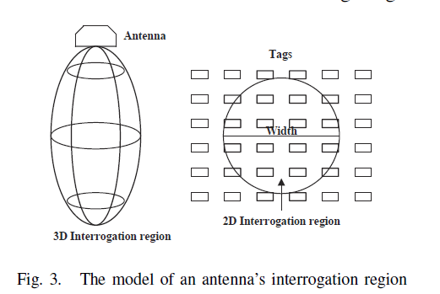
System Model
Antenna is rotatable.
Power is adjustable.
Motivation and Problem
Observations
Baseline Solutions
Our Solutions
Evaluation and Conclusion
4

Slide 6
Problem Description
Number of target tags in the specified area: m
Number of identified interference tags: u
Number of identified target tags: s
Efficient tag Identification in the specified area:
→ 1) Constraint: Coverage ratio, ≥ α
Identify as many target tags as possible while minimize the execution time.
2) Objective: Minimize execution time T
Misreading ratio: , which is related to T.
Motivation and Problem
Observations
Baseline Solutions
Our Solutions
Evaluation and Conclusion
5

Slide 7
Challenge
Realistic environments:
Interference;
Energy absorption;
Multipath effect…
target tags
interference tags
(1) Make the antenna face towards the specified area;
How to efficiently focus on the specified area ?
(2) How to find the boundary of the area?
(3) How to select the optimal power ?
Motivation and Problem
Observations
Baseline Solutions
Our Solutions
Evaluation and Conclusion
6

Slide 8
Observations from the realistic environments
Angle between the antenna and the tag
→1) As the angle between the radiation direction and the surface of the antenna decrease,
the reading performance decreases.
2) When a tag is located in the center of the interrogation region, the reader often has a
good reading performance, no matter how the tag is placed.
Motivation and Problem
Observations
Baseline Solutions
Our Solutions
Evaluation and Conclusion
7

Slide 9
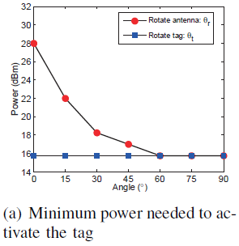
Observations from the realistic environments
Angle between the antenna and the tag
→1) As the angle between the radiation direction and the surface of the antenna decrease,
the reading performance decreases.
2) When a tag is located in the center of the interrogation region, the reader often has a
good reading performance, no matter how the tag is placed.
Motivation and Problem
Observations
Baseline Solutions
Our Solutions
Evaluation and Conclusion
8

Slide 10
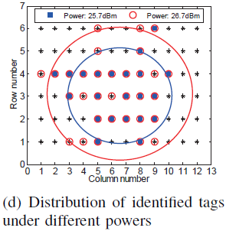
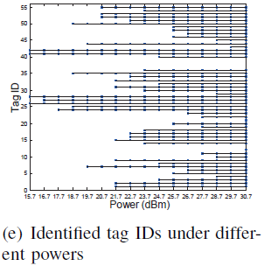
Observations from the realistic environments
Reader's Power
→1) The larger the reader’s power, the larger the interrogation region.
2) As the power increases, the new identified tags may not be located in the boundary.
3) If a tag can be identified with a low power, it must be identified with a larger power.
Motivation and Problem
Observations
Baseline Solutions
Our Solutions
Evaluation and Conclusion
9

Slide 11
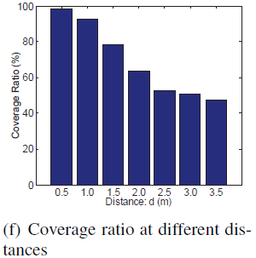
Observations from the realistic environments
Distance between the tags and the antenna
→1) As the distance of the tags and the antenna increases, the reading performance decreases.
2) When the distance and the tags are fixed, the maximum converge ratio has an upper bound.
Motivation and Problem
Observations
Baseline Solutions
Our Solutions
Evaluation and Conclusion
10

Slide 12
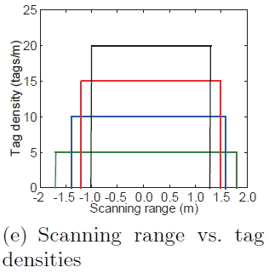
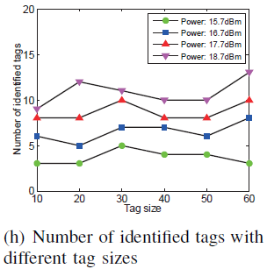
Observations from the realistic environments
Effect of Tag Size
→1) The tag size can affect the effective interrogation region.
2) The tag size has little effect on the number of identified tags.
Motivation and Problem
Observations
Baseline Solutions
Our Solutions
Evaluation and Conclusion
11

Slide 13
Indication from the realistic environments
When the distance between the tags and the antenna is fixed, the distribution of tags is fixed, the converge ratio has an upper bound (Depend on the realistic Environments).
If we want to improve the reading performance, we should make the objects be located in the center of the interrogation region.
Since the tag size has little effect on the number of identified tag, we can find the boundary of the specified area by identifying some tags around the area.
When we need to focus on a specified area, we need to select an optimal power.
Motivation and Problem
Observations
Baseline Solutions
Our Solutions
Evaluation and Conclusion
12

Slide 14
Baseline Solutions
Identification with Maximum Power
In order to identify as many target tags as possible:
The solution uses the maximum power to identify the tags.
Identification with the maximum power.
Weakness:
1) More misreading ratio;
2) More execution time.
The effective interrogation region is too large.
Motivation and Problem
Observations
Baseline Solutions
Our Solutions
Evaluation and Conclusion
13

Slide 15
Baseline Solutions
Identification with Minimum Power
In order to only focus on the specified area (not identify the interference tags):
The solution uses the minimum power to identify the tags.
Identification with the minimum power.
→ It needs to rotate the antenna to scan all the target tags.
Weakness:
1) Multiple scans;
2) Low converge ratio;
3) More execution time
How to make the interrogation region just enough to cover the area ?
The effective interrogation region is too small.
Motivation and Problem
Observations
Baseline Solutions
Our Solutions
Evaluation and Conclusion
14

Slide 16
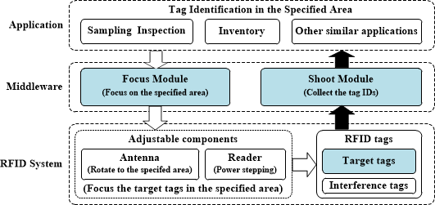
Photography based tag Identification with Distance measurement (PID)
The process of PID can be compared to the picture-taking process in a camera.
—— 1) Focusing Process: focus on the specified area (area A) with a 3D camera;
—— 2) Shooting Process: collect the tag IDs in the interrogation region.
Motivation and Problem
Observations
Baseline Solutions
Our Solutions
Evaluation and Conclusion
15

Slide 17
Photography based tag Identification with Distance measurement (PID)
The process of PID can be compared to the picture-taking process in a camera.
—— 1) Focusing Process: focus on the specified area (area A) with a 3D camera;
—— 2) Shooting Process: collect the tag IDs in the interrogation region.
Focusing Process
The distance between the tags and the antenna is fixed.
The distribution of tags is unknown.
→ We can only adjust the antenna’s angle and the reader’s power.
1) The antenna rotates towards the center of the specified area A with a 3D camera;
2) The reader adjusts the power to make its scanning range just enough to cover the area A：
—— Establishing the boundary;
—— Power Stepping;
Motivation and Problem
Observations
Baseline Solutions
Our Solutions
Evaluation and Conclusion
16

Slide 18
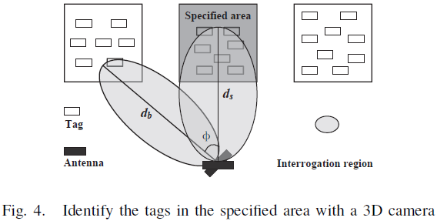


Photography based tag Identification with Distance measurement (PID)
Focusing Process
1) Establishing the boundary:
Although the specified area A is appointed by a 3D camera, the reader can hardly find
the boundary of the area.
→ Outline the specified area.
1) Identify a part of interference tags in the boundary:
2) Use these tags as reference tags of the boundary.
Minimum interval
, represents the number of tags that should be steadily identified, in order to describe the boundary.
Motivation and Problem
Observations
Baseline Solutions
Our Solutions
Evaluation and Conclusion
17

Slide 19


Photography based tag Identification with Distance measurement (PID)
Focusing Process
2) Power Stepping:
Adjust the reader’s power to make its scanning range be just enough to cover the area A.
→ Find optimal power to just enough cover the area A.
1) Choose the minimum active power ;
2) Update reader’s power:
3) Identify tags in the boundary:
—— When , optimal power
, is related to the realistic environments,
while can be derived from the value coverage ratio.
Motivation and Problem
Observations
Baseline Solutions
Our Solutions
Evaluation and Conclusion
18

Slide 20

Photography based tag Identification with Distance measurement (PID)
Shooting Process
ID₁, ID₂, ID₃, …, ID_{n}
ID_{i}
Request message
We do not modify any parameter of the commercial reader (Alien-9900+), which conforms
to EPC C1G2 Standard.
Objective: Collecting the tag IDs in the interrogation region.
Approach: —— Identifying one tag ID in each slot.
—— Only no tags respond to reader, the process terminates, which means
each tag has transmitted its tag ID to the reader.
Motivation and Problem
Observations
Baseline Solutions
Our Solutions
Evaluation and Conclusion
19

Slide 21
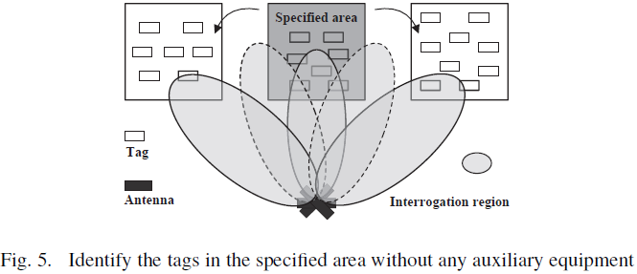




Photography based tag Identification with Angle rotation (PIA)
Identify the target tags without any auxiliary equipment.
Focusing Process
1) Exploring the boundary:
Rotate the antenna to explore the boundary of the specified area.
→ Outline the specified area.
1) Identify a part of target tags:
2) Identify some interference tags N_{l} (N_{r}) of the boundary by rotating ( ) to left (right);
3) Use the tags identified with smaller angle as the reference tags of the boundary.
Smaller angle
and .
The remaining process is the same as that in PID.
Motivation and Problem
Observations
Baseline Solutions
Our Solutions
Evaluation and Conclusion
20

Slide 22
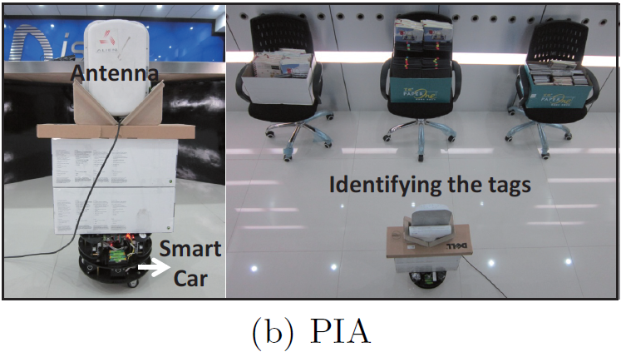
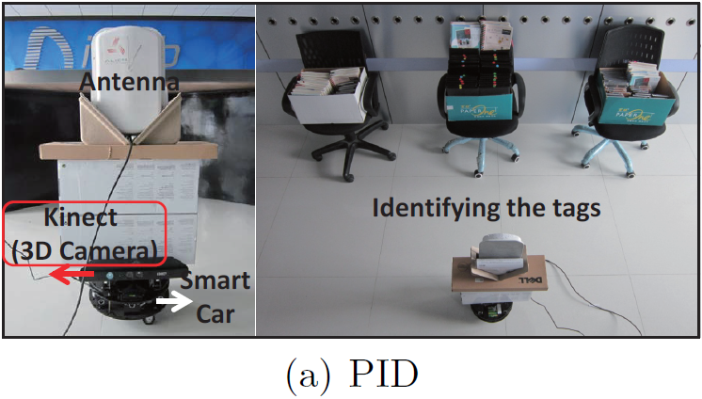
Performance Evaluation
System Prototypes
Minimum Interval: l
Minimum Interval: l
d
d
The center box is the specified area.
The number of target tags in the specified area is s.
The number of interference tags out of the specified area is u.
We get α=60% and based on the realistic environments. We vary s, u, d, l to
evaluate the performance of each solution.
Performance Metrics: Execution time, coverage ratio, misreading ratio.
Motivation and Problem
Observations
Baseline Solutions
Our Solutions
Evaluation and Conclusion
21

Slide 23
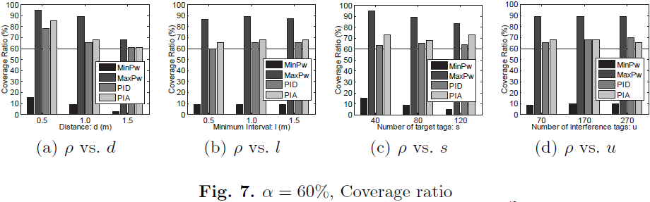
Performance Evaluation
We set d=1m, l=1m, s=80, u=70 by default.
Coverage Ratio
PID, PIA, and MaxPw can satisfy the requirement of coverage ratio.
MinPw can not satisfy the requirement because of its power is too small.
→ We ignore MinPw in the following comparisons.
Motivation and Problem
Observations
Baseline Solutions
Our Solutions
Evaluation and Conclusion
22

Slide 24
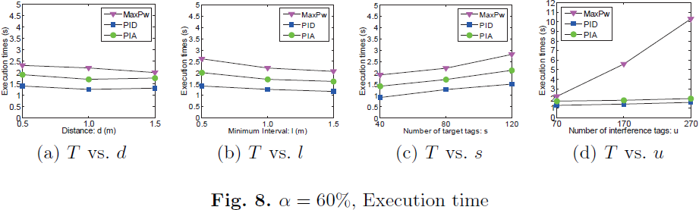
Performance Evaluation
We set d=1m, l=1m, s=80, u=70 by default.
Execution Time
PID and PIA have better performances than MaxPw.
When s=120, PID can reduce T by 46% compared to MaxPw.
When u=270, PID can reduce T by 84.5% compared to MaxPw.
Motivation and Problem
Observations
Baseline Solutions
Our Solutions
Evaluation and Conclusion
23

Slide 25
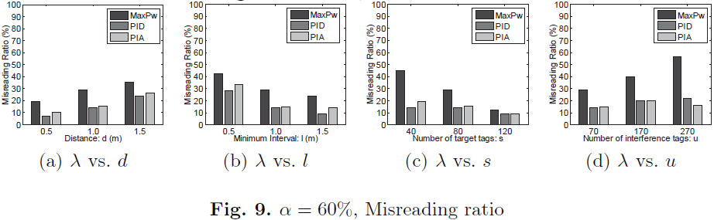
Performance Evaluation
We set d=1m, l=1m, s=80, u=70 by default.
Misreading Ratio
PID and PIA have lower misreading ratios that MaxPw, because PID and PIA only focus
on the specified area and use the optimal power.
Motivation and Problem
Observations
Baseline Solutions
Our Solutions
Evaluation and Conclusion
24

Slide 26
Conclusion
—— We investigate the problem of tag identification in the specified area.
—— We conduct extensive experiments on the commodity RFID systems.
—— We propose the photography based identification method, which works in a similar way of picture-taking in a camera.
Based on the picture-taking scheme, we propose two solutions PID and PIA.
1) PID works with a 3D camera;
2) PIA works without any auxiliary equipment.
—— Realistic environments show that our solutions outperform the baseline solutions.
Motivation and Problem
Observations
Baseline Solutions
Our Solutions
Evaluation and Conclusion
25

Slide 27
MobiQuitous 2013
Questions ?
Thank you !

