Slide 1


Minimum Makespan Workload Dissemination in DTNs: Making Full Utilization of Computational Surplus Around
Sheng Zhang, Nanjing University
Jie Wu, Temple University
Sanglu Lu, Nanjing University

Slide 2



Motivations
Wireless devices around us: laptops, smartphones, …
  Intermittent and opportunistic connectivity
Most of them are idle during most of the time.
Why not utilize these computational surplus around us?

Slide 3
Advantages of Utilizing Nearby Devices
- compared with mobile cloud computing
Low cost for users
  Users do not need to pay any service fee to cloud providers for offloading computation to remote clouds.
Ad-hoc
  The approach can be used in cases where there are no infrastructure-based services, e.g., in a disaster.
Friendly to the Internet (wide-area network)
  The Internet is relieved, since, otherwise, uploading tasks and data to clouds may take up a large amount of bandwidth.

Slide 4

Problem Statement
Task
  Output is small, thus, we focus on workload disseminating phase, and do not care about output gathering phase.
  Workload is fine-grained: the total workloads can be redistributed in any ratio between two nodes in a contact.
Network
  Each node has a processing rate.
  Inter-contact time is exponentially distributed.
  We do not consider storage and bandwidth constraints.
As a starting point, we only consider a single task in an “empty” DTN.
Given a task that originates at some node in a DTN, how are we to disseminate the workload during pairwise contacts, so as to minimize the makespan?

Slide 5
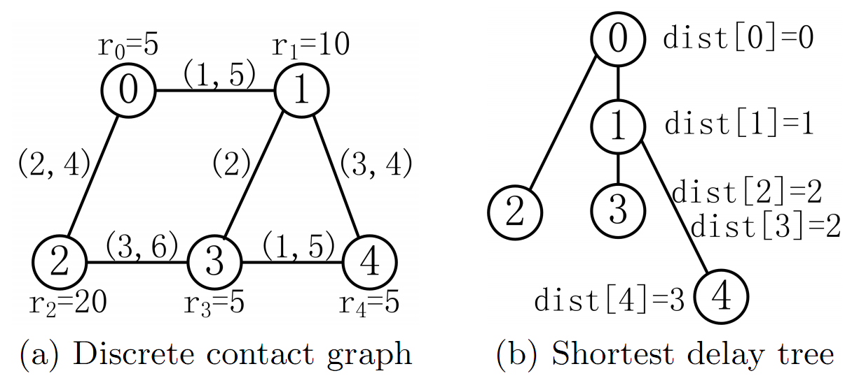
The Oracle Case with Global and Future Knowledge
When we have global and future information, we can derive the shortest communication delays from the source to all of the other nodes.
To minimize the makespan, we just have to utilize each node as soon as possible, and make sure that all participating nodes finish their respective workloads at the same time.

Slide 6
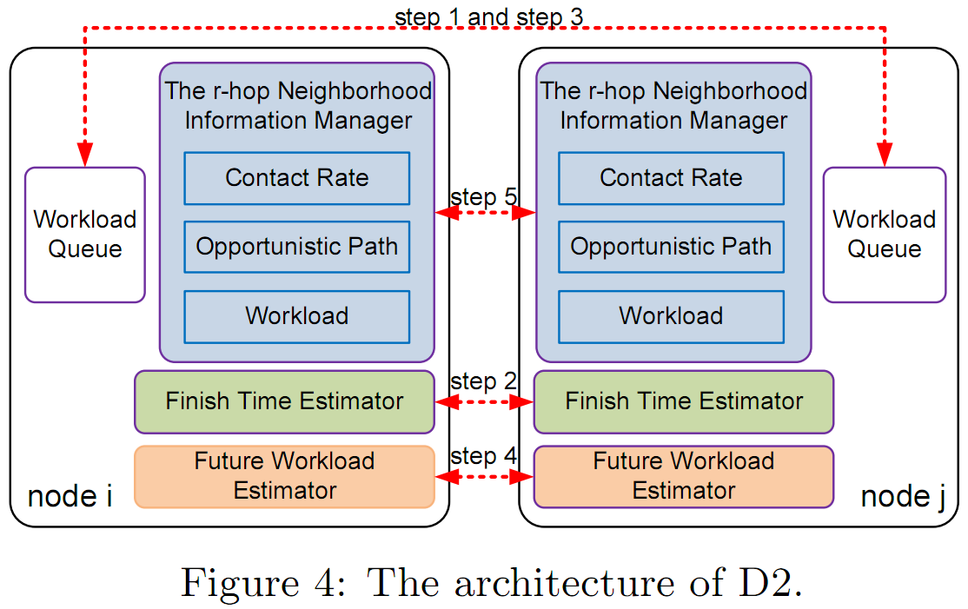
The Distributed Case
Workload queue: manages operations on actual workload.
The r-hop manager: maintains contact rate, opportunistic path, and workload of each node that is r-hop away.
Finish time estimator: estimates the expected finish time, given a workload.
Future workload estimator: estimates the expected future workload of itself
The total workloads are split between two nodes in a contact such that the expected finish time of their respective workloads are equal.

Slide 7
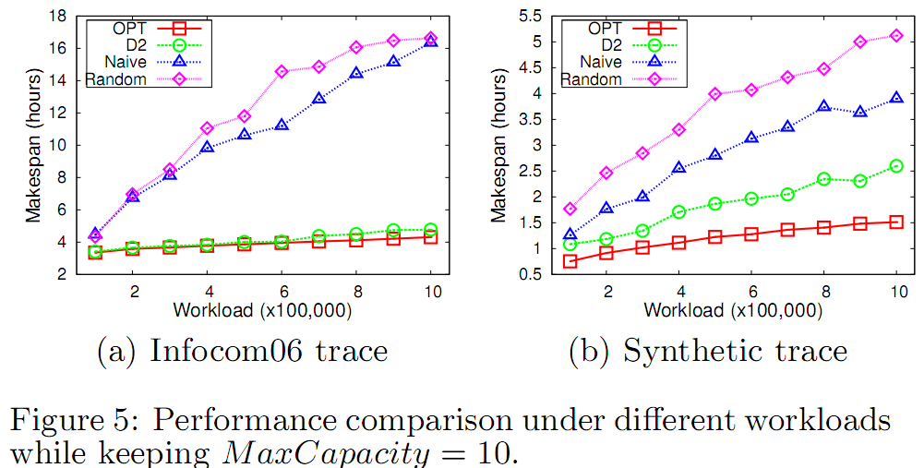
Trace-driven Simulations

Slide 8
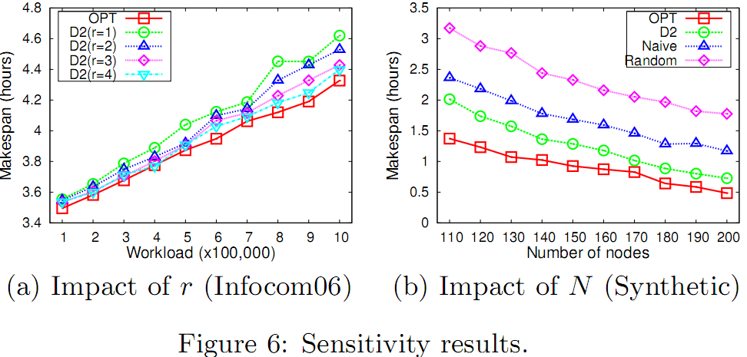
Trace-driven Simulations

Slide 9
Conclusion
In this paper, we propose making full utilization of computational surplus around us.
We design a centralized optimal algorithm, OPT, and a distributed protocol, D2, for the minimum makespan workload disseminating problem.
Future work
  Multiple simultaneous tasks
  Storage and bandwidth constraints

Slide 10
Thanks for your attention.

