Slide 1
Heterogeneous Community-based Routing in Opportunistic Mobile Social Networks
Yunsheng Wang
Kettering University
Jie Wu
Temple University
Mingjun Xiao
University of Science and Tech. of China
Daqiang Zhang
Tongji University
© 2014 Kettering University

Slide 2
Outline
Opportunistic Mobile Social Networks
Heterogeneous Community-based Routing
    Forwarding Set Selection
    Recursive 2-Hop Routing
Simulation Results
Conclusion

Slide 3



Opportunistic Mobile Social Networks
Opportunistic mobile social networks (OMSNs) are designed to operate without the supports of preset infrastructures and guaranteed network connectivity.
Notes:
In these networks, mobile nodes exploit node mobility and opportunistic contacts for communication while coping with such intermittent connectivity, which enables eventual message delivery even ifend-to-end paths never exist.

Slide 4
Challenges
Frequent disruptions and delays
Intermittent connectivity environment
Insecure communication

Slide 5
Social-aware Single-copy Routing
Social Information
  Internal Social Features
    Low Overhead to Obtain
Single-copy Scenario
  Priorities of the Social Features

Slide 6
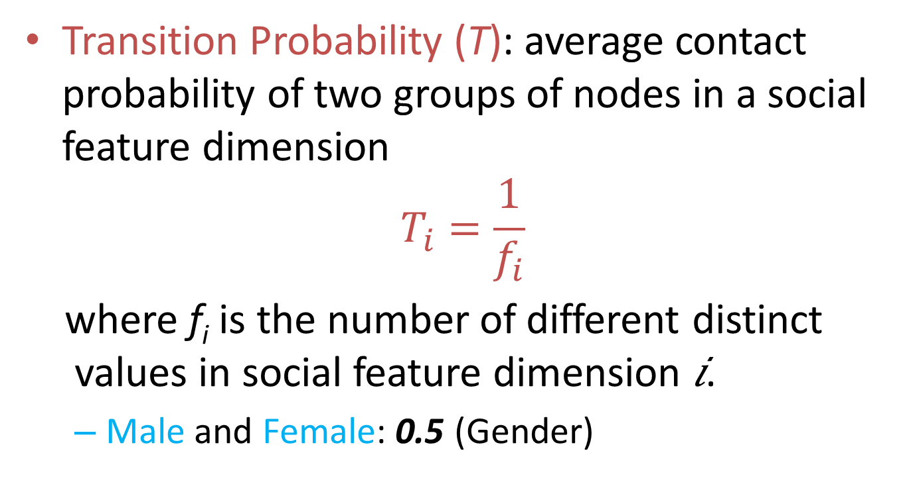
Transition Probability
Transition Probability (T): average contact probability of two groups of nodes in a social feature dimension
$$T_{i}=\frac{1}{f_{i}}$$
where f_{i} is the number of different distinct values in social feature dimension 𝑖.
  Male and Female: 0.5 (Gender)

Slide 7
Two-Hop Routing
Uses local network information.
Achieves a high delivery ratio through mobility [1].
Each message copy will be forwarded at most twice, resulting in the advantage of the bounded resource (e.g., energy and buffer) consumption.
[1] M. Grossglauser and D. Tse, “Mobility increases the capacity of ad-hoc wireless networks,” IEEE/ACM Trans. Netw., vol. 10, pp. 477–486, Aug. 2002.

Slide 8
Different Dimension Set & Forwarding Set
Different Dimension Set (D): the different social feature dimensions to the destination
Forwarding Set (F): a set of next relay dimensions that can reduce the expected delivery delay based on the transition probabilities

Slide 9
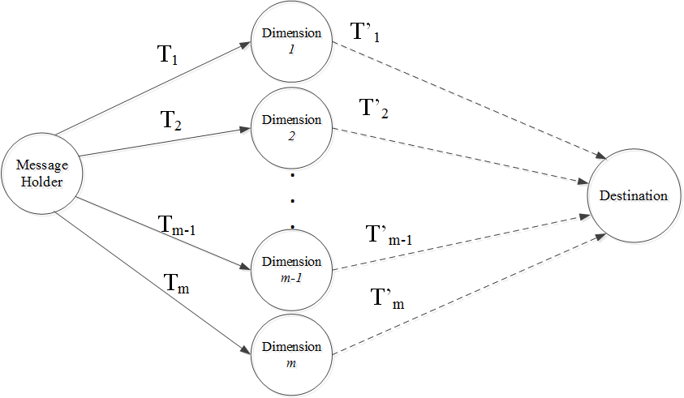
Link-state Graph

Slide 10

Link-state Graph Cont’d
The first hop from the message holder to a relay node in social feature dimension 𝑑_{𝑖}, has a transition probability 𝑇_{𝑖}.
The second hop is a virtual hop from the relay node to the final destination, which can be estimated as
where D is the dimension difference set between the message holder and the destination. (∣𝐷∣ − 1)! shows the possible combination of the sequences.

Slide 11
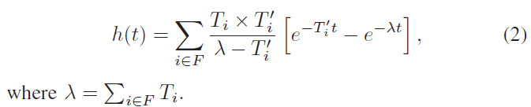

Expected Delay
The probability density function (PDF) of the message delivery delay is
The expected delay

Slide 12
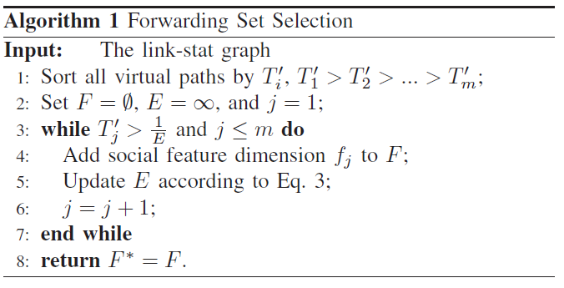
Forwarding Set Selection
The optimal forwarding set, 𝐹∗, should minimize the corresponding expected delay 𝐸.
The virtual links have a higher probability than 1/𝐸 will be selected into the forwarding set.

Slide 13
Recursive 2-Hop Routing
Opportunistic forwarding:
  The message will be forwarded to the first encountered relay node who has the same social feature in the forwarding set 𝐹.
After each step, the resolved social feature dimension will be deleted from the dimension set.
The social feature resolve process is a recursive 2-hop routing process.

Slide 14
Shortcut
If there are multiple social feature dimensions in the forwarding set, we can extend the basic scheme by shortcuts, which means that more than one social feature distance can be resolved at one step.
These social feature dimensions will be deleted from the dimension forwarding set.

Slide 15
Extension: Multi-Copy
The source node will partition the message copies to its encountered nodes.
m-D space with C copies
Each qualified relay node will receive one copy.
In order to increase the delivery efficiency, the forwarding paths of these C copies should be C node-disjoint paths from the source to the destination.

Slide 16
Node-Disjointness
The node-disjointness means that these 𝐶 paths are parallel without overlap, which can control the overhead, and at the same time, increase the efficiency.

Slide 17
Greedy Algorithm
Estimate the expected delay from source to the destination based on the transition probability.
Select the best sequence with the smallest expected delay.
Use this sequence to find C paths.

Slide 18
Coordinate Sequence
D⁰: <1,2,…,k> is defined as the coordinate sequence from a given D. (D⁰ is the best sequence).
D⁰ determines how a path is constructed based on the resolution order of dimension differences given in D.

Slide 19
Coordinate Sequence Cont’d
D^{i}: i circular left shifts of D⁰.
k node-disjoint shortest paths:
Path 1 generated by D⁰ : <1,2,…,k> ;
Path 2 generated by D¹ : <2,3,…,k,1> ;
…
Path k generated by D^{k} : <k,1,…,k-2,k-1>.

Slide 20
C best paths selection
Once we have k coordinate sequence paths, we need to select the best C paths since we only have C copies of message.
The C best paths selection process is the smallest expected delay paths selection process

Slide 21
Simulation
Infocom 2006 trace: a conference contact trace (6 social features) ;
MIT reality mining trace: a campus communication trace (6 social features) .
Synthetic trace: a 100-node network with 8 social features.

Slide 22
Comparison Schemes
Heterogeneous Community-based Routing
Random Forwarding
SimBet [2]
[2] E. M. Daly and M. Haahr. Social network analysis for routing in disconnected delay-tolerant manets. In Proc. of ACM MobiHoc, pages 32–40, 2007.

Slide 23
Comparison Parameters
Latency
Delivery Rate
Number of Forwardings

Slide 24
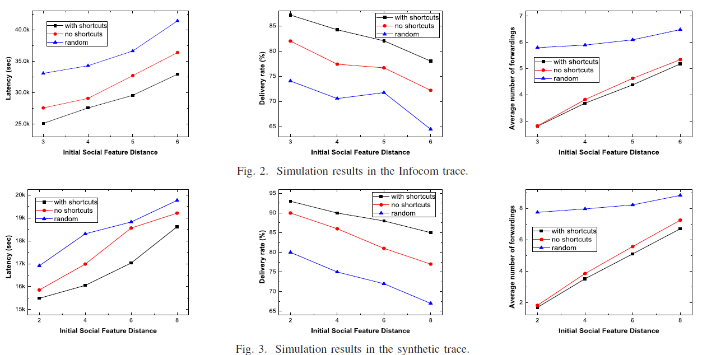
Results 1

Slide 25
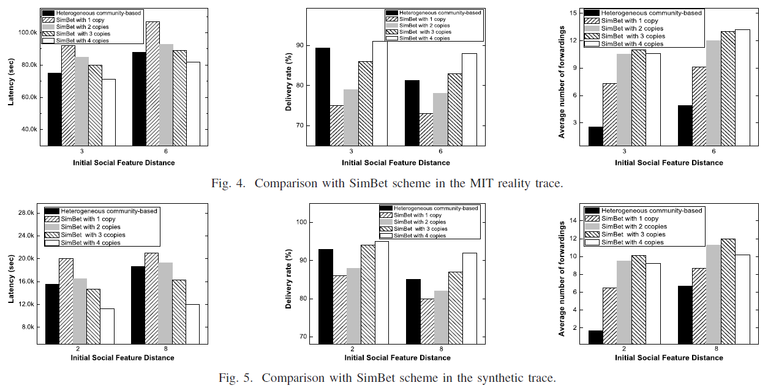
Results 2

Slide 26
Conclusion
Heterogeneous Community-based Routing
    Forwarding Set Selection
    Recursive 2-Hop Routing
Single Copy vs Multi-Copy

Slide 27
Thank You

