Slide 1
Maximum Elastic Scheduling based on the Hose Model
基于软管模型的最大弹性调度
Jie Wu (吴杰)
Temple University (天普大学)
Notes:
1

Slide 2
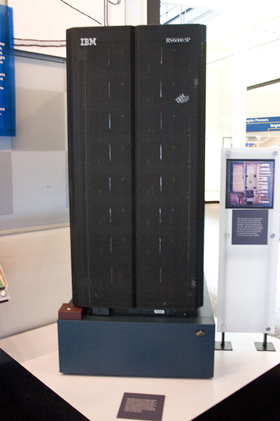
1. AI Takeoff
  Deep Blue
    1997: defeated Kasparov.
    ICPP’96 panel: F. –H. Hsu (許峰雄) talked about LB instead.
  HPC-AI convergence
    AI blackbox (黑箱子）
    However, DARPA: Explainable AI (XAI)
      Produce more explainable models
      Enable human users to understand
  Back to fundamentals
    Direct algorithmic/combinatoric solutions
    A scheduling problem related to maximum elasticity

Slide 3
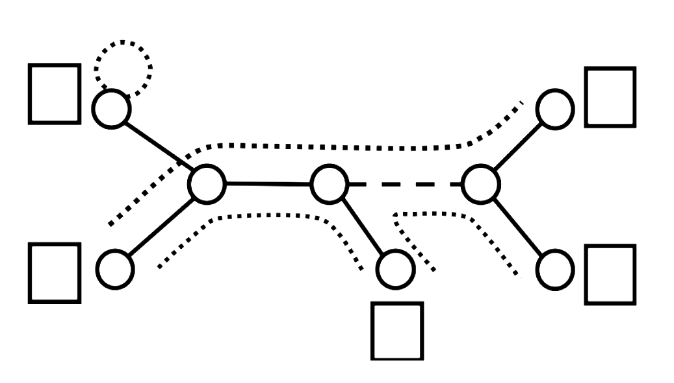
A Simple Illustration
  Given a cable connection in a graph, each household has an occupancy limit and each cable section has bandwidth limit.
  What is the maximum total occupancy that can support all possible simultaneous pairwise telephone conversations (hose model)?
  What is the schedule with the maximum elasticity (i.e., maximum uniform growth in occupancy)?
2
1
2
1
2
hose model (软管模型): statistical multiplexing

Slide 4
2. Model and Formulation
How to define elasticity?
  Maximum Admissible Load (MAL) 最大容许负载
    Provisioning MAL of VMs in PMs for hose-model-based DCNs
  Maximum Elastic Scheduling (MES) 最大弹性调度
    A task assignment of a given load (< MAL) with potential maximum uniform growth in computation and communication

Slide 5
A Simple 2-Level Tree
On DCN (数据中心网络), DCN cloud, or Internet cloud
G = (V, E), V: server (服务器) or switch (交换器), E: link (链路)
MAL: 3 VM +6 VM =9 VM
MES for 3: 1+2
Max. Elasticity: 200%
MAL: 2+6 =8
MES for 3: 1+2 or 0+3
Max. Elasticity: 100%
Each VM has 1B Gbps aggregate bandwidth

Slide 6
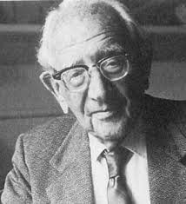
How to Solve It (Polya)
If you can’t solve a problem, then there is an easier problem you can solve: find it
Tree topology (typical DCN)
Direct solutions
Shortest path problem (最短路径)
  LP solution
  Greedy solution: Dijkstra algorithm
Maximum elastic scheduling (最大弹性调度)
  LP solution
  Greedy solution: Two-phase sweep

Slide 7
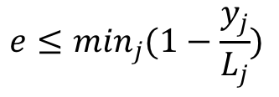
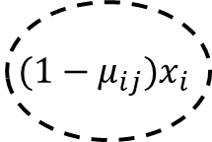


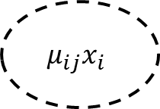


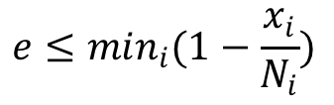
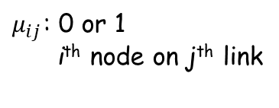




LP Solution
$$maximize$$
$$e$$
(1)
s.t.
$$e≤\min_{i}(1−\frac{x_{i}}{N_{i}})$$
and
$$x_{i}≤N_{i}$$
for
$$∀i$$
(2)
$$e≤\min_{j}(1−\frac{y_{j}}{L_{j}})$$
and
$$y_{j}≤L_{j}$$
for
$$∀j$$
(3)
$$y_{j}=min\left[\sum_{i}{μ_{ij}x_{i}},\sum_{i}{(1−μ_{ij})}x_{i}\right]$$
for
$$∀j$$
(4)
  Eq. (1): objective function
  Eq. (2) and Eq. (3): constraints on nodes (N_{i}) and links (L_{j})
  Eq. (4):
$$μ_{ij}x_{i}$$
$${(1−μ}_{ij})x_{i}$$
$μ_{ij}$: 0 or 1
i^{th} node on j^{th} link
$$y_{j}$$

Slide 8

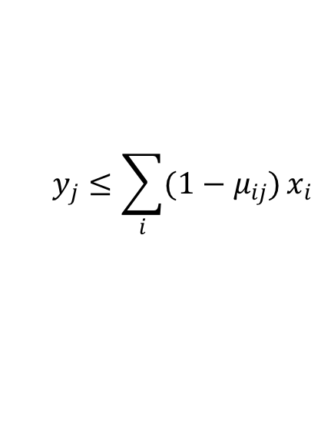




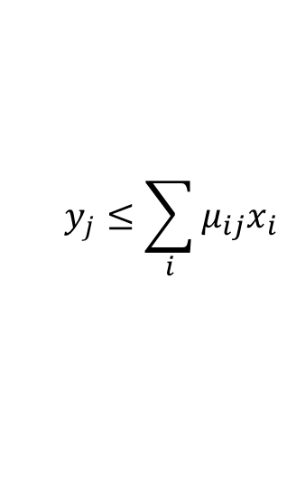
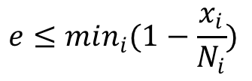



LP Solution (cont’d)
$$maximize$$
$$e$$
(5)
s.t.
$$e≤\min_{i}(1−\frac{x_{i}}{N_{i}})$$
and
$$x_{i}≤N_{i}$$
for
$$∀i$$
(6)
$$e≤\min_{j}(1−\frac{y_{j}}{L_{j}})$$
and
$$y_{j}≤L_{j}$$
for
$$∀j$$
(7)
$$y_{j}≤\sum_{i}{μ_{ij}x_{i}}$$
$$y_{j}≤\sum_{i}{(1−μ_{ij})}x_{i}$$
and
for
$$∀j$$
(8)
Variables: 3n−1
  n: # of leaf nodes
  2n-2: # of links
  1: objective function e
Inefficiency: Simplex or Eclipse
Constraints: 10n−8
  Eq. (6): 2n
  Eq. (7): 4n − 4
  Eq. (8): 4n − 4

Slide 9








3. Two-Phase Sweep Solutions
Up phase: Cal. MAL of a 2-level subtree
MAL
v₁
11
6
16
$$min\left\{N_{l},L_{l}\right\}+min\left\{N_{r},L_{r}\right\}$$
v₂
v₃
4
7
2
5
10+6
$$L_{l}$$
$$L_{r}$$
5
6
6
4
11
6
$$N_{l}$$
$$N_{r}$$
v₄
v₅
v₆
v₇
10
6
Down phase: Given a load $N($<MAL) at root
v₁
11
6
8
v₂
Left
$$min\left\{N_{l},L_{l}\right\}/N$$
v₃
4
7
2
5
Right
$$min\left\{N_{r},L_{r}\right\}/N$$
5
6
6
4
10
6
5
3
v₄
v₅
v₆
v₇

Slide 10
Why Simple Solution May Fail?
v₁
14
A simple solution
6
MAL
11->8
v₂
v₃
4
7
2
5
5
6
6
4
8
6
v₄
v₅
v₆
v₇
10
6
However
v₁
How to find the OPT Solution?
8
6
v₂
v₃
4
7
2
5
8
6
16
>
14
5
6
6
4
10
6
10+6
v₄
v₅
v₆
v₇

Slide 11
How to Calculate?
  Hose-model tree orientation
    Directed tree: Link orientation is based on the selected root.
    Find a root with the maximum summation of branch values.
root
root

Slide 12
Optimal Solution
Insights
    Apply the simple solution to different orientations.
    Select the best orientation.
  MAL at the left leaf
  MAL at the right leaf
MAL at the center

Slide 13
Distributed Implementation
At each node
v₁
16
4+6+6
8
6
v₂
v₃
4
7
2
5
5
6
6
4
4
7
min{8,6}
v₄
v₅
v₆
v₇
5
6
6

Slide 14
4. Properties and Extensions
Theorem 1: The up-phase determines the MAL.
Theorem 2: The two-phase solution generates a schedule with maximum elasticity.
Theorem 3: The two-phase solution uses 2logn+1 parallel steps. The computation complexity is 5(n−1), and the communication complexity is 4(n − 1) .

Slide 15
Extensions
  General trees
    Any k-nary trees
  Optimal simple solution
    Trees with computational-bottleneck
  Fat trees (used in DCN)
    Still work !

Slide 16
5. Performance Comparisons
  Basic setting
    Binary trees with levels: k = 4, 5, and 6
    Node capacity: 0 to 100 units
    Link bandwidth: 0 to 100 GB
    Bandwidth demand: 1 Gbps
  Comparison algorithms
    Equally Distributed Placement (EDP)
    Proportion to PM Capacities (PPMC)
    Proportion to Physical Link Capacities (PPLC)
    Proportion to PM and Channel Capacities (PPCC)

Slide 17
Binary Tree Simulation
Comparison of the elasticities
Three comparison algorithms and PPCC
Capacity ratio: average link capacity / node capacity
  (a) k = 4
  (b) k = 5
  (c) k = 6

Slide 18
Fat Tree
Equal-cost multi-path routing (ECMP) with m=4 (ports)
Core Layer
10
Aggregation Layer
(Pods)
10
5
Edge Layer

Slide 19
Fat Tree Equivalence

Slide 20
Fat Tree Simulation
Settings
  m = 4, 6, 8, and 10
Node capacity
  PM: 0 to 100 slots
  VM comm. bandwidth: 1 Gpbs
Link bandwidth
  edge layer： [0, 10] Gbps
  aggregation layer：[0, 15] Gbps
  core layer： [0, 30] Gbps
m=4
m=6
m=8
m=10

Slide 21
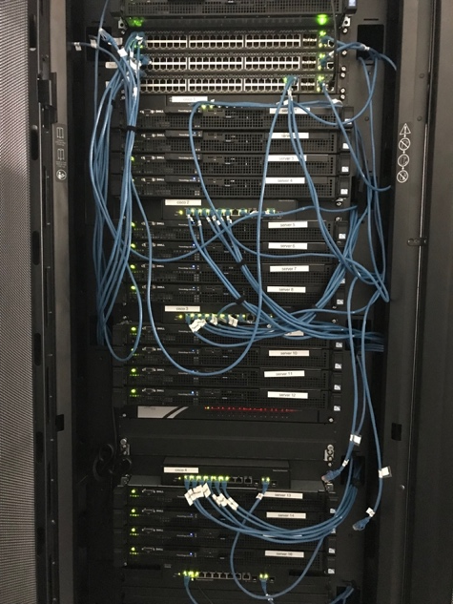
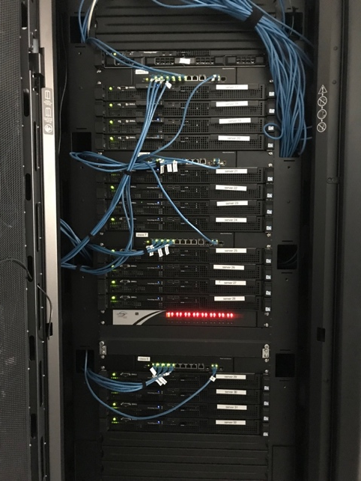
Tree Testbed
    Central server: Grnlntrn
    Cisco switch: 8-port connector
    Pica8 switch: 48 ports
    Sever: Dell Power Edge R210 (2.4 GHz CPU, 4 GB memory)
    Maximum link capacity: 1 Gbps
1
0.6
0.7
0.4
0.6
0.5
EDP
25%
25%
25%
25%
PPCC
41%
24%
19%
16%

Slide 22


Testbed Results
One-to-all comm.
Stress-test on a hose:
Map (comp.), shuffle (scatter/gather comm.), and reduce (comp.)
$≈$1.2 min
$≈$0.3 min

Slide 23

6. Conclusions
Models
  Hose model on trees
Elastic scheduling
  Maximum admissible load (MAL)
  Maximum elastic scheduling (MES)
Future work
  Other topologies
  Applications: Hadoop and Spark
J. Wu, S. Lu, and H. Zheng, “ On maximum elastic scheduling of virtual machines for cloud-based data center networks. " IEEE ICC, 2018.

