Slide 1

The 22nd IEEE Mobile Ad-Hoc and Smart Systems (MASS 2025)
Efficient Zero-Cost Neural Architecture Search for Personalized AI Systems in Cloud-Edge Networks
Kai Huangª, Yingchi Maoª, Benteng Zhangª, Yihan Chenª, Yuchu Chenª, Jie Wu^{b}
ª College of Computer Science and Software Engineering, Hohai University, Nanjing, China
^{b} Center for Networked Computing, Temple University, Philadelphia, USA
October 6, 2025
Notes:
I enlarge the fontsize

Slide 2
Outline
1. Introduction
2. Approach
3. Experimental Evaluation
4. Conclusion

Slide 3
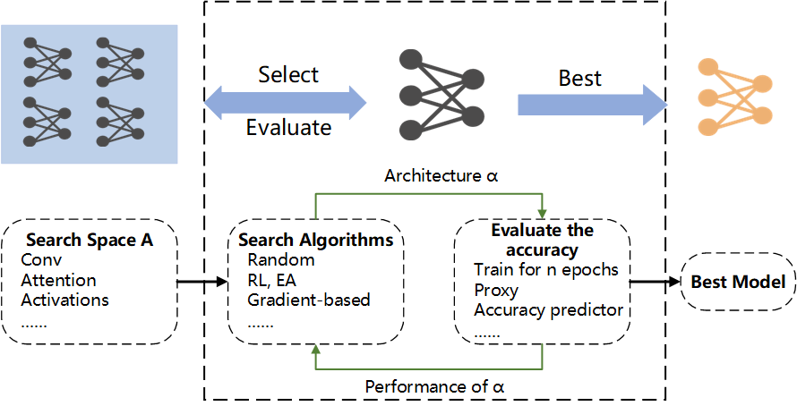


1.1 What is NAS (Neural Architecture Search)?
NAS: Neural Network Design
Efficient Deployment
Diverse Task Requirements
Objects
Design Efficient Subnets
Solutions
Low Accuracy
Manual Design or Compression
NAS[1]
NAS as a subfield of automated machine learning (AutoML)
High Accuracy
[1] B. Zoph and Q. V. Le, “Neural Architecture Search with Reinforcement Learning,” Proc. Int. Conf. Learn. Represent (ICLR), 2017.
Notes:
Please add the original NAS paper as a reference here
What is efficiency here?
The inefficiencies we address manifest in two ways:
1. The manual design process of neural networks is highly time-intensive.
2. Model compression techniques frequently result in degraded network accuracy

Slide 4
1.2 The Challenges of NAS
High Computational Power
Long Search Time
RL-based NAS requires 2000 days.
EA-based NAS requires 3000 hours.
Huge Search Space
SubNets Training
Cause
Solution
[2] Zero-cost NAS (ZC-NAS)
RL(Reinforcement Learning)
EA(Evolutionary Algorithm)
Design Train-Free Proxy Based on Features or Gradients
ZC-NAS: predict a network’s trained accuracy from its initial state without training.
[2] observed that the linear maps of the network are uniquely identified by a binary code corresponding to the activation pattern of the rectified linear units.
[2] J. Mellor, J. Turner, A. Storkey, E. J. Crowley, “Neural Architecture Search without Training,” arXiv:2006.04647, 2020.
Notes:
What does proxy mean here?
In this context, proxies refer to a set of designed evaluation metrics. Their purpose is to assess the quality of a neural architecture without any training process

Slide 5
1.3 The Challenges of Current Zero-cost Proxy NAS
Advantages: Fast Search Speed
Disadvantages: Lack of Accuracy
Dynamic Nonlinear Aggregation
Based on Forward Propagation: Zen-NAS[3]
Multi-Proxies Combination: FreeREA[4]
Based on Backward Propagation: ZiCo[5]
Advantage: High Accuracy
Disadvantages: Linear combination leads to accuracy degradation.
Disadvantages: Intensive Computation
Design Efficient Algorithms
Advantages: High Accuracy
Disadvantages: Slow Search Speed
Solutions
[3] M. Lin, P. Wang, Z. Sun, et al. “Zen-Nas: A Zero-Shot Nas for High-Performance Image Recognition, “ Proc. International Conference on Computer Vision (ICCV), 2021.
[4] N. Cavagnero, L. Robbiano, B. Caputo, and G. Averta, “FreeREA: Training-Free Evolution-based Architecture Search,” Winter Conference on Applications of Computer Vision (WACV), 2023.
[5] G. Li, Y. Yang, K. Bhardwaj, and R. Marculescu, "ZiCo: Zero-shot NAS via Inverse Coefficient of Variation on Gradients," Proc. Int. Conf. Learn. Representations (ICLR), 2023.
Notes:
[4] also a multi-proxies combinacation. What is the difference, linear vs. non-linear?
The method in [4] through a Multi-Proxies Combination uses linear aggregation, which leads to evaluation accuracy degradation.

Slide 6
Outline
1. Introduction
2. Approach
3. Experimental Evaluation
4. Conclusion

Slide 7
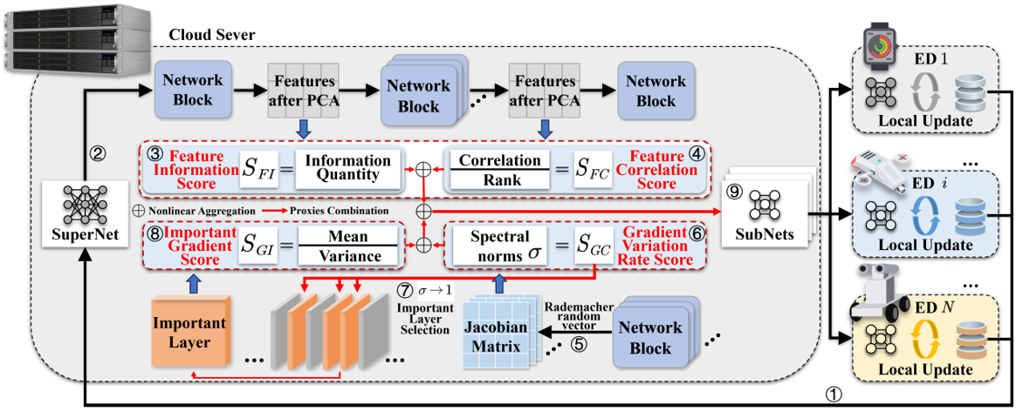
2.1 Approach: FG-NAS(Featrue-Gradient Aggregated Zero-Cost Neural Architecture Search)
Upload data characteristics.
Input SuperNet.
Compute Feature Information Score.
Compute Feature Correlation Score.
Generate Jacobian Matrix.
Compute Gradient Variation Rate Score.
Select Important Layer.
Compute Important Gradient Score.
Output the SubNet ranking and send the optimal SubNet to the ED.

Slide 8
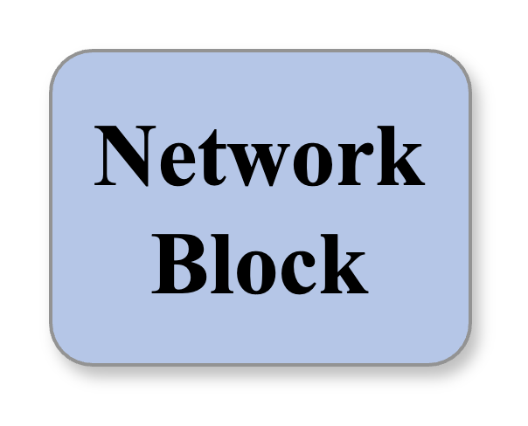
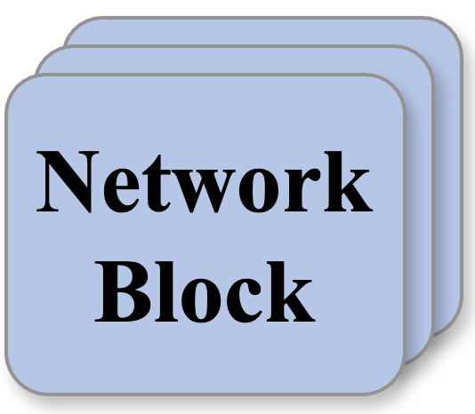
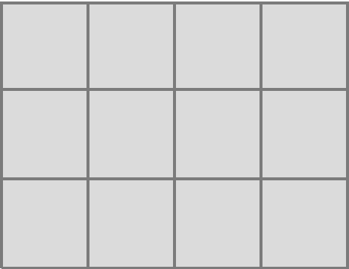

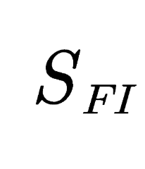
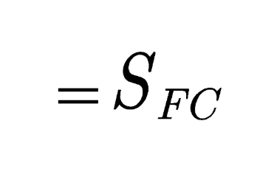
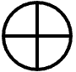







2.2 Feature Proxies
Features after PCA
Features after PCA
Feature Information Score
Information Quantity
Correlation
Rank
Feature Correlation Score
Nuclear Norm
Feature Extraction Capability
The Richness of Features Extracted by the Subnet
The Diversity of Features Extracted by the Subnet
$${\left\|f_{l}\right\|}_{nuc}$$
$$S_{FC}$$
Pearson correlation coefficient
Feature Extraction Capability
Variance of the Feature Matrix (in part based on local data D_{i} from ED_{i})
$$σ$$
$$S_{FI}$$
$$P_{f_{l}}$$
$$S_{FC}$$
Notes:
Need to explain several concepts here: richness, diversity, Pearson correlation coefficienct.
Richness:Feature Informativeness quantifies the richness and effectiveness of features from a network's intermediate outputs. This metric serves as a proxy to rapidly evaluate its feature extraction capacity, thereby directly reflecting the network's comprehension of the input data.
Diversity: Low inter-feature correlation indicates that the network learns more independent and diverse features. This diversity enables the model to capture a wider range of patterns and complex relationships, which in turn enhances its generalization and representational power.
The Pearson correlation coefficient reflects the network's feature extraction capability.

Slide 9
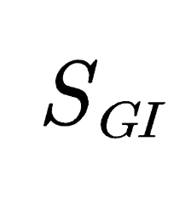
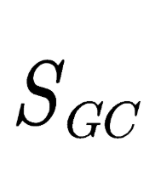
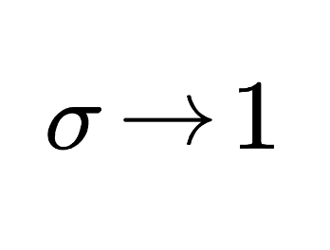


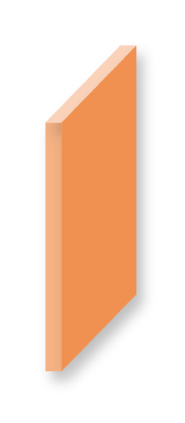








2.3 Gradient Proxies
Stability of Gradient Propagation
Convergence and Generalization Capabilities
Mean of Gradient
$$E\left[g\left(x\right)\right]$$
Variance of Gradient
$$Var\left[g\left(x\right)\right]$$
Spectral norms
$$S_{GI}$$
$$σ_{l} 1$$
$$S_{GC}$$
Important Gradient Score
Mean
Variance
Spectral norms
Gradient Variation Rate Score
Important Layer
Important Layer Selection
Rademacher random vector
Select Layer $σ→1$
Search Speed Enhancement
Jacobian Matrix
Notes:
S_{GC} should be high, like the other three?
Higher values indicate better performance.

Slide 10
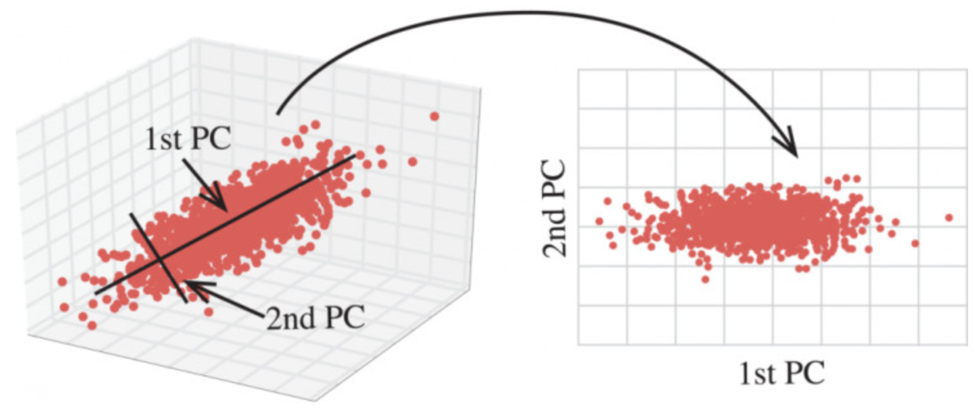
2.4 Dimensionality Reduction
Our Solution:
Principal Component Analysis (PCA) is a linear method for dimensionality reduction and feature extraction.
The purpose of dimensionality reduction
Acceleration of the Subnet Evaluation Process
Concentration on Important Features

Slide 11

2.5 Jacobian Matrix
Important Gradient Score
Mean
Variance
Spectral norms
Gradient Variation Rate Score
Important Layer
Important Layer Selection
Rademacher random vector
Jacobian Matrix
Rademacher random vector
Reduce Compute Complexity with Rademacher Random Vector.
Directly calculating Jacobain Martix needs high compute complexity.
$$J_{l}=\frac{∂f_{l}}{∂f_{l−1}}$$
Notes:
Radematcher is to reduce complexity?
To avoid the computational cost of differentiation in direct Jacobian matrix calculations, we employ Rademacher random vectors, thereby reducing time complexity.
Also, what is the main purpose of Jocobain matrix?
The Jacobian matrix is introduced to compute the spectral norm for the Gradient Variation Rate Score.

Slide 12



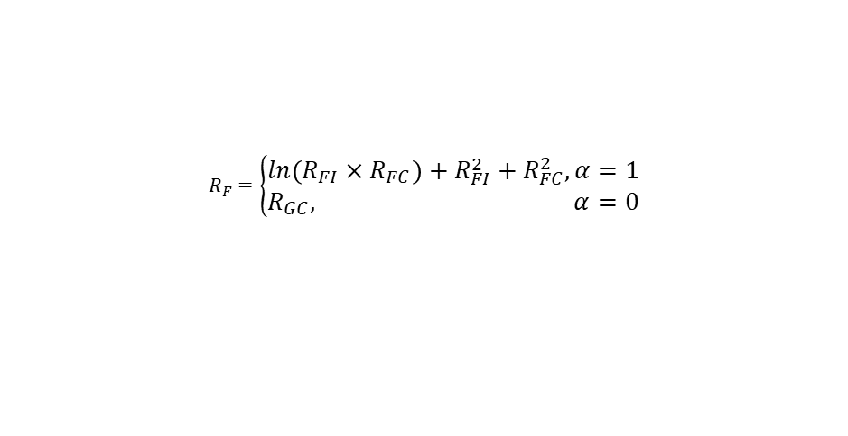
2.6 Dynamic Nonlinear Aggregation
Squared: Low-Rank Penalty
Logarithmic: High-Rank Emphasis
The Presence of Labels in Input Data
1 for Presence, 0 for Absence
Feature Aggregation Ranking
Ranking by Score(High-to-Low)
$$S_{FI}→R_{FI}$$
$$S_{FC}→R_{FC}$$
$$S_{GI}→R_{GI}$$
$$S_{GC}→R_{GC}$$
$$R_{F}=\left\{\begin{aligned}ln\left(R_{FI}×R_{FC}\right)+R_{FI}^{2}+R_{FC}^{2}, α=1 \\ R_{GC}, α=0\end{aligned}\right.$$
Final Ranking
$$R=ln\left(R_{F}×R_{G}\right)+R_{F}^{2}+R_{G}^{2}$$
Gradient Aggregation Ranking
$$R_{G}=ln\left(R_{GI}×R_{GC}\right)+R_{GI}^{2}+R_{GC}^{2}$$
Feature Information Score
Information Quantity
Correlation
Rank
Feature Correlation Score
Nonlinear Aggregation
Final Ranking
Proxies Combination
Important Gradient Score
Mean
Variance
Spectral norms
Gradient Variation Rate Score
Notes:
Ln vs. square
We compute the logarithm of each agent's rank, thus making the evaluation focus more on higher-ranked agents. This is used to identify networks with strong overall performance.
We calculate the square of each agent's rank, thereby penalizing those with lower rankings. This helps us find networks where every agent performs consistently well.

Slide 13
Outline
1. Introduction
2. Approach
3. Experimental Evaluation
4. Conclusion

Slide 14
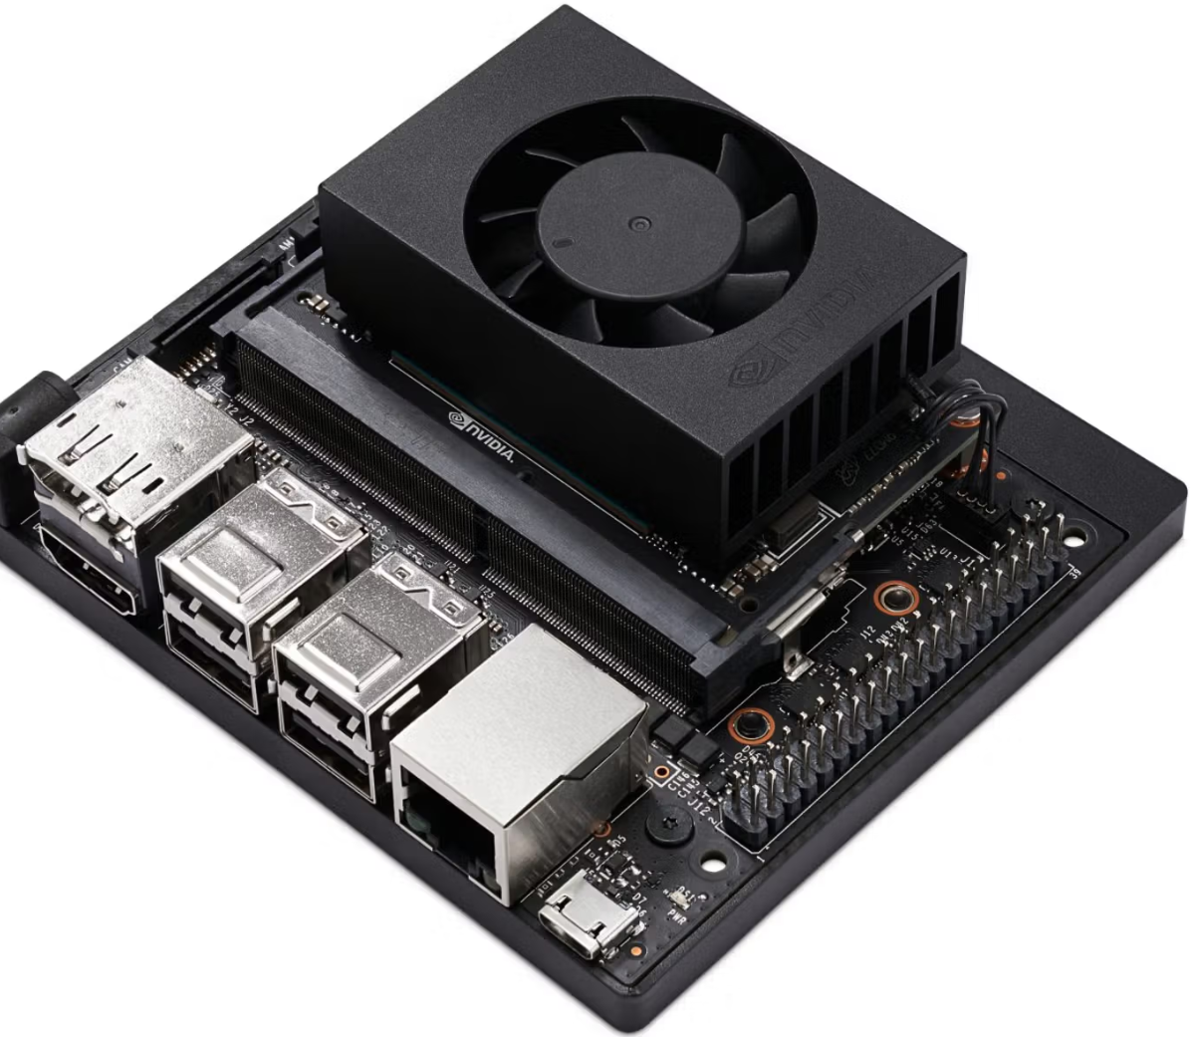
3.1 Experimental Environment and Search Space
Experimental Environment
Cloud Servers | NVIDIA A100 GPUs with 80GB memory and 256GB RAM
End Devices(EDs) | Jetson Xavier NX equipped with 8GB memory and 6-core ARM CPUs
Datasets | CIFAR-10 CIFAR-100 ImageNet16-120
  Search Space
  NAS-Bench-201: Search Space with 15,625 Subnets
  MobileNetV2: Search Space with Inverted Residual Structures
  AutoFormer: Search Space for Evaluating Transformer Architectures
Jetson Xavier NX
Notes:
Can add a picture of Jetson Xavier

Slide 15



3.2 Baseline and Metrics
Baseline
Zero-Cost Proxy Methods | / | #Params/FLOPS
 | Based on Forward Propagation | NASWOT
 | Based on Backward Propagation | SNIP ZiCo
 | Multi-Proxies + Linear Aggregation | TE-NAS
Training-Based Methods | OFA
 | AutoFormer
Metrics
Spearman $ρ$: The Correlation Between Predicted Subnet Ranks and True Performance
Top-1 Accuracy: Measure Accuracy of the Subnet
Search Time: Subnet Search Time
$$ρ=1−\frac{6\sum_{i=1}^{n}{d_{i}^{2}}}{n\left(n^{2}−1\right)}$$
$$Top1 acc.=\frac{\text{Number} \text{of} \text{Correctly} \text{Predicted} \text{Samples} }{\text{Total} \text{Number} \text{of} \text{Samples} }$$
Notes:
#Params/FLOPS: Network complexity and prospective performance are assessed directly through parameter counts and floating-point operations

Slide 16
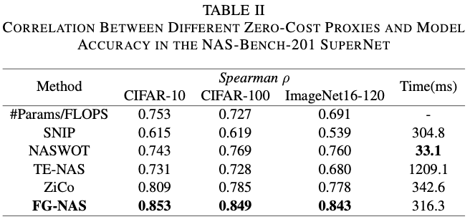
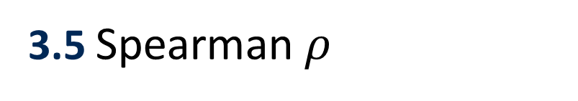
3.5 Spearman $ρ$
It demonstrates efficiency and accuracy of the FG-NAS.
Proxy methods based on the forward propagation alone are significantly faster.
Notes:
Proxies based on backward sentence should probably be written the other around: forward propagation proxies use less time.
FG-NAS achieved the highest correlation across three datasets. It enhances the effectiveness and generalizability of zero-cost proxies.
NASWOT, a forward-propagation proxy, achieved the shortest evaluation time, indicating that backward-propagation proxies require substantially more computation than their forward-based counterparts.
Compared to the backward proxy ZiCo, FG-NAS reduced search time by selectively computing critical layers. Against the multi-proxy method TE-NAS, FG-NAS decreased search time by approximately 75%.

Slide 17
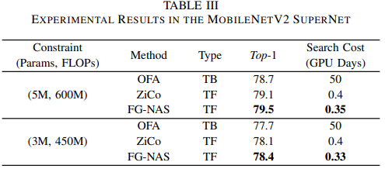
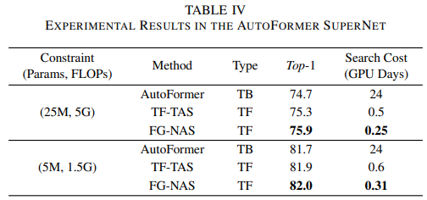
3.6 Top-1 Accuracy
TB(Training-based methods)
Substantial Increase in Search Time Due to Training
TF(Training-free methods)
Notes:
Training-based methods exhibit substantially longer search times than training-free approaches, validating the effectiveness of zero-cost proxy methods.
Under resource constraints, FG-NAE identifies optimal architectures in considerably less time, demonstrating its strong applicability and generalization capability in resource-constrained scenarios.

Slide 18
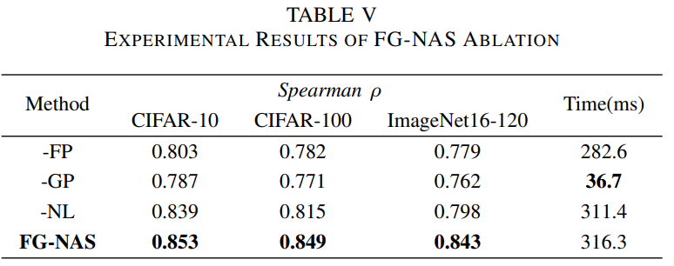
3.7 Search Time
-FP(Remove Feature Proxy)
-GP(Remove Gradient Proxy)
-NL(Remove Dynamic Nonlinear Aggregation)
Important Ratio Layer
Proxy methods based on the forward propagation alone are significantly faster.
An important ratio layer of 0.6 achieves balance of the accuracy and search time.
Notes:
Using only feature-based proxies yields the lowest correlation but shortest evaluation time, confirming gradient-based proxies' higher accuracy correlation at the cost of greater computational overhead.
An important ratio layer of 0.6 achieves the optimal trade-off between evaluation accuracy and computational time.

Slide 19
Outline
1. Introduction
2. Approach
3. Experimental Evaluation
4. Conclusion

Slide 20
Conclusion
The proposed FG-NAS framework introduces feature and gradient zero-cost proxies to achieve accurate and efficient subnet search.
Dynamic nonlinear aggregation contributes to higher search accuracy.
Thank You!

