Slide 1


Stackelberg Game Based Resource Pricing and Scheduling in Edge-Assisted Blockchain Networks
Sijie Huang¹, He Huang¹, Guoju Gao¹,
Yu-E Sun¹, Yang Du¹, Jie Wu²
¹ Soochow University, ² Temple University
Notes:
Hello everyone, my name is Huang Sijie, and I am from Soochow University. It is my honor to be able to present my paper here, titled “Stackelberg Game Based Resource Pricing and Scheduling in Edge-Assisted Blockchain Networks”.

Slide 2
Outline
Background & Motivation
Model & Problem
Challenge
Solution
Simulations
Conclusion
Sijie Huang et al. IEEE MASS 2021
Notes:
Today, in my presentation, I will first introduce the background of bitcoin and blockchain, and then briefly review some existing solutions and their limitations. After that, I’ll present our designed scheme and analyze its performance.
At first, we’ll introduce the research background and motivation.

Slide 3


Bitcoin Mechanism
Traditional currency (relies on government or third-party issuance)
  Additional cost of transactions
  Risk of account being frozen
  Risk of financial crisis
Bitcoin (decentralized electronic currency)
  No third-party financial institutions
  Global currency
  Security, irrevocability and privacy
Sijie Huang et al. IEEE MASS 2021
Notes:
As we know, traditional currency relies on government or third-party issuance. The existence of the third party brings additional cost of transactions and may even trigger the risk of financial crisis. Bitcoin is an decentralized encrypted electronic currency, it does not rely on third-party financial institutions.
Bitcoin has the advantage of secure, irrevocable and does not contain sensitive personal information. It can circulate all over the world without worrying about being frozen by any financial institutions.

Slide 4
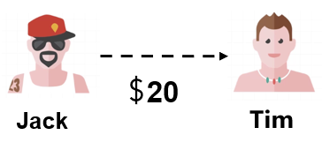
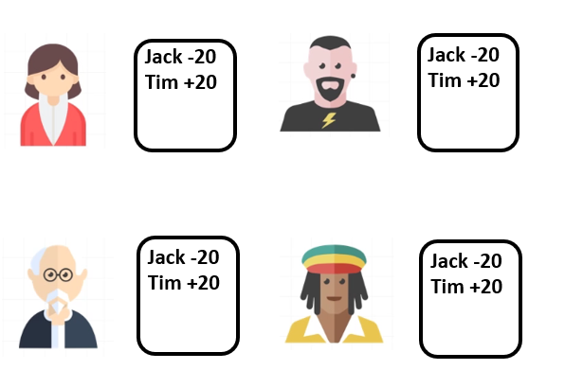
Bitcoin Mechanism
Transaction in network
  Point to point
Ledger
  Unchangeable
  Identical, public
  Update in real time
Happen all the time!
When the transaction occurs, every user in the network will record the transaction in their local ledger
Sijie Huang et al. IEEE MASS 2021
Notes:
Bitcoin is a value transmission network, the users involved in the operation of the Bitcoin system can be regarded as nodes in the network. The transaction in bitcoin network can be seen as point to point form.
Since there is no third-party accounting institution, every user in the Bitcoin network maintains a ledger. When the transaction occurs, every user in the network will record the transaction in their local ledger.
However, transactions happen all the time. It will be a waste of resources if everyone is busy keeping accounts.

Slide 5







Bitcoin Mechanism
Recorder: the user who selected to record the all transaction happened in a time slot
Record
Reward
Recorder will receive a bit of money for each transaction as reward
Sijie Huang et al. IEEE MASS 2021
Notes:
Therefore, to avoid keeping accounts all the time, one person is responsible for recording all the transaction in a time slot. He will receive a bit of money for each transaction as reward.

Slide 6

Proof of Work (PoW)
Block: The ledger contains the transactions in a time slot
Block head: Hash value
  Simplify, identify, anonymize
  and verify the information
Block Head
Head of Last Block
Hash (SHA 256 )
256-bit Binary Hash Value
Transactions in a Time Slot
Timestamp
Only the hash value that meets the requirements will be accepted by the blockchain
Random Number
Sijie Huang et al. IEEE MASS 2021
Notes:
The ledger containing the transactions in this slot can be packaged into a block, The recorder links the block to the end of the existing blockchain to form a new blockchain and get the reward in return.
Many users want to compete to be the recorder to get the rewards. Therefore, the Proof of Work (PoW) mechanism was developed to select the recorder. Every block has a 256-bit hash value at the head of each block. Each hash value uniquely identifies a block
The input of the hash value includes the head of the previous block, the transaction in this time slot, the timestamp and a random number.
But it isn’t all hash values meet the requirements. If you want to pack a block, you can only continue to exhaust the random number until the appropriate hash value is calculated.
This process is so called Proof of Work puzzle.

Slide 7



Ledger Verification
Leger verification
  Correctness and consistency
Blockchain
  Block be linked to Blockchain
verified by majority of people
Block 1
Block 2
…
Block n
verify
Sijie Huang et al. IEEE MASS 2021
Notes:
After completing the Pow puzzle, the packager needs to announce the ledger to all other users so that they can verify the authenticity of the block. Only when a block is verified by the majority of users in this network, it can be considered to be added to the end of the blockchain successfully.

Slide 8
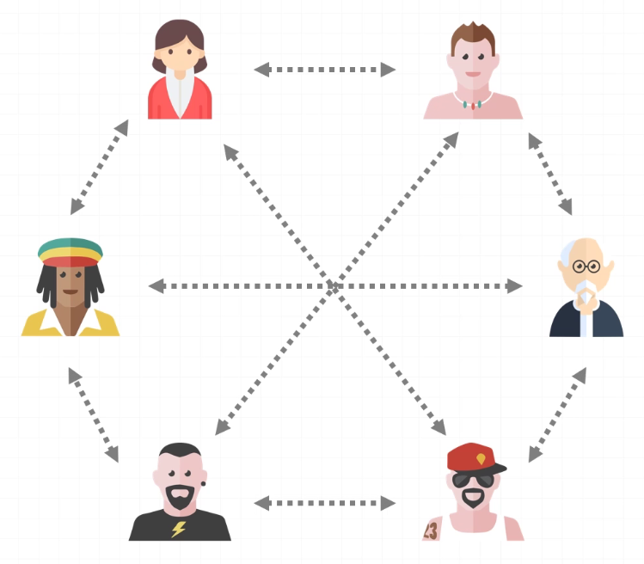
Block Convergence
Block broadcasting in P2P network
Flooding propagation
The process of verifying and broadcasting the ledger can be regarded as the process of block propagation convergence
Sijie Huang et al. IEEE MASS 2021
Notes:
Since the Bitcoin system is a network, users in the network can communicate with each other and consult the ledger. The process of verifying and broadcasting the ledger can be regarded as the process of block propagation convergence.

Slide 9

Mining Process
Solve the PoW problem
  Great number of computation and storage resources.
Block convergence
  Propagation delay
  Geographical location
It’s hard to be satisfied with terminal devices
Speed game !!
Appending a Block to the Current Blockchain
Solve the PoW Problem
Block Convergence
Reward
Sijie Huang et al. IEEE MASS 2021
Reward
Notes:
Therefore, we can summarize as follows: In order to successfully package a block and link it to the end of the existing blockchain, you need to do the following two steps.
The first step is to package the ledger and calculate the Proof of Work problem.
The second step is broadcast the block to all the nodes in this network. The two steps above are called the mining process and it can be regarded as a speed game. Only the first one who finish the two steps in the competition can get rewards.
However, solving the PoW problem needs a mass of computation and storage resources, it’s hard to be satisfied with a miner’s terminal devices. Thanks to the development of edge computing technique, the miners can lease some demand resources from the edge service provider.

Slide 10
Outline
Background & Motivation
Model & Problem
Challenge
Solution
Simulations
Conclusion
Sijie Huang et al. IEEE MASS 2021
2/20
Notes:
Next, let us look at the details of model design.

Slide 11














Edge-Assisted Blockchain Networks
Central Cloud
Edge
Broadcast the Block
Package a Block
Block
Block
Block
Miner
Upload the PoW Computing Task
Sijie Huang et al. IEEE MASS 2021
Notes:
In our model, we consider the following scenarios.
There are n ESPs and a remote central cloud in the edge-assisted blockchain network. Besides, there are m users in the network trying to complete the mining process called miners. To complete the Proof of Work puzzle, the miners will purchase computing service from ESPs or CSP.
Firstly, miners upload the computing task to the ESPs and determine the amount of resources to lease. Every ESP has its maximum resource capacity, if the demands from users exceeds the capacity, it will upload the demand to the CSP. After that, if one ESP calculated the appropriate hash value, which means it packaged a block successfully, this ESP needs to broadcast the block to the other nodes as soon as possible.
It is worth noting that these n ESPs are distributed in different geographical locations in the network. According to the characteristics of propagation convergence, ESPs in different geographical locations will receive the broadcast of this block at different times, thus it will lead to inconsistency in convergence time.
Therefore, the ESP at the center of the network has a greater advantage during the propagation process, it can make the propagation block to be received by other nodes faster. Therefore, users will be more interested in it because it can increase the user’s probability of winning mining process.

Slide 12
Two-stage Stackelberg Game
Central cloud
  Amount of Computing Resources
  Fixed Price
  Remote Location
Edge cloud: leader
  Limited Resources
  Variable Prices
  Different Geographic Locations
Miners: follower
  Selfish and rational
Central Cloud
upload the task when it exceed the resource capacity
broadcast the block
Edge Cloud
set price
lease resources
Miners
Sijie Huang et al. IEEE MASS 2021
Notes:
We designed a multi-leader multi follower two-stage Stackelberg game to model the interaction between the service providers and miners. The ESPs are leaders with limited resources and variable prices. They set the price of its unit resource in the first stage. And then, the miners, followers, determine their optimal computing service request based on the prices and propagation delay of ESPs in second stage. If the service demand for one ESP exceeds its maximum resource capacity, it will upload the task to the CSP. We suppose that the CSP has unlimited computing resources and it has fixed price that will not change. After one ESP calculated the Proof of Work Puzzle, it will broadcast the block in the network.

Slide 13









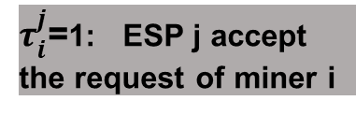



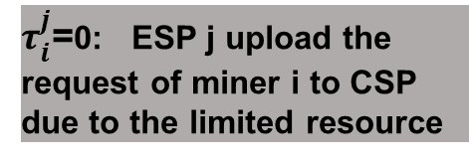
Problem Formulation
Central Cloud
$τ_{i}^{j}$=0: ESP j upload the request of miner i to CSP due to the limited resource
$$\overline{t}$$
…
…
ESP₁
ESP₂
ESP_{j}
ESP_{n}
t₁ < t₂ < … < t_{j} < … < t_{n}
Propagation delay
$$x_{i}^{j}$$
$τ_{i}^{j}$=1: ESP j accept the request of miner i
$$τ_{i}^{j}$$
…
…
Miner₁
Miner₂
Miner_{i}
Miner_{n}
Request of Miner i $X_{i}=\left(x_{i}^{1},x_{i}^{2}, …,x_{i}^{n}\right)$
Sijie Huang et al. IEEE MASS 2021
Notes:
Next, let’s talk about the mathematical model in detail.
We use t to present the propagation delay caused by geographical location. We suppose that t1 is less than t2 and sorted to tn. The central cloud has the maximum propagation delay due to the remote location.
We use x_i_j to express the request for ESP j from miner i. Request of miner I for all the ESPs denotes as uppercase X. $τ_{i}^{j}$ indicate whether the request of miner i for ESP j is accepted by this ESP. $τ_{i}^{j}=0$ means the request of miner I is exceed the maximum capacity of ESP j, and then it will be upload to the central cloud.

Slide 14







Problem Formulation
ESP j ’s utility
Miner Side Utility in Stage I
ESP Side Utility in Stage II
Hash power
orphaning probability on the propagation delay tj
winning probability of mining game for miner i on ESP j
winning probability for miner i on the CSP
winning probability of miner i on all service providers
miner i ’s utility
Sijie Huang et al. IEEE MASS 2021
Notes:
We list the explicit-form expressions of key issue. We use the ratio of the x_i_j to the total request volume to represent the probability that the miner i calculates the hash value on the ESP j, called hash power.
We consider that the block mining time follows the Poisson distribution, the orphaning probability on the propagation delay tj caused by ESP j, denoted as P_orphan (tj ).
W_i_j denotes the winning probability of mining game. It composed of two parts: hash power and orphaning probability.
W_i_j_’ indicate the winning probability for miner i on CSP. The utility of miner i is the difference between profit and payment.
P_j denotes the unit price of ESP j. The electricity cost of ESP for calculating the hash value denotes as c and the cost for uploading to CSP denotes as h. Therefore, the utility of ESP j can be expressed explicitly.

Slide 15
Outline
Background & Motivation
Model & Problem
Challenge
Solution
Simulations
Conclusion
Sijie Huang et al. IEEE MASS 2021
Notes:
In the following, I will introduce the contributions and challenges of our paper.

Slide 16
Contributions
Existing Study for Blockchain:
    Only consider the case of one edge service provider (ESP)
    Each ESP has consistent price
    Assumed that all ESPs have a uniform propagation delay
    Did not consider the delay factor due to geographical location
Our Work:
    We consider the interaction between the multi-users and multi-ESPs
    Each ESP sets variable price
    Consider the orphan probability in propagation process
    Consider the propagation delay due to the different geographical locations of ESPs
Sijie Huang et al. IEEE MASS 2021
Notes:
We surveyed the existing study for blockchain finding the following shortage: they only consider the case of single ESP or treat all ESPs as a whole part, so that all the ESPs have the identical price and undifferentiated geographical locations.
However, in real world, it may have multiple edge assistances distributed in every corner of the city. They are affected by geographic location and network delays when they communicate.
The greatest innovation of our paper is to consider the propagation delay caused by geographic location, which is actually worth to consider. In addition, when a block is discarded due to falling behind in the propagation phase, we call it orphan block. We consider the orphan probability caused by propagation delay in block convergence stage in this paper. And then derive the explicit-form expressions of ESPs’ and miners’ utility.

Slide 17

Challenges
Multi-Leader and multi-follower Stackelberg game
  Existence and uniqueness of Nash Equilibrium
  Variable prices
  Multiple requests from one user
Variable winning probabilities brought about by different geographical locations delay
Central Cloud Participation
Sijie Huang et al. IEEE MASS 2021
Notes:
To solve the problems above, we have to face the following challenges.
It is hard to model the interaction between multi-leader and multi-follower Stackelberg game. Each ESP has variable price, a user’s requests for different ESPs are also variable. That make the interaction between two parts becomes a multidimensional coupled mathematical problem. The existence and uniqueness of Nash Equilibrium is difficult to prove.
Besides, the probability of orphan block effect the miners’ utility, we should quantify the geographical location as propagation delay and mathematically measure the orphan rate. What’s more, the participation of central cloud makes the problem even more complicated.

Slide 18
Outline
Background & Motivation
Model & Problem
Challenge
Solution
Simulations
Conclusion
Sijie Huang et al. IEEE MASS 2021
Notes:
Next, let’s see the algorithm to find the Nash equilibrium

Slide 19
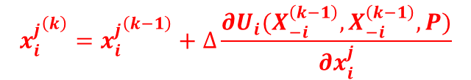


Solution for Nash Equilibrium
Step1: ESPs choose random feasible price strategy
Step2: Every miner predicts other miners’ optimal requests and adjusts his demand according to the prices of ESP
Step3: ESPs update the price with a step and predict whether the new price will bring more profit, and then adjust the pricing strategy
Repeat step2 and step3 until the difference of the price strategy in two rounds is less than a given threshold
$${x_{i}^{j}}^{\left(k\right)}={x_{i}^{j}}^{\left(k−1\right)}+∆\frac{∂U_{i}(X_{−i}^{\left(k−1\right)},X_{−i}^{\left(k−1\right)},P)}{∂x_{i}^{j}}$$
$$p_{j}^{\left(k\right)}←p_{j}^{\left(k−1\right)}+δ$$
$$∥P^{\left(k\right)}−P^{\left(k−1\right)}∥<ε$$
Sijie Huang et al. IEEE MASS 2021
Notes:
The skeleton of our algorithm is shown on the slide. In the first step, ESPs choose a random feasible price strategy.
In second step, every miner predicts other miners’ optimal requests and adjusts his demand according to the prices of ESP. We use the gradient iteration methods to update the miners’ demand.
And then, ESP continues to adjust its price according to the new round of user requests. The new prices will feedback to miners for a new round of strategy adjustment.
The iteration will stop when the difference of the Frobenius norms of the price strategy in previous round and that in this round is less than a given threshold.

Slide 20
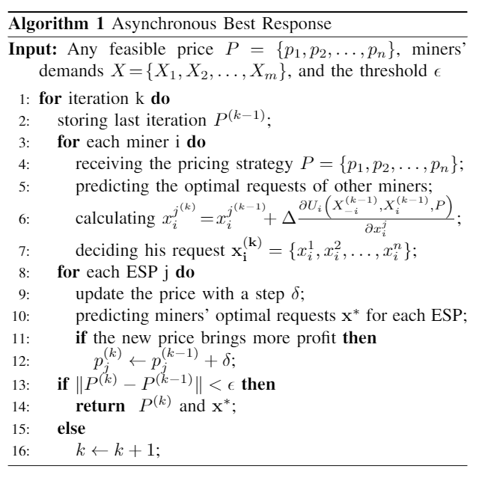
Solution for Nash Equilibrium
User adjusts strategy
Gradient iteration algorithm
ESP pricing adjustment
Sijie Huang et al. IEEE MASS 2021
Notes:
We use this algorithm to find the Nash equilibrium. Line 3 to line 7 is the part of user adjusting strategy and the line 8 to line 12 is the part of ESP pricing adjustment

Slide 21
Outline
Background & Motivation
Model & Problem
Challenge
Solution
Simulations
Conclusion
Sijie Huang et al. IEEE MASS 2021
Notes:
Now, let us look at the details of simulation

Slide 22
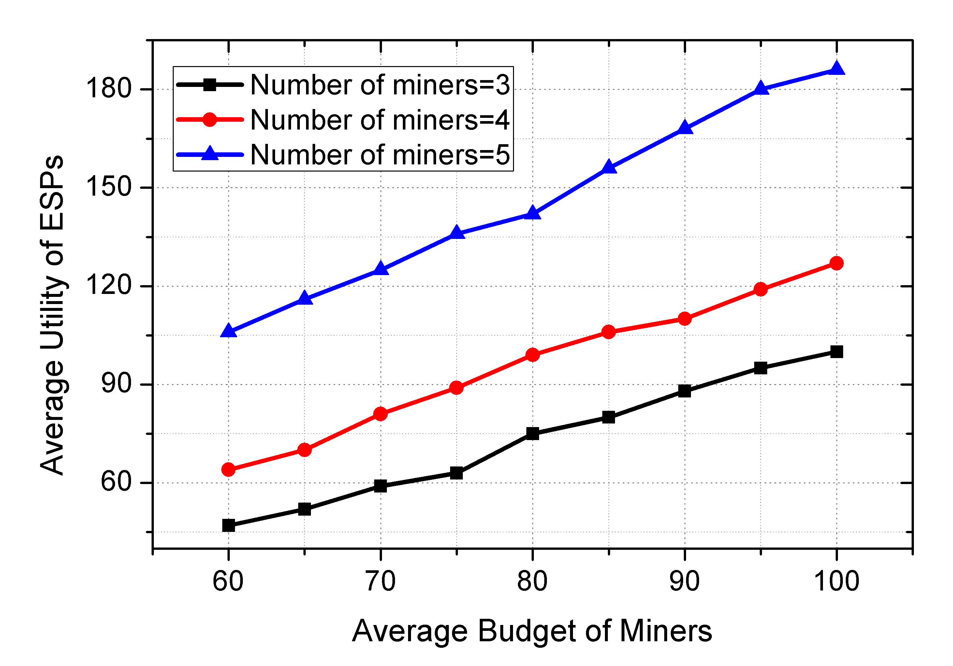
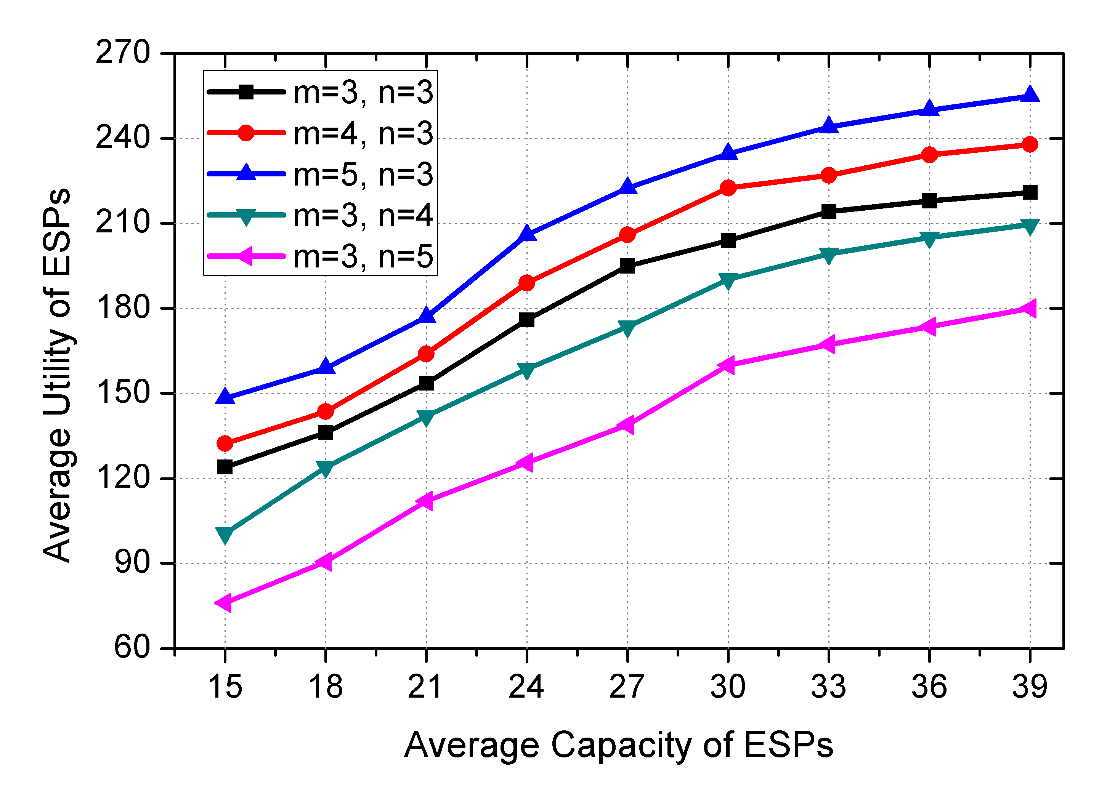
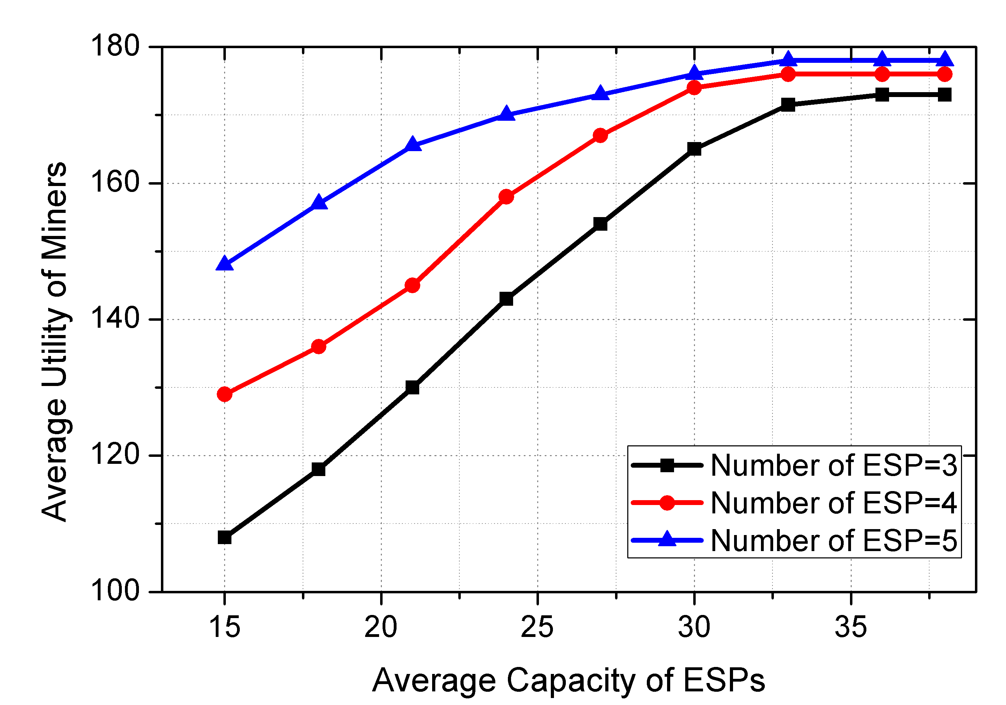
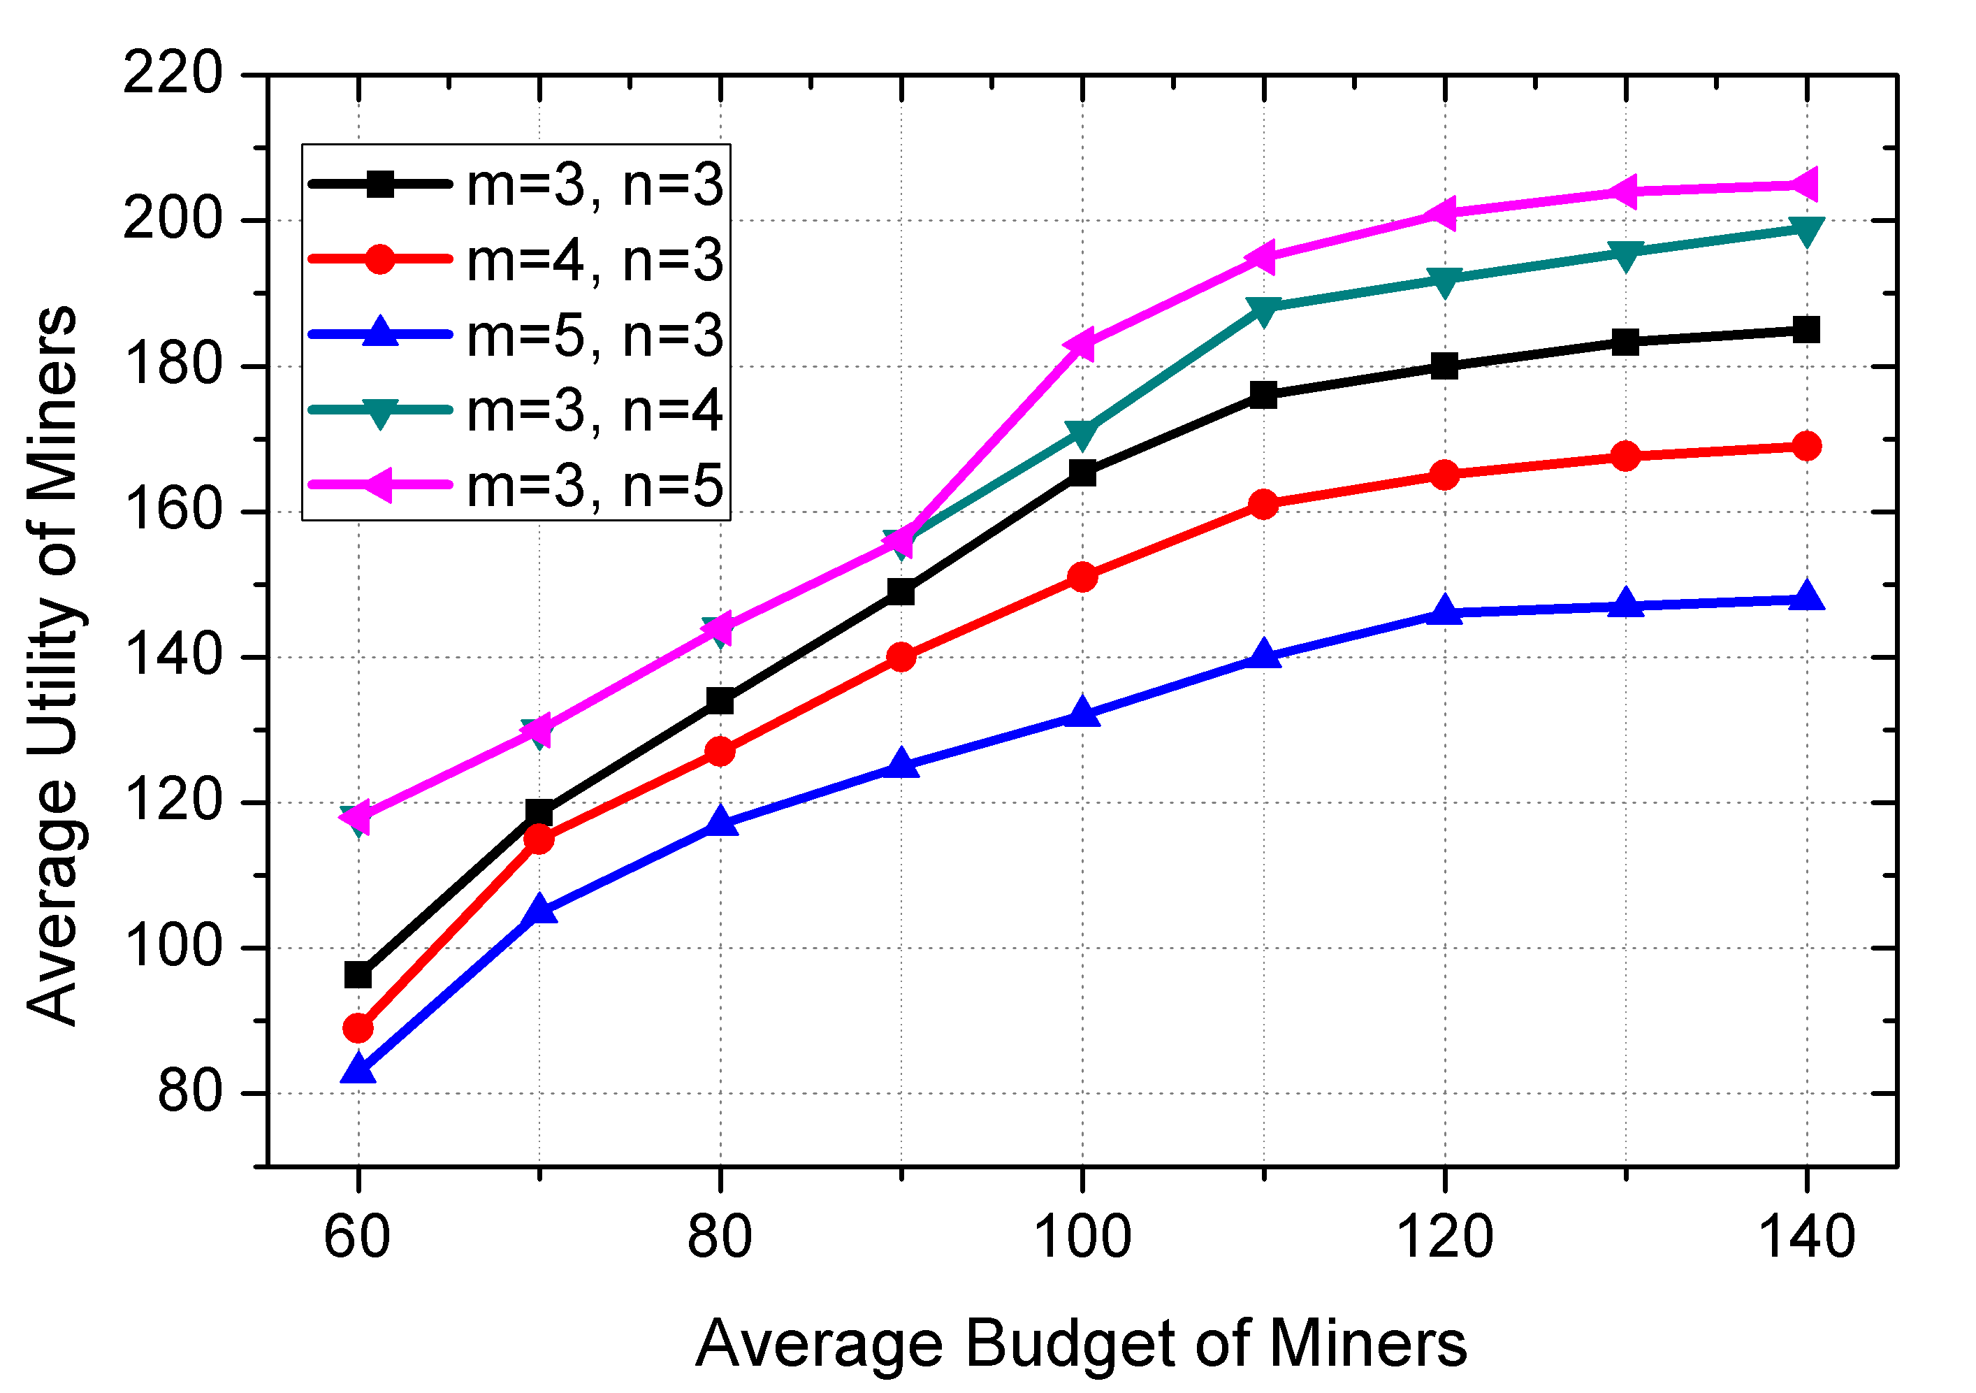
Result: Utility in Two Stages
Sijie Huang et al. IEEE MASS 2021
Notes:
Next, we present the experiment results. We simulate the model and evaluate the performance of our approach. The experimental results show that our estimator works meet expectations.
When the budget of miners increased, the utility of both miners and ESPs raised. If the miners have more money to purchase the computing service, he increase the probability of solving the PoW problem and further enhances his profits. At the same time, higher demand for service will further increases the utility of ESPs.
Similarly, increasing the capacity of ESPs will incur more benefit and also enhance the miners’ utility. This is because more capacity allows the ESP to accept more requests and reduces the amount of the computing tasks uploading to the remote CSP. Which lower the risk of being orphan block and further raise the miners’ utility.

Slide 23
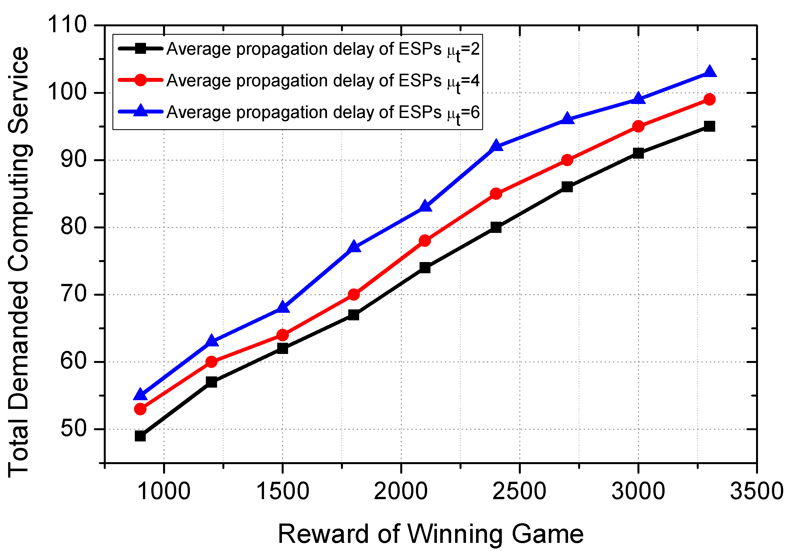
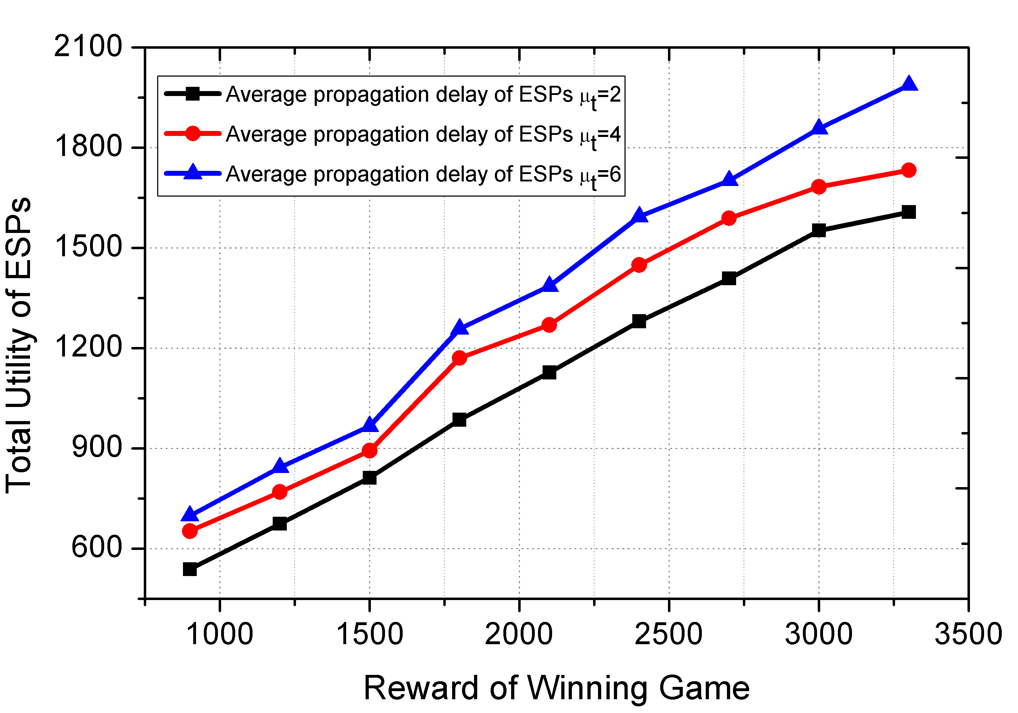
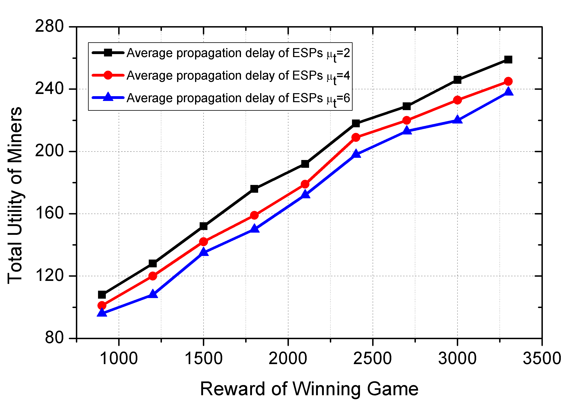
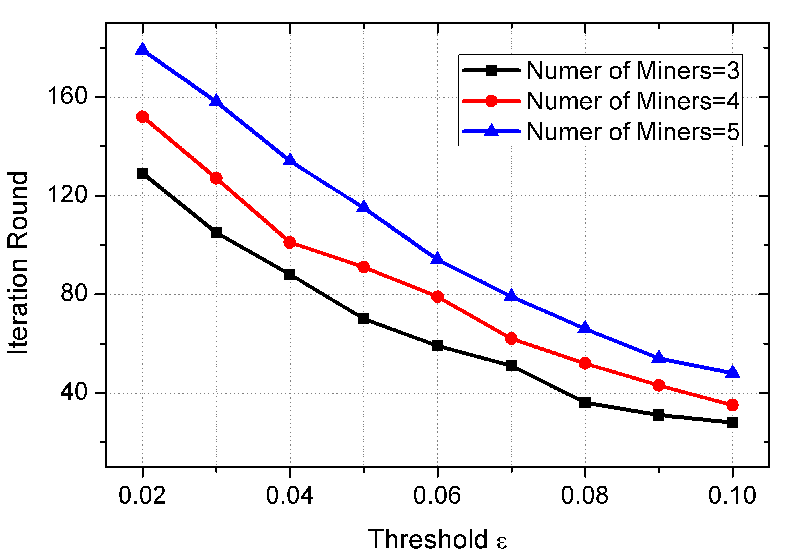
Result: System Performance
Sijie Huang et al. IEEE MASS 2021
Notes:
We also estimate the relation between demand and propagation delay. These results are within reasonable evaluation.
Besides, the impact of the number of users on the system efficiency were measured in picture. We adjust the threshold to observe different iteration rounds.

Slide 24
Outline
Background & Motivation
Model & Problem
Challenge
Solution
Simulations
Conclusion
Sijie Huang et al. IEEE MASS 2021
Notes:
At last, we make a concluding remark of our work.

Slide 25
Conclusion
We investigate the resource pricing and scheduling problem in the edge-assisted blockchain mining networks by using the multi-leader multi-follower Stackelberg game theory.
We propose the edge computing model where ESPs has different propagation delays according to his geographical location.
We analyze the utility of both miners and ESPs and further discuss the existence and the uniqueness of Stackelberg Equilibrium (SE).
We conduct extensive simulations to validate the convergence as well as evaluate the network performance.
Sijie Huang et al. IEEE MASS 2021
Notes:
Well, to sum up, this paper proposes an efficient system that model the resource pricing and scheduling in the edge-assisted blockchain networks. Base on existing study, we take the edge service providers’ geographical location into consideration. The proposed algorithm can help us to find the equilibriums point in this Stackelberg game.

Slide 26
@ Contact Me
Thank You!
Q & A
20205227091@stu.suda. edu.cn
Sijie Huang et al. IEEE MASS 2021

