Slide 1
Asymptotically-Optimal Incentive-Based En-route Caching Scheme
Ammar Gharaibeh*, Abdallah Khreishah*, Issa Khalil†, Jie Wu‡
*New Jersey Institute of Technology
†Qatar Computing Research Institute
‡Temple University

Slide 2
Introduction
The Internet traffic is dominated by content retrieval services.
Content Replication schemes are used by CDN
Shorter delivery times.
Better scalability.
Better performance.
Better energy efficiency.
No caching at intermediate routers
Replication is done offline.
Notes:
Content retrieval such as Video on Demand

Slide 3
Introduction
Several caching techniques have emerged.
Example: CCN
content naming
caching at intermediate nodes.
Requires changes to the TCP/IP protocol stack.
Caching decision is not designed to optimize network performance
Requires broadcasting of Interest packets.
Notes:
To overcome the limitations of caching at dedicated servers, several caching techniques have emerged

Slide 4
Introduction
What are the factors that affect achieving the maximum traffic savings?
Which contents are to be cached in order to achieve the same objective?
Notes:
Given the limited cache size at intermediate nodes, we need to answer the following questions

Slide 5
Related Work
Different Objectives
Such objectives include:
Optimizing joint latency-traffic problem [Guan et. al. ′13].
Reduce cache redundancy [Psaras et. al. ′12].
Maximizing cache cooperation through dynamic request routing [Dai et. al. ′12].
Notes:
Several techniques for content caching have been proposed but for different objectives.

Slide 6
Objectives
Optimality.
Providing incentive for caching nodes.
Easily integrated in the TCP/IP suite
Notes:
We study content caching from the following point of views

Slide 7
Contributions
Asymptotically (in terms of number of nodes) Optimal (in terms of traffic savings) online caching algorithm under common cases.
Incentives for the caching nodes.
Low complexity.
Easily implemented in a distributed fashion.
Easily integrated in TCP/IP suite.
Reactive caching
Notes:
Reactive caching unlike CDN

Slide 8
En-Route Caching
A request for a content is only forwarded along the path to the content’s source.
Reduces the amount of forwarded Interest packets as opposed to CCN.
Easily implemented.

Slide 9
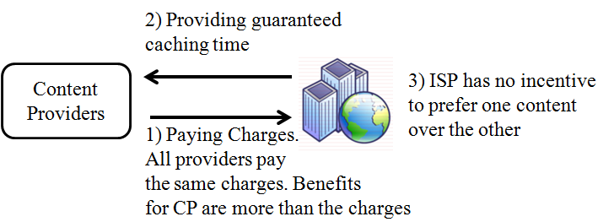
Settings

Slide 10
Settings
Total Traffic Savings of caching in the interval [0,t] is defined as:

Slide 11





Traffic Savings Example
Caching at alone for a single time slot will yield a saving of
S₁
v₁
v₂
v₃
v₄

Slide 12
Definitions
Offline vs. Online Algorithms:
Offline algorithm has the complete knowledge of the future.
Offline algorithm knows when, where, and how many times a content will be requested.
This knowledge leads to the optimal performance.
Online algorithm does not possess such knowledge.
Online algorithm has to make a caching decision based on the available information at the time of the content arrival.

Slide 13




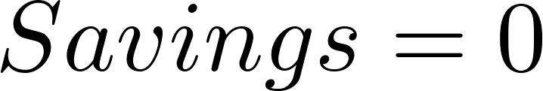
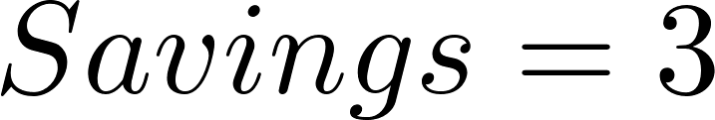

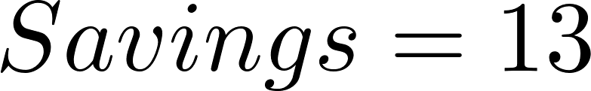



Offline vs. Online Example
has a full cache
and can cache one content at most.
Contents X and Y will be requested twice by
S_{X} S_{Y}
v₁
v₂
v₃
v₄
First request for X
First request for Y
Second request for Y
Second request for X

Slide 14

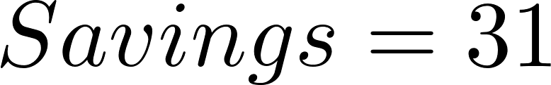
Offline vs. Online Example
has a full cache
and can cache one content at most.
Contents X and Y will be requested twice by
S_{X} S_{Y}
v₁
v₂
v₃
v₄
First request for X
First request for Y
Second request for Y
Second request for X

Slide 15
Offline vs. Online Example
The offline algorithm knows in advance the order in which the contents will be requested, and can decide to cache X at and Y at , to achieve traffic savings of 31.

Slide 16
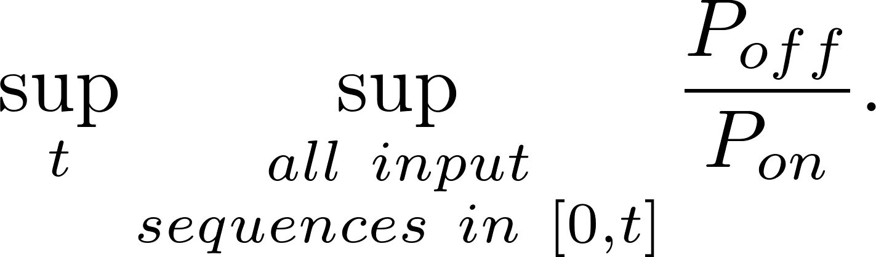
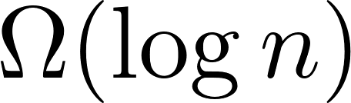
Definitions
Competitive Ratio:
Defined as the ratio of the performance achieved by the best offline algorithm to the performance achieved by the online algorithm.
We show that the best online algorithm has a competitive ratio which is lower bounded by
Notes:
A way to measure the performance of the online algorithm against the performance of the offline algorithm.
Lower competitive ratio means better online algorithm performance.

Slide 17
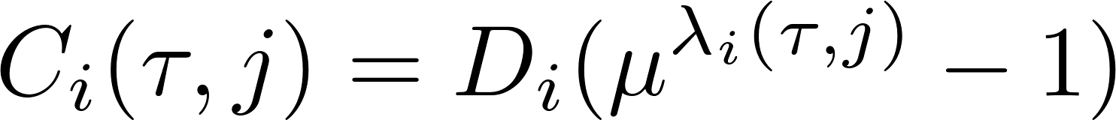

Cost-Reward Caching (CRC) Algorithm
Exponential caching cost function.
where is a constant that depends on the number of the nodes in the network.

Slide 18
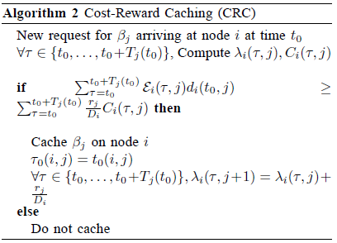
The Algorithm

Slide 19













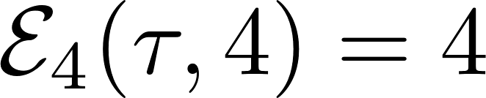



Request for
Header = 21
Request for
Header = 2
Request for
Header = 8
Request for
Header = 2
Request for
Header = 0
Request for
Header = 2
Request for
Header = 0
Request for
Header = 0

Slide 20
CCN vs. CRC
 | CCN | CRC
Caching Decision | Not designed to optimize network performance | Designed to maximize the traffic savings
Changes to TCP/IP protocol stack | Requires a radical change to the protocol stack | Does not require changes to the protocol stack
Interest Packet Forwarding | Broadcast | En-route

Slide 21
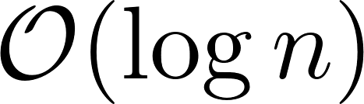
Performance Analysis
Capacity constraints are not violated
The algorithm achieves a competitive ratio.
Any online algorithm has a competitive ratio which is lower bounded by

Slide 22
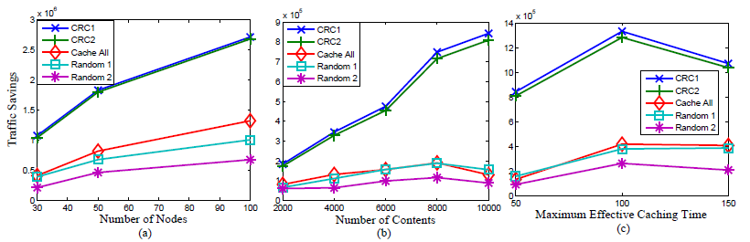
Results on Random Topology

Slide 23
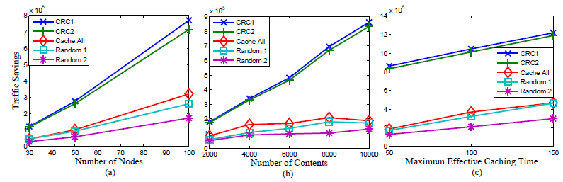
Results on Small World Topology

Slide 24
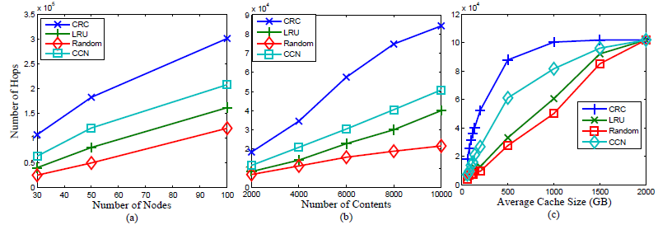
Replacement CRC

Slide 25
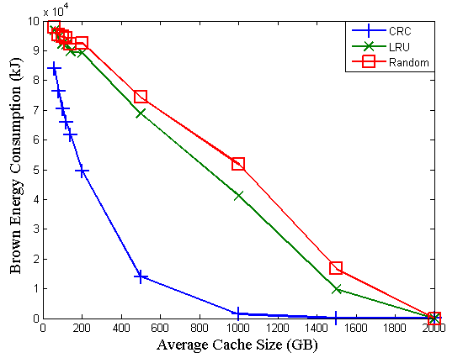
Energy CRC

Slide 26
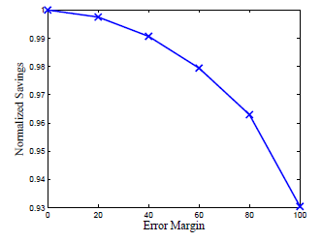
CRC Performance vs. Expectation Errors

Slide 27
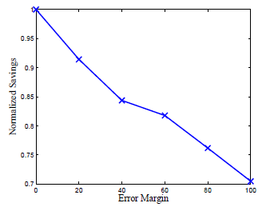
CRC Performance vs. Errors in Effective Caching Time
Notes:
CRC is more sensitive to error margins in effective caching time

Slide 28
Future Work
Theoretical analysis of the CRC extensions
Incorporating learning techniques to estimate the values of content popularity expectations.

Slide 29
Thank You

Slide 30
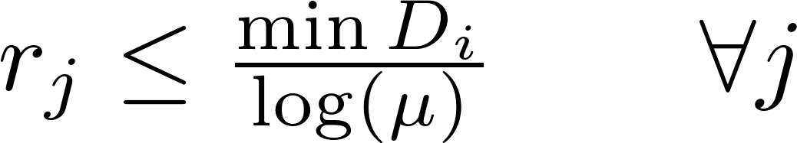
Appendix: Performance Analysis
Assumptions:

Slide 31


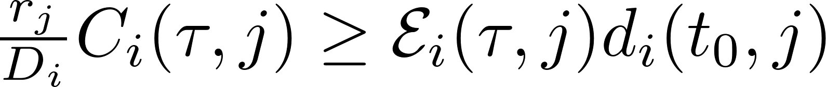
Appendix: Performance Analysis
The CRC algorithm does not violate the capacity constraints.
Proof: Let be the first content that caused a violation in the capacity constraints at node . Using the assumptions from the previous slide, along with the definition of the cost function, we reach
From the definition of the algorithm, should not be cached at node

Slide 32
Appendix: Performance Analysis
CRC algorithm achieves competitive ratio under common cases.
Lemma: Traffic savings gained by CRC algorithm is lower bounded by the sum of the caching costs.
Lemma: The additional traffic savings of the offline algorithm is upper bounded by the sum of the caching costs.
Using these lemmas, the traffic savings of the CRC is within of the traffic savings achieved by the offline algorithm under common cases.

Slide 33
Appendix: Performance Analysis
Proposition: Any online algorithm has a competitive ratio which is lower bounded by
Proof: We show this proposition by giving an example network, such that the best online algorithm competitive ratio is lower bounded by

Slide 34





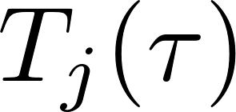

Settings
A network is represented by a graph , where every node has a caching capacity .
For each contents , we define the following:
: The source of
: The size of
: The effective cache duration for when the first request appears at time
Slotted time system.

Slide 35
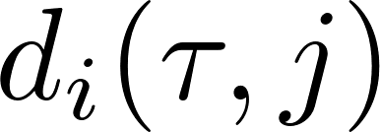
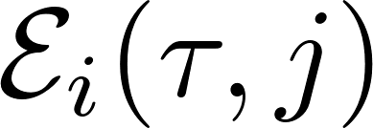

Settings
: Number of hops between node and the first node caching along the path to
: Total number of requests for to be served from the cache of node at time
: The time when is cached at node
Total Traffic Savings of caching in the interval [0,t] is defined as:

Slide 36



Traffic Savings Example
Caching at alone for a single time slot will yield a saving of
S₁
v₁
v₂
v₃
v₄

Slide 37
Settings
The caching nodes charge the contents providers in order to cache their contents, thus providing the incentives for the nodes to cache.
The charging policy is assumed to be the same for all contents providers. This prevents favoring one content over the other.
The caching nodes has to provide guarantees for the content providers. To this end, we consider non-preemptive caching scheme.
In the simulations, we provide results for an extension to the basic scheme that considers content replacement.

Slide 38
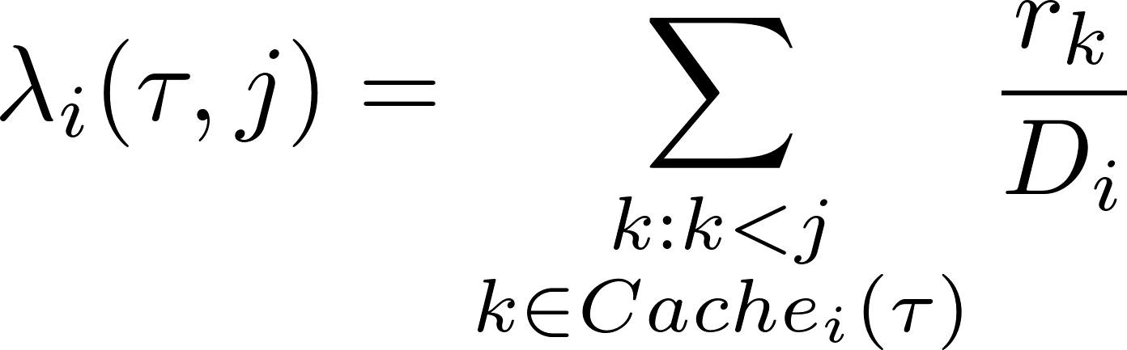
The Algorithm (CRC)
Definition:
The relative load on a caching node at time when a request for arrives is the sum of sizes of currently cached contents divided by the cache capacity and is defined as:

Slide 39
Practical Issues
Calculating Initial Content Expectation Values:
Calculated before any request for any content appears.
For each content, a caching tree rooted at the content’s source is established.
Based on the content popularity at each caching node, number of clients connected to each caching node, and the caching tree, the initial values of contents expectations ( ) are calculated.

Slide 40
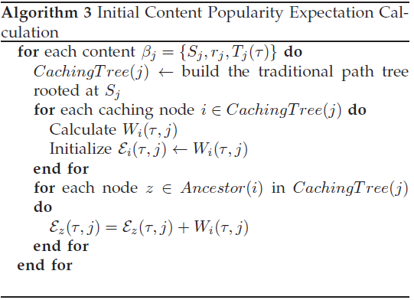
Practical Issues

Slide 41






















Practical Issues
S₁
v₀
v₁
v₂
v₃
v₄
v₅
v₆

Slide 42
Practical Issues
Effective Caching Duration:
Depends on the content arrival time.
Requires the broadcast of the first arrival time to all other nodes.
Additional overhead to broadcast the first arrival time is negligible compared to the reduction of the broadcasted Interest packets achieved through En-Route caching.

Slide 43
Simulation Results
Five schemes are simulated
CRC: Represents our basic algorithm
CRC Version 2: A variation of CRC, where the content is retrieved from the closest node that has a copy of the content, not necessarily along the path to the content’s source.
All Cache
Random Caching Version 1: The probability of caching a content is proportional to the content’s popularity
Random Caching Version 2: The probability of caching a content is proportional to the content’s popularity and inversely proportional to the relative load of the caching node.

Slide 44
Extensions to CRC Algorithm
We introduce three different extensions of the basic CRC algorithm:
Energy CRC: The traffic savings are measured based on the energy saved on the upstream path from the caching node up to the first node that already has the content in its cache.
Replacement CRC: In this extension, content replacement is allowed.
Energy CRC with Replacement: combination of the previous two extensions.

